Slide 1

Neutronics Analysis of CEFR Start-up Tests at IGCAR using FARCOB AND ERANOS 2.1 Code Systems
FR22: IAEA-CN-291/316
Abhitab Bachchan, M. Alagan, A. Riyas, K. Devan
Indira Gandhi Centre for Atomic Research, Kalpakkam, India
Notes:
25 Mins Presentation by each participating organization (using template):
• One/two slide on the CEFR model + codes used (description on use of code, deterministic/MC, homogenous/heterogenous model, treatment of spacer wire, etc.)
• One/two slide each (WP) on the calculation results and observations
• One/two slides on modelling challenges and missing information (if any)
• One slide on future plan

Slide 2
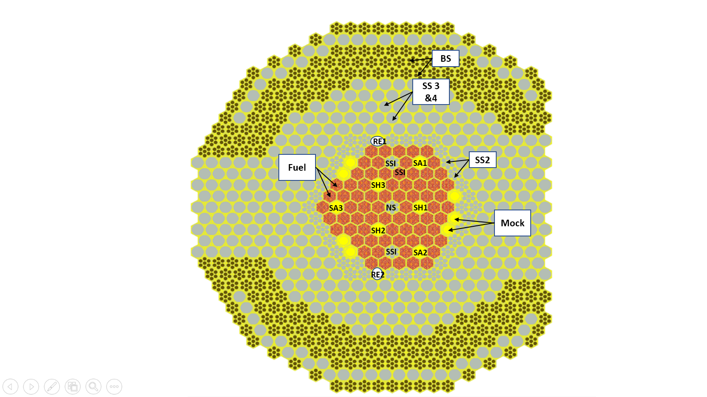
Benchmark Analysis
Analysis is carried as a part of ongoing IAEA CRP on “Neutronics Benchmark of CEFR Start-Up Tests”.
CEFR (60 MWt)
-- compact nature of the core,
-- fuel is followed by high-quality SS reflector
-- RR rod positioned on the interface of fuel and reflectors etc.
Codes used :
Deterministic : FARCOB (in-house) & ERANOS 2.1 (European)
-- developed and validated against Medium Sized Reactor
Stochastic : OpenMC
The objective of the benchmark is to perform
-- verification of the physical models and the library
-- an validation of the simulation code against the CEFR like core
Clean core layout (72 FAs).

Slide 3
Neutronics Code Systems
Code Systems | FARCOB | ERANOS 2.1
Nuclear data library | ABBN-93 (Russian); adjusted | ERALIB-1: adjusted JEF-2.2 | ENDFB-VIII.0
Energy groups | 26 | 33 | Point cross-section
Geometry Modeling | Homogeneous | Homogeneous
Core Calculation | HEX-3D geometry with finite difference diffusion theory | HEX-3D geometry with finite difference diffusion theory
Cell calculation: Fuel and Blanket | CONSYST2 (1D Cylindrical) | ECCO: 2D heterogeneous with fine groups | Detailed 3D Pin Modeling
Control rods | CONSYST2+COHINT | ECCO+ BISTRO | Detailed 3D Pin Modeling
Transport Correction | DORT (2D Transport) | BISTRO (2D Transport) | ---
Analysed WPs | WPs: 1-5 | WPs: 1-5 | WPs: 1-7
Considered for the discussion | WPs: 1-4

Slide 4
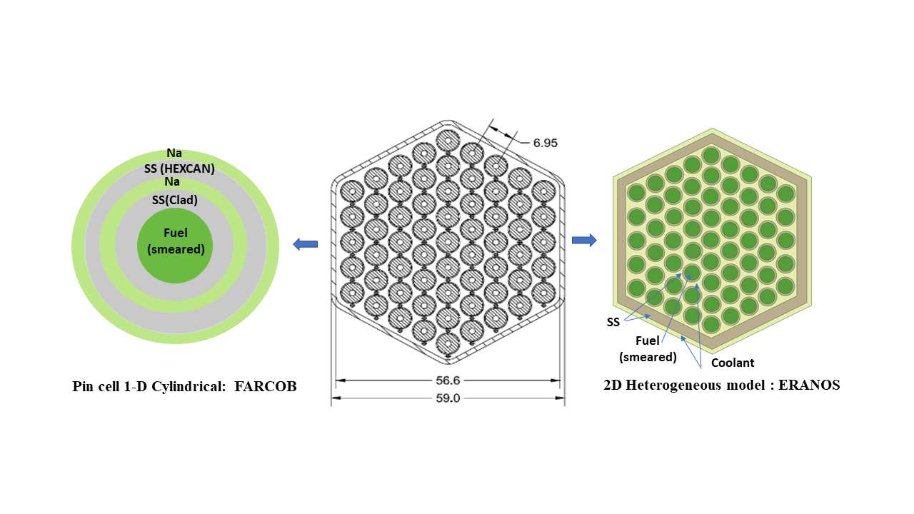
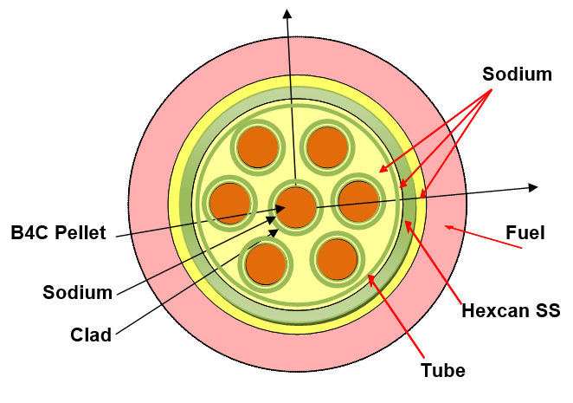
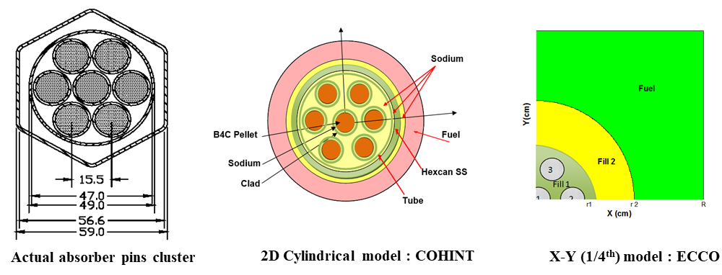
Spatial Heterogeneity : FARCOB
Modelled up to to 14th Ring
Rod bundle and 1D heterogeneous cell model for fuel & blanket: CONSYST2
Clean core layout (72 FAs).
Super Cell for SH, SA & RE in COHINT : 2-D collision probability:

Slide 5
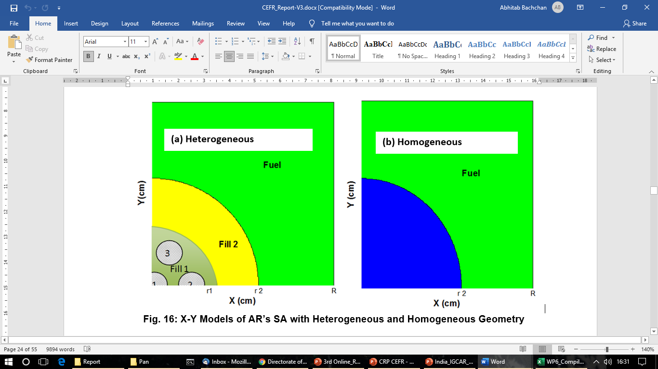
Absorber Rod Heterogeneity : ERANOS
Rod bundle and 2D heterogeneous cell model for fuel & blanket: ECCO
Reactivity equivalence method is adopted for homogenization
1/4th X-Y Models of AR’s SA with Heterogeneous and Homogeneous Geometry

Slide 6
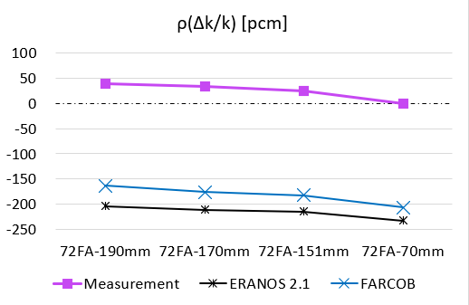
WP1: Net Criticality
Experiment :
approach to the criticality by replacing mock-up assemblies step-by-step with actual fuel assembly.
Reactor was brought to the critical state by loading 72 fuel assemblies by the reactor period method
For super-critical extrapolation, the RE2 was withdrawn step by step to three positions to reach super-criticality.
Fuel Assemblies | RE2 Position (mm) | k-eff |  | Measurement (pcm)
 |  | FARCOB | ERANOS
70 | Out of Core | 0.99005 | 0.98941
71 | Out of Core | 0.99459 | 0.99393
72 | 190 | 0.99836 | 0.99796 | 40 ± 5
72 | 170 | 0.99825 | 0.99789 | 34 ± 5
72 | 151 | 0.99817 | 0.99785 | 25 ± 5
72 | 70 | 0.99794 | 0.99767 | 0 ± 5
Observations:
: Significant transport correction
: Both code systems underpredicted predicted the core reactivity
by only ~200 pcm.

Slide 7
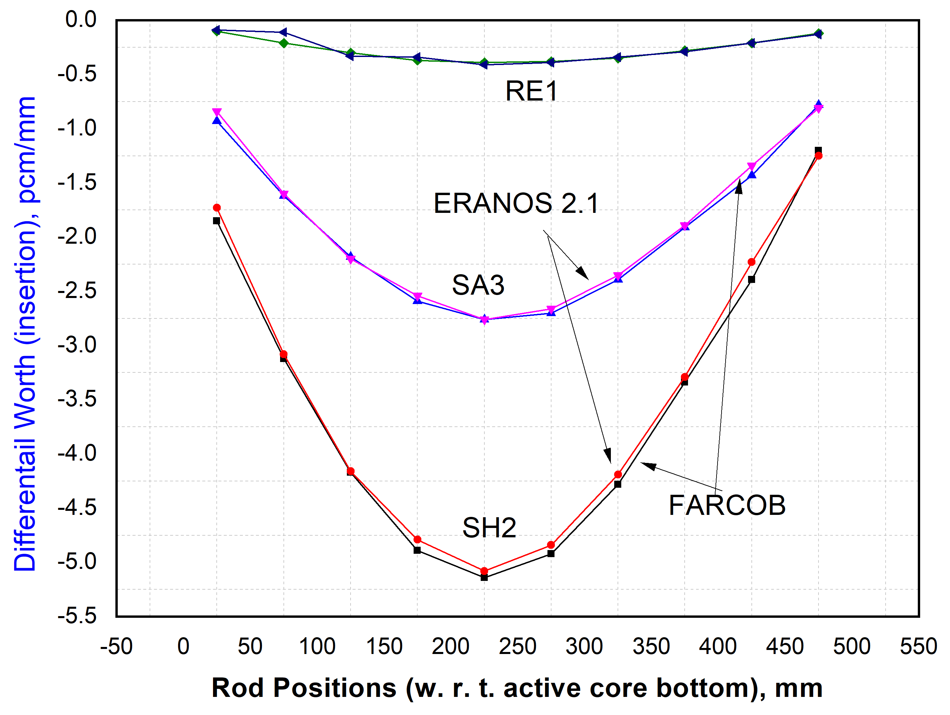
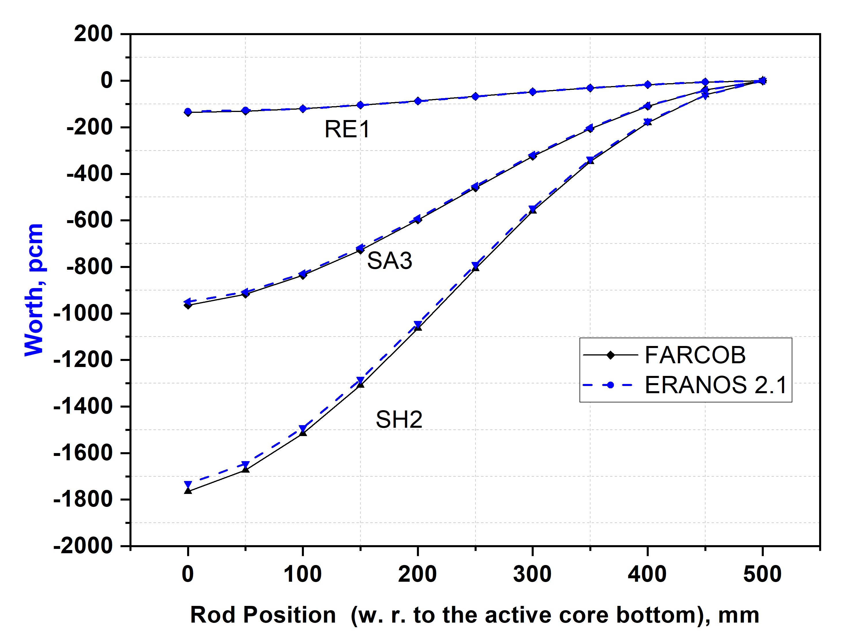
WP2: Control Rod Worth
Experiment :
The worth of each shutdown system was measured at operation
The integral worth: using the rod-drop method
The differential worth : the normal movement of the control rod
Configuration
Model
Experimental
Simplified
Differential worth : RE1, SH2 and SA3
Actual/Partial drop
Measured data available
Full drop model
Measured data not available
Integral worth : RE1, SH2 and SA3

Slide 8
WP2: Control Rod Worth
Measurement object | Rod or rod group | Reactivity worth, pcm
 |  | Simplified Model |  | Experimental Configuration | ERANOS | Measured
 |  | FARCOB | ERANOS | FARCOB | ERANOS | Measured
Regulating rod worth | RE1 | -136 | -132 | -137 | -133 | -150
 | RE2 | -136 | -132 | -137 | -133 | -149
 | 2*RE | -273 | -271
Shim rod worth | SH1 | -1806 | -1774 | -1915 | -1881 | -2019
 | SH2 | -1765 | -1732 | -1818 | -1803 | -1839
 | SH3 | -1765 | -1732 | -1818 | -1805 | -1839
 | 3*SH | -5501 | -5410 |  |  | -
Safety rod worth | SA1 | -935 | -923 | -905 | -893 | -945
 | SA2 | -935 | -923 | -887 | -875 | -911
 | SA3 | -964 | -949 | -932 | -917 | -946
Worth of 1st shutdown system | 3*SH+2*RE | -5785 | -5697 |  |  | -2877
Worth of 1st shutdown system with SH1 stuck | SH2+SH3+2*RE | -3851 | -3793 |  |  | -881
Worth of 2nd shutdown system | 3*SA | -2967 | -2937 |  |  | -2981
Worth of 2nd shutdown system with SA3 stuck | SA1+SA2 | -1910 | -1892 |  |  | -1950
All control rods | 2*RE+3*SH+3*SA | -8874 | -8746 |  |  | -6079
All control rods with SH1 stuck | 2*RE+SH2+SH3+3*SA | -6882 | -6788 |  |  | -3899
Observations/Used : close prediction for SH &SA /simplified model

Slide 9
WP3: Temperature Reactivity Coefficient
SAs
Experiment :
Measured in the operation core state of 79 FAs
After recording the absorber rod positions, the reactor was shut down by inserting all the control rods.
Five steps of measurements
SHs
Simulation :
Core :
: criticality calculation for 10 isothermal conditions;
5 steps from 250 ºC to 302 ºC, : increasing and
5 steps for decreasing temperatures from 300 ºC to 250 ºC.
: Remodeled and self –shielded cross-section prepared for
--- the rise in temperature
RE1
RE2
Core Mid Plane
Method
Experimental Method
3-Step Method
The coefficient
the reactivity change due to the temperature effect is fitted using a linear function
--- slope of this graph gives TRC.

Slide 10
WP3: Temperature Reactivity Coefficient
Computed k-eff and CR reactivity worth
Simulation :
3-step Method :
Reactivity change in j^{th} step :
where is the net change in the core reactivity in the previous step
Experimental method
Reactivity change i.e. P_{i}’s to P_{j}’s, with the help of differential worth of each rod as
where
and is the change of critical height of the m^{th} control rod.

Slide 11
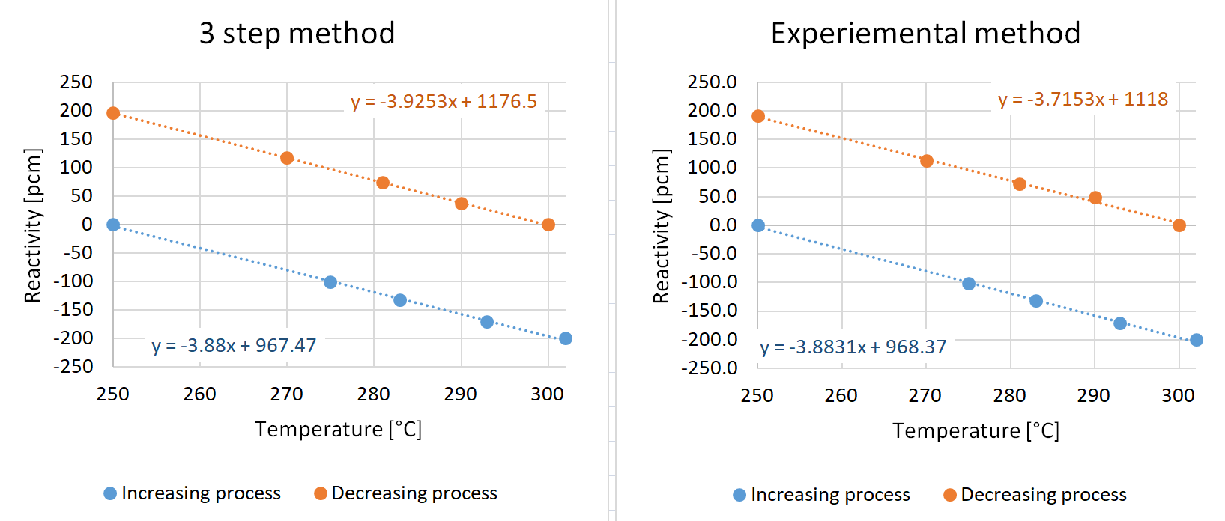
WP3: Temperature Reactivity Coefficient
Temperature | Code System | Reactivity coefficient, pcm/K |  |  | Ratio (C/E)
 |  | Calculated(C) |  | Measured (E)
 |  | 3-Step method | Experimental method | Measured | C(3step)/E | C(exp.)/E
Increasing | FARCOB | -3.880 | -3.883 | -3.759 | 1.03 | 1.03
 | ERANOS | -4.136 | -3.907 |  | 1.10 | 1.04
Decreasing | FARCOB | -3.925 | -3.715 | -4.384 | 0.90 | 0.85
 | ERANOS | -4.143 | -3.917 |  | 0.95 | 0.89
Fitted line using FARCOB results
Observation:
3-step method : within 10 %
Experimental method : 15 % (max. deviation) (FARCOB)
Maximum measured error :
about 13.5 %.

Slide 12
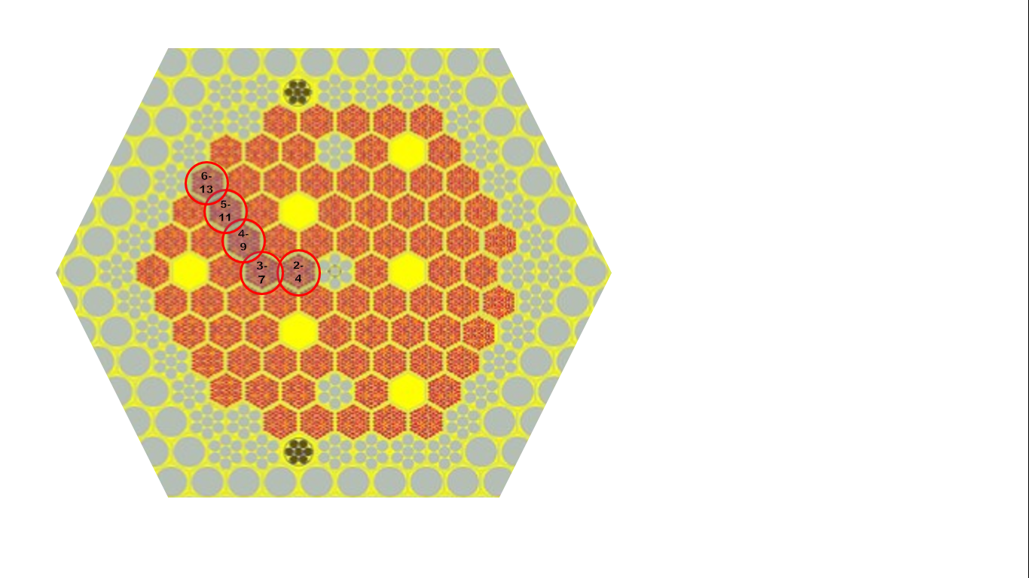
WP4: Sodium Void Reactivity Coefficient
Experiment :
Measured in the operation core state of 79 FAs
A specially designed ‘voided’ assembly was used
Sodium inlet and outlet sealed in fuel assembly
Measured mainly by changing the parking positions of REs;
shim rods and safety rods positions were kept unchanged.
Measured at five locations
Simulation :
SAs
SHs
Fig. Positions of SVR measurement.
Method
RE1
Experimental Method
3-Step Method
RE2
Core Mid Plane
Reactivity Correction :
Experimental method – based on S-curve,
3-step method -- based on reactivity difference

Slide 13
WP4: Sodium Void Reactivity Coefficient
Process Simulation :
3-step Method :
Reactivity change in j^{th} step:
where the reactivity
is considered as a correction factor.
Experimental method
Core reactivity from P_{i}’s to P_{j}’s,
where
and is the change of critical height of the m^{th} control rod.

Slide 14
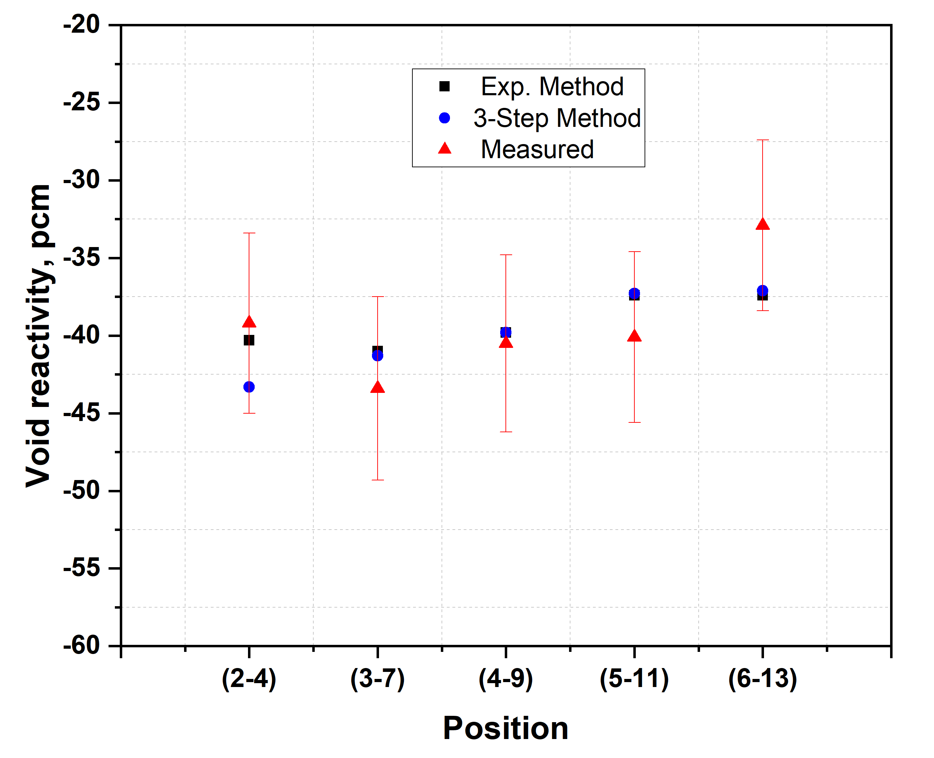
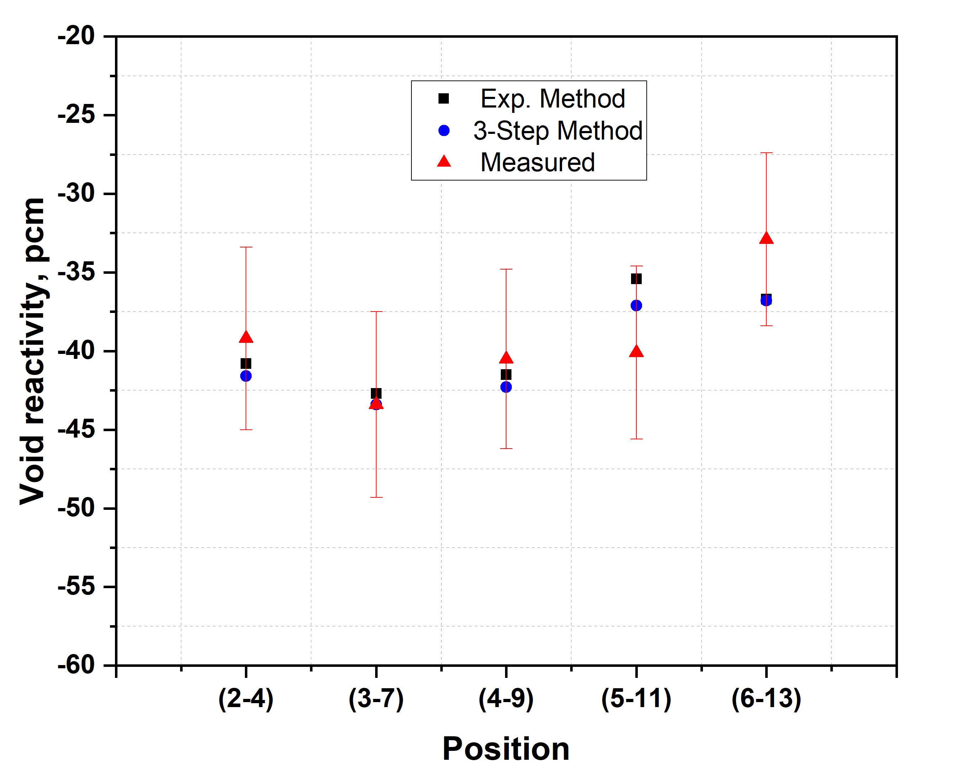
WP4: Sodium Void Reactivity Coefficient
C/E for sodium void reactivity
Measurement position in core | Experimental Method |  | 3 Step Method
 | FARCOB | ERANOS | FARCOB | ERANOS
(2-4) | 1.03 | 1.04 | 1.07 | 1.06
(3-7) | 0.94 | 0.98 | 0.95 | 1.00
(4-9) | 0.98 | 1.02 | 0.98 | 1.04
(5-11) | 0.93 | 0.89 | 0.93 | 0.93
(6-13) | 1.14 | 1.12 | 1.13 | 1.12
FARCOB
Observation:
Reactivity worth are well within the measurement error
(The relative measur. error is about 13 % to 17 % )
ERANOS 2.1

Slide 15
Summary & Conclusions
Core reactivity : under predicted by only ~200 pcm
AR worth : -3 % to - 7 % ( for SH & SA) , -8 to -11 % for RE’s
Temperature reactivity coefficient : ± 10 % (3-step Method)
Sodium void reactivity coefficient : ± 7 % ( In fuel region), 12 to 14 % (on boundary)
All computed parameters using both code systems are in within the measurement error.
The in-house FARCOB code system can be used for analysis of small-sized experimental SFRs.

Slide 16
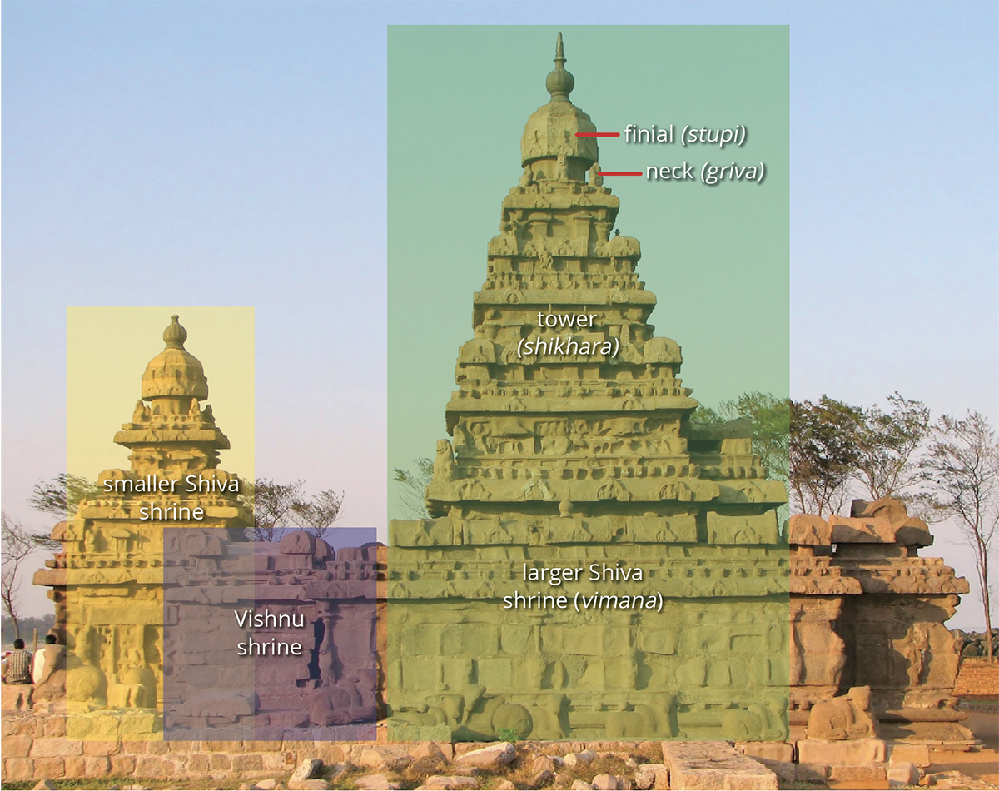

Many thanks to Group Director, RDTG and Director, IGCAR for the support and guidance.
Gratitude to CEA, France, for providing ERANOS 2.1 system.
Sincere thanks to CIAE and IAEA team their support !
Notes:
• One/two slide on the CEFR model + codes used (description on use of code, deterministic/MC, homogenous/heterogenous model, treatment of spacer wire, etc.)
• One/two slide each (WP) on the calculation results and observations
• One/two slides on modelling challenges and missing information (if any)
• One slide on future plan

