Slide 1
Spatial interdependence of safety related effects in ESFR-SMART core
Jiri Krepel :: Advanced Nuclear System Group :: Paul Scherrer Institut
International Conference on Fast Reactors and Related Fuel Cycles:
Sustainable Clean Energy for the Future (FR22)
19–22 April 2022, Vienna, Austria

Slide 2
Introduction
ESFR-SMART core belongs to the low void SFR concepts relying:
1) on upper sodium plenum with neutron absorber above it and
2) on flux importance shift towards this plenum
by means of bottom axial blanket.
System behavior analysis of this concepts should be accomplished at best with spatial neutron kinetics coupled to thermal-hydraulics solver.
However, often only point kinetics is applied.
This simplification rely on so called temperature reactivity coefficients and
its application to the transients with sodium boiling could be inaccurate.
This study focuses on spatial dependence of these coefficients.

Slide 3
Issue with reactivity coefficients
Spatial kinetics rely on parametrized multi-group cross-sections.
They are not perfect, but they capture well the local conditions and address possible changes in flux shape and spectrum.
Point kinetics assumes that
1) flux can be separated into amplitude and shape function,
2) the shape function is constant during transient,
3) and that the coefficients are independent and additive.
During the unprotected loss of flow sodium boiling can occur in SFR core.
This strong effect can result in:
  Shape function change and
  interdependency and non-additivity of the partial coefficients.

Slide 4
Coefficients derivation
  The major coefficients are fairly independent (especially for mild transients).
  Accordingly, coefficient are usually based on nominal value and derivatives. Actual coefficient is obtained by linear and logarithmic interpolations.
  More precise would be bi-interpolation based on four values (needs 1 more point).
  Sometimes also tabulated coefficients and interpolation could be used.
1
2
3

Slide 5
Four analyzed coefficients
Sodium void effect
(sodium removal from the respective zone,
keeping it between the wrappers)
Doppler effect
(fuel temperature increase by 1000K)
Fuel density effect
(fuel density reduction by 10%, not preserving the total mass)
Cladding density effect
(cladding density decrease by 10%, not preserving the total mass)

Slide 6
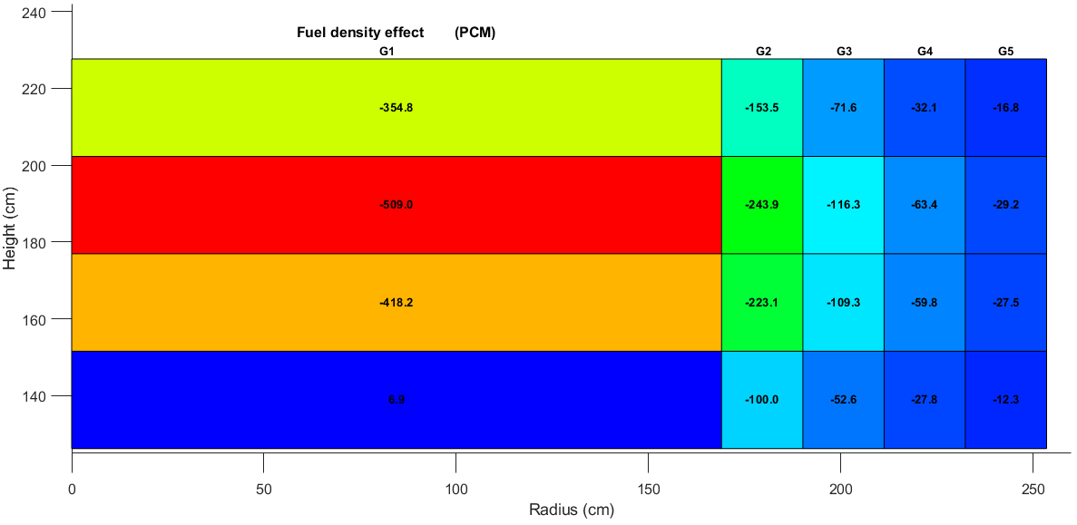
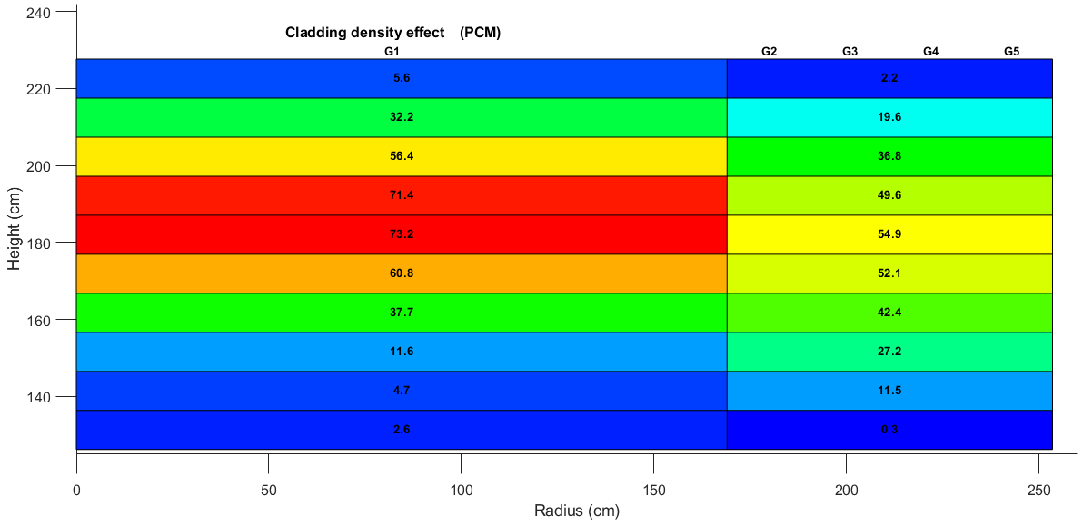
Fuel and cladding density effects
Generally the effects distribution
follows the flux importance.
The effects have also three components:
  Direct, caused by XS change
  Spectral, cause by spectra change
  Leakage, caused by increased or decreased neutron leakage.

Slide 7
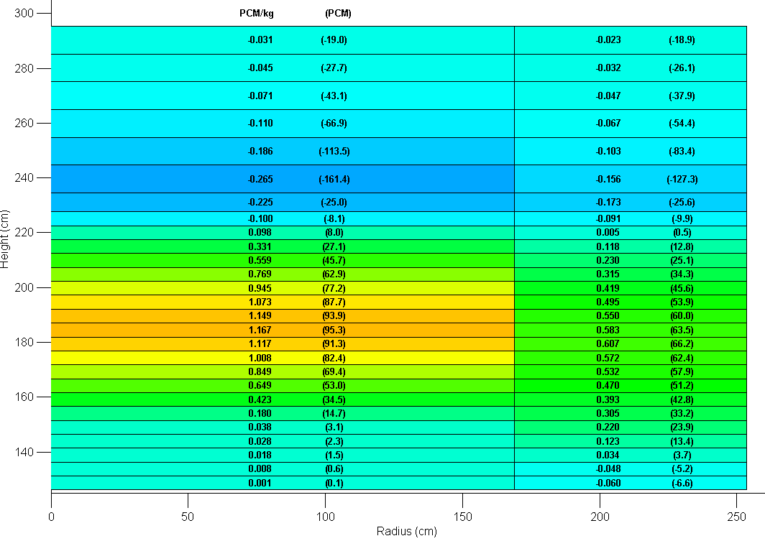
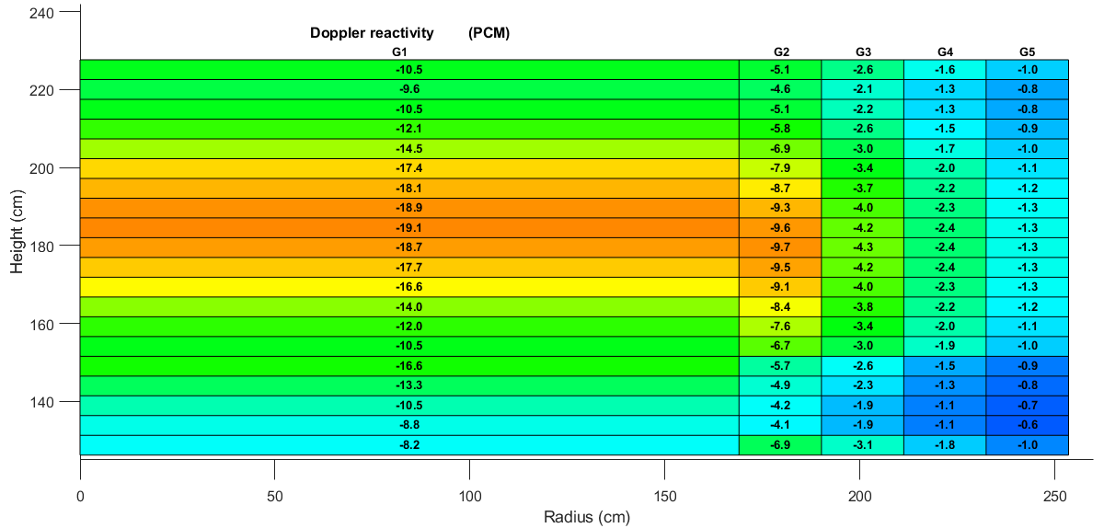
Doppler and void effect
On peripheries the spectral component can strongly influence the resulting effect.
Plenum voiding, in case of void effect introduce negative reactivity.

Slide 8
Void effect additivity
Void effect is
not additive
in the sodium
plenum.
Void is not additive in plenum.

Slide 9
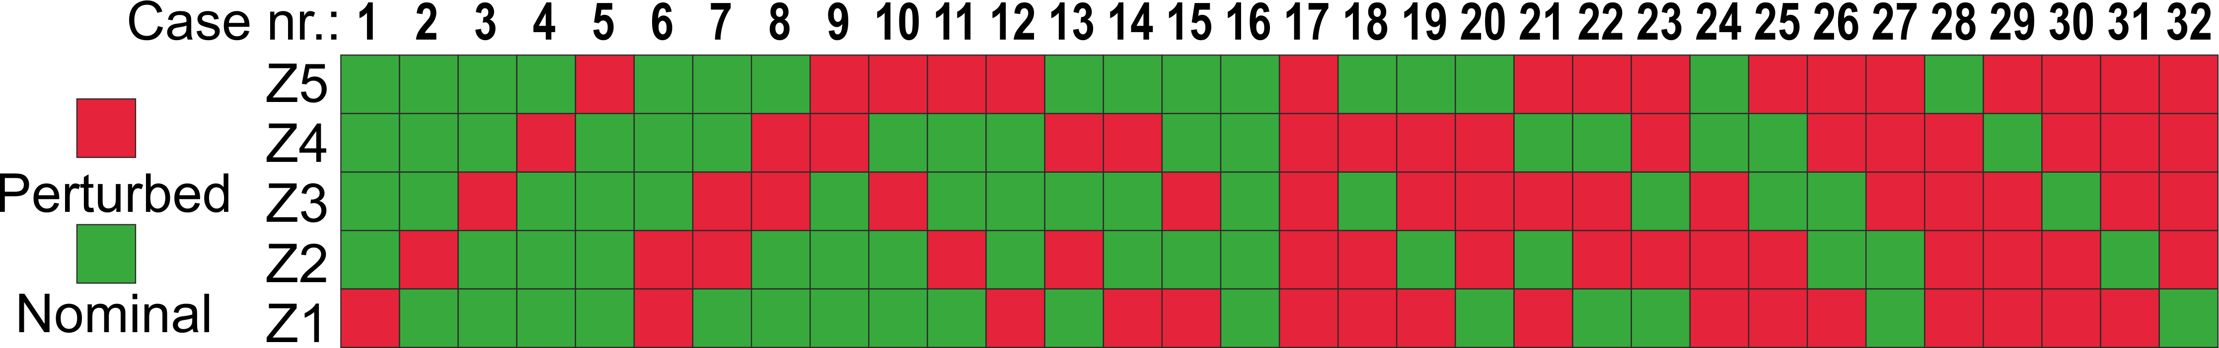
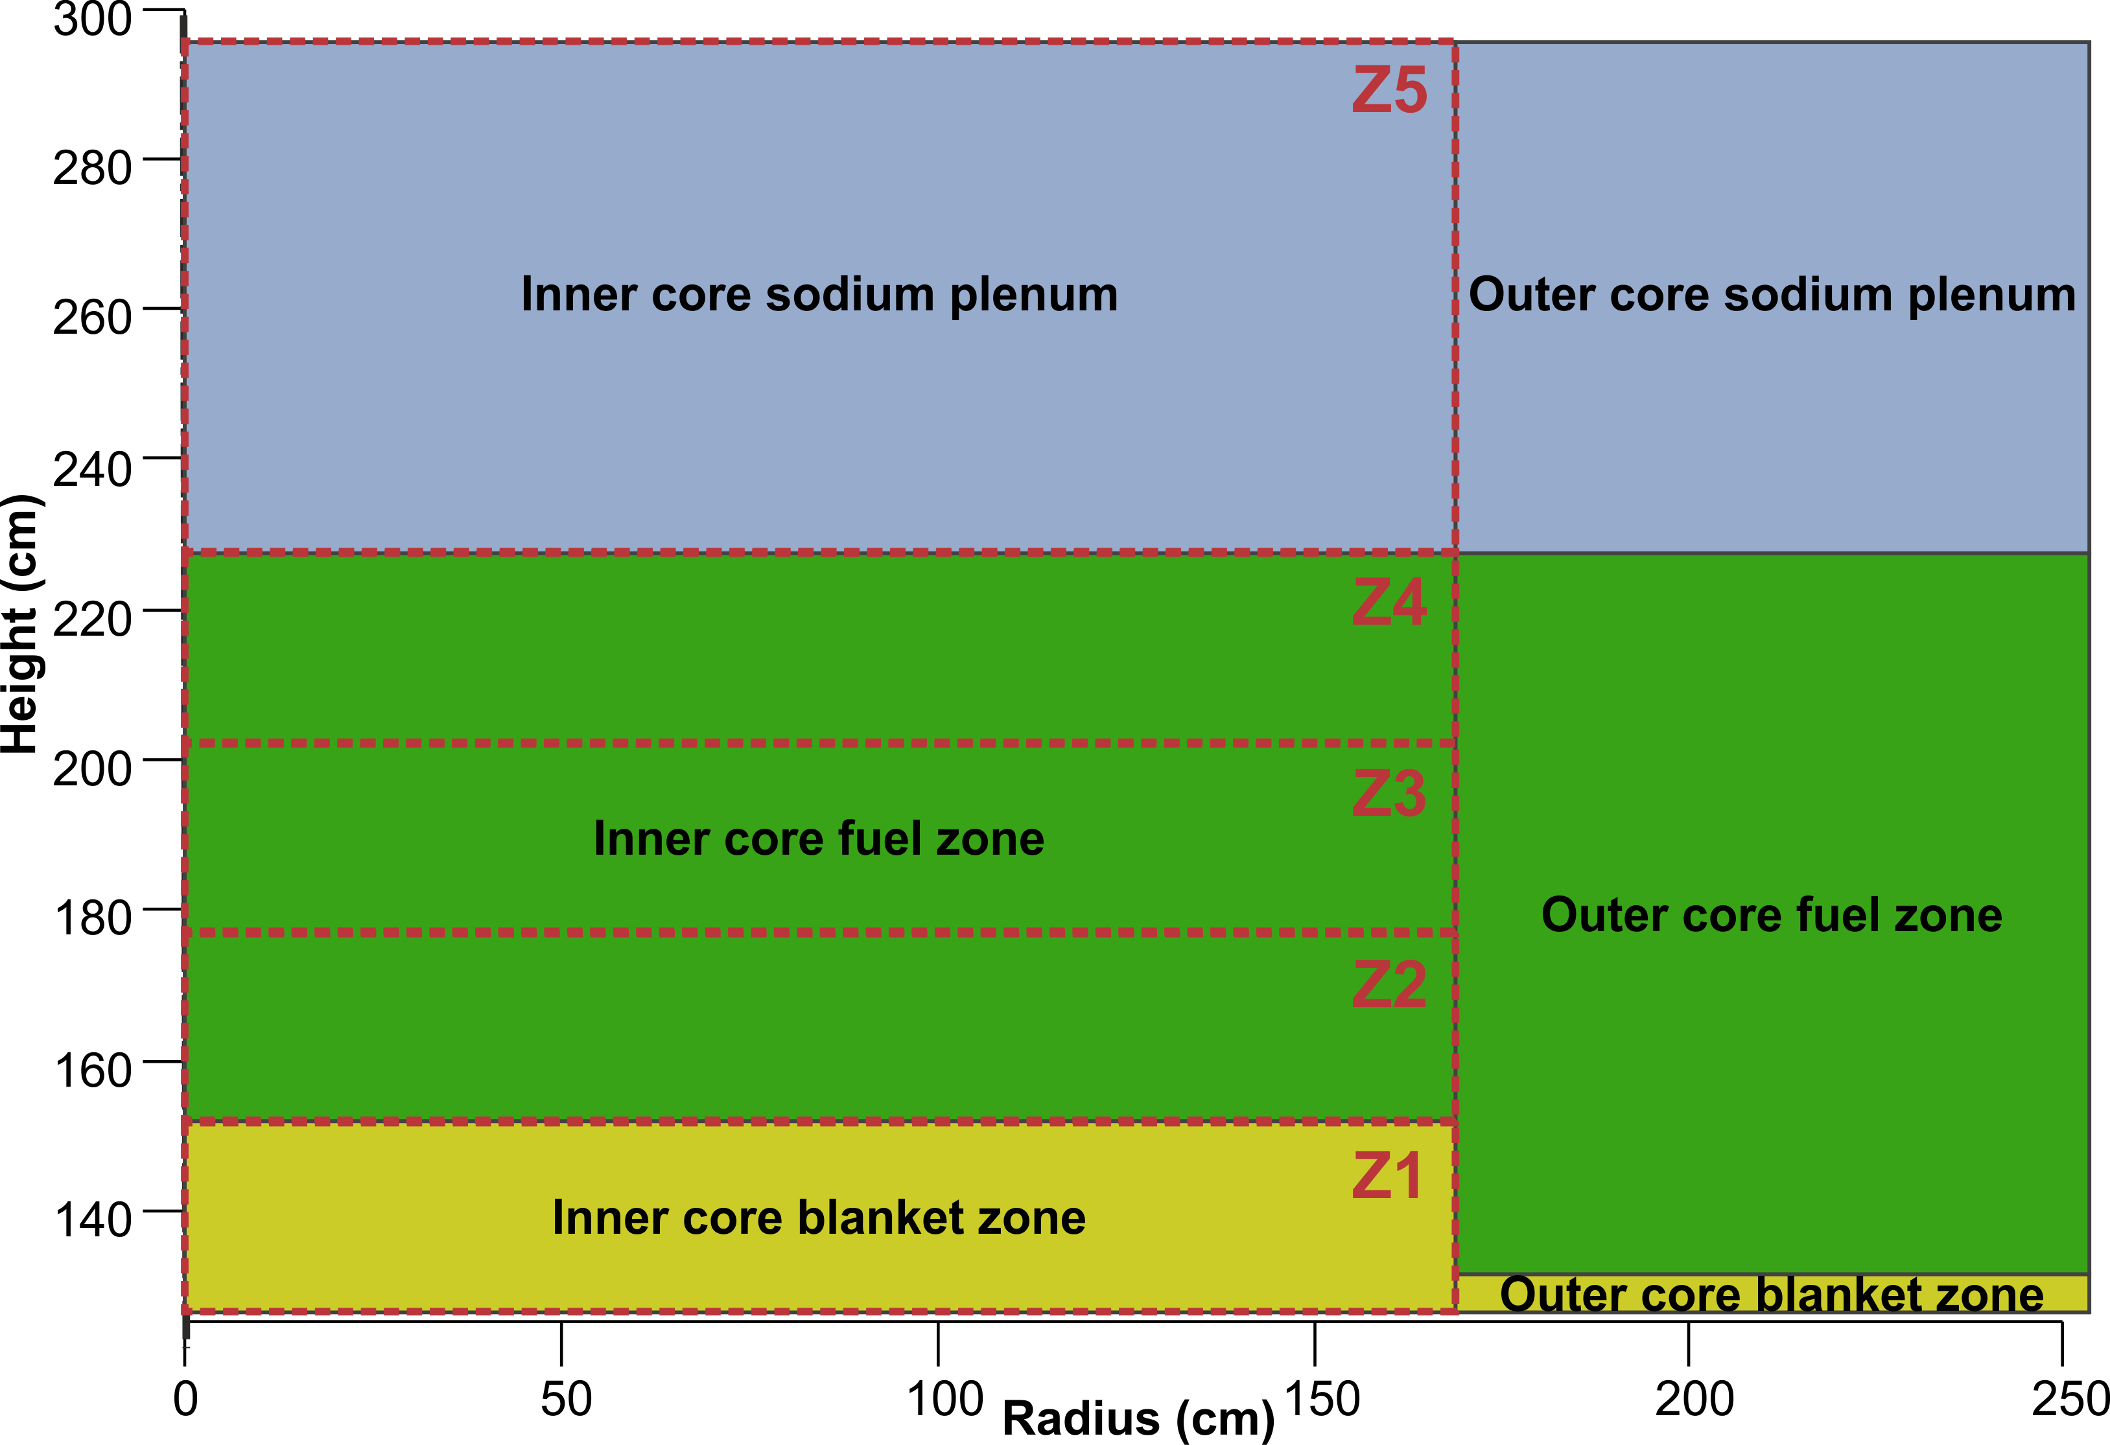
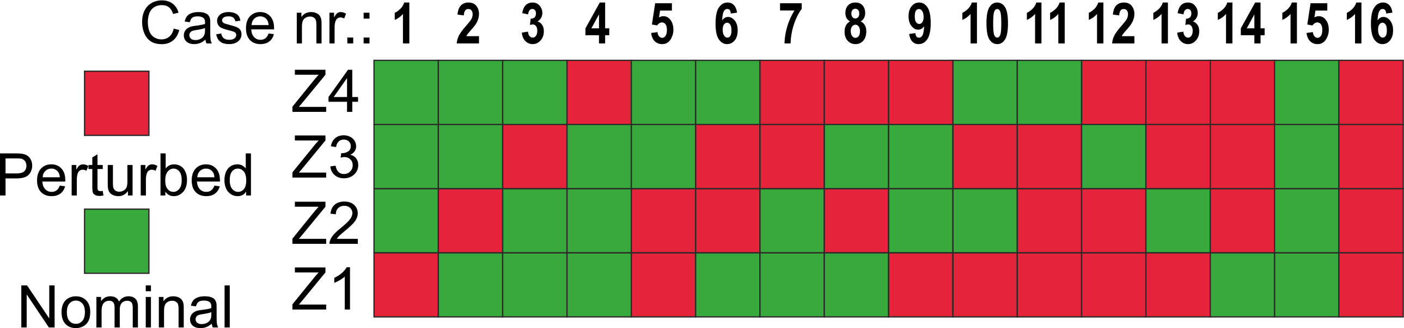
Mutual inter dependence: perturbation of the zones
For sodium void effect
all 5 zones were used.
There are 32 possible
voiding option.
For other effect:
Fuel temperature,
Fuel density, and
Cladding density
only the 4 core zones
have been used,
resulting in 16 combinations.

Slide 10
Void mutual inter dependence
The void effect is positive in the core and negative in the sodium plenum.
strongest mutual inter dependence was identified for upper core part Z4 and plenum Z5.
Krepel, J., et al., 2021, SPATIAL INTERDEPENDENCE OF SAFETY RELATED EFFECTS IN ESFR-SMART CORE, FR21 (FR22) proceedings.

Slide 11
Doppler effect mutual inter dependence
The Doppler effect (+1000K) is generally negative.
Mutual inter dependence is much weaker (smaller flux shape changes).
Krepel, J., et al., 2021, SPATIAL INTERDEPENDENCE OF SAFETY RELATED EFFECTS IN ESFR-SMART CORE, FR21 (FR22) proceedings.

Slide 12
Additivity of the effect in active core
Sodium void effect, Fuel temperature, Fuel density, and Cladding density are
all reasonable additive in the active core

Slide 13
Void in upper part
Sodium void effect is
not really additive for upper fuel Z4
and sodium plenum Z5 zones.
Sodium plenum void increases neutron leakage and is not linear =>
However summation of two effects in Z4 and Z5 is more conservative than bi-linear interpolation between 4 points.
(only because of compensating effects)

Slide 14
Summary
Coupled neutronics & TH simulation are important for
conceptual studies as well as for safety assessment.
Accuracy of the simulation tool should be selected according
to the importance of the results.
Standard solution uses multi-group XS as the coupling between TH & neutronics solver.
(the solver uses prepared XS to calculate flux shape)
Transients without sodium boiling, can be well addressed by TH & point kinetics.
In transients with sodium boiling, which are CPU demanding from TH perspective,
point kinetics is less precise and the related CPU savings are less important.

Slide 15
Wir schaffen Wissen – heute für morgen
Thank you for
your attention.

