Slide 1
Thermohydraulic tests in justification of design characteristics of the BREST-OD-300 steam generator
International Conference on Fast Reactors and Related Fuel Cycles:
FR22: Sustainable Clean Energy for the Future (CN-291), Vienna, Austria
Vera Grabezhnaya, Alexander Mikheyev*, Julia Kuzina
19-22 April 2022

Slide 2
Outline
Introduction
Experimental models and facility loop
Lead loop of the test facility
Steam generator models
Results of steam generator models’ testing
Three-tube SG module
Multi-tube (fragment) SG model
Heat transfer during transverse lead flow around tubes
Experiments with coolant on the oxygen saturation line
Basic oxygen regime
Conclusion

Slide 3
Introduction
The BREST-OD-300 reactor plant (RP) is under development at the Dollezhal Research and Development Institute of Power Engineering (NIKIET).
Lead has been selected as reactor coolant, the steam generator (SG) version adopted for this plant uses helical tubes arranged in coils.
To substantiate operability of any steam generator (SG), it is necessary to prove its design characteristics. To confirm the design characteristics and hydrodynamic stability in all modes of operation, experimental studies are required on models of a staff SG.
Initially, a SG model (version 2000) was developed, consisting of two identical three-tube sections (modules), but with a longitudinal coolant flow although in the full-size steam generator configuration the heating coolant has down flow.
The test program of the SG model was aimed at studying heat transfer and thermal-hydraulic stability of the steam generating tubes during operation of one module, as well as at identifying flow pulsations in the secondary circuit due to parallel (joint) operation of two modules with the parameters of partial and startup modes.

Slide 4
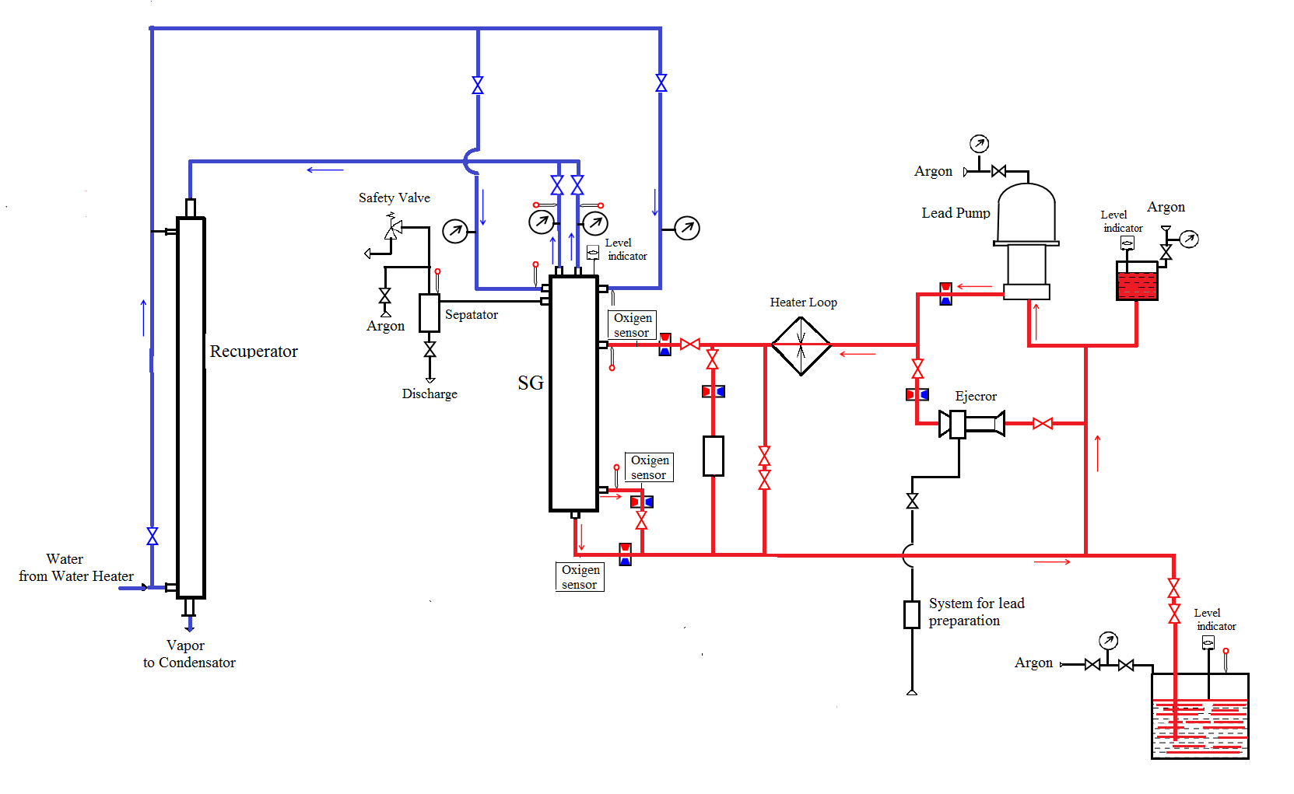
Lead loop of the test facility
To carry out tests for the steam generator of the BREST-OD-300 RP, a lead loop was arranged for the first time in the world at the SPRUT test facility, which makes it possible to perform tests and experiments with various models of steam generators heated by any liquid metal coolants.
Characteristic of the sprut stend
Parameter | Value
Inlet coolant temperature of the models, °С | up to 550
Feed water temperature, °С | above 180
Outlet water vapor temperature of the models, °С | up to 550
Water pressure, MPa | up to 30
Maximum coolant flow rate, m³/h | 40
Maximum water flow rate, m³/h | 8
Power (electric), MWt | up to 1.0

Slide 5
Steam generator models
a
Lead inlet
Vapor outlet
b
Vapor outlet
The first SG model with longitudinal flow of coolants consisted of two identical three-tube modules (Fig. a). Each module consists of a downcomer section, through which up to 5% of the total lead flow is pumped, and a helical riser section where the main lead flow is pumped. The flow of coolants in the coiled section was parallel.
A
A
A – A
Lead inlet
A – A
The multi-tube (fragment) thermo-hydraulic model (Fig. b) consists of 18 helically coiled steam generating tubes, divided into two groups, nine tubes in each group. Depending on the model test conditions, a different number of tubes are involved: 9 tubes at the parameters of nominal operating conditions, 18 tubes under the conditions of partial modes.
Water inlet
Lead
inlet
Lead outlet
Lead outlet
Lead outlet

Slide 6
Results of steam generator models’ testing: three-tube module
Distribution of adiabatic wall temperature along the model length at a pressure of 18 (a), 25 MPa (b), [1].
At the supercritical pressure values, the module shell (Fig. b) and, thus, the heat-transfer tubes are less loaded (in terms of temperature) than at subcritical pressure (Fig. a).
a
The tests which were carried out at the parameters corresponding to the nominal operating mode showed that outlet vapor temperature values were in line with its design value under different levels of feed water pressure.
b
●– inlet/outlet of lead; ▲ – inlet/outlet of water/steam;
○ , △ – shell temperature
[1] - GRABEZHNAYA, V., MIKHEYEV, A., STEIN, YU., SEMCHENKOV, A., Numerical and experimental investigation of the model steam generator reactor facility BREST-OD-300, Proceedings of Universities. Nuclear Energy, 1 (2013), 101–109, DOI: https://doi.org/10.26583npe.2013.1.13 (in Russian).

Slide 7
Results of steam generator models’ testing: three-tube module (2)
Fragment of time recording of water flow rate
To identify possible pulsation modes of operation of the secondary circuit, tests were carried out with a change in water flow rate from 30 to 4% of the nominal value.
a
Time recording of water flow rate pulsations in start-up modes during the operation of one module [2] is shown in Fig. a, when two models work together [3] – in Fig. b.
Module No. 2
There were no pulsations in the pressure and flow rate of the feed water associated with the hydrodynamic instability of the steam generating channel, and there was no throttling at the water inlet.
Module No. 1
b
[2] - GRABEZHNAYA, V., MIKHEYEV, A., KRYUKOV, А., “Tests of the BREST steam generator model when operating in partial and startup modes”, Results of Scientific and Technical Activities of the Institute of Nuclear Reactors and Thermal Physics for 2012, SSC RF – IPPE Publ., Obninsk, (2013), 131–142 (in Russian).
[3] - GRABEZHNAYA, V., KRYUKOV, А., MIKHEYEV, A., STEIN, YU., “Some research results on the model of the helically coiled steam-generator heated by liquid lead”, 4th Conf. Heavy Liquid Metal Coolants in Nuclear Technology (HLMC-2013) (Proc. Conf. Obninsk, SSC RF – IPPE, September 23-26, 2013), Obninsk, SSC RF – IPPE, Publ., (2013), 1, 139–152 (in Russian).

Slide 8
Results of steam generator models’ testing: three-tube module and fragment model (3)
Temperature distribution on the shell of helically coiled (a) and fragment (b) models
The advantages of this or that way of heat removal by steam generating tubes can be estimated by comparing the integral characteristics.
a
The flow rates of feed water and lead per one steam-generating tube were almost identical, however, steam overheating in the case of transverse (oblique) flow (Fig. b from [4]) is 50 °C higher than in the case of longitudinal flow over the tubes (Fig. a from [5]) .
[4] - GRABEZHNAYA, V., MIKHEYEV, A., Thermal-hydraulic tests of multi-tube model steam generator in partial parameters, Questions of Atomic Science and Technology. Series: Nuclear-Reactor Constants, 3, (2017), 177–186, https://vant.ippe.ru/year2017/3/thermal-physics-hydrodynamics/1384-15.html (in Russian).
[5] - GRABEZHNAYA, V., MIKHEYEV, A., BEREZIN, A., “The pressure effect on the model of the helically coiled steam generator heated by heavy metal”, 6th Russian National Heat Transfer Conference (RNHTC-6), (Proc. Conf., Moscow, Russia, October 27-31, 2014), Public House MEI, Moscow, (2014), Paper № 224, (CD) (in Russian).
b

Slide 9
Results of steam generator models’ testing: fragment model (4)
Fragment of time recording of water flow rate [6]
Fragment of time recording of water pressure in collectors No. 1 (a) and No. 2 (b)
The conducted thermos-hydraulic tests of the steam generator model in the steam generation mode at various power levels showed that neither instability nor pulsation modes associated with it were found.
[6] - GRABEZHNAYA, V., MIKHEYEV, A., Experimental study of thermal hydraulics on the model of helically coiled steam generator heated by liquid lead with longitudinal and transverse flow, Questions of Atomic Science and Technology. Series: Nuclear-Reactor Constants, 1, (2019), 133–143, https://vant.ippe.ru/year2019/1/thermal-physics-hydrodynamics/1667-11.html (in Russian).

Slide 10
Results of steam generator models’ testing: fragment model (5)
Hydraulic losses in the heat-transfer tubes [7]
T, °C
● – 25
■ – 100
▲ – 140
The tests of a fragmentary model were carried out, aimed at determining the hydraulic losses in the heat-transfer tubes in the modes of cold and hot flushing.
In the course of hot flushing, no noticeable effect of the feed water temperature on the hydraulic characteristics of the steam generating pipe was found in the temperature range from 100 to 200 °C.
The hydrodynamic characteristic of throttle No. 3.
[7] - GRABEZHNAYA, V., MIKHEYEV, A., Thermal-hydraulic tests of multi-tube model steam generator in partial parameters, Questions of Atomic Science and Technology. Series: Nuclear-Reactor Constants, 3, (2017), 177–186, https://vant.ippe.ru/year2017/3/thermal-physics-hydrodynamics/1384-15.html (in Russian).

Slide 11
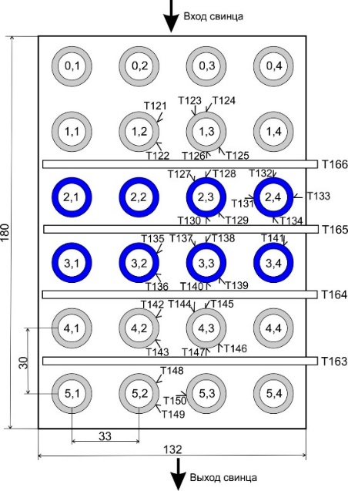
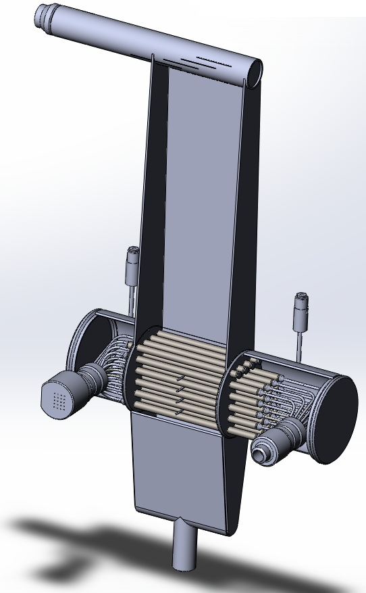
Heat transfer in transverse flow of lead around steam generating tubes
To verify the thermohydraulic knowledge about heat transfer in a lead coolant when flowing around steam generating tubes is required.
The experimental model
а
b
Lead inlet
The first data were obtained using models consisting of bundles of six rows of tubes, five of which are heat-transfer tubes. The length of the tubes was 250 mm. Instead of lead, a eutectic alloy of lead with bismuth was chosen as a heating coolant, which made it possible to carry out experi-ments with a single-phase flow of water with a water pressure of 1.4 MPa. Since the experimental data obtained covered mainly the region of transitional turbulent flow it was accepted the decision to carry out the experiments on a new model with a lead coolant [8].
The experimental model consists of six vertical and four horizontal rows of tubes, connected by a common collector, five of which are heat transfer ones, (Fig. a). In order to increase the mass velocity of water in rows 2, 5 and 6 (Fig. b), the heat transfer tubes were plugged. The third and fourth rows of tubes remained to study heat transfer.
Lead outlet
View of model in the assembly (a) and arrangement of thermocouple (b). (The first number means the row number, the number after dot means the tube number in a row)
[8] - KALYAKIN, S., GRABEZHNAYA, V., “Experimental study of heat transfer in a liquid metal with a transverse flow around a tube bundle to substantiate a steam generator of the BREST-OD-300 reactor plant”, 4th Russian National Heat Transfer Conference (RNHTC4) (Proc. Conf., Moscow, Russia, October 23-27, 2006), Public House MEI, Moscow, (2006), 2, 128–131 (in Russian).).

Slide 12
Heat transfer in transverse flow: a coolant on the oxygen saturation line
Fragments of time recording of tube wall temperatures in the first (a) and second (b) horizontal rows, Re_{Pb} = 5.1⋅10³
Overall heat transfer coefficient as a function of duration of lead circuit operation [9]
Т128
Т132
36 °С
Т127
Т131
а
Т133
Т141
Т137
26 °С
Т139
Start of operation on 24 Jul. (▲); 25 Jul. (▲);
2 Aug. (○,●).
Т135
b
[9] - GRABEZHNAYA, V., MIKHEYEV, A., Effect of oxygen content on heat transfer in steam-generating tubes in transverse flow of heavy liquid-metal coolant, Atomic energy, 127, 4, (2020), 207–215, DOI: https://doi.org/10.1007/s10512-00612-8.

Slide 13
Heat transfer in transverse flow: basic oxygen regime
Fragments of time recording of tube wall temperatures in the first (a) and second (b) horizontal rows, Re_{Pb} = 5.1⋅10³
Before the experiments, the coolant was purified by means of an argon-hydrogen mixture. As a result, the oxygen concentration in the lead decreased to a value, which corresponds to the basic oxygen operating mode of the lead loop.
Temperature drop
11 °С
The data of one of the experiments with the minimum lead flow rate are shown in Fig. a, b. Low-frequency temperature fluctuations with a frequency of less than 0.25 Hz occur on the surface of the heat-transfer tubes.
а
Temperature drop
On the one hand, over 3.5-time increase in the lead flow rate resulted in an appreciable reduction of the amplitude of temperature pulsations; on the other hand, in an increase in the temperature maldistribution between the coolant layers.
9 °С
b
Time, s
[9] - GRABEZHNAYA, V., MIKHEYEV, A., Effect of oxygen content on heat transfer in steam-generating tubes in transverse flow of heavy liquid-metal coolant, Atomic energy, 127, 4, (2020), 207–215, DOI: https://doi.org/10.1007/s10512-00612-8.

Slide 14
Heat transfer in transverse flow: basic oxygen regime
Based on the results obtained, the lead heat transfer coefficient in the basic oxygen regime can be calculated by the formula previously determined at the IPPE JSC [10]:
The Nusselt number as a function of the Peclet number
Nu = 5.5 + 0.025·Pe^{0.8}. (1)
1 - Eq. (1)
1
However, the most reliable is the overall heat transfer coefficient k, since to determine it, it is not required to know water heat transfer coefficient.
Linear overall heat transfer coefficient as a function
of lead velocity
The data presented are related only to the experiments with supercritical water parameters. A decrease in the lead heat transfer coefficient was found out in case of severe lead contamination with oxygen to the Nusselt number equal to 2.0.
[10] - PARFENOV, A., MIKHEYEV, A., GRABEZHNAYA, V., SHCHERBAKOV, S., “Experimental study of heat transfer in a transverse flow of lead around a bundle of steam-generating tubes”, Thermophysics of Fast Neutron reactors “Theplophyzika-2013” (Proc. Sci.-Tech. Conf., Obninsk, SSC RF – IPPE, October 30 – November 1, 2013), SSC RF – IPPE Publ., Obninsk, (2014), 1, 294–299, (in Russian).

Slide 15
Conclusion
At the State Scientific Centre of the Russian Federation – Leypunsky Institute for Physics and Power Engineering, Joint-Stock Company (IPPE JSC), a large scope of work was carried out to justify the BREST-OD-300 RP steam generator, which is under development at NIKIET JSC. The tests carried out with various models of the steam generator showed the following:
under the nominal operating conditions, the design steam superheating is provided at the outlet of the steam-generating tube;
in all the operating modes (nominal, startup, partial parameters), steady-state operation of the steam-generating channel is ensured up to a water flow rate of 4% of the nominal value.
The dependence of lead coolant heat transfer on the oxygen concentration in the lead has been experimentally confirmed. Under basic oxygen conditions, it is recommended to calculate lead heat transfer by the formula Nu = 5.5 + 0.025⋅Pe^{0.8}.
For lead with oxygen concentration on the saturation line, the lower limit of Nu = 2 is set in the range of Peclet numbers from 80 to 600. The dependence of the heat transfer coefficient on the lead velocity in a narrow cross section was not found, which agrees with the data of other authors.
It was found out that after transition from lead on the saturation line to the basic oxygen regime, the values of the heat transfer coefficient come back to the values characteristic of this regime.

Slide 16
Thanks
for your attention
Mikheyev Alexander S.
Grabezhnaya Vera A.
Leading Researcher
Senior Researcher
Моб. тел.: +7 (484) 399 89 34
E-mail: mikheyev@ippe.ru
Моб. тел.: +7 (484) 399 86 86
E-mail: gva@ippe.ru
21.03.2022

