Slide 1
Complex of experimental facilities for design and safety justification of fast reactors with liquid metal coolants
Kuzina Yu.А., Klinov D.A., Mikhailov G.M., Sorokin A.P.
IPPE JSC, Obninsk, Russian Federation

Slide 2
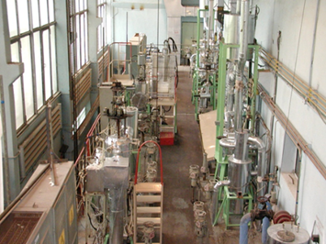
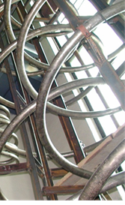
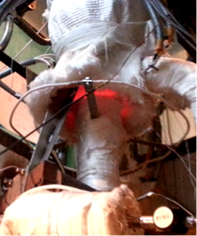
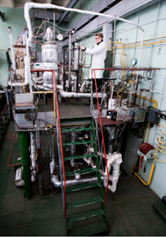
Specification of IPPE test facilities in support of liquid metal cooled fast reactors
Air and water hydrodynamic test facilities – SGDI (air), V-2 (air), SGI (water)
Thermal hydraulic water and liquid metal test facilities – V-200 (water), PLUTON (Na), 6B (Na, Na-K), AR-1 (Na, Na-K), SPRUT (Na, Na-K, Pb, Pb-Bi), RS-M (Na)
Technological test facilities (Na, Na-K, Pb, Pb-Bi) – PROTVA-1 (Na, Na-K), PROTVA-2 (Na), TT-1M (Pb),TT-2M (Pb, Pb-Bi), SID (Na, Na-K)
Critical facilities for full-scale simulation of nuclear reactor cores of various types - BFS-1, BFS-2

Slide 3
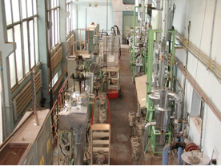
Test facility "6B" (liquid metal test facility for thermal hydraulic studies)
The “6B” three-loop facility is designed to study hydrodynamics, heat transfer and temperature regimes in the elements of cores, “metal – metal” heat exchangers, mixing chambers of fast reactors under nominal and transient conditions, etc.
The parameters measured: power, flow rate, temperature, velocity, pressure
Loop | 1 | 2
Coolant | Na-K | Na
Flow rate, m³/h | 150 | 150
Pressure, MPa | 0,6 | 0,6
Temperature, °С | 450 | 450
Power, kW | 400 | 1200
Scope of studies:
Thermophysical studies of single-phase liquid metal flow regimes in the models of fast reactor fuel assemblies and equipment components as applied to various operating conditions (local measurements of coolant velocity and temperature of model fuel element, studies of temperature regimes in mixing chambers).
local measurements temperature fields in fast reactor fuel assembly models to study the effects of components (spacers, displacers), deformation, blockages
measurements of velocity and temperature fields in intermediate heat exchangers
efficiency of coolant mixing in the mixing chambers, efficiency of the core temperature regime diagnostics
natural convection processes as applied to decay heat removal systems
testing and calibration of sensors, equipment testing

Slide 4
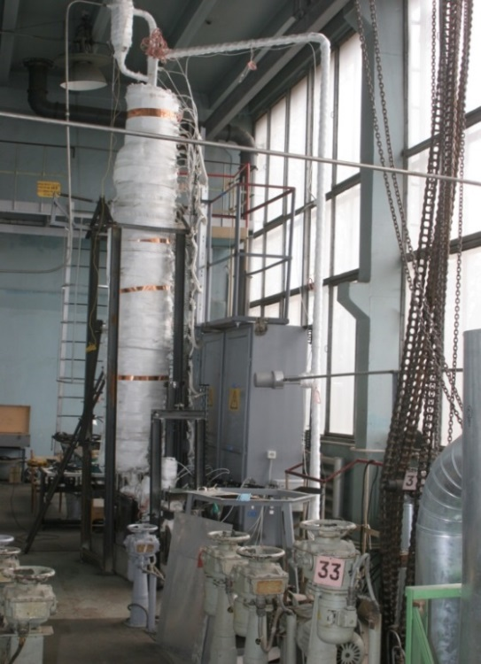
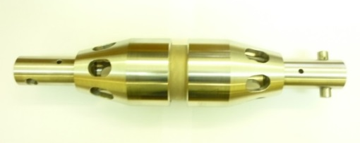
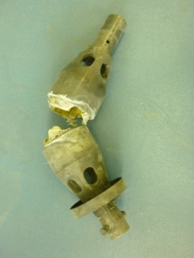
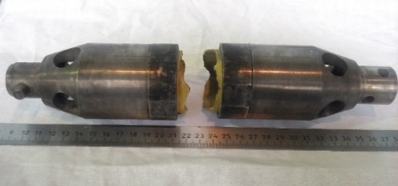
High temperature section of 6B test facility used for studying components of passive safety system of sodium fast reactors
For testing the passive safety system devices of various designs with various fusible elements, a high-temperature section was created at the 6B test facility, which provides the parameters of temperature variation rate close to those in a reactor.
The test section allows studying samples of PSS-T elements and defining conditions and time of their destruction in hot sodium flow (operating temperature is 720°С, flow rate is 1 m/s)
Test chamber

Slide 5
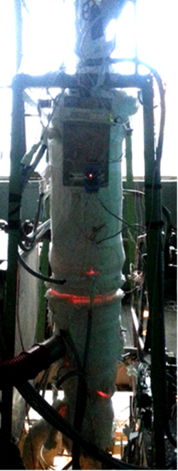
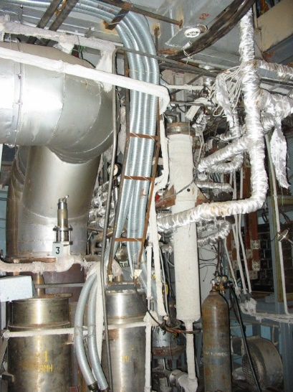

Test facility "AR-1" (high-temperature liquid-metal test facility)
Coolant | Na | Na-K
Flow rate, m³/h | 50 | 5
Pressure, MPa | 1,0 | 0,6
Temperature, °C | 1000 | 700
Power, kW | 1500 | 750
The "AR-1“ (Accident Regimes) high-temperature liquid-metal test facility is designed to carry out research into thermohydraulic processes under emergency conditions of sodium fast reactors operation, including severe accident progression with sodium boiling in the core.
The parameters measured: power, flow rate, temperature, velocity, pressure in the gas loop and coolant, indication of boiling condition (acoustic transducers, potentiometry)
Performance capabilities of the test facility:
Experimental modeling of thermohydraulic processes in two-phase liquid metal flows in the channels with fuel assemblies to substantiate fast reactor safety under emergency conditions (UTOP, ULOF, etc.).
Test model to study sodium boiling
in the FA in the core

Slide 6
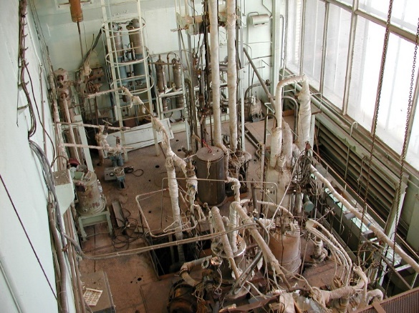
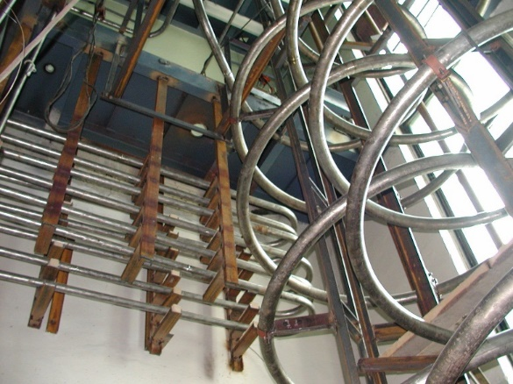
Test facility "SPRUT" (multipurpose liquid metal test facility)
The "SPRUT" facility is designed to study thermal-hydraulic characteristics of steam generators in reactors with liquid metal coolants
Performance capabilities of the test facility:
Research into steam-water flow characteristics in various channels (pipes (tubes), annular channels, Field channels, etc.).
Studies of heat flux distribution and heat transfer coefficients along the length of steam-generating tubes under nominal and starting operation conditions, wall temperature pulsations, heat transfer and stability of operation of parallel channels, dynamic conditions (in case of fluctuating water flow), emergency conditions to justify steam generators of reactors with various liquid metal coolants.
Research into corrosion resistance of steam generator tubes.
Development of water chemistry and pipe (tube) flushing.
Loop | 1 | 2 | 3 | 4
Coolant | Na | Pb-Bi | H₂O | Na-K
Flow rate, m³/h | 10 | 5 | 8 | 2
Pressure, mPa | 1 | 1,5 | 20 | 0,5
Temperature, °С | 600 | 600 | 500 | 250
Power, kW | 600 | 1000 | 1200 | 15

Slide 7
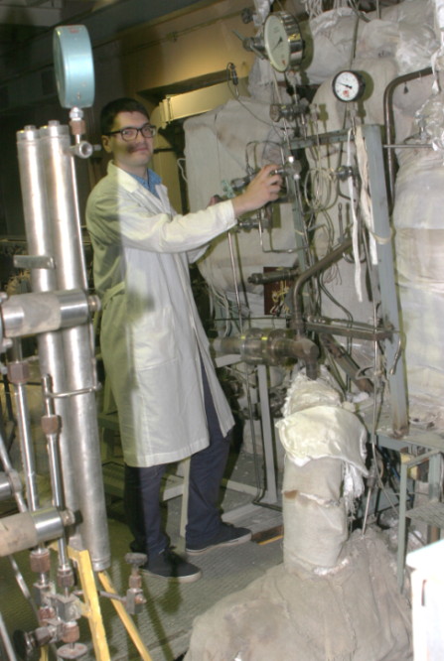
Liquid metal test facility "Protva-1"
Test facility "Protva-1 is designed to solve the issues of sodium coolant technology as applied to fast reactor, including such tasks as to study mass transfer of impurities in a circulation loop with sodium, to study the improved methods for sodium purification from impurities, to test the devices that control impurities in the coolant.
The parameters measured: flow rate, temperature, velocity, coolant pressure, pressure in a gas loop, oxygen and hydrogen in coolant
Loop | 1 | 2
Coolant | Na | Na-K
Flow rate, m³/h | 200 | 10
Pressure, mPa | 0,4 | 0,6
Temperature, °С | 580 | 350
Quantity of sodium in a loop, m³ | 0,9 | 0,15
Power, kW | 800 | 500
Performance capabilities of the test facility:
Studies of impurities mass transfer (oxygen, hydrogen, water, organic impurities) in a high-temperature non-isothermal sodium loop.
Studies of methods and tools to purify sodium coolant from impurities.
Studies of methods and tools to control impurities in sodium coolant.

Slide 8
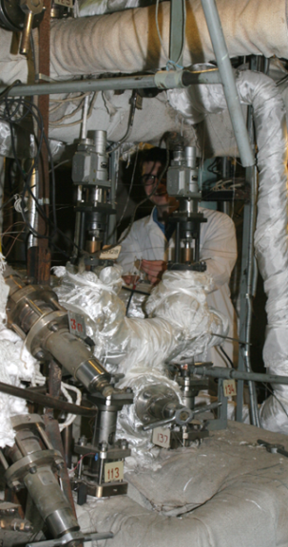
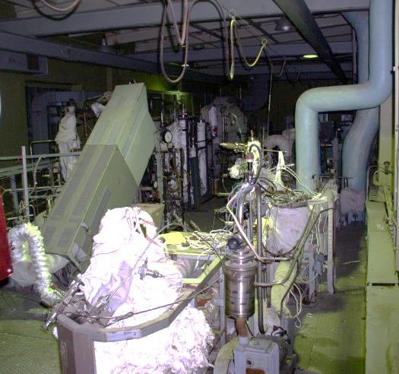
Sodium test facility “PROTVA-2”
The test facility “PROTVA-1” is designed for experimental studies of the behaviour of structural materials in sodium-water reaction zone, the studies of mass transfer in a gas plenum of sodium loop, tests of devices for impurities control in sodium.
The parameters measured: flow rate, temperature, velocity, coolant pressure, pressure in a gas loop, oxygen and hydrogen in coolant.
Coolant | Na
Flow rate, m³/h | 50
Pressure, MPa | 0,6
Temperature, °С | 550
Sodium volume, m³ | 0,45
Power, KW | 350
Performance capabilities of the test facility:
testing the systems of impurity monitoring in coolant
reactive capacity of deposits formed in gas plenum at their contact with sodium
heat-transfer tube material rupture under the small sodium-water leak

Slide 9
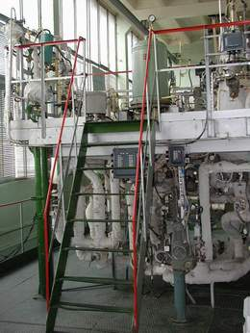
Test facility «TT-1М» (Pb, Pb-Bi)
The "TT-1M" liquid metal test facility is designed for integrated research into the technology of heavy liquid metal coolants (Pb-Bi, Pb) related to the study of the processes involving automatic control and maintenance of the preset level of thermodynamic activity of oxygen in the coolant, maintaining the purity of the liquid metal loop, filtration and sorption purification of the coolant
Basic specifications of the test facility:
The volume of the liquid metal loop is 250 l (lead-bismuth), 40 l (lead),
The coolant flow rate is up to 6.5 m3/h (lead-bismuth), 1.0 m3/h (lead),
The coolant temperature for the non-isothermal regime (lead-bismuth) is 200–600 °С, for the isothermal regime (lead) – 370–550 °С,
The heating loop power is 200 kW,
The total power is up to 350 kW.
Performance capabilities of the test facility:
Measurements in support of the research into the following issues:
Maintaining purity of the coolant. Integrity control of the passivation films on the liquid metal loop surfaces.
Steam generator leakage control in case of water ingress into the coolant. Mass transfer processes.
Full-scale models/mock-up specimens of coolant technology systems and devices.

Slide 10
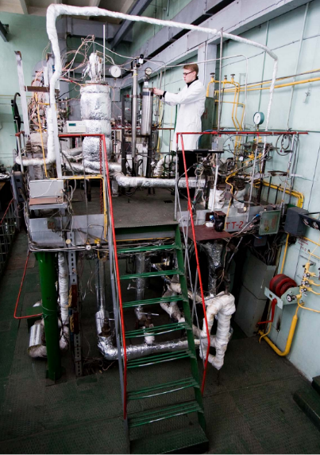
Test facility «TT-2М» (Pb-Bi)
The "TT-2M" liquid metal test facility is designed to study the physicochemical processes occurring in the course of interaction of heavy liquid metal coolant with water, air, ceramic and composite materials, carbon, etc.,
Basic specifications of the test facility:
The volume of the liquid metal loop is 200 l,
The coolant flow rate is up to 5 m3/h,
The coolant temperature for the non-isothermal regime is 200–550 °C,
The total power is up to 250 kW.
Performance capabilities of the test facility:
Measurements in support of the research into the following issues:
Maintaining purity of the coolant, inner surfaces of the loops and various-application equipment,
Processes of coolant impurity composition control,
Mass transfer processes,
Release of coolant components to the gas phase.
Tests:
Full-scale models/mock-up specimens of coolant technology systems and devices,
Integrated automated systems for monitoring, prediction and control of the coolant condition,
Various mass transfer devices. Corrosion testing of advanced materials for nuclear power systems.

Slide 11
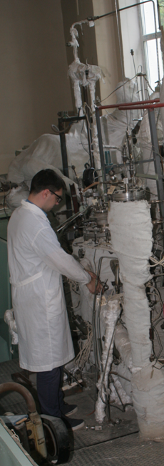
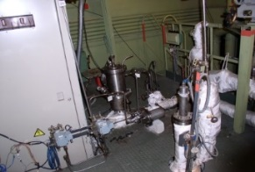
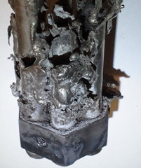
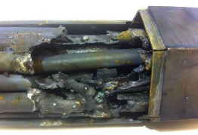
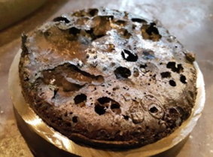
Liquid Metal Facility “PLUTON”
Facility “Pluton” is designed for investigation of ULOF accidents through the use of corium simulators including uranium-containing ones (material movement in the course of fuel melting in FA models of various geometries, fuel heat-to-mechanical energy conversion factors, etc.)
Measured parameters: coolant power, temperature, flow rate, pressure.
Coolant | Na
Maximum coolant flow rate, m³/h | 10
Maximum coolant pressure , MPa | 0.25
Argon pressure in the gas cavity of the pump tank and drain tank (excess), MPa | 0.08
Maximum coolant temperature, °С | 750
Maximum power rating , KW | 150
Scope of studies:
Studies on the characteristics of simulated corium-sodium interaction processes as dependent on the input parameters of the experiments (initial sub-cooling of sodium, melt mass outflow parameters, mNa/mcorium mass ratio, etc.)
Study on the fuel cladding failure
Study of the reactor structural materials’ behavior in case of their contact with corium
Study in justification of in-vessel corium traps

Slide 12
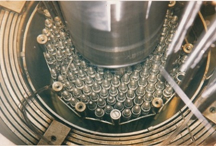
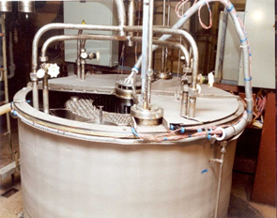
Water test facility “V-200” with integral model of fast reactor
The "V-200" test facility is designed for experimental research into thermal hydraulic processes (hydro-dynamics of non-isothermal flow, distribution of velocity and temperature fields, stratification of coolant) in the volumes and equipment of the primary circuit of a fast reactor under various operating conditions
Coolant | water
Pressure | atmosphre
Temperature, °С | 90
Flow rate, m³/h | 20
Power on subassembly model, kW | 150
Dimensions of the model tank, - diameter, m - height, м | 2.0 1.8
Количество датчиков | > 400
Scope of studies:
A large amount of research was carried out on non-stationary temperature and velocity fields in the primary circuit elements for the BN-800 and BN-1200 reactors in various operating conditions: with forced circulation, in transients, under emergency cooldown conditions.
local structure of non-isothermal coolant flow in the elements of the reactor primary loop including the upper plenum in various operating modes (coolant stratification, temperature pulsation etc.).

Slide 13

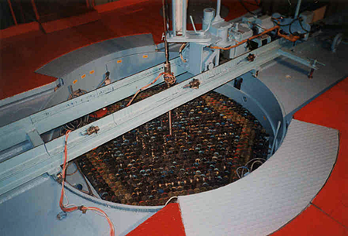
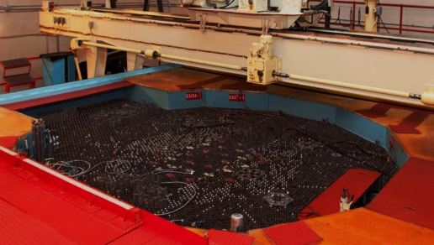



BFS fast critical facilities
The world’s only experimental tool for full-scale simulation of nuclear reactors of any type, composition and configuration
It is a unique experimental facility designed for:
reactor physics research
safety problems solving
core optimization
minor actinides burn-up,
disposition of weapons-grade plutonium
  Materials of the facility allow to model core, reactor blanket, reflectors, and in-core protection, as well as fuel cycles, spent nuclear fuel storages and radioactive waste repositories
The BFS complex includes two critical facilities:
BFS-1 and BFS-2
BFS is located at
IPPE JSC
Obninsk, Kaluga Oblast
BFS-1
BFS-2
Notes:
Все направления исследований на критстендах можно условно разбить на две части - моделирование проектируемых реакторов и интегральные эксперименты на критсборках
исследования физики (нейтронно-физических характеристик) любого класса реакторов - от исследовательских (МБИР) до крупных энергоблоков (БН-1200)
Моделирование практически любого этапа топливного цикла – от производства топлива до захоронения РАО в геологических породах
Моделирование нейтронных спектров в любом энергетическом диапазоне
Разнообразие имеющихся материалов позволяет исследовать характеристики различного типа топлива и теплоносителя
Бенчмарки для тестирования нейтронных данных по новым материалам для активных зон.
обоснования ядерной безопасности.
отработка методик измерений нейтронно-физических параметров
Решение проблем безопасности объектов атомной энергетики
оптимизация активных зон
обоснование технологии выжигания МА
обоснование топливного цикла и программ по утилизации оружейного Pu

Slide 14


BFS composition
BFS complex includes 2 critical facilities BFS-1 and BFS-2
BFS complex includes 2 critical facilities BFS-1 and BFS-2, and an electron accelerator MI-30
 | BFS-1 | BFS-2
Capacity, kW | 0,2 | 1,0
Size, m | diameter – 2,0 height – 2,2 | diameter – 5,0 height – 3,2
Neutron flux density, neutron*cm^{–2}·s^{–1} | 10¹⁰ | 10⁹
Max capacity of simulated reactors, MW | 350 (el.) | 3000 (el.)
Simulated coolant | Na, Pb, Pb-Bi, water, gas
Reflector | U, UO2, Pb, Pb-Bi, steel, etc.
Moderator for light water reactors | distillate, boron solution, polyethylene, graphite
 | BFS-1 | BFS-2
Capacity, kW | 0,2 | 1,0
Size, m | diameter – 2,0 height – 2,2 | diameter – 5,0 height – 3,2
Neutron flux density, neutron*cm^{–2}·s^{–1} | 10¹⁰ | 10⁹
Max capacity of simulated reactors, MW | 350 (el.) | 3000 (el.)
Simulated coolant | Na, Pb, Pb-Bi, water, gas
Reflector | U, UO2, Pb, Pb-Bi, steel, etc.
Moderator for light water reactors | polyethylene, graphite
14
Notes:
Все направления исследований на критстендах можно условно разбить на две части - моделирование проектируемых реакторов и интегральные эксперименты на критсборках
исследования физики (нейтронно-физических характеристик) любого класса реакторов - от исследовательских (МБИР) до крупных энергоблоков (БН-1200)
Моделирование практически любого этапа топливного цикла – от производства топлива до захоронения РАО в геологических породах
Моделирование нейтронных спектров в любом энергетическом диапазоне
Разнообразие имеющихся материалов позволяет исследовать характеристики различного типа топлива и теплоносителя
Бенчмарки для тестирования нейтронных данных по новым материалам для активных зон.
обоснования ядерной безопасности.
отработка методик измерений нейтронно-физических параметров
Решение проблем безопасности объектов атомной энергетики
оптимизация активных зон
обоснование технологии выжигания МА
обоснование топливного цикла и программ по утилизации оружейного Pu

Slide 15











Research capabilities at BFS
BFS
Modeling of future reactor facilities
Mock-up
experiments
Benchmark
experiments
Integral experiments at critical assemblies
Optimization of reactor cores and control & protection system
Reactor physics studies
from research to commercial high-power reactors
  Feasibility evaluation of the minor actinides burn-up technology
Validation of calculation codes and neutron data
Feasibility evaluation of nuclear safety
Staff training
Addressing safety issues
Feasibility evaluation of nuclear energy facilities
Simulation of
life cycle
from fuel fabrication to radioactive waste disposal
  Weapons-grade Pu disposition program
Approbation of new research and measurement methods
Study of new materials
Notes:
Все направления исследований на критстендах можно условно разбить на две части - моделирование проектируемых реакторов и интегральные эксперименты на критсборках
исследования физики (нейтронно-физических характеристик) любого класса реакторов - от исследовательских (МБИР) до крупных энергоблоков (БН-1200)
Моделирование практически любого этапа топливного цикла – от производства топлива до захоронения РАО в геологических породах
Моделирование нейтронных спектров в любом энергетическом диапазоне
Разнообразие имеющихся материалов позволяет исследовать характеристики различного типа топлива и теплоносителя
Бенчмарки для тестирования нейтронных данных по новым материалам для активных зон.
обоснования ядерной безопасности.
отработка методик измерений нейтронно-физических параметров
Решение проблем безопасности объектов атомной энергетики
оптимизация активных зон
обоснование технологии выжигания МА
обоснование топливного цикла и программ по утилизации оружейного Pu

Slide 16
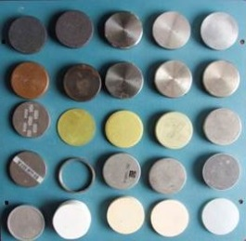
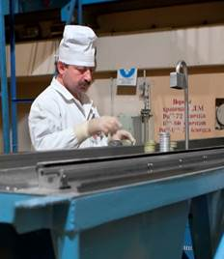
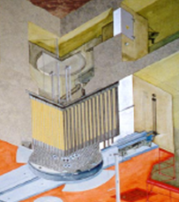
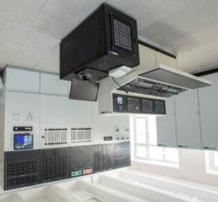
Simulation at BFS
A simple principle to create reactor models: large compositions are assembled from small parts
Stage 1
Stage 2
Stage 3
Stage 4
Collection of reactor materials
Critical assemblies
Core simulation
Data analysis
Reactor materials (fissile, structural, absorbing, imitating coolant) are gathered in the form of disks (Ø47 mm, 0.3-10.0 mm thickness)
Disks with the necessary materials in the required sequence are assembled into rods and loaded into the reactor core.
The assemblies form a model of core and side shields.
The created critical assembly is a zero-power reactor
Data is collected and analyzed using a state-of-the-art supercomputer
Notes:
Принцип создания моделей на БФС очень прост и напоминает работу с детским конструктором - из мелких деталей собираются большие композиции.
Модели собираются из малых по геометрическим размерам дисков, состоящих из различных материалов.
Диски с ядерными материалами, диски с составом теплоносителей, диски с составом конструкционных материалов.
Компонуя соответствующим образом диски, мы получаем модели, детально описывающие активные зоны, отражатели и органы СУЗ.
Собранная модель - это критическая сборка, которую мы можем вывести на критику. Получается реактор "нулевой мощности".
Реакторные материалы стендов (металлический плутоний, оксид и металлический высокообогащенный уран с обогащением 36% и 90% по урану-235, сотни тонн воспроизводящих материалов, конструкционных материалов, различных теплоносителей) позволяют собирать как сложные полномасштабные модели быстрых реакторов, так и бенчмарки, эксперименты на которых проводятся для корректировки нейтронно-физических констант и совершенствования расчетных методов

Slide 17
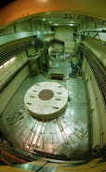
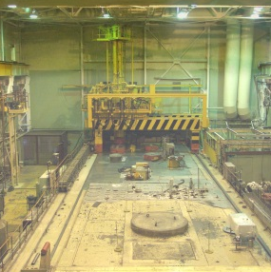
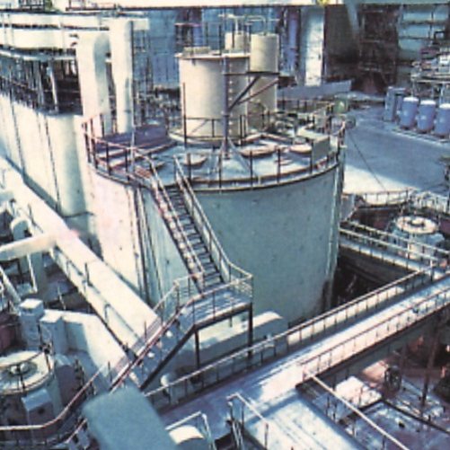
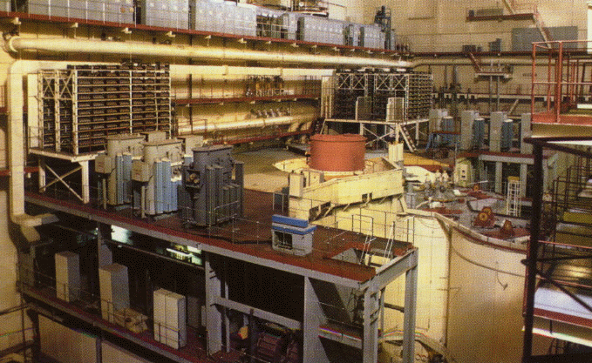
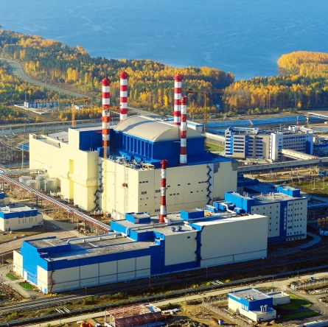
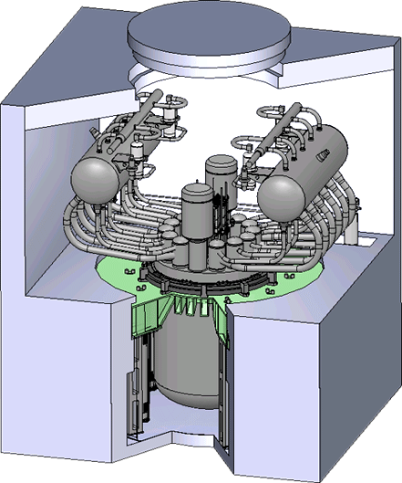
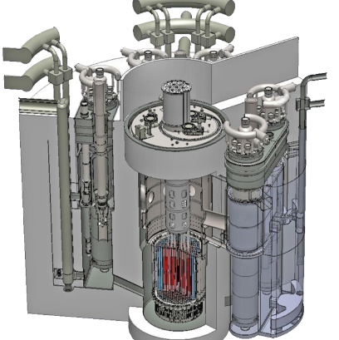
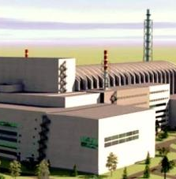
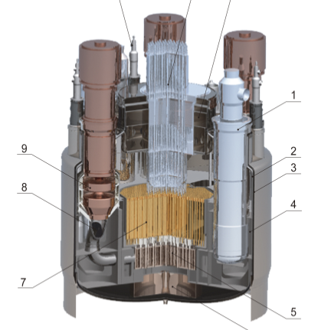
BFS research expertise: studying Russian research reactors
Almost all Soviet and Russian fast reactors were modelled at the BFS critical facilities
BN-350
1973
BN-600
1980
BN-800
2015
IBR-2
1981
BOR-60
1969
Operating
reactors
SVBR-100
BREST-OD-300
MBIR
BN-1200
Current research program:
MOX fuel BN-800
simulation of the BN-1200 campaign
full-scale models BREST-OD-300 and BREST-1200
the influence of experimental devices on the parameters of MBIR
Future
reactors
Notes:
Комплекс быстрых физических стендов (БФС) в настоящее время является единственным экспериментальным инструментом для полномасштабного моделирования ядерных реакторов различного типа

Slide 18
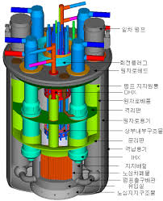
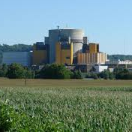
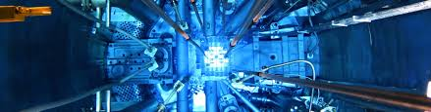
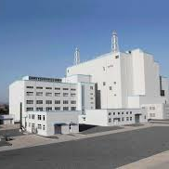
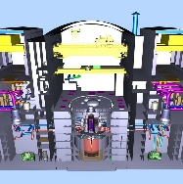
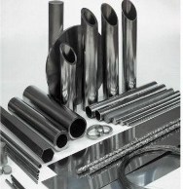
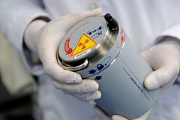
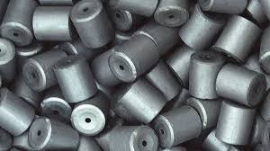
BFS research expertise: experiments for foreign customers
Republic of Korea:
KALIMER-650, SFR-100,
SFR-300, PGSFR-150
2009-2015
France:
minor actinides
(SUPERPHENIX)
1994-1999
Japan, France, USA, Germany: reactivity, neutron effects, β_{eff}
1980-2005
France:
optimization of reactor ASTRID
2010-2020
China:
limits for normal operation of CEFR
2000-2020
Germany: construction
materials and fission products
1980-1990
USA, Japan: disposal and reprocessing of ex weapons-grade Pu
1999-2000
China, Korea, France:
new types of fuel
2000 - 2015

Slide 19
Thank you
for your attention
Kuzina Iuliia
Head of Nuclear Energy Department,
IPPE JSC, Obninsk, Russian Federation
Tel.: +7 (484) 399 86 63,
E-mail: namesurname@rosatom.ru
www.rosatom.com
19-20 April 2022

