Slide 1


DESIGN OF SECONDARY SODIUM SYSTEM BASED DECAY HEAT REMOVAL SYSTEM FOR FUTURE FAST BREEDER REACTOR
Paper ID: 502
Pritam Kumar Patel
Reactor Design and Technology Group (RDTG),
Indira Gandhi Centre for Atomic Research (IGCAR),
India

Slide 2

Outline of Presentation
1/17
Brief description of Fast Breeder Reactor (FBR) 1&2
Decay Heat Removal Systems (DHRS) - Background
Requirement of SSDHRS
Literature survey
Required heat removal capacity of SSDHRS
Conceptual design of SSDHRS
Process design of SSDHRS: Forced flow
Optimization studies of AHX
Parametric studies
Sodium pump selection and need of bypass line to SSDHRS
Design finalisation
Method for calculation of Heat capacity under natural circulation
Results with only natural circulation
Conclusion

Slide 3
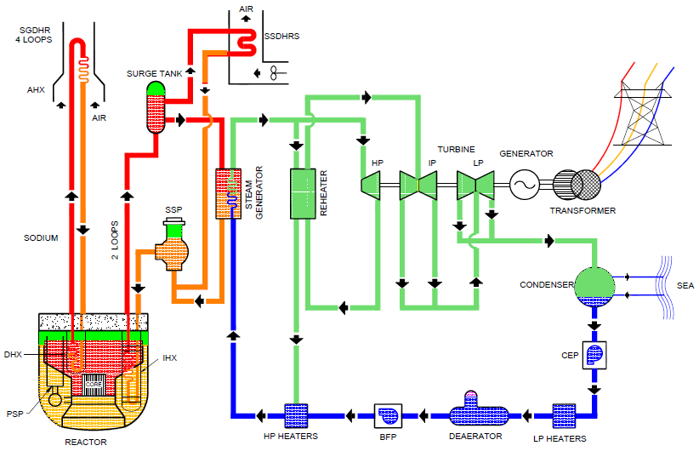
Brief description of FBR 1&2
2/17
FBR 1&2 is a twin reactors
Power capacity/unit: 1500 MWt
: 600 Mwe
Fuel: Mixed Oxide (MOX)
Coolant : Sodium
Type : Pool
Secondary loop/unit : 2 No’s
Major equipment in Secondary loop: 2 IHX
Schematic of FBR 1&2

Slide 4
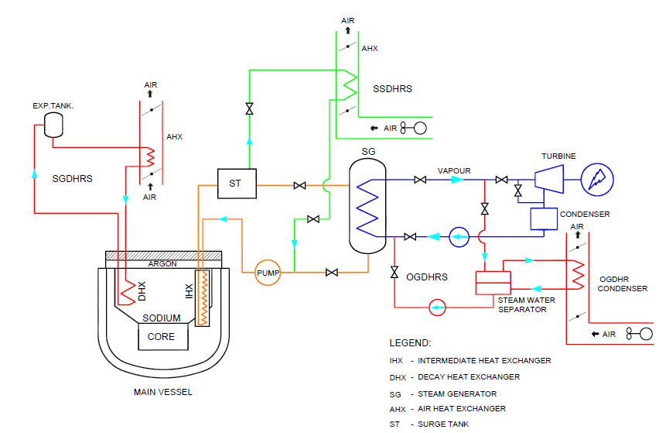
Decay Heat Removal Systems (DHRS)
3/17
Background:
Decay Heat Removal (DHR) system removes the heat generated in the core after reactor shutdown.
In PFBR, there are two diverse paths for DHR:
Operation Grade Decay Heat Removal Circuit(OGDHR)
Saftey Grade Decay Heat Removal Circuit (SGDHR)
For FBR 1&2 it is planned to have an additional DHR: called Safety Grade Decay Heat Removal System (SSDHRS)
SSDHRS:
SSDHRS loops are integrated to Secondary Sodium Main Circuit (SSMC) .
Decay heat removal systems for FBR 1&2

Slide 5
Requirement of SSDHRS
4/17
Need of an additional decay heat removal system:
To reduce the number of demands on SGDHRS.
Mainly to cater to the planned activity viz. fuel handling and other maintenance conditions, if OGDHR system is not available.
SSDHRS is seismically qualified (unlike OGDHR), Hence the reliability of the SSDHR system improves the reliability of the overall DHR system significantly.
Features of SSDHRS system:
Designed to operate on active mode.
Provided with class III power.
It is capable to work in passive mode with reduced capacity.

Slide 6
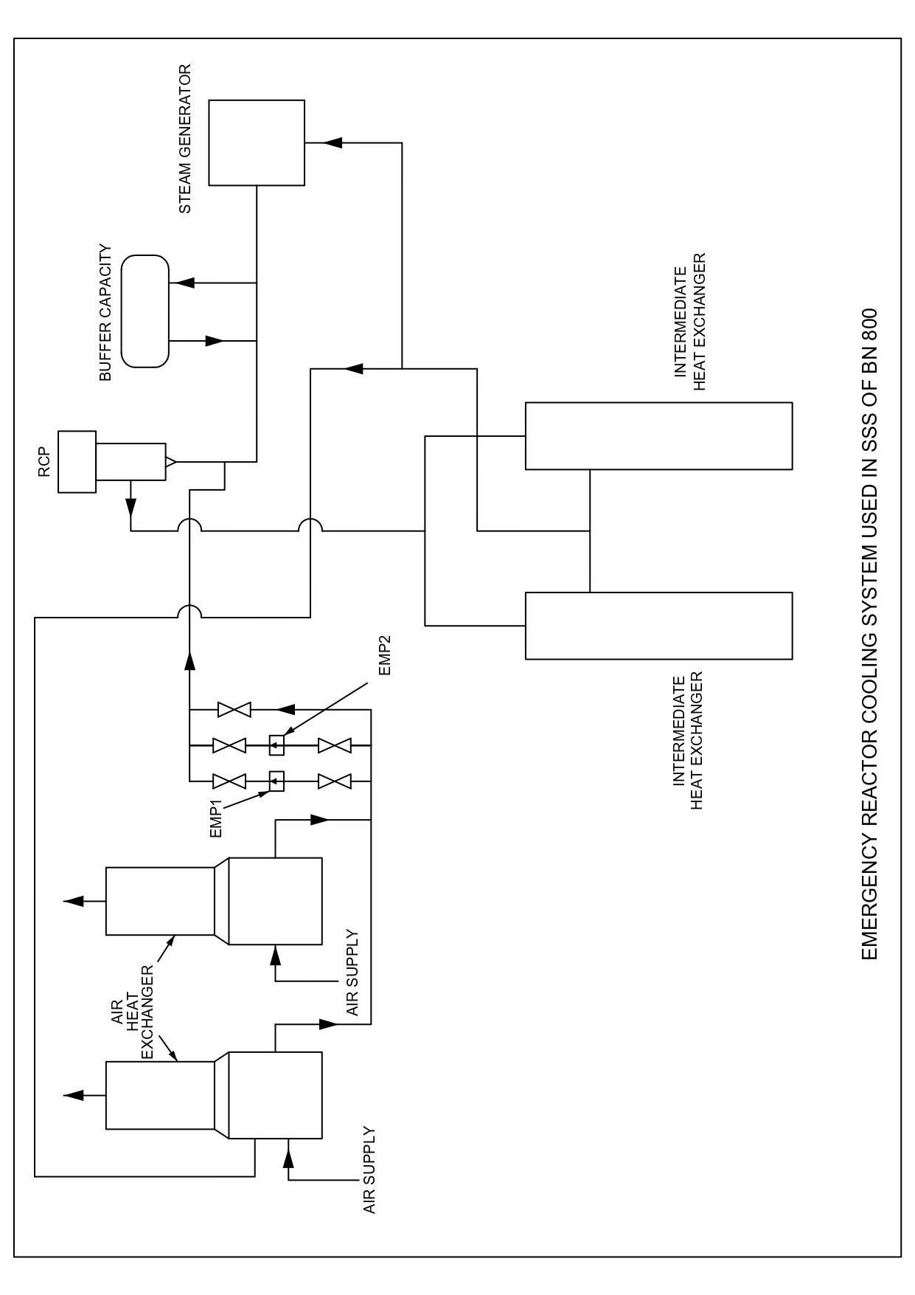
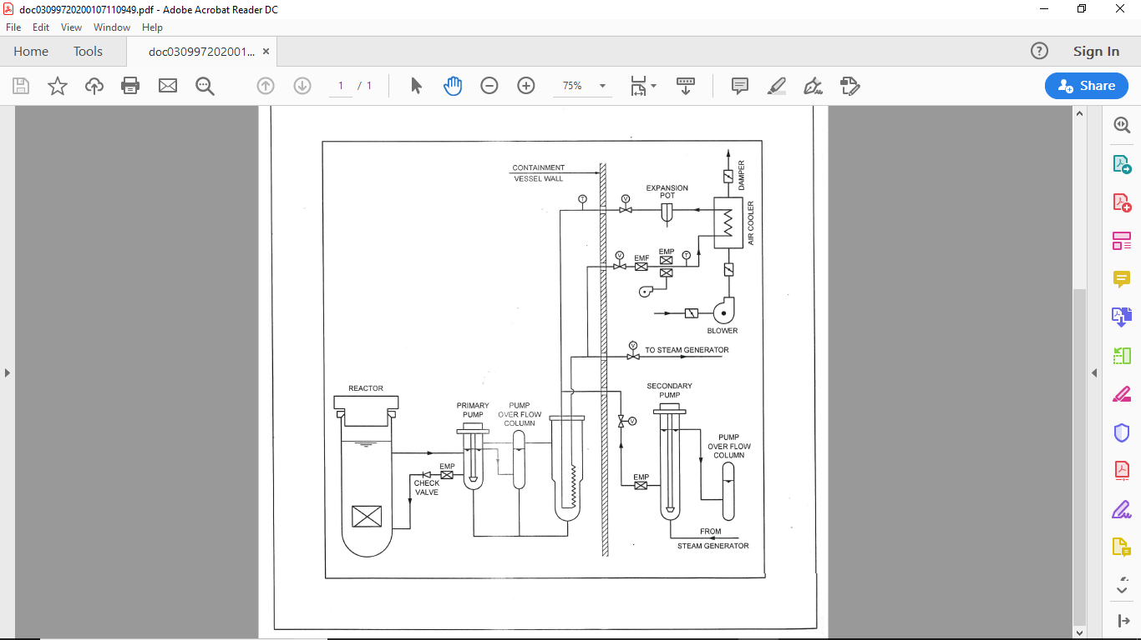
Literature survey-SSDHRS
5/17
BN 800 (RUSSIA) :
BN800 is a pool type reactor with 800 MWe and 2100 MWt.
It has three secondary loops and each having one DHRS.
DHRS on secondary system has 2 AHX and 2 EMP per loop.
In case of failure of EMP, the loop can also operate using SSP.
  MONJU (JAPAN).
It is a loop type reactor with 280 MWe and 714MWt.
It has three secondary loops and each having one DHRS.
DHRS on secondary system has 1 AHX and 1 EMP per loop.
No provision is provided to operate on SSP.
Contd. (1/2)

Slide 7
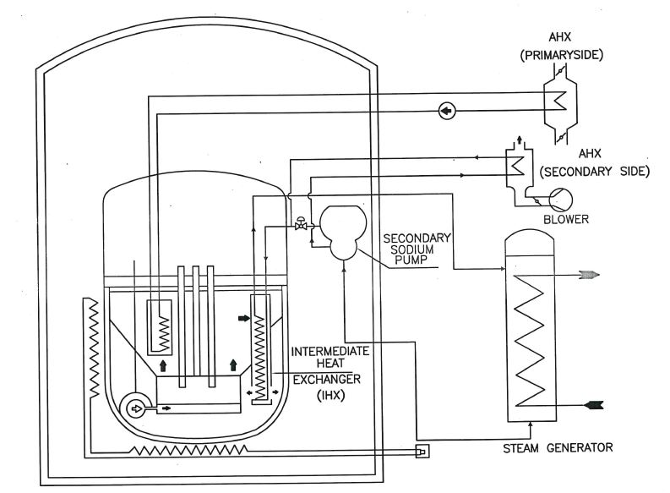
Literature survey-SSDHRS
6/17
SUPERPHENIX (FRANCE):
It is a pool type reactor with 1250 MWe and 3000 MWt.
It has four secondary loops and each having one DHRS
DHRS on secondary system has 1 AHX per loop with no EMP.
It operates only on SSP using a separate auxiliary motor.
All the reactors are deigned to operate on active mode.
Also provision is made for passive mode with reduced capacity.
(2/2)

Slide 8
Required heat removal capacity of SSDHRS
7/17
PFBR’s SGDHRS: 24 MWt, with 3 out of 4 circuits available (i.e., n-1 criteria)
(DHR capacity = 1.92 % of the total power of 1250 MWt).
FBR 1&2 SSDHRS: DHR capacity = 1.92 % of the total power of 1500 MWt
= 28.8 MWt (approx. to 30 MWt)
Considering
The space constraints
Optimization of the overall cost
2 secondary sodium main loops in FBR 1&2
SSDHR in each secondary sodium loop is designed for 15MWt.

Slide 9
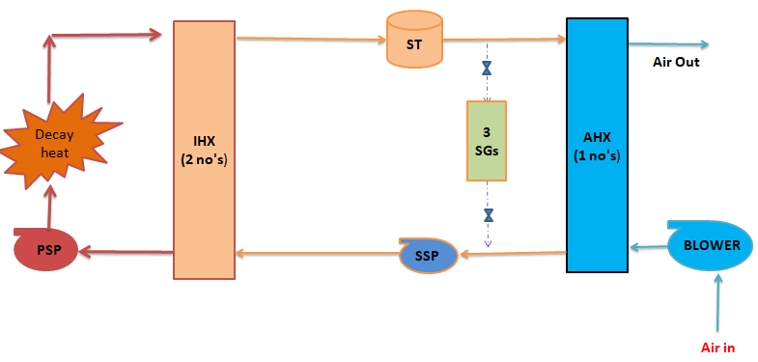
Conceptual design of SSDHRS
8/17
Schematic of SSDHRS for forced flow:
PSP : Primary Na Pump
IHX : Intermediate Heat Exchanger
ST : Surge Tank
SG : Steam Generator
SSP : Secondary Na Pump
AHX : Air Heat Exchanger
Contd. (1/2)

Slide 10
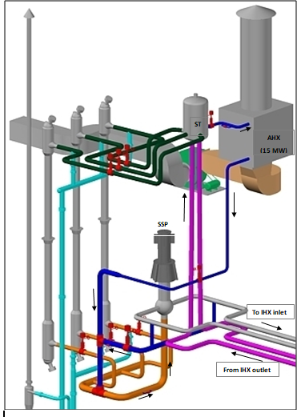
Conceptual design of SSDHRS
9/17
Air Heat Exchanger:
Type: Cross flow type shell and tube Heat eXchanger (HX)
LOCATION OF AHX:
It is planned to place inside SGB, below surge tank which allows gravity flow.
Hence, there is no need of additional tank for expansion of sodium.
ST
AHX
SSP
To IHX
From IHX
3D layout of SSDHRS
AIR BLOWER:
Blower for active operation mode.
To increase reliability, blower is provided with class 3 power.
The sectional view of the AHX
(2/2)

Slide 11
Process design of SSDHRS: Forced flow
10/17
Aim:
Design of blower
Design of AHX
Select an operating point for SSP
Q= m_{a} Cp (TAo-TAi)
IHX
(2 no's)
ST
AHX
(1 no's)
Hot pool
TPi=544 °C
TSo=544 °C
Assume (2): TAo=286.5 °C
Decay heat
Q=m_{s} Cs (TSo - TSi)
Q= (UA θ_{LMTD})_{IHX}
3 SGs
Q= (UA θ_{LMTD}) _{AHX}
52.8 m³/sec
TPo= 531.5 °C
TSi=454.3 °C
BLOWER
ON
PSP-ON
SSP
Assume (3) : PSP operates on 20 % flow during decay heat removal
Assume (1):
4 % SSP full flow
No of tube= 129
Q= m_{a} Cp (TPi - TPo)
TAi=40 °C
Heat Removal capacity : 15 MW

Slide 12
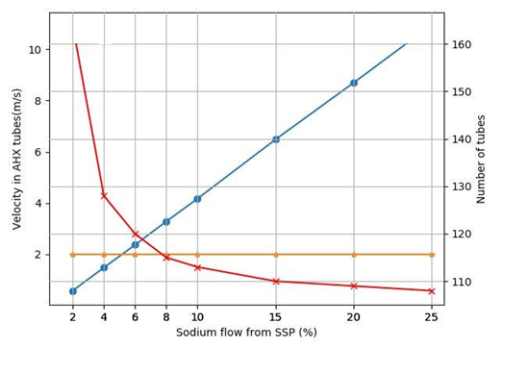
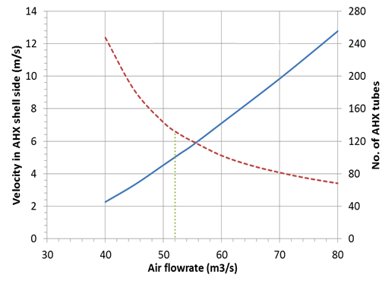
Optimization studies of AHX
11/17
Assume (1): 4 % SSP full flow
Assume (2): air flow rate of 52.8 m³/sec
Velocity in AHX shell side
No of tube in AHX
No of tube in AHX
Velocity inside AHX tube
Velocity limited to 2 m/s
Parametric study of sodium flow rate on AHX design for an air flow rate of 52.8 m³/sec
Parametric study of air flow rate on AHX design for an sodium flow rate of 4% nominal SSP flow

Slide 13
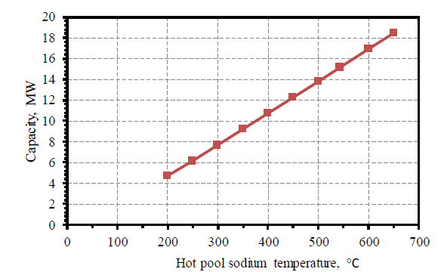
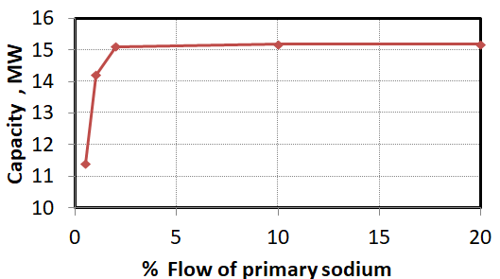
Parametric studies
12/17
Assume (3) : PSP operates on 20 % flow during decay heat removal
% Flow of primary sodium pump
Heat removal capacity of SSDHR at various primary sodium temperatures
Performance of SSDHRS at various primary sodium flow rates

Slide 14
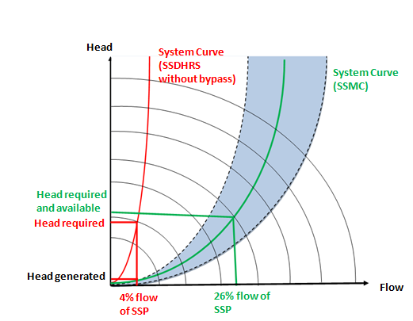
Pump selection and need of bypass line to SSDHRS
13/17
PUMP SELECTION:
Flow requirement of SSDHRS for FBR 1&2 is 568.6 m³/h (4 % of nominal), (Existing EM pump is not adequate).
SSP will be operated with reduced flow.
REQUIREMENT OF BYPASS LINE TO SSDHRS:
Head generated by the SSP for 4 % flow is not adequate for SSDHRS circuit.
Bypass line is provided in the circuit to increase flow so that, SSP can be operated in best efficiency zone.
Bypass line is designed to have SSP flow of 22 % of nominal capacity. Total flow through SSP is 26 %.
SSDHRS Circuit
Bypass loop
SSP
ON
Typical pump - system characteristic curves for SSDHRS and SSMC
Bypass line to SSDHRS

Slide 15
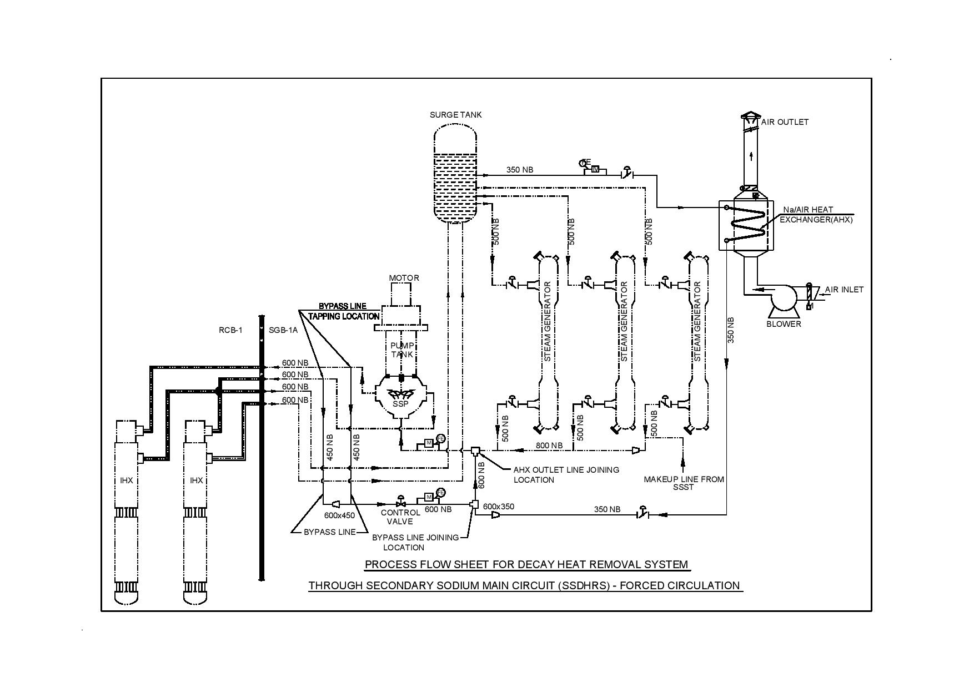
Finalized design
14/17
Process flow sheet of secondary sodium decay heat removal circuit

Slide 16
Method for calculation of Heat capacity under natural circulation
15/17
Known variable: IHX and AHX geometry, TPi, Tai, Assumption: Primary side flow is 20 % of full flow
6 unknown variable: TPo, TSi, TSo, TAo, Secondary flow rate (m_{s}), Air flow rate (m_{a})
Derived quantity: Heat transfer capacity (Q)
TPi=544 °C
Chimney
IHX
(2 no's)
ST
AHX
(1 no's)
TSo
= 544 °C
TAo
= 339.8 °C
IHX details
Eq 1. m_{s} Cs (TSo - TSi)= m_{a} Cp(TPi - TPo)
Eq 2. m_{s} Cs (TSo - TSi)= (UA θ_{LMTD})_{IHX}
Eq 3. m_{s} Cs(TSo - TSi)= m_{a} Cp (TAo - TAi)
Eq 4. m_{s} Cs(TSo - TSi)= (UA θ_{LMTD})_{AHX}
Eq 5. (ρ_{cold} - ρ_{hot} ) g Hs = (DP on secondary side)
Eq 6. (ρ_{cold} - ρ_{hot} ) g Ha = (DP on air side)
AHX details
Decay heat
Air flow rate
Secondary flow rate
= 25 kg/sec
TPo
= 536.8 °C
TSi
= 449.5 °C
= 73 kg/sec
Blower-OFF
PSP-ON
SSP-OFF
20 % of full flow
By pass line
TAi= 40 °C
Q= m_{s} Cs (TSo - TSi)= m_{a} Cp(TPi - TPo) = m_{a} Cp (TAo - TAi) =8.6 MW

Slide 17
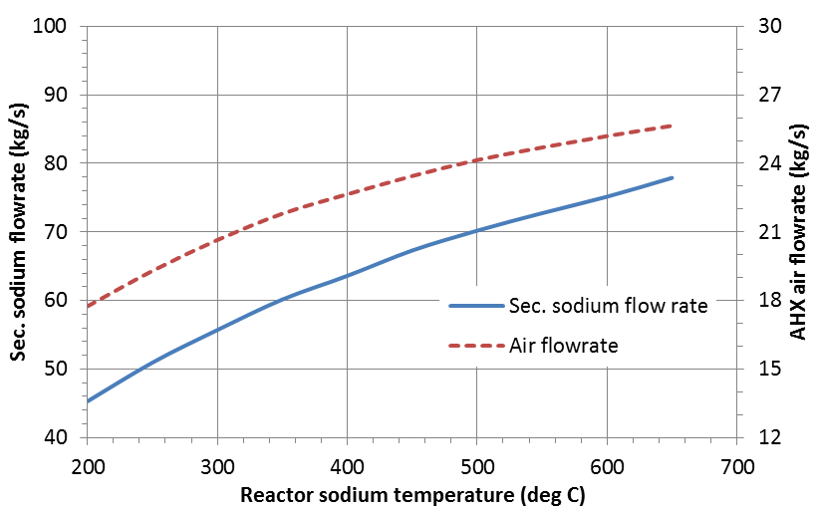
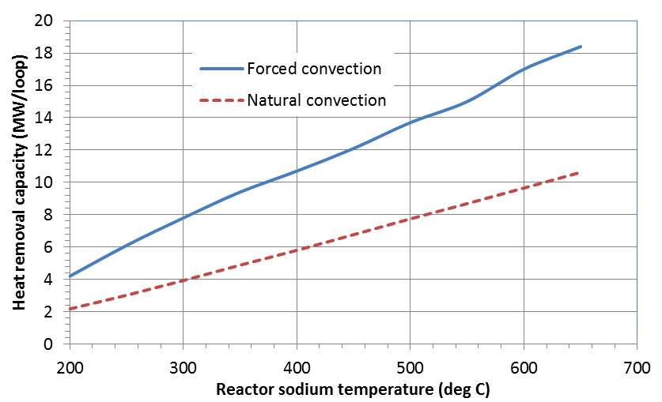
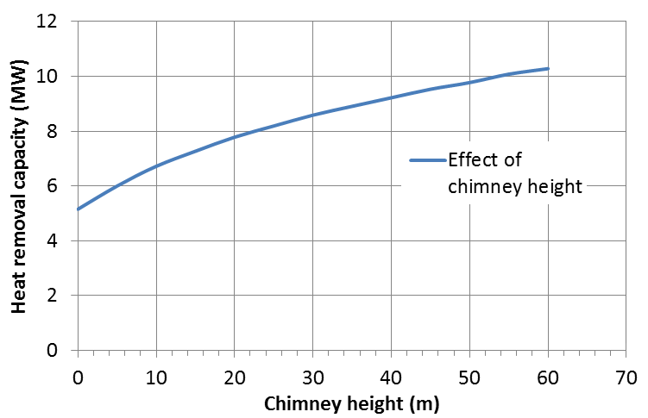
Results with only natural circulation
16/17
Evolution of secondary Sodium and air flow rate during natural conv.
Heat removal capacity between forced and natural convection
Effect of chimney height on heat removal capacity by natural circulation

Slide 18
Conclusion
17/17
The no of design basis events for which SGDHR is called has been brought down.
Process design of SSDHRS is carried out for active mode (15 MWt) per loop.
Process path, piping layout and component locations are finalized considering existing FBR 1&2 (2×600 MWe) layout.
SSP shall be operated at 26 % nominal flow with 22 % of nominal flow bypassed.
Primary sodium flow required for active operation is less than 3 % nominal achieved by natural circulation.
For chimney of 30 m height, SSDHRS with passive mode can remove 8.6 MWt per loop.

Slide 19
THANK YOU

