Slide 1
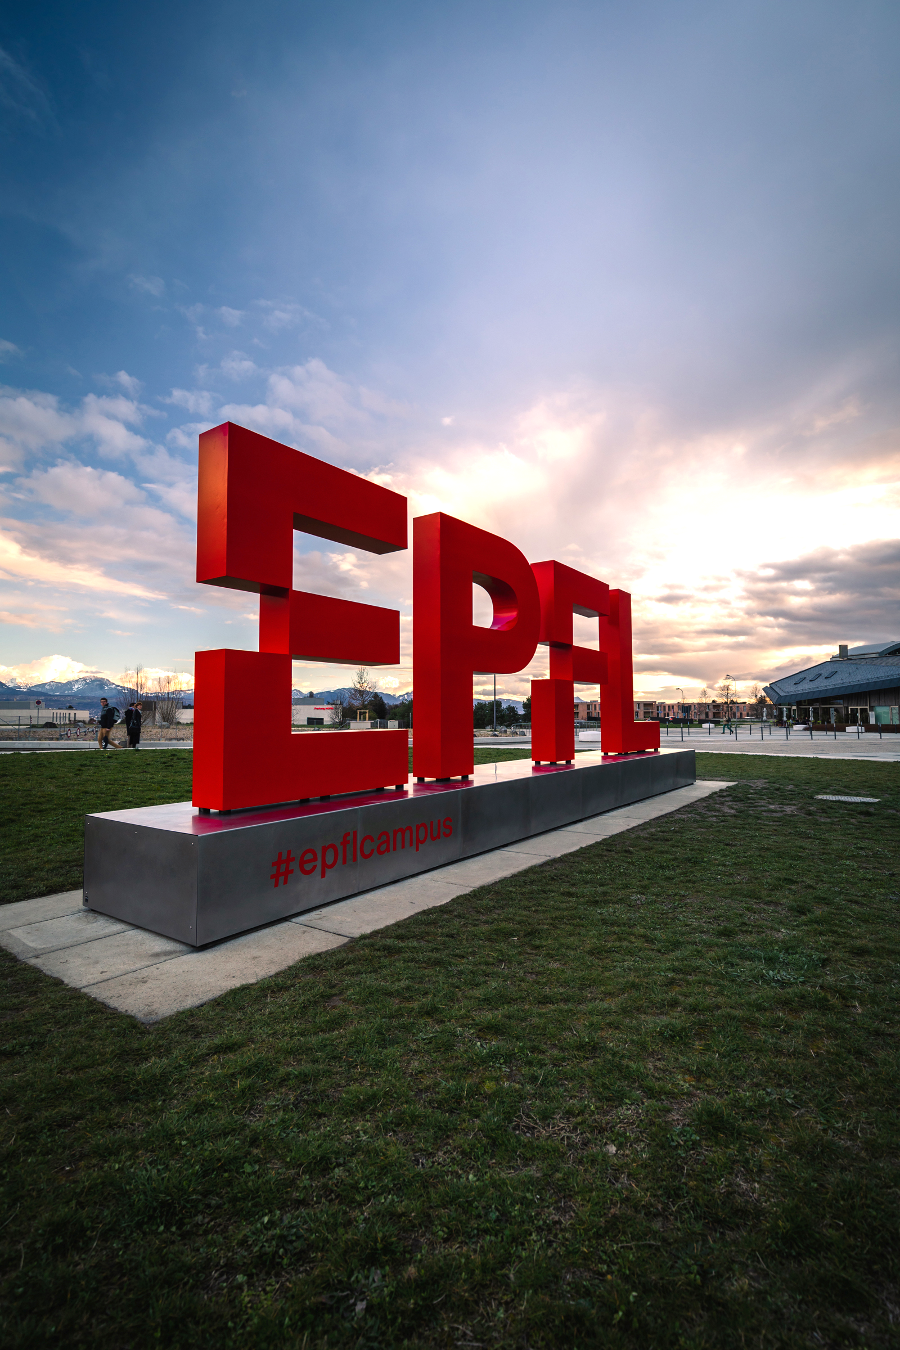
IAEA Fast Reactor Conference 2022
SIMULATION OF FISSION GAS RELEASE IN THE 3D FUEL PERFORMANCE CODE OFFBEAT
Authors: A. GIANESELLO, A. SCOLARO, C. FIORINA
Presenter: Carlo Fiorina
April, 2022

Slide 2
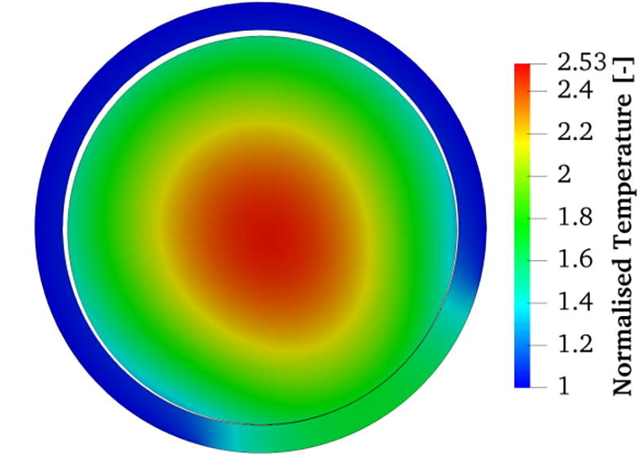
OpenFOAM Fuel Behavior Analysis Tool
2-D temperature profile I. Clifford et al., Ann. of Nuc. Eng., 2019
Multi-dimensional code developed at EPFL and PSI since 2017
Prompted by:
Complex fuel failure in a Swiss NPP
Lack of readily-available tool
Objectives:
Studying multi-dimensional and multi-physics effects.
Creating a general-purpose code for research and education
International projects:
Collaboration with the JRC-Ka
Bilateral with the CEA
Participation to the H2020 PUMMA project
Participation to the HEU ESFR-SIMPLE project
EPFL as collaborating center on the IAEA ONCORE project

Slide 3
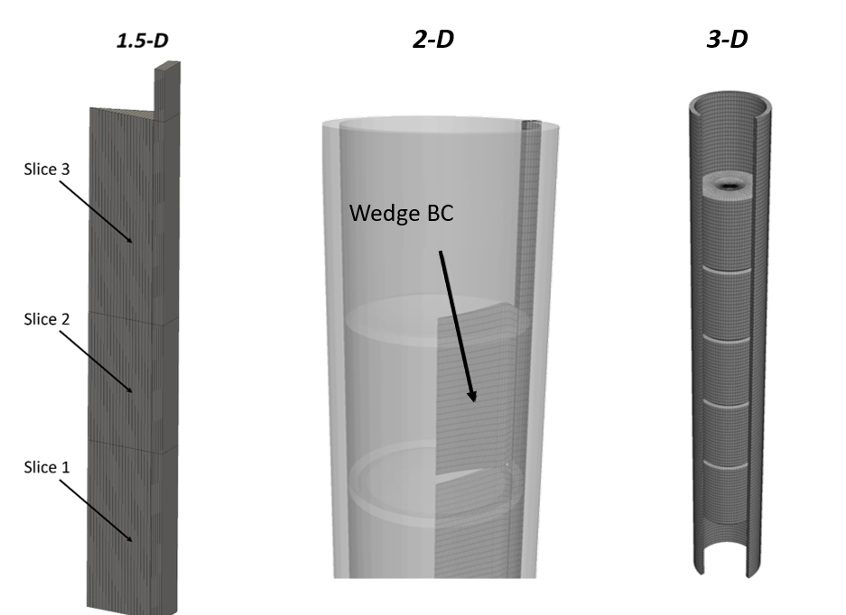
OFFBEAT – Code Overview
Open-source C++ library for PDEs
Flexible tailoring to specific needs
Intuitive Finite Volume Method discretization
Arbitrary geometry and unstructured mesh
Main fuel behavior models:
Relocation, densification, swelling
Creep and plasticity
Gap heat transfer and contact
Corrosion
Fission Gas Release

Slide 4
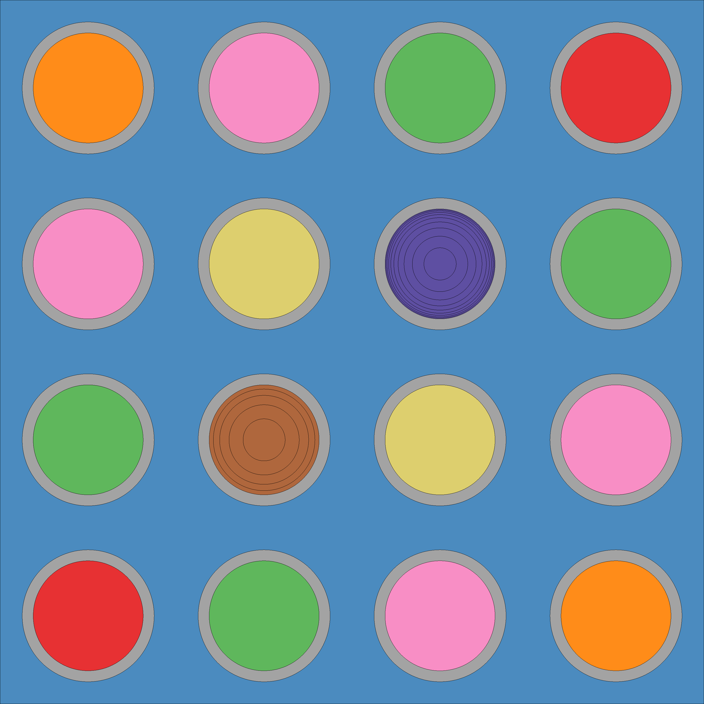
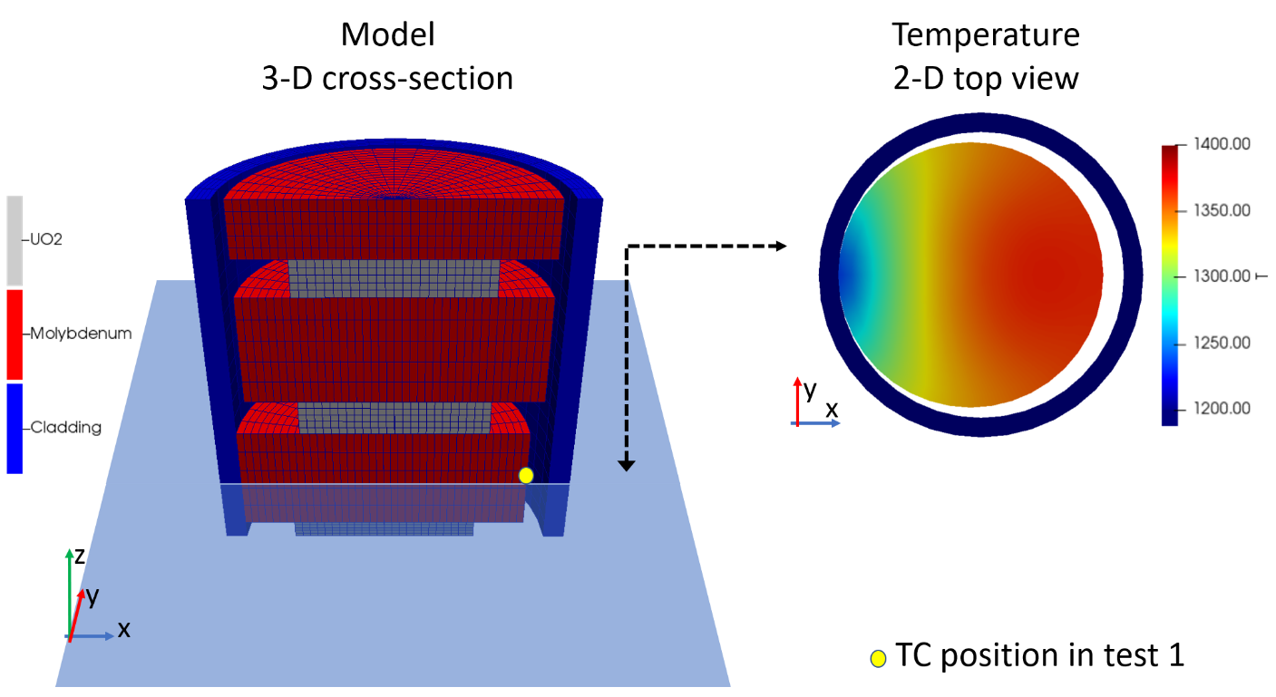
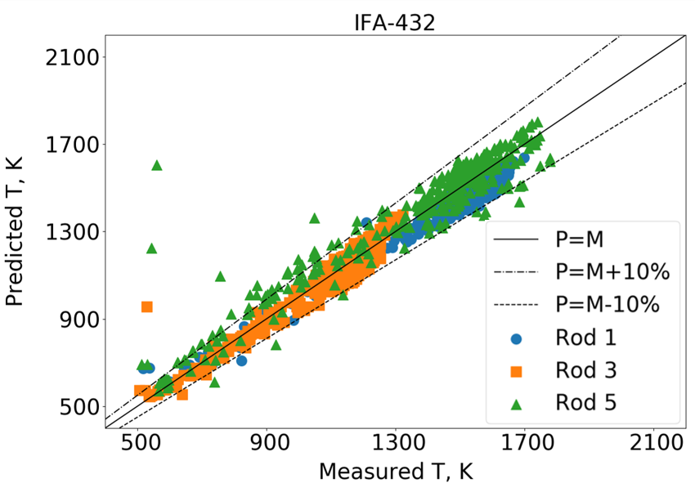
Overview of activities
V&V → Focus on FCT and FGR%
Multi-dimensional test cases
(e.g. missing pellet surface)
Gad OFFBEAT
Gad
No gad 1
No gad 2
3-D analysis of eccentricity in fuel disc irradiation campaigns
No gad 3
No gad 4
No gad 5
Coupling with Serpent
Cladding
Water

Slide 5
Simulation of fission gas release: SCIANTIX
Developed at PoliMi and released as open-source
Intra-granular and inter-granular inert gas behavior in UO2 under constant or transient conditions
Diffusion of gas atoms inside grains
Release from the grain boundaries
In addition, models for grain growth, as well as intra- and inter-granular gaseous swelling

Slide 6
Integration of SCIANTIX in OFFBEAT
Wrapping into a C++ class
OFFBEAT feeds SCIANTIX with the values of temperature, fission rate and hydrostatic stress
SCIANTIX is then called for each cell of the fuel mesh and it calculates the volume number density (atoms/m3) of helium, xenon and krypton, both produced and released
This is then then converted into moles and transferred to the gap gas model
$$FGR\left[\%\right]=\frac{\sum_{cells}{n_{released}{Volume}_{cell} }}{\sum_{cells}{n_{produced}{Vol}_{umecell} }}$$

Slide 7
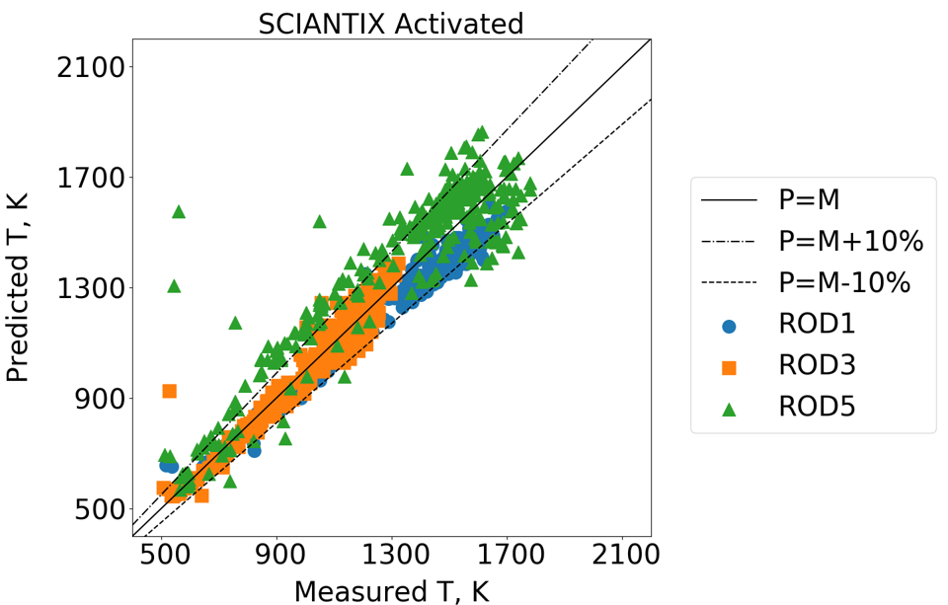
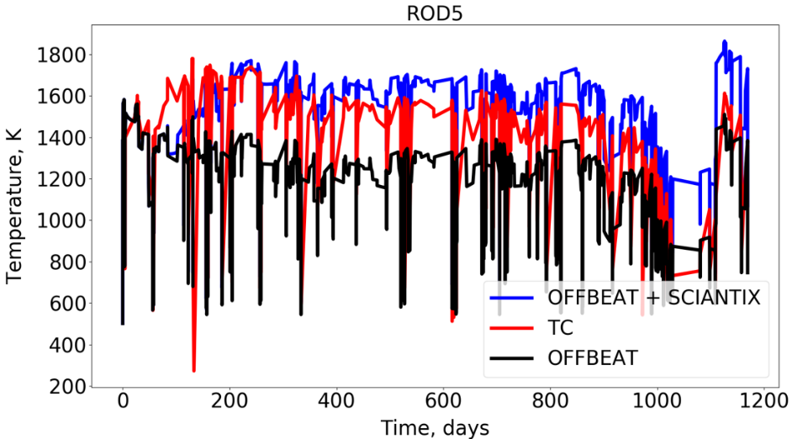
Validation cases
IFA-432 assembly (rods 1, 3 and 5)
FCTs
Designed to study the thermal and mechanical response of BWR fuel, up to a burnup of approximately 40 MWd/kgU
Halden Boiling Water Reactor

Slide 8
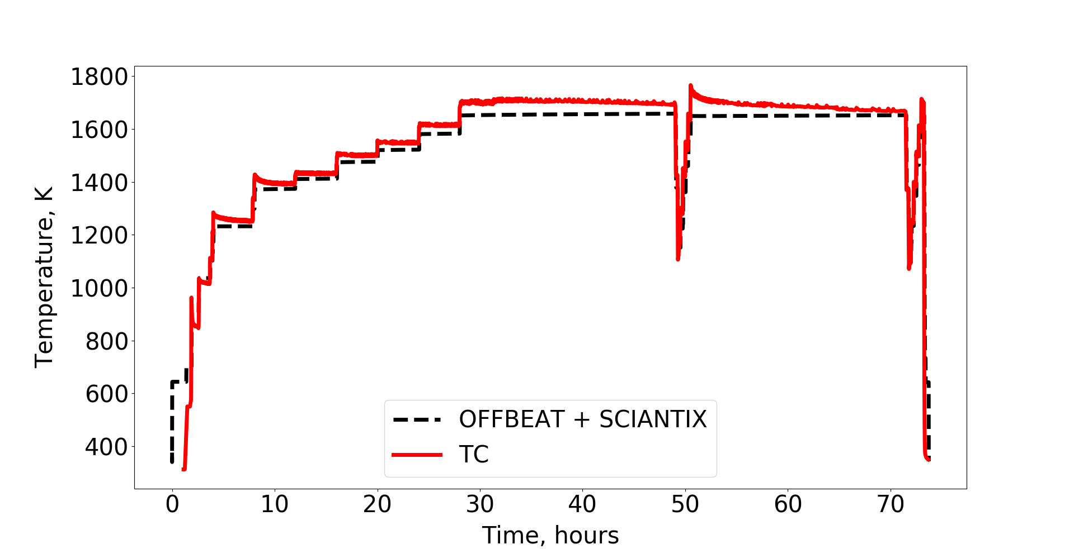
Validation cases
Super-ramp program (groups PK1, PK2 and PK6 )
FGR
First base irradiated in the Obrigheim power reactor in Germany, then ramp tested in the research reactor R2 at Studsvik in Sweden

Slide 9
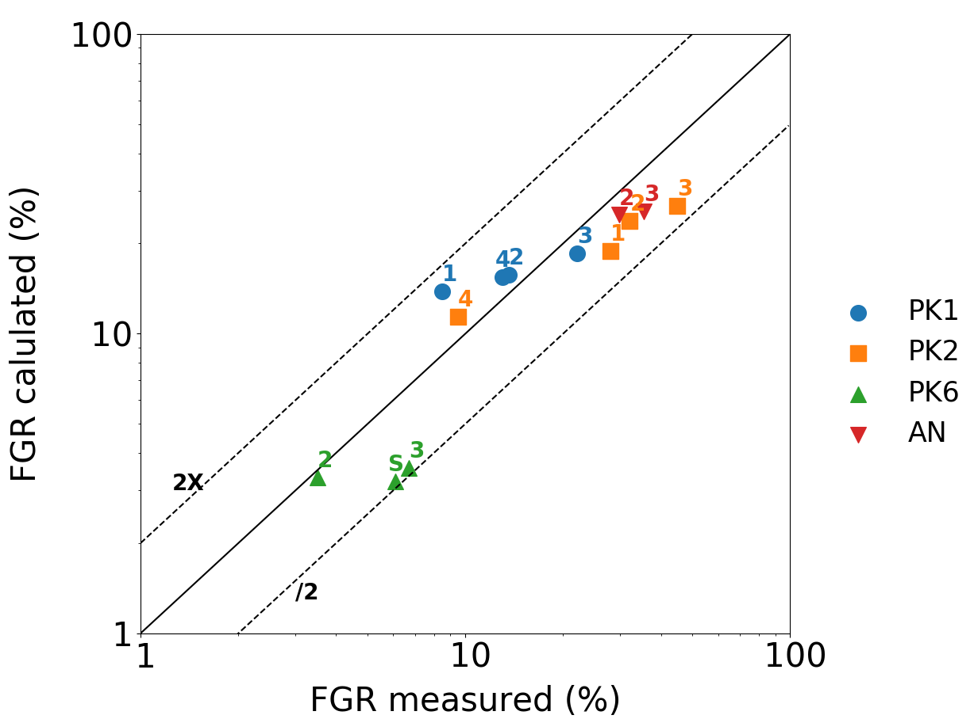
Validation cases
Risø 3 experiment
FCTs + FGR
Experimental fuel segments AN2 and AN3 from the Risø-3 fission gas project
First base irradiated in the Biblis A PWR in Germany, then bump tested during 72 hours in the test reactor DR3 at Risø in Denmark

Slide 10
Current and future plans
Fast reactor fuels
MOX fuel benchmark under H2020 PUMMA project: introducing models for central hole formation and Joint Oxide Gaine (JOG).
Extension to metallic fuels under HEU ESFR-SIMPLE
Beyond traditional approximations
Modeling corrosion and crud layer growth with dynamic mesh modification (cell layer addition/removal).
Introducing thermo-chemistry routines for PCI and SCC.
Higher-fidelity fuel relocation modeling with multi-fragment simulations.
Implementation of 3-D neutronic solver(s) and extension of the OFFBEAT-Serpent coupling to 2-D/3-D realistic cases.
Gap conductance: assessing the impact of eccentricity and relocation on traditional models
Coupling with OpenFOAM CFD solvers and with the GeN-Foam multi-physics platform for higher fidelity BCs
V&V and usability
LOCA and ballooning: introduction of high-temperature models (e.g. creep) and application to the IFA-650.2 ballooning test
Shift V&V focus on cladding elongation, deformation and rod failure
Improvement of code documentation and creation of automatic regression test
Code release in Q2 2022

Slide 11
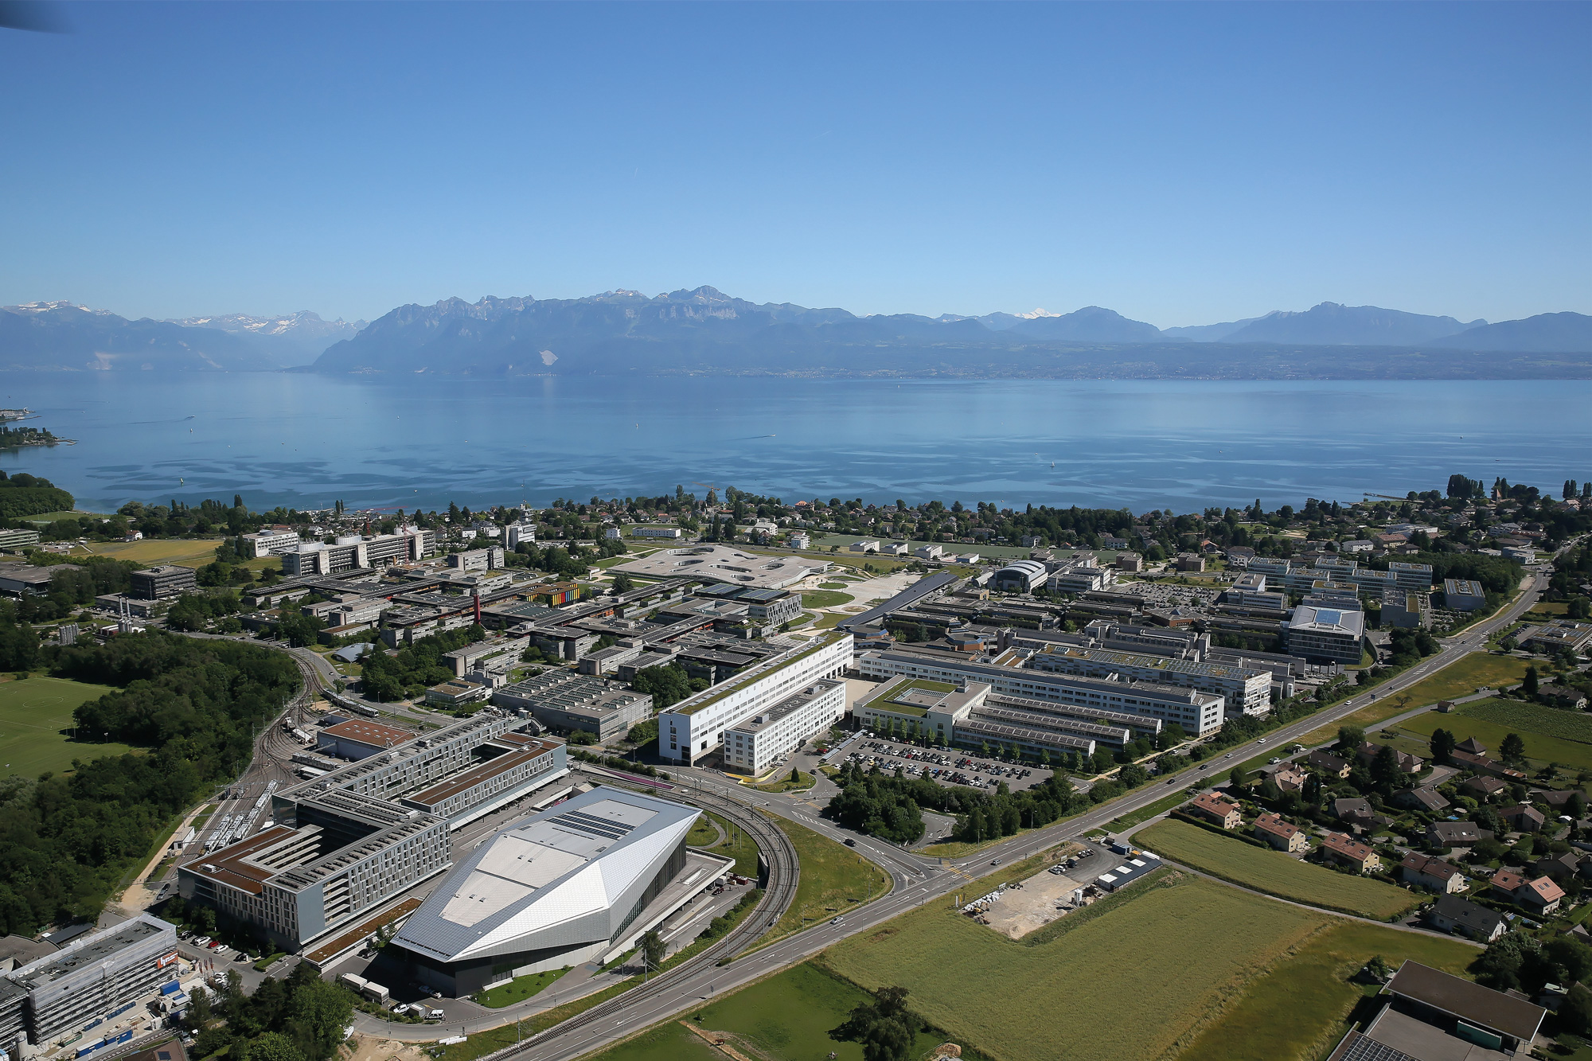
Thanks for your attention！
Carlo Fiorina - carlo.fiorina@epfl.ch

