Slide 1
Many thanks to …
Presenters for adjusting so smoothly to the new format and delivering the presentations in advance
Programme Committee and IAEA secretary for
all the good suggestions concerning the new format
the intense organisational work
the preparation of the summary talks

Slide 2
Meeting structure
Monday Disruption Consequences I. Bandyopadhyay, F. Villone, A. Huber
Tuesday Disruption Avoidance and Prediction A. Bhattacharjee, A. Isayama, G. Pautasso, C. Rea, C. Sozzi
Wednesday Disruption Mitigation – Shattered Pellet Injection N. Eidietis, J-H. Kim, E. Nardon
Thursday Disruption Mitigation – General aspects and alternative methods N. Eidietis, S. Konovalov, L. Zeng

Slide 3
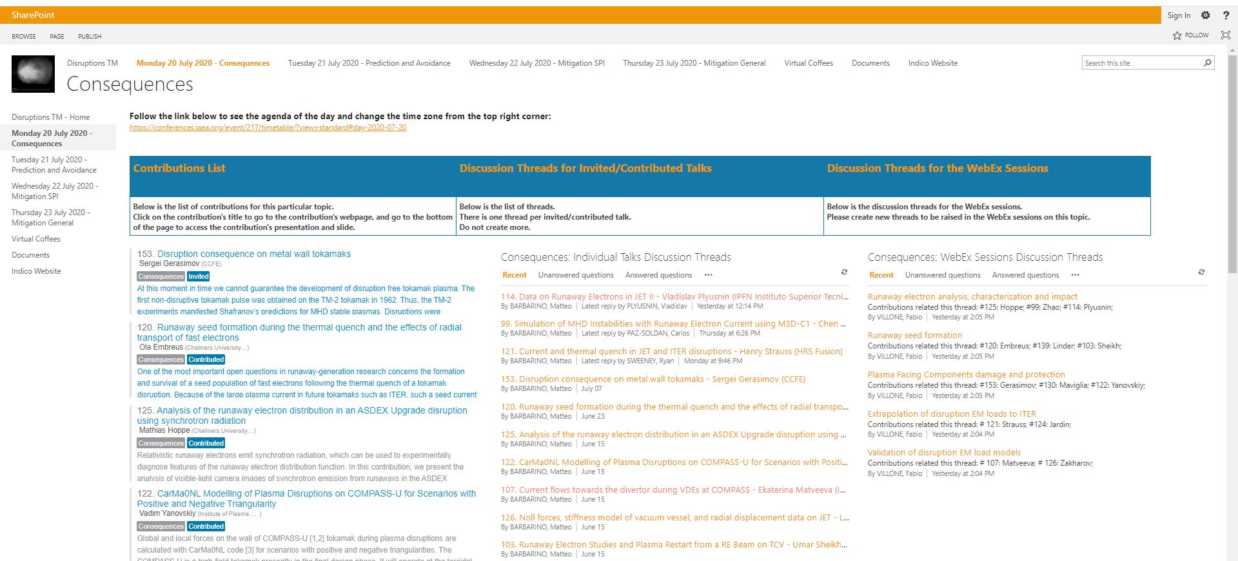
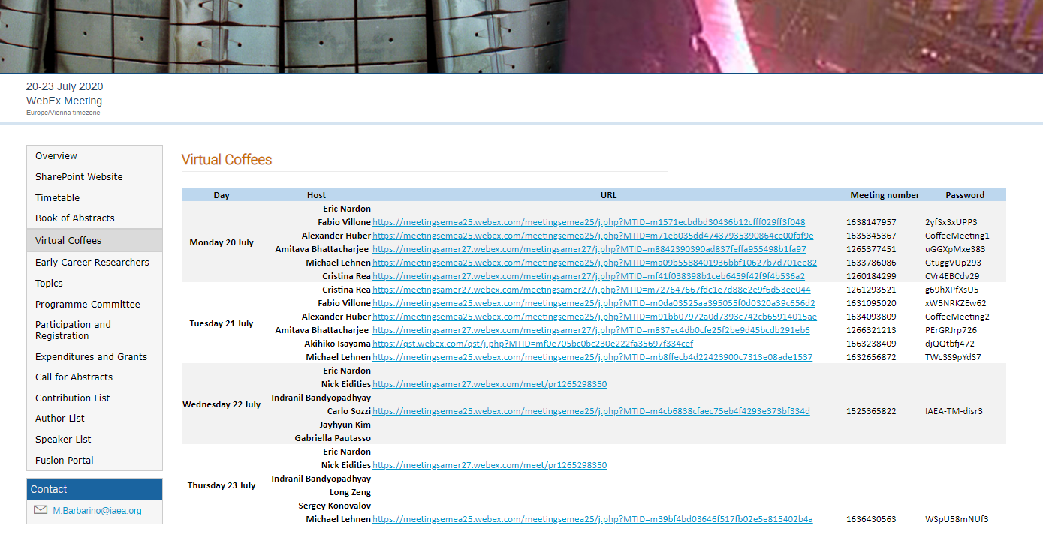
Daily Agenda
Summary talk
Summary of the presented material in the specific topic
Q&A
Technical questions to presented material → 2nd column on sharepoint + new
Discussion 1
Discussion based on topical threads → 3rd column on sharepoint + new
Virtual Coffee
Get into contact with other participants (Experiment!)
Discussion 2
Discussion based on topical threads → 3rd column on sharepoint + new
Presenters:
check regularly!

Slide 4
Discussion Objectives
Provide a common understanding of the present knowledge on disruption consequences, prediction & avoidance and mitigation
Identify the gaps in our understanding and find a way forward to make these smaller or even close them
Discuss the related risks for ITER and future devices and how to mitigate or remove these

Slide 5
Online Discussion
Please continue using the online discussion tools during the meeting, but especially before the topical session
The online discussion threads together with the live discussion will be the basis for the meeting summary
The possibility of small follow-up virtual meetings to process further discussion will be evaluated by the PC groups

Slide 6
Meeting Output
Summary paper published in Nuclear Fusion (target date for submission: end of September)
Summary of presented material
Main outcome of the online and live discussion
Outlook on high priority needs for the next 2-3 years
Unique database of high quality presentation videos and related discussion threads openly available 2 weeks after the meeting

Slide 7
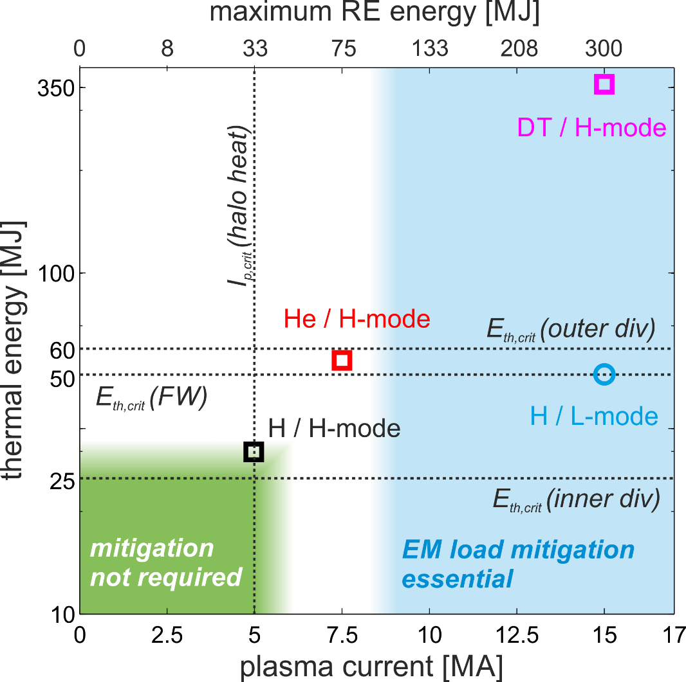
Disruptions - a key challenge for ITER
Consequences
Thermal energy
20 MJ is the estimated melt limit (inner divertor)
Deposition footprint uncertain
Magnetic energy
Heat fluxes through halo region
DINA/MEMOS simulations show melting already for 5 MA
Halo parameters uncertain
Runaway Electrons
Deposited energy depends strongly on E_{mag} conversion
Energy limits (MEMOS): 0.33 MJ / FW panel or cassette (melting) 1.75 MJ / FW panel (6 mm melt depth)
Toroidal peaking uncertain
Energy / Current Range in ITER
*
* full magnetic energy conversion

Slide 8
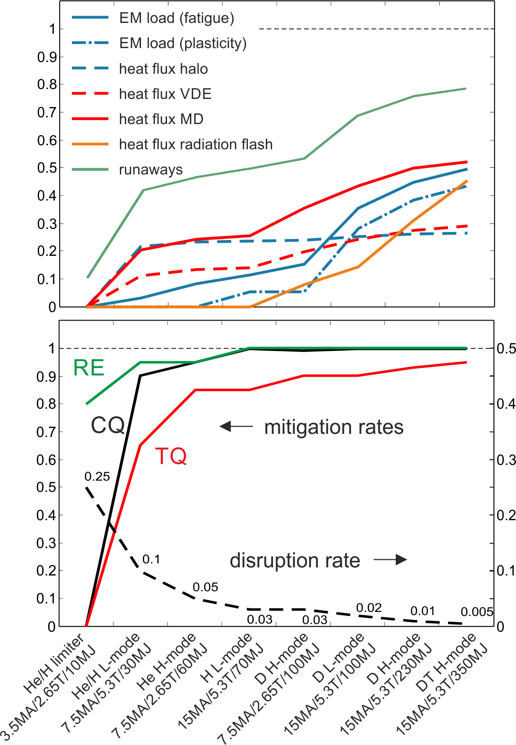
Disruptions - a key challenge for ITER
P & A
Plasma control and exception handling is disruption avoidance
The ITER Plasma Control System for the pre-fusion power operation (PFPO) will be developed 2021-2024
Mitigation is not enough, avoidance is essential
Example of required disruption and mitigation rates to stay within nominal lifetime of components
RE formation rate: 0.5%/0.2% (15/7.5MA)
Based on pre-2017 ITER research plan

Slide 9
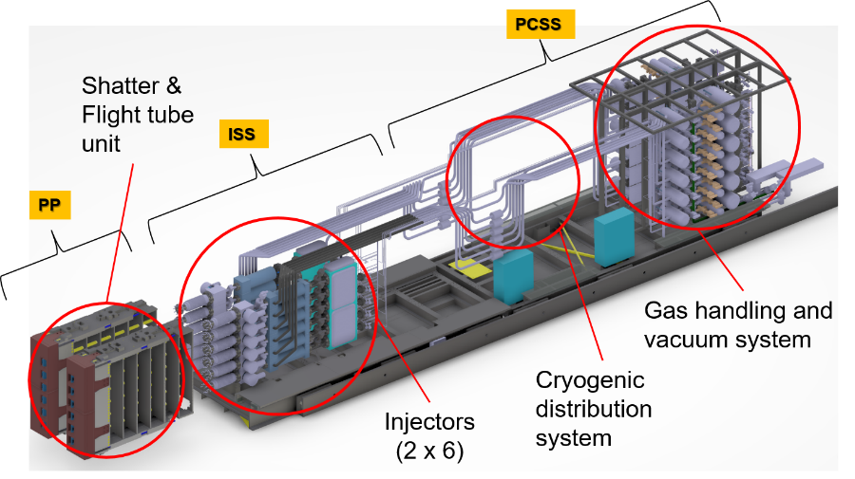
Disruptions - a key challenge for ITER
Mitigation
The DMS is presently designed with requirements based on current knowledge – FDR target 2022
Shattered Pellet Injection
24 pellets with 28.5 ∅ x 57 mm in 3 EPs 3 pellets in 3 UPs
The DMS is a major plant system that is required from early operation onward and must have high availability and reliability
→ Requires development and optimisation of key components
Key design input required:
jitter in arrival time
fragment size, velocity, and velocity dispersion
Open questions on the mitigation effectiveness, e.g.:
RE avoidance possible through material injection?
Density rise ~ number of pellets?
Radiation peaking ~ 1 / # locations?
→ ITER DMS Task Force (design validation and component optimization)

Slide 10
Looking forward to a lively and fruitful meeting…

