Slide 1
Progress on Tokamak Disruption Event Characterization and Forecasting Research and Expansion to Real-Time Application
S.A. Sabbagh¹, J.W. Berkery¹, Y.S. Park¹, J.H. Ahn¹, J.D. Riquezes¹, J. Butt¹, J.M. Bialek¹, Y. Jiang¹, J.G. Bak², S.H. Hahn², J. Kim², J. Ko², W.H. Ko², J.H. Lee³, S.W. Yoon³, C. Ham³, A. Kirk³, L. Kogan³, D. Ryan³, A. Thornton², M.D. Boyer⁴, K. Erickson⁴, Z.R. Wang⁴
¹Department of Applied Physics, Columbia University, New York, NY
²Culham Centre for Fusion Energy, UKAEA, Abingdon, UK
³National Fusion Research Institute, Daejeon, Republic of Korea
⁴Princeton Plasma Physics Laboratory, Princeton, NJ
IAEA Technical Meeting on Plasma Disruptions and their Mitigation
20-23 July 2020
St. Paul-lez-Durance, France
V1.5

Slide 2
A broadened disruption prediction and avoidance analysis is progressing for ITER and future tokamaks
Motivation: Disruption prediction/avoidance is a critical need
  Why? A disruption stops plasma operation, might cause device damage
  A highest priority DOE FES (Tier 1) initiative - present “grand challenge” in tokamak stability research:
    Can be done! (JET: < 4% disruptions with carbon wall)
    ITER disruption allowance: < 1 - 2% (energy + E&M loads); << 1% (runaways)
Outline
  Disruption Event Characterization and Forecasting (DECAF) approach
  Overview of DECAF results, disruption event chains, early forecasting
  Initial multiple-device, large database analysis, forecasting performance
  Physics support research: i.e. KSTAR high β_{N}, Δ’, ~100% non-inductive CD
  Recent focus on real-time design and implementation on KSTAR

Slide 3
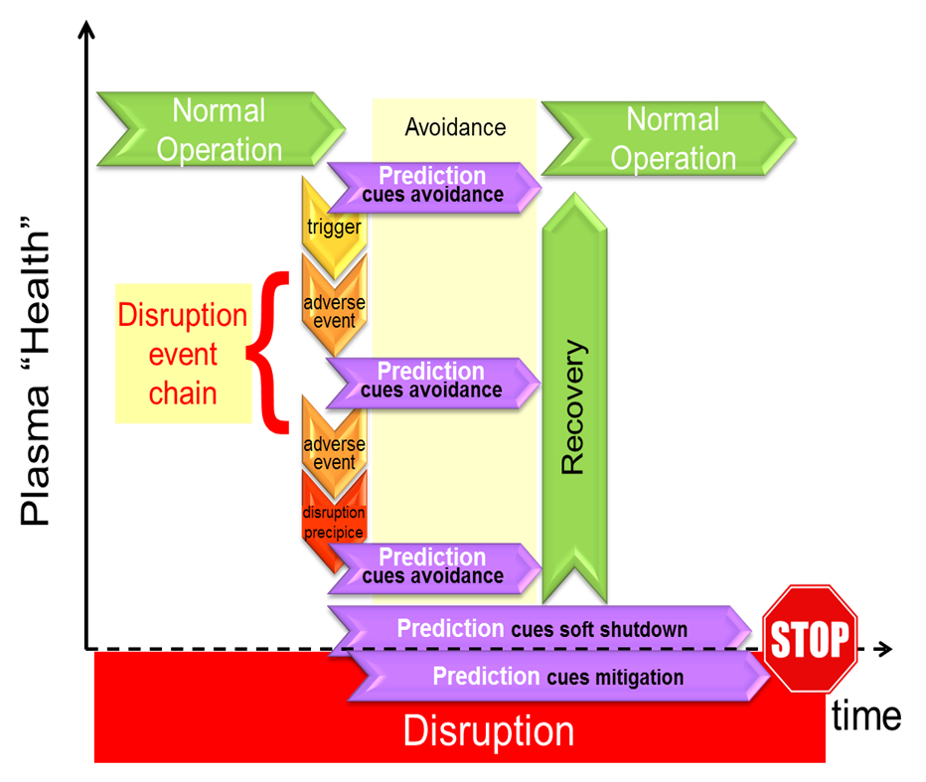
DECAF is a logical, physics-based paradigm that meets all disruption predictor requirement metrics
DECAF in disruption prediction / avoidance framework
Disruption predictor must
  Predict SPECIFIC pre-disruptive phenomena ➔ link to control
  Provide CONTINUOUS variable quantifying proximity (& can GENERATE triggers)
  Provide SUFFICIENT LEAD TIME for mitigation or avoidance
  Be EXTRAPOLABLE to new device (e.g. ITER) prior to operation
  Be REAL-TIME calculable
DECAF
D. Humphreys, et al., PoP 22 (2015) 021806

Slide 4
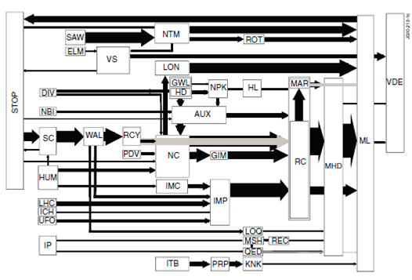
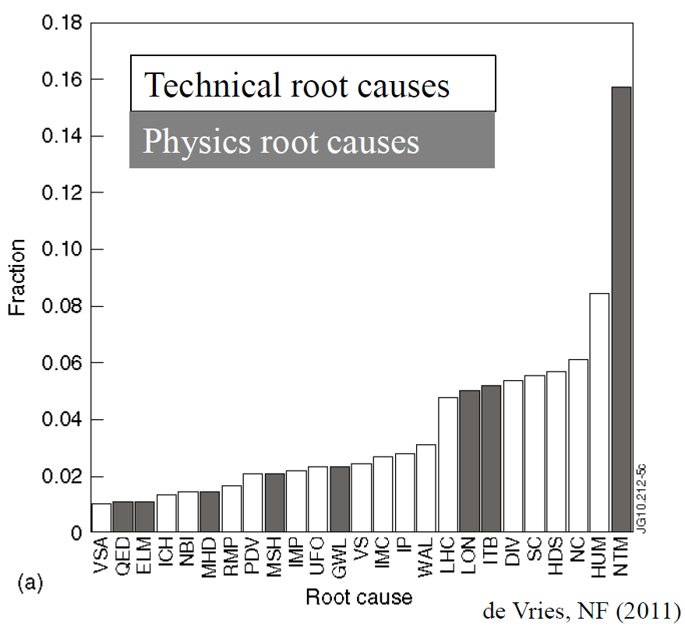
DECAF follows disruption event framework (de Vries) to provide understanding of disruption chains ➔ automates it
JET disruption event chains
Related disruption event statistics
P.C. de Vries et al., Nucl. Fusion 51 (2011) 053018
JET disruption event chain analysis performed by hand, desire to automate
General code DECAF: automates event chain process, provides disruption warning signals, being validated against databases from multiple devices

Slide 5
DECAF is structured to ease parallel development of disruption characterization, event criteria, and forecasting
Tokamak databases
Physical event modules encapsulate disruption chain events
  Development focused on improving these modules
  Structure eases parallel development incl. real-time
Physical events are objects in physics modules
  e.g. VDE, LOQ, RWM are objects in “Stability”
  Python “objects” having attributes and methods
  Carry metadata, event forecasting criteria, event linkages, etc.
Physical event modules
Code control workbooks
Density Limits
Confinement
Main data structure
Stability
Tokamak dynamics
Output processing
Power/current handling
DECAF database
Technical issues

Slide 6
DECAF is structured to ease parallel development of disruption characterization, event criteria, and forecasting
Tokamak databases
Physical event modules encapsulate disruption chain events. Examples:
Physical event modules
GWL
Greenwald limit
Code control workbooks
Density Limits
IPB
Island power balance
LON
Low density
Confinement
HLB
H-L back-transition
MHD
Bifurcation
Locked mode
Main data structure
Stability
MHD
BIF
LTM
VDE
VDE
Tokamak dynamics
PRP
Pressure peaking
LOQ
Low q
Output processing
RWM and
Kinetic RWM
forecasting
Power/current handling
RKM
RWM
IPR
Not at requested I_{p}
DECAF database
Technical issues
WPC
Wall proximity control
DIS
Disruption

Slide 7
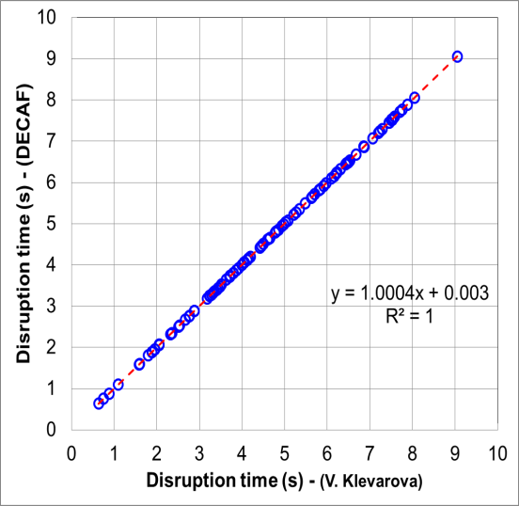

DECAF connected to databases from multiple machines, expanding analysis
Analysis
  Density limits
  Ideal, kinetic, resistive MHD stability
  Rotating MHD, etc.
DECAF database started
  Presently ~50 TB stored
Device / Capability | KSTAR | MAST | NSTX | DIII-D | AUG, TCV
Full database access (required!) | Yes (MDSplus) | Yes (UDA) | Yes (MDSplus) | Yes (MDSplus) | Yes (MDSplus)
Database analysis | continuing | continuing | continuing
Equilibrium analysis | Magnetic, Kinetic + MSE | Magnetic, Kinetic + MSE | Magnetic, Kinetic + MSE | available
Stability | Ideal, Resistive Kinetic MHD | Ideal (so far) | Ideal, kinetic MHD (resistive) | Ideal, kinetic MHD
shot*seconds (for kinetic analysis) | ~ 3,880 (2016-2018) | 2,667 (est) (M5 - M9 runs) | 2,000 / year (est)
AUG
Now, full access interface to AUG database; expanding to others
  100 shot LTM disruption database by V. Klevarova analyzed for

Slide 8
DECAF now connected to databases from multiple machines, expanding analysis
Analysis
  Density limits
  Ideal, kinetic, resistive MHD stability
  Rotating MHD, etc.
DECAF database started
  Presently ~50 TB stored
Device / Capability | KSTAR | MAST | NSTX | DIII-D | AUG, TCV
Full database access (required!) | Yes (MDSplus) | Yes (UDA) | Yes (MDSplus) | Yes (MDSplus) | Yes (MDSplus)
Database analysis | continuing | continuing | continuing
Equilibrium analysis | Magnetic, Kinetic + MSE | Magnetic, Kinetic + MSE | Magnetic, Kinetic + MSE | available
Stability | Ideal, Resistive Kinetic MHD | Ideal (so far) | Ideal, kinetic MHD (resistive) | Ideal, kinetic MHD
shot*seconds (for kinetic analysis) | ~ 3,880 (2016-2018) | 2,667 (est) (M5 - M9 runs) | 2,000 / year (est)
AUG
(100 shot LTM database)
Now, full access interface to AUG database; expanding to others
  100 shot LTM disruption database by V. Klevarova analyzed for

Slide 9
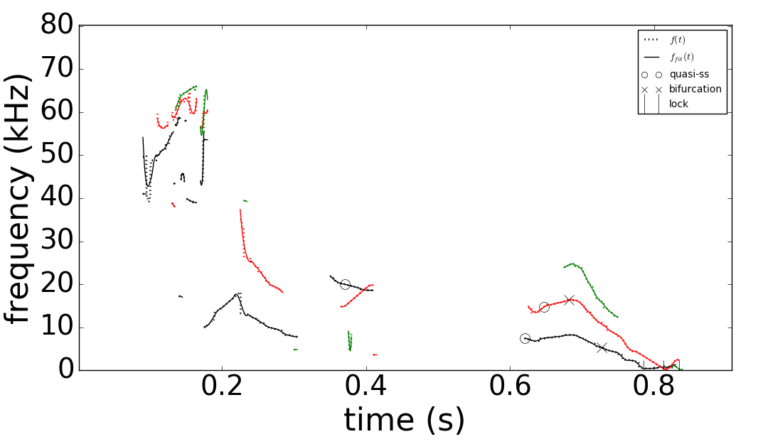
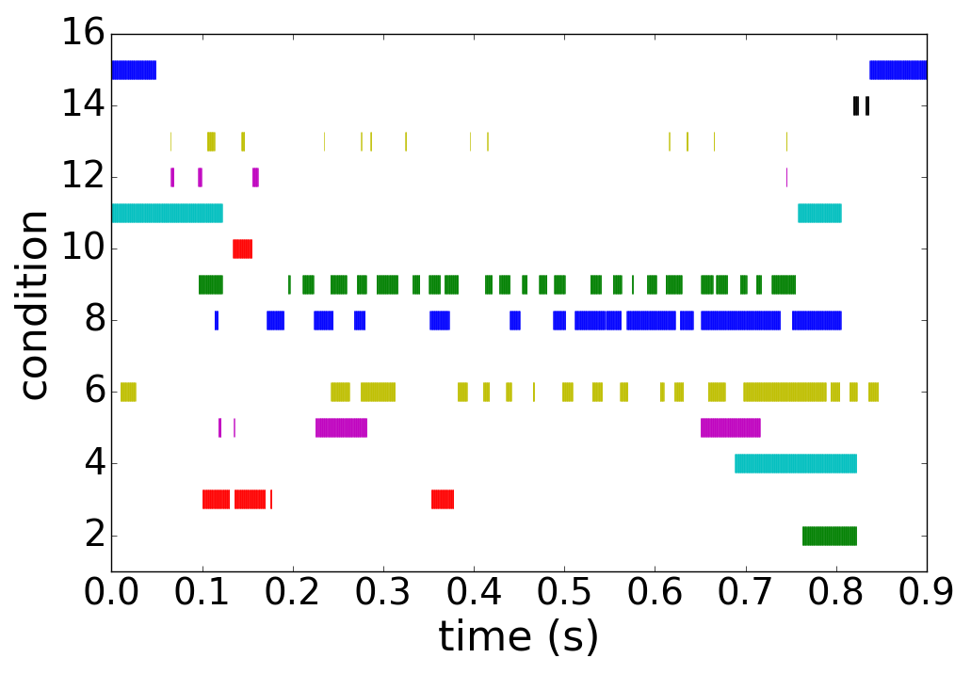
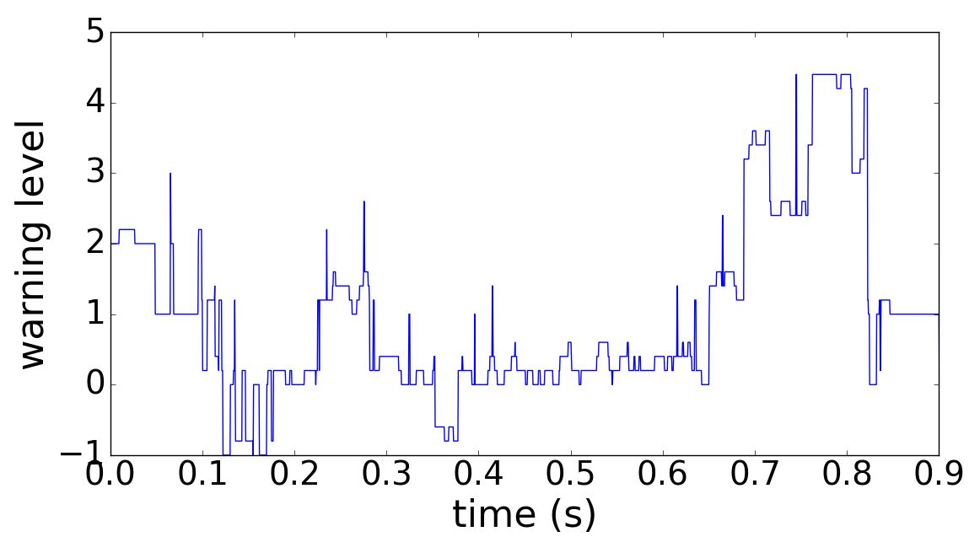
DECAF MHD events utilize history of 15 criteria to define time evolving disruption warning level
DECAF automated MHD objects
DECAF “heat map” (for MHD)
MHD-n3
Locked mode > 25G ➔
MHD-n2
MHD-n1
⬅ Core plasma rotation < 6 kHz ➔
BIF-n2
“quasi-steady
state (O)”
BIF-n1
Decreasing plasma rotation ➔
LTM-n1
⬅ High amplitude ➔
LTM-n2
f below bifurcation ➔
Very low f mode ➔
DECAF MHD warning level
Key notables of MHD warning
  “Safe”/“unsafe” MHD periods found
  Early, slow warning level evolution
    Locked mode amplitude important, but warning comes in very late
  Mode frequency below bifurcation, decreasing plasma rotation key
Safe

Slide 10
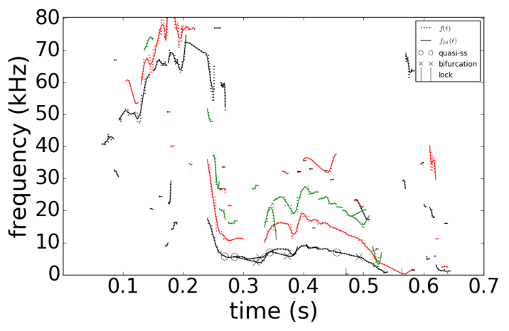
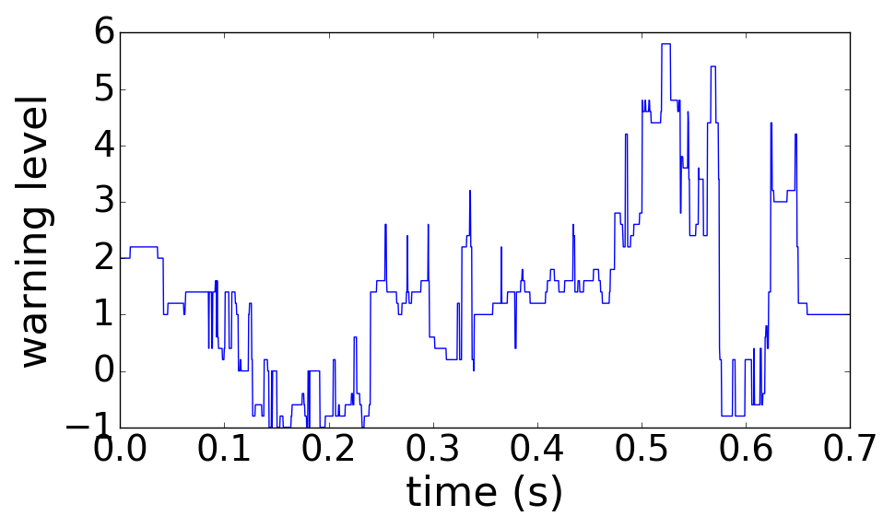
DECAF provides an early disruption forecast - on transport timescales – giving potential for disruption avoidance
DECAF event chain
MHD-n1
BIF-n1
LTM-n1
PRP
IPR
WPC
DIS
VDE
(0.490s)
(+.005s)
(+.045s)
(+.068s)
(+.073s)
(+.073s)
(+.077s)
(+.080s)
NSTX
n
DECAF MHD events
3
2
1
126962
Disruption forecast level
Safe
DECAF event chain reveals physics
  Rotating MHD slows, bifurcates, and locks
  Then, plasma has an H-L back-transition (pressure peaking warning PRP) before DIS
  Important: Early warning occurs in apparently SAFE region of operating space!

Slide 11
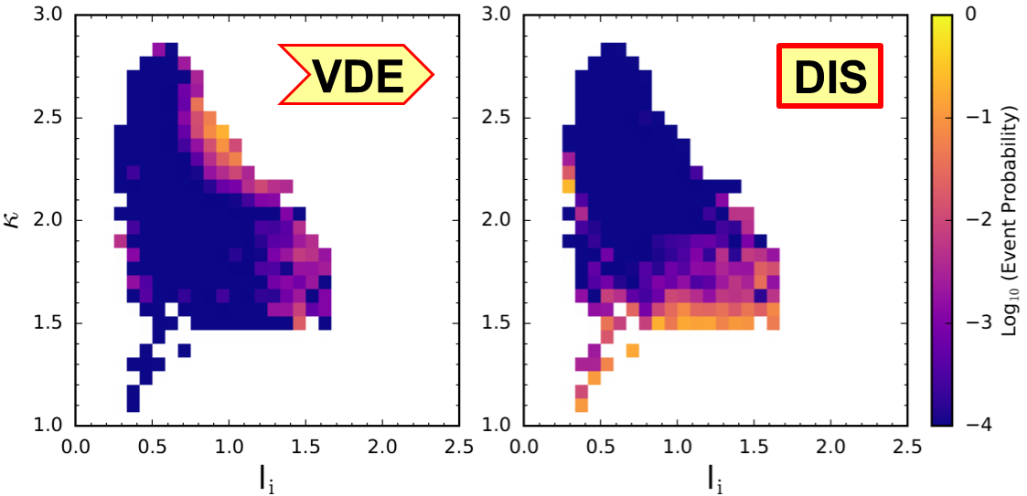
Example: DECAF shows plasma parameters of VDE event can occur far from those of DIS event
NSTX
Largest portion of detected VDE events appear at (l_{i},κ) with very small portion of DIS events detected

Slide 12
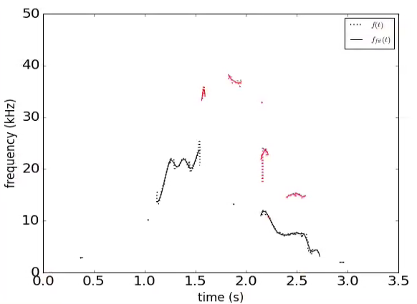
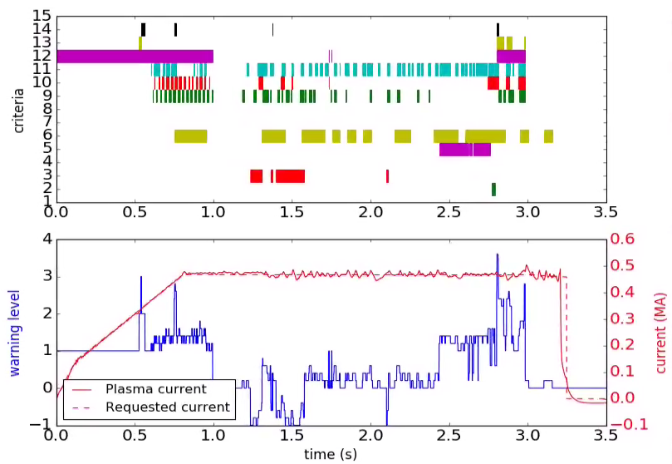

DECAF MHD events also produce early disruption warnings for KSTAR
DECAF automated MHD objects
DECAF “heat map” (for MHD)
n
Plasma rotation profile
and dynamics
}
3
MHD-n1
2
MHD-n2
frequency (kHz)
condition
1
Decreasing β_{N} ➔
High amplitude mode ➔
KSTAR
16299
Very low frequency mode ➔
time (s)
MHD warning level
Mode locking at reduced plasma rotation
Key notables of MHD warning
  “Safe”/“unsafe” MHD periods
  Early disruption warning (300 ms) ➔ on transport timescale
warning level
Safe

Slide 13
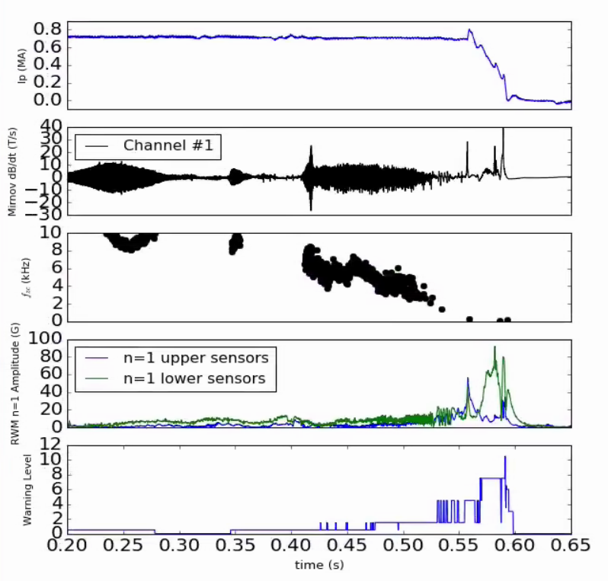
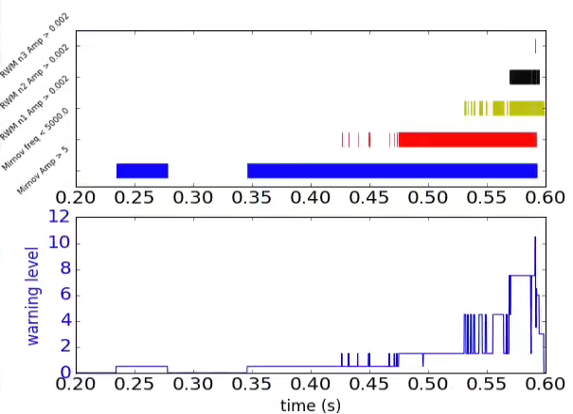
New “reduced” locked tearing mode event being created, aimed for real-time use / comparison
DECAF “heat map” (for LTM v2)
LTM
n = 3 saddle loop > 20 G
NSTX 127733
(version 2)
n = 2 saddle loop > 20 G
warning critera
n = 1 saddle loop > 20 G
Frequency < 5 kHz
Pickup loop > 5 T/s
0.
t (s)
Using pickup coils and partial saddle loops
Compare to full FFT approach
Warning level criteria
  Pickup coil amplitude > 5 T/s
  Low zero-crossing measured frequency < 5 kHz
  High mode identified saddle loops amplitude > 20 G
Warning level

Slide 14
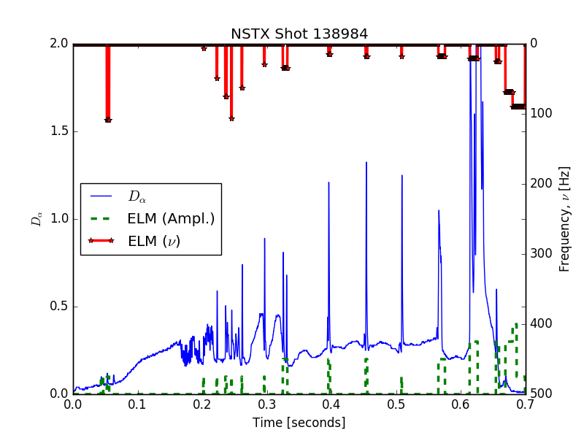
New DECAF edge localized mode event created to start examining correlations to other MHD
DECAF ELM event
  Presently determines ELM triggering times, along with frequency and relative amplitude
Near-term-goals
  Determine greater understanding between ELM triggering and more deleterious MHD excitation
Compatible with real-time use
ELM

Slide 15
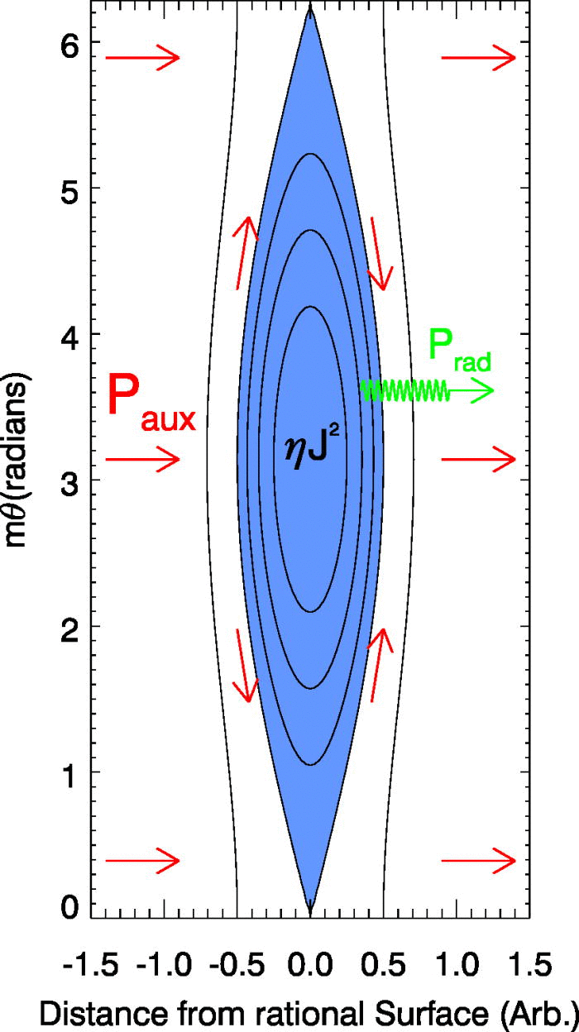
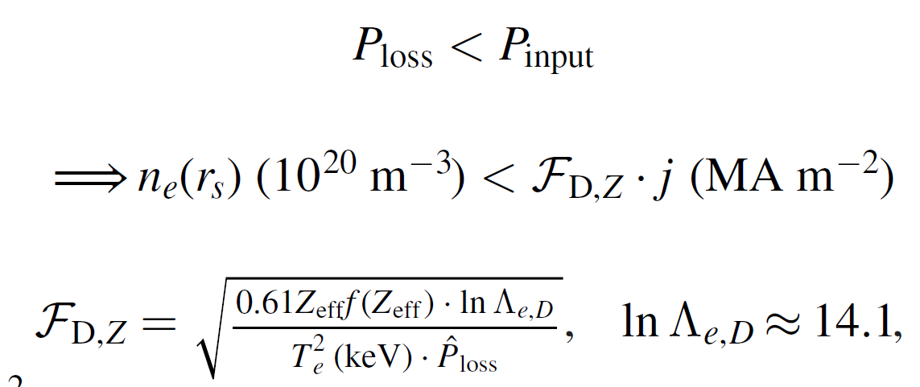
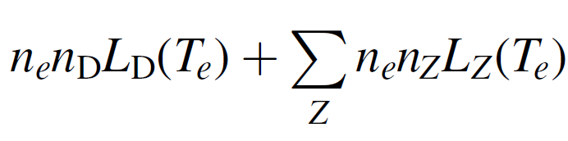
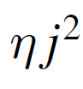
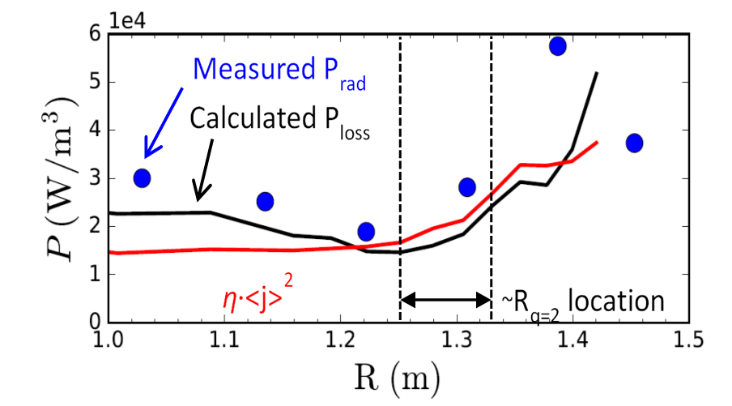
A density limit model has been examined in DECAF based on power balance in an island
Local island power balance limit
  Power balance in island between Ohmic heating and radiated power loss
  If radiated power at the island exceeds the input power (P_{loss} > P_{input}), island grows
Power density balance:
NSTX
134020
D. Gates et al., Phys. Rev. Lett. 108 165004 (2012)

Slide 16
Initial assessment of density limit model shows correlation with MHD events
DECAF automated MHD events
Magnetic spectrogram
(toroidal array)
MHD-n3
MHD-n2
MHD-n1
NSTX
GWL
Greenwald limit
  Near 0.9 when mode starts (range 0.75 – 1.05)
Rad. island power balance
  Near 1.0 when mode starts (range 0.60 – 1.50) ⬅ next step: reduce range
IPB
0.9

Slide 17
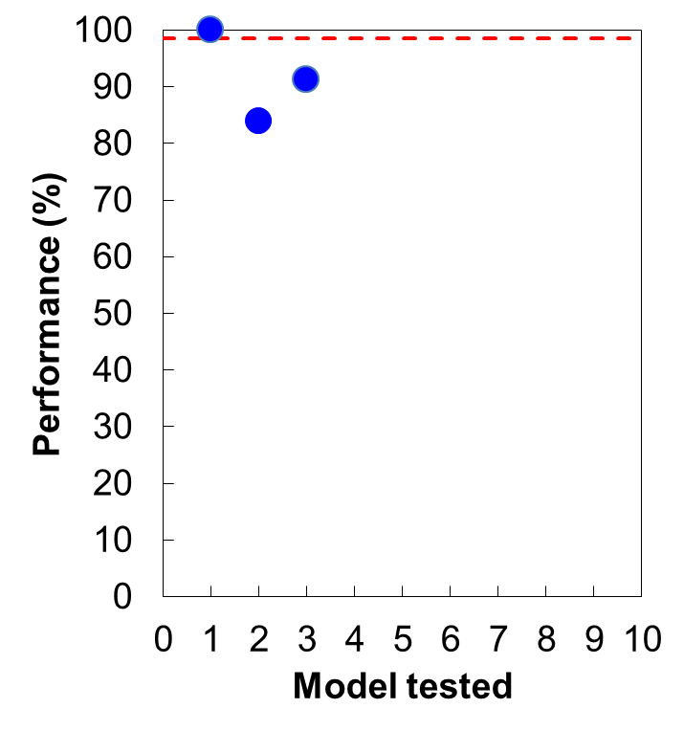
Limited event chain analysis of large databases evolves initial performance of disruption prediction
DECAF Disruption Forecasting Performance Evolution
First test on large, general database
Analysis with only 5 DECAF events tested for 10,094 discharges with disruptions (NSTX)
  Events used: VDE, GWL, LOQ, IPR, DIS
Performance (Model 3)
  91.2% true positives (warning occurs)
  8.7% false negatives (no warning)
    Somewhat high number of false negatives expected: only 5 DECAF events are used in this large database analysis
In 5,909 shots, vertical instability is part of the disruption chain
ITER need
5 events
~10⁴ shots*s
(general database)
~10 events, ~10² shots*s
(earlier forecasting)
~10 events, ~10² shots*s
(initial event validation)
VDE
greater realism

Slide 18
DECAF is fueled by coordinated research that continues to validate/develop physics models, e.g.:
Resistive MHD
  Detection / forecasting: available magnetic diagnostics, plasma rotation
  Forecasting: starting examination of MRE ➔ start with Δ’ evaluation
Density limits
  Detection: rad. power, global empirical limit
  Forecasting: starting examination of rad. island power balance model
Global MHD
  Detection: available magnetic diagnostics, plasma rotation, equilibrium
  Forecasting: Kinetic MHD model has high success in NSTX, DIII-D
Physics analysis / experiments to build DECAF models
  Interpretive and “predict-first” TRANSP analysis of KSTAR long-pulse, high beta plasmas with high non-inductive fraction

Slide 19
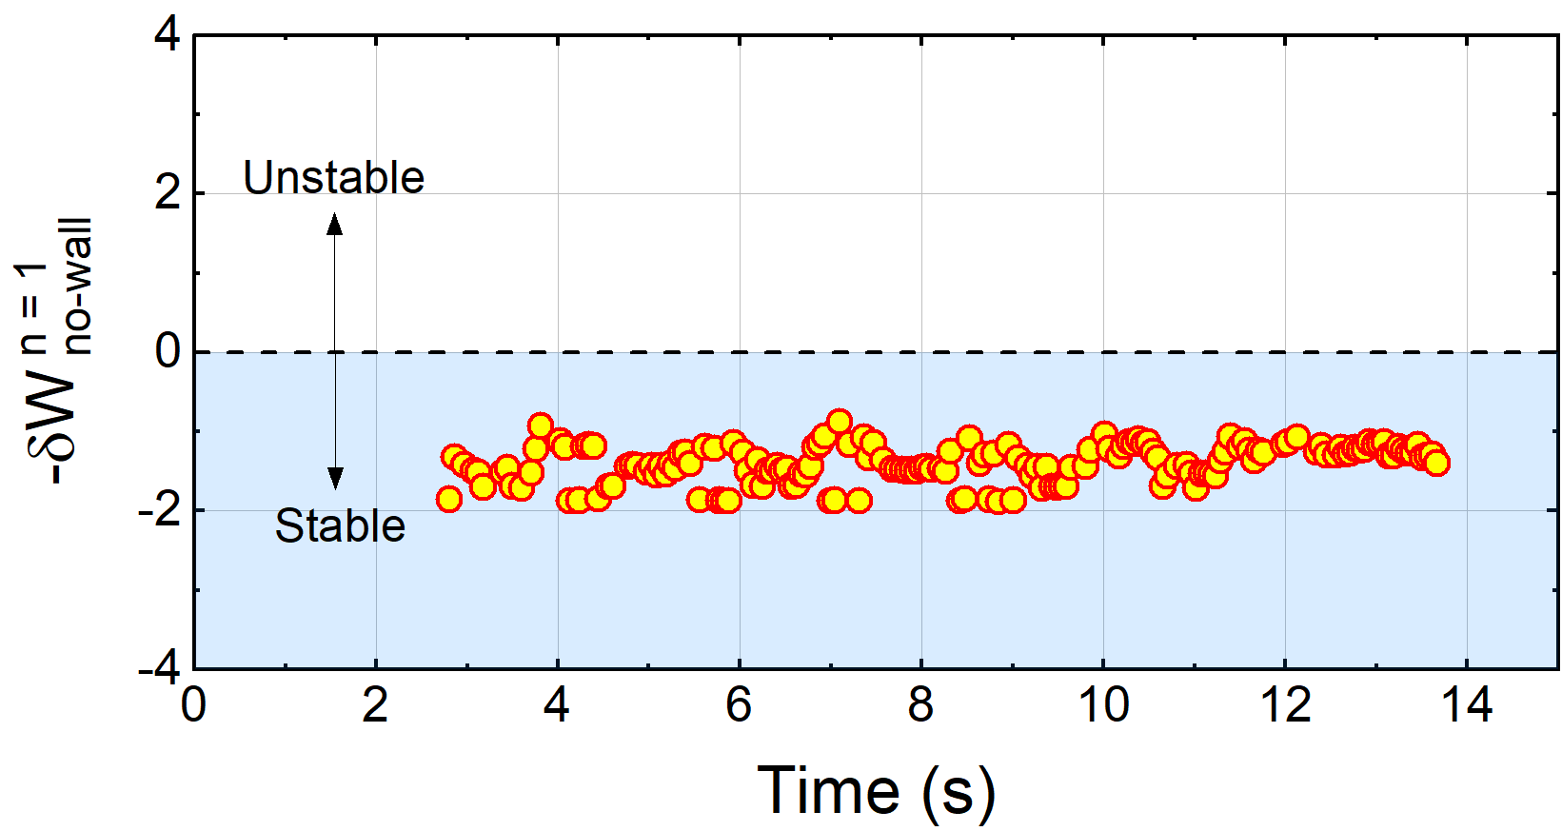
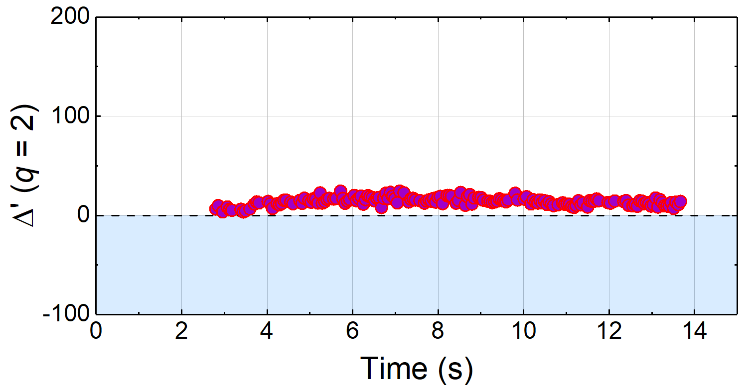

Tearing mode classical Δ’ stability examined in KSTAR plasmas (supports future DECAF models)
Ideal DCON δW
*Resistive DCON $Δ′$
β_{N} ~ 2
β_{N} ~ 2
Experimentally
2/1 stable
16325
16325
*A.H. Glasser PoP (2016)
Classical tearing stability index, Δ′, computed at q = 2 surface using outer layer solutions
At higher q₉₅, Δ′ is mostly positive predicting unstable classical tearing mode
  Indicates neoclassical effects, additional physics needed to reproduce XP
  KEY POINT: Conclusions regarding Δ’ evolution can be made!
    Recent paper with MRE evaluation ➔ Y.S. Park, et al., NF 60 (2020) 056007

Slide 20
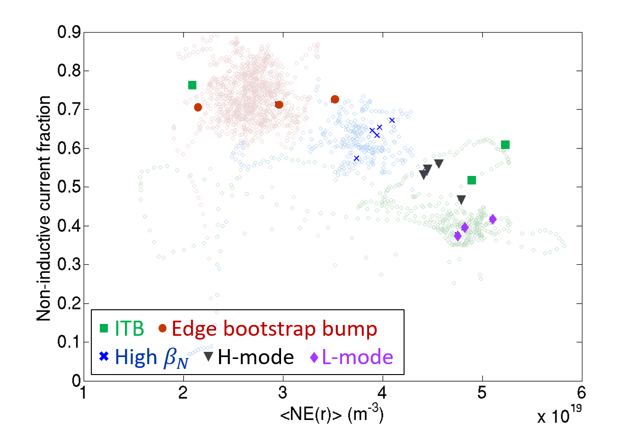
A database of high-non-inductive fraction plasmas is important for disruption forecasting ; NICF ~ 75% in KSTAR
TRANSP analysis of experimental plasmas
Non-inductive fraction
  Beam-driven
  Bootstrap
Non-inductive fraction is key for stable high beta steady state operation
16498
16325
16295
18476
18492
Volume average electron density (m⁻³)

Slide 21
“Predict-first” KSTAR TRANSP analysis shows expected high performance plasmas at > 80% NICF
Predicted high non-inductive current fraction (NICF) current profiles
81.5% NICF
93% NICF
101% NICF
High non-inductive current fraction predicted for 6.5, 7.5, 8.5 MW NBI
  The β_{N} ranges from 3.0 – 3.5; based on KSTAR plasmas with NICF ~70%
Aim to generate a significant database of long pulse, high NICF plasmas in 2020-2021 KSTAR runs for disruption prediction studies

Slide 22
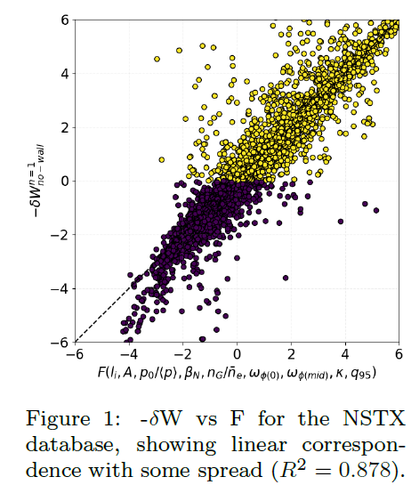
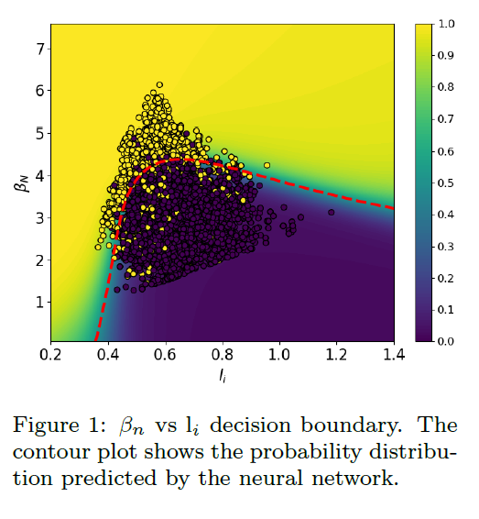
Machine learning approaches are now coupling to DECAF to compute sub-elements of computations
Determination of ideal MHD no-wall stability limit by DL NN
(2019 Marseille conference)
Determination of ideal MHD stability function by non-linear random forest regression
(2019 IAEA ML conference)
Collaboration with CCFE / UCL (A. Piccone (UCL)); ➔ A. Piccone, et al, Nucl. Fusion 60 (2020) 046033
FES/ACSR Advancing Fusion with Machine Learning - Research Needs Workshop (May 2019)

Slide 23
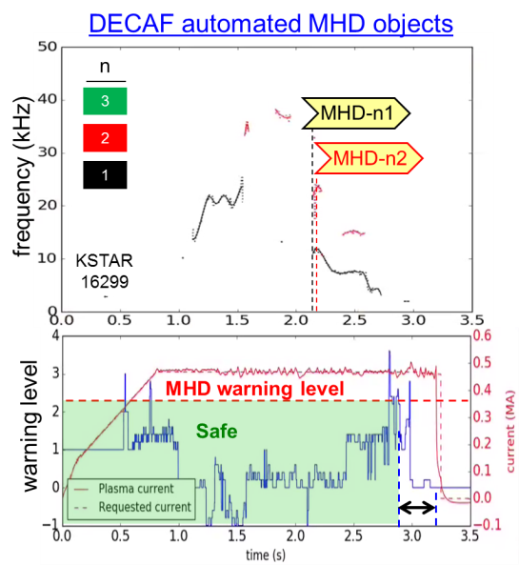
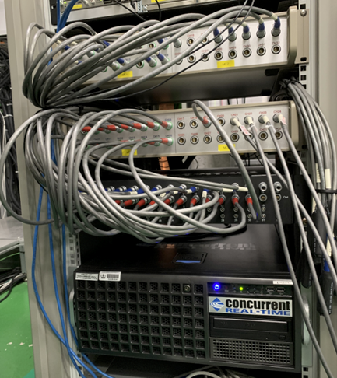
Disruption prediction and avoidance research on KSTAR moving to real-time application
Disruption forecasting physics analysis expansion
Implementation of real-time diagnostic capabilities
Real-time implementation of DECAF analysis and sensor input
  Plasma control system (PCS) code specifications written for 10 DECAF events – process continues
Real-time control leveraging real-time DECAF analysis and sensors
  Initial specification for model-based control in the PCS is written; interfaces to DECAF events being made
Next slides

Slide 24



KSTAR DPA grant research “fills in” the desired real-time (r/t) diagnostic capability for r/t DECAF
Real-time measurement of rotating / locking MHD
  < 300 kHz; Data collected during Jan/Feb 2020 run
Real-time and offline Motional Stark Effect - IN FINAL DESIGN
  “offline” MSE background polychrometer system, Z_{eff} profile
  Real-time implementation of MSE; includes δB profile measurement
Real-time plasma rotation profile – 1st system shipped to NFRI
  Completely new for KSTAR: 8 channels; 1 – 2 kHz time resolution
Real-time electron temperature profile – IN PROCUREMENT
  Implement real-time acquisition of heterodyne radiometer system
Real-time T_{e} fluctuation profile – IN PROCUREMENT
  Implement real-time acquisition to 2-D ECE imaging system

Slide 25
Overall setup for KSTAR real-time diagnostic integration and DECAF analysis for the PCS
KSTAR Test Cell / ECE Screen Room
Optical isolation
(Dolphin)
r/t ECEI and r/t DECAF development computer
PCS Room
1G to KSTAR imaging data server & MDSPlus
A-to-D (192 ch)
Expansion box connected to main ECEI r/t computer
RFM
rtDECAF
Dolphin
1G to MDSPlus
r/t ECE computer (includes Te(R) calibrations 73 ch)
Dolphin
r/t MHD computer
1G to MDSPlus
RFM
RFM
1G to MDSPlus
rtDECAF
Dolphin
r/t V_{φ} computer (includes profile calibration 8 ch)
Dolphin
1G to MDSPlus
r/t DECAF development computer
RFM
RFM
1G to MDSPlus
Dolphin
r/t MSE computer (includes profile calibration 25 ch)
rtDECAF
Dolphin
KSTAR PCS
RFM
Main Diagnostics Room
All software development under GIT version control
v1.0s

Slide 26
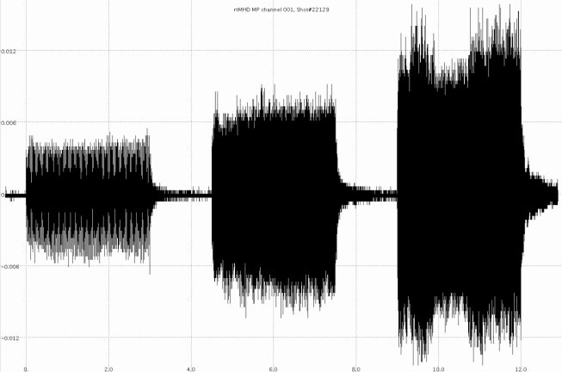

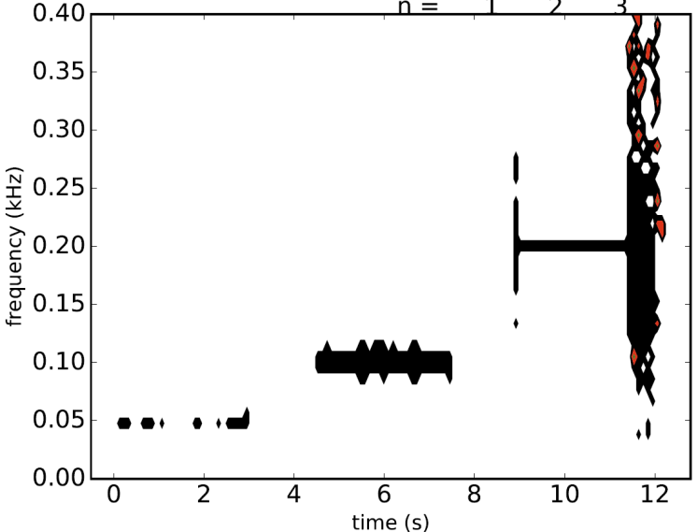
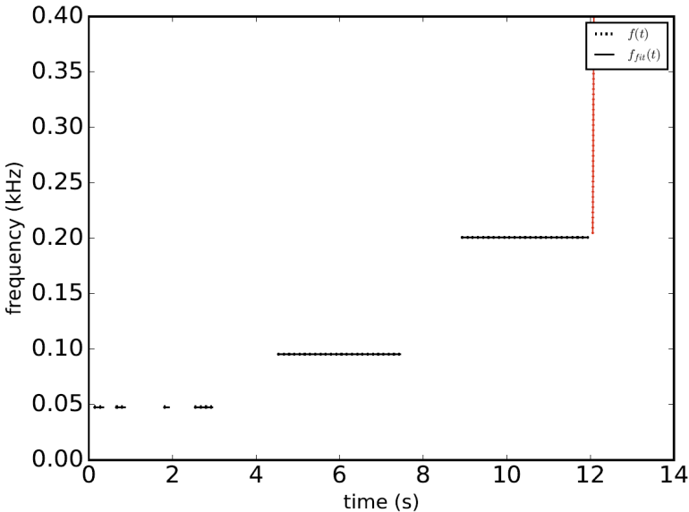
Disruption prediction and avoidance research on KSTAR moving to real-time application
Real-time MHD analysis computer installed at NFRI
  Designed for connection to plasma control system (PCS)
  Interface to MHD probes built
Real-time magnetic probe data acquired
(14 toroidal probes: n = 1 rotating field applied)
0.10 kHz
0.20 kHz
0.05 kHz
t(s)
Offline DECAF analysis of real-time signals
DECAF spectrogram
DECAF mode decomposition
n
n
3
3
0.20 kHz
2
0.20 kHz
2
0.10 kHz
1
0.10 kHz
1
0.05 kHz
0.05kHz

Slide 27
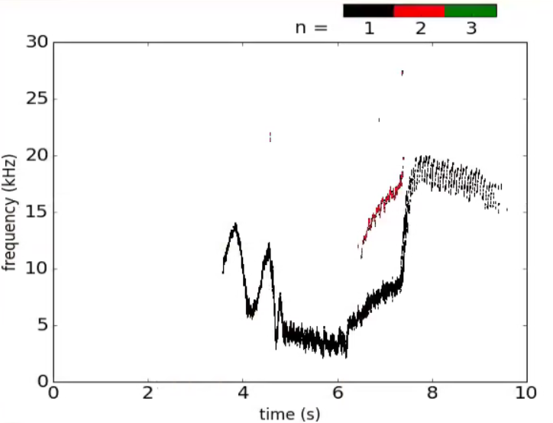
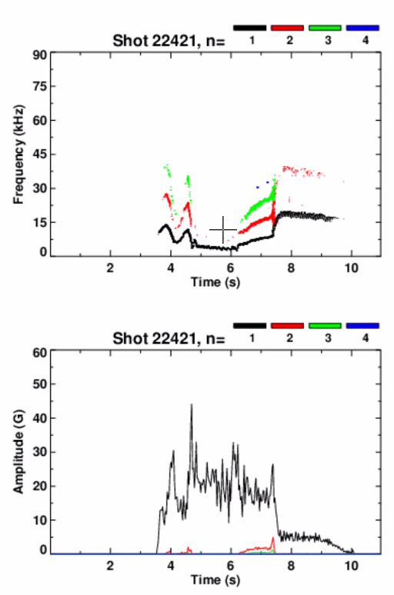
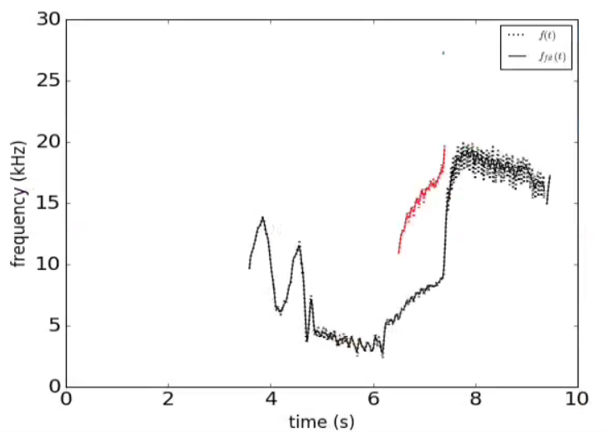
KSTAR real-time MHD computer acquired data for 2019 campaign – data quality as good as offline
Offline data, native code analysis
Real-time data, DECAF analysis (offline)
n
Spectrogram
3
Frequency (kHz)
Frequency (kHz)
2
1
DECAF object decomposition
n
~ 2 G
amplitude
3
Amplitude (G)
Frequency (kHz)
2
1

Slide 28
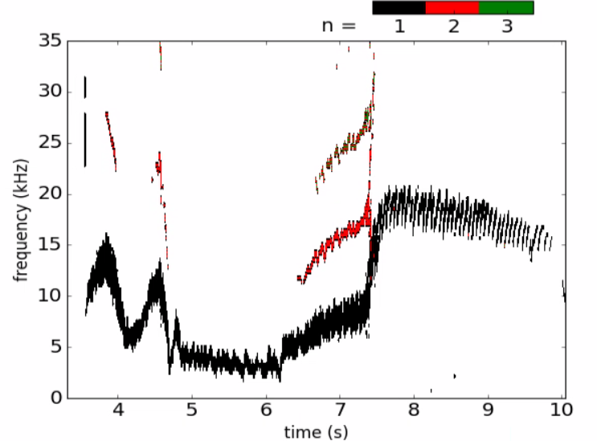

Analysis of KSTAR real-time MHD computer data compared to simulated FPGA* r/t analysis (I)
DECAF analysis using various inputs
From simulated FPGA FFTs
From offline FFTs
Δt = 3.06 ms , Δf = 0.31 kHz (offline analysis set to match FPGA)
*FPGA: field-programmable gate array

Slide 29
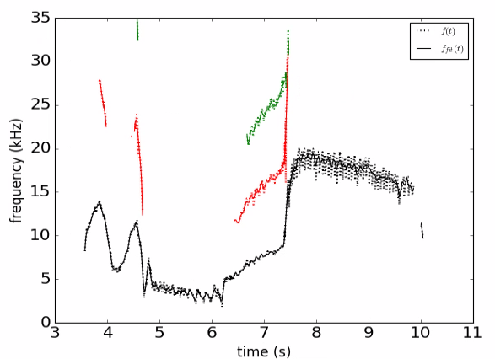
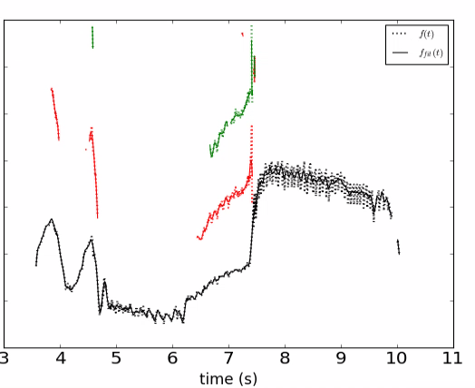
DECAF object decompoition of r/t MHD computer data works well on simulated FPGA analysis
DECAF object decomposition
From simulated FPGA FFTs
From offline FFTs
n
n
3
3
2
2
1
1

Slide 30
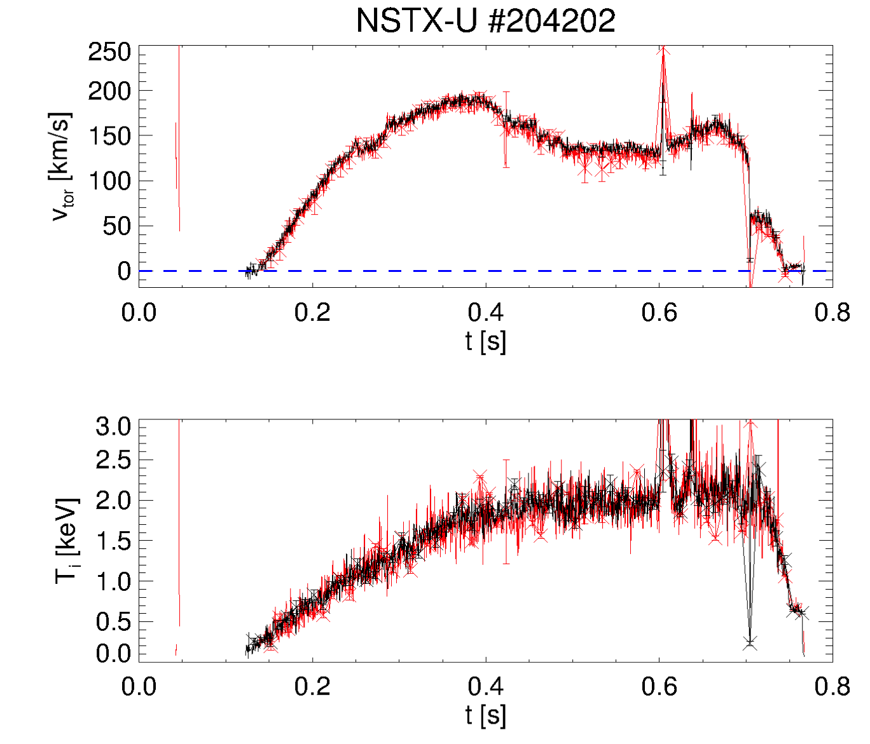
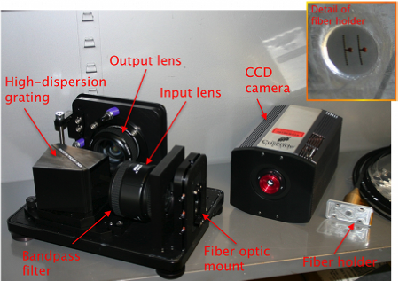
New real-time velocity diagnostic for KSTAR expands design of NSTX-U system (operated in 2016)
NSTX-U: demonstrated RT analysis for v_{φ}, T_{i} (for T_{i}>150eV)
  4 radial channels, active + backgrd, 5 kHz
KSTAR: plan for 8 radial channels, ~1kHz sampling rate
  Assess requirements in FY20 to optimize design & analysis software
  Re-locate NSTX-U system, interface w/ KSTAR
Status / plan
  NSTX-U system shipped to KSTAR (arrival this Wed July 22nd evening)
  Use data from initial system for final design of new KSTAR system
  Install new KSTAR system 2021
R~112cm
real-time
post-discharge
M. Podesta (PPPL)

Slide 31
Expanding DECAF approach provides a new paradigm for disruption avoidance research
Multi-device, integrated approach to disruption prediction and avoidance that meets disruption predictor requirement metrics
  Physics-based “event chain” yields key understanding of evolution toward disruptions needed for confident extrapolation of forecasting, control
  Present performance on large (10⁴) databases: 91.2% w/ only 5 Events
  Full multi-machine databases used (full databases needed!)
  Innovative use of machine learning started (event analysis, pred. models)
  Physics analysis, experiments run to understand, create, validate models
DECAF producing early warning disruption forecasts
  On transport timescales: ➔ guide disruption avoidance by profile control
Continuing development
  Improve DECAF forecasting performance run on large database analysis
  Continue / expand disruption forecasting performance analysis (➔ ITER)
  Implement DECAF disruption forecasting models in real-time (➔ KSTAR)

Slide 32
Supporting slides follow

Slide 33
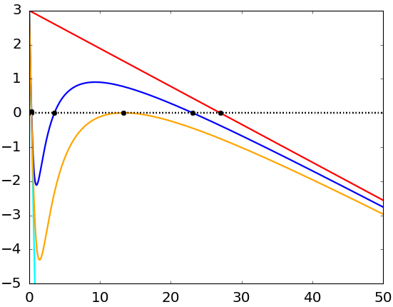
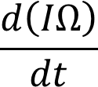



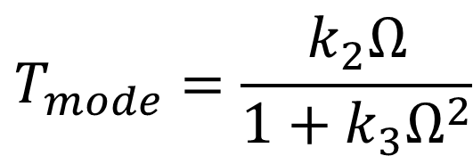
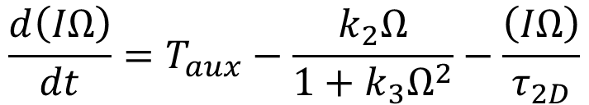

Simple island rotation dynamics model presently being constructed to forecast the bifurcation point
Start with cylindrical, rigid body model
Possible model of drag for both a “slip” and a “no slip” condition:
At very low angular speed mode reaches a stable steady state, ➔ investigating this in KSTAR
Collaborating with UW Madison theoreticians to add explicit effect of island size on viscosity, toroidal effects, etc.
$$\frac{d\left(IΩ\right)}{dt}=T_{aux}−\frac{k_{2}Ω}{1+k_{3}Ω^{2}}−\frac{\left(IΩ\right)}{τ_{2D}}$$
$$T_{mode}=\frac{k_{2}Ω}{1+k_{3}Ω^{2}}$$
$$k_{2}=0$$
R. Fitzpatrick et al., Nucl. Fusion 33 (1993) 1049
$$Ω_{0}$$
Bifurcation

Slide 34
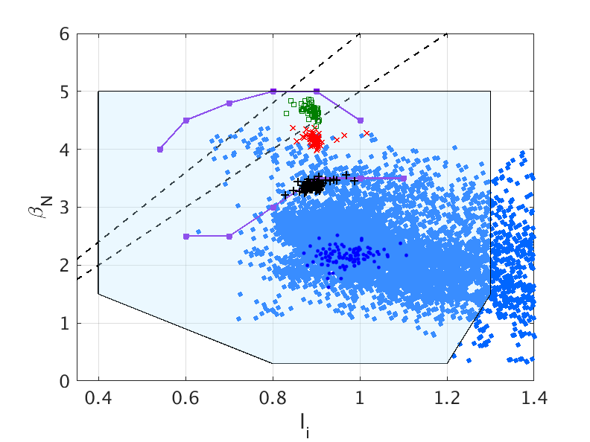
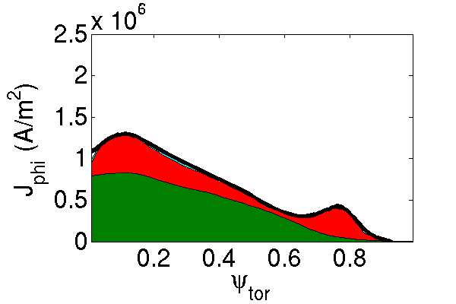
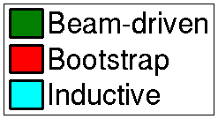



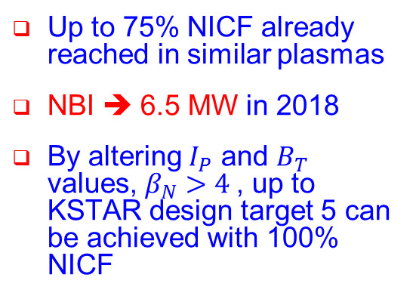

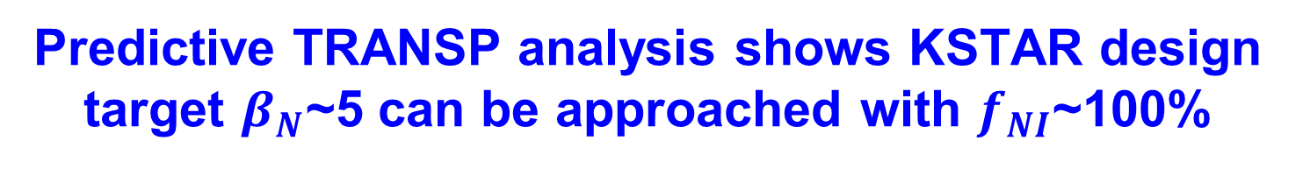

Predictive TRANSP analysis shows KSTAR design target $β_{N}$~5 can be approached with $f_{NI}$~100%
“Predict-first” analysis used to design high-β , 100% non-inductive current fraction (NICF) experiments for present KSTAR run campaign
$β_{N}$/$l_{i}$=6
$β_{N}$/$l_{i}$=5
<TRANSP>
$B_{T}$=1.5T
P_{NBI} = 6.5 MW
Predicted
n=1 with-wall limit
β_{N} = 3.4
f_{NI} = 96%
$B_{T}$=1.7T
$B_{T}$=2.0T
n=1 no-wall limit
Up to 75% NICF already reached in similar plasmas
NBI ➔ 6.5 MW in 2018
By altering $I_{P}$ and $B_{T}$ values, $β_{N}>4$, up to KSTAR design target 5 can be achieved with 100% NICF
Interpretive
See J-H Ahn CO6.00005

Slide 35
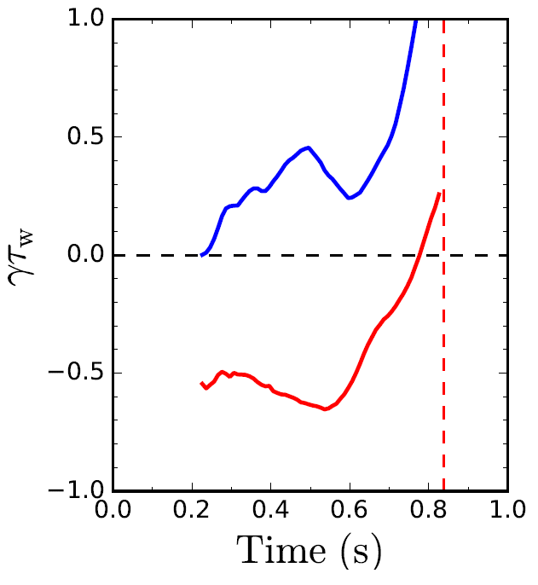
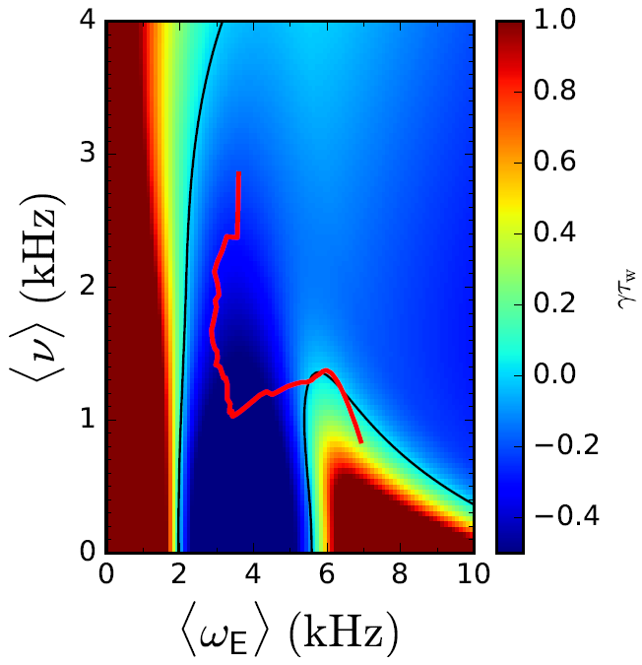

      DECAF reduced kinetic MHD model provides early forecast of instability boundary to global MHD modes
Norm. growth rate vs. time
Disruption forecasting
Predicted instability statistics
γτ_{w}
unstable
Increasing time
ideal
γτ_{w}
Collisionality (kHz)
stable
Global kinetic MHD mode growth
Ideal + kinetic
disruption
NSTX
139514
Rotation
predicted instability
84% of shots are predicted unstable (stringent evaluation)
44% predicted unstable < 320 ms (approx. 60τ_{w}) before current quench
33% predicted unstable within 100ms of a minor disruption
Favorable characteristics
  Stability contours CHANGE for each time point
  Model allows real-time stability and mode growth rate prediction
J.W. Berkery, S.A. Sabbagh, R. Bell, et al., Phys. Plasmas 24 (2017) 056103

Slide 36
DECAF analysis of large databases further supports published results that disruptivity doesn’t increase with β_{N}
MAST
KSTAR
NSTX
DIS
DECAF analysis of event
  Shots analyzed at 10 ms intervals
Analysis during I_{p} flat-top
  MAST: 8,902 plasmas analyzed
  NSTX: 10,432 plasmas analyzed
  KSTAR: 1,309 plasmas analyzed

Slide 37
Initial analysis of large databases further supports published result that disruptivity doesn’t increase with plasma β
MAST
KSTAR
NSTX
DIS
DECAF analysis of event
  Similar to a “standard” disruptivity analysis
  Shots analyzed at 10 ms intervals
Analysis during I_{p} flat-top
  MAST: 8,902 plasmas analyzed
  NSTX: 10,432 plasmas analyzed
  KSTAR: 1,309 plasmas analyzed

Slide 38


Global MHD modes can also be “slow” and allow early warnings for disruptions, potentially allowing avoidance
DECAF event chain
RWM
IPR
PRP
VDE
DIS
MHD-n1
LTM-n1
WPC
LOQ
(0.629s)
(+.010s)
(+.012s)
(+.058s)
(+.101s)
(+.101s)
(+.101s)
(+.106s)
(+.107s)
NSTX
DECAF MHD events
n
3
2
1
DECAF rotating MHD warning level
Safe
123856
Global MHD (RWM) can also be “slow”
  Rotating MHD warning level decreases after 0.46s ➔ DANGEROUS for RWM onset!
  H – L back transition (PRP) drags out time to disruption (> 100 ms – transport timescale)

Slide 39




New 2nd NBI system installed in KSTAR, may be available for 2020 run campaign
90°
Geometry of 2nd NBI system is included in TRANSP model
  Available power
  $P_{NBI}≃$1.5MW/source
  (conservative)

Slide 40




Clear pressure profile distinction between Internal Transport Barrier and H-mode phases
15
10
5
0
15
10
5
0
ITB phase
H-mode phase
t = 2.5s
t = 4.8s
Safety factor
t = 2.5s
Safety factor
t = 4.8s
Safty factor q
ITB
H-mode
L-mode
0.0 0.2 0.4 0.6 0.8 1.0
ψ_{N}
0.0 0.2 0.4 0.6 0.8 1.0
ψ_{N}
1.2
1.0
0.8
0.6
0.4
2
0.0
-0.2
1.2
1.0
0.8
0.6
0.4
2
0.0
-0.2
Total Pressure
t = 2.5s
Total Pressure
t = 4.8s
Total Pressure (10⁵Pa)
2.5
4.8
△ data
— fitted
△ data
— fitted
16498
1.8 1.9 2.0 2.1 2.2 2.3
R (m)
1.8 1.9 2.0 2.1 2.2 2.3
R (m)
Broad pedestal pressure reconstructed in H-mode is not observed in earlier ITB phase
Xp by Jinil Chung

