Slide 1
IAEA Technical Meeting on Plasma Disruptions and their Mitigation
Continuous update of machine learning disruption prediction and prevention models at JET
E. Aymerich¹, A. Fanni¹, G. Sias¹, S. Carcangiu¹, B. Cannas¹, A. Murari², A. Pau³ and JET Contributors
1
1
2
3
Notes:
Hello, the title of my talk is continuous update of machine learning models at JET. In our work we focused on the automatic update of the GTM

Slide 2
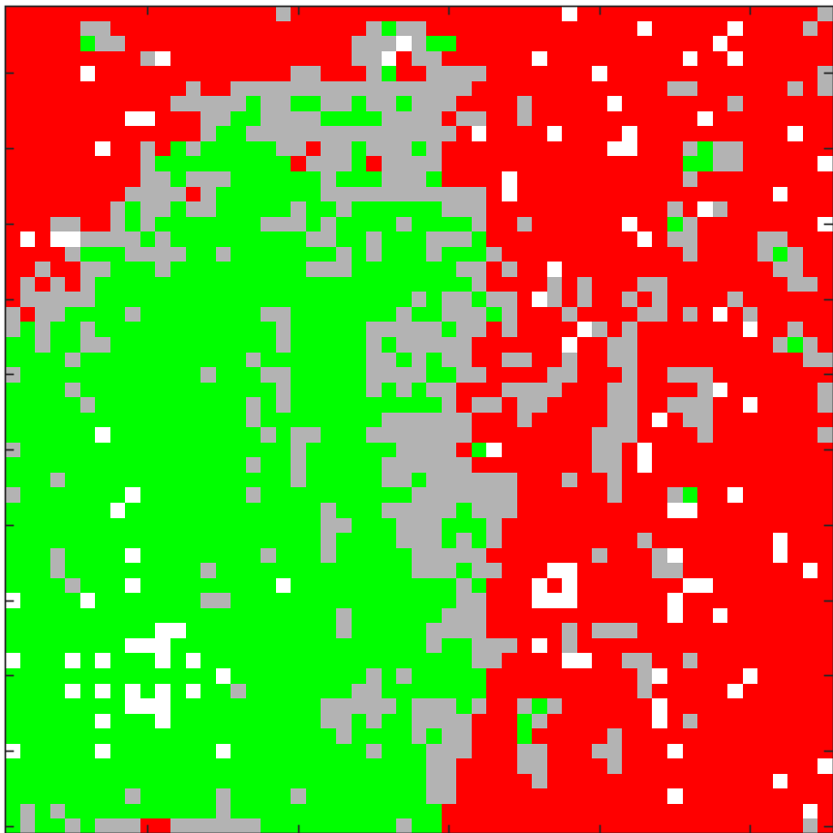
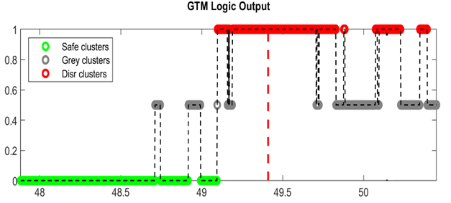
GTM model
Pre-disrupted part of disrupted shots (Ref. WT)
2D GTM map
GTM mapping
N-D Input data space
Shot projection
Flat-top of regularly terminated shots
Input Features (6D space)
$${\text{Te}}_{\text{pf}}$$
$${\text{N}\text{e}}_{\text{pf}}$$
$${\text{Rad}}_{\text{pf}\text{−}\text{CVA}}$$
$${\text{Rad}}_{\text{pf}\text{−}\text{XDIV}}$$
Internal Inductance li
Radiated Fraction PFRAC
Notes:
The Generative Topographic mapping method is a way to map a multi-dimensional space into a lower dimensional manifold. We start from an N-Dimensional Input space, where N is given by the number of input features. We give as input to the GTM all the flat-top of regularly terminated discharges and the pre-disrupted part of disrupted shots. The pre-disrupted part of each disruption is identified by the so-called Reference Warning Time). After the mapping process, we have a 2D representation of a multi-dimensional input space. The GTM can then be used as a supervised machine learning algorithm by coloring each cell of the map depending on the percentage of disrupted and non-disrupted samples in it. Then we project a shot on the map and we can associate a probability to disrupt depending on the cluster where the shot is.
The input parameters of the GTM are:
the electron density and temperature peaking factors
the peaking factors of core and divertor radiation, from the horizontal camera of the bolometer
The internal inductance
the radiated fraction of the total input power.

Slide 3
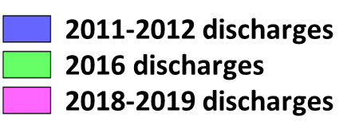
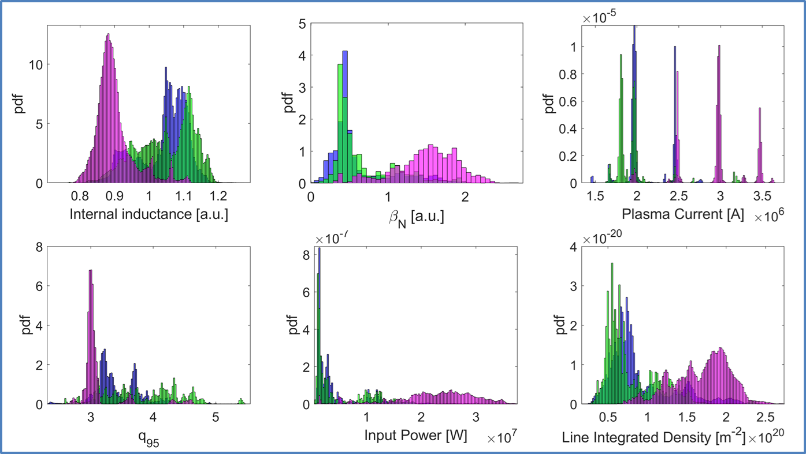
Change of parameter space
We observed:
Experiments with higher currents/power
Shift of Li (GTM input) and q95
Notes:
As it is well known, every machine learning model tends to age if the test distribution input space changes with time. This fact requires the model to be progressively updated in order to keep up with the change of the input parameters. In particular, looking at our data we can see that the operational space progressively changes from 2011 to 2019 discharges. In fact, we can see the more recent discharges have higher current, power density and beta. This change in the operational space also has an impact in the input space. For instance, we can see it from the internal inductance distribution in the top left.

Slide 4
GTM automatic update
Manual Reference Ti
Automatic Reference Ti
GTM C28-C30 MAN [1]
GTM C28-C36 AUT
89 Disrupted shots
70 regularly terminated discharges
Updated with automatically determined reference times
111 Disrupted shots
111 regularly terminated discharges
[1]: A.Pau et al.,“A Nucl. Fusion 2019, 106017 (22pp).

Slide 5
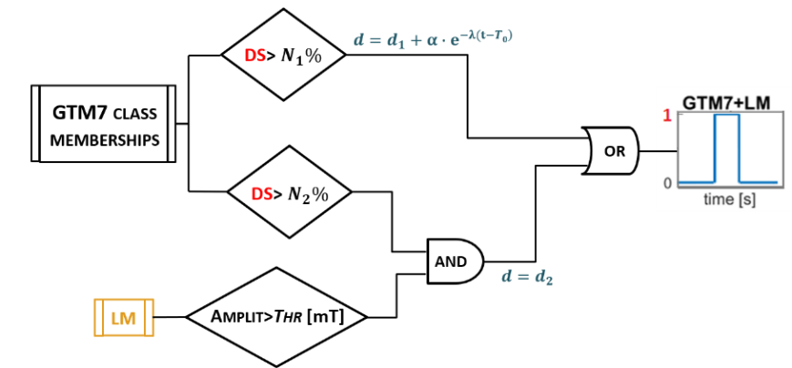
More recent baseline scenario shots
High Ip, high power test set
37 Disrupted shots
94 regularly terminated discharges
Selection criteria:
HRTS, Bolometer available
X-point configuration
Current over 1.5 MA
No VDE
DMV shots (until ${\text{t}}_{\text{DMV}}$)
99.8%
220ms
50%
Thr: 0.43mT/MA
We adopted the same GTM alarm scheme and hyperparameters for the trigger criterion as in [1].
[1]: A.Pau et al.,“A Nucl. Fusion 2019, 106017 (22pp).

Slide 6
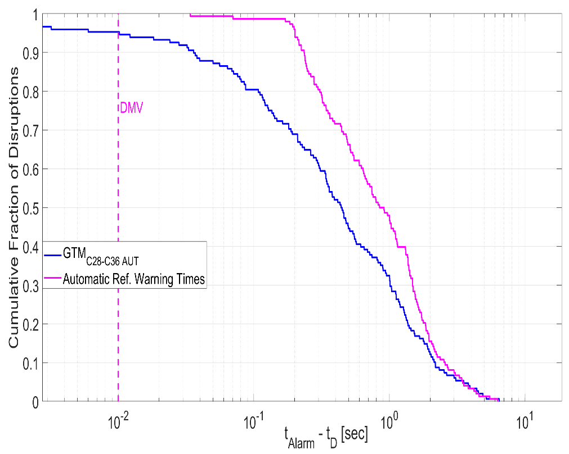
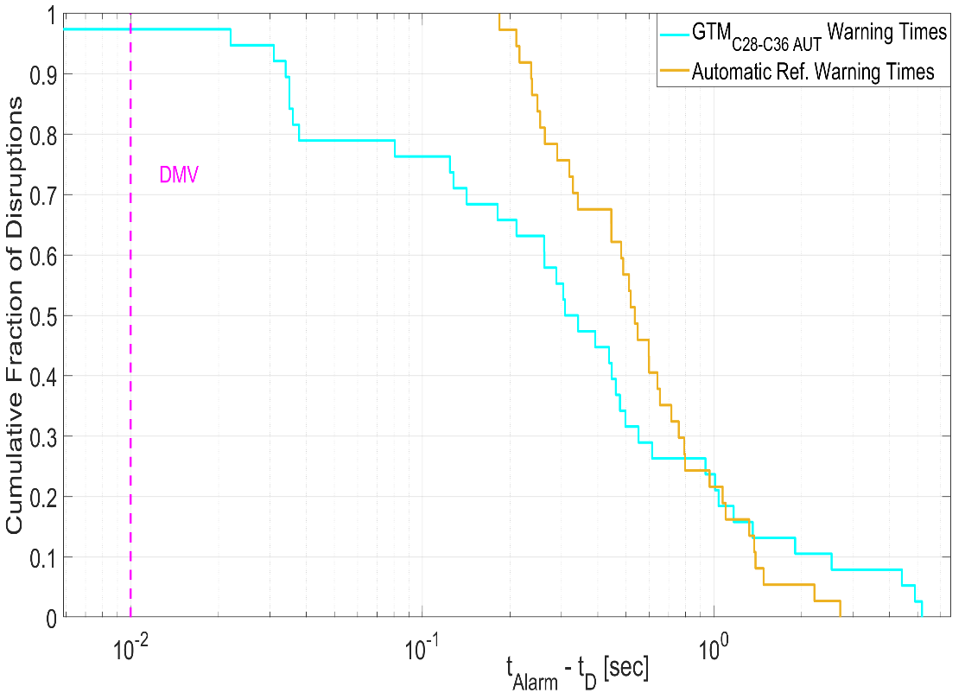
Performances on the dataset
 | Training Set | Test Set
SP | 94.6 % | 97.3%
FA | 0% | 8.51%
Dataset performances (+ ref. Ti)
Test performances (+ ref. Ti)

Slide 7
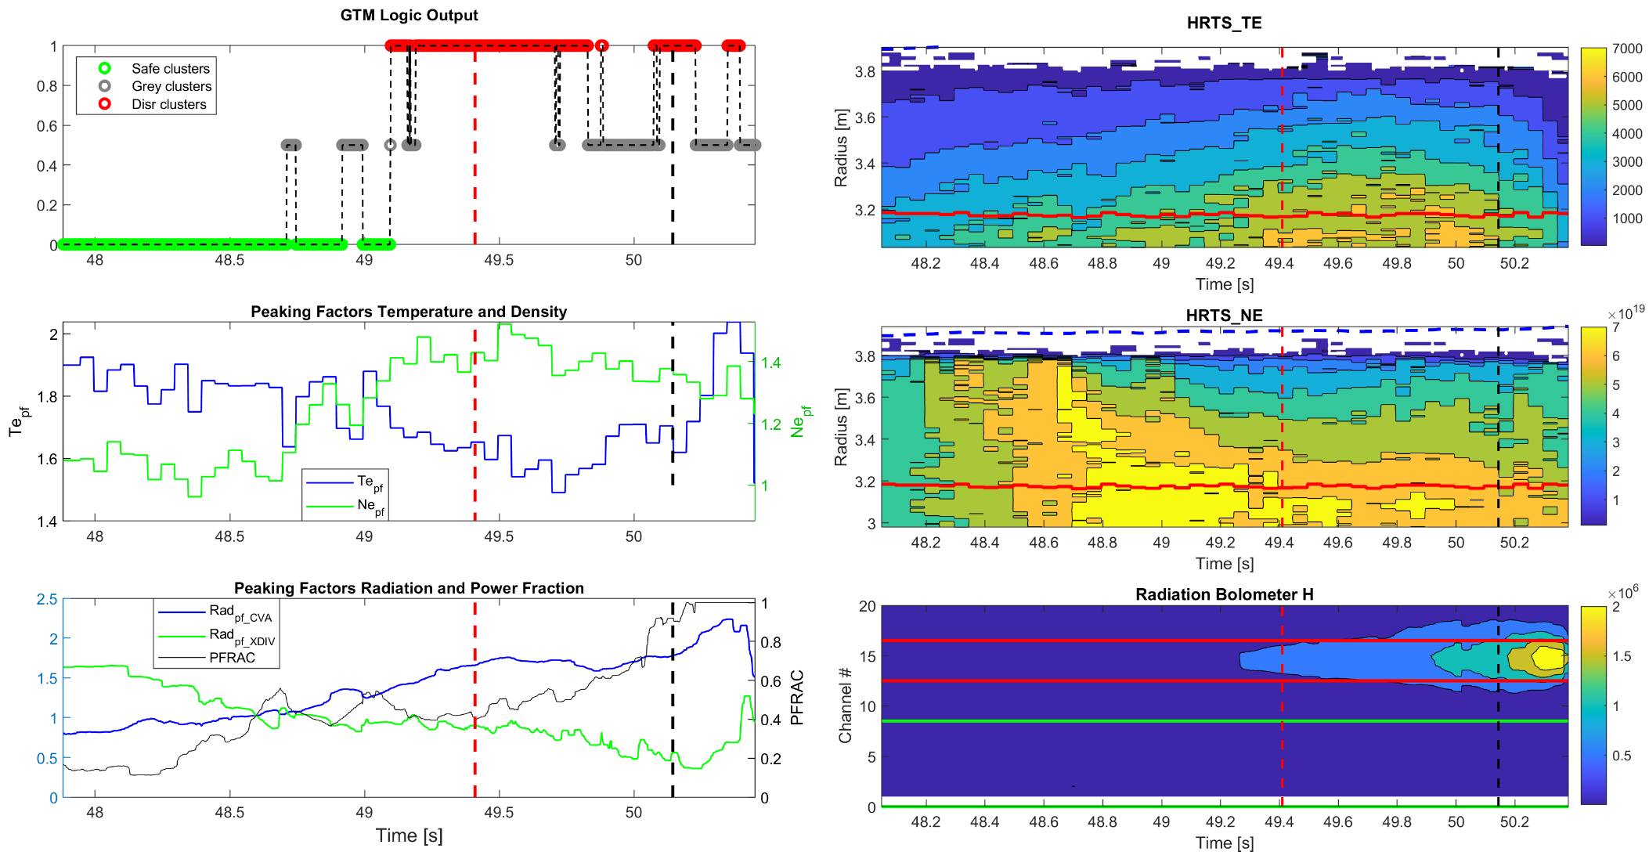
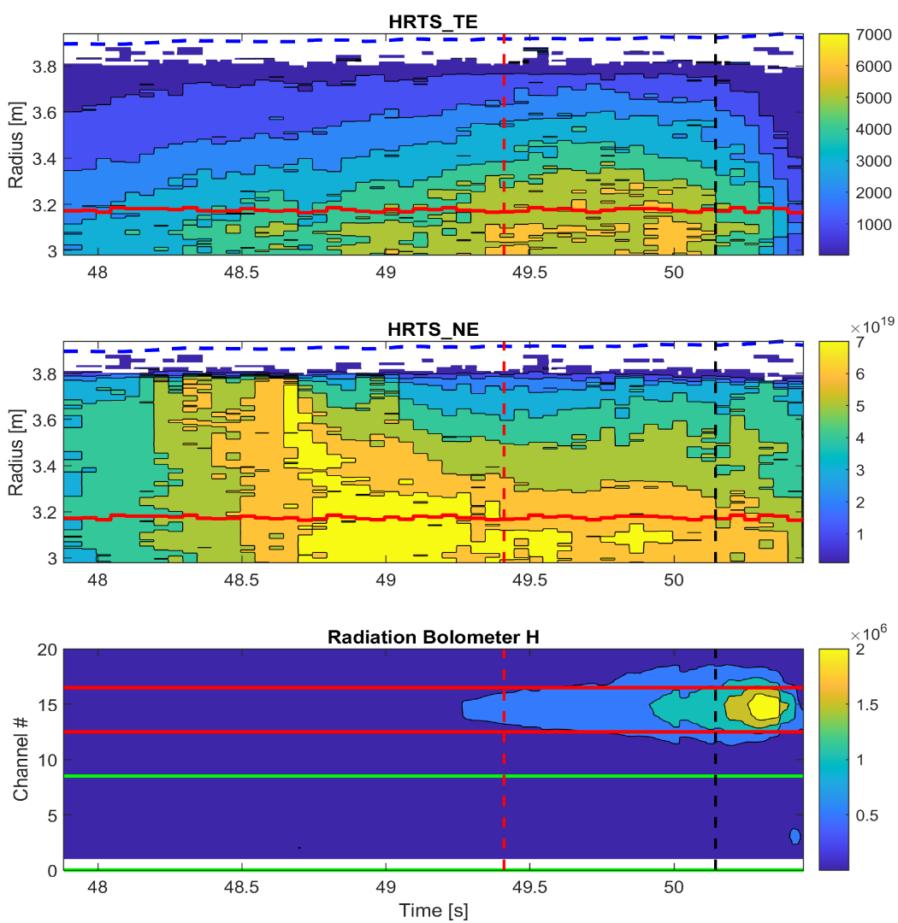
Example: Disrupted
#96385
Frad trip
GTM alarm
Notes:
Now I will show you how this model works in some examples from the test set. I am using some shots for which also another automatic alarm, based on radiated power fraction, was provided. All the examples I will show you were in a list of shots with high outboard radiation. The first shot is a disrupted discharge. On the top left so we can see the GTM's logical output, so that when the function reaches one, the GTM triggers an alarm after a certain assertion time. On the left we can also see the GTM input signals: in the middle, the temperature and density peaking factor in blue and green respectively, on the bottom the radiation peaking factors, with two different signals to represent the core and divertor region, also in blue and green. On the bottom plot we also see the fraction of radiated power PFRAC. Finally on the bottom right we have the last input signal, the plasma internal inductance, in yellow. On the right we can see the profiles from which the peaking factors are computed, on the top we can see the electron temperature profile from the Thompson scattering, in the middle plot the electron density profile from the same diagnostic. And in the bottom right the radiation from the bolometer horizontal camera.
Here we can see how the GTM alarm time, highlighted with a red dashed line anticipates the other alarm, called Frad trip and highlighted with a black dashed line. We can also see how the GTM correctly sees a flattening of the temperature profile and an increase of the electron density in the plasma core, together with the rise of the core radiation. This mechanism is associated with impurity accumulation.

Slide 8
Example: Disrupted
#96385
Notes:
Here we can see how the shot is projected on the map during its evolution. In this slide, we have the GTM on the top left plot, and its component planes, which show the distribution of the input parameters over the map, after the mapping process. In the projection, the circles increase in size as we go towards the end of the projection. The red diamond highlights the position of the shot on the map when the alarm is triggered. We can see how it starts from The green region of the map and terminates in the top right of the map. The right part of the map is associated with the core radiation mechanism, as we can see from the higher values of the core radiation peaking factor, lower values of the temperature peaking factor and higher values of the electron density profile. The top left of the map is instead associated with edge radiation mechanisms, as we see that the electron density picking factor is lower and the temperature peaking factor and the internal inductance are higher.

Slide 9
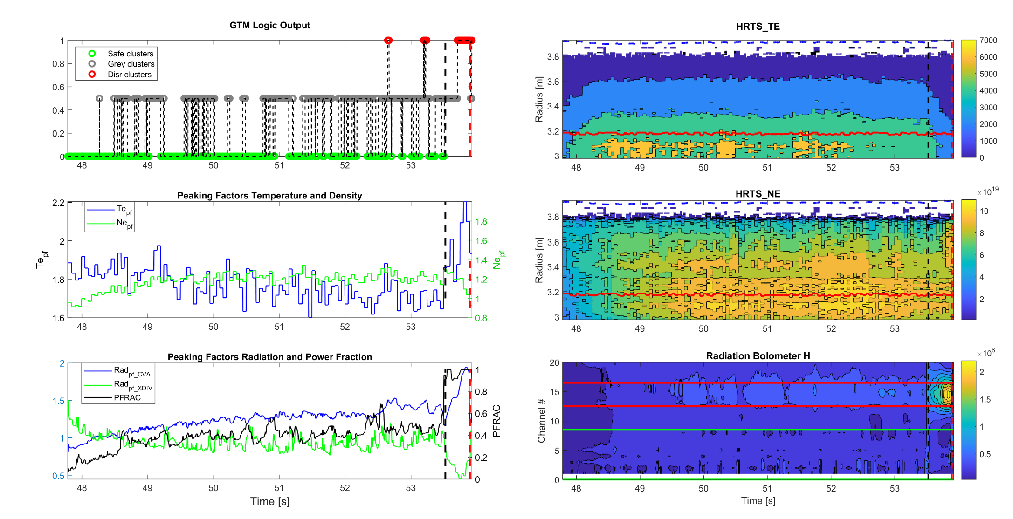
Example: Disrupted
#96729
Frad trip
GTM alarm
Notes:
In the second example we can see that the GTM alarm is after the black dashed line. In this shot temperature and density profiles are more regular and we can only see a Radial collapse of the temperature profile, highlighted by the rise of the Te pf, together with a flattening of the electron density profile, highlighted by the decrease of the Ne pf, at the very end of the pulse. We can also see the current profile contraption from the internal inductance and a blob of radiation in the core of the plasma. This mechanism is instead associated with edge radiation.

Slide 10
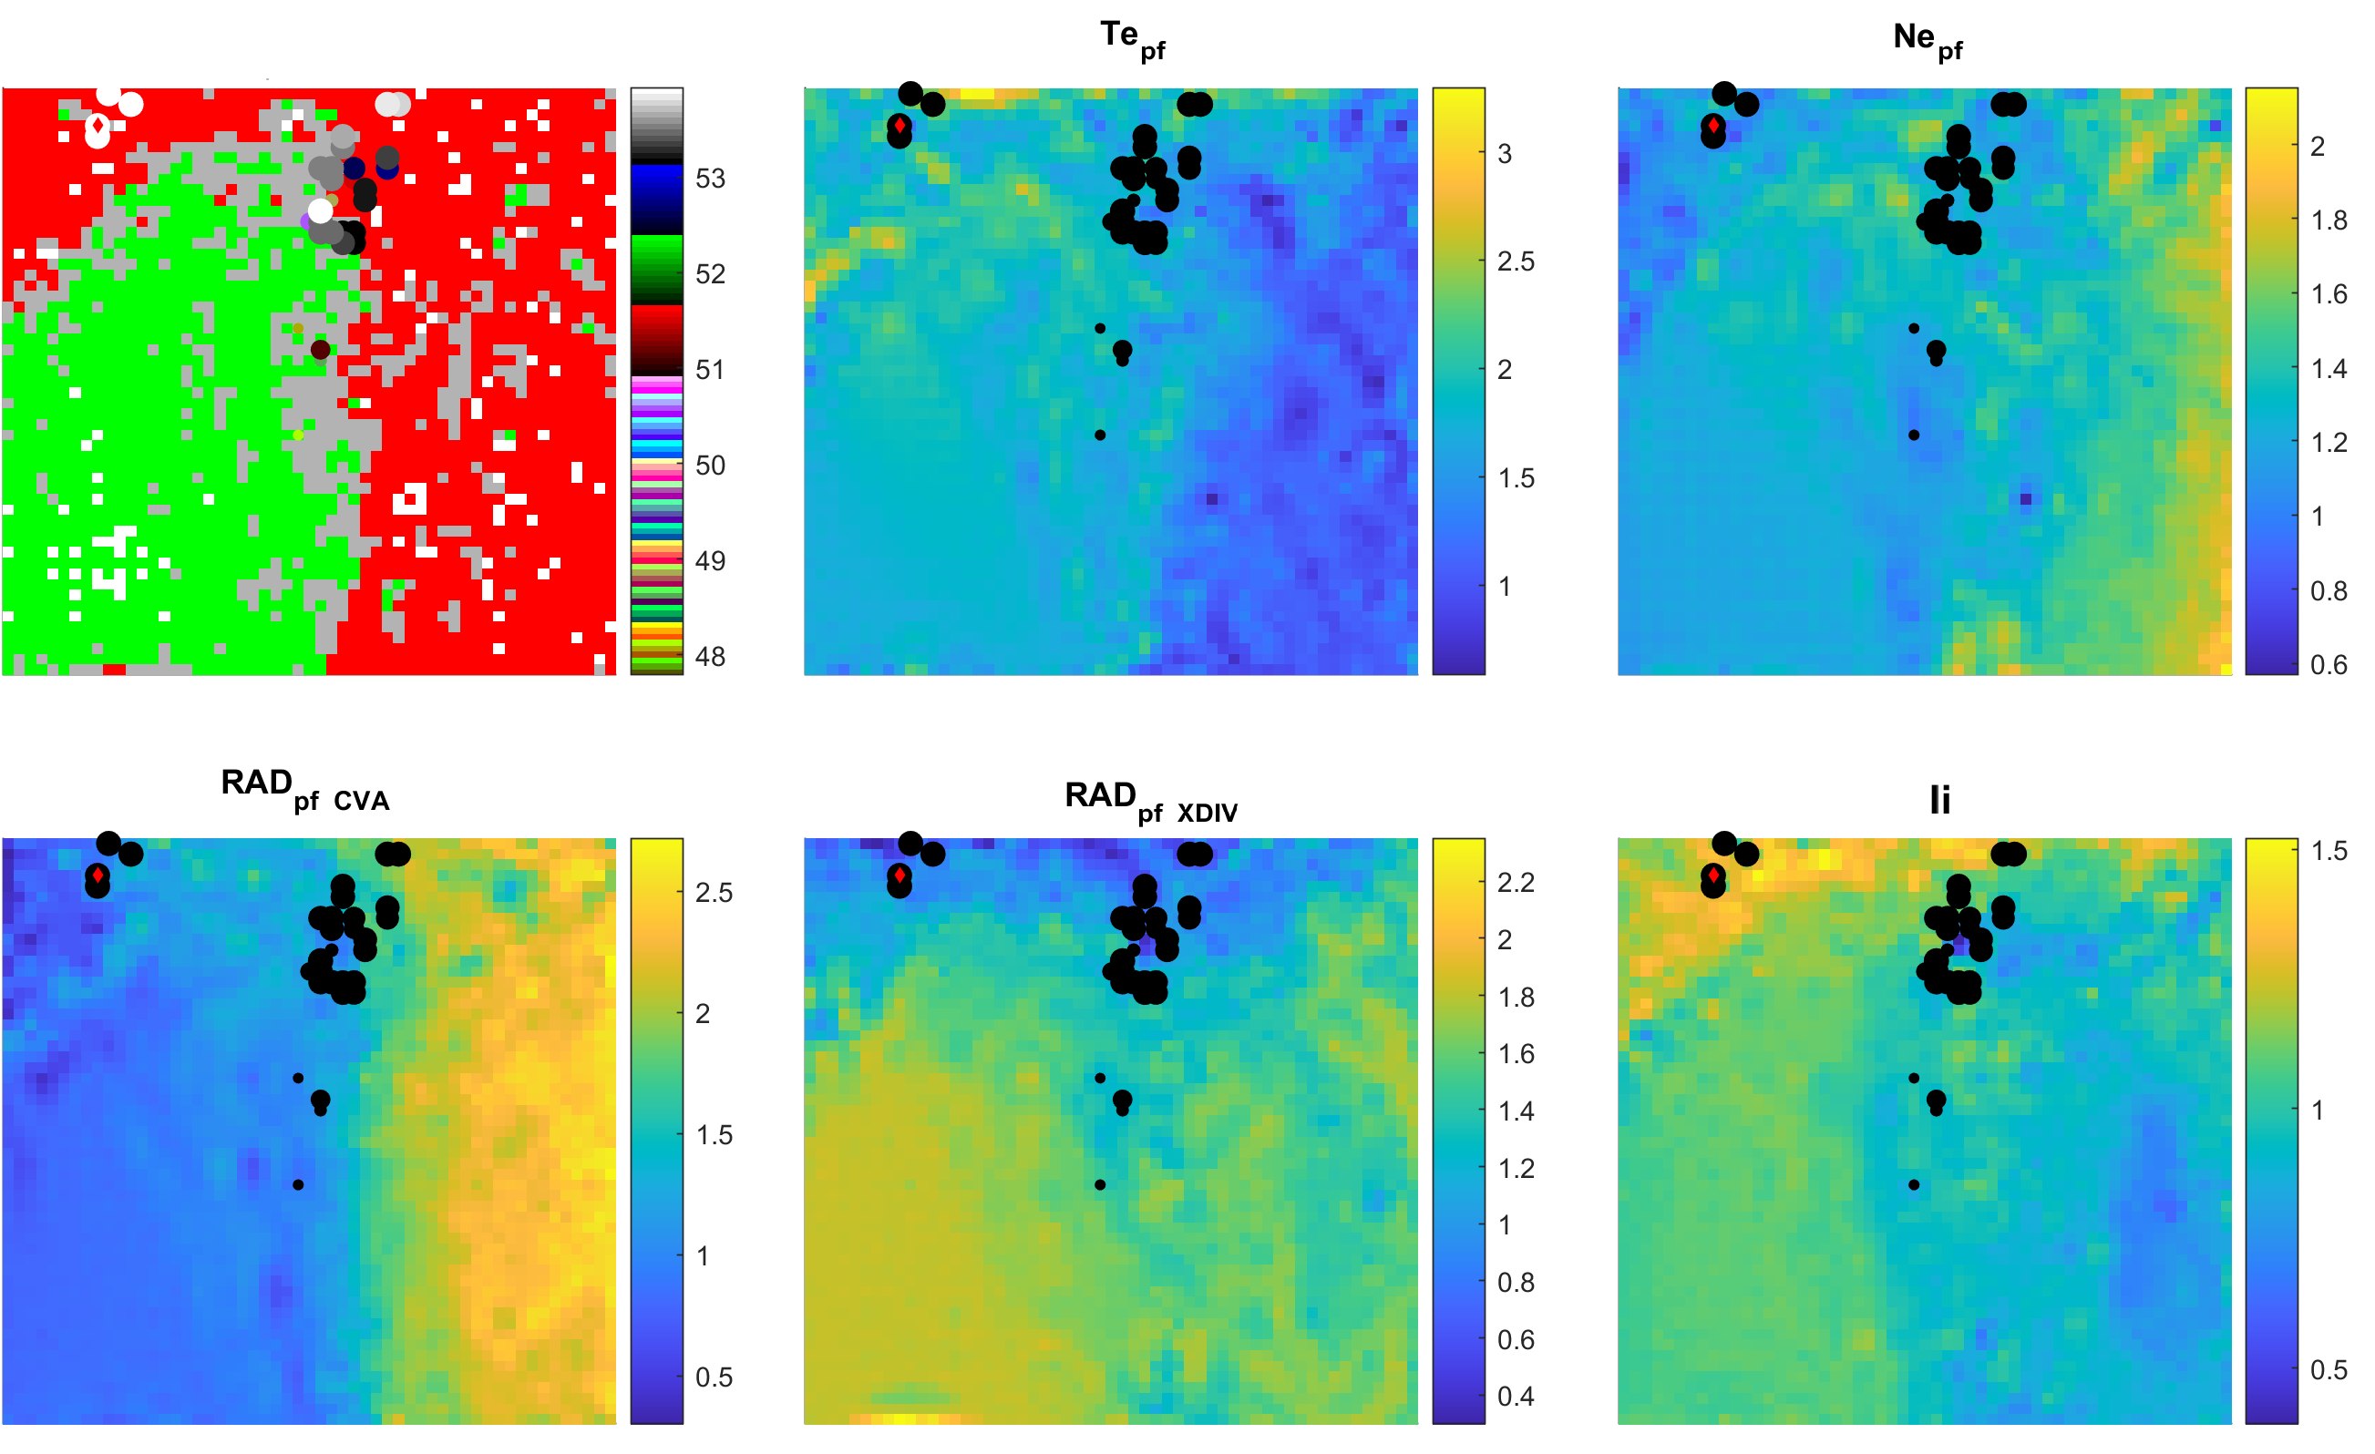
Example: Disrupted
#96729
Notes:
we can see how the projected shot also starts from the green region, enters the red region, then terminates in the top left part of the map. We observed a similar trajectory for other shots characterized by edge radiation. In this case, the alarm is triggered in the samples in the top left of the map.
so we can see that the automatically trained GTM is correctly discriminating these two different mechanisms.

Slide 11
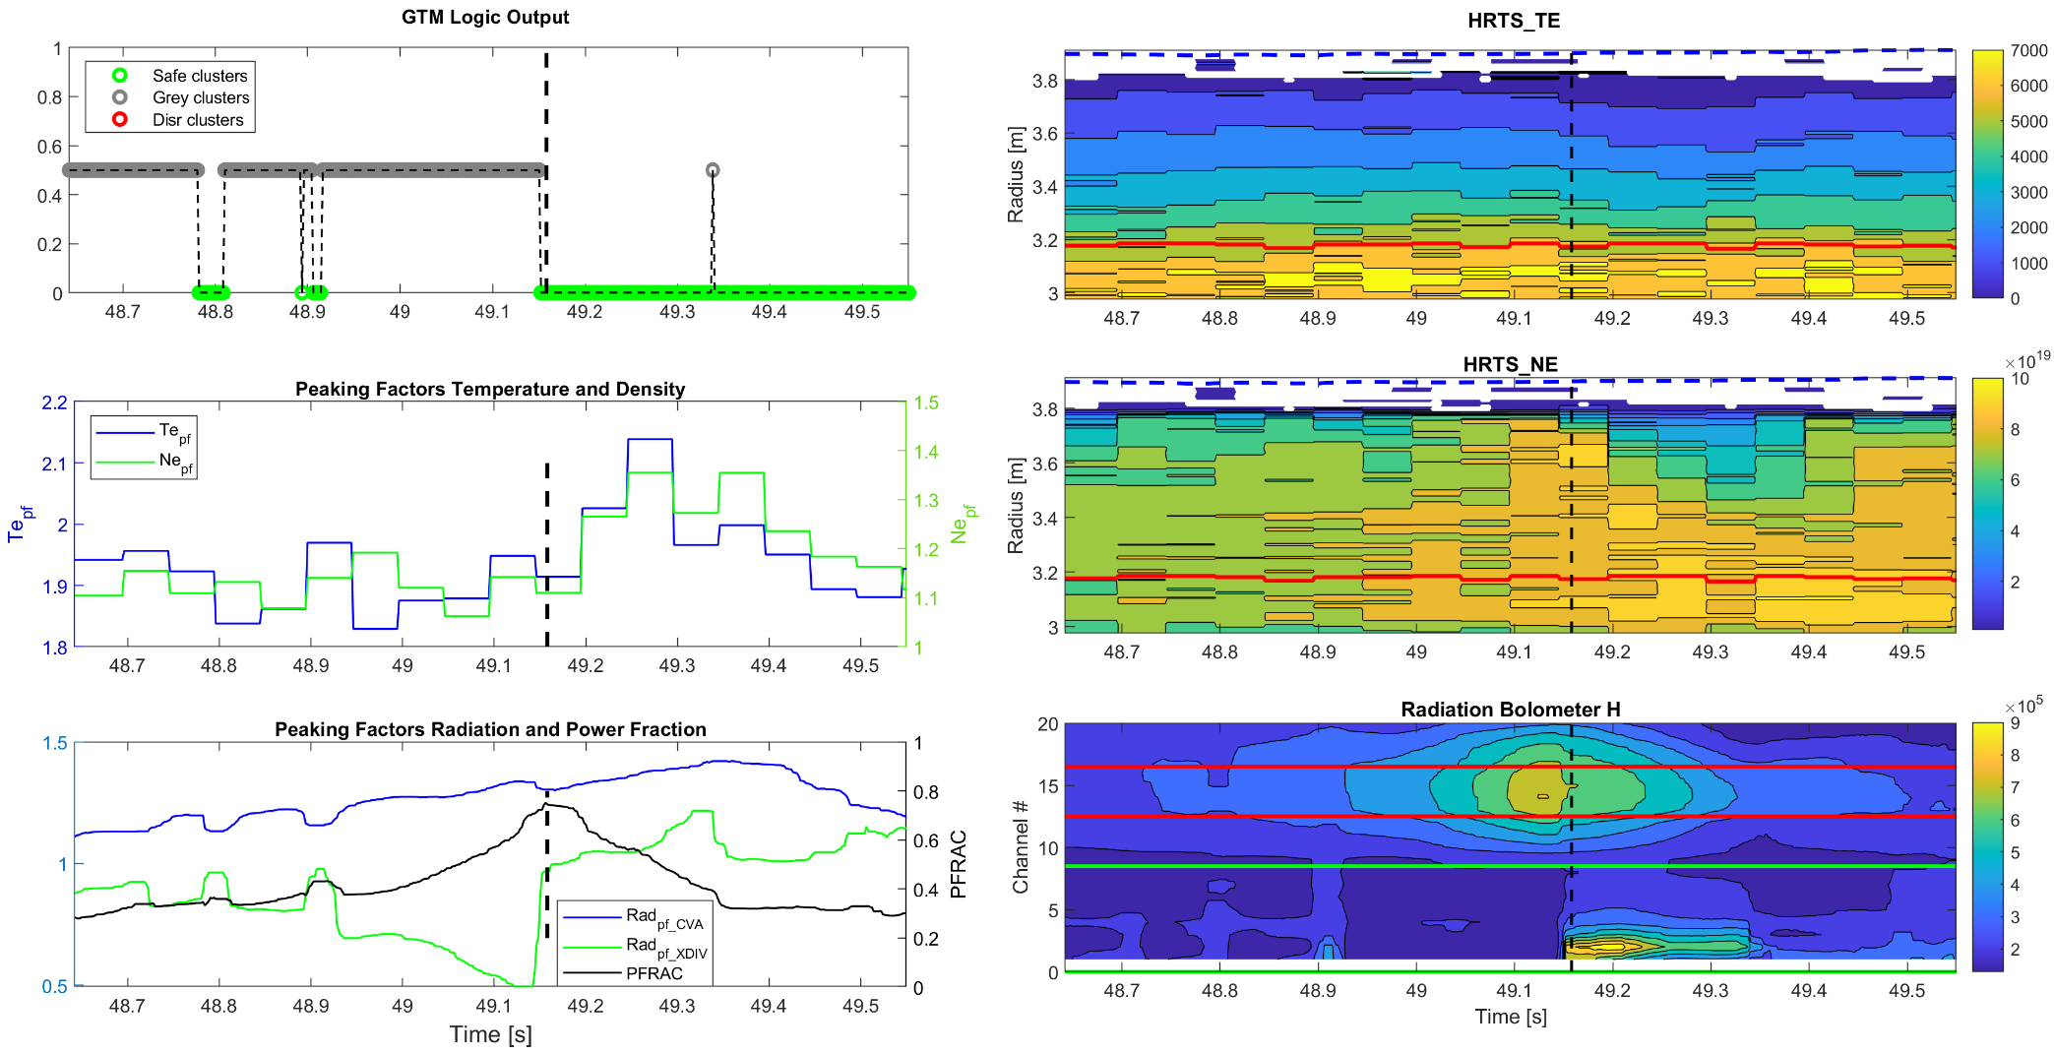
Example: Regularly terminated
#96744
Frad trip
Notes:
The last example is a regularly terminated shot, and we can see that the GTM's output never goes to 1, despite the presence of a blob of radiation in the centre and the flattening of the density profile around 49.15 seconds. The temperature profile over the whole flat top is instead regular.

Slide 12
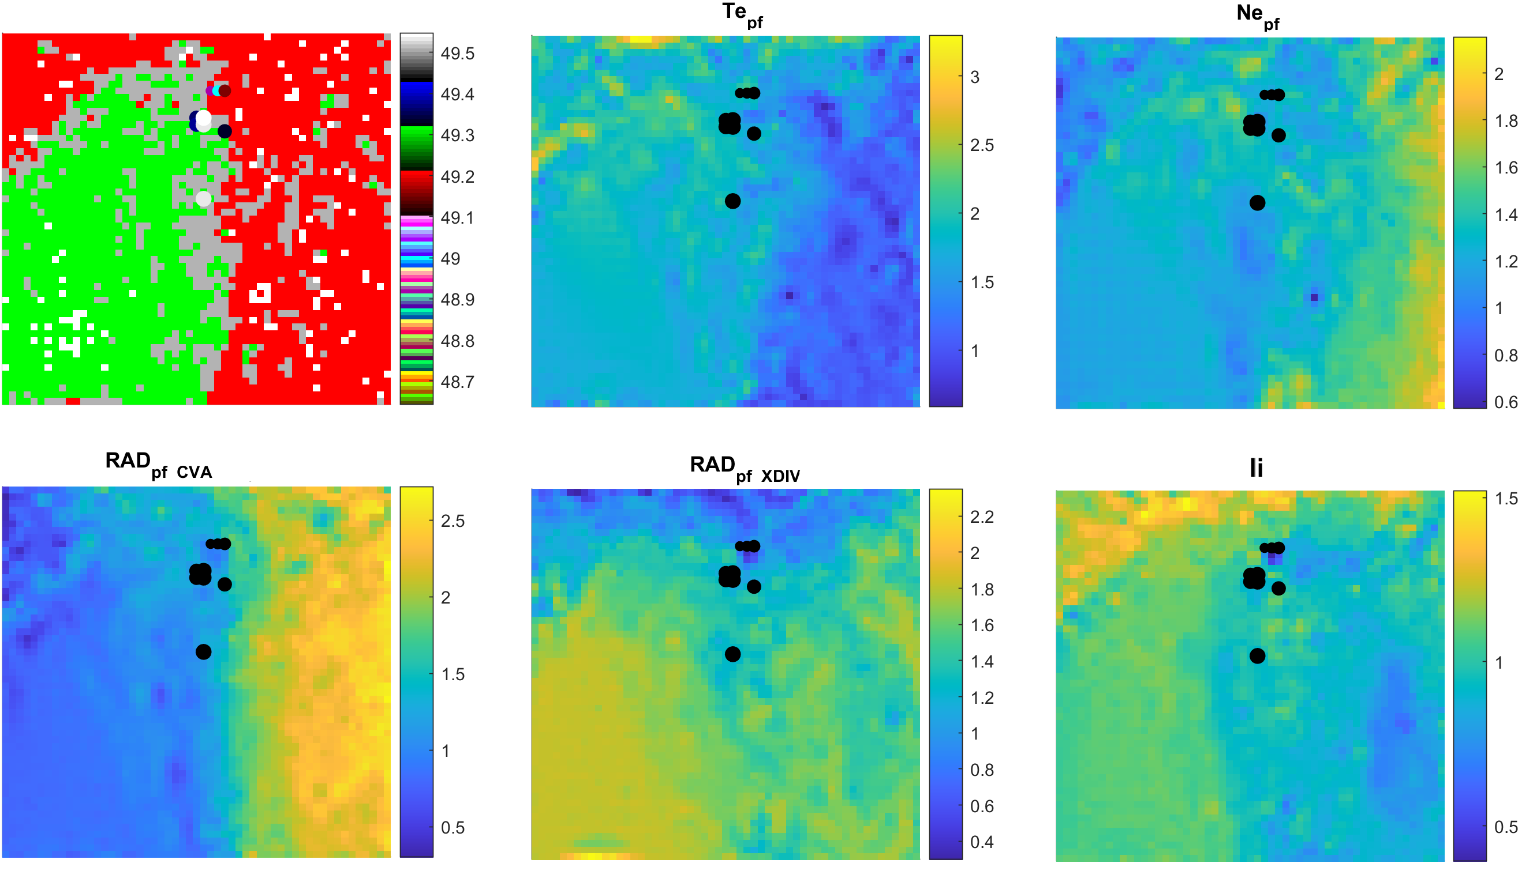
Example: Regularly terminated
#96744
Notes:
Looking at the map, we can see that the shot starts from grey clusters and then terminates in the green region.

Slide 13
Conclusions
The shift of the JET operational space affects the GTM input parameter space => performance decreases
In [2] we proposed an algorithm to automatically detect the reference times to train the GTM
We have experienced better performances with the automatically updated GTM, over a more recent set of discharges
Future Work
Implementing a strategy to continuously upgrade the GTM and to keep track of the input space evolution
[2]: E. Aymerich, A. Fanni, G. Sias, S. Carcangiu, B. Cannas, A. Murari, A. Pau, and the JET Contributors. “A statistical approach for the automatic identification of the start of the chain of events leading to the disruptions at JET”, EUROfusion Pinboard, submitted to Nucl. Fusion
Notes:
In conclusion, we have seen that the shift of the jet operational space affects the GTM input space, then we have the need to update the model to keep the performances high. In a submitted work we propose an algorithm to automatically identify the pre-disrupted phase of disruptions, hence automatically providing the reference times to train the GTM. With this algorithm, we updated the GTM and we demonstrated an improvement of the performances for a set of more recent baseline high-power discharges. and were also able to distinguish two different destabilizing mechanism as core and edge radiation.
In the future we plan to implement a strategy to continuously update the GTM, in order to keep track of the input space evolution

