Slide 1
On the Potential of Adaptive Predictors and their Transfer between Different Devices for both Mitigation and Prevention of Disruptions
Authors: M.Gelfusa, A.Murari, R.Rossi, M.Lungaroni, E.Peluso, G.Rattà, J.Vega, and Many Thanks to JET and AUG teams

Slide 2
Closed-World Learning
Traditional supervised Machine Learning is based on the closed-world assumption:
All the classes in the test and final applications must have been seen in the training (with suitable number of examples).
The systems under study must be stationary. The i.i.d. assumption (data independent and identically distributed) means that the results are valid only if the pdf of the data are the same for the training set, the test set and the final application.
Large amounts of data required for the training, obsolescence etc
600 × 379Images may be subject to copyright. Find out more

Slide 3
Open-World Machine Learning
Motivations for open-world learning:
Plasmas are not necessarily stationary physical objects (adaptive learning).
It would be advantageous to transfer knowledge from one device to another (transfer learning).
In Tokamaks there are two main historical effects which violate the stationarity assumption: a) Evolution of the experimental programme between discharges b) Memory effects during shots.
Transfer Learning could be very important particularly at the beginning of operation of new devices.

Slide 4
Adaptive/Transfer Learning
The most powerful approach for learning in non stationary conditions is adaptive learning: predictors are updated when appropriate to track the evolution of the phenomena to be predicted. Two main types of adaptation have been implemented to reflect the different time scales involved during and between discharges.
a) Updates of the training sets and modification of the decision functions between discharges
b) Trajectory learning during discharges.

Slide 5
Outline
Overview of Ensemble Classifiers
Strategies of Adaptive Learning for prediction in non stationary conditions
Results for AUG (mitigation and prevention)
Transfer to JET (mitigation and prevention)
Conclusions and future lines of investigation

Slide 6
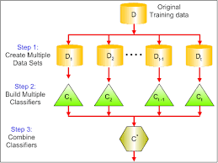
Weak Learning and Ensembles of classifiers
Many classifiers are not very stable; small changes in the training set can result in major differences in the final trees and therefore in the final classification.
A 'weak' learner (either classifier or predictor) is just a machine learning tool, which might not have excellent performance but is computationally not too demanding.
The relatively limited computational resources required allow training various versions of such weak learners which can then be pooled together to create a "strong" ensemble classifier.
The trick is to increase diversity by training with slightly different sets.
The basic classifiers used as weak learners are CART trees.

Slide 7
Outline
Overview of Ensemble Classifiers
Strategies of Adaptive Learning for prediction in non stationary conditions
Results for AUG (mitigation and prevention)
Transfer to JET (mitigation and prevention)
Conclusions and future lines of investigation

Slide 8
Between discharges: updating the Training Set
The training set is updated according to two different criteria.
When there is a error in the prediction (for example a missed or a tardy alarm).
To implement de-learning: old examples are discarded when they become obsolete and therefore misleading.

Slide 9
Between discharges: updating the decision function
The ensembles are pooled and the final output is obtained with a decision function.
Various decision functions are run in parallel and the one with the best results so far is used to generate the alarm.
At this stage one can optimise de-learning, the rejection of old and therefore misleading examples.

Slide 10
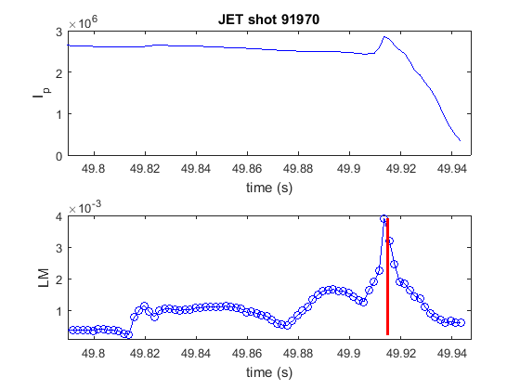
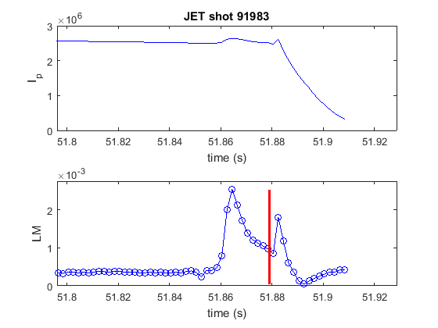
During a disxcharge: trajectory learning
In trajectory learning, the training sets contains the history of the data (sequence of samples) so that the predictors can learn the system trajectory in the feature space.
Statistically, the trajectory of the ML amplitude can be different
depending on the shot.

Slide 11
Outline
Overview of Ensemble Classifiers
Strategies of Adaptive Learning for prediction in non stationary conditions
Results for AUG (mitigation and prevention)
Transfer to JET (mitigation and prevention)
Conclusions and future lines of investigation

Slide 12
Features and time rescaling
For mitigation the inputs used are: normalised locked mode amplitude (and its std deviation), internal inductance.
For prevention a profile factor of bolometry has been added: ratio of divertor versus core lines of sight.
Features are dimensionless or normalized: no need to modify them
For mitigation a time dilation of a factor of 4 has has been derived “a priori” by heuristic comparison of the two machine electromagnetic circuits (from 1.5 to 6 ms).
For prevention a time dilation of a factor of 100 has been derived by observing the dynamics of impurity transport of the two devices (from 10 to 1000 ms).

Slide 13
Database AUG and settings
The AUG database analysed comprises 154 disruptive and 535 safe discharges. The interval of discharges ranges of from shot 28007 to shot 30585 (from 2012 to 2014).
The signals have been resampled at 0.1 ms time resolution and all the time slices with plasma current higher than 300 kA have been analysed.
The scan of plasma currents covers the interval from 300 kA to about 1.2 MA.
With regard to the criteria to calculate the statistics of the results, the alarms triggered less than 1 ms from the beginning of the current quench are considered tardy. An alarm is considered early if it is launched more than 1 s before the beginning of the current quench.

Slide 14
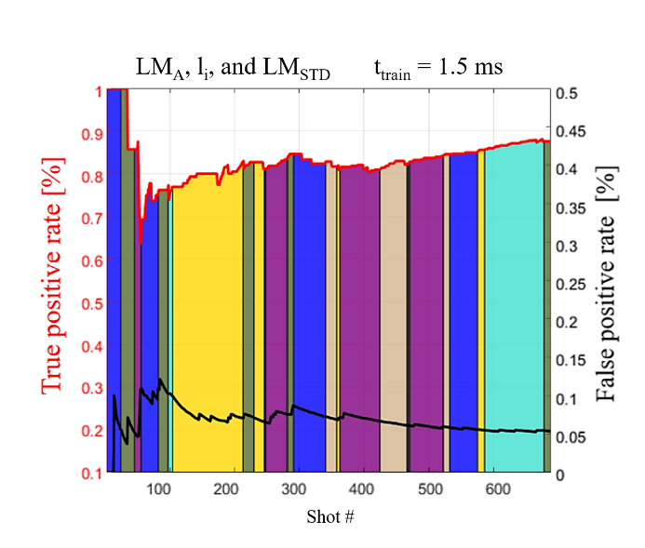
Results on AUG for mitigation
Different colours indicate different decision functions.
LM_{A} normalised locked mode amplitude, LM_{STD} locked mode std deviation, li internal inductance
AUG | Success rate | Missed | Early | Tardy | False | Mean [ms]
LM_{A}, LM_{STD} li | 87.66% (135/154) | 5.84% (9/154) | 5.84% (9/154) | 0.65% (1/154) | 5.70% (31/538) | 22.30

Slide 15
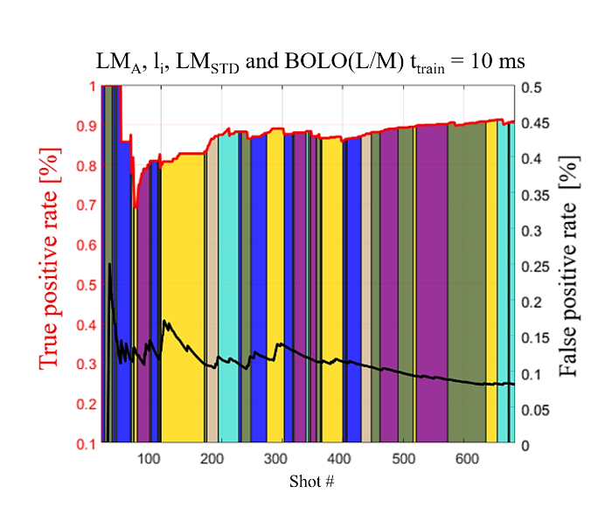
Results on AUG for prevention
Different colours indicate different decision functions.
LM_{A} normalised locked mode amplitude, LM_{STD} locked mode std deviation, li internal inductance, BOLO profile indicator
AUG | Success rate | Missed | Early |  | Tardy | False | Mean [ms]
LM_{A} LM_{STD} Bolo L/M | 90.73% (137/154) | 5.84% (9/154) |  | 3.31% (5/154) | 0.00% (0/154) | 8.16% (44/539) | 43.10

Slide 16
Database JET with the ILW wall and settings
The DB analyzed covers campaigns C28-C32 (430 disruptions and 1998 safe shots) with 1 ms time resolution and all time slices with Ip > 750 kA.
Tardy alarms: if the alarm is triggered less than 10 ms from the beginning of the current quench.
Early alarms: triggered more than 3 s from the beginning of the current quench.
The first model is obtained after the first disruption (from scratch). No selection on the discharges.
No modification of the AUG predictor when transferred to JET: all the parameters of the predictors have been rescaled in time according to the criteria previously described.
A.Murari et al Adaptive learning for disruption prediction in non-stationary conditions Nuclear Fusion, July 2019, Volume 59, Number 8

Slide 17
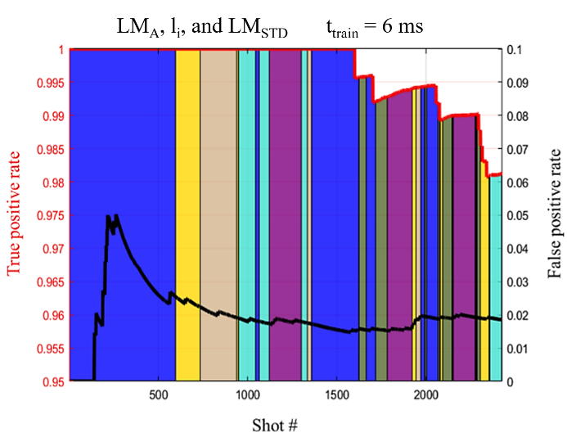
Results on JET for mitigation
AUG predictors have been applied directly to JET shots without any manipulation (except the time translation)
Different colours indicate different decision functions.
LM_{A} normalised locked mode amplitude, LM_{STD} locked mode std deviation, li internal inductance
JET | Success rate | Missed | Early | Tardy | False | Mean [ms]
LM_{A}, LM_{STD} , li | 98.14% (421/429) | 1.4% (6/429) | 0% (0/429) | 0.47% (2/429) | 1.9% (38/1998) | 278.3

Slide 18
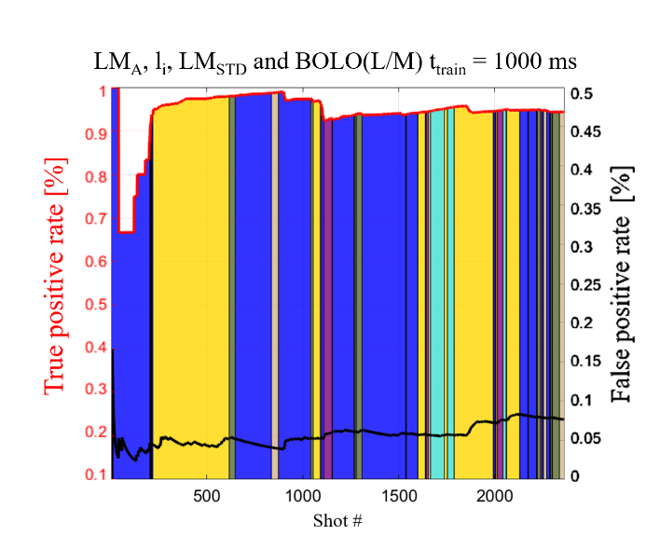
Results on JET for prevention
Different colours indicate different decision functions.
LM_{A} normalised locked mode amplitude, LM_{STD} locked mode std deviation, li internal inductance, BOLO profile indicator
JET | Success rate | Missed | Early | Tardy | False | Mean [ms]
LM_{A}, LM_{STD}, li ,Bolo | 94.17% (404/429) | 1.63% (7/429) | 3.73% (16/429) | 0.47% (2/429) | 7.69% (150/1951) | 489.7

Slide 19
Conclusions
Adaptive and Transfer Learning are becoming important tasks in Tokamak physics, particularly for disruption prediction.
The innovative approach of CART Ensembles has proved to be sufficiently flexible to implement complex strategies of adaptive learning and the first example of transfer learning.
The developed techniques of adaptive/transfer learning have been quite successful in predicting disruptions on JET at the beginning of operation with the new ITER Like Wall after training on AUG.
The adaptive/transfer learning approach is a good fall-back solution for ITER given the great variations in its operational scenarios
In the future we intend to apply the same techniques of adaptive learning from scratch and transfer learning to the identification of the disruption types as prerequisite to predicting the time to disruption.

Slide 20
Thanks for Your Attention!
Questions?

