Slide 1
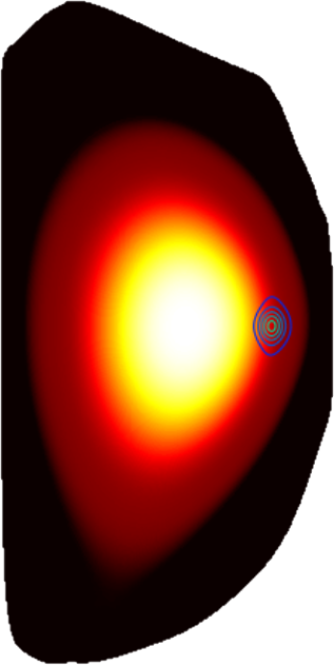
MHD modeling of dispersive shell-pellet injection (DSP) for disruption-mitigation in DIII-D
V.A. Izzo, Fiat Lux
IAEA Technical Meeting on Plasma Disruptions and their Mitigation
20-23 July 2020
Acknowledgements: E. M. Hollmann, P. B. Parks, D. Shiraki, N. Alexander, N.W. Eidietis, C. J. Lasnier, R. A. Moyer, C.C. Kim, E. Nardon

Slide 2
The DSP Concept for Disruption Mitigation*
Thin low-Z shell (diamond)
Pre-Thermal Quench
Thermal Quench
(don’t perturb edge flux surfaces, reduce conduction to divertor)
(inward heat flux, high radiation fraction, assimilation)
T_{e}
T_{e}
shell ablates in edge
Payload disperses in core
Dispersive payload (boron dust)
r/a
r/a
*P. B. Parks, “METHODS AND APPARATUS FOR DISRUPTION MITIGATION IN FUSION DEVICES,” U.S. Patent Application Attorney Docket No.: 074915-8030.US00

Slide 3
Overview of NIMROD MHD+Radiation+RE Model
Single fluid MHD: Single temperature (one energy equation, instantaneous dilution cooling due to added impurities) Single velocity (one momentum equation, all species are advected together) | Free boundary, ideal wall simulation: Simulations boundary is outside the separatrix, open flux region is included Simulation boundary is perfectly conducting
Multiple ion species/charge states: Deuterium ions plus two impurity ion species: C and Be with all charge states of each impurity tracked separately (1+7+5 = 13 continuity equations). Electron density from quasi-neutrality. Ionization, recombination and radiation calculated for each species | Drift orbits calculated for RE test particles: Three equations in real space plus two in velocity space, includes E-field acceleration, slowing due to small angle collisions, synchrotron, and bremmstrahlung radiation Test particles have no feedback on the MHD equations

Slide 4
Overview of NIMROD MHD+Radiation+RE Model
Single fluid MHD: Single temperature (one energy equation, instantaneous dilution cooling due to added impurities) Single velocity (one momentum equation, all species are advected together) | Free boundary, ideal wall simulation: Simulations boundary is outside the separatrix, open flux region is included Simulation boundary is perfectly conducting
Multiple ion species/charge states: Deuterium ions plus two impurity ion species: C and Be with all charge states of each impurity tracked separately (1+7+5 = 13 continuity equations). Electron density from quasi-neutrality. Ionization, recombination and radiation calculated for each species | Drift orbits calculated for RE test particles: Three equations in real space plus two in velocity space, includes E-field acceleration, slowing due to small angle collisions, synchrotron, and bremmstrahlung radiation Test particles have no feedback on the MHD equations

Slide 5
Overview of NIMROD MHD+Radiation+RE Model
Single fluid MHD: Single temperature (one energy equation, instantaneous dilution cooling due to added impurities) Single velocity (one momentum equation, all species are advected together) | Free boundary, ideal wall simulation: Simulations boundary is outside the separatrix, open flux region is included Simulation boundary is perfectly conducting
Multiple ion species/charge states: Deuterium ions plus two impurity ion species: C and Be with all charge states of each impurity tracked separately (1+7+5 = 13 continuity equations). Electron density from quasi-neutrality. Ionization, recombination and radiation calculated for each species | Drift orbits calculated for RE test particles: Three equations in real space plus two in velocity space, includes E-field acceleration, slowing due to small angle collisions, synchrotron, and bremmstrahlung radiation Test particles have no feedback on the MHD equations

Slide 6
Overview of NIMROD MHD+Radiation+RE Model
Single fluid MHD: Single temperature (one energy equation, instantaneous dilution cooling due to added impurities) Single velocity (one momentum equation, all species are advected together) | Free boundary, ideal wall simulation: Simulations boundary is outside the separatrix, open flux region is included Simulation boundary is perfectly conducting
Multiple ion species/charge states: Deuterium ions plus two impurity ion species: C and Be with all charge states of each impurity tracked separately (1+7+5 = 13 continuity equations). Electron density from quasi-neutrality. Ionization, recombination and radiation calculated for each species | Drift orbits calculated for RE test particles: Three equations in real space plus two in velocity space, includes E-field acceleration, slowing due to small angle collisions, synchrotron, and bremmstrahlung radiation Test particles have no feedback on the MHD equations

Slide 7
Outline
Part I: Phenomenology of an inside out TQ
→ Simulation results with constant shell ablation rate, near-axis payload delivery
Part II: Results with plasma parameter dependent ablation rates
→ Single and dual shell pellet injection simulations

Slide 8
Constant source rate model for shell & payload
1.0
r/a
0.2
0.0
Toroidally and poloidally localized source of neutral impurities propagates along outer midplane from edge to core
N_{payload} = 1.17x10²¹ atoms Be
(= 100% DIII-D B payload quantity)
Be Payload delivery rate (1/s) = N_{payload}v_{pellet}/(0.2a)
C Shell delivery rate (1/s) = N_{shell}v_{pellet}/(0.8a)
N_{shell} = 7.525x10¹⁹ atoms C
(= 25% of DIII-D nominal quantity)
time

Slide 9
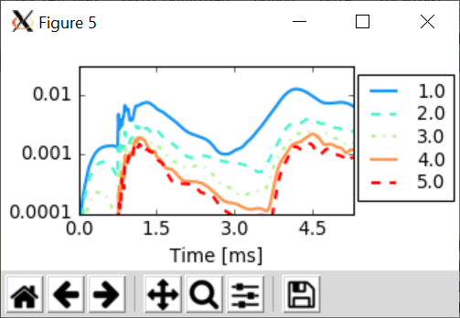
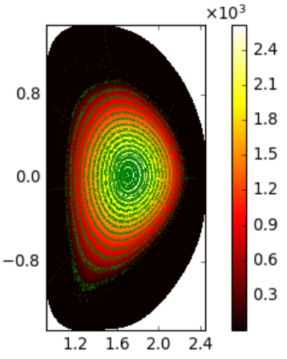
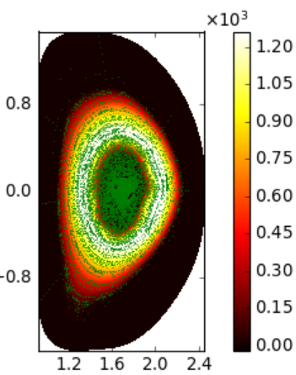
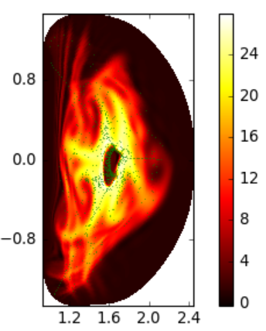
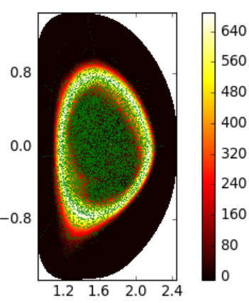
Constant shell ablation simulations: phenomenology of an inside-out TQ
δB/B
W_{Th} [MJ]
0.72 ms
0.96 ms
1.40 ms
4.75 ms

Slide 10
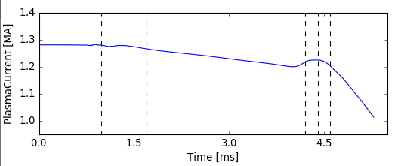
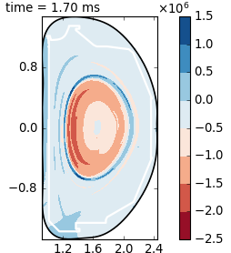
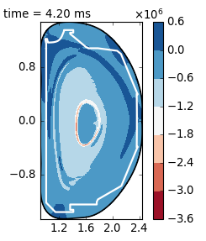
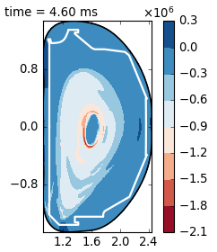
Current profile evolution during I_{p} spike
*“Negative voltage spike in tokamak disruptions”
J.A. Wesson et al (1990) Nucl. Fusion 30 1011
Current spike is associated with disappearance of reversed current regions after “flux trapping” in still warm plasma

Slide 11
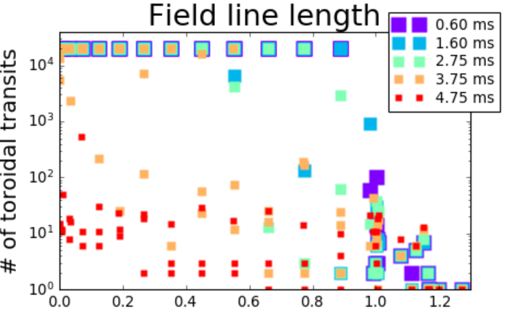
RE confinement time drops to ~μs
RE test particle losses vs. time
~ms confinement (at speed of light)
Fastest rate of RE losses is just prior to current spike
~μs confinement (at speed of light)
ψ_{N} (eq)

Slide 12
100% RE loss is not typical for DIII-D rapid shutdown simulations
Simulations with uniform or edge-localized impurity delivery in DIII-D typically retain some fraction of RE test particles after flux surfaces re-heal at end of TQ

Slide 13
Summary of Part I
Inside out TQ characterized by rapid loss of core thermal energy followed by slow drop in edge T_{e}
Ring of reversed current forms outside of current channel and expands outward
Destabilization and loss of reversed current ring at end of TQ produces current spike, large magnetic fluctuations, and very rapid loss of remaining RE population

Slide 14
Outline
Part I: Phenomenology of an inside out TQ
→ Simulation results with constant shell ablation rate, near-axis payload delivery
Part II: Preliminary results with plasma parameter dependent ablation rates
→ Dual shell pellet injection simulations

Slide 15
Shell pellet ablation model
Temperature and density dependent shell ablation given as:
dN/dt (atoms/s) = C_{abl} T^{5/3} n^{1/3 *}
r_{p} (pellet radius) dependence neglected due to thin shell, payload delivery triggered by total ablated quantity threshold
Coefficient is presently a free parameter: With T in eV, n in cm⁻³, C_{abl}=1.2x10¹³ chosen for payload delivery near axis @ 200 m/s
NGS* (H pellet) with M_{i}=12, r_{p}=0.36cm gives C_{abl}=1.25x10¹⁵
*P. B. Parks, and R. J. Turnbull, The Physics of Fluids 21, 1735 (1978); doi: 10.1063/1.862088

Slide 16
Two simultaneous shell pellets separated by 180° are launched with 5% difference in velocity
 | Pellet 1 | Pellet 2
φ (deg) | 0 | 180
V (m/s) | 420 | 400
N_{shell} | 50% | 50%
N_{payload} | 50% | 50%
Q. Will payload release of the faster pellet prevent payload release of the slower pellet?

Slide 17
Two simultaneous shell pellets separated by 180° are launched with 5% difference in velocity
 | Pellet 1 | Pellet 2
φ (deg) | 0 | 180
V (m/s) | 400 | 420
N_{shell} | 50% | 50%
N_{payload} | 50% | 50%
t_{payload} (ms) | 1.09 | 1.21
Q. Will payload release of the faster pellet prevent payload release of the slower pellet?
A. The slower pellet released its payload first!

Slide 18
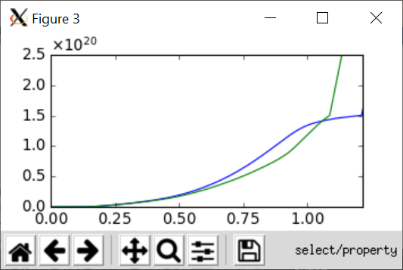
Sudden increase of slow pellet ablation rate corresponding to growth of unstable MHD
Total ablated material from each pellet (# atoms)
Faster Pellet
Slower Pellet
Time [ms]

Slide 19
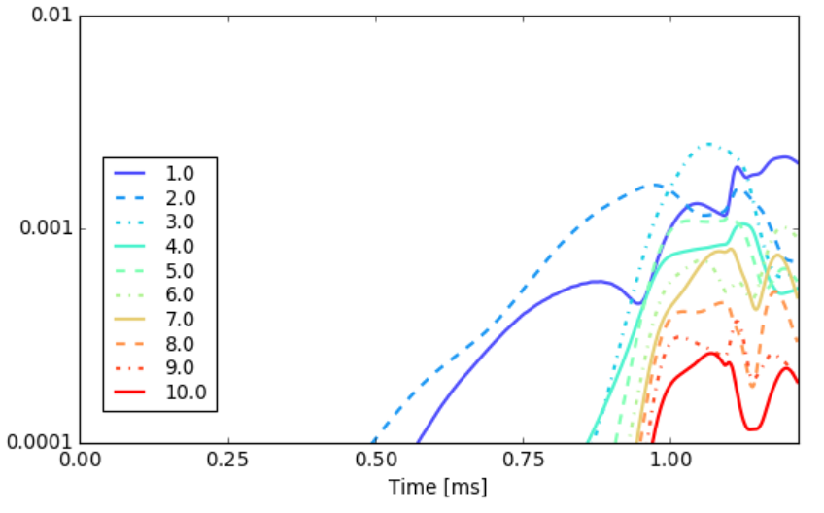
Increase of slow pellet ablation rate corresponding to growth of unstable MHD
δB/B

Slide 20
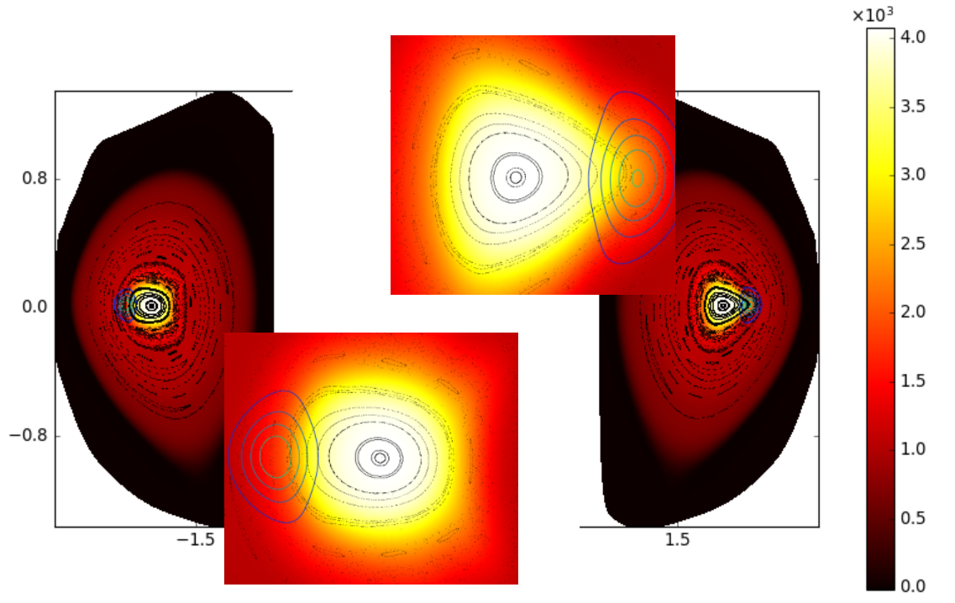
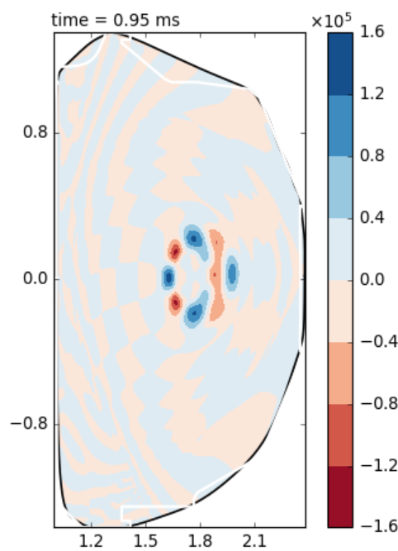
Unstable modes distort/shift hot core away from faster pellet toward slower pellet
Time = 0.95 ms
φ=180°
Slower Pellet
φ=0°
n=3
Faster Pellet
Temperature (eV)

Slide 21
Consistent with observations of 1/1 phase in MGI simulations
From IAEA 2014 presentation on MGI simulations
General finding from MGI simulations with NIMROD was that core modes triggered by gas jets tend to be phased such that they push hot core away from injected gas

Slide 22
Summary of Part II & Conclusion
In dual DSP simulation, both payloads are delivered
Interaction between two simultaneous shell pellets could be mediated by MHD triggered by shell material
DSP simulations show : radiation of core thermal energy while maintaining edge confinement , fast loss of REs at end of TQ, potential for multiple DSPs

