Slide 1
NSTX-U
Supported by
Alternate disruption mitigation methods for fast time response & core impurity deposition
College W&M
Colorado Sch Mines
Columbia U
Comp-X
General Atomics
INL
Johns Hopkins U
LANL
LLNL
Lodestar
MIT
Nova Photonics
New York U
Old Dominion U
ORNL
PPPL
PSI
Princeton U
Purdue U
SNL
Think Tank, Inc.
UC Davis
UC Irvine
UCLA
UCSD
U Colorado
U Maryland
U Rochester
U Washington
U Wisconsin
R. Raman¹, E.M. Hollmann², L.R. Baylor³,
R. Lunsford⁴, V.A. Izzo⁵, C. Clauser⁴
¹University of Washington, Seattle, WA, USA
²University of California San Diego, La Jolla, CA, USA
³Oak Ridge National Laboratory, Oak Ridge, TN, USA
⁴Princeton Plasma Physics Laboratory, Princeton, NJ, USA
⁵Fiat Lux, San Diego, CA, USA
Culham Sci Ctr
U St. Andrews
York U
Chubu U
Fukui U
Hiroshima U
Hyogo U
Kyoto U
Kyushu U
Kyushu Tokai U
NIFS
Niigata U
U Tokyo
JAEA
Hebrew U
Ioffe Inst
RRC Kurchatov Inst
TRINITI
KBSI
KAIST
POSTECH
ASIPP
ENEA, Frascati
CEA, Cadarache
IPP, Jülich
IPP, Garching
ASCR, Czech Rep
U Quebec
This work is supported by US DOE contract numbers
DE-SC0006757, DE-AC02-09CH11466, DE-AC05-00OR22725,
DE-FG02- 07ER54917, DE-FC02-04ER54698
IAEA Technical Meeting on Plasma Disruptions and their Mitigation
Saint-Paul-Lez-Durance, France
20—23 July 2020

Slide 2
It does this by injecting a radiative payload into the tokamak plasma to try to uniformly radiate the plasma stored energy to the vessel walls, while trying to satisfy the Thermal Quench (TQ) and Current Quench (TQ) requirements
Disruption Mitigation System (DMS) is the Final Line of Defense to Protect the Reactor Infrastructure
Outline
Time scales of relevance to disruption mitigation
Types of disruption mitigation systems
Systems alternate to Shattered Pellet Injection (SPI)
  - Shell Pellet
  - Two-stage gas gun
  - Electromagnetic Particle Injector (EPI)
Supporting MHD modeling work
Summary and conclusions

Slide 3
Some Limitations of Present DM Systems
SPI has been adopted by ITER as the baseline DMS
On DIII-D, some SPI fragments penetrate to the q=2 before or during the TQ
    - Becomes more challenging as q=2 surface moves farther away in larger devices with much more energetic plasma in between q=2 surface and plasma edge
Shattered pellet payload cannot be tuned to individual fragment size, rather a distributions of sizes with a range of velocities, including a pellet vaporized gas load is injected
    Computer codes need to model this process for reliable projection to ITER

Slide 4
Time Scales of Relevance to Disruption Mitigation
Warning time for an impending disruption (could be < 20ms for some disruptions)
  To ensure the TQ can be controlled (& avoid uncontrolled disruption)
  Faster DMS response time provides increased safety factor
Thermal Quench duration (< 5 ms in ITER)
  High velocity would permit material propagation to core before TQ is over
  Modelers should better quantify this time
  Synchronization of multiple systems < TQ duration
Overall system response time
  Determines arrival time of payload at the plasma boundary (should be < Warning time)
Payload symmetrization time around torus
  To reduce toroidal peaking of radiated power (multiple systems)
  Core deposition may be desirable
Current quench duration & Suppression of Runaway current generation
  - May be influenced by amount assimilated and by core vs edge deposition

Slide 5

Edge vs Core DMS
Penetration Depth Big Issue for ITER & Requires High Velocity
Edge material injection systems
  Small fragment size results in too much ablation of injected material outside the q=2 surface, which initiates an Outside to Inside thermal collapse, and is largely controlled by the resulting MHD that causes impurity mixing
    Massive Gas Injection (MGI)
    Inductive Li injection using flyer plate (Glenn Wurden)
    Nano-particle injection (Far Tech)
Core material injection systems
  Relatively large payload size coupled with high-velocity reduces payload surface area to volume permitting bulk of the injected material to be deposited inside the q=2 surface before a TQ is initiated
    Two-stage gas gun
    EPI
Intermediate systems
  SPI on DIII-D deposits some fragments inside q=2 surface

Slide 6
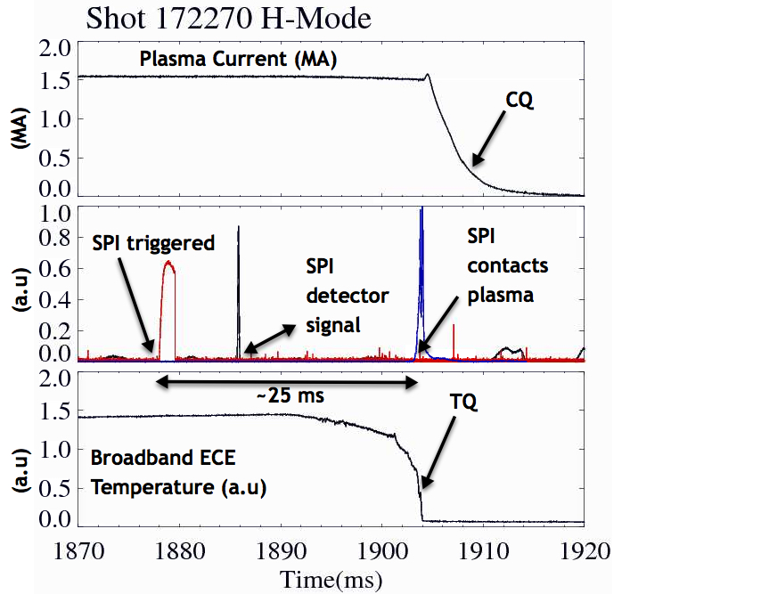

Overall Response Time of SPI on DIII-D is ~25 ms
R. Raman, et al., NF 60 (2020) 036014

Slide 7

Shell Pellet Concept
The DIII-D shell pellet concept uses a low-Z shell to protect a dispersive payload.
Goal is to get impurities into the core without current channel contraction and then cause a radiative collapse of the core.
  - To induce an inside-out TQ with low wall heat loads without the high-Z impurity deposition normally required to achieve >90% radiated fraction
Without using high-Z impurities, RE seeds will be reduced, as will be CQ induced current forces.
  - Provides more control over the core electron T_{e} at the end of the TQ
E.M. Hollmann, et al., “Demonstration of tokamak discharge shutdown with shell pellet payload impurity dispersal,” Phys. Rev. Lett. 122, 065001 (2019).

Slide 8
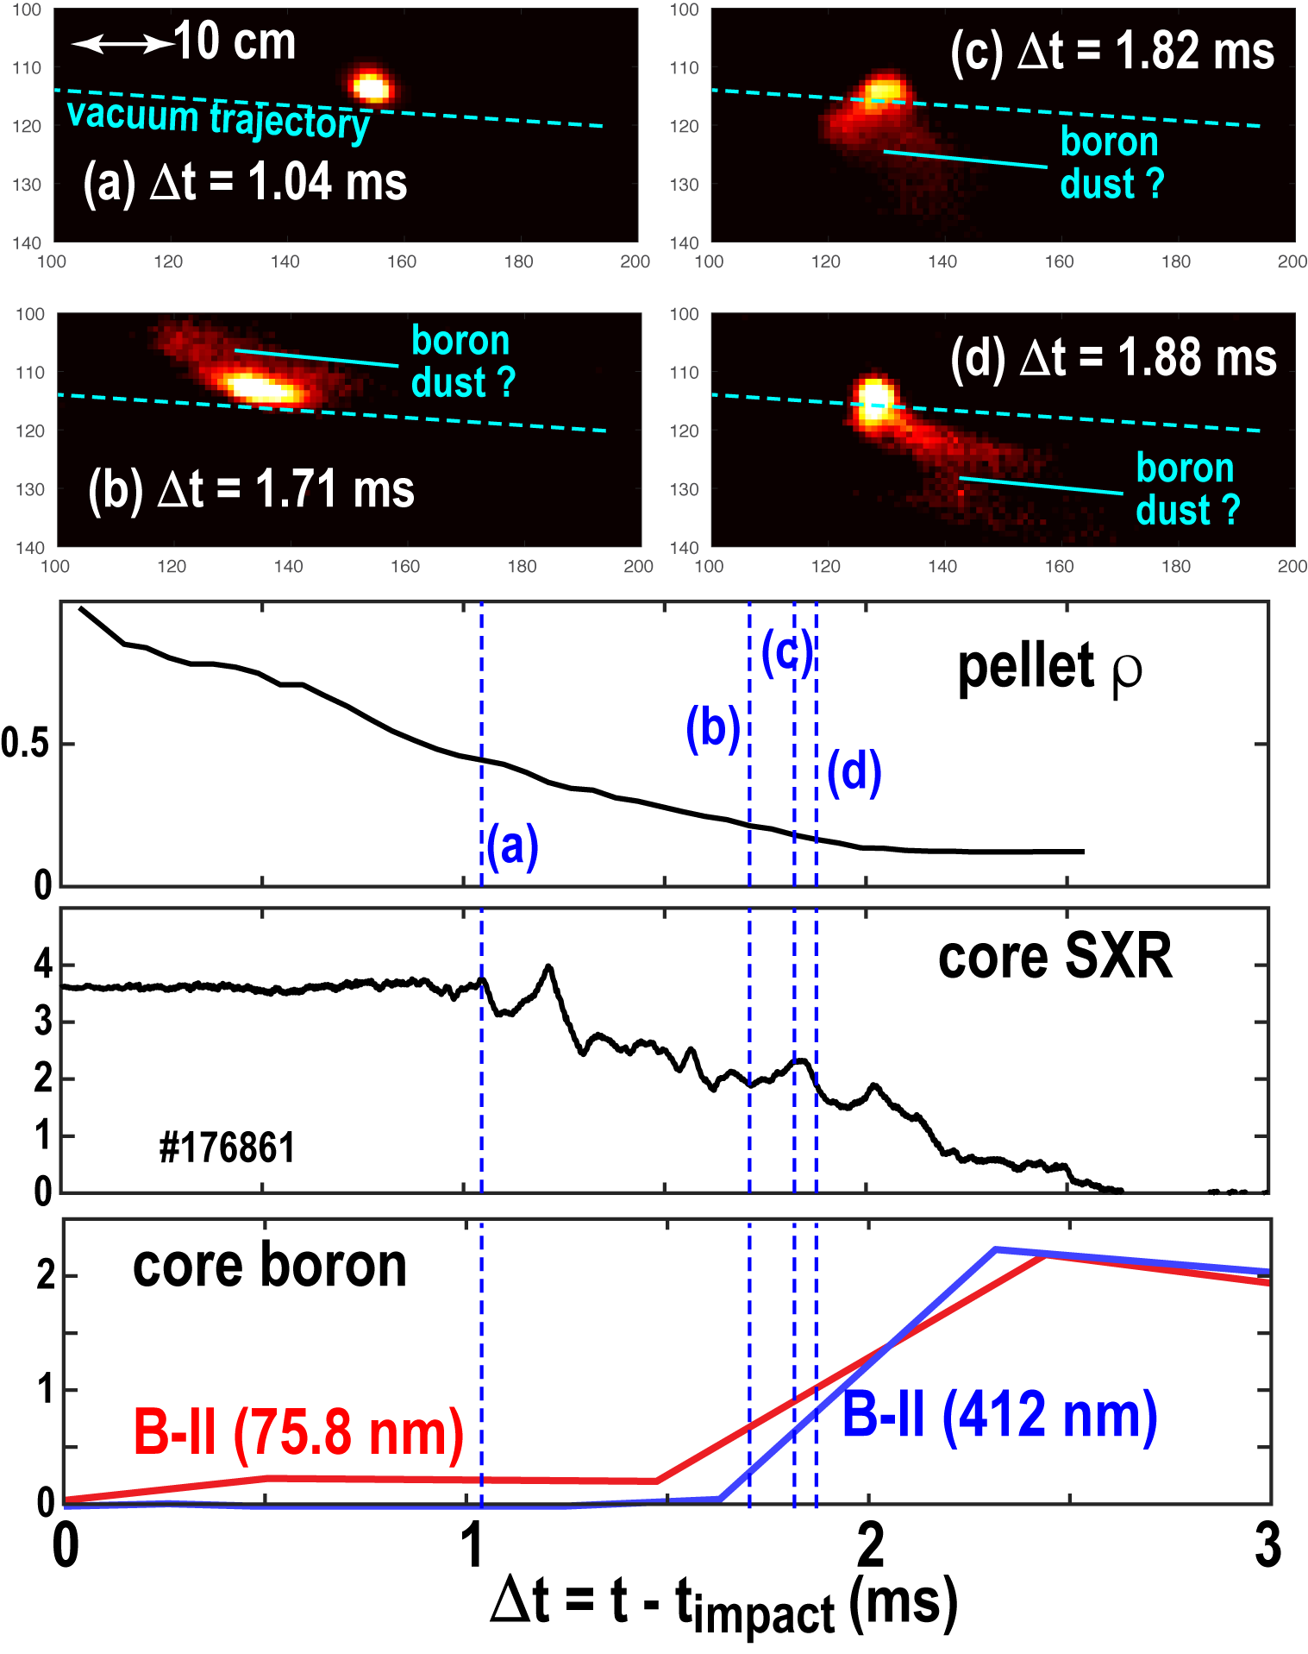
Demonstration of core payload deposition with Shell Pellet in DIII-D
Used OD = 3.6 mm, t = 40 μm diamond shells filled with boron dust.
See evidence for boron dust emission in core of plasma (ρ ~ 0.2).
See strong rise in core boron line emission at same time, consistent with boron deposition in core.

Slide 9
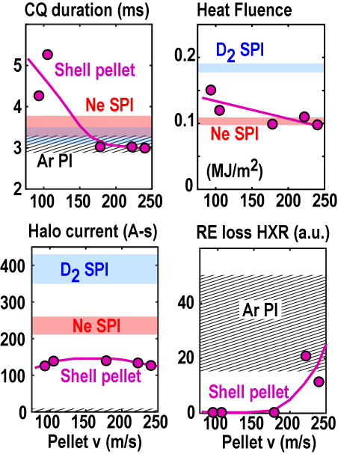
0D disruption metrics: shell pellets better than Ne SPI in some areas, worse in others
Significant variation in metrics depending on shell pellet velocity.
Goal is to achieve long CQ duration plus good heat flux mitigation.
For heat flux mitigation as good as Ne SPI, get slightly shorter CQ duration.
Halo currents lower than Ne SPI.
Do get some runaway seed formation for fast shell pellets.

Slide 10
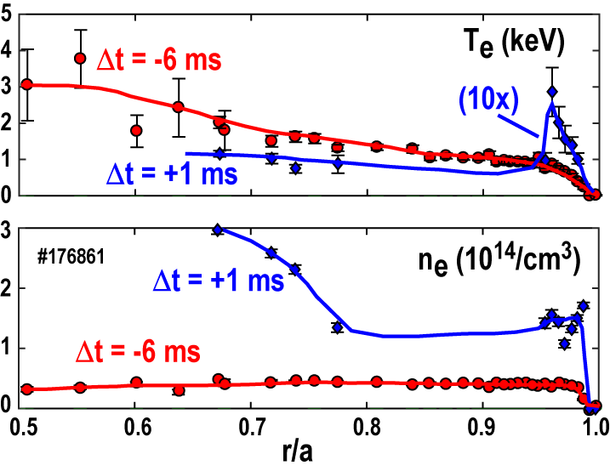
Preliminary indications seen of inside-out thermal quench
Want to achieve rapid core dispersion of payload to collapse core T_{e} faster than edge.
- Prevent shrinking current channel and large TQ MHD.
- Get inward conducted heat, rather than out toward wall.
Do see some preliminary evidence of hollow T_{e} profile during TQ in TS data.

Slide 11
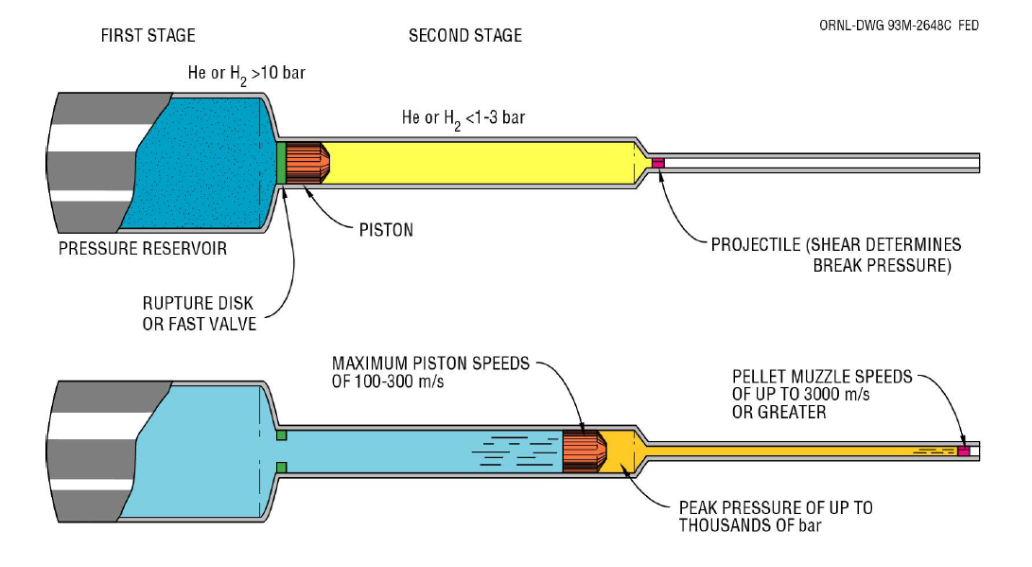

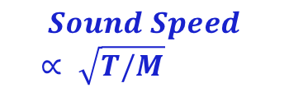
Ideal Two-Stage Gas Gun (Early Versions)
Speed of sound determines maximum rate at which gas can transmit pressure to projectile
$$Sound Speed ∝ \sqrt{T/M}$$
Heat low molecular weight gas to high Temperature by adiabatic compression

Slide 12
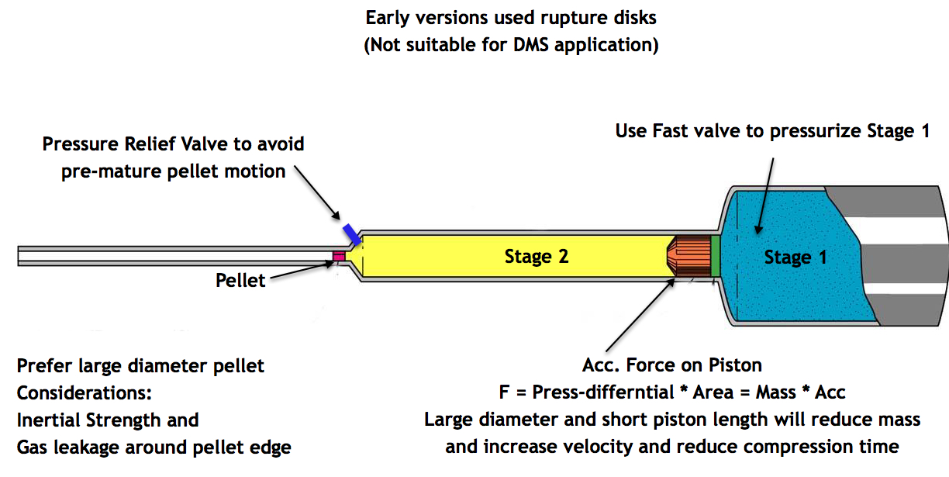
Two-Stage Gas Gun (recent improvements)

Slide 13
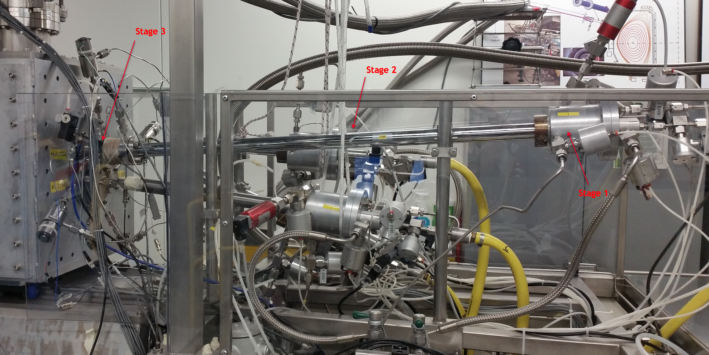

Existing EU-US collaboration on 2-Stage Gas Gun for Pellet Fueling has Accelerated 20 mg Pellet to 2.7 km/s
A. Frattolillo, et al., IEEE Transactions on Plasma Science, Vo. 46, No. 5, (2018) 1429

Slide 14
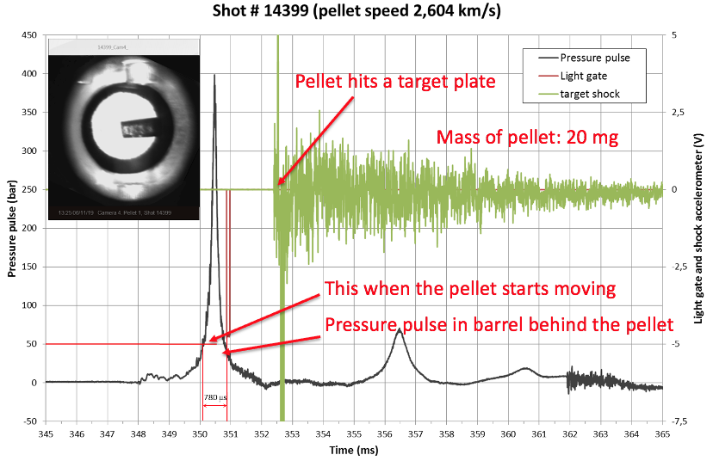
Recent Results with the ENEA/ORNL High-Speed D₂ Pellet Injector

Slide 15
Reducing the Time Required in order the Pellet can Reach the Plasma
The typical delay between the trigger of the firing NUPRO valve and the pressure pulse is about 25 ms; this delay may be reduced, with some improvement, to about 10 ms⁽¹⁾
Single stage SPI takes ~2-3ms to release the pellet
The pellet speed may be increased by more than a factor 2, thus reducing the time of flight (TOF) of the pellet toward the plasma⁽²⁾;
The TOF of a pellet travelling at 300 m/s inside a 7 m long guide tube is about 23 ms;
At a speed 2.5 times higher (750 m/s) the TOF is reduced to about 9 ms, with a gain of roughly 17 ms.
A more shallow shatter tube will be required for a 2-stage SPI
Implementation of sabot will extend usage to propel Shell Pellet
G. D'Elia et al. J. Vac. Sci. Technol. B 36(1), JanFeb 2018, 01A103-1-9
S.K. Combs et al. Rev. Sci. Instrum. 67 (3), March 1996, 837-839

Slide 16
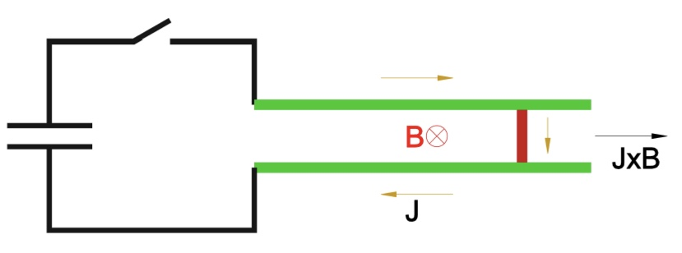
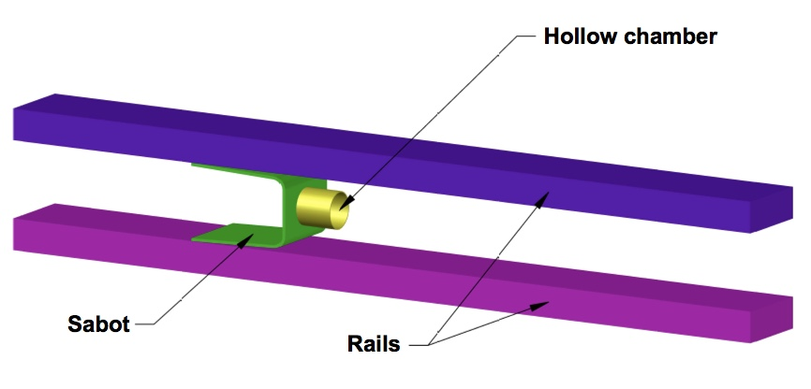
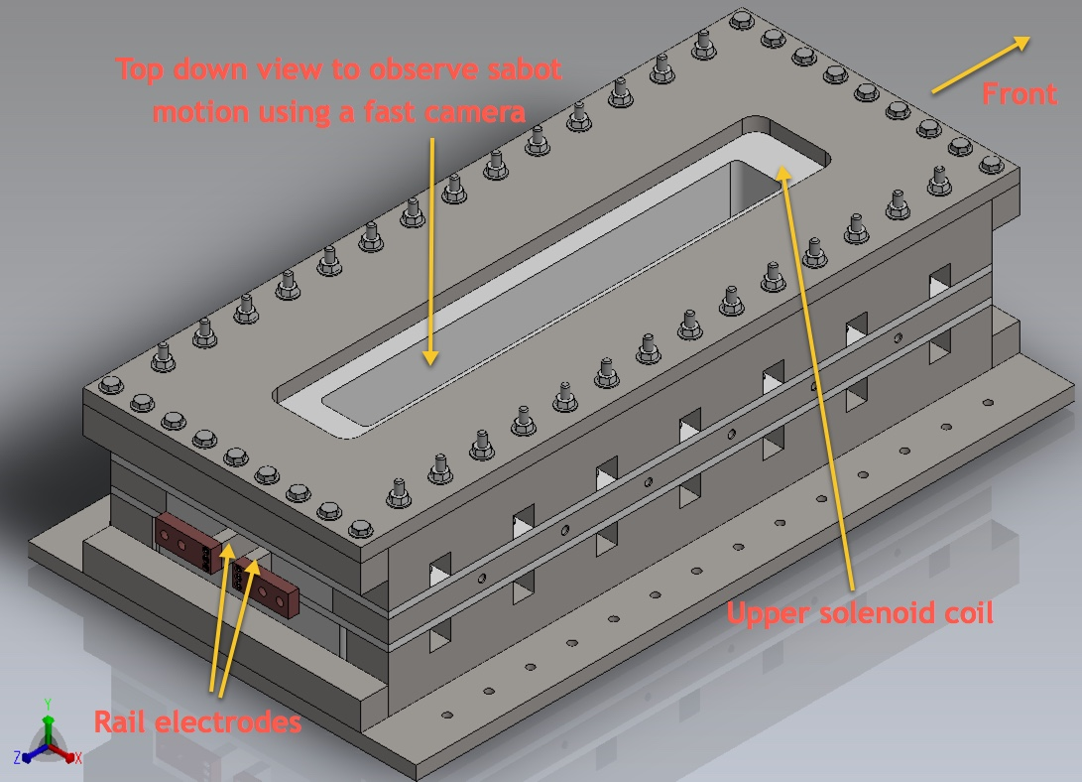
The EPI is a Rail Gun that uses an External Magnetic Field
Injector can be positioned very close to the vessel, to use ambient fields near a high-field tokamak to reduce overall response time to a few ms.
Can use high-field coils (>12T) if located outside port plug
At end of acceleration phase (~2ms), metallic sabot releases particles of known size and velocity, of any material, or a Shell Pellet

Slide 17
EPI has Fast Response Time (<10ms) & High Velocity (>1 km/s)
  Because EPI injects payload of known size and velocity, one can precisely calculate the needed parameters for penetrating to the center of any given plasma, including the ITER plasma
    - Can control shape and size of payload
    - Modeling and extrapolation to ITER should be more reliable
  EPI does not use plasma or gas for propulsion – only electromagnetic forces
  During acceleration, the highest force is not present at t=0, rather it can be made gradual through the use of a simple pulse forming network (control acceleration shape waveform)
    – Important for accelerating a Shell Pellet to avoid impact fracture
The present understanding (based on the theoretical work of Konavalov, et al., proceedings of the IAEA-FEC 2012 conference, ITR/P1-38) is that as little as 5g of Be may be adequate for both thermal quench and runaway electron mitigation in ITER. This radiative payload must be deposited sufficiently deep inside the plasma

Slide 18
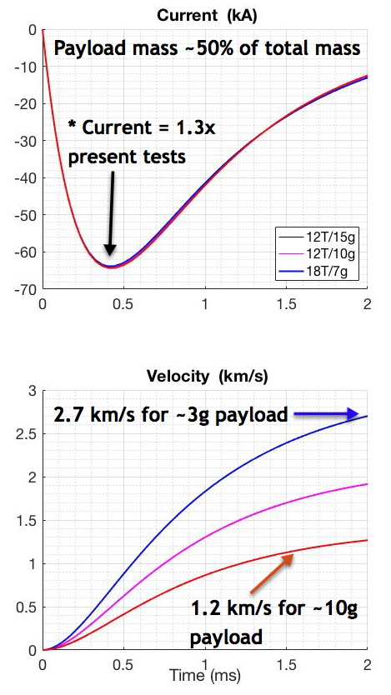
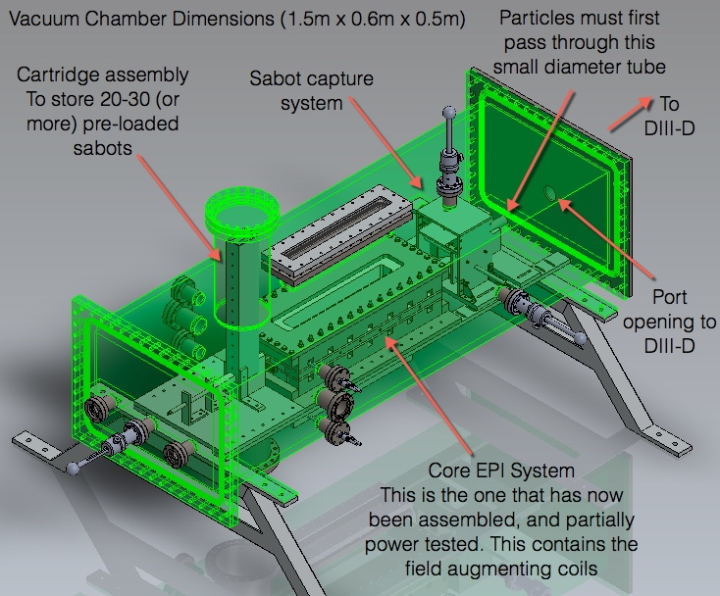
ITER Scale Injector Predicted to Attain >1 km/s in ~1 ms
Configuration for a near-term tokamak test
* R. Raman, et al., Nucl. Fusion 59 (2019) 016021

Slide 19
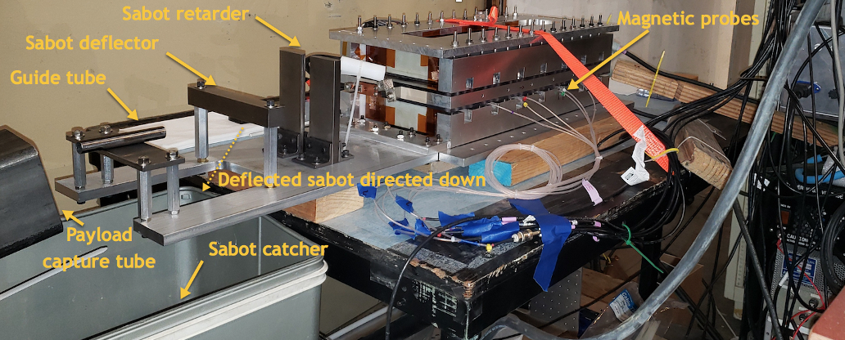
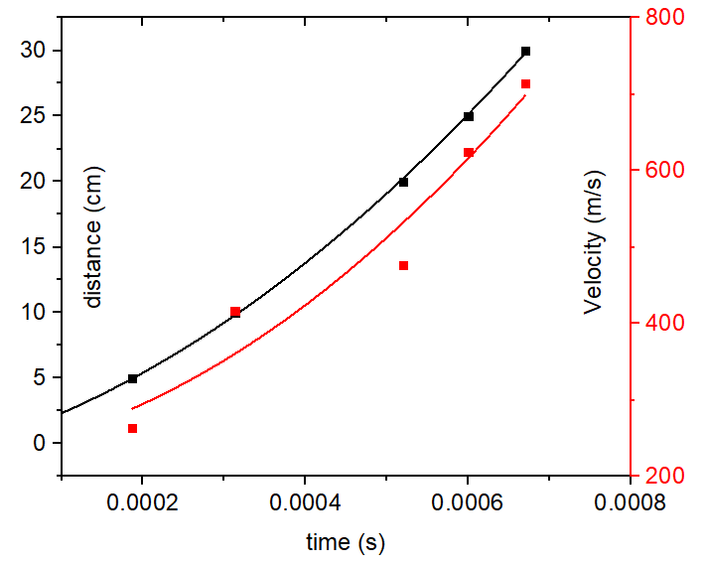
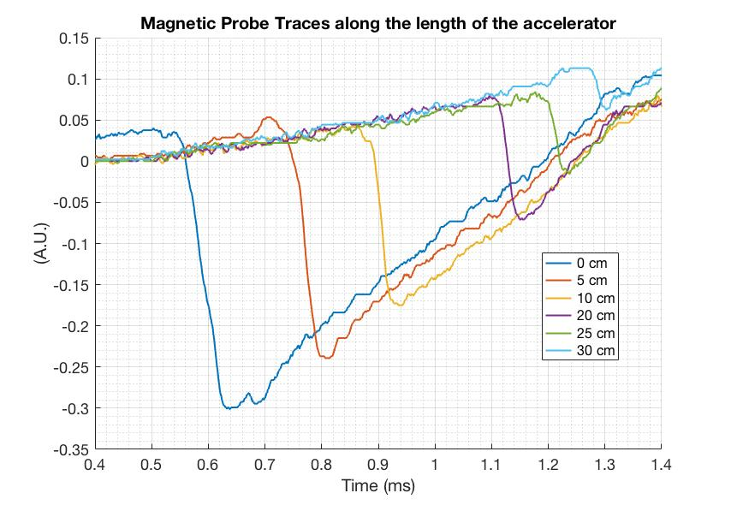
Present EPI-2 Test Assembly with Boost Coils Capable of reaching >0.5km/s in 1ms
With 3T boost coil and at 1kV, sabot capture and payload separation demonstrated at >200m/s
Sabot capture is based on concept used on SSPX at LLNL* and can be extended to >2km/s
All materials in an ITER-EPI would consist of materials allowed in ITER
  - Tungsten rails
  - Be sabots
  - Vespel insulators
  - Tungsten, Inconel or SS for external assembly
* C.T. Holcomb, et al., Review of Scientific Instruments, Vol 72, No. 1 (2001) 1054

Slide 20
NIMROD Modeling has thus far focused on understanding Core Response following Core Payload deposition
DIII-D Shell Pellet experiment modeled with simplifications to Shell Pellet propagation to core and some important results found
It is possible to successfully maintain outer flux surfaces successfully during an inside-out thermal quench (TQ) of the core thermal energy (Important new result for DM applications)
With proper control of payload delivery, it is possible to make the region of magnetic stochasticity expand from the core outward and keep the edge warmer than the core.
  - Consequently, it may be possible to deconfine the seed runaway electrons
V.A. Izzo, Nuclear Fusion, 60 (2020) 066023
See V.A. Izzo presentation at this meeting

Slide 21
M3D-C1 Modeling has thus far focused on understanding Penetration of Pellet to the Core
Simulations with different pellet velocities (up to 1 km/s) are being conducted. Results for a single 1mm carbon pellet show that thermal quenches are incomplete and that radiation losses can be significant before the pellet penetrates sufficiently deep into the core plasma
  This is also work in the early stages of development
  Simulation with a different simpler species such as Be would be helpful
  Present simulations used an L-mode plasma with no q=2 surface – extend to H-Mode discharges
  Experimental data from the injection of multiple pellets of well-defined shape and velocity would aid in the modeling effort
See C.F. Clauser presentation at this meeting

Slide 22
Tokamak-based Reactors & ITER Will Require Reliable & Fast Response Device Protection Capability
Much of the DM research has relied on edge radiative material deposition
Core deposition provides new powerful capabilities that can help protect tokamak-based reactors & ITER
Initial Shell Pellet studies on DIII-D & the supporting NIMROD modeling have highlighted some of these important capabilities
  Possibility of Inside to outside quench requiring much less material injection
  Possibility of deconfining the seed runaway electrons
The two-stage gas gun is capable of 3 km/s pellet velocities, but developments needed to extended to a system capable of larger mass injection. and with faster response time and with high reliability of multiple components
The EPI system has many advantages – fast response time, high-velocity, capable of accelerating almost any payload of known size, including shell pellets
Simulations that can be benchmark against present experiments and that can be used to reliably project to ITER is the only way to know how the ITER DMS will perform
> 6 Yrs needed to develop any new alternate DMS for ITER (including ~3 Yrs of large tokamak experiments)

Slide 23
This material supported by the U.S. Department of Energy, Office of
Science, Office of Fusion Energy Sciences, under Award(s) DE-FC02-04ER54698
Disclaimer: This report was prepared as an account of work sponsored by an agency of the
United States Government. Neither the United States Government nor any agency thereof, nor
any of their employees, makes any warranty, express or implied, or assumes any legal liability or
responsibility for the accuracy, completeness, or usefulness of any information, apparatus,
product, or process disclosed, or represents that its use would not infringe privately owned rights.
Reference herein to any specific commercial product, process, or service by trade name,
trademark, manufacturer, or otherwise does not necessarily constitute or imply its endorsement,
recommendation, or favoring by the United States Government or any agency thereof. The views
and opinions of authors expressed herein do not necessarily state or reflect those of the United
States Government or any agency thereof.

