Slide 1
Full suppression of runaway electrons by magnetic perturbation during disruptions
Z. Y. Chen (HUST), L. Zeng (ASIPP), D. Weisberg(GA), X.D. Du (GA)
IAEA Technical Meeting on Plasma Disruptions and their Mitigation, 20-23 July, 2020

Slide 2
  Outline
  Introduction
  RE suppression by magnetic purturbation
  RE suppression by RMP
  RE suppression by SMBI
  Runaway avoidance during CQ
Summary

Slide 3
  Outline
  Introduction
  RE suppression by magnetic purturbation
  RE suppression by RMP
  RE suppression by SMBI
  Runaway avoidance during CQ
Summary

Slide 4
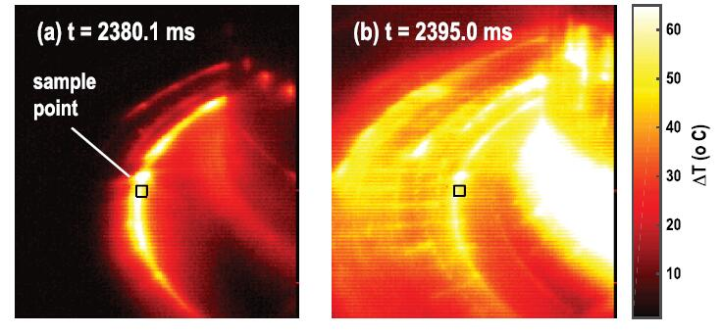
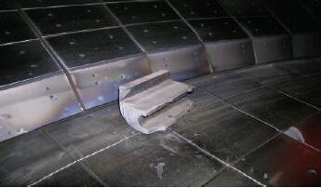
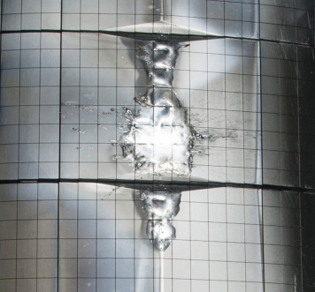
Major Disruption
Heat loads (TQ)
Electromagnetic force (CQ)
Runaway electrons (CQ)
Hollamnn E.M.D., et al., POP (2018)
Coutesy of A. Kellman
Mattews G. F., et al., Phys.Scr. (2016)
Major disruptions have 3 damaging effects on tokamak machine:
1）high heat loads on the divertor surfaces (during thermal quench);
2）electromagnetic force（J×B）via poloidal Halo current (during current quench) ；
3）conversion of plasma current into runaway current, loss of runaway electrons (REs) to PFC (during current quench).

Slide 5
Runaway electrons
Conversion of magnetic energy into runaway kinetic energy!
Serious problem for high I_{p} operation;
~10MA runaway current with ~100MeV runaway beam for ITER;
Localized impact of REs can damage tokamak wall . ~ten thousands electronic torches!
REs plateau
REs hit wall
REs mitigation is key task force for future reactor-scale tokamaks!

Slide 6
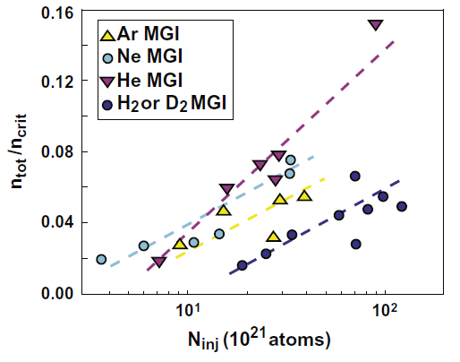
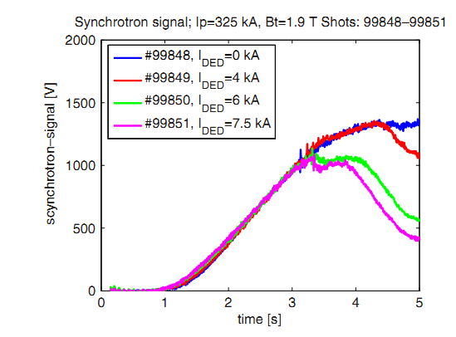
Runaway electrons mitigation
Methods for REs mitigation:
Collision suppression: massive gas injection (MGI), shattered pellet injection (SPI);
Deconfinement of REs: resonant magnetic perturbation (RMP);
Hollmann E.M., et al., POP (2010)
TEXTOR, NF (2006, 2007)
S. C. Li, et al., PPCF (2017)
Collision suppressin by impurity injecton (MGI/SPI) is limited by the impurity mixing efficinecy.
Suppression of REs with the RMP provide alternative solution.
Advantages of magnetic perturbation: 1) Increase of threshold electric field E for runaway generation;
2) Reduction of avalanche growth rate.

Slide 7
  Outline
  Introduction
  RE suppression by magnetic purturbation
  RE suppression by RMP
  RE suppression by SMBI
  Runaway avoidance during CQ
Summary

Slide 8
RE suppression by magnetic perturbation
TEXTOR
J-TEXT
TEXTOR
In the same toroidal magnetic field, the RE plateau is not reproducible.
The magnetic turbulence level could be the reason to cause the difference.
Runaway suppression has been experimentally found only with magnetic turbulence larger than a threshold.
The runaway current is a function of the maximum magnetic turbulence during the current quench both in TEXTOR and J-TEXT.
L. Zeng, PRL, 110 (2013) 235003; L. Zeng, NF 57 (2017) 046001.

Slide 9
  Outline
  Introduction
  RE suppression by magnetic purturbation
  RE suppression by RMP
  RE suppression by SMBI
  Runaway avoidance during CQ
Summary

Slide 10
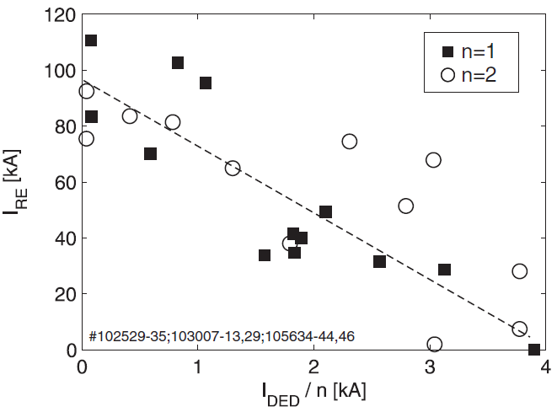
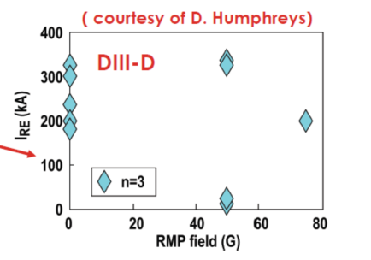
Reduction of REs by RMP
TEXTOR
Lehnen, M. et al., PRL (2008)
Reduction of REs by n=3 magnetic perturbation in D3D.
Without robust reduction of REs by n=3 magnetic perturbation in D3D.
Clear reduction of REs by n=1 magnetic prturbation in TEXTOR.
Not so clear for n=2 RMP.

Slide 11
Three interaction regimes of REs with RMP
  1. Partial RE suppression;
  2. Enhancement of RE generation;
  3. Full RE suppression.
q_{a}~4.4, n_{e}~1.0×10¹⁹ m⁻³

Slide 12
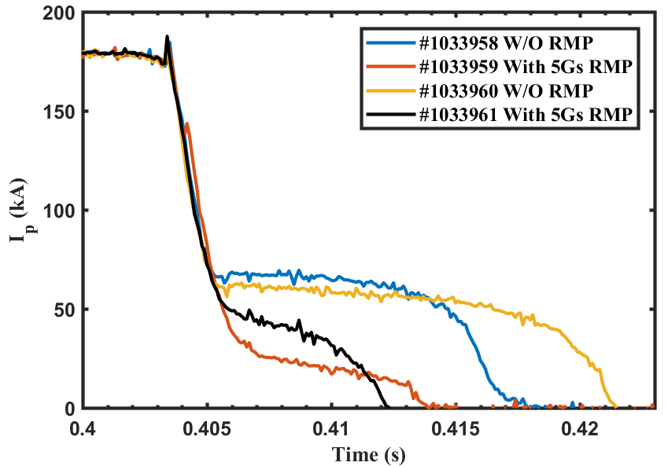
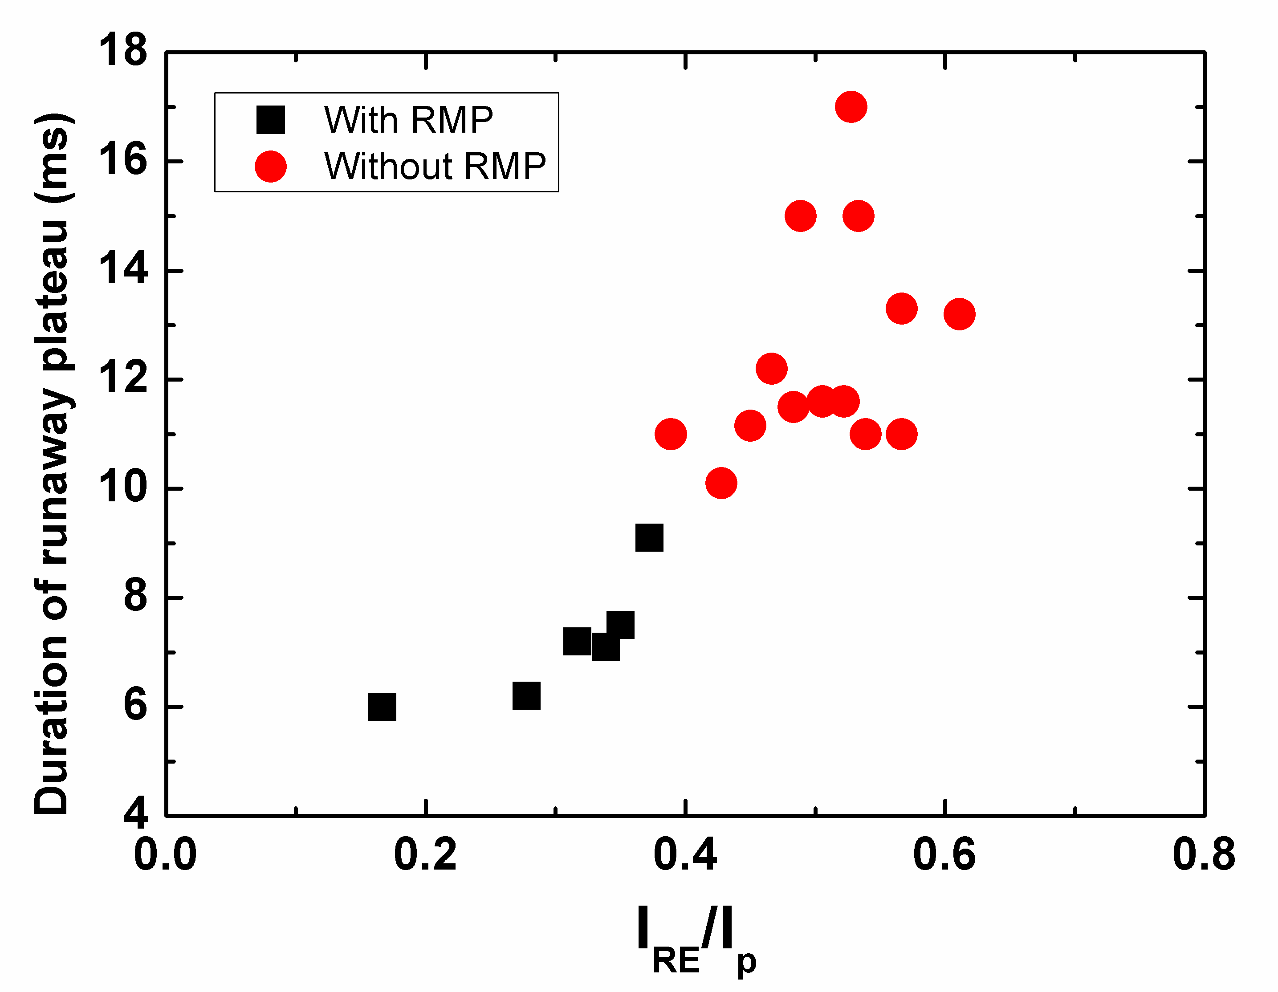
1. Partial RE suppression by RMP
MGI fast shutdown with 5Gs RMP (m/n=2/1):
Reduction of runaway current;
Reduction of the duration of runaway plateau.
Simulation indicates the REs loss:
Related to the radial position of REs ;
Shrinkage of confinement region.
Chen Z. Y., et al., NF (2016). Jiang Z. H., et. al., NF (2016).

Slide 13
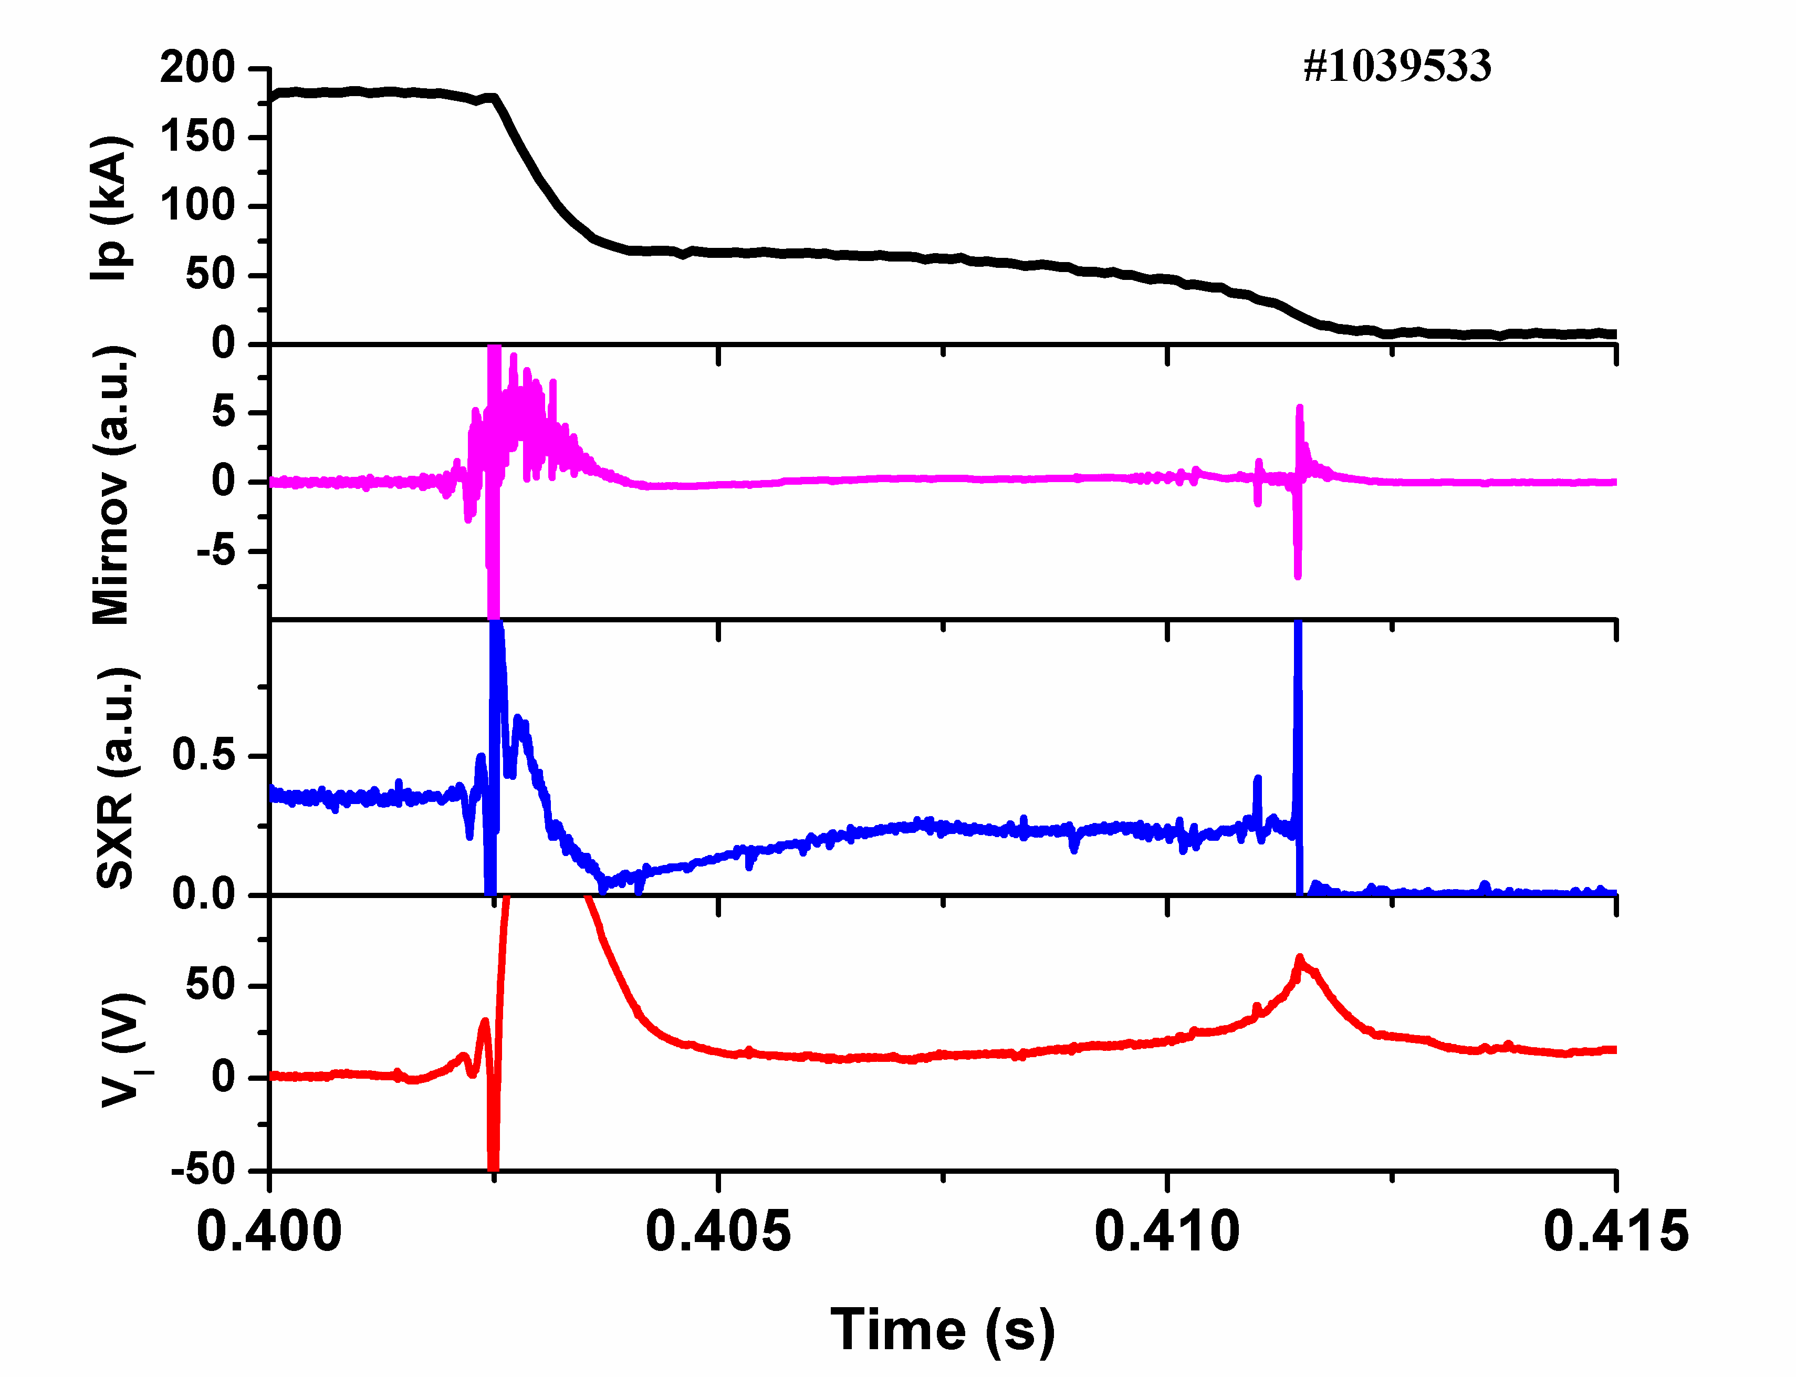
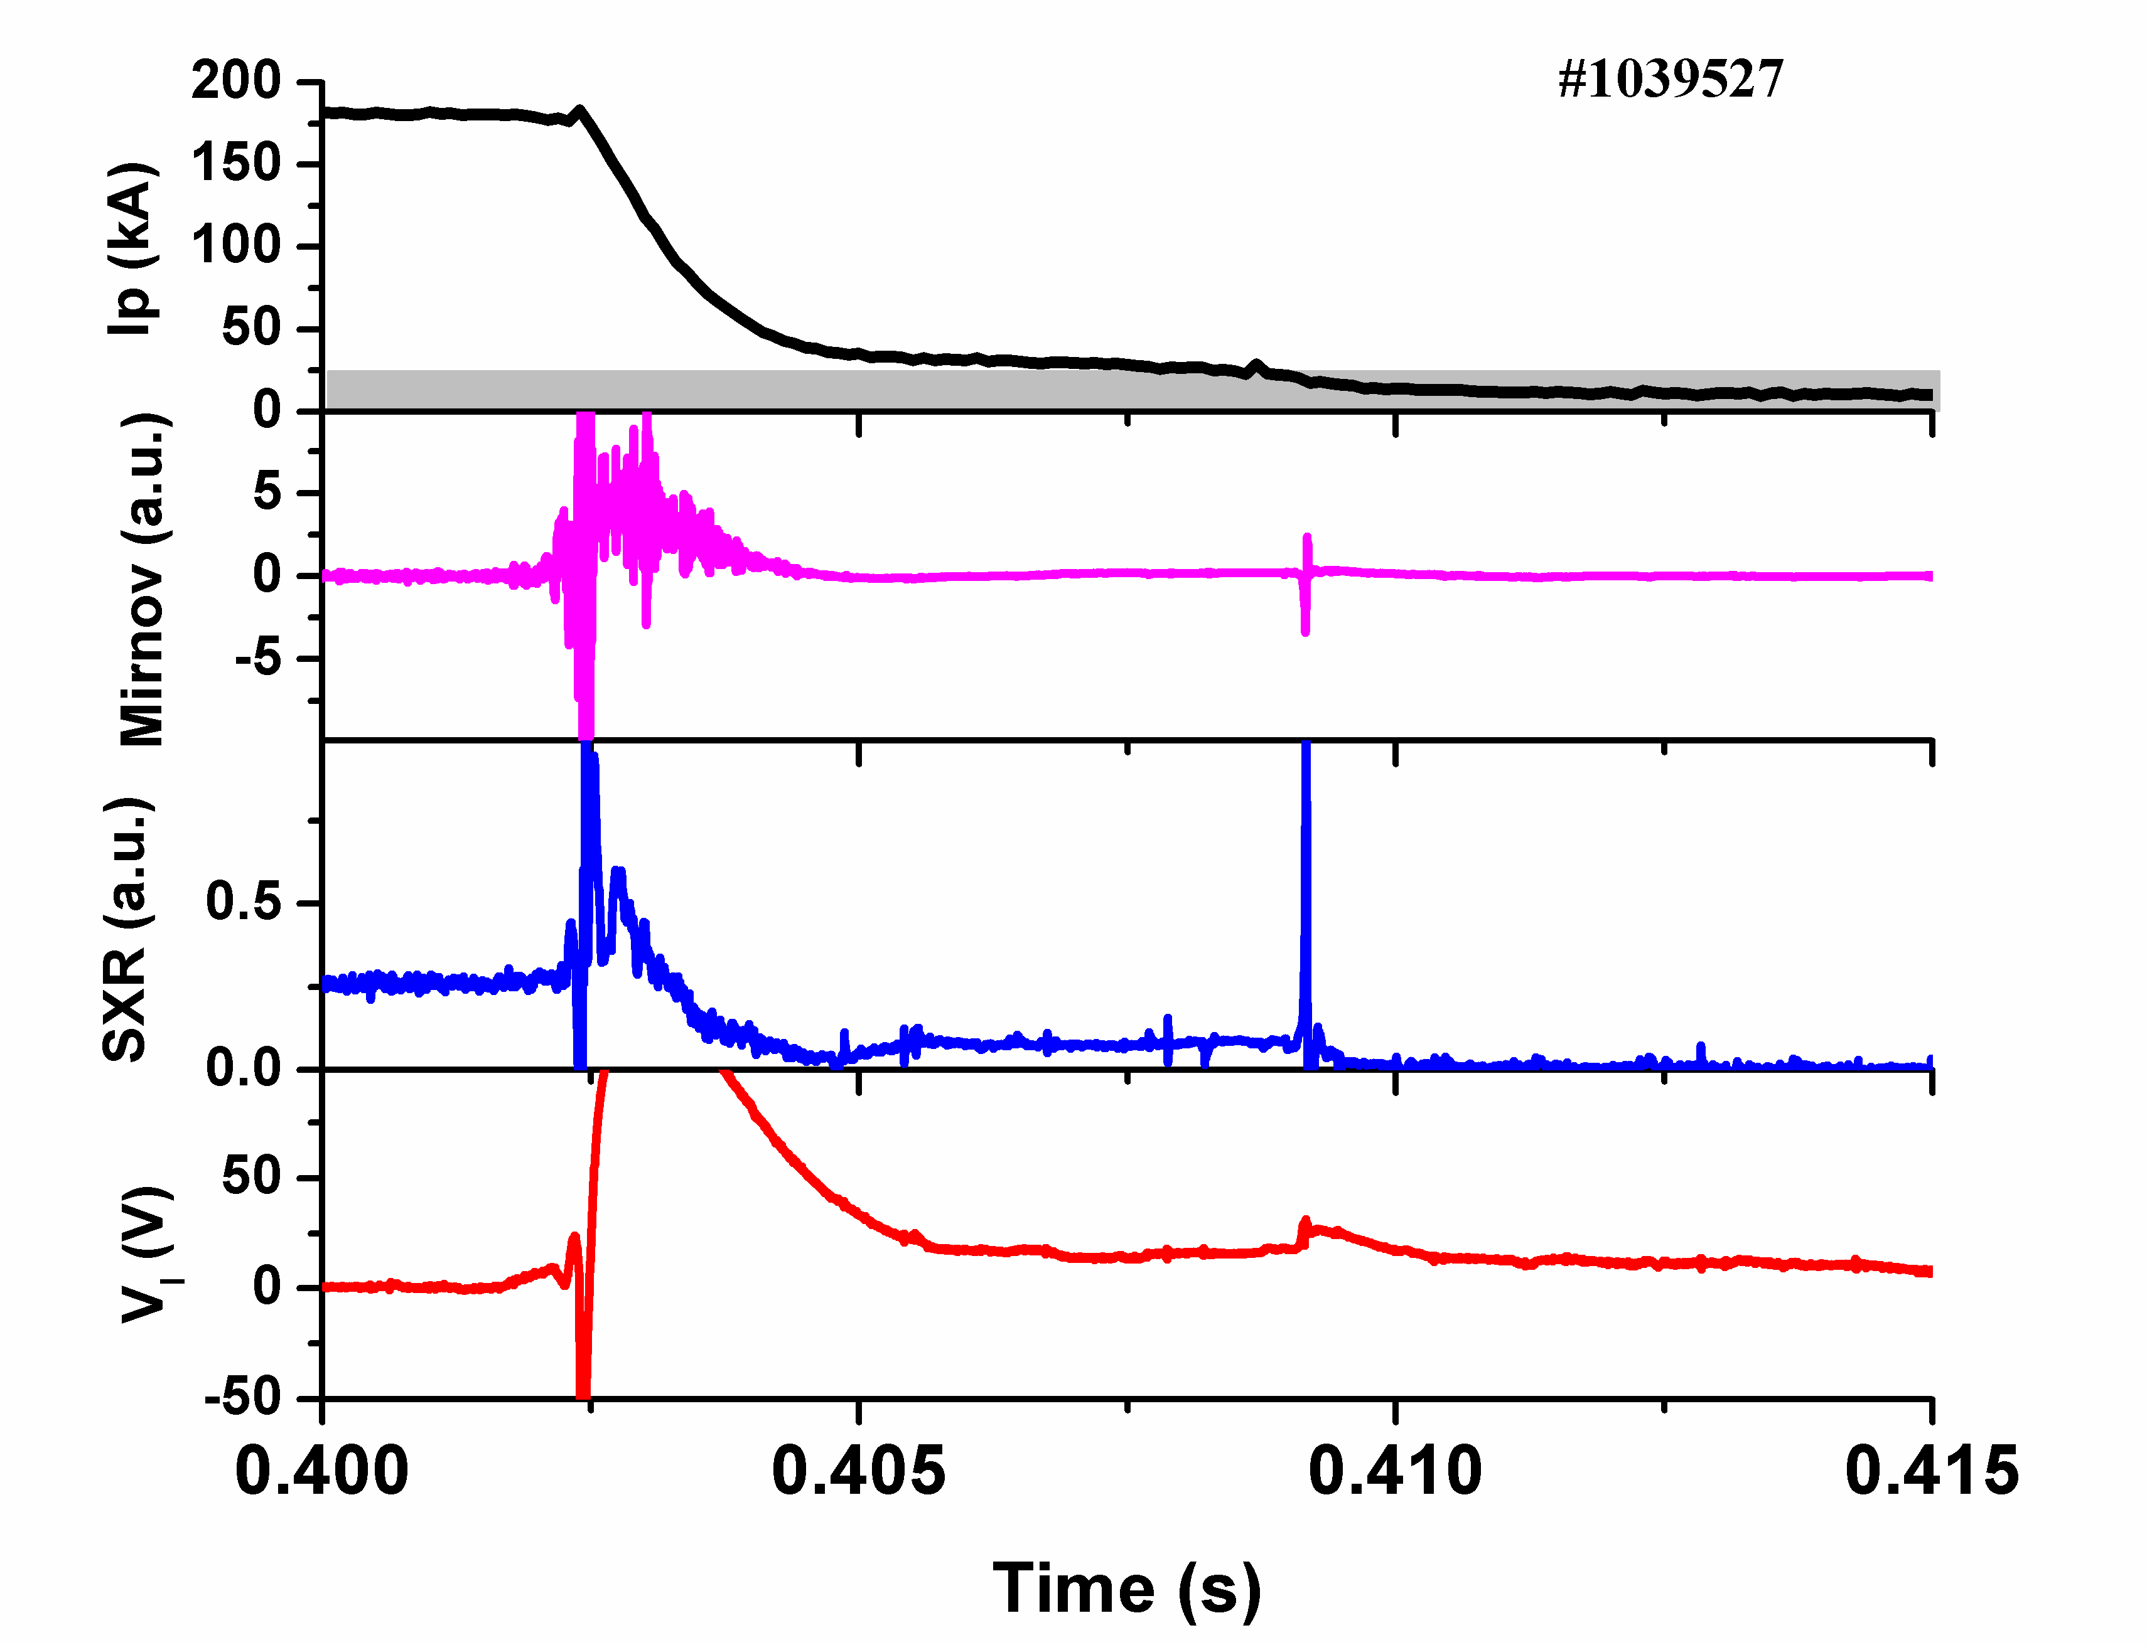
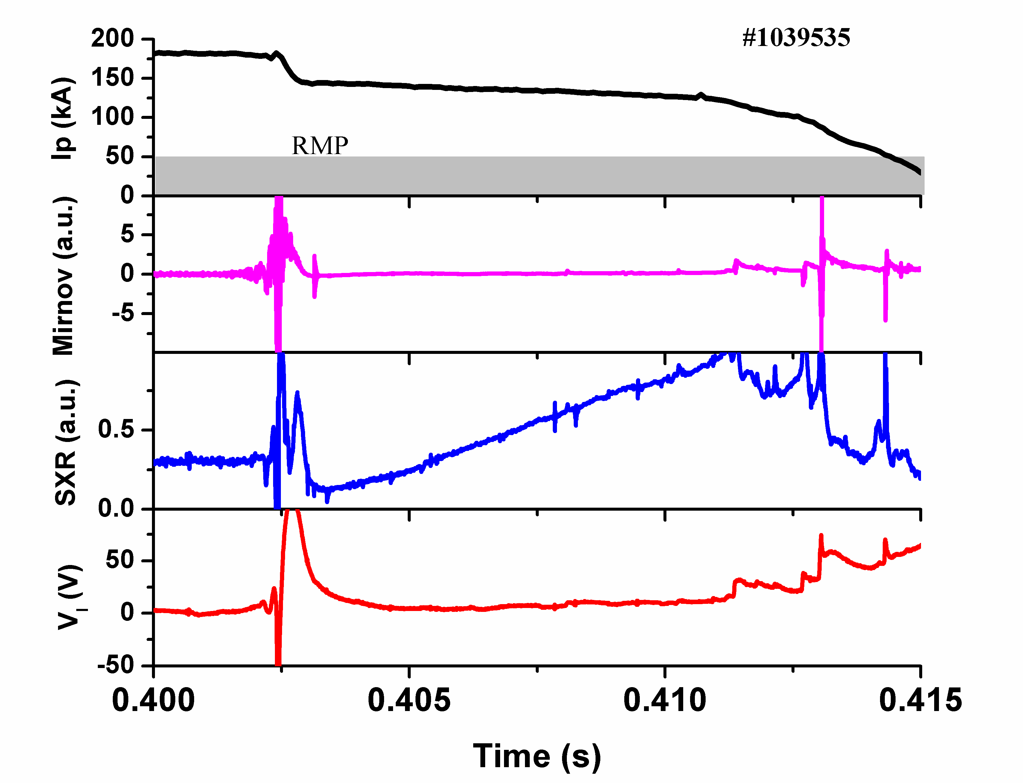
2. Enhancement of RE generation by RMP
I_{RE}=67 kA
Without RMP
B_{r(2/1)=}5 Gs
I_{RE}=35 kA
B_{r(2/1)}=10 Gs
I_{RE}=145 kA
B_{T}=2.2 T, I_{p}=180 kA, q_{a}~4, n_{e}~1.0×10¹⁹m⁻³.
The runaway current is enhanced instead of suppression when the amplitude of RMP was increased to a higher level.
Ar MGI at 0.4 s to induce stable runaway current plateau.
Chen Z. Y., et al., NF (2016)

Slide 14
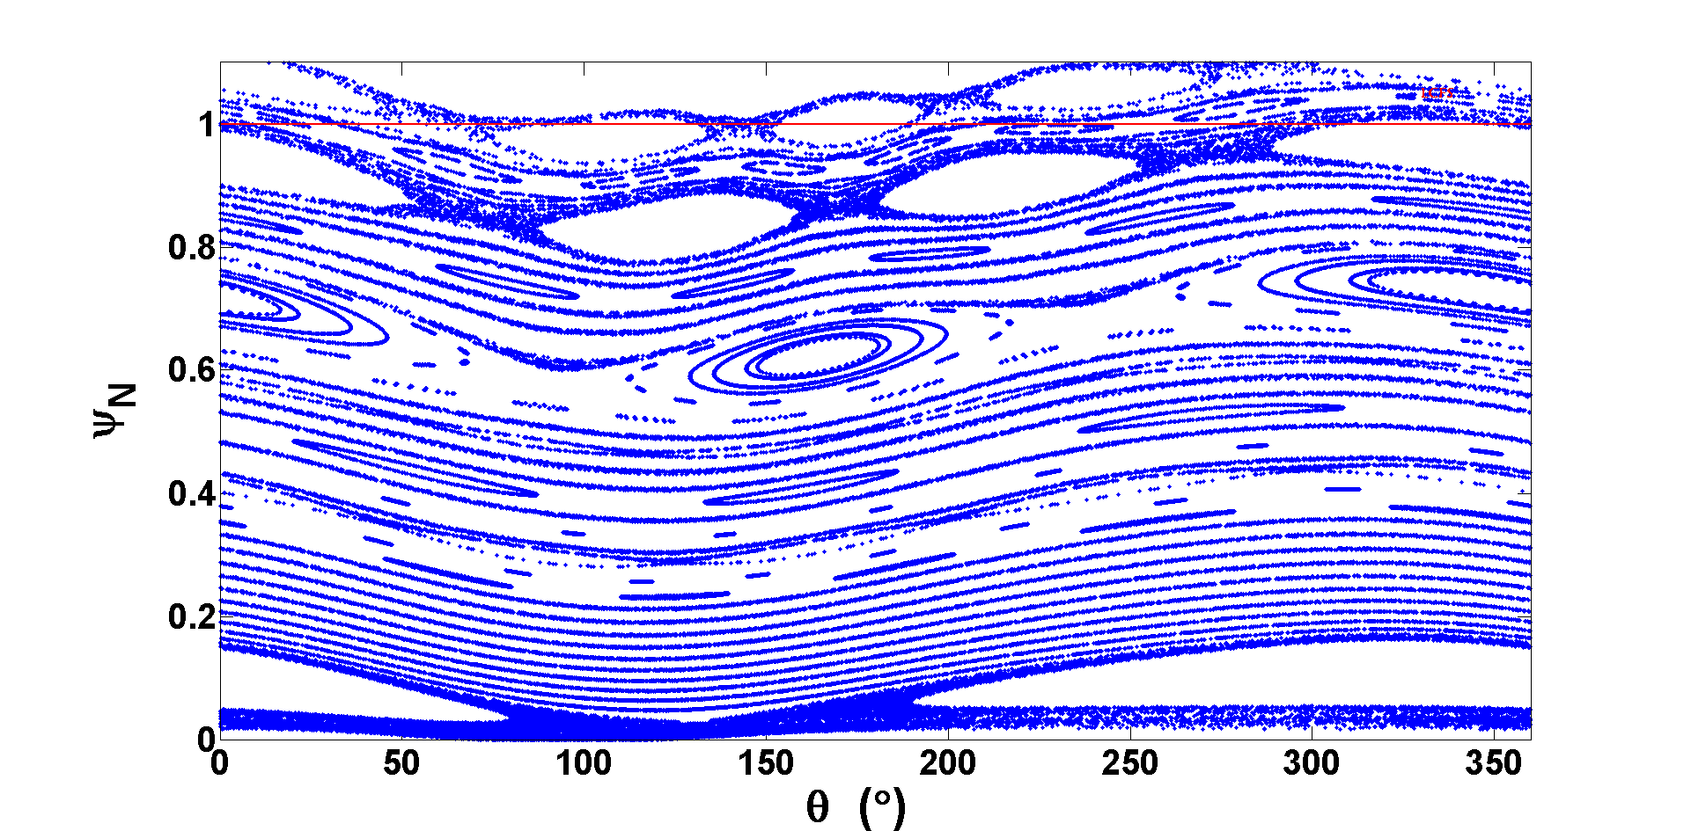
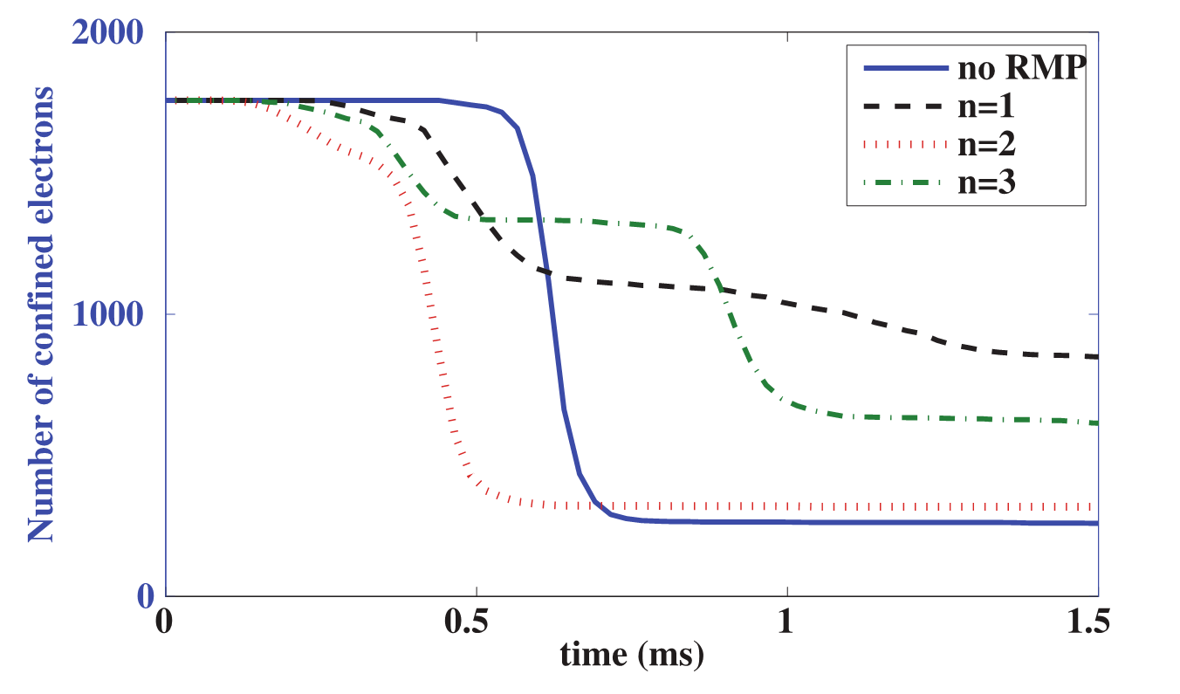
NIMROD Simulation (by V.A. Izzo):
Poincare plotting of the magnetic surface with 4 kA m/n=2/1 mode RMP.
Big size magnetic islands near q=2 surface was formed by the application of 4 kA m/n=2/1 mode dominated RMP.
The runaway seed can survive in the magnetic islands!
Number of confined RE test particles vs. time for three NIMROD simulations of disruption with RMP.
It is found that n=1 and n=3 RMP has the potential for runaway enhancement.

Slide 15
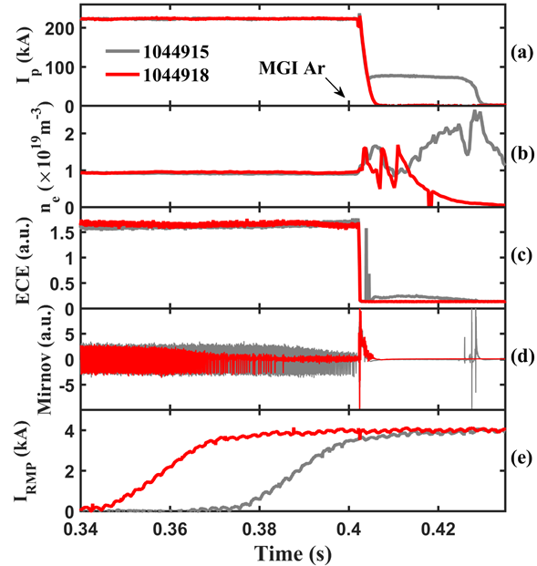
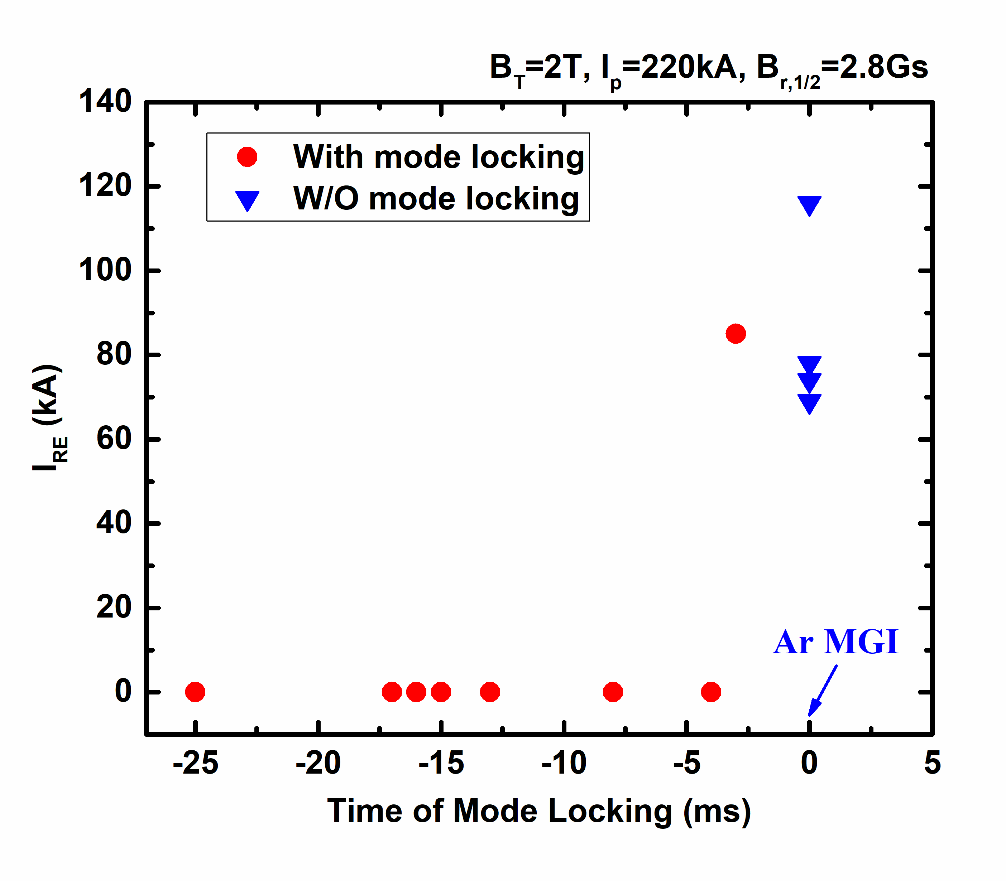
3. Full suppression of RE by RMP-mode locking
Target plasma with 2/1 tearing mode. B_{T}=2 T, I_{p}=220 kA, q_{a}~2.8, n_{e}~1.0×10¹⁹m⁻³.
Locked mode before disruption by RMP suppressed runaway current generation!
RMP coils may far away from the plasma core. The strength of RMP is limited in the core regime.
Mode locking by RMP need only small amplitude.
This scenario is possible for large scale device.
The mode locking implemented large magnetic islands inside the plasma which acted as an “explosive bomb” during disruptions and led to stronger stochasticity in the whole plasma cross section which deconfine the runaway seed!
Chen Z. Y., et al., NF (2018)

Slide 16
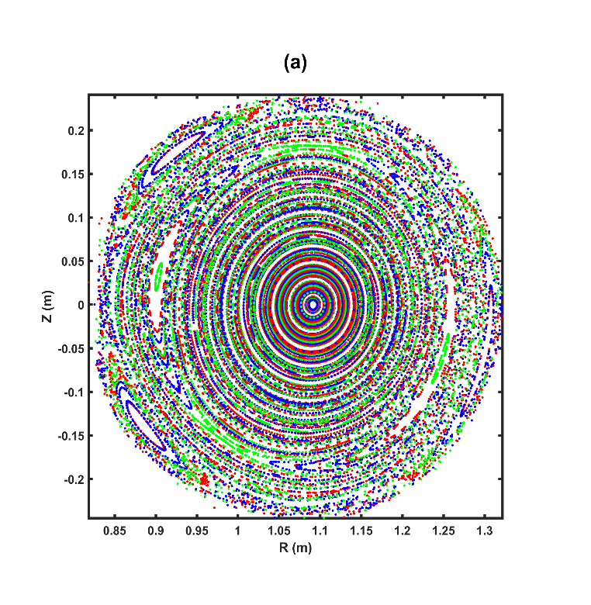
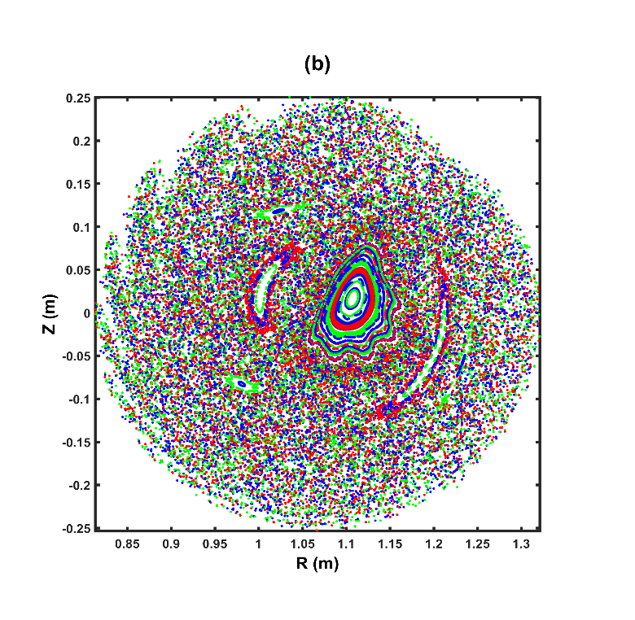
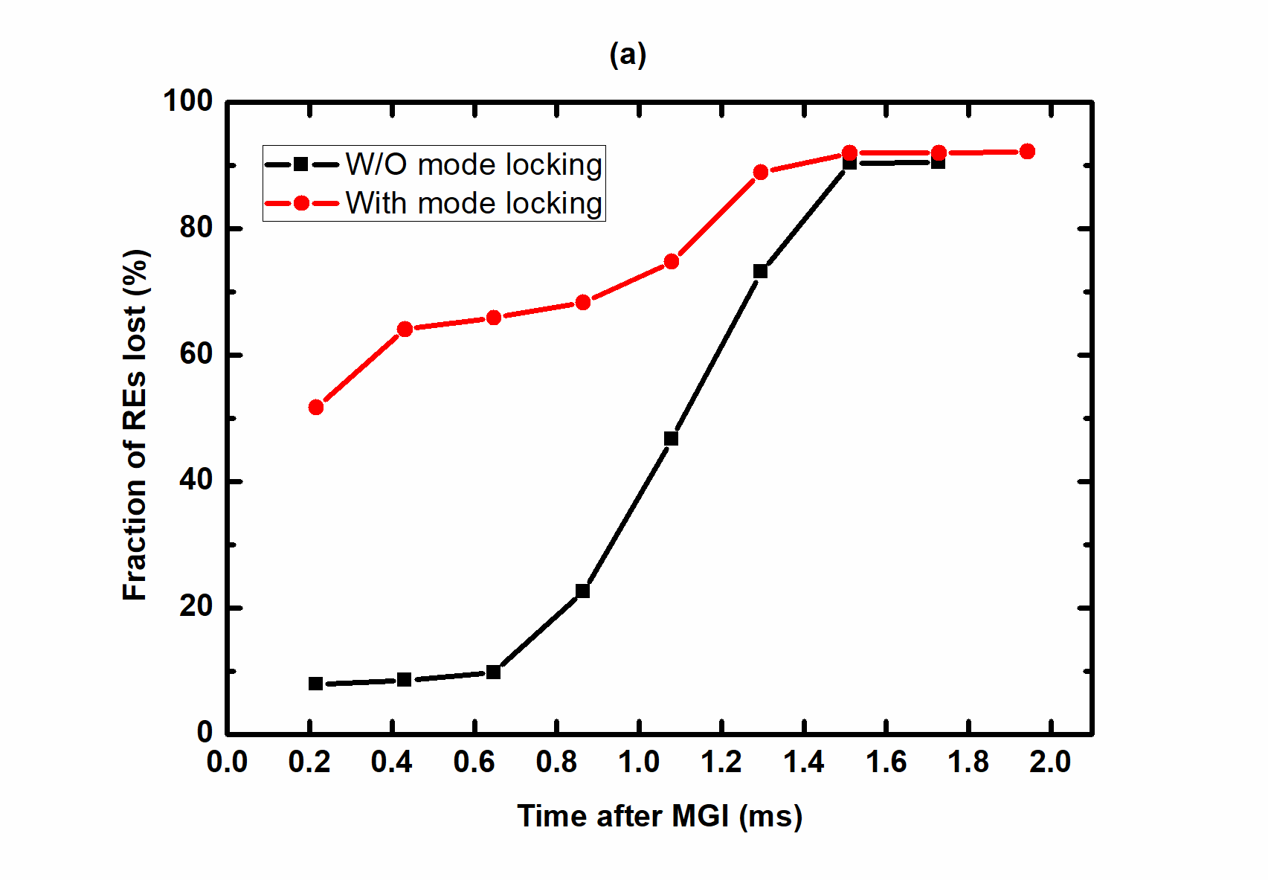
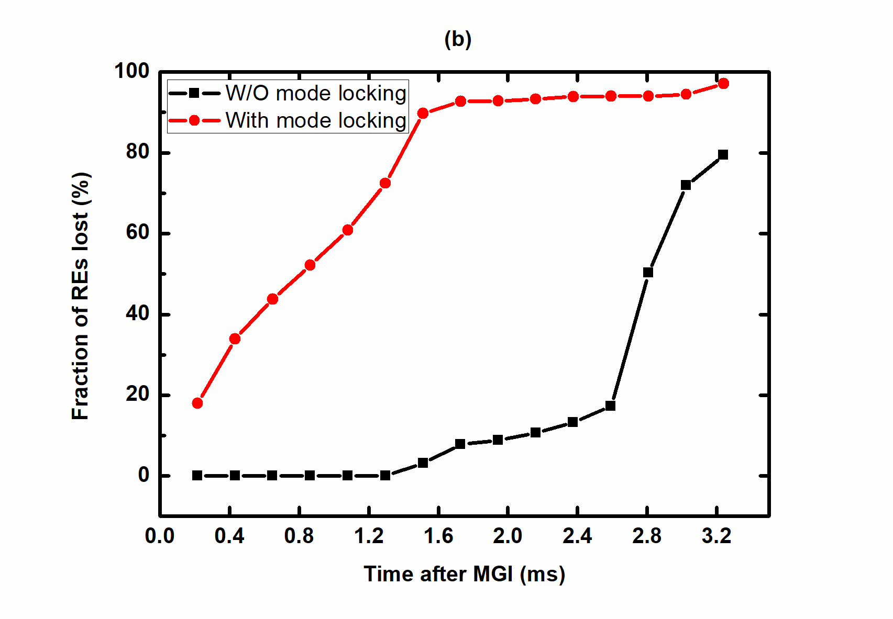
mode locking in 3ms, just before TQ phase
NIMROD Simulation:
The NIMROD simulation indicates that this strong stochasticity expel out the runaway seeds and results in runaway free disruptions on J-TEXT.
This might provide an alternative runaway suppression technique during disruptions for large-scale tokamaks.
mode locking in 0.2ms
(a) Initial REs with 5 MeV
(b) Initial REs with 50 keV
Notes:
(a) is mode locking in 0.2ms, (b) is mode locking in 3ms, just before TQ phase.

Slide 17
3. Full suppression of RE by RMP-mode penetration
Tearing mode free plasma, RMP: m/n=2/1, q_{a}~3.48, B_{r,2/1} ~12.5Gs (@ r=a )
150 keV REs
Robust runaway suppression has been achieved by RMP mode penetration early than Ar MGI (~ 25ms). Similar mechanism with mode locking.
NIMROD simulation indicate: Threshold of magnetic islands width: ~0.16a (4cm for J-TEXT)
Due to the large distance of RMP coil with the plasma center, this scenario is a chanllenge for large scale device.
Lin Z. F. et al., PPCF (2019)

Slide 18
  Outline
  Introduction
  RE suppression by magnetic purturbation
  RE suppression by RMP
  RE suppression by SMBI
  Runaway avoidance during CQ
Summary

Slide 19
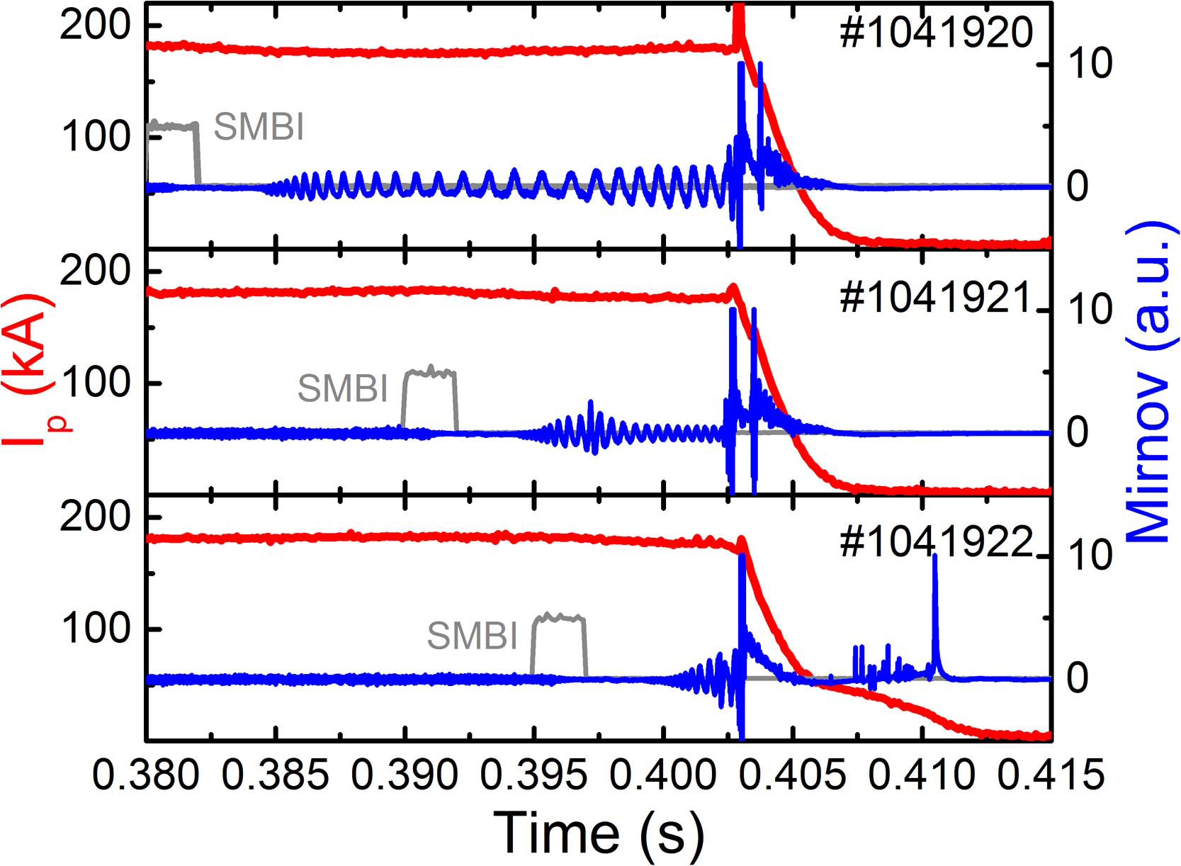
RE suppression by SMBI (H₂) induced magnetic pertubation
B_{T}=2.2 T, I_{p}=180 kA, q_{a}~3.8, n_{e}~1.0×10¹⁹m⁻³
SMBI and MGI are triggered simultaneously
The magnetic perturbation can be induced by the SMBI H₂;
The runaway current has been suppressed by the magnetic perturbation of SMBI.
Huang D.W et al., PPCF (2017)

Slide 20
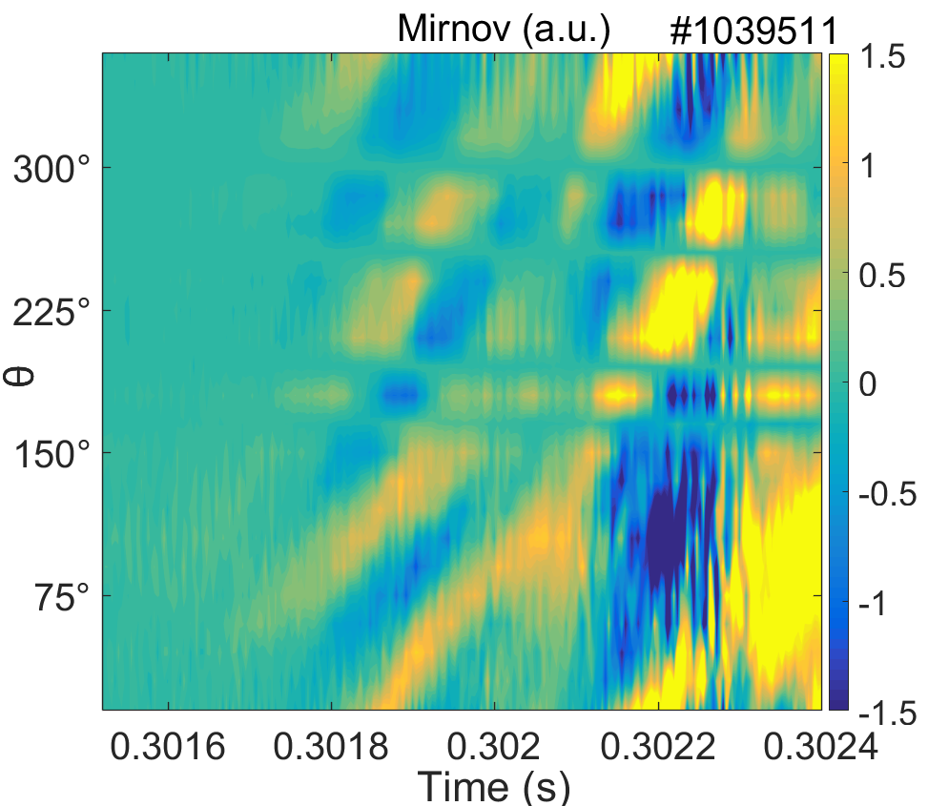
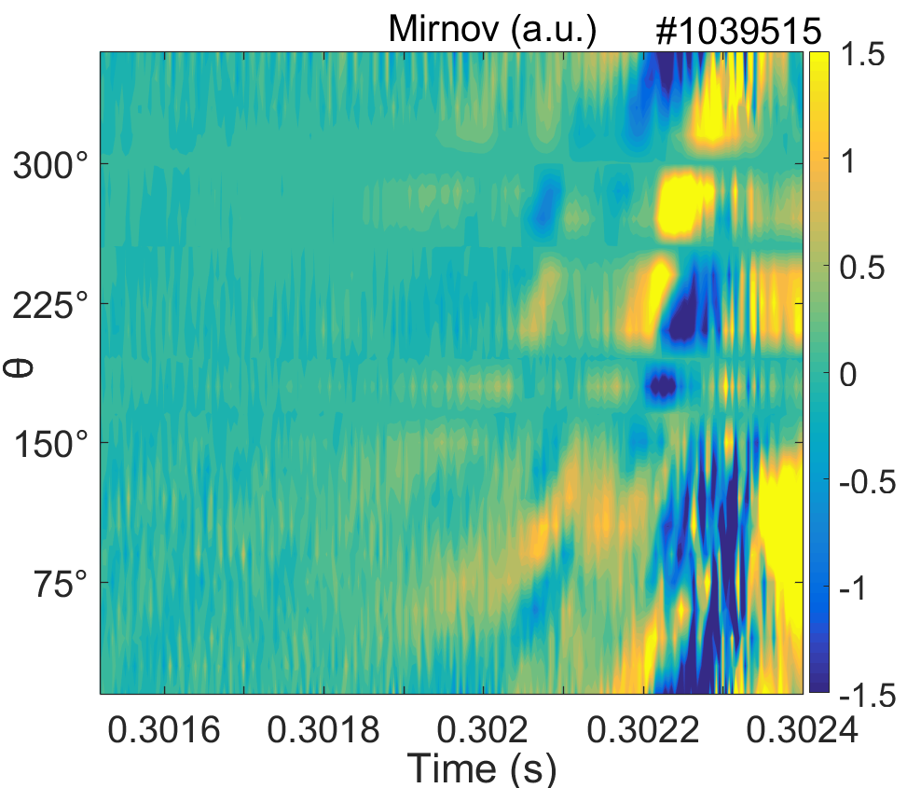
RE suppression by SMBI (H₂) induced magnetic pertubation
The supersonic H₂ beam reaches plasma edge earlier than Ar.
The combination of supersonic H₂ beam and the following massive Ar gas jet enhances the stochasticity of magnetic field during disruption.
SMBI+MGI:
RE free
0.3017s: m/n=3/1
0.3022s: m/n=2/1
Only MGI
With runaway current

Slide 21
  Outline
  Introduction
  RE suppression by magnetic purturbation
  RE suppression by RMP
  RE suppression by SMBI
  Runaway avoidance during CQ
Summary

Slide 22
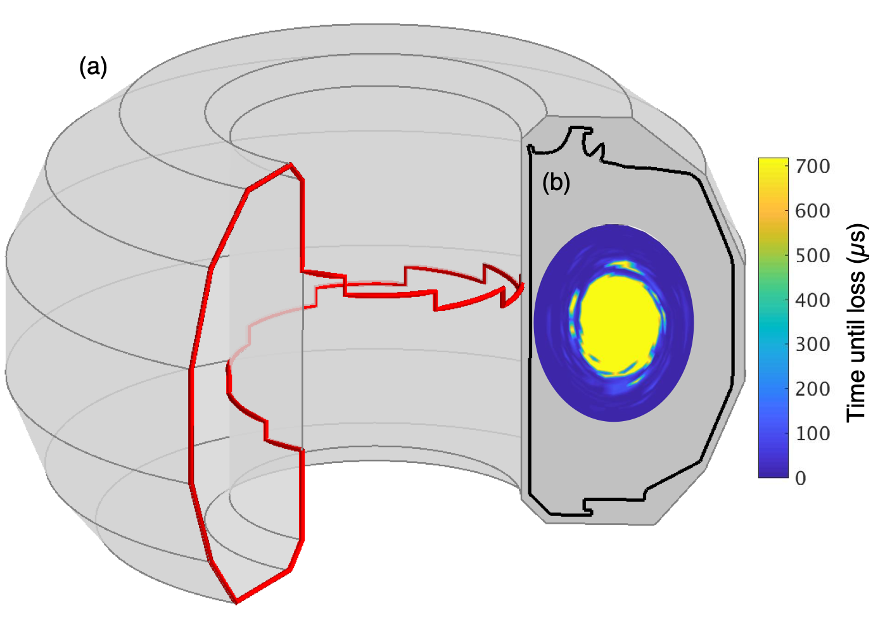
Runaway avoidance: by Passive Helical Coil
MHD modeling shows that a passive helical coil is effective at deconfining runaway electrons in DIII-D
A 3D helical coil is being studied for passive deconfinement of REs during the current quench
  CQ inductively drives current in 3D coil
MARS-F¹ is used to model the full plasma response and trace RE drift orbits during a DIII-D disruption
  Induced coil current is expected to be 6% of pre-disruption I_{P}
  3D coil is predicted to deconfine 30% of RE population in low-current equilibrium (q_{a} = 5)
  RE loss fraction increases to 70% in high-current equilibrium (q_{a} = 2.5)
q_{a} = 5.0
q_{a} = 2.5
12% I_{P}
6% I_{P}
3% I_{P}
6% I_{P}
Liu et al, Nuclear Fusion 59 (2019) 126021

Slide 23
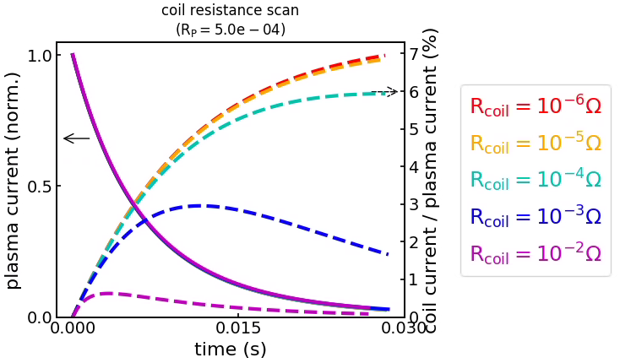
Modeling of equilibrium evolution predicts large coil currents on appropriate time scale
Runaway avoidance: by Passive Helical Coil (cont.)
TokSys GS-Evolve² is used to model inductive coupling between 3D coil and disrupting plasma
  Choosing to build a coil with lower resistance increases induced current up to 6-7% of pre-disruption I_{P}
Extrapolation to larger devices suggests favorable scaling
  For constant safety factor and aspect ratio, inductive coupling is independent of size!
Engineering limits also scale favorably
  no active cooling required
  J x B forces are well below stainless steel yield strength
Humphreys et al, Nuclear Fusion 47 (2007) 943

Slide 24

Plasma Recovery from CQ can be acheived by Generating large Core Magnetic Islands.
Runaway avoidance: by Plasma Recovery from CQ
Recovery from major disruptions in aid of 3D fields is demonstrated in high plasma current operation regime
  --In both IWL and Divertor configurations
This is realized by promptly generating magnetic islands in plasma core after thermal quench
Very recent experiment shows that this scenario features a significantly extended current quench duration (from ~10 ms to 100 ms), when thermal quench is mitigated by neon puffing
  --Absence of runaway formation and vertical unstable disruption
Healing via 3D equilibrium
Current Quench
Thermal Quench
Core T_{e}
Edge T_{e}
X.D. Du et al Nucl. Fusion 59, 094002 (2019)

Slide 25
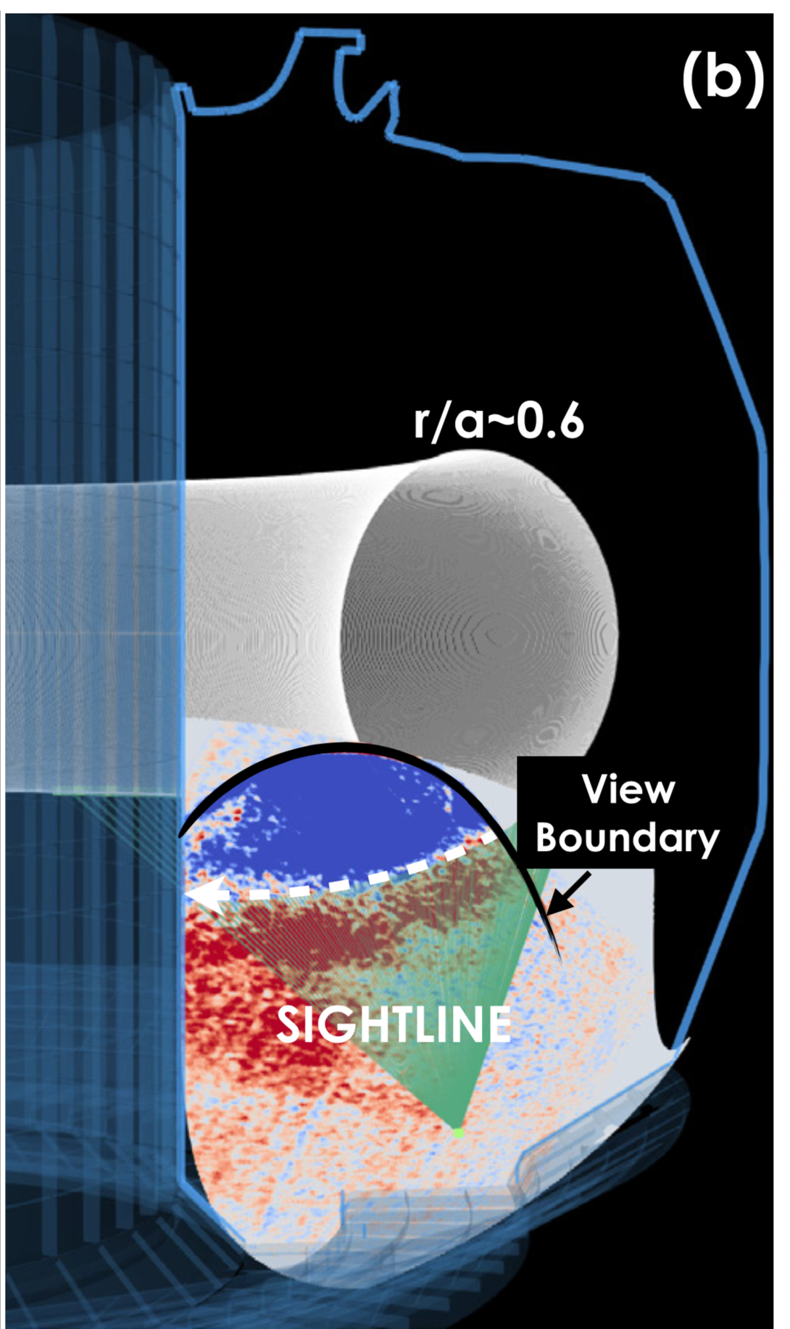
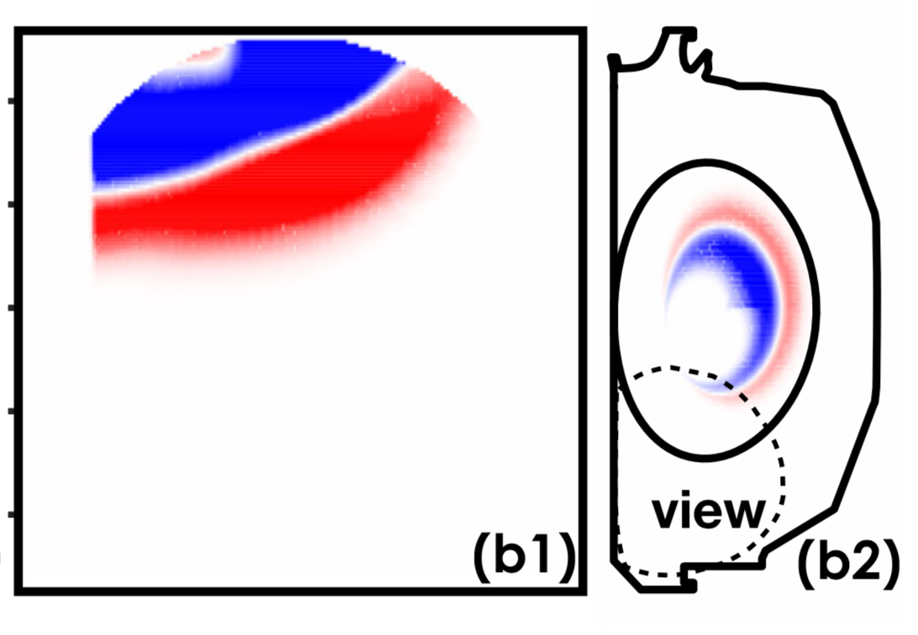
Runaway avoidance: by Plasma Recovery from CQ (cont.)
Measured image
SIMULATION with 1/1 Island
The observed structure is consistent with large locked island with m/n=1/1
  With phase from 0-60 degree
  Exact phase cannot be determined due to the large wavelength of perturbation relative to the small viewing area

Slide 26
  Outline
  Introduction
  RE suppression by magnetic purturbation
  RE suppression by RMP
  RE suppression by SMBI
  Runaway avoidance during CQ
Summary

Slide 27
Summary
RE mitigation is essential for the next generation fusion machine. The magnetic perturbations have the ability to full suppress the REs during disruptions.
High magnetic turbulence is favor for the runaway suppression.
Two methods have been used to generate magnetic perturbation: RMP (current) and SMBI (cold pulse).
By the application of RMP, full runaway suppression has been achieved by mode locking/ mode penetration. Runaway suppression by mode locking is possible for large scale device.
The SMBI H₂ shows RE suppression effect due to the induced magnetic perturbation.
MHD modeling shows that a passive helical coil is effective at deconfining REs in DIII-D
RE avoidance has been observed on DIII-D during Plasma Recovery from CQ by Generating large Core Magnetic Islands.

Slide 28
Thank you for your attention!

