Slide 1





Mitigation of runaway electron heat loads by deuterium SPI injection and kink activity
C. Reux, C. Paz-Soldan, E.M. Hollmann, N. Eidietis, M. Lehnen, S. Jachmich, E. Joffrin, P.J. Lomas, F. Rimini, V. Bandaru, L. Baylor, I. Bykov, L. Calacci, F. Causa, D. Carnevale, I. Coffey, D. Craven, A. Dal Molin, G. De Tommasi, X. Du, O. Ficker, T. Gebhart, S. Gerasimov, L. Giacomelli, J. Herfindal, M. Hoelzl, A. Huber, C. Lasnier, Y.Q. Liu, A. Lvovskiy, C. Lowry, E. Macusova, A. Manzanares, A. McLean, M. Nocente, E. Panontin, G. Papp, G. Pautasso, A. Peacock, V. Plyusnin, D. Rudakov, D. Shiraki, S. Silburn, C. Sommariva, C. Sozzi, S. Sridhar, R. Sweeney, R. A. Tinguely, J. Wilson and JET contributors
IAEA Technical Meeting on Plasma Disruptions and their Mitigation
20th-23th July 2020

Slide 2
Outline
General background
  Disruptions and runaways
  Runaway scenarios
Experimental data
  High-Z MMI
  D₂ MMI
D₂ cases: role of the instability
  Pre-collapse phase
  Characterization of the instability
  MHD Simulations
D₂ cases: role of the companion plasma
  Transport during the purge phase
  Final collapse dynamics

Slide 3
Outline
General background
  Disruptions and runaways
  Runaway scenarios
Experimental data
  High-Z MMI
  D₂ MMI
D₂ cases: role of the instability
  Pre-collapse phase
  Characterization of the instability
  MHD Simulations
D₂ cases: role of the companion plasma
  Transport during the purge phase
  Final collapse dynamics

Slide 4
Runaway electron mitigation – general issues
First layer of defense on ITER runaways: preventive suppression
  D₂+Ne mixtures: aim at mitigating heat loads, EM loads and preventing runaway generation all simultaneously
  Unsure if the first layer is efficient enough for complete runaway suppression [O. Vallhagen 2020, arXiv] [see T. Fülop, this conference]
  If mitigation unsuccessful: risk of multi-MA runaway beam [Martin-Solis NF 2017]
Second layer of defense: in-flight runaway beam mitigation
  If a runaway beam is generated: need to suppress it without PFC impact
  Candidate scheme: Massive Material Injection (MMI): High-Z MGI or SPI (Ne, Ar, Kr, Xe), low-Z MGI or SPI (D₂, He)
Focus of this talk: in flight RE mitigation
Main questions to be solved:
  Is it efficient?
  Which gas species to use?
  Is SPI better than MGI?

Slide 5
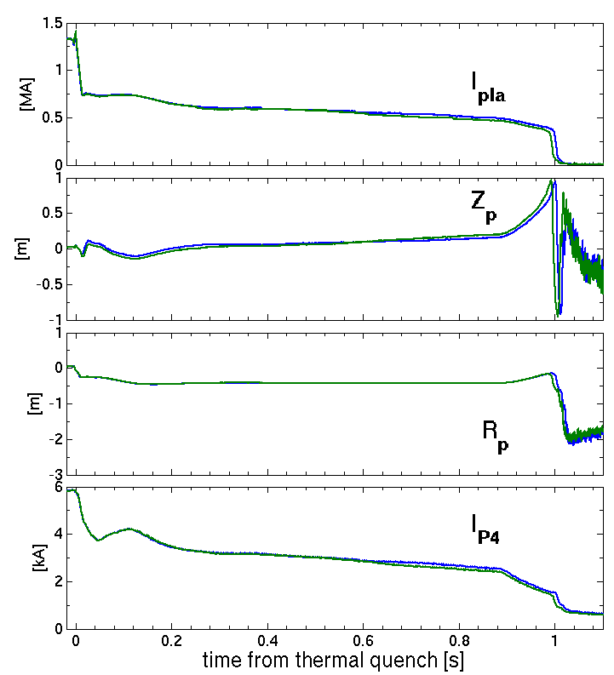

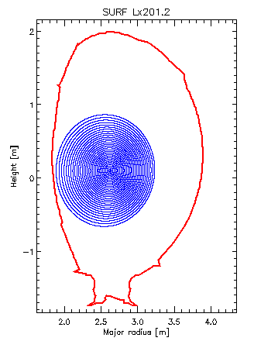
Baseline runaway scenarios – JET
Usual recipe:
  Small Ar MGI (~4 Pa.m3)
  Small limiter, low elongation, outboard limited plasma
  Bt = 3.0 T, Ip = 1.5 MA. Ohmic
Result: ~500 kA beam
Companion plasma:
  Free electron density 2.5x10¹⁹ m⁻²
  Te = 5-15 eV [Sridhar NF 2020]
Vertical control:
  Beam naturally vertically unstable due to the current decay
  Sensitive parameters:
    Companion plasma density
    Poloidal flux provided to the beam (current drive) → use external PF coils (CS coil at max voltage already)
JPN #95125, #95129 (reproducibility)
I_{P4} push
Standard RE scenario: 500-600 kA, 1.0s, max current drive

Slide 6
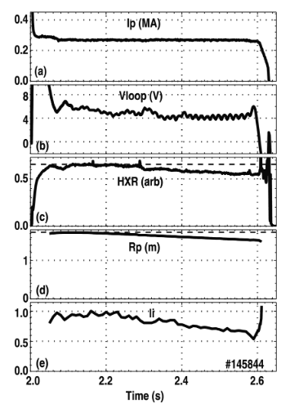
Baseline runaway scenarios – DIII-D
Usual recipe:
  Small argon pellet (~1 Pa.m3)
  Big limiter, low elongation (1.2 – 1.4), inboard limited plasma
  Bt = 2.1T ,Ip = 1.2-1.5 MA
  ECRH heated 1-3 MW [Eidietis PoP 2012]
Result: 275 kA beam
Companion plasma:
  Free electron density ~10²⁰m⁻² [Shiraki NF 2018]
  Position control [Eidietis PoP 2012]
  Beam vertically stable
  Radial excursion due to vertical field mismatch, compensated by a specific control scheme.
  Current controlled
[Eidietis PoP 2012]
Standard RE scenario: 275 kA, ~600 ms, current controlled

Slide 7
Outline
General background
  Disruptions and runaways
  Runaway scenarios
Experimental data
  High-Z MMI
  D₂ MMI
D₂ cases: role of the instability
  Pre-collapse phase
  Characterization of the instability
  MHD Simulations
D₂ cases: role of the companion plasma
  Transport during the purge phase
  Final collapse dynamics

Slide 8
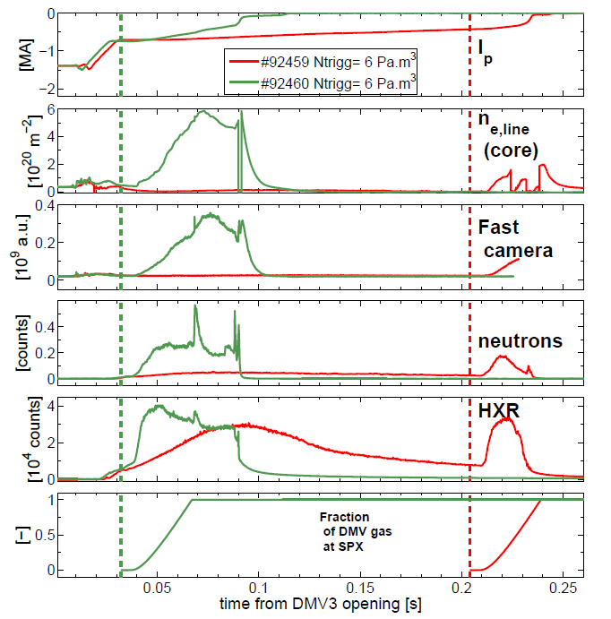

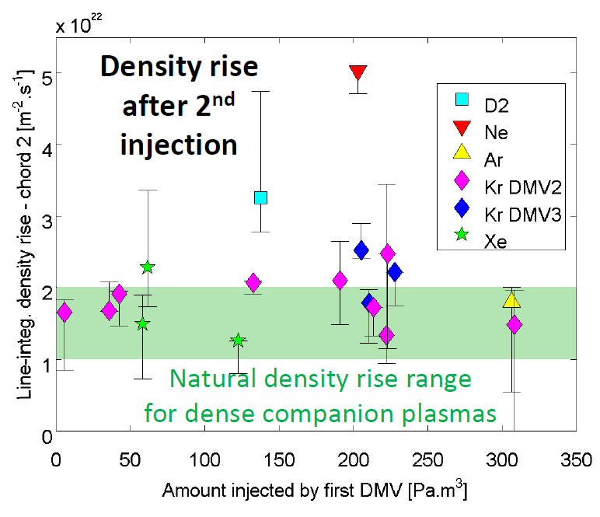
High-Z MMI – effect on RE beam - JET
High Z MMI (MGI or SPI) accelerates the RE current decay
  (Free) electron density increases
  HXR/neutrons increase ➔ enhanced collisions/dissipation
  Destabilizes the beam vertically
Only works when the companion plasma electron density is low enough
Saturates beyond a certain quantity threshold for MGI
  inability to mix arbitrary amounts of impurities into the plasma?
  Beam duration set by electromagnetic time constants?
[Reux APS 2017]
High-Z MMI accelerates beam current decay, up to a certain companion plasma electron density

Slide 9
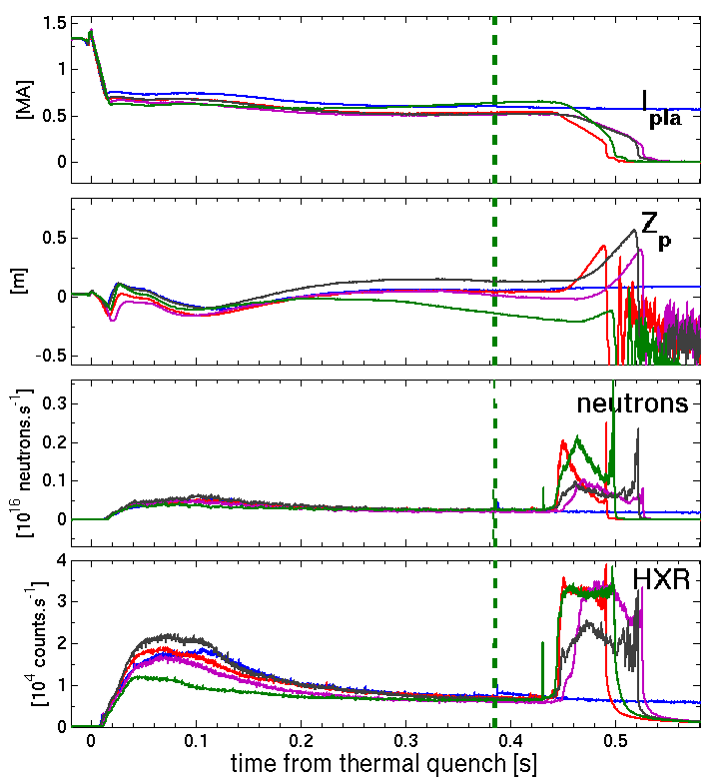

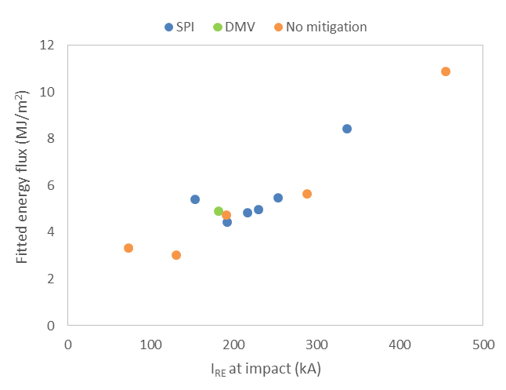
High-Z MMI – effect on the beam termination- JET
Larger pellets lead to a slightly faster decay
Surprisingly: no obvious difference on current decay rate Ar vs. Ne ➔saturation?
All cases have a final collapse and impact on the wall
SPI trigger
Ne, SPI 8 mm
No SPI
Ar, SPI 8mm
Ar SPI 12.5 mm
Ne SPI 12.5mm
High-Z MMI not very beneficial on final impact avoidance. Argon and Neon similar
Courtesy of S. Silburn

Slide 10
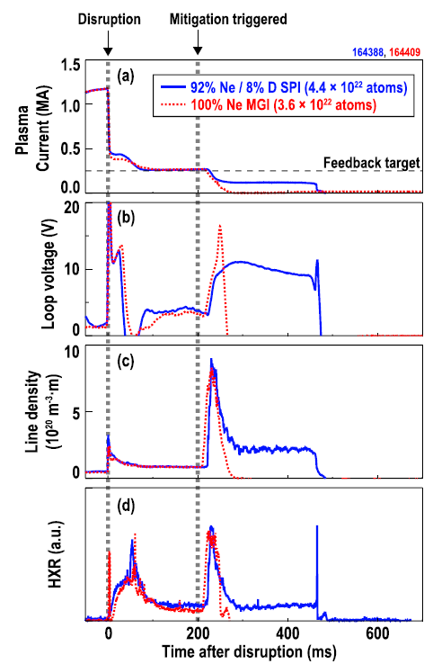
High-Z MMI - effect on the RE beam – DIII-D
Neon SPI leads to accelerated current decay
  Free electron density increases
  HXR increase
  Beam position & current control is kept
No particular condition needed for it working, but fewer companion plasma electron densities reported
Is able to reach zero runaway current without final collapse.
High-Z MMI ramps down RE current to zero
[Shiraki NF 2018]

Slide 11
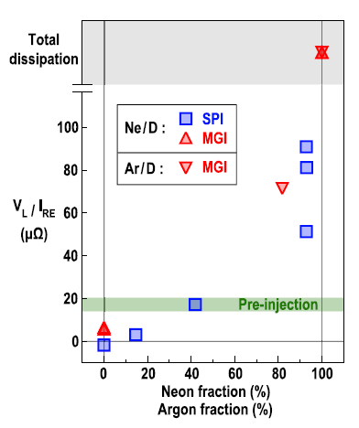
High-Z MMI - effect on the RE beam – DIII-D
In case of incomplete dissipation: new current equilibrium with increased V_{loop} is reached
Argon vs Neon: Effective resistance of the plasma lower with neon than with argon
Argon more potent at decreasing runaway current
Argon MMI leads to faster RE decay

Slide 12
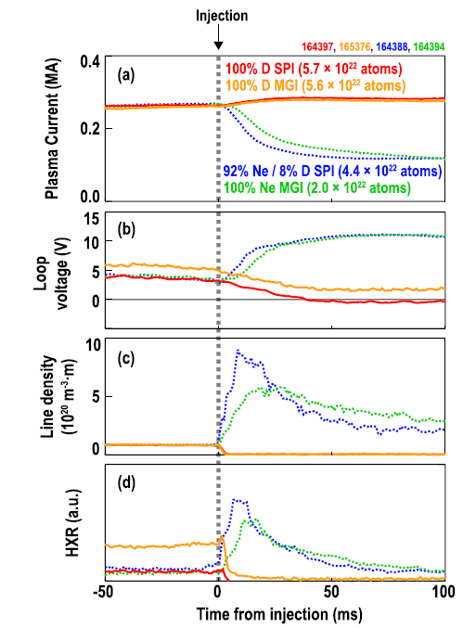
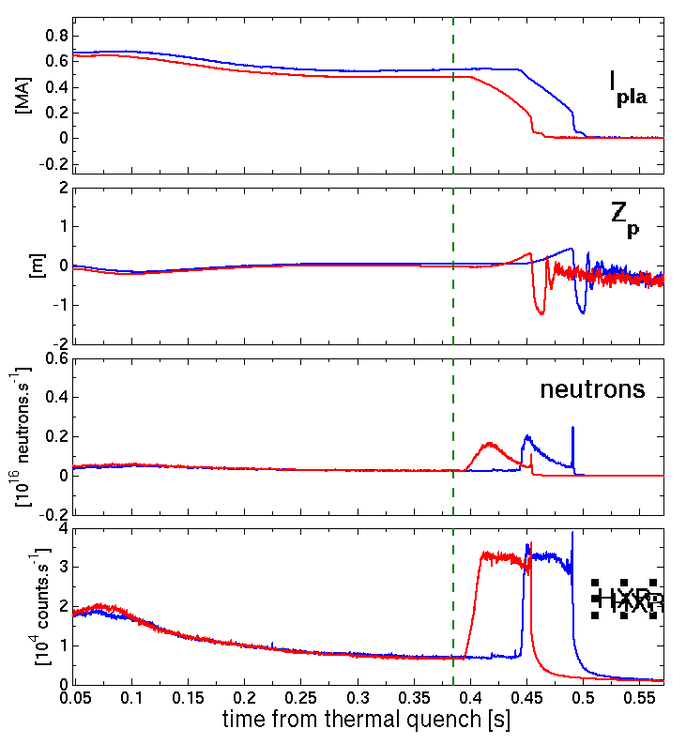

MGI vs. SPI
JET and DIII-D at high-Z : no clear difference between MGI and SPI
  (also D₂ – see later)
SPI trigger
Ar SPI 12.5 mm (200 Pa.m³)
Ar MGI 280 Pa.m³
HXR

Slide 13
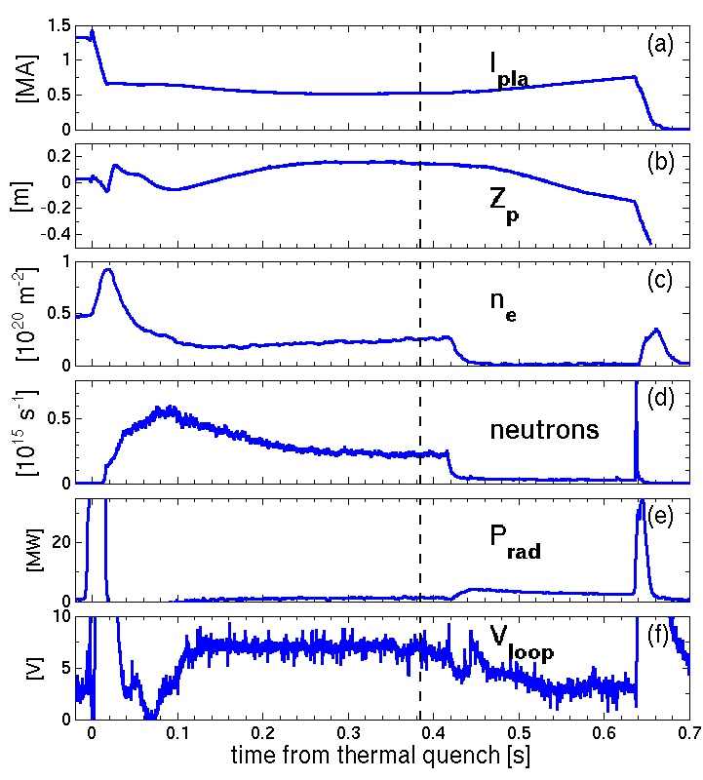
D₂ SPI - JET
Current increases shortly after SPI
Neutrons and HXR drop
Synchrotron emission changes (islands sometimes visible)
Electron density drops to <10¹⁸ m⁻²
  Plasma recombination
V_{loop} decreases
  Possibly a hint at argon purge-out
  Ar VUV lines become dominated by D lines [S. Sridhar’s talk – this conf.]
Runaways disappear in a few ms
  Synchrotron emission stops
  Large neutron/HXR spike
  Large MHD burst
  No visible localized damage
Rest of the current decay similar to an ohmic CQ
#95135
SPI trigger

Slide 14
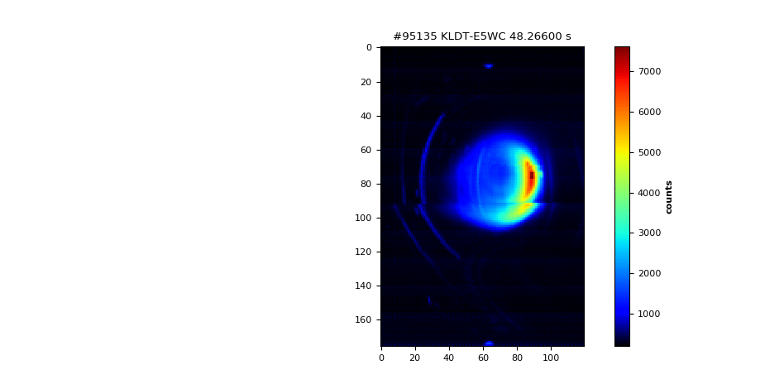
D₂ SPI - JET
Current increases shortly after SPI
Neutrons and HXR drop
Synchrotron emission changes (islands sometimes visible)
Electron density drops to <10¹⁸ m⁻²
  Plasma recombination
V_{loop} decreases
  Possibly a hint at argon purge-out
  Ar VUV lines become dominated by D lines [S. Sridhar’s talk – this conf.]
Runaways disappear in a few ms
  Synchrotron emission stops
  Large neutron/HXR spike
  Large MHD burst
  No visible localized damage
Rest of the current decay similar to an ohmic CQ
D₂ leads to fast benign termination even at high currents

Slide 15
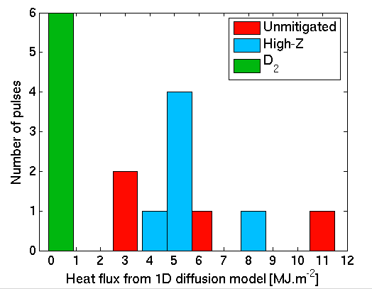
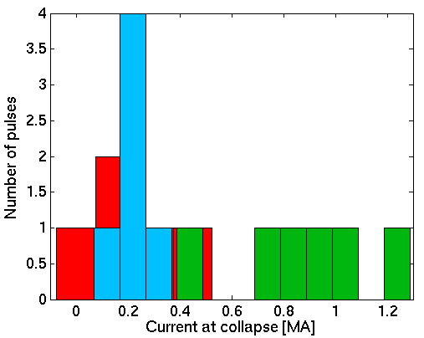
D₂ SPI - JET
Current increases shortly after SPI
Neutrons and HXR drop
Synchrotron emission changes (islands sometimes visible)
Electron density drops to <10¹⁸ m⁻²
  Plasma recombination
V_{loop} decreases
  Possibly a hint at argon purge-out
  Ar VUV lines become dominated by D lines [S. Sridhar’s talk – this conf.]
Runaways disappear in a few ms
  Synchrotron emission stops
  Large neutron/HXR spike
  Large MHD burst
  No visible localized damage
Rest of the current decay similar to an ohmic CQ
D₂ leads to fast benign termination even at high currents

Slide 16
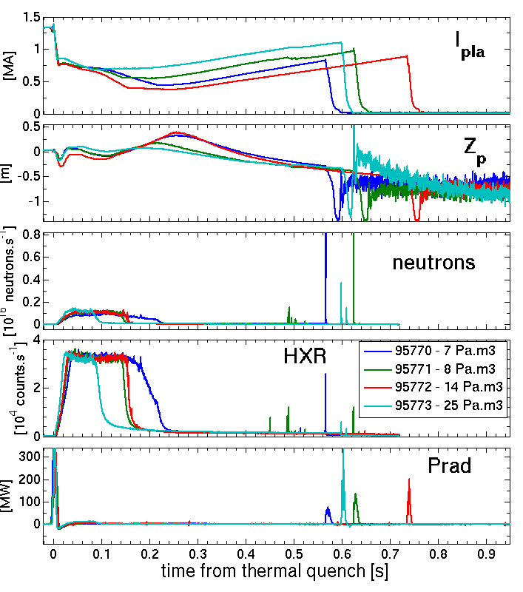
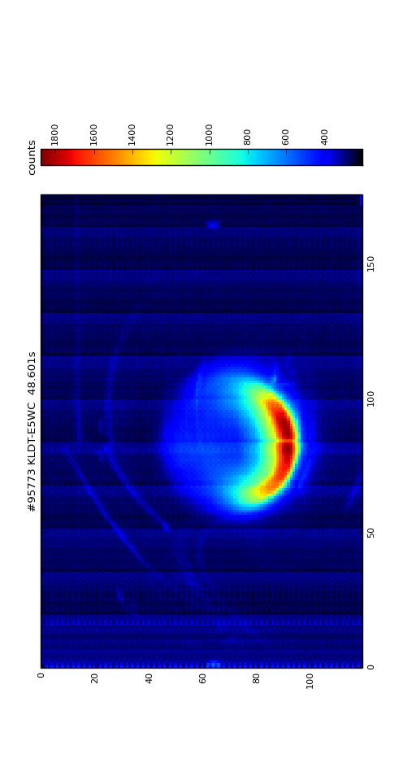
D₂ SPI – JET – boundary conditions
D₂-SPI efficient from 7 to 25 Pa.m³ initial argon injection.
25 Pa.m³ : tiny impact by a secondary RE beam created during the final collapse.
Large enough neon SPI after a D₂ SPI cancels the D₂ effect
Termination no longer completely benign when the f_{Ne} in a D₂+Ne SPI is >20%.
D₂-effect works only with a pure enough companion plasma

Slide 17
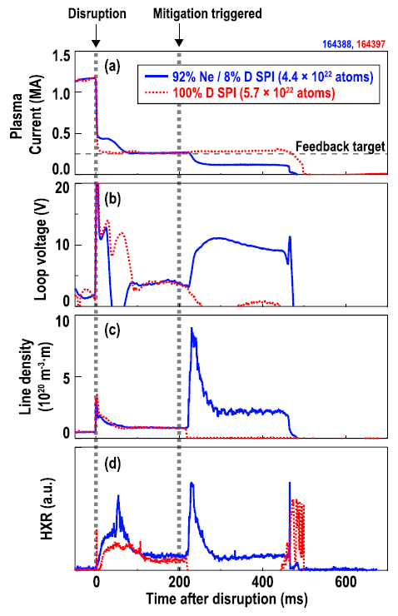
D₂ SPI – DIII-D
Loop voltage drops (beam current control)
  Consequence of lower RE drag on impurities
  = lower effective resitivity
Free electron density drops to almost zero
HXR drop to zero
  Runaways are still there though
Ar lines are replaced by deuterium lines
Final RE collapse does not happen in a single burst
Presence of a wall impact unclear
[Shiraki NF 2018]
D₂ purges the plasma from impurities but does not always affect the termination the same way as in JET

Slide 18
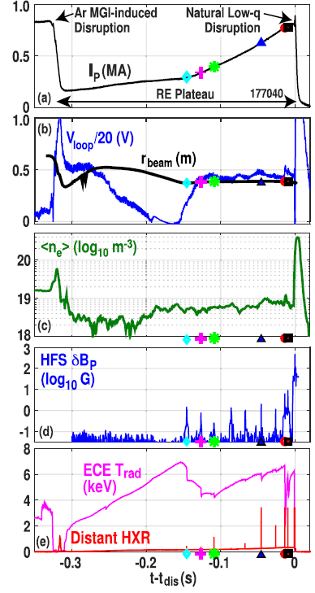
D₂ SPI – DIII-D – kink activity
1 case with 1 MA RE termination:
D₂ MGI at the beginning of the plateau
Central solenoid at max voltage ➔ Ip rise
Low free electron density (not zero)
Final collapse : ~single burst of HXR, losing all runaways
  Alfvenic time scale (~100 µs)
Conversion of RE current into ohmic current
  Conventional disruptive current spike
  Conventional current quench
Several intermediate MHD bursts, the last one being the largest
Attributed to low q_{edge} (q>3 for intermediate crashes, q_{edge} ~2 for final collapse)
[Paz-Soldan PPCF 2019]
D₂ with increasing Ip leads to fast RE loss

Slide 19
Outline
General background
  Disruptions and runaways
  Runaway scenarios
Experimental data
  High-Z MMI
  D₂ MMI
D₂ cases: role of the instability
  Pre-collapse phase
  Characterization of the instability
  MHD Simulations
D₂ cases: role of the companion plasma
  Transport during the purge phase
  Final collapse dynamics

Slide 20
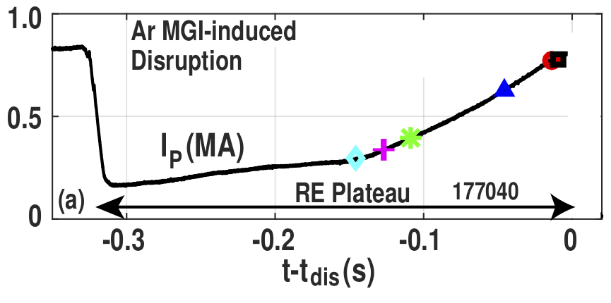
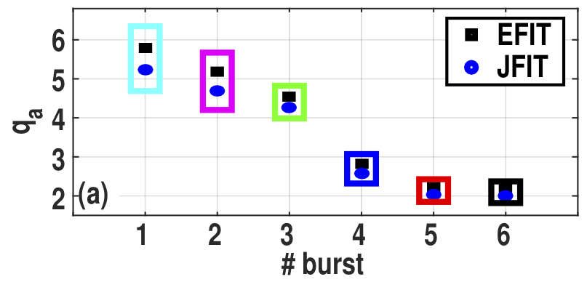
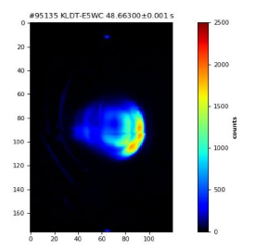
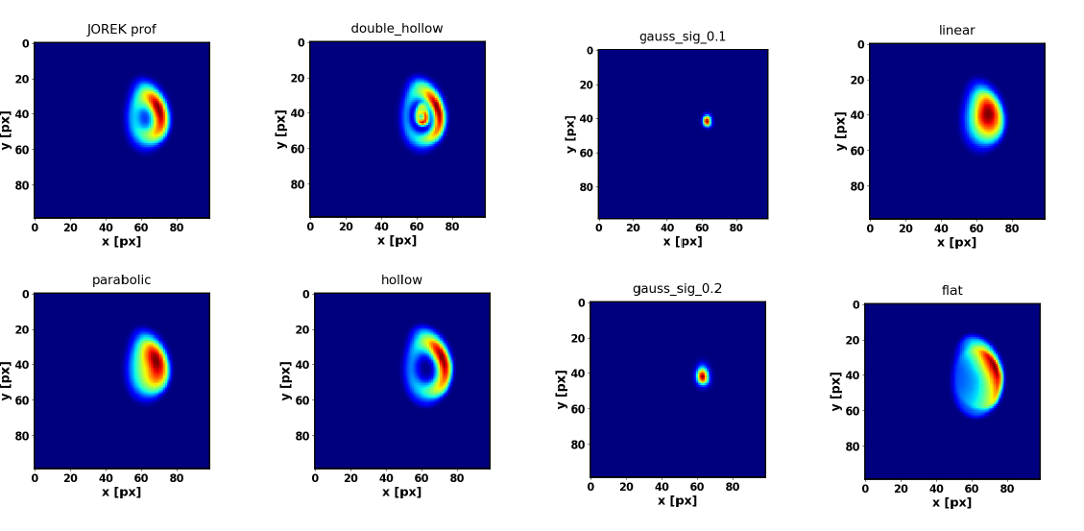
Instability development: JET and DIII-D
Most representative cases
  Increase of RE current up to MA levels
  low q_{edge} @collapse (DIII-D: 2, JET: 2-4)
  High levels of MHD activity
Some evidence at JET that current and q profiles are hollow ➔key feature?
  From SOFT reconstructions of IR pictures
  From island movement on IR pictures
  Indirectly: on results from JOREK simulations [see V. Bandaru’s talk – this conference]
[Paz-Soldan PPCF 2019]
Courtesy of O. Ficker

Slide 21
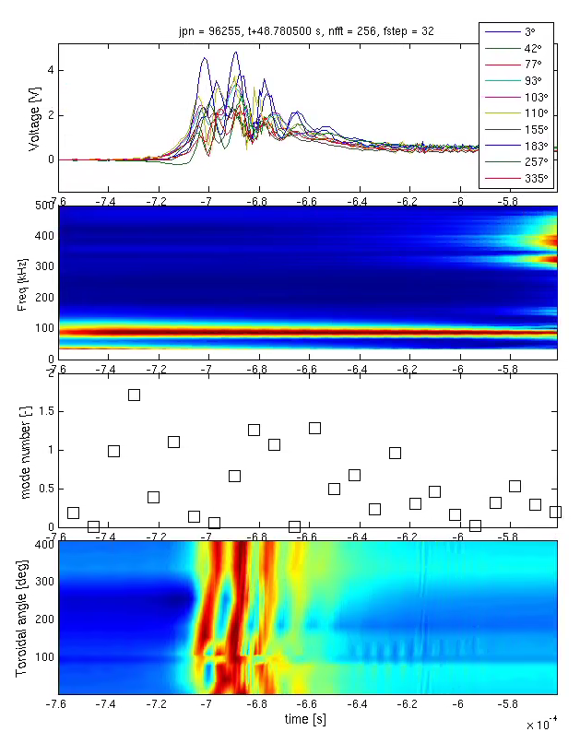
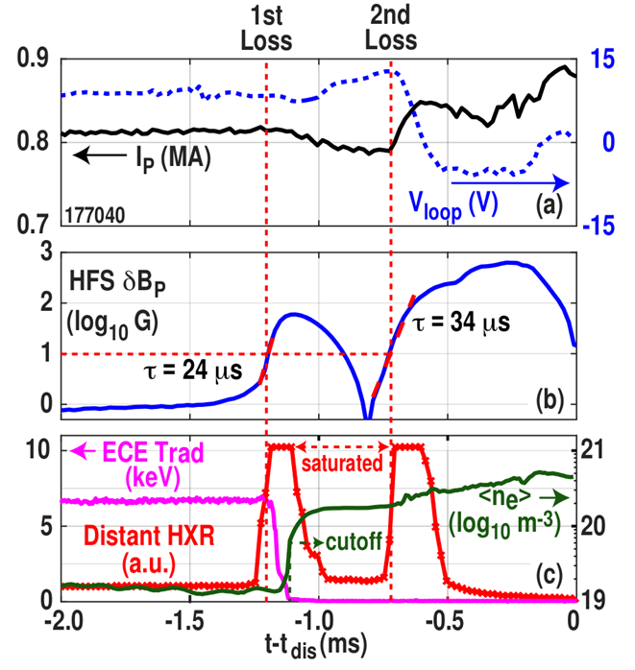
Instability characterization: similarities on timescales and mode numbers
Close-up on the termination
JET: 50-100 µs spike: DIII-D ~100 µs
Low n structure (n=1 mostly), rotating at 100-300 kHz (when rotating – sometimes single spike)
JET: Pre-existing islands but no real precursor
DIII-D: some intermediate collapses
Mirnov voltage
50 µs!
mode frequency
n mode number
[Paz-Soldan, PPCF2019]

Slide 22
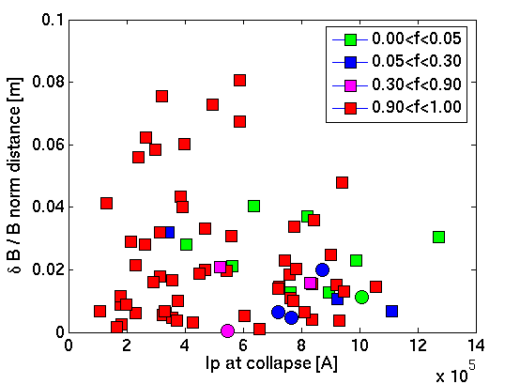
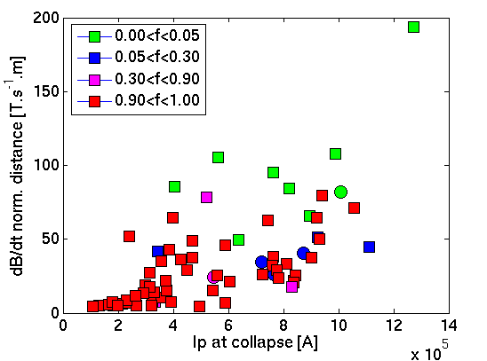
Instability characterization : amplitude - JET
Benign cases associated with large δB
But not systematic: large δB/B also observed with RE beams leading to impacts
similar observations on DIII-D [see C. Paz-Soldan, this conference]
What matters more (JET) is the perturbation timescale (growth rate, or maximum dB/dt)
  ➔ more obvious separation of the low-Z/high-Z mitigation
Some overlap between both groups ➔ not the only ingredient
δB/B
High-Z fraction
dB/dt_{max}
High-Z fraction
High MHD activity part of the recipe, but not entirely

Slide 23

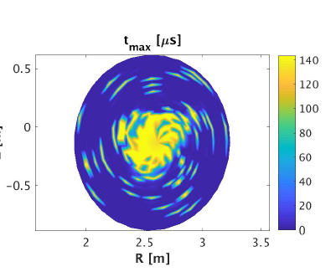

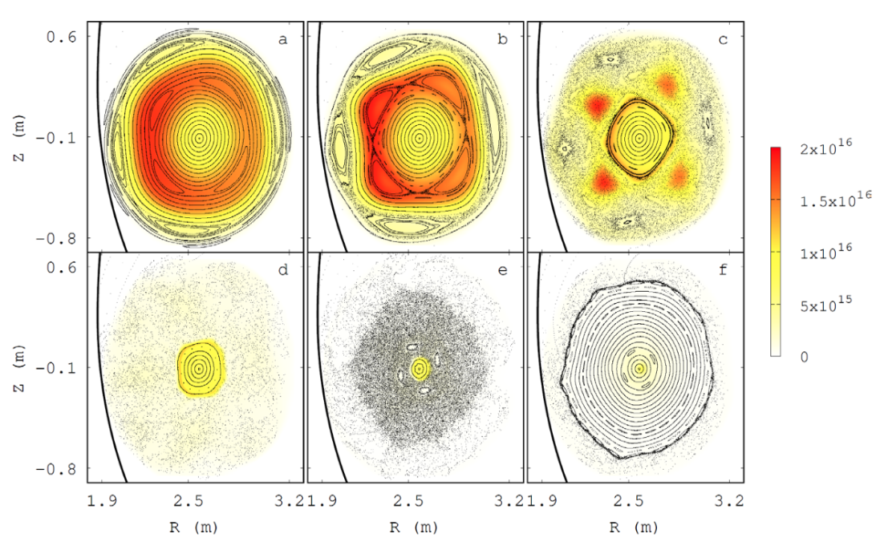
Final collapse: MHD simulations
MARS-F runs: REs (almost) completely deconfined if perturbation amplitude large enough
More in C. Paz-Soldan’s talk (this conference)
JOREK: self-consistent simulations using the RE fluid model
  Most of RE lost
  Timescale compatible with the experiment
More in V. Bandaru’s talk (this conference)
R vs Z
200 G
1 kG
MARS-F
Follow orbit for 16 μs
100 G
MHD+runaway simulations confirm the importance of the instability in RE losses
JOREK

Slide 24
Outline
General background
  Disruptions and runaways
  Runaway scenarios
Experimental data
  High-Z MMI
  D₂ MMI
D₂ cases: role of the instability
  Pre-collapse phase
  Characterization of the instability
  MHD Simulations
D₂ cases: role of the companion plasma
  Transport during the purge phase
  Final collapse dynamics

Slide 25

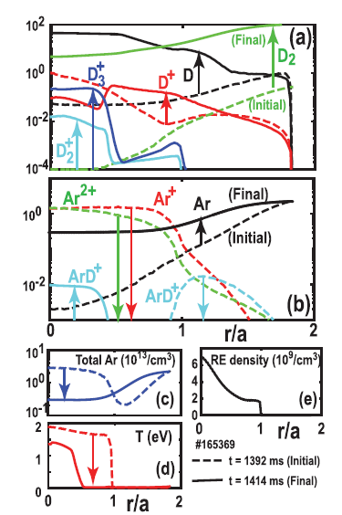
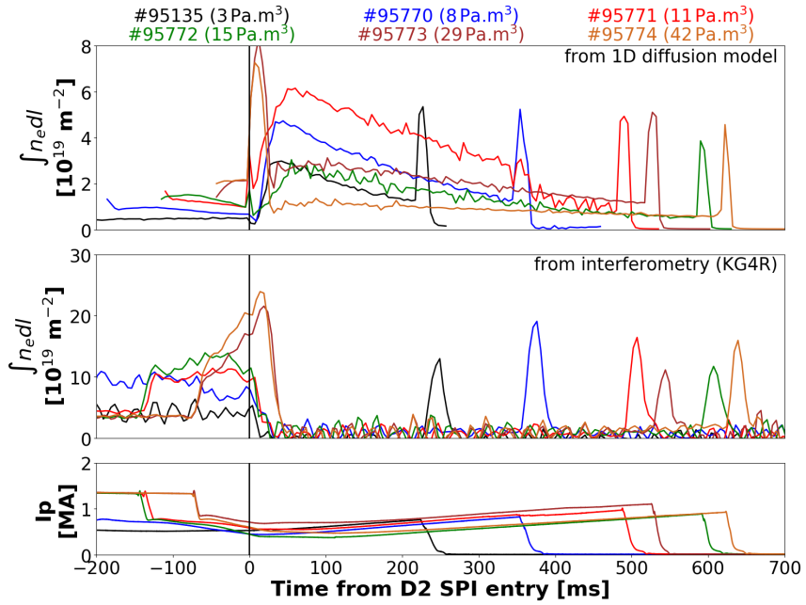

Companion plasma: impurity transport during the D₂ purge phase
Results on D₂ purge cases on DIII-D:
  Confirms the recombination + purge effect.
  Runaway power lost through collisions with neutrals then radial transport to the wall
JET:
  Recombination cannot be obtained in the simulation
  Possibly due to higher direct RE-neutral interaction (non-thermal radiation), not accounted in the code
[Hollmann PoP 2020]
n_{e} from model
[See S. Sridhar’s talk, this conference]
n_{e} from measure
Ar purge-out successfully modelled for DIII-D, but incomplete for JET

Slide 26
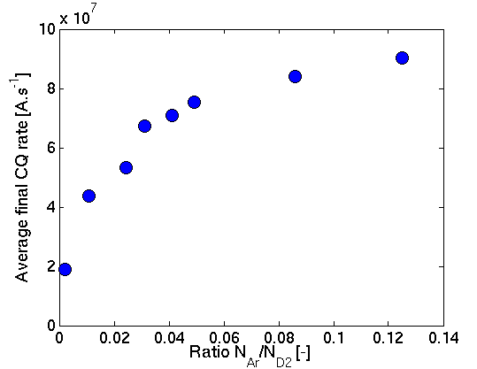
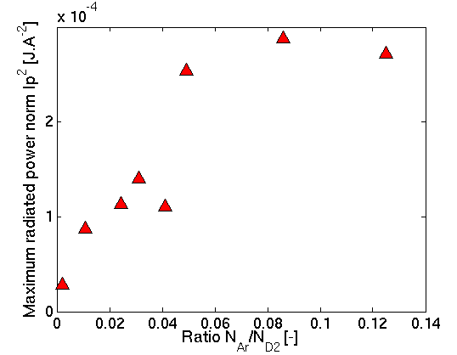
Companion plasma: role of impurity remnant in the final collapse
Enough remaining argon leads to runaway reacceleration during CQ
  Hints at the fact that not all the argon is flushed out.
Timescale and radiated power during the final collapse also scale with the initial argon amount
  An argon remnant exists in the companion plasma
RE reacceleration
RE reacceleration
Remnant impurities in the companion plasma set the final collapse features

Slide 27
Conversion from magnetic to kinetic energy: how to reaccelerate runaways during your final collapse
Calculation of the fraction of the initial runaway magnetic energy converted into kinetic energy
Inspired by the method proposed in [Loarte NF 2011]
Conversion happens when HXR bursts are recorded while current decreases
Synchrotron power
Radiated power
☑
☑
Collisions
RE magnetic energy
Conversion
RE kinetic energy
Companion plasma
☑
Direct impact
EM coupling
☒
☑
External conducting structures
Wall

Slide 28
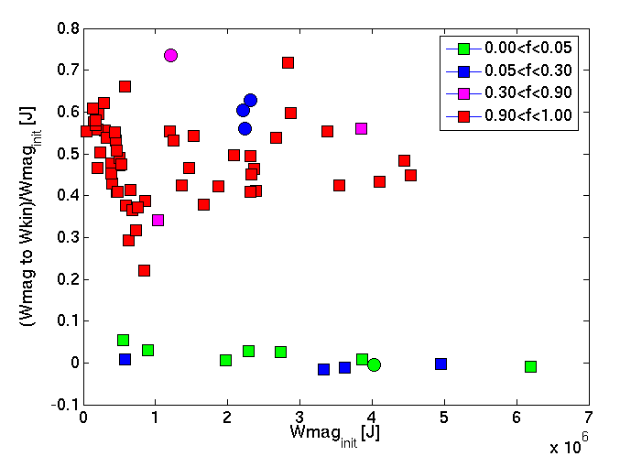
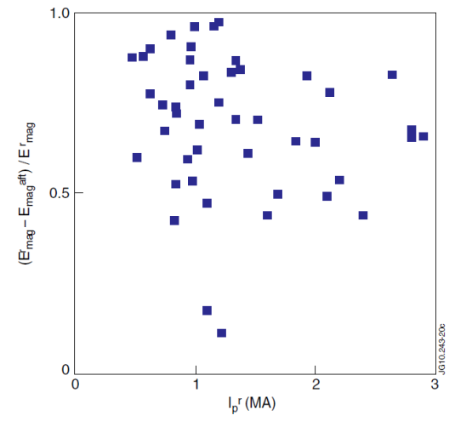
Conversion from magnetic to kinetic energy: JET database
Fraction of magnetic energy converted:
  25% < f_{conv} < 80% for high-Z
    Similar range as in [Loarte NF 2011]
  f_{conv} <10% for low-Z
Note: reacceleration of small RE beams not taken into account : too small RE currents
  ➔Gap between pure D2 and pure Ar to be filled
High-Z fraction
W_{mag,converted}/W_{mag,init}
Three outliers with MGI: vertically unstable configuration ? High density companion plasma?
Clear distinction between low-Z and high-Z cases : absence of W_{mag} to W_{kin} conversion is key
[Loarte NF 2011]

Slide 29
Conclusions
D₂ SPI leads to quick dissipation of runaways on both JET and DIII-D
No wall heating at JET (6 pulses) despite currents up to 1.27 MA.
Runaway dissipation in 50-100 µs on both machines
Runaway current increases is present in most cases➔key ingredient ?
Presently assumed that the « D₂-effect » is a combination of two mechanisms:
  Large MHD instability (kink ? – not necessarily related to low q_{edge} at JET – possibly linked to li, q=2 on DIII-D)
  A pure enough companion plasma to prevent runaway reacceleration and conversion of W_{mag} to W_{kin}
A potential mitigation method for ITER and beyond.

Slide 30
Acknowledgements
This work has been carried out within the framework of the EUROfusion Consortium and has received funding from the Euratom research and training programme 2014-2018 and 2019-2020 under grant agreement No 633053. The views and opinions expressed herein do not necessarily reflect those of the European Commission.
This material is based upon work supported by the U.S. Department of Energy, Office of Science, Office of Fusion Energy Sciences, using the DIII-D National Fusion Facility, a DOE Office of Science user facility, under Award(s) DE-FC02-04ER54698.
  Disclaimer: This report was prepared as an account of work sponsored by an agency of the United States Government. Neither the United States Government nor any agency thereof, nor any of their employees, makes any warranty, express or implied, or assumes any legal liability or responsibility for the accuracy, completeness, or usefulness of any information, apparatus, product, or process disclosed, or represents that its use would not infringe privately owned rights. Reference herein to any specific commercial product, process, or service by trade name, trademark, manufacturer, or otherwise does not necessarily constitute or imply its endorsement, recommendation, or favoring by the United States Government or any agency thereof. The views and opinions of authors expressed herein do not necessarily state or reflect those of the United States Government or any agency thereof.

