Slide 1
Validation of state-of-the-art runaway electron generation models in simulations of ASDEX Upgrade disruptions
IAEA Technical Meeting on Plasma Disruptions and their Mitigation 20th - 23rd July 2020
O. Linder¹, E. Fable¹, F. Jenko¹, G. Papp¹, G. Pautasso¹,
the ASDEX Upgrade Team† and the EUROfusion MST1 Team‡
¹Max-Planck-Institut für Plasmaphysik, Boltzmannstr. 2, 85748 Garching, Germany
†See author list of H. Meyer at al. 2019 Nucl. Fusion 59 112014 ‡ See author list of B. Labit et al. 2019 Nucl. Fusion 59 086020
Notes:
In this talk on the validation of state-of-the-art runaway electron generation models, we will explore how reduced models can be used in 1.5D transport simulations to calculate the runaway current during artificially induced disruptions.

Slide 2
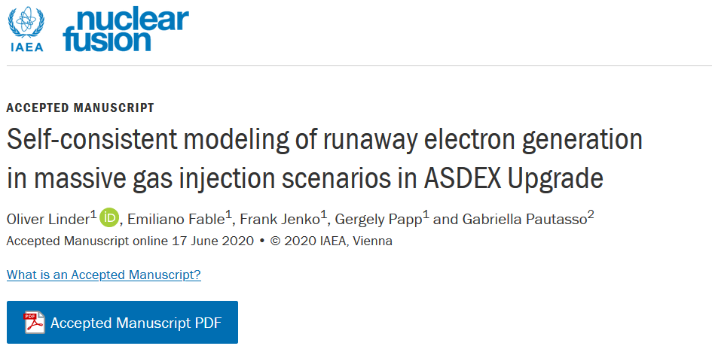
Brief remark: RE modeling beyond this talk
More details and analyses on this topic can be found in the following publication:
Notes:
A brief remark: This talk can only provide a brief overview on the work carried out on this topic. For further details and analyses, please refer to the article mentioned below, which has been recently accepted for publication in the journal Nuclear Fusion. With this mentioned, let’s dive into modeling runaway electron generation in transport simulations.

Slide 3
Towards understanding RE generation
ITER DMS
Understanding RE generation
theoretical
experimental
investigation
computational
Notes:
As identified by the ITER Organization, the conversion of a substantial fraction of the Ohmic current to relativistic runaway electrons during a disruption must be avoided to prevent potential severe damage to ITER. Designing an effective disruption mitigation system (DMS) is therefore of prime importance to ensure the successful operation of the ITER tokamak. This task in turn demands a solid understanding of the processes governing runaway electron generation and dissipation in a rapidly changing plasma environment; that is in the presence of high-Z material, stochastic magnetic field lines and a cold background plasma. These interactions are being studied experimentally across various machines, aided by theoretical investigation. A method to bridge both approaches and to complement the ongoing effort is through computational investigation.
In this talk, we will focus on this 3rd pillar of tackling the runaway electron problem.

Slide 4
Integrated simulations with the transport codes ASTRA-STRAHL
Experimental agreement
Model validation
Material transport
RE generation
MMI
Main plasma
Notes:
As we will see in the following, integrated modeling tools can be used successfully to self-consistently model the interactions between background hydrogen plasma, impurity species introduced through massive material injection (MMI) and runaway electrons. For this task, the 1.5D transport code toolkit ASTRA-STRAHL is chosen. On the following slides, we will first familiarize ourselves with the toolkit ASTRA-STRAHL and then apply it to model an ASDEX Upgrade discharge.
Here, we will explore three aspects of the modeling process, being
a) the description of the material transport,
b) agreement between simulation and experiment and
c) the validation of reduced models for runaway electron generation.

Slide 5
The model: main plasma & impurity evolution
Experimental agreement
Solving transport equation
$$\frac{∂Y}{∂t}=\frac{1}{V^{′}}\frac{∂}{∂ρ}\left(V^{′}〈{\left(Δρ\right)}^{2}〉\left[D\frac{∂Y}{∂ρ}−v Y\right]\right)+\sum_{j}{S_{j}}$$
Model validation Material transport
MMI
Main plasma
RE generation
ASTRA¹
STRAHL³
For arbitrary quantity $Y$; here:
Poloidal magnetic flux $Ψ$
Electron temperature $T_{e}$
Ion temperature $T_{i}$
RE current density $j_{RE}$
Flux-surface average; toroidally symmetric
Magnetic geometry:
3-moment solver
SPIDER²
For individual ion charge states (incl. neutrals) ($n_{e}(t)$ from quasineutrality)
Transport coefficients $D$ & $v$:
From NEOART⁴
Externally provided
Atomic processes (sources $S_{j}$) from ADAS⁵
Impurity radiation for $T_{e}(t)$
³R Dux et al. Nucl. Fusion 39, 1509 (1999)
⁴A G Peeters. Phys Plasmas 7, 268 (2000)
⁵H P Summers. The ADAS User Manual, version 2.6. http://www.adas.ac.uk
¹E Fable et al. Plasma Phys. Control. Fusion 55, 074007 (2013)
²A A Ivanov et al. 32nd EPS Conference on Plasma Physics 2005, P5.603
Notes:
Each of the two coupled codes ASTRA and STRAHL evaluates the macroscopic transport equation for certain fluid quantities $Y$ as a function of the normalized radial coordinate $ρ$ and time $t$ in the presence of diffusion $D$, convection $v$ and sources $S$. The calculations are thus performed in one radial dimension for flux-surface averages assuming toroidal symmetry.
In the case of ASTRA, evolution is performed for the main plasma parameters, which here are the poloidal magnetic flux, both the electron and ion temperatures, and the runaway electron current density. The magnetic geometry can be obtained either from a 3-moment solver under the assumption of circular flux surfaces or from the code SPIDER for shaped plasmas. For the simulation of ASDEX Upgrade disruptions, application of the 3-moment solver is sufficient.
Evolution of individual impurity charge states including the neutral populations is performed by STRAHL. The electron density evolution is obtained by demanding quasineutrality. For the transport of impurities, neoclassical transport coefficients can be provided by the built-in code NEOART. Further coefficients can be provided if necessary. Electron impact atomic processes such as ionization and recombination are taken into account by prescribing tabulated rate coefficients obtained from ADAS as sources. Additionally, impurity radiation can be calculated with ADAS and used as a sink term during the evaluation of the electron temperature evolution.

Slide 6
The model: RE generation mechanisms
Primary generation
Experimental agreement
Secondary generation
Model validation Material transport
MMI
Main plasma
RE generation
Dreicer mechanism:
Classical formula by Connor & Hastie¹
Neural-network version of kinetic solver CODE² by Hesslow et al³ incl. impact of partially ionized impurities
Hot-tail mechanism:
Model by Smith & Verwichte⁴ to be implemented
Nuclear sources not considered (tritium $β^{−}$-decay, Compton $γ$)
Irrelevant for AUG
Avalanche mechanism:
Classical formula by Rosenbluth & Putvinski⁵
Formula with partially ionized impurities by Hesslow et al⁶
¹J W Connor and R J Hastie. Nucl. Fusion 15, 415 (1975)
²A Stahl et al. Nucl. Fusion 56, 112009 (2016)
³L Hesslow et al. J. Plasma Phys. 85, 475850601 (2019)
⁴H M Smith et al. Phys. Plasma 15, 072502 (2008)
⁵M N Rosenbluth and S V Putvinski. Nucl. Fusion 37, 1355 (1997)
⁶L Hesslow et al. Nucl. Fusion 59, 084004 (2019)
Notes:
The generation of runaway electrons in this framework is described through reduced fluid-models for both primary and secondary generation.
In the former case, two models for Dreicer generation are included. The first one is the classical formula by Connor & Hastie, which is valid only for fully ionized plasma species. To correct for the effect of partially ionized impurities in simulations of mid to high $Z$ material injection, a neural network version of the kinetic solver CODE is additionally included in this framework. Further primary generation mechanisms are at the moment not considered. However, a model to describe hot-tail generation is currently being implemented. Sources due to nuclear processes can be neglected for simulations of ASDEX Upgrade discharges.
In the case of secondary runaway generation, the classical formula by Rosenbluth & Putvinski is included. However as this model is also valid only for fully ionized species, a model by Hesslow et al is additionally included to capture the impact of partially ionized impurities on avalanching.

Slide 7
The model: RE implementation
Dreicer generation
Experimental agreement
Avalanche generation
Model validation Material transport
MMI
Main plasma
RE generation
Classical formula by Connor & Hastie
CODE-NN by Hesslow et al
Classical formula by Rosenbluth & Putvinski
Updated formula by Hesslow et al
Fortran module + wrapper for ASTRA (https://github.com/o-linder/runawayelectrongeneration)
Incl. calculation of auxiliary quantities (e.g. $E_{D}$, $E_{c}$, $E_{c}^{eff}$, $p_{⋆}$, ${\overline{ν}}_{D}$, ${\overline{ν}}_{s}$ )
Formulae w/ partially ionized impurities
Classical formulae
Applied throughout this work
Implementation verified against MATLAB versions by Hesslow et al
Applied to assess impact of partially ionized impurities
Implementation verified against disruption code GO¹ (exp. $T_{e}$-decay for AUG plasmas)
¹G Papp et al. Nucl. Fusion 53, 123017 (2013)
Notes:
The two models for each Dreicer and avalanche generation are implemented in a standalone fortran module, which is now available on github.com. Along with the corresponding growth rates for each generation mechanism, auxiliary quantities such as for example characteristic electric fields and collision frequencies are calculated. In combination with a wrapper routine, this module is used in ASTRA for the calculation of runaway sources.
Throughout this work, the models by Hesslow et al are applied, thus taking the effect of partially ionized impurities on electron runaway into account. To assess the impact of these effects, simulations may also be performed with the classical formulae by Connor & Hastie and by Rosenbluth & Putvinski. The implementation of each of the four models has been verified either against MATLAB implementations of the respective models or against calculations by the disruption code GO.

Slide 8
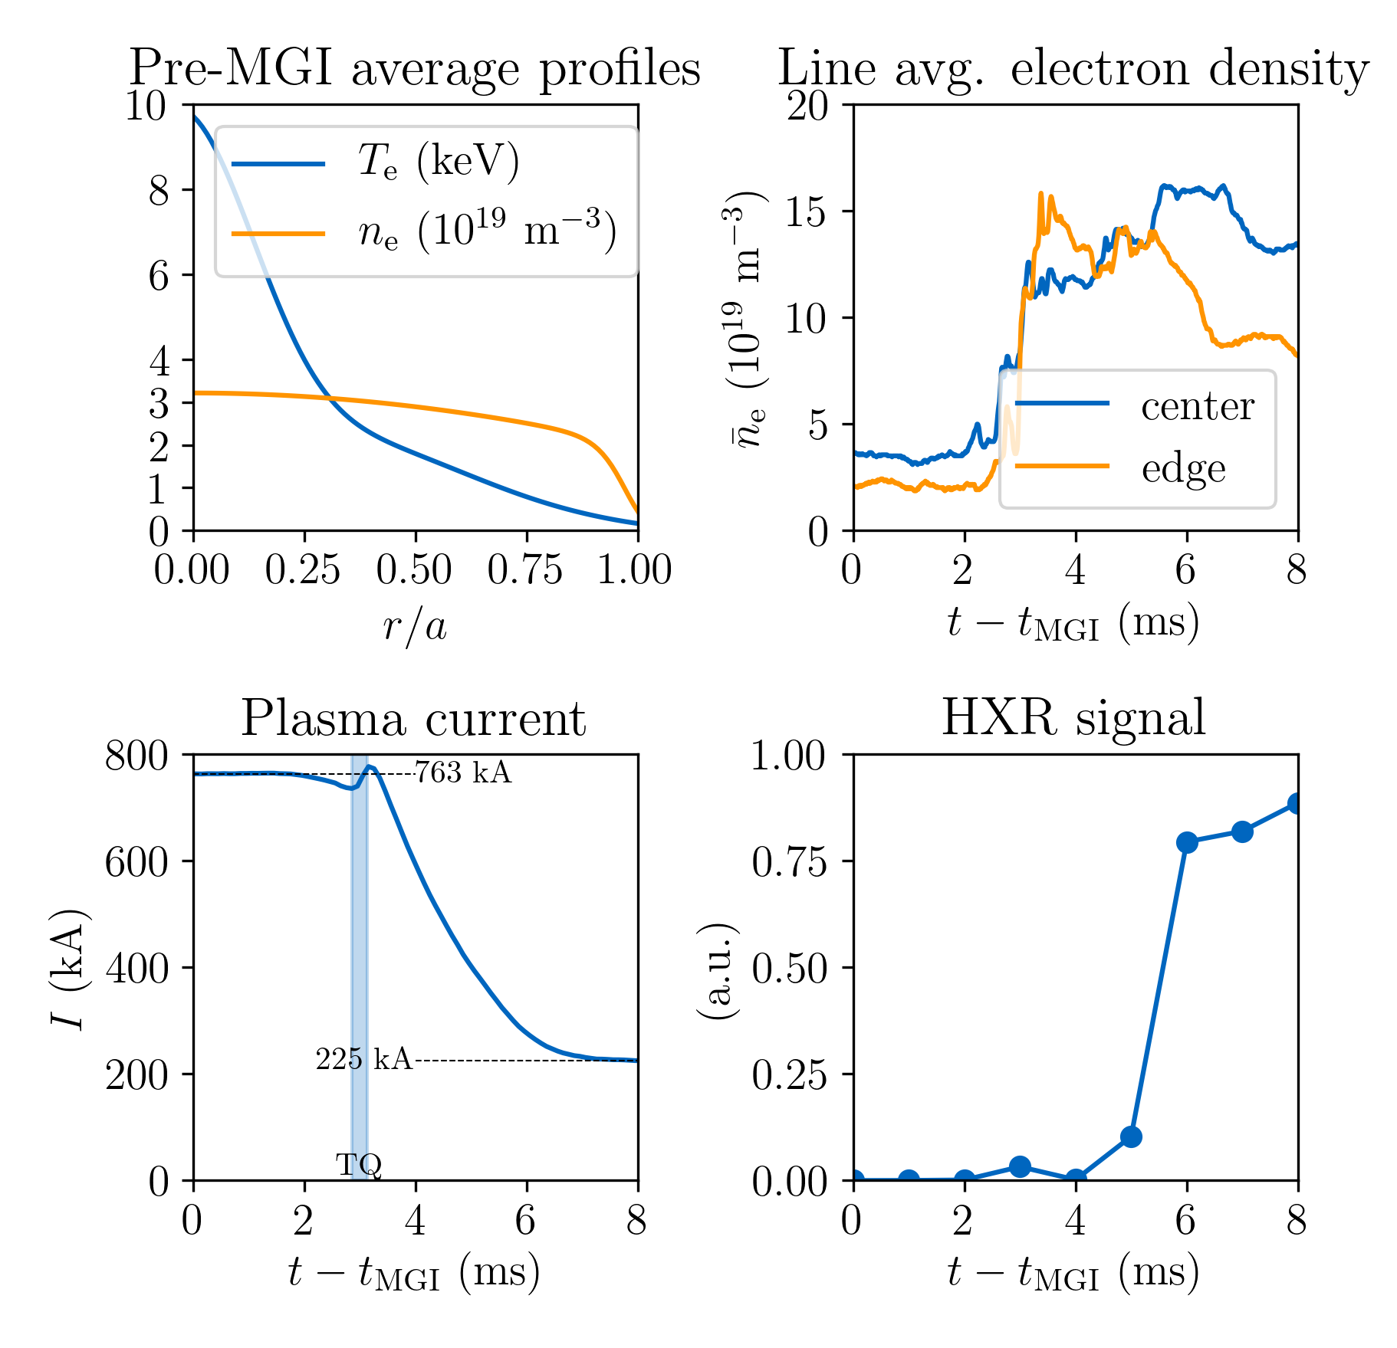
Experimental scenario: ASDEX Upgrade #33108
Scenario
Circular L-mode limiter plasma
Low density $〈n_{e}〉=2.8×{10}^{19}m^{−3}$
High temperature $T_{e}\left(ρ=0\right)≈10 keV$
Evolution
Ar MGI at $t_{MGI}=1.0 s$
Thermal quench (TQ): $2.85 ms≤t−t_{MGI}≤3.13 ms$
Final (RE) current: $763 kA→225 kA$
Experimental agreement
Model validation Material transport
MMI
Main plasma
RE generation
Notes:
The capabilities of the toolset discussed can be illustrated by applying the model for the simulation of ASDEX Upgrade discharge #33108. The scenario chosen is a circular L-mode limiter plasma with low density and high temperature. Argon is injected 1 s after the beginning of the discharge. As a result, the free electron density measured increases abruptly after 3 ms as the material is ionized and induces a thermal quench. During the following 4 ms, the plasma current decreases from 760 kA to around 220 kA, being carried by relativistic electrons in the cold post-disruption plasma as indicated by the hard X-ray signal.

Slide 9
Material transport
Experimental agreement
Model validation Material transport
Material transport
MMI
Main plasma
RE generation
MMI
Notes:
Now that we have familiarized ourselves with the toolkit ASTRA-STRAHL and the scenario to be simulated, a few aspects regarding material transport need to be addressed.

Slide 10
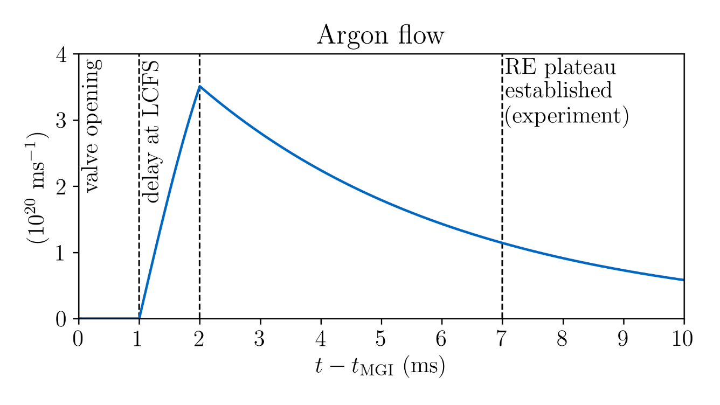
Material transport: deposition
Outflow from gas valve described by continuity equation¹ $$\frac{dN_{Ar}}{dt}=−v_{Ar} N_{Ar}\frac{A_{v}(t)}{V_{v}(t)}$$
Experimental constraints
$NAr\left(t=0\right)=1.75×{10}^{21}$ Ar atoms
$vAr$: inward propagation with thermal velocity $v_{th}=\sqrt{T/m} =246 m/s$
$Av$: valve opens within 1 ms
In simulation located 1 cm outside LCFS → 1 ms delay (no need to model propagation from valve to LCFS)
Experimental agreement
Model validation Material transport
Material transport
MMI
Main plasma
RE generation
MMI
¹G Pautasso et al. Nucl. Fusion 47, 900 (2007)
Notes:
In this model, the material deposited originates from a gas valve. The outflow from the valve can be described by a continuity equation under consideration of experimental constraints and observations. For the scenario to be modeled, around 1.8 x 10²¹ Ar atoms are located in the reservoir. The material is assumed to propagate with thermal velocity of around 250 m/s into the plasma. To simplify the simulation, the material is assumed to originate from just outside the LCFS; requiring a delay in the gas flow rate, which can be determined experimentally.

Slide 11
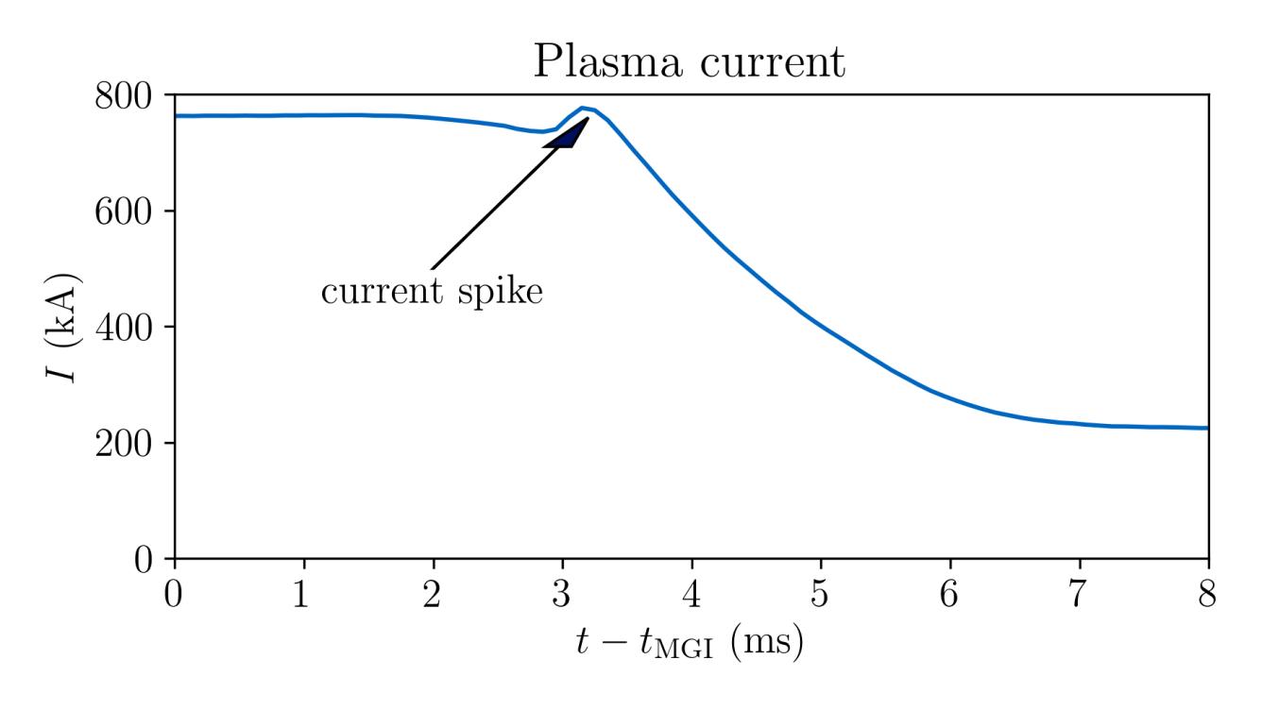
Material transport: rapid redistribution
MHD effects
Currently missing
Evidence: current spike
Hypothesis: gas triggers $\left(m,n\right)=\left(2,1\right)$ mode upon reaching $q=2$ surface¹
Mimic rapid redistribution through exponential decay at $ρ≤ρ(q=2)$:
$$D_{add}\left(t\right)=D_{add}^{max}\exp\left(−\frac{t−t_{q=2}}{τ_{add}}\right)⋅Θ\left(t−t_{q=2}\right)$$
$$v_{add}\left(t\right)=v_{add}^{max}\exp\left(−\frac{t−t_{q=2}}{τ_{add}}\right)⋅Θ\left(t−t_{q=2}\right)$$
Experimental agreement
Model validation Material transport
Material transport
MMI
Main plasma
RE generation
MMI
$$D_{add}^{max} (m^{2}/s)$$ | $$v_{add}^{max} (m/s)$$ | $$τ_{add} (ms)$$
$$100$$ | $$−200$$ | $$1.0$$
Applied parameters
¹E Fable et al. Nucl. Fusion 56, 026012 (2016)
Notes:
In this framework, phenomena due to MHD effects cannot be modeled self-consistently. Experimental observations imply the presence of such effects, one such example being the current spike measured at around 3 ms. Under the assumption that the cold gas front triggers (2,1) modes and higher harmonics upon reaching the q=2 surface through a contracting current density, an ad-hoc model can be applied to mimic the impact of rapid redistribution on the material injected. Transport coefficients radially constant inside the q=2 surface and decreasing exponentially in time are found suitable for this task. Here, the additional transport is assumed to decay on time scales of 1 ms.

Slide 12
Experimental agreement
Experimental agreement
Experimental agreement
Model validation Material transport
MMI
Main plasma
RE generation
Main plasma
Notes:
Having understood the necessary ingredients, transport simulations of ASDEX Upgrade discharge #33108 can be performed and compared to experimental measurements.

Slide 13
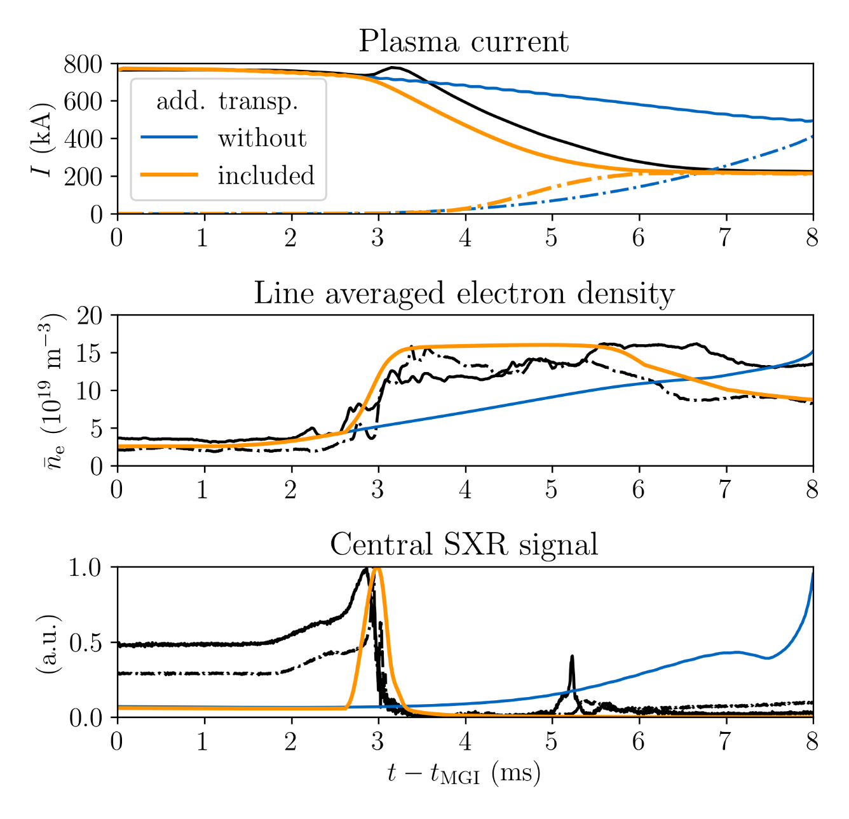
Experimental agreement: key parameters
Experimental agreement
Key observations reproduced:
plasma current
electron density
TQ occurrence
Distinct phases of disruption covered (pre-TQ, TQ, CQ)
Rapid density increase requires additional transport (increased neutral propagation velocity does not help)
Density increase reproduced → current decay reproduced (conductivity $σ∝Z_{eff}^{−1}$)
→ 1D approach suitable for modeling MGI
Experimental agreement
Model validation Material transport
MMI
Main plasma
RE generation
Main plasma
Notes:
Modeling ASDEX Upgrade discharge #33108, key parameters of the experimental evolution are reproduced successfully. As illustrated in the upper subfigure, the calculated plasma current in orange decreases at a similar rate as observed experimentally, yielding a similar runaway current at the end of the current quench. In the middle subfigure, the steep increase of the electron density at around 3 ms as well as the occurrence of the thermal quench as inferred from soft X-ray radiation shown in the bottom subfigure are captured with this approach. Consequently, the distinct phases of pre-thermal quench, thermal quench and current quench are covered by this model.
Agreement between simulation and experiment can be obtained only under application of the additional transport coefficients. In their absence, the material propagates into the core plasma too slowly, resulting in a long delay of the onset of the thermal quench. Simultaneously, the Ohmic current density decays slower than observed. Only when the increase of the free electron density and thus of the effective plasma charge are calculated correctly, the current evolution obtained can agree with measurements.
Applying the toolkit ASTRA-STRAHL to the simulation of argon MGI in ASDEX Upgrade discharge #33108, we observe that this 1D approach is suitable for modeling MGI scenarios.

Slide 14
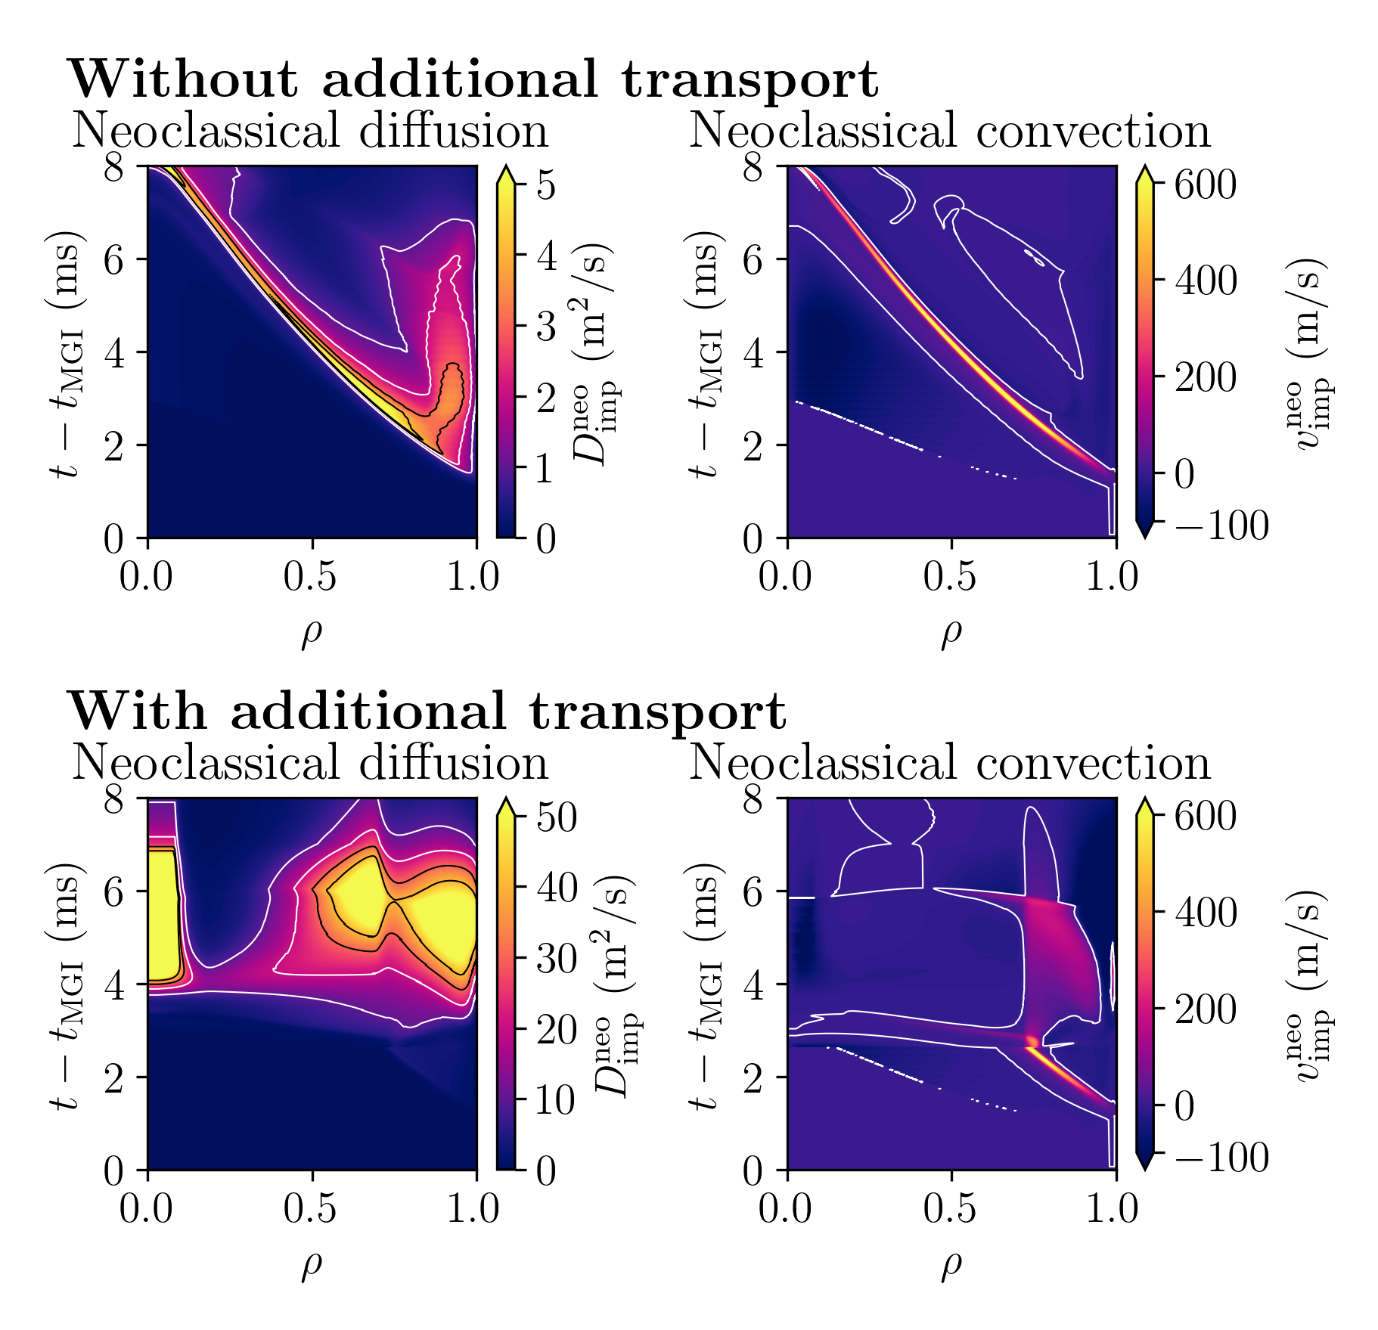
Experimental agreement: neoclassical transport
In absence of additional transport
Diffusion & strong outward convection almost cancel
Propagation driven by neutrals
Slow inward propagation of material
With additional transport
Outward convection vanishes; diffusion present
Neoclassical transport contributes noticeably to inward transport (current decay too slow in absence of neoclassical effects)
strong outward convection
inward diffusion
still present
vanishes
With NEOART
Without NEOART
Notes:
The slow propagation of the cold gas front into the central plasma in the absence of additional transport coefficients stems from opposing neoclassical fluxes. The steep density gradient in front of the ionized material results in inward transport due to diffusive processes. Simultaneously, a strong neoclassical pinch transports particles outward, effectively canceling the inward diffusive flux, as shown in the upper part of the right figure. As a result, the propagation of the cold gas front is predominantly driven by the incoming neutrals under these conditions.
In the presence of additional transport coefficients, neoclassical convection effectively vanishes, causing net inward transport of ionized impurities due to neoclassical diffusion. This process cannot be neglected in the simulations performed. As shown in the figure on the left side, ionized material reaches the central plasma significantly later when not utilizing NEOART in the simulations. The experimentally observed decay of the residual Ohmic current cannot be reproduced under these conditions. Consequently, neoclassical processes are important for describing the transport of ionized impurities during disruptions.

Slide 15
Runaway electron generation & model validation
Experimental agreement
Model validation Material transport
Model validation
MMI
Main plasma
RE generation
RE generation
Notes:
Since we have now shown that the evolution of the background plasma can be adequately described by our model, we can investigate the generation of runaway electrons in this setting.

Slide 16
Runaway electron generation
Ohmic current contracts due to MGI
Electric field (normalized) locally increases ($E_{∥}∝j_{Ω}T_{e}^{−3/2}$)
Experimental agreement
Model validation Material transport
Model validation
MMI
Main plasma
RE generation
RE generation
contraction
Dreicer generation
Avalanche generation
Dreicer generation transiently at radii with high $j_{Ω}$ → only small seed generated: $1.1\% I_{RE,tot}$
Multiplication over a few ms → RE current avalanche dominated: $98.9\% I_{RE,tot}$
$$E_{∥}/E_{D}∝j_{Ω}/T_{e}^{1/2}n$$
high $j_{Ω}$ → high source
$$E_{∥}/E_{c}∝j_{Ω}/T_{e}^{3/2}n$$
Notes:
As illustrated in the top right figure, the Ohmic current contracts into the central plasma where the plasma temperature has not collapsed yet. As a result, the parallel electric field increases locally up to a few percent of the Dreicer electric field for a short duration. This magnitude is sufficient to cause electron runaway. However, given the transient nature of the increased electric field, Dreicer generation only produces a small seed population of runaways of around 1% of the final runaway population.
The seed runaways are then multiplied by the avalanche mechanism. As the parallel electric field exceeds the critical electric field throughout the entire plasma radius for several ms, a significant runaway population is generated, being in total around 210 kA. This estimate is well in line with experimental observations as seen on the previous slides.

Slide 17
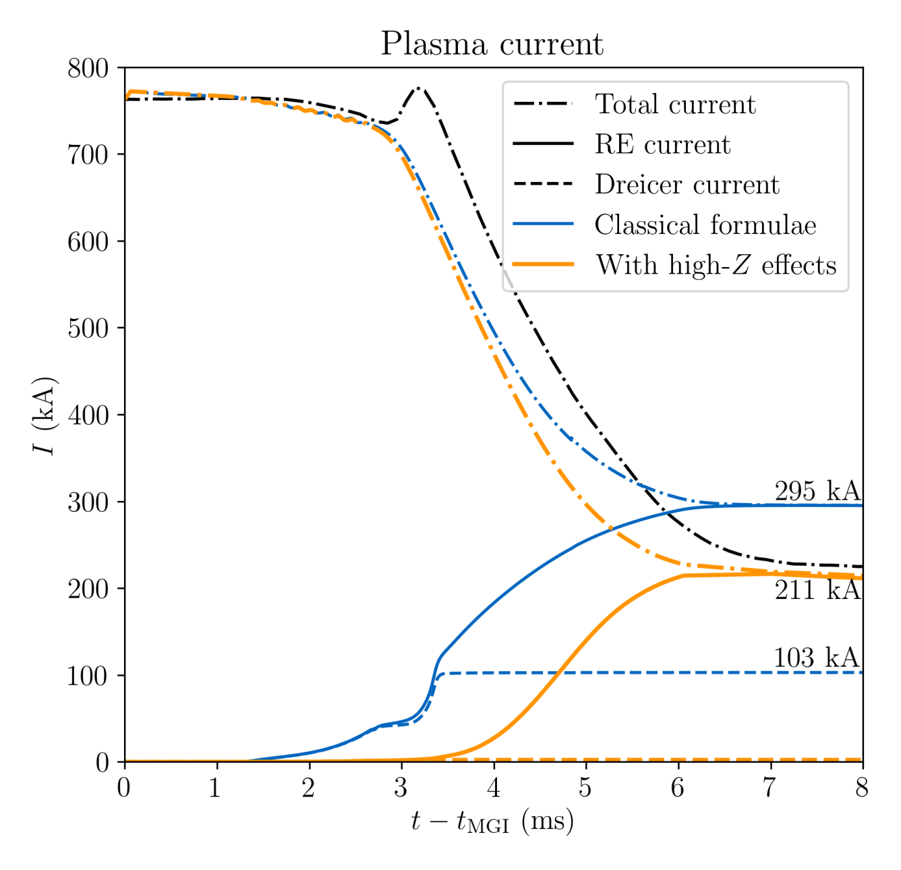
Model validation: impact of partially ionized impurities
Neglecting impact
Earlier & stronger onset of Dreicer source
Weaker avalanching (similar $I_{av}$ despite larger seed)
Final RE current not too different, but evolution & composition is
→ Impact or partially ionized impurities important for RE evolution
Experimental agreement
Model validation Material transport
Model validation
MMI
Main plasma
RE generation
RE generation
Note: Agreement with all measurements cannot be re-obtained by adjusting $D_{add}^{max}$, $v_{add}^{max}$ and $τ_{add}$
Notes:
The simulations presented were carried out applying the models for runaway generation under consideration of the impact of partially ionized impurities as developed by Hesslow et al. To assess the importance of these effects, the runaway generation models used can be replaced by the classical formulae by Connor & Hastie for Dreicer generation and by Rosenbluth & Putvinski for avalanche generation.
Neglecting the impact of partially ionized impurities on electron runaway, which is shown in blue in the figure on the right, the Dreicer mechanism produces a noticeably increased runaway population of around 100 kA earlier in the disruption. The strength of avalanche multiplication is however reduced. In both cases, the amounts of avalanche generated runaways are of comparable magnitude despite the larger Dreicer population when employing the formula by Connor & Hastie. The final runaway current calculated does therefore not agree with experimental measurements, although being in the right order of magnitude. It should be noted, that even though our model employs free parameters, agreement with all experimental measurements cannot be re-obtained adjusting their values when applying the classical formulae.
From this we conclude, that the impact of partially ionized impurities on runaway electron generation cannot be neglected in self-consistent simulations of tokamak disruptions.

Slide 18
Conclusion
Experimental agreement
Model validation Material transport
1D framework captures 3D material delivery
Transport governed by neoclassical and
MHD effects
RE generation
MMI
RE generation
MMI
Main plasma
Impact of partially ionized impurities not negligible for RE evolution
Successful simulation of Ar MGI in AUG #33108 with ASTRA-STRAHL
Notes:
This brings us the end of this talk. We have seen that the transport toolkit ASTRA-STRAHL can be used successfully for the simulation of argon MGI and runaway electron generation, correctly calculating the evolution of key plasma parameters in agreement with experimental observations. Here, a 1D approach for material deposition and propagation is found suitable, despite the complexity and 3D nature of MGI. Even though neoclassical processes are important for the transport of ionized impurities, additional effects due to MHD also play a significant role in re-distribution of material. In this setting, the impact of partially ionized impurities cannot be neglected for the calculation of electron runaway.

Slide 19
Further questions?
Send a mail to Oliver.Linder@ipp.mpg.de
Let’s discuss during the Consequences session on Monday, 20th July
Look up the detailed article recently accepted for publication in Nuclear Fusion

Slide 20
References
^{5.1} E Fable, C Angioni, A A Ivanov, K Lackner, O Maj et al. Dynamical coupling between magnetic equilibrium and transport in tokamak scenario modelling, with application to current ramps. Plasma Phys. Control. Fusion 55, 074007 (2013)
^{5.2} A A Ivanov, R R Khayrutdinov, S Yu Medvedev and Yu Yu Poshekhonov. New adaptive grid plasma evolution code SPIDER. Contribution at the 32nd EPS Conference on Plasma Physics 27.06.-01.07.2005, Tarragona, Spain, P5.603
^{5.3} R Dux, A G Peeters, A Gude, A Kallenbach, R Neu et al. $Z$ dependence of the core impurity transport in ASDEX Upgrade H mode discharges. Nucl. Fusion 39, 1509 (1999)
^{5.4} A G Peeters. Reduced charge state equations that describe Pfirsch Schlüter impurity transport in tokamak plasma. Phys Plasmas 7, 268 (2000)
^{5.5} H P Summers. The ADAS User Manual, version 2.6. www.adas.ac.uk
^{6.1} J W Connor and R J Hastie. Relativistic limitations of runaway electrons. Nucl. Fusion 15, 415 (1975)
^{6.2} A Stahl, O Embreus, G Papp, M Landreman and T Fülöp. Kinetic modelling of runaway electrons in dynamic scenarios. et al. Nucl. Fusion 56, 112009 (2016)
^{6.3} L Hesslow, L Unnerfelt, O Vallhagen, O Embreus, M Hoppe et al. Evaluation of the Dreicer runaway growth rate in the presence of high-$Z$ impurities using a neural network. J. Plasma Phys. 85, 475850601 (2019)
^{6.4} H M Smith and E Verwichte. Hot tail runaway electron generation in tokamak disruptions. Phys. Plasma 15, 072502 (2008)
^{6.5} M N Rosenbluth and S V Putvinski. Theory for avalanche of runaway electrons in tokamaks. Nucl. Fusion 37, 1355 (1997)
^{6.6} L Hesslow, O Embreus, O Vallhagen and T Fülöp. Influence of massive material injection on avalanche runaway generation during tokamak disruptions. Nucl. Fusion 59, 084004 (2019)
^{7.1} G Papp, T Fülöp, T Feher, P C de Vries, V Riccardo et al. The effect of ITER-like wall on runaway electron generation in JET. Nucl. Fusion 53, 123017 (2013)
^{10.1}G Pautasso, C J Fuchs, O Gruber, C F Maggi, M Maraschek et al. Plasma shut-down with fast impurity puff on ASDEX Upgrade Nucl. Fusion 47, 900 (2007)
^{11.1}E Fable, G Pautasso , M Lehnen, R Dux, M Bernert et al. Transport simulations of the pre-thermal-quench phase in ASDEX Upgrade massive gas injection experiments. Nucl. Fusion 56, 026012 (2016)

