Slide 1
Modeling and simulation of runaway electrons: Spatiotemporal effects in dynamic scenarios
D. del-Castillo-Negrete¹, M. Beidler¹, L. Carbajal²,
L. Baylor¹, D. Shiraki¹, J. Martinell², and D. Spong¹
1 Oak Ridge National Laboratory. USA
2 Institute for Nuclear Sciences. UNAM, Mexico
IAEA (virtual) Technical Meeting
Plasma Disruptions and their Mitigation
July 20-23th, 2020

Slide 2
ORNL research program on Runaway electrons (RE)
Kinetic modeling of RE incorporating spatiotemporal orbit dynamics (KORC)
Modeling of RE dissipation by impurity injection (KORC)
Probabilistic models of RE generation (Backward Monte Carlo method)
Synchrotron emission synthetic diagnostic
Kinetic coupling to MHD (NIMROD and M3DC1)
Collaboration with experiments (DIII-D, and most recently JET)

Slide 3
This talk will focus on progress in the following topics:
Runaway electron transport in stochastic toroidal magnetic fields
L. Carbajal, D. del-Castillo-Negrete, and J. J. Martinell,
Phys. Plasmas 27, 032502 (2020); doi: 10.1063/1.5135588
Spatially-dependent modeling and simulation of RE mitigation
M. T. Beidler, D. del-Castillo-Negrete, L. R. Baylor, D. Shiraki, and D. A. Spong, Preprint. Submitted for publication (2020).

Slide 4
KORC (Kinetic Orbit Runaway electrons Code)
Simulation results obtained using KORC
The original full–orbit version with radiation losses has been extended to include:
  Guiding-center model
  Advanced Monte Carlo sampling techniques
  Advanced collision models incorporating partially ionized-impurities
  Dynamic interpolation of spatiotemporal (externally provided) electric and magnetic fields (JFIT, EFIT, NIMROD, M3DC1, MARS-F) as well as impurities distributions (numerical or experimentally inferred)
  Simplified bremsstrahlung radiation losses
Not included yet, full self-consistent coupling with MHD and large-angle collisions

Slide 5
Runaway electron transport in stochastic toroidal magnetic fields
Magnetic disruptions are typically accompanied by magnetic field stochasticity
In order to accurately predict the generation of RE it is critical to understand the role of stochasticity on RE orbits
If seed RE are rapidly deconfined, the avalanche generation will be significantly reduced
On the other hand, the assessment of resonant magnetic perturbations and wave-particle resonances to control RE requires to understand the interaction of RE with stochastic fields
Motivated by this, here we present a study of RE transport and confinement in the presence of islands and stochastic fields
L. Carbajal del-Castillo-Negrete, and J. J. Martinell,
Phys. Plasmas 27, 032502 (2020); doi: 10.1063/1.5135588

Slide 6
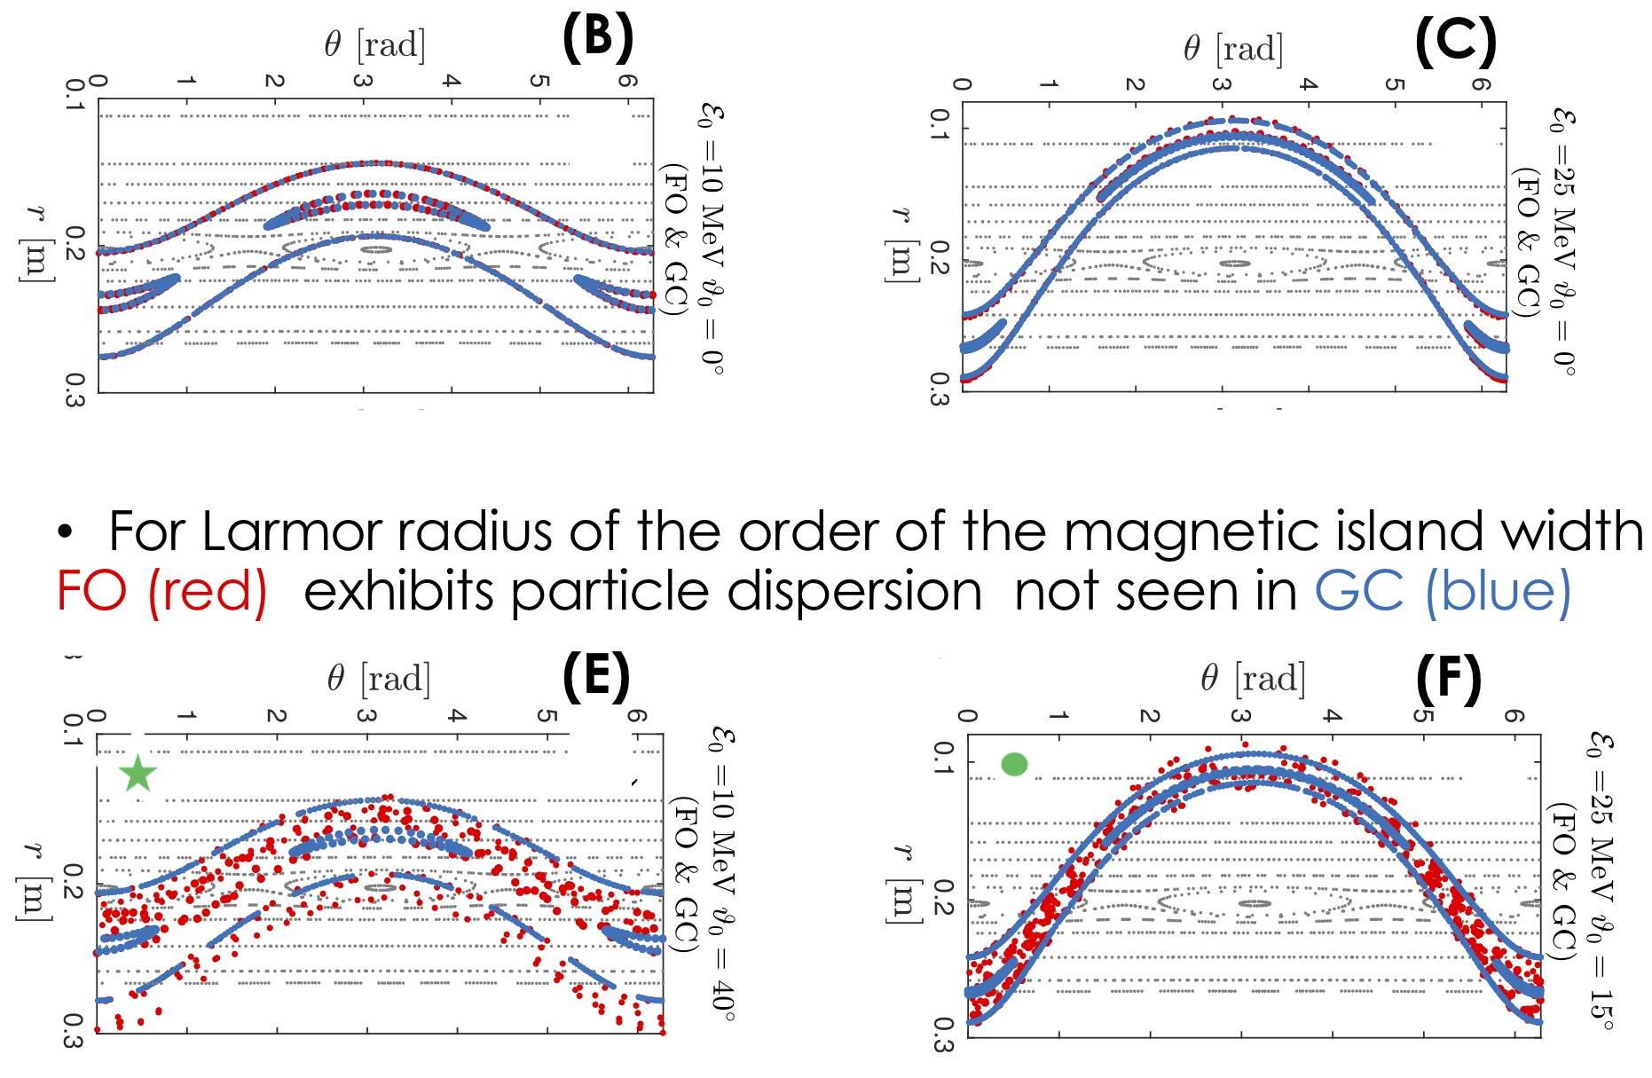
Full orbit (FO) and Guiding center (GC) dynamics in the presence of a single magnetic island
For small pitch (small Larmor radius) and low energy, orbits track the B field
As the energy increase (with small Larmor radius) FO (red) and
GC (blue) exhibit similar distorted island dynamics

Slide 7
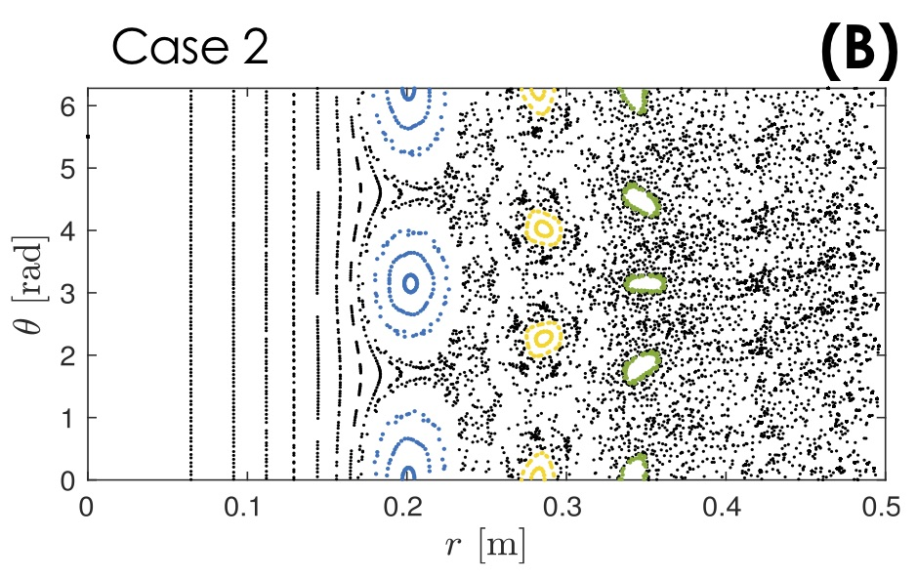
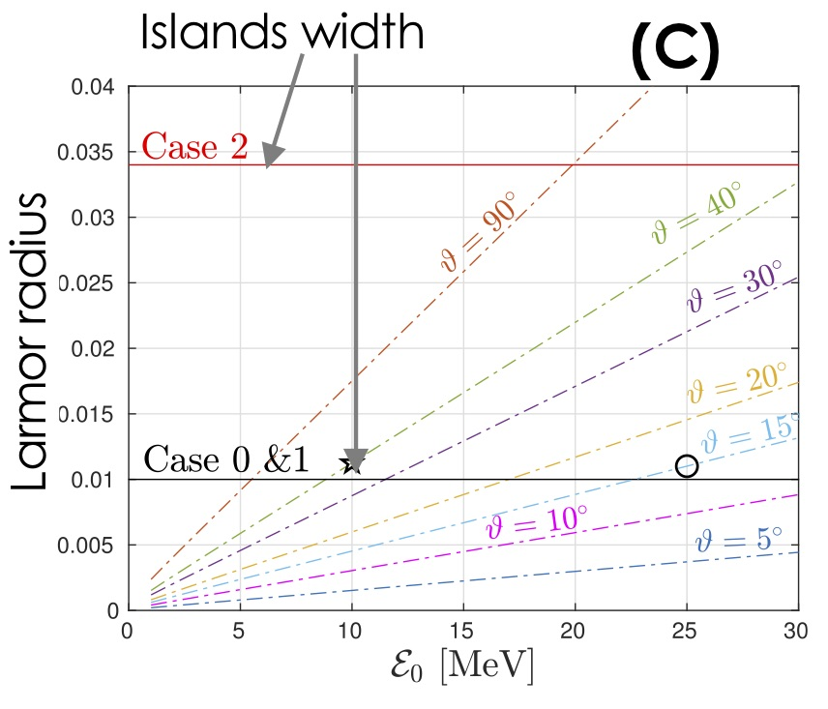
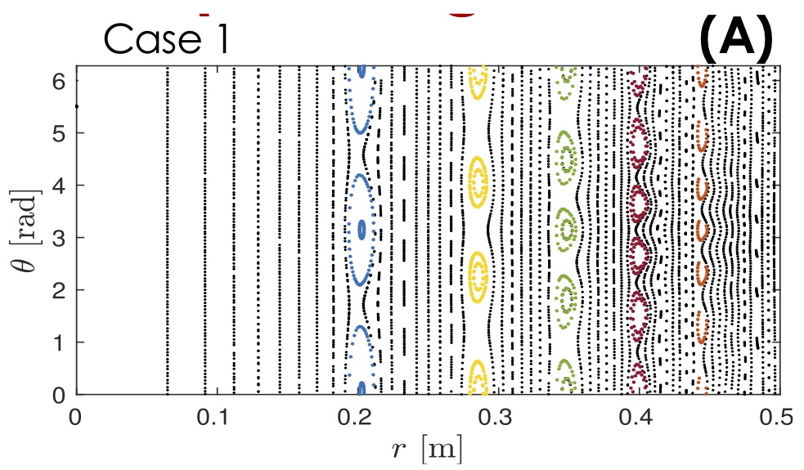
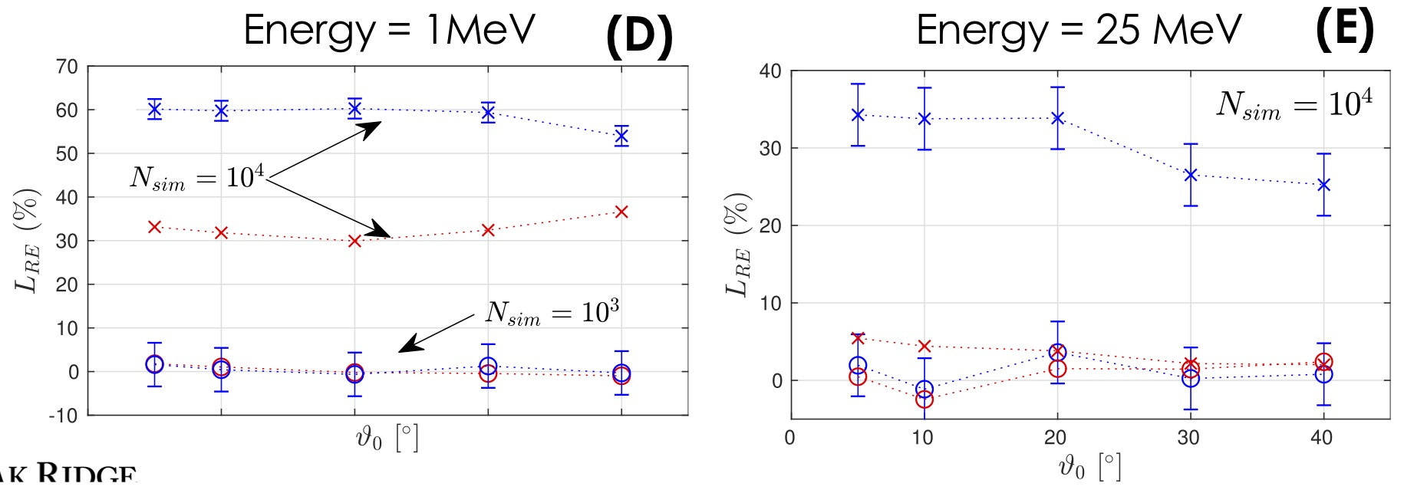
Full orbit (FO) and Guiding center (GC) dynamics in the presence of multiple magnetic islands and stochasticity
N_{PL}= # RE after prompt losses
N = # RE end of simulation
FO and GC predict L_{RE}~0
in the absence of stochasticity
With B field stochasticity
FO and GC predict significantly
different L_{RE} at t= 0.54 ms
As the energy increases L_{RE}
decreases but the disparity
increases and FO seems
insensitive to B field
stochasticity at t= 1 ms

Slide 8
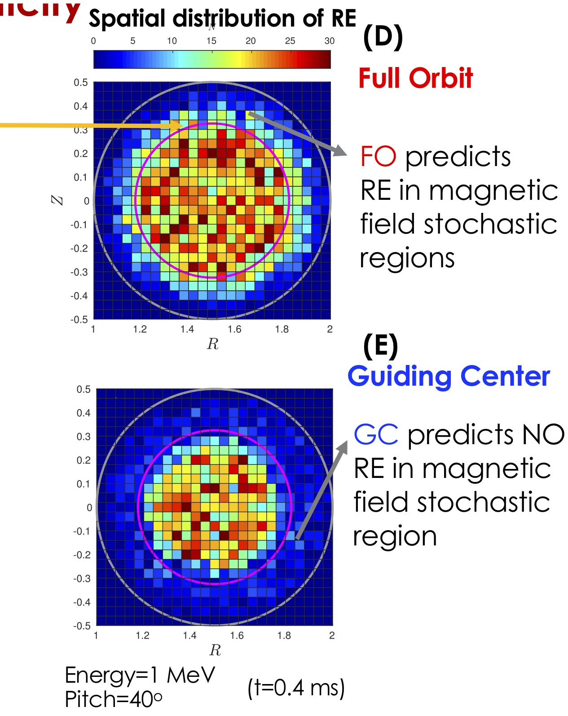
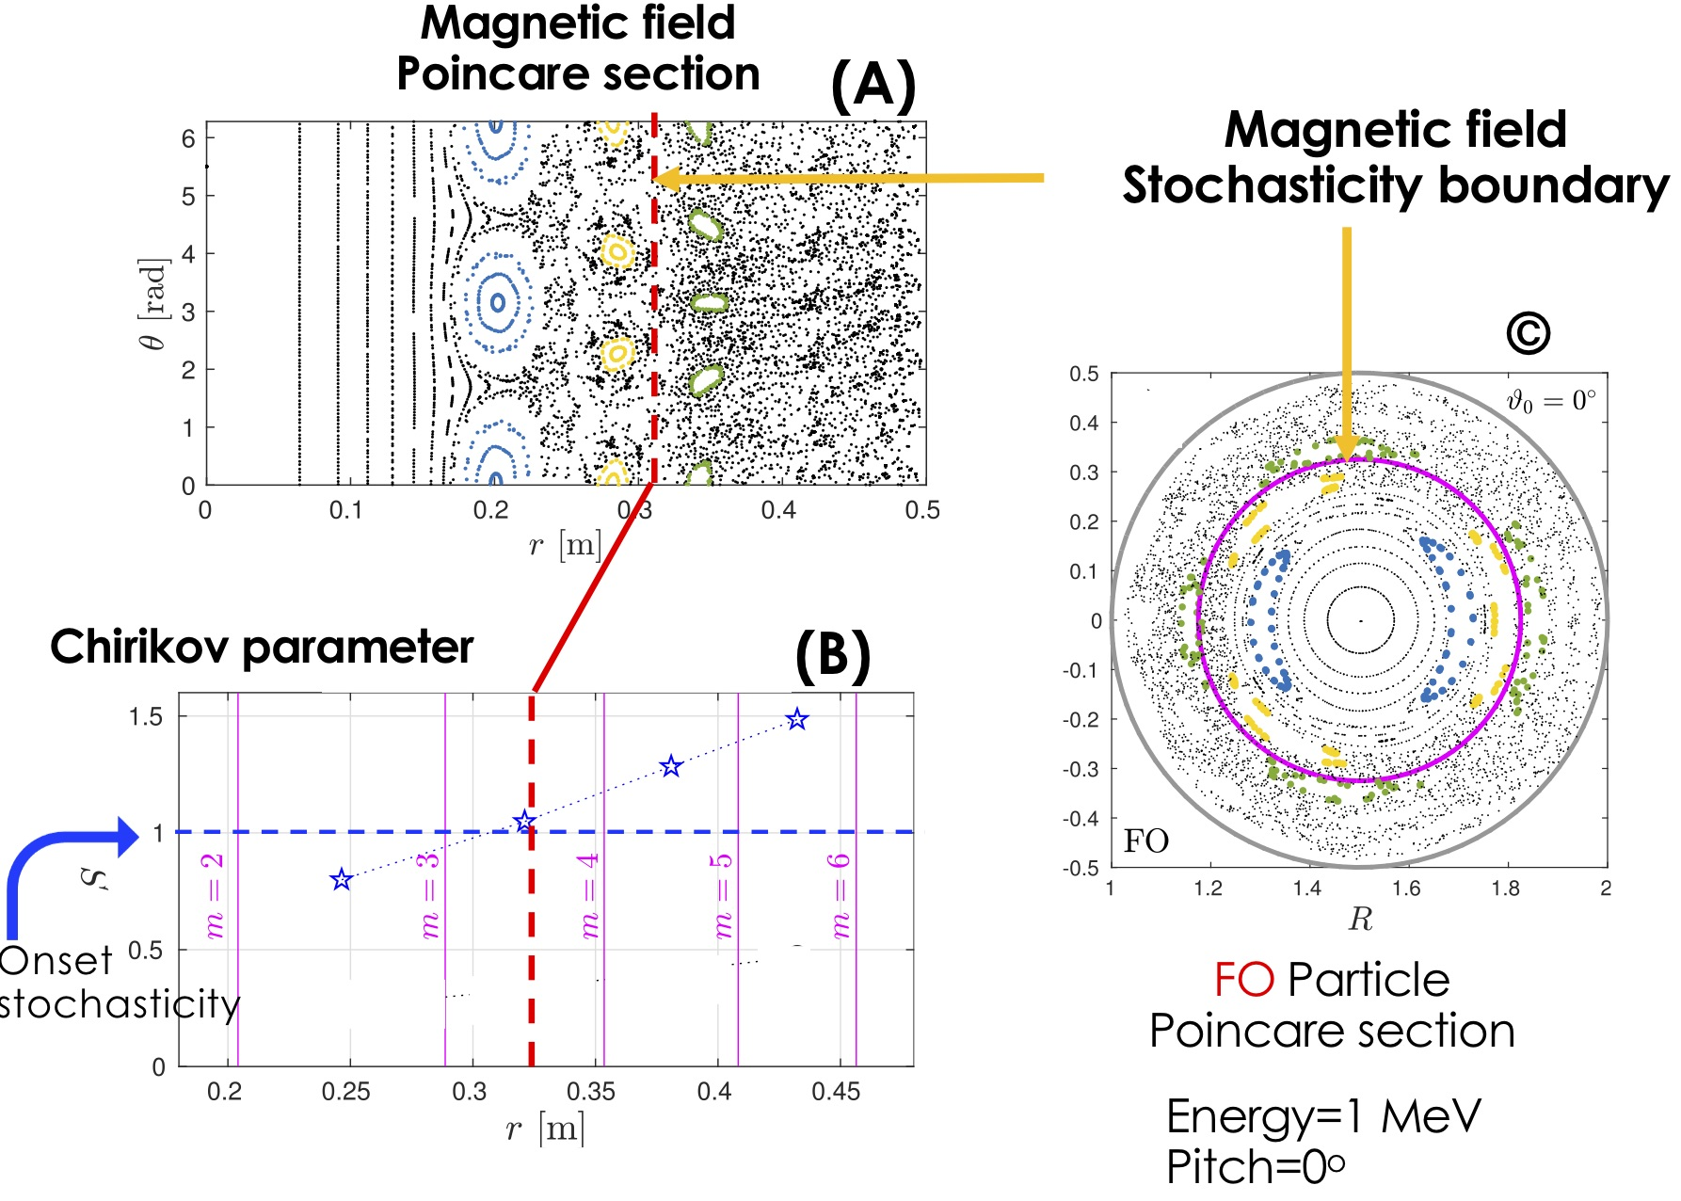
Full orbit (FO) and Guiding center (GC) spatial distribution of losses in the presence of magnetic field stochasticity

Slide 9
Spatially-dependent modeling and simulation of RE dissipation
Impurity injection is the leading candidate for the dissipation of RE
However, the efficiency of this technique and the optimal injection
protocol(s) are still open problems
The dissipation of RE is accompanied by the nontrivial spatiotemporal
evolution of the RE beam, magnetic and electric fields, current, as well as
impurities and plasma densities
Here we focus on the critical role
played by the loss of confinement
which, for the DIII-D shot analyzed,
acts on a time scale considerable
faster than the collisional dissipation
time scale
dissipation
M. T. Beidler, D. del-Castillo-Negrete, L. R. Baylor, D. Shiraki, and D. A. Spong, Preprint. Submitted for publication (2020).

Slide 10
Initial conditions and collisions model
Collisions model Monte-Carlo implementation
of [Heslow, et al 2017] model including bound
electrons and partially ionized impurities
(A)
(B)
Slowing down
Pitch angle distribution: “canonical”
(Coulomb drag + E acceleration equilibrium)
Energy distribution: power law [Hollmann 2015]
(inferred from DIII-D VIS, IR and HXR emission)
Spatial distribution: uniform toroidal
Also considered mono-energetic and
mono-pitch
Pitch angle
diffusion
Also studied collisionless cases and
no bound electron models

Slide 11
Magnetic field, electric field, and impurity density spatiotemporal models inferred from DIII-D experimental data [shot # 164409]
Time evolution of JFIT reconstructed B field
[DIII-D #164409]
Line integrated n_{e} [DIII-D #164409]
(C)
(A)
data
model
Time evolution of n_{e} and n_{impurity}
(D)
Time evolution of E field
JFIT inferred
(B)

Slide 12
RE dissipation mostly due to RE loss of confinement with highly localized strike points
RE fraction
Confinement
loss onset
No collisions
lost to wall
Bound e-model
mono-E mono-pitch
beam
Bound e-model
f(E,pitch)
dissipated
DIII-D Data [#164409]
(C)
(A)
time (sec)
RE power deposition at inner wall
(B)
(D)
time (sec)

Slide 13
Conclusions
Comparative full orbit (FO) and guiding center (GC) study of RE orbits in toroidal geometry
In the absence of magnetic perturbations, FO and GC predict similar
prompt losses (due to energy dependent rapid orbit shift)
In the presence of a single magnetic island of width ~ Larmor radius, GC
orbits exhibit trapping in island-like structures but not FO that shows dispersion
In stochastic magnetic fields:
  As the energy increases, RE confinement improves for both FO and GC
  GC overestimates losses compared to FO (x2 for 1MeV and x4 for 25 MeV)
  FO exhibits confinement in fully stochastic regions.

Slide 14
Conclusions
Comparative modeling and simulation study of RE dissipation by impurity injection
Magnetic field, electric field, and impurity density spatiotemporal models inferred from DIII-D experimental data
Best agreement between KORC and experiment found for canonical pitch angle distribution, power law energy distribution, and bound-electrons partially ionized impurities collision model
However, the loss of spatial confinement due to the magnetic field evolution is the main mechanism for the reduction of the RE current, with collisional dissipation playing a relatively minor role.
RE beam energy increases due to electric field acceleration before loss of confinement

