Slide 1
Study of the companion plasma during runaway electron mitigation experiments with massive material injection in the JET tokamak
IAEA Technical Meeting on Plasma Disruptions and their Mitigation, 20-23 July, 2020
Sundaresan Sridhar (CEA-IRFM),
Cedric Reux (CEA-IRFM), Eric Hollmann (UCSD), Ivor Coffey (CCFE), Michael Lehnen (ITER-IO), Peter Beyer (PIIM-AMU) and JET contributors*
* See the author list of “E. Joffrin et al. Nuclear fusion 59.11 (2019): 112021.”
Sundaresan Sridhar | IAEA Technical Meeting on Plasma Disruptions and their Mitigation| 20-23 July, 2020 | Page 1

Slide 2
Outline
Background
Argon SPI as trigger injection
Argon SPI as killer injection
Deuterium SPI in Argon background plasma
Diffusion model : Deuterium SPI in Argon background plasma
Diffusion model : CRETIN vs ADAS data
Summary and Perspectives

Slide 3
Background
Avoidance of RE beam generation
Strategy for Runaway electrons (RE)
Mitigation of RE beam
MMI to mitigate heat/EM loads
2nd killer MMI to mitigate RE beam
MMI can be Massive Gas Injection (MGI) or Shattered Pellet Injection (SPI)
RE mitigation experiments in JET-ILW (using MGI) [C.Reux, APS-2017] :
no effect of 2nd MGI on RE beam in some discharges
Maybe due to poor penetration of 2nd MGI into RE beam due to cold dense background (BG) plasma from 1st MGI
BG plasma is very poorly characterized, specially the electron temperature T_{e}
T_{e}-profile estimation from VUV spectroscopy [Sundaresan Sridhar et al 2020 Nucl. Fusion in press]
JET-SPI experiments in 2019 ➔ disruption and RE beam mitigation using Ar SPI. RE beam mitigation tried using D₂ SPI [see also the invited talk by C. Reux for more information]
In this talk ➔ analysis of JET SPI experiments using VUV spectroscopy and simulation of BG plasma using 1D Diffusion model [EM Hollmann et al., NF-2019]

Slide 4
Outline
Background
Argon SPI as trigger injection
Argon SPI as killer injection
Deuterium SPI in Argon background plasma
Diffusion model : Deuterium SPI in Argon background plasma
Diffusion model : CRETIN vs ADAS data
Summary and Perspectives

Slide 5
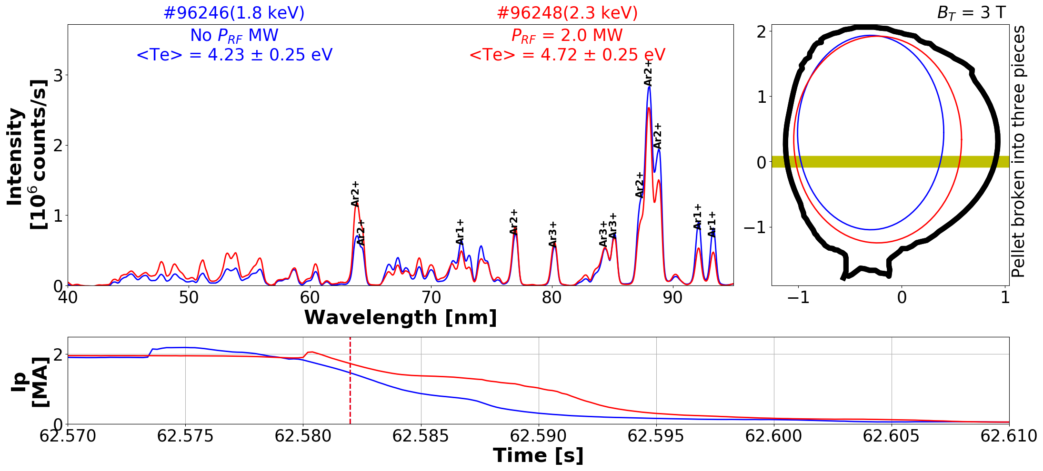
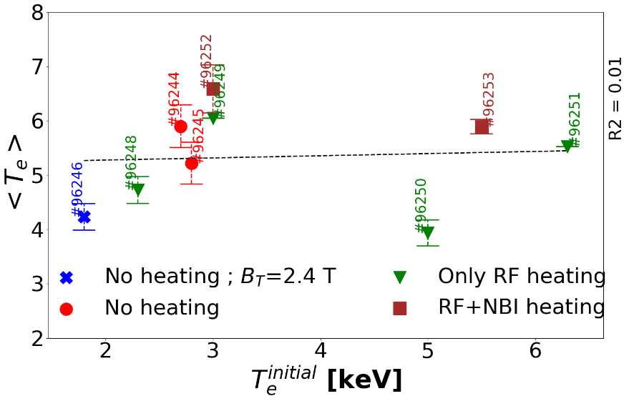
Argon SPI as trigger injection : Effect of initial T_{e} on VUV spectra
No significant change in the VUV spectra due to change in initial temperature
T_{e} of BG plasma ➔ no correlation with initial electron temperature T_{e}

Slide 6
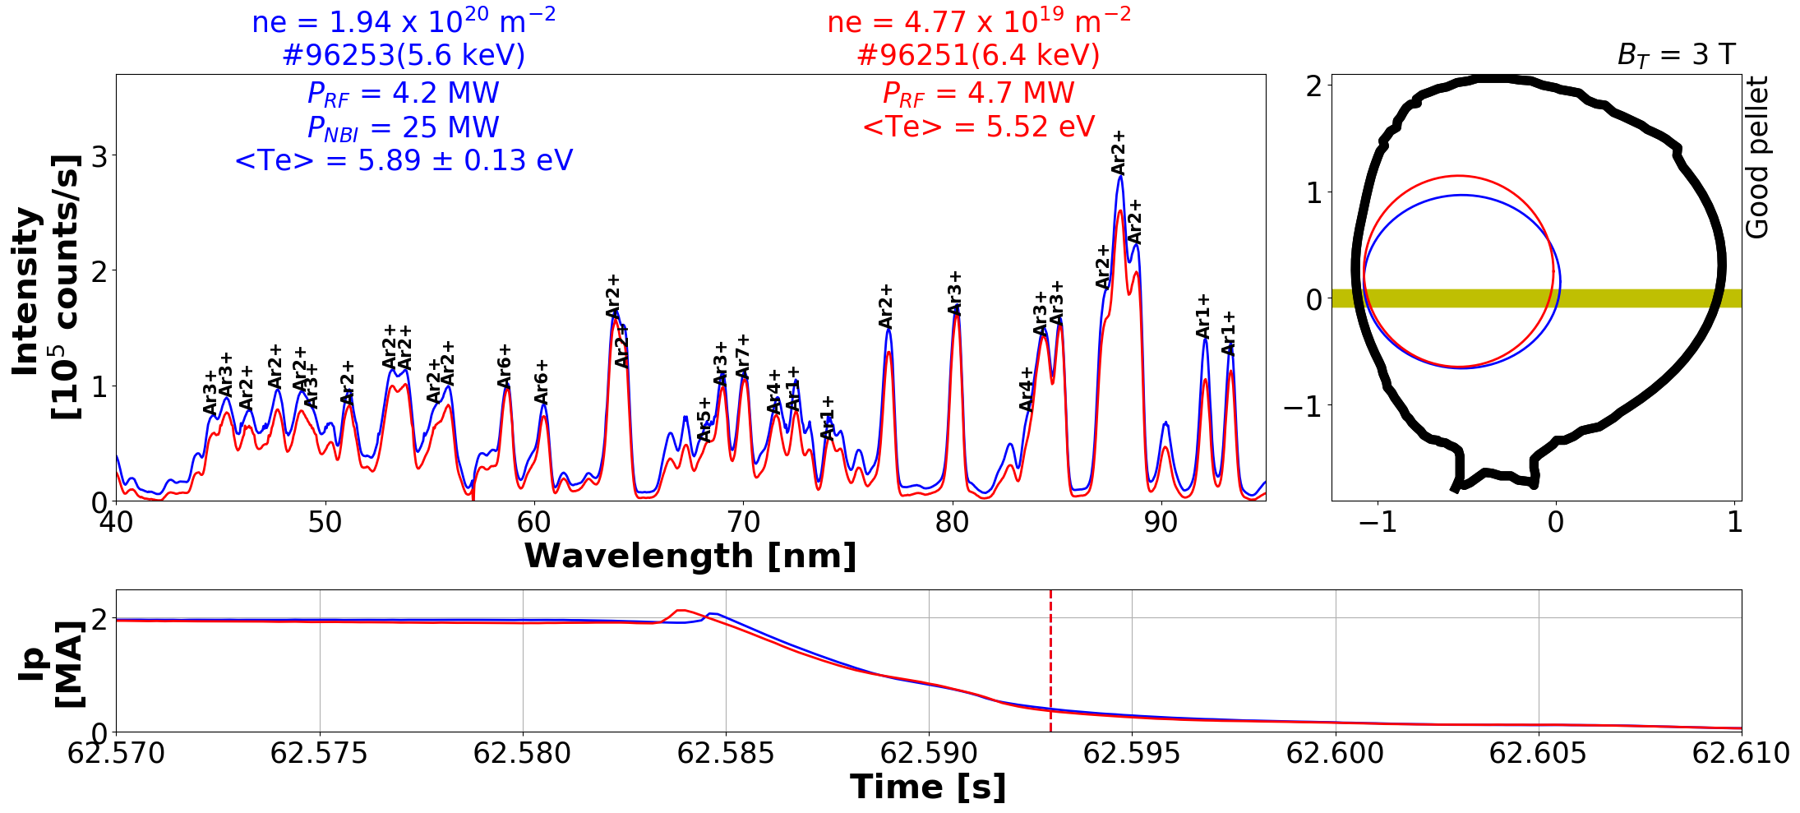
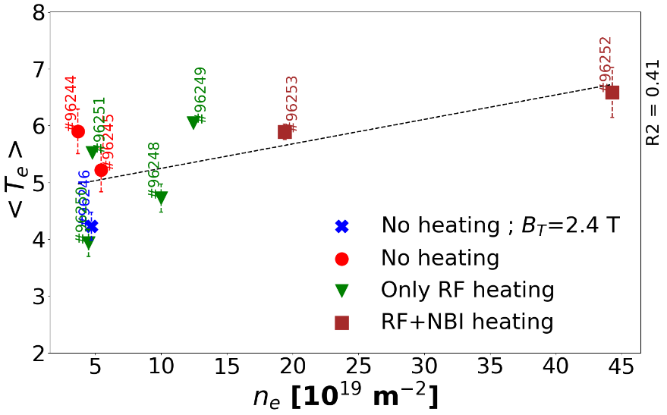
Argon SPI as trigger injection : Effect of initial n_{e} on VUV spectra
RF ➔ ICRH heating
No significant change in the VUV spectra due to NBI heating (only n_{e} changes)
BG plasma T_{e} ➔ increases with initial n_{e} → similar to MGI trigger injections [Sundaresan Sridhar et al 2020 Nucl. Fusion in press]

Slide 7
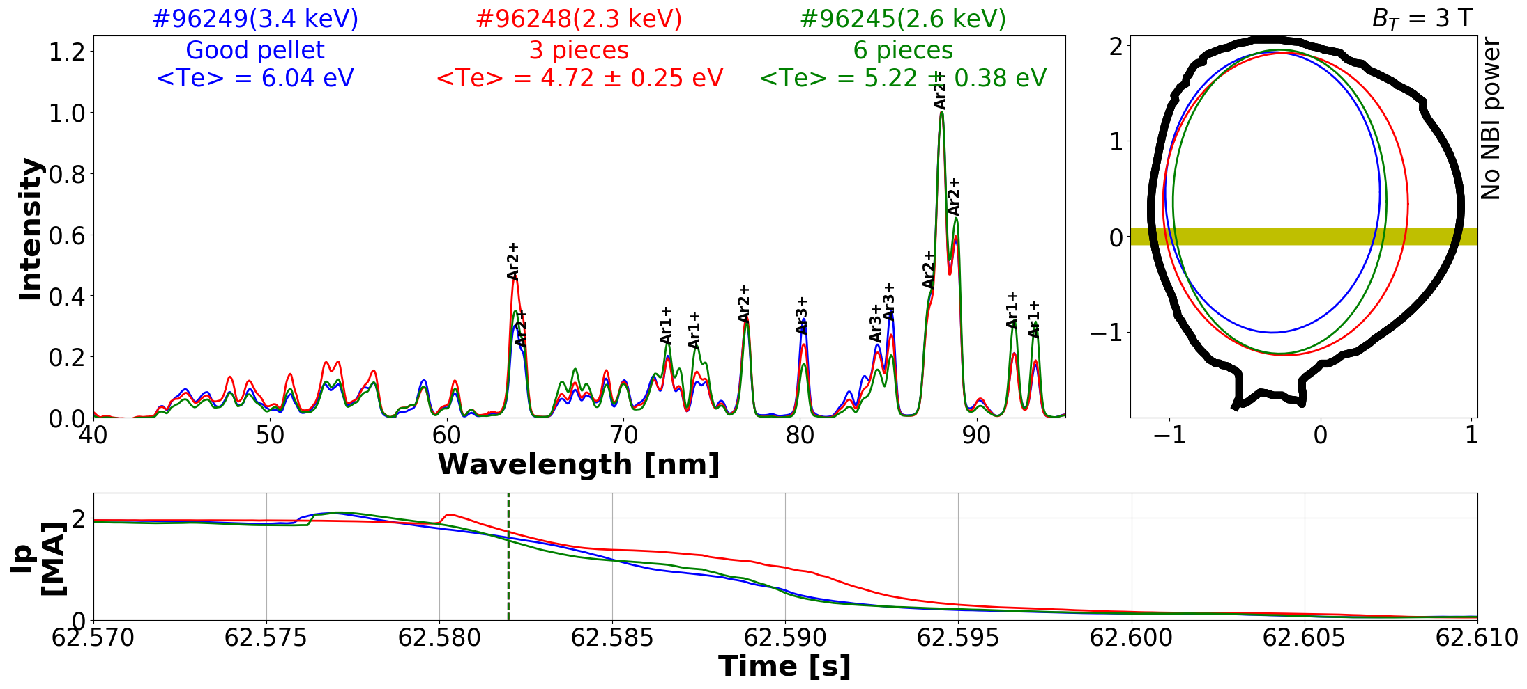
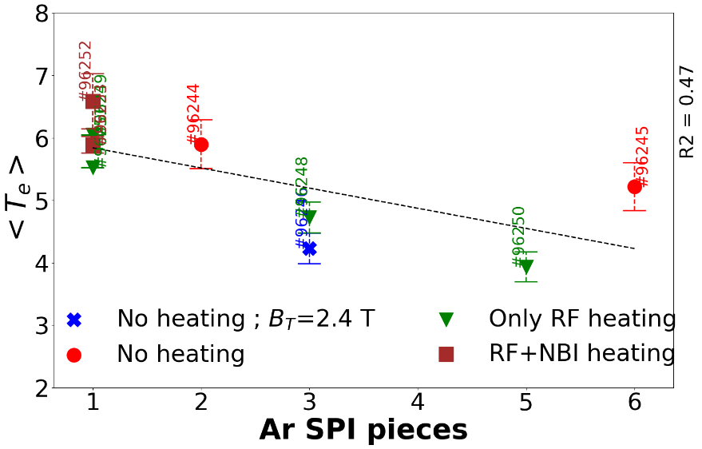
Argon SPI as trigger injection : Effect of pellet breaking on VUV spectra
intact
96249
KL8=E8WA
6 pieces
96245
Intact pellet seems to have higher T_{e} than broken pellets
Possible reason ➔ pellet penetration may depend on the pellet integrity, intact pellets penetrate deeper

Slide 8
Outline
Background
Argon SPI as trigger injection
Argon SPI as killer injection
Deuterium SPI in Argon background plasma
Diffusion model : Deuterium SPI in Argon background plasma
Diffusion model : CRETIN vs ADAS data
Summary and Perspectives

Slide 9
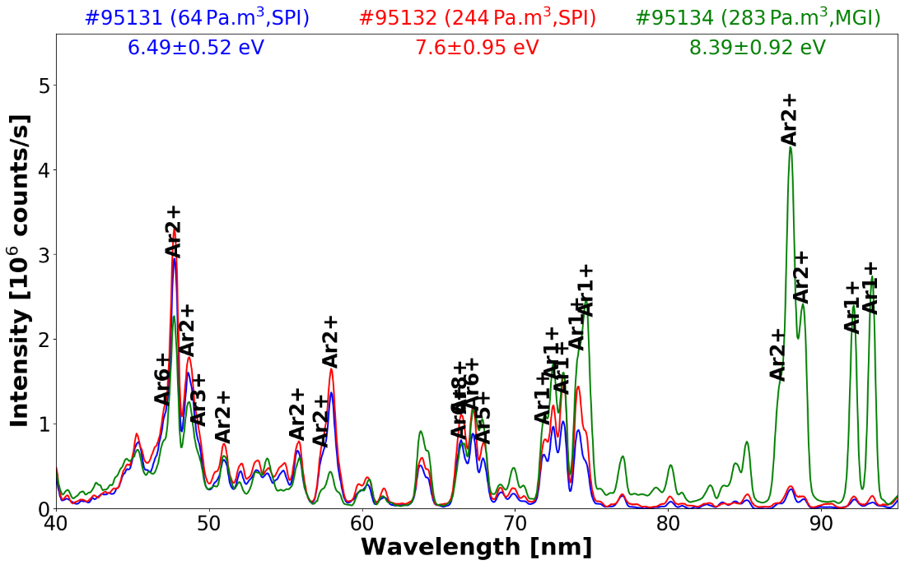
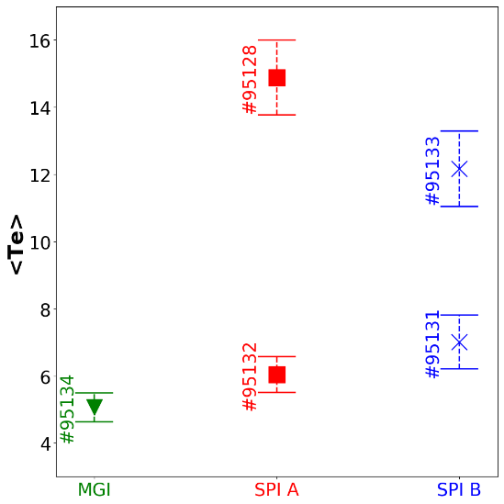
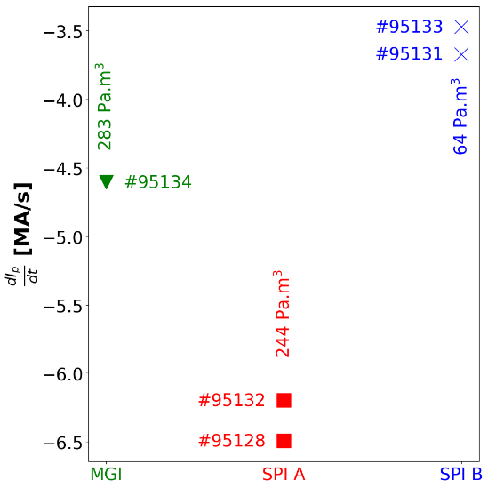
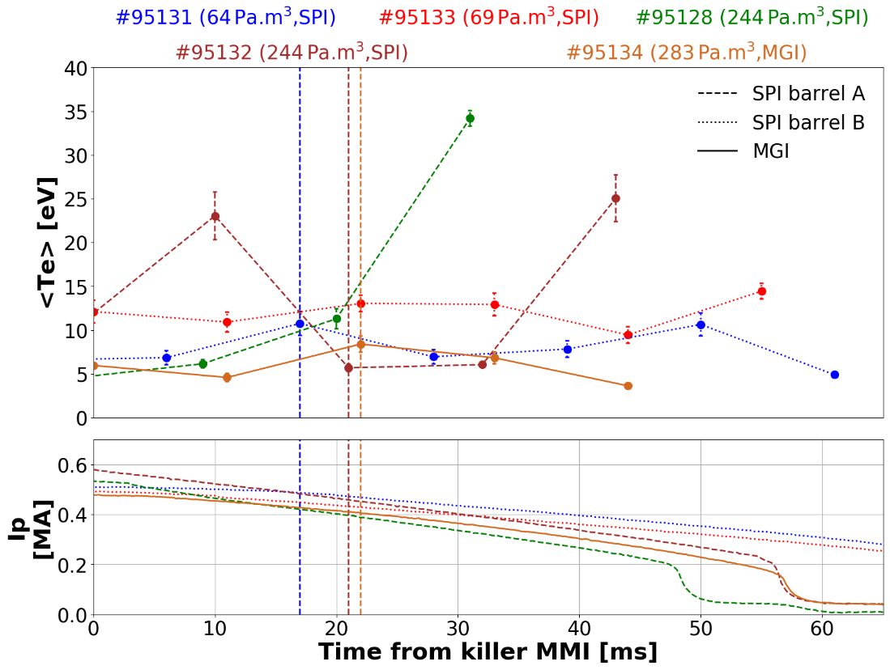
Ar SPI as killer injection :
Difference between different SPI pellets and MGI only at higher wavelength (85-100 nm)
No clear difference in BG plasma temperature for different SPI pellets and MGI
SPI pellet A seems to decay plasma current faster than MGI and SPI pellet B

Slide 10
Outline
Background
Argon SPI as trigger injection
Argon SPI as killer injection
Deuterium SPI in Argon background plasma
Diffusion model : Deuterium SPI in Argon background plasma
Diffusion model : CRETIN vs ADAS data
Summary and Perspectives

Slide 11
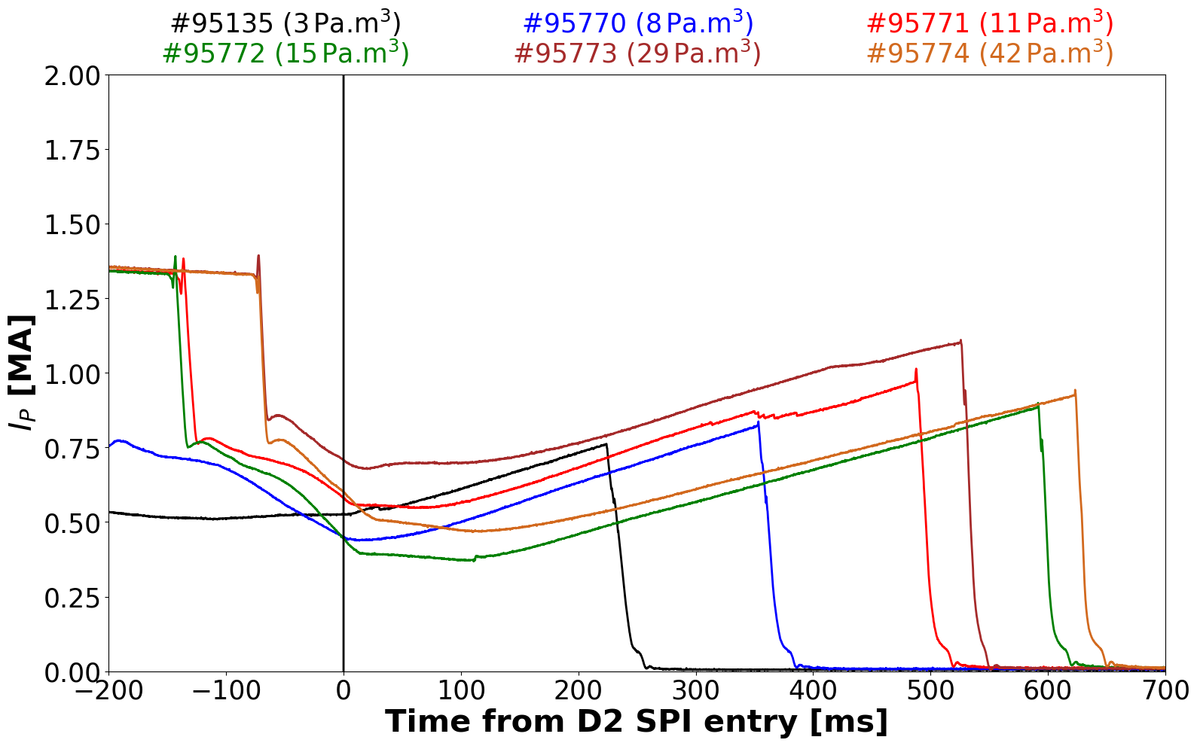
D₂ SPI into Ar background plasma : Ip increase after D₂ SPI
In the Ar BG plasma, D₂ SPI is injected
After D₂ SPI entry ➔ plasma current I_{p} increases
After D₂ SPI entry ➔ electron density ne drops to very low value (interferometry)
Benign termination of RE beam ➔ no wall impact when the RE disappears
Different Ar amounts used to trigger disruptions ➔ Ar BG plasma with different Ar quantities
Ar MGI triggered disruptions
D₂ SPI from barrel A ( ~300 Pa.m³)
By introducing D₂ SPI in the Ar BG plasma ➔ significant drop in n_{e} and I_{p} increase
Please also see the invited talk from C. Reux for more information

Slide 12
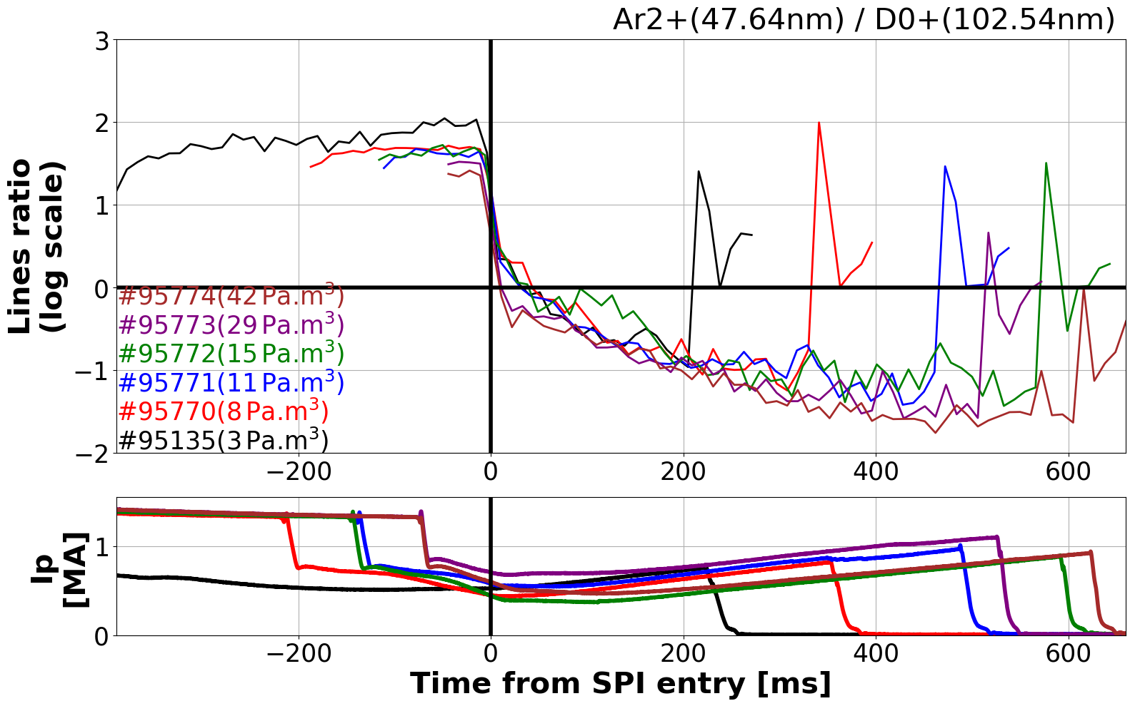
D₂ SPI into Ar background plasma : Drop in Ar brightness from VUV spectra
D₂ SPI from barrel A ( ~300 Pa.m3)
Ar dominated BG plasma
D₂ dominated BG plasma
By introducing D₂ SPI in the Ar BG plasma ➔Ar line brightness drops significantly as seen by VUV spectrometer
Possible explanation ➔ after D2 SPI, BG plasma cools down to low T_{e} so that Ar recombines to form Ar neutrals. This effect was also seen in DIII-D tokamak [Hollmann.E et al. Phys. Plasmas 27, 042515 (2020)]

Slide 13
Outline
Background
Argon SPI as trigger injection
Argon SPI as killer injection
Deuterium SPI in Argon background plasma
Diffusion model : Deuterium SPI in Argon background plasma
Diffusion model : CRETIN vs ADAS data
Summary and Perspectives

Slide 14
Diffusion model : Deuterium SPI in Ar background plasma
Inputs
N_{Ar}⁰,N_{D}⁰, n_{e}^{l},
radiated power profile
Initial guess for the T_{e} and n_{e} profile
1:Nt (No of time steps)
Change in densities
1 iteration ➔ 2 μs max
Diffusion
Neutral and ion diffusion calculation
Atomic processes
D,D₂,D⁺,D₂⁺,D₃⁺,ArD⁺,Ar^{+n} (n=0-5)
Features :
T_{i} = T_{e}
Only RE impact ionization considered (for >Ar¹⁺)
CRETIN model ➔ ionization, recombination and cooling rate coefficients
Same diffusion coefficients for all Ar species
from E.M. Hollmann et al 2019 Nucl. Fusion 59 106014
Updating n_{RE} ➔ based on species densities and n_{e}
T_{e} profile ➔ from P_{rad} profile and densities
Outputs
Species density profiles and temperatures
Special thanks to EM Hollmann for sharing the code

Slide 15
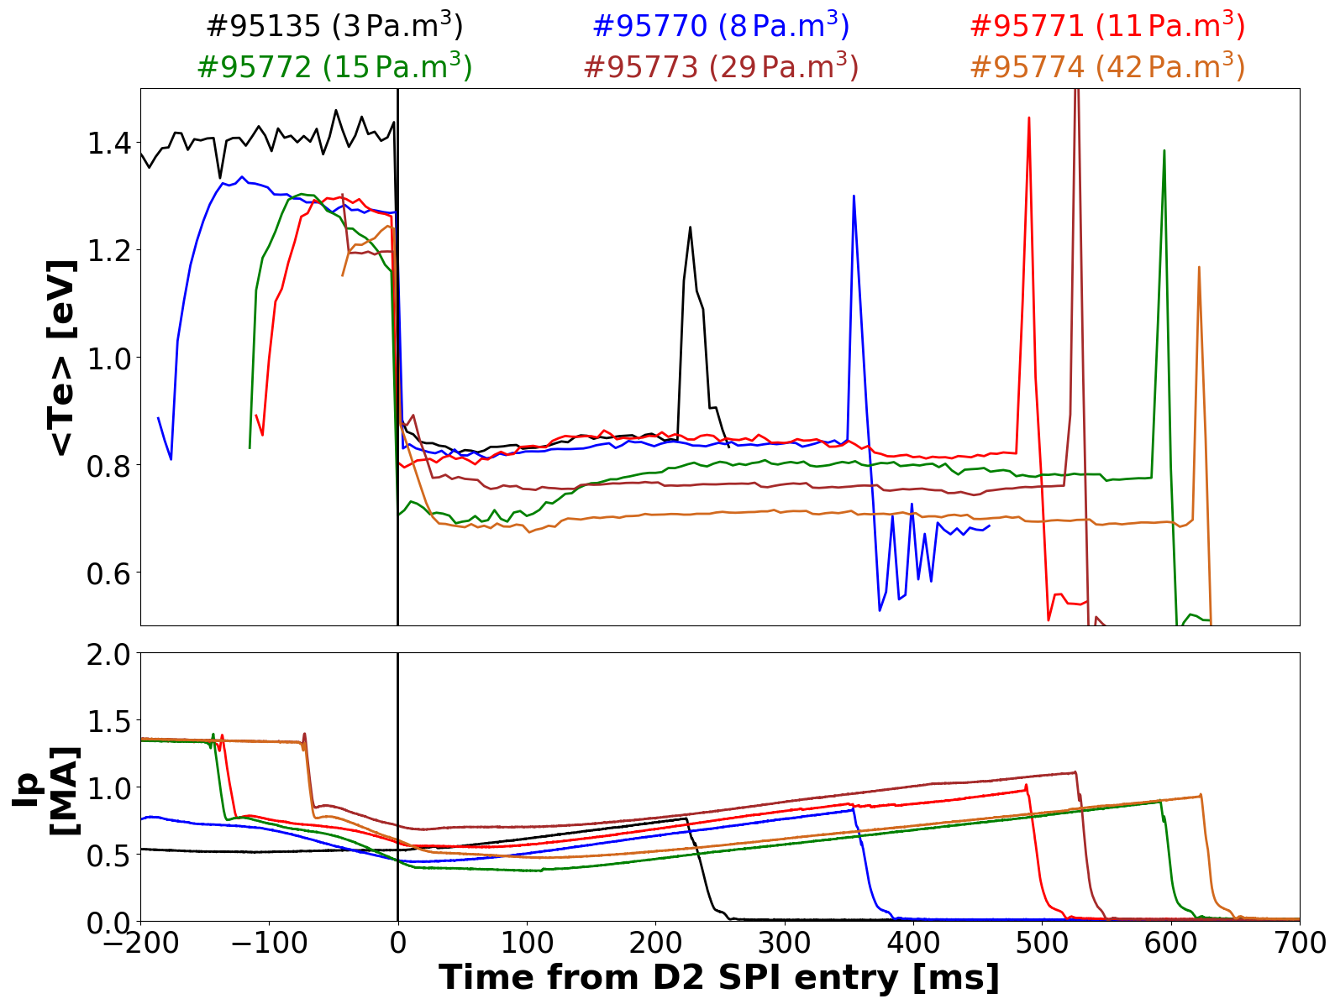
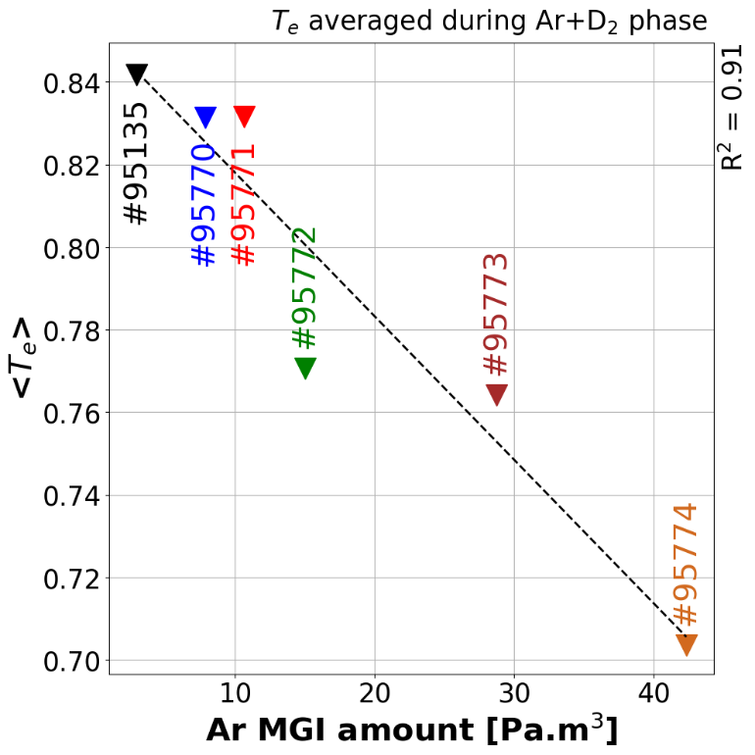
Diffusion model : T_{e} prediction Deuterium SPI in Ar background plasma
<T_{e}> less than 1 eV
T_{e} during Ar+D₂ phase decreases linearly with initial Ar MGI amont
Diffusion model predicts that Te drops significantly ➔ expected from previous reasoning of Ar recombination

Slide 16
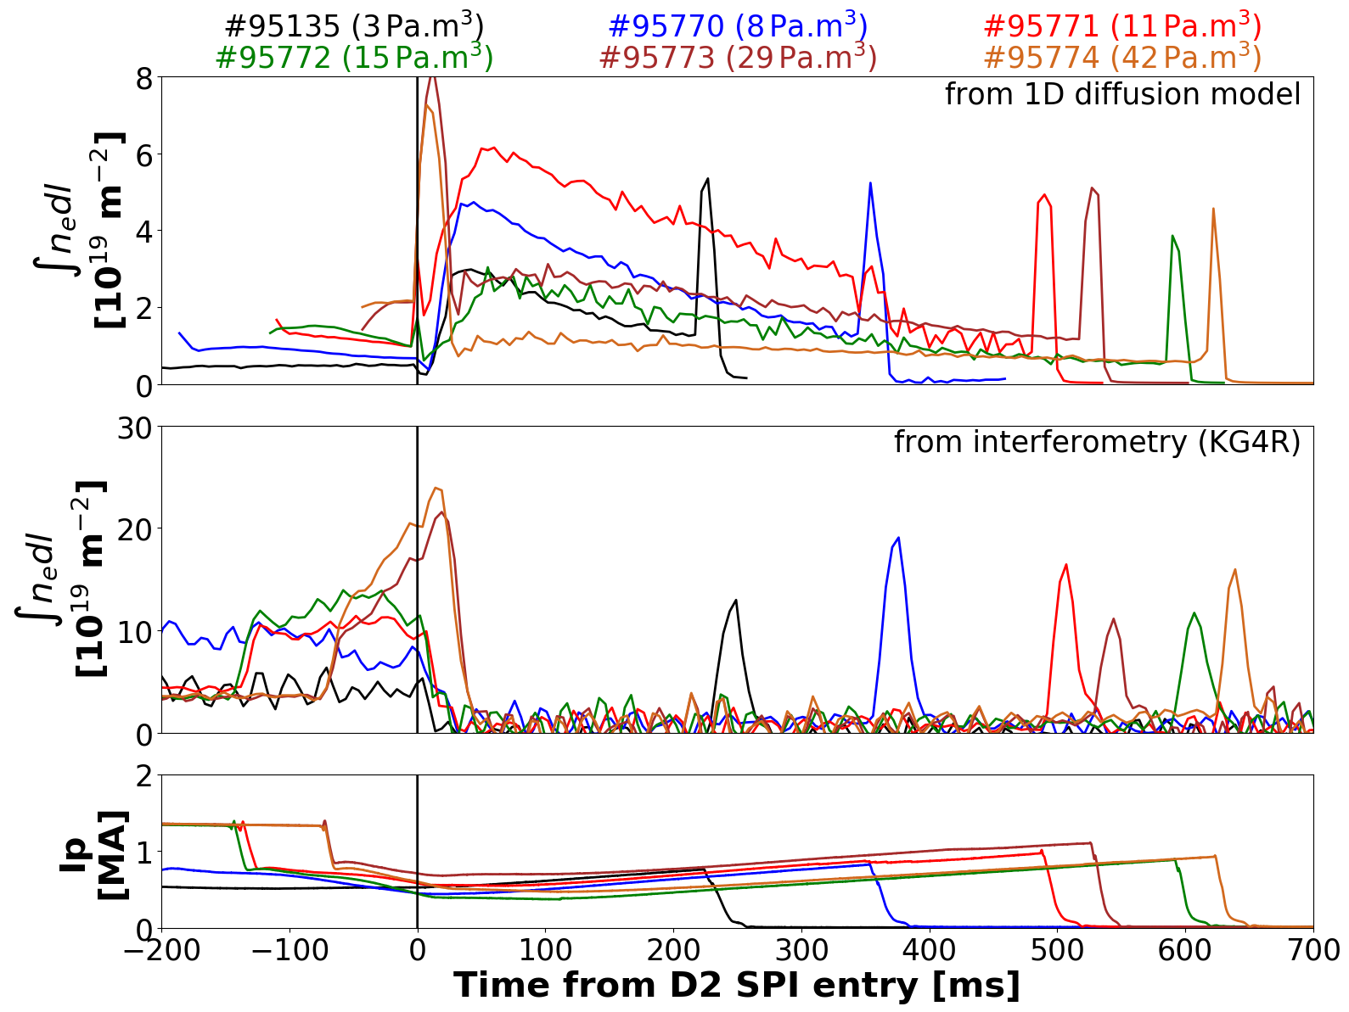
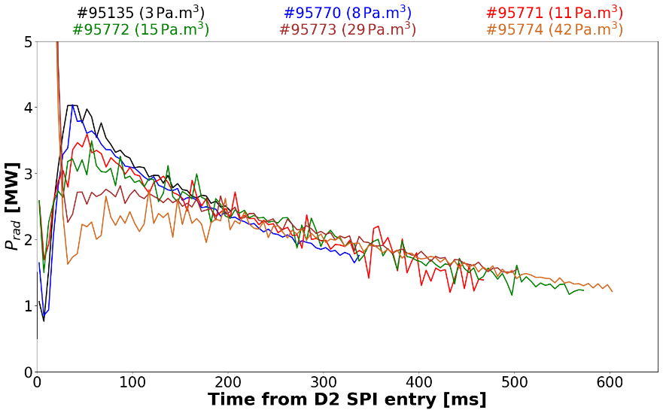
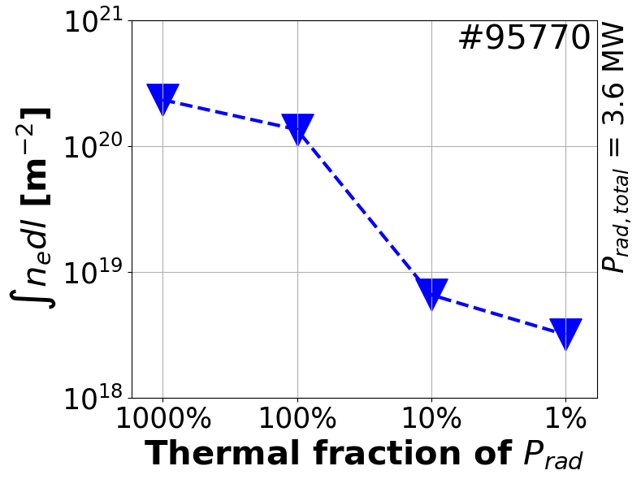
Diffusion model : n_{e} prediction Deuterium SPI in Ar background plasma
P_{rad} around 1-4 MW (bolometry) even at low n_{e} and T_{e} ?
➔ may be due to non-thermal radiation
Diffusion model overestimates n_{e} after D₂ SPI entry ➔ may be due to the omitting of non-thermal radiation in the radiated power ?

Slide 17
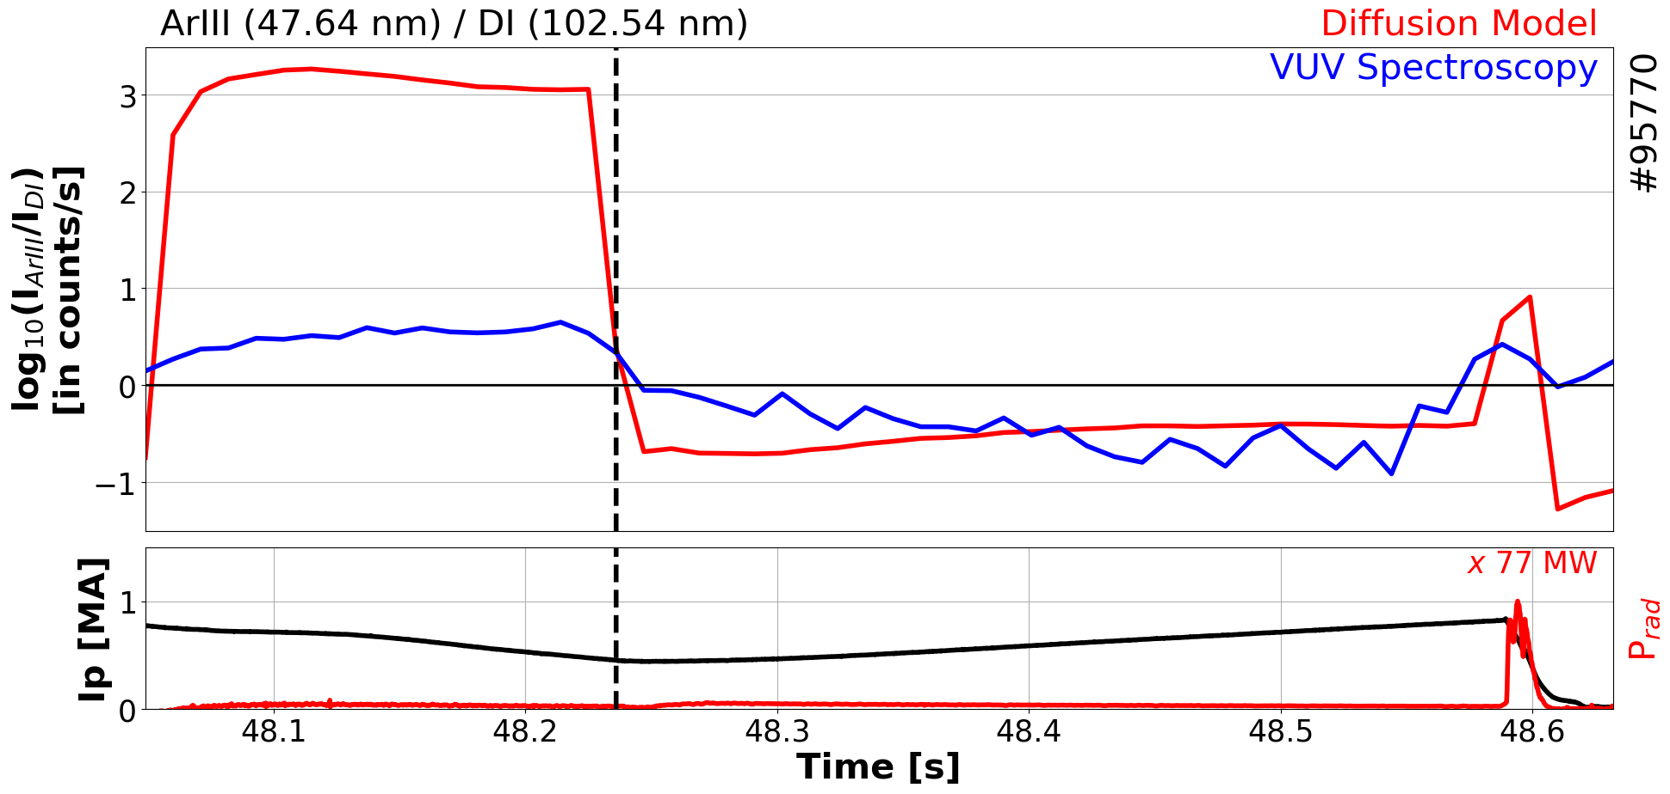
Diffusion model : Drop in Ar brightness after D₂ SPI
Ar dominated background plasma
D2 SPI entry
Deuterium dominated background plasma
Diffusion model predicts drop in Ar line brightness following D₂ SPI ➔ correlating with VUV spectroscopy

Slide 18
Outline
Background
Argon SPI as trigger injection
Argon SPI as killer injection
Deuterium SPI in Argon background plasma
Diffusion model : Deuterium SPI in Argon background plasma
Diffusion model : CRETIN vs ADAS data
Summary and Perspectives

Slide 19
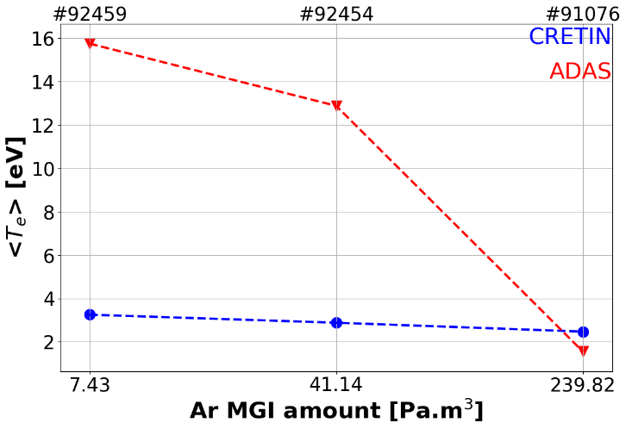
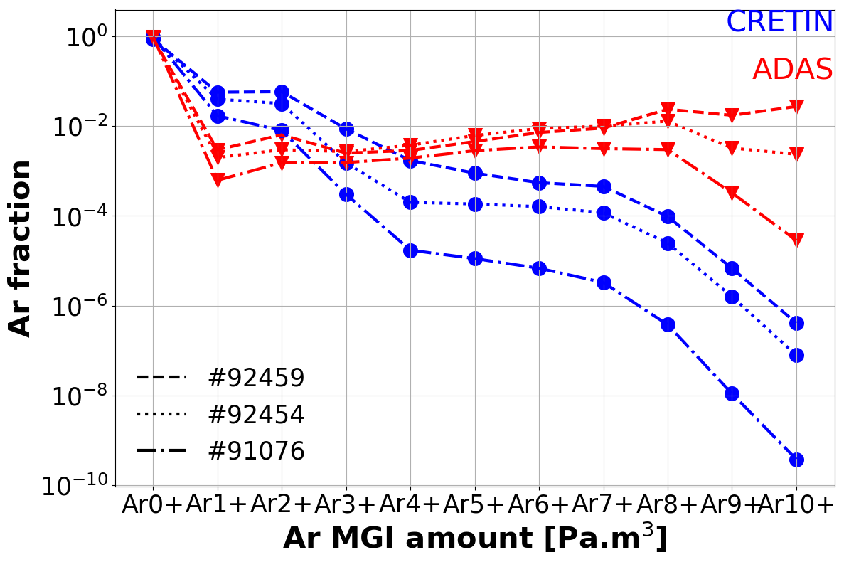
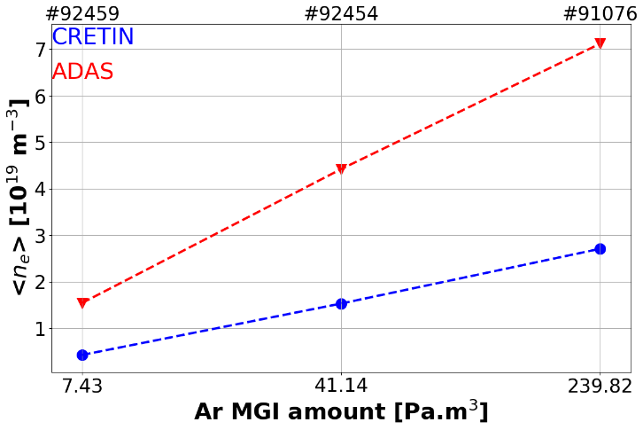
CRETIN data vs ADAS data
CRETIN data ➔ hydrogenic model ; ADAS data ➔Collisional Radiative Equilibrium (CRM), VUV T_{e} estimation
In ADAS, ionization rates are much higher than CRETIN whereas recombination rates are magnitudes lower than CRETIN ➔ ADAS predicts higher ionization states and thus higher n_{e}
Cooling rates (T_{e},n_{e}) in CRETIN is higher than ADAS ➔ ADAS predicts higher Te in spite of higher n_{e} than CRETIN
ADAS data predicts higher n_{e}, higher ionization states and thus higher T_{e} than CRETIN data
1 ms simulation with 0.33μs resolution

Slide 20
Summary and Perspectives
Ar SPI as trigger injection :
No effect of initial T_{e} on VUV spectra and T_{e} estimation
T_{e} of BG plasma seems to increase with initial n_{e} ➔ similar to MGI
Intact pellet seems to have better penetration and hotter BG plasma
Ar SPI as killer injection :
Ar SPI pellet A seems to reach higher <T_{e}> however no clear trend was observed
Ar SPI pellet A seems to decay plasma current faster than MGI and pellet B
D₂ SPI in Ar BG plasma :
After D₂ SPI entry, Ar line brightness drops and deuterium lines dominates the VUV spectra
Diffusion model :
T_{e} drops significantly after D₂ SPI injection
Overestimation of n_{e} may be due to omission of non-thermal radiation in P_{rad}
Model can correctly predict the drop in Ar brightness
ADAS data seems to predict hotter and denser BG plasma than CRETIN
➔ PrismSPECT atomic data also consider non-thermal radiation in cooling rate

