Slide 1
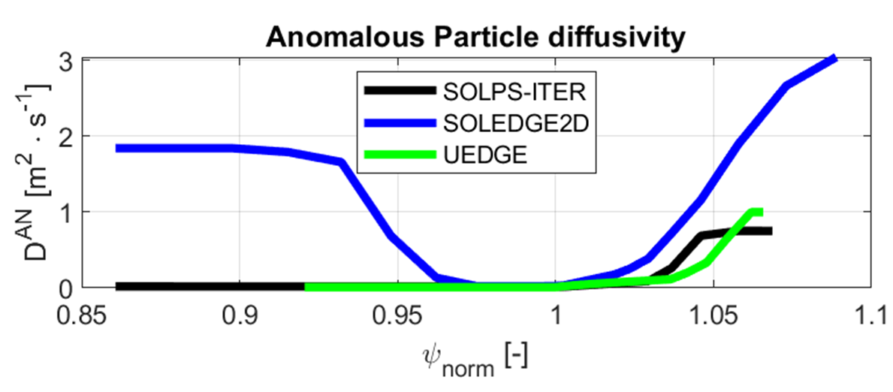
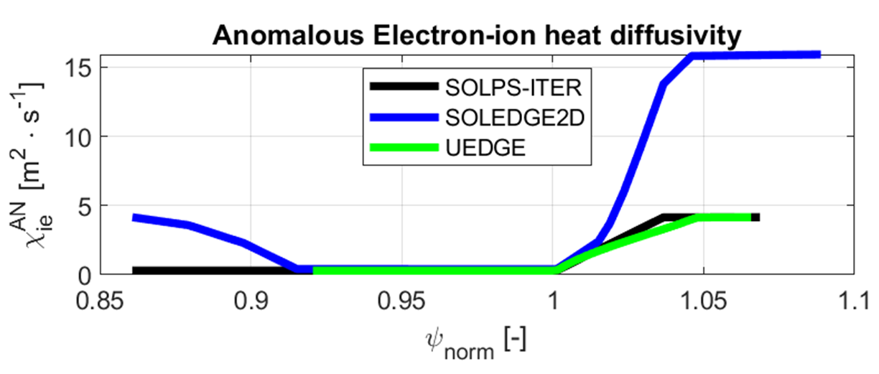
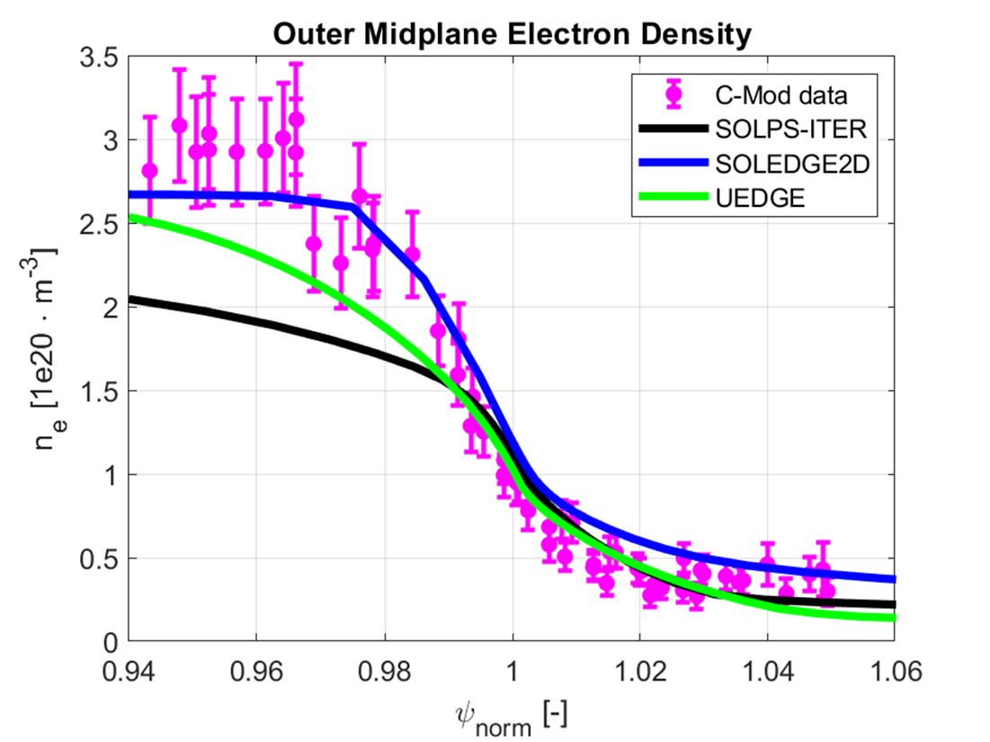
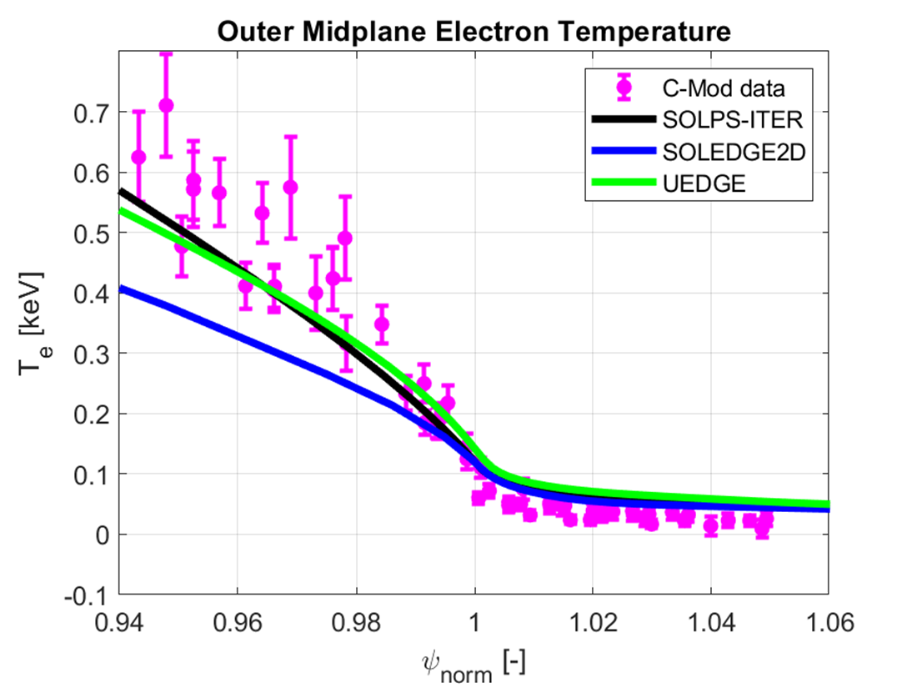
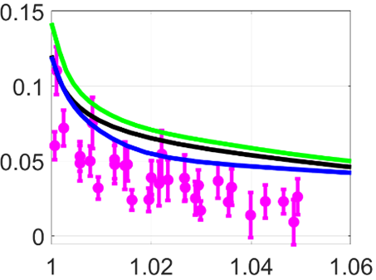
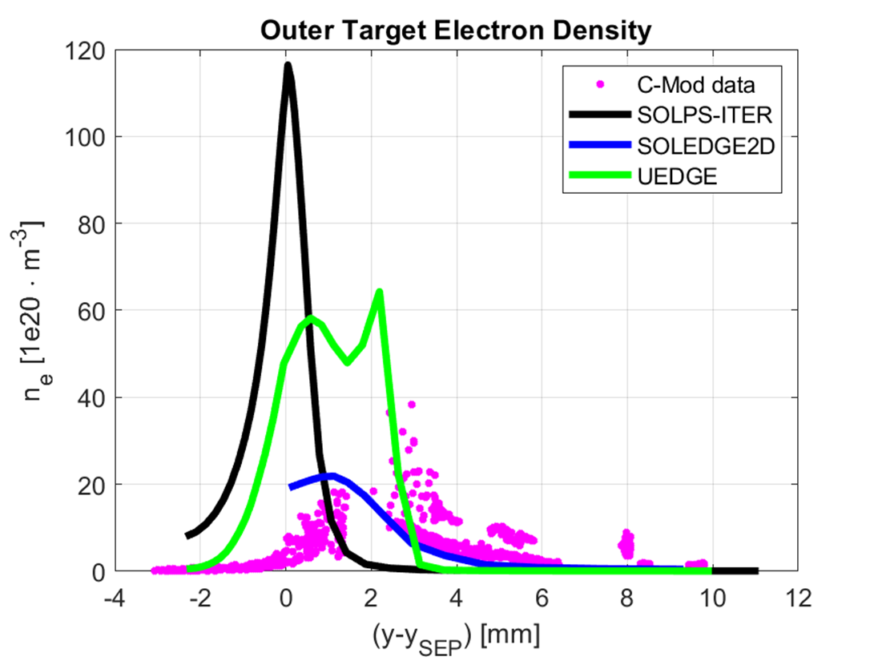
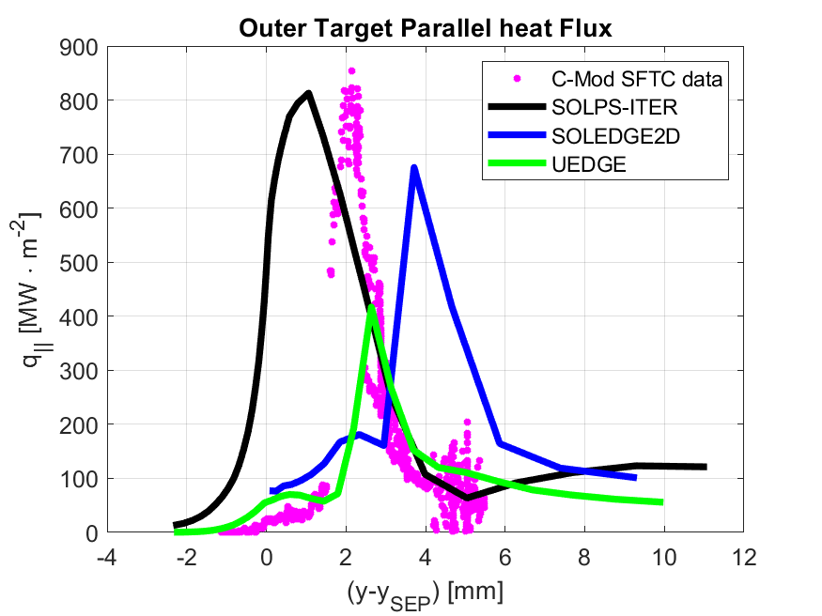
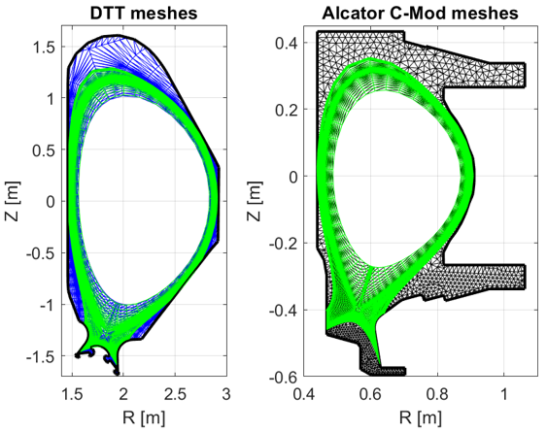
Benchmarking and Validating SOLPS-ITER, SOLEDGE2D
and UEDGE for Power Exhaust Modelling in Future Tokamaks
M. Moscheni⁽¹⁾, C. Meineri⁽¹⁾, M. Wigram⁽²⁾, C. Carati⁽³⁾, E. De Marchi⁽³⁾, P. Innocente⁽⁴⁾, F. Subba⁽¹⁾, R. Zanino⁽¹⁾
(1) NEMO Group, Dipartimento Energia, Politecnico di Torino, Corso Duca degli Abruzzi 24, 10129, Torino, Italy
(2) MIT Plasma Science and Fusion Center, Cambridge, MA 02139, USA
(3) Eni S.p.A., Italy
(4) Consorzio RFX, corso Stati Uniti, 4, Padova, Italy ID: TH/P6-24 – fabio.subba@polito.it
1. INTRODUCTION
3. RESULTS
The open issue of Power EXhaust (PEX) in future fusion reactors will be soon addressed in Divertor Tokamak Test (DTT) experiment. In the meanwhile, modelling helps extrapolation in future machine design.
We present the progress so far in comparing SOLPS-ITER [1], SOLEDGE2D [2] and UEDGE [3] in modelling the edge plasma.
We perform a benchmark on a DTT pure-deuterium low-power scenario, showing that the codes agree within 2-28% at outer midplane (OMP), but only within 2-84% at outer (OUT) and inner (IN) targets.
We validate our codes by modelling a DTT-relevant Alcator C-Mod shot via fine-tuning of the transport coefficients. We obtain different levels of accuracy, within a factor $∼$ 1.1–3.0.
DTT benchmark
Quantity | SOLPS-ITER | SOLEDGE2D | UEDGE | $$Δ_{rel} [\%]$$
OMP $λ_{n}$ | 6.9 mm | 6.0 mm | 5.2 mm | 3–28
OMP $λ_{T_{e}}$ | 6.3 mm | 6.2 mm | 6.0 mm | 2–5
OUT peak $n$ | 7.4 ⋅ 10²¹ m⁻³ | 5.6 ⋅ 10²¹ m⁻³ | 6.7 ⋅ 10²¹ m⁻³ | 10–28
OUT peak $T_{e}$ | 49 eV | 50 eV | 71 eV | 2–36
OUT peak $q_{∥}$ | 635 MW m⁻² | 545 MW m⁻² | 687 MW m⁻² | 8–23
IN peak $n$ | 7.0 ⋅ 10²¹ m⁻³ | 2.9 ⋅ 10²¹ m⁻³ | 5.6 ⋅ 10²¹ m⁻³ | 22–84
IN peak $T_{e}$ | 41 eV | 42 eV | 68 eV | 24–49
IN peak $q_{∥}$ | 285 MW m⁻² | 535 MW m⁻² | 353 MW m⁻² | 21–61
Alcator C-Mod validation
2. INPUT PARAMETERS AND MESHES
Feature | DTT | Alcator C-Mod [4]
Plasma model | Multi-fluid approach
Neutral model | Kinetic in SOLPS-ITER and SOLEDGE2D (EIRENE [5]) – Fluid in UEDGE (diffusive momentum equation)
Meshes (Fig. 1) | Plasma quadrilateral mesh: artificially limited SOL/PFR in SOLPS-ITER and UEDGE; full coverage in SOLEDGE2D – Neutral triangulation: same as for plasma in UEDGE; full-coverage in SOLPS-ITER and SOLEDGE2D
Scenario parameters | $I_{p}$ = 5.5 MA $B_{0}$ = 6.0 T | Shot number 1160729008 – High $q_{∥}$, narrow $λ_{q}$∼ 0.6 mm, highly confined neutrals
Boundary conditions (BCs) | Non-rotating plasma – Wall: Bohm criterion; el. / ion heat transmission coefficient 4.5 / 2.5; zero secondary el. emission – SOLPS-ITER and UEDGE SOL/PFR: decay-length BCs for $n$ and $T$ ($λ$ = 3 cm)
 | $P_{in}$ = 8 MW (50:50 el. / ion) – $Γ_{in}^{core}$ = 5⋅10²⁰ s⁻¹; $Γ_{in}^{puff}$ = 5⋅10²¹ s⁻¹ | $P_{in}$ = 3.6 MW (50:50 el. / ion) – $Γ_{in}^{puff}$ = 0 and 100% pump albedo in SOLEDGE2D and UEDGE, 10²¹ s⁻¹ and 98% in SOLPS-ITER
Anomalous transport cofficients | $χ_{ie}^{AN}$ = 0.15 m²/s – $D^{AN}$ = 0.05 m²/s – $ν^{AN}$ = 1 m²/s | Fine-tuning of [6] to match data at best (Fig. 2)
Flux limiters | El. / ion heat flux 0.21 – Viscosity flux 0.50
To be matched | $n_{e,SEP}^{OMP∗}$ = 5⋅10¹⁹ m⁻³ – Pump albedo ≳ 98 % | Experimental data (Fig. 3)
Fig. 2. Anomalous transport coefficient profiles vs. $ψ_{norm}$ (separatrix at 1) at outer midplane obtained via fine-tuning of the ones in [4]. Left: anomalous particle diffusivity. Right: anomalous electron-ion heat diffusivity.
Fig. 3. Top: outer midplane density and temperature vs. $ψ_{norm}$. Bottom: outer target density and parallel heat flux vs. $(y−y_{SEP})$ (separatrix at 0). Alcator C-Mod experimental data in magenta.
Fig. 1. Left, DTT: SOLEDGE2D plasma and neutrals mesh (blue). Right, Alcator C-Mod: SOLPS-ITER neutrals mesh (black). SOLPS-ITER (plasma) and UEDGE (plasma and neutrals) meshes in green.
4. CONCLUSION
In the current work, we employed SOLPS-ITER, SOLEDGE2D and UEDGE to perform a preliminary:
Benchmark on DTT scenario. Good agreement recovered at outer midplane and outer target. Disagreement at inner target presumably due to: SOLPS-ITER and UEDGE limited mesh extension; different EIRENE reactions.
Validation against Alcator C-Mod experimental data. Mixed success obtained so far with the different accuracy of the computed profiles (vs. data) most likely reflecting the different progress in tuning of transport coefficients.
In perspective, we plan to extend the comparison to advanced divertor scenarios.
ACKNOWLEDGEMENTS and REFERENCES
Alcator C-Mod experiments were supported by US DOE Award DE-FC02-99ER54512. This work was made possible with fellowship support from Eni S.p.A. through the MIT Energy Initiative and is funded by Eni S.p.A., contract n. 4310369990, in the framework of a 4-Ways Agreement between Eni, MIT, CFS and ENEA.
[1] X. Bonnin, et al., Plasma and Fusion Research, 11, 1403102 (2016). [2] H. Bufferand, et al., Nuclear materials and energy, 12, 852 (2017). [3] M. Wigram, et al., Nuclear Fusion, 59, 106052 (2019). [4] M. Greenwald, et al., Physics of Plasmas, 21, 110501 (2014). [5] D. Reiter, The EIRENE code user manual, 2019. [6] W. Dekeyser, et al., Plasma and Fusion Research, 11, 1403103 (2016).

