Slide 1
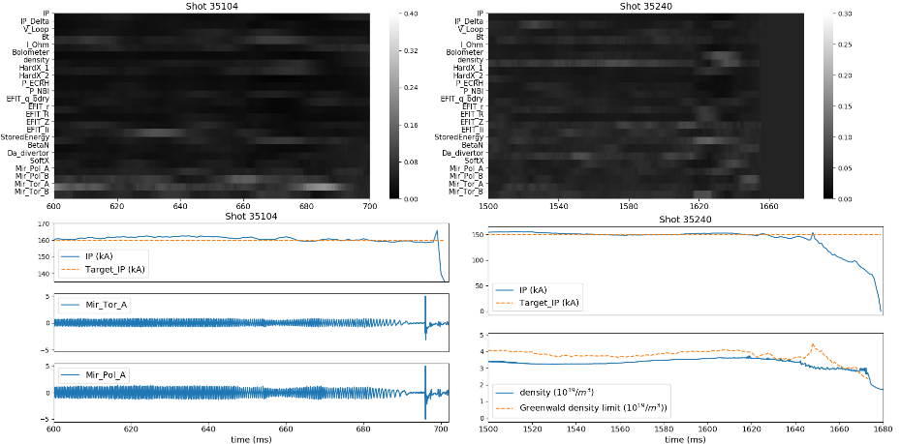
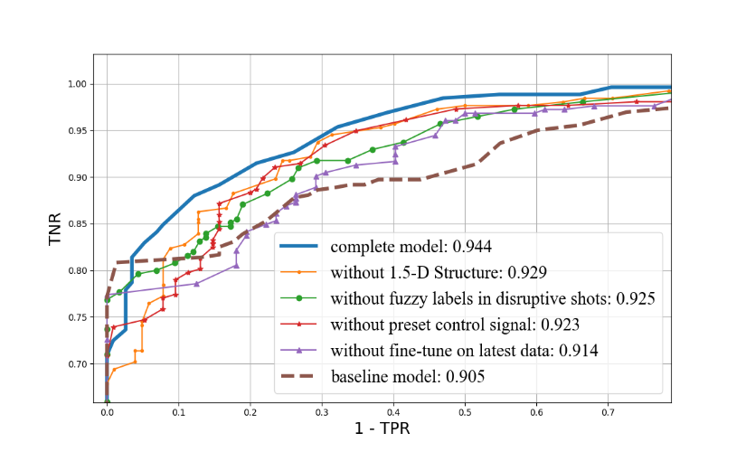
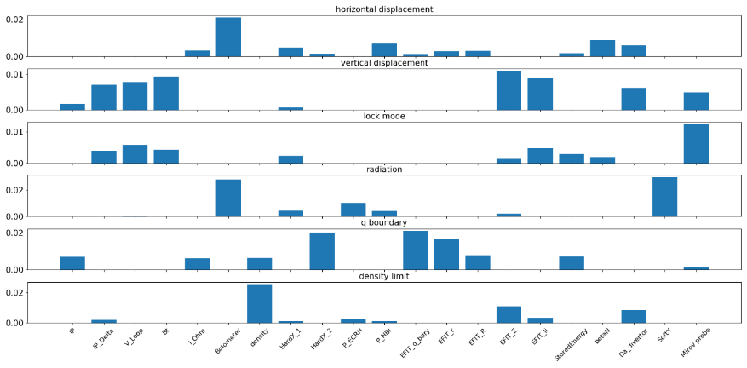
In-depth research on the interpretable disruption predictor in HL-2A
4 optimizations are proposed to promote the AUC of HL-2A’s disruption predictor from 0.905 to 0.944.
An interpretation method is applied on HL-2A’s disruption predictor. Both the results of single shot interpretation and statistical analysis show good coherence with the causes of disruption.
A Bayes classifier is developed to recognize the cause of disruption based on the output of the interpretation algorithm. This classifier has an accuracy of 71.2% on the labelled dataset.
Result of interpretation algorithm and related input signals of example shots.
Averaged importance of each input signal among shots of each disruption cause.
ROC Curve the model with and without each optimization

