Slide 1
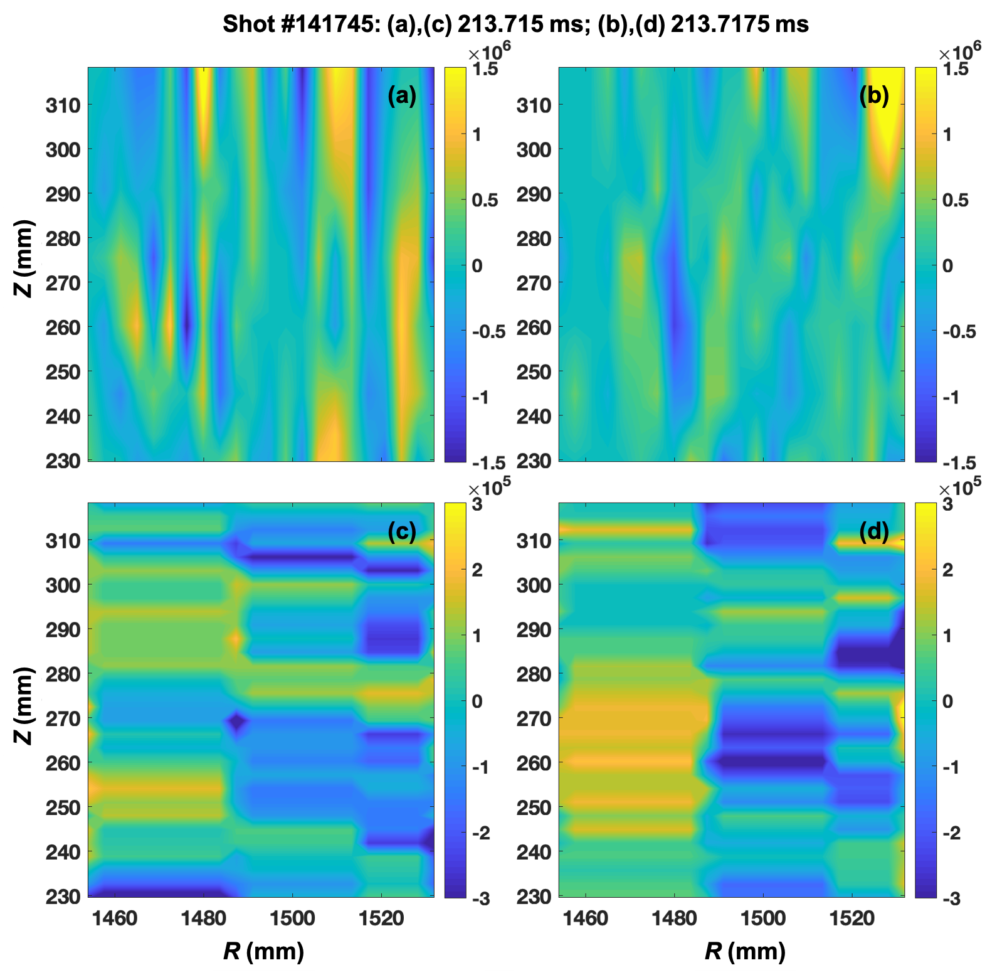
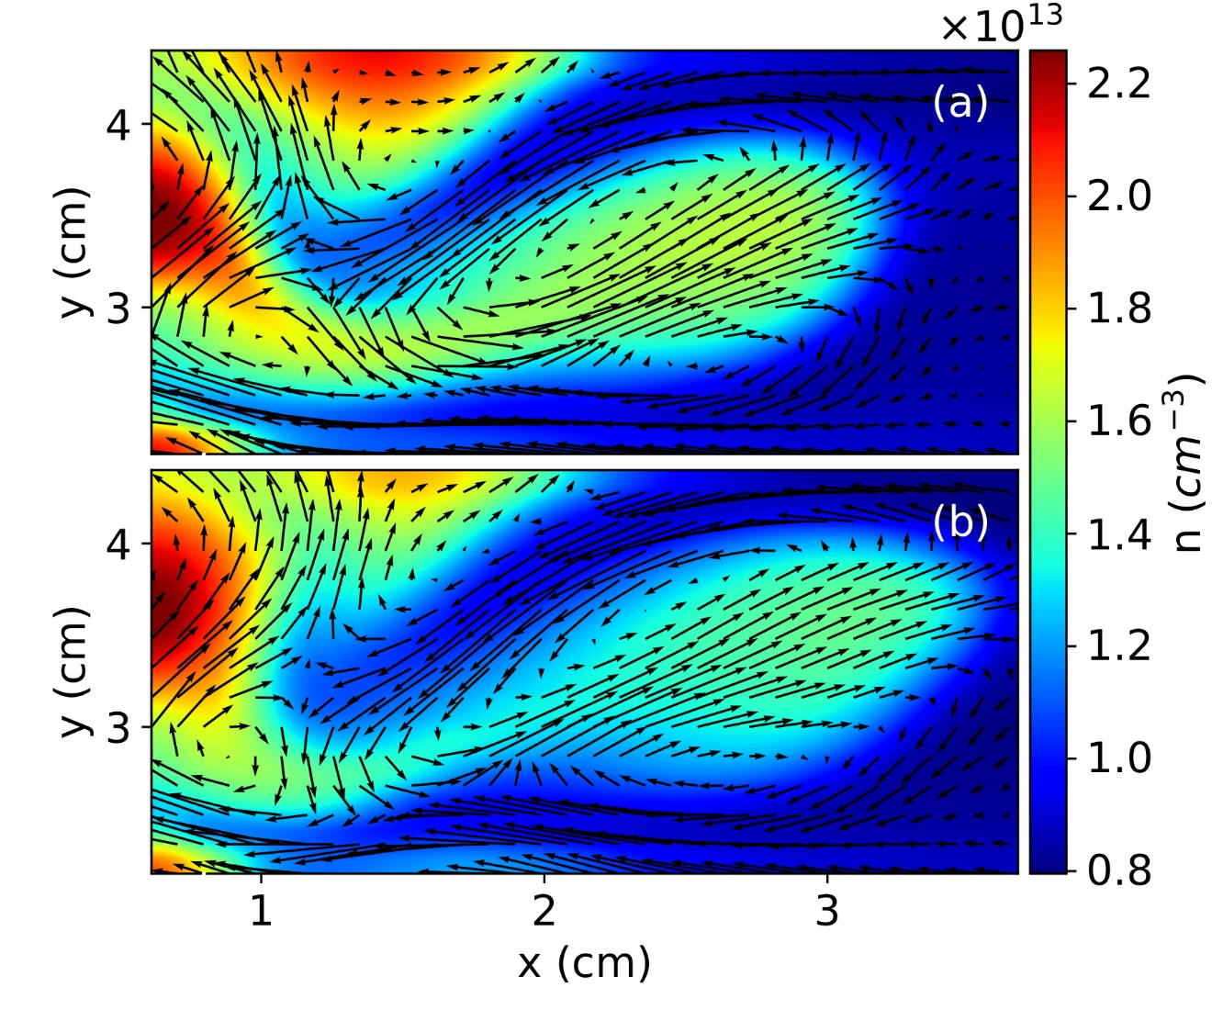
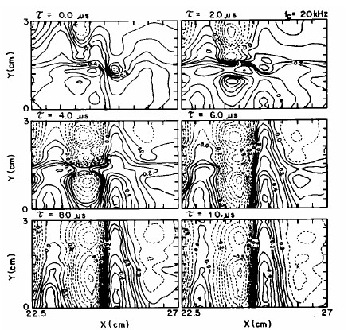
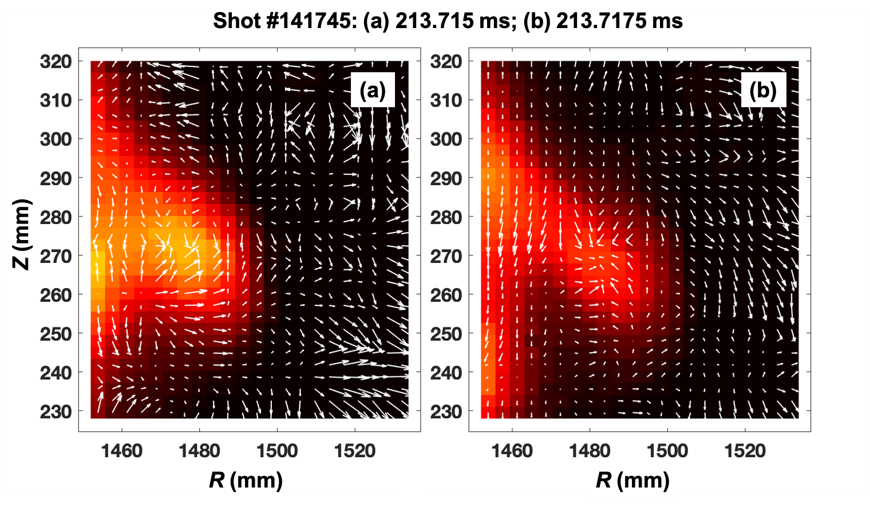
Experimental Validation of Universal Plasma Blob
Formation Mechanism
N Bisai^{1,2}, Santanu Banerjee^{2,3}, S. J. Zweben⁴ and A Sen^{1 , 2}
¹Institute for Plasma Research, Bhat, Gandhinagar 382428, India
²Homi Bhabha National Institute (HBNI), Mumbai, 400094, India
³Department of Physics, William & Mary, Williamsburg,VA 23187-8795, USA
⁴Princeton Plasma Physics Laboratory,100 Stellarator Rd, Princeton, NJ 08540, USA
Corresponding Author: nirmal@ipr.res.in
ID: TH/P4-17
Abstract
NSTX velocimetry data
Plasma blob formation is due to the breaking process of a radially elongated streamer due to the poloidal and radial velocity shear [1].
In this work, we report the first ever experimental validation of this universal criterion by testing it against NSTX data on blobs obtained using the gas-puff imaging (GPI) diagnostic [2].
The criterion is widely satisfied in most L-mode discharges and may explain the predominance of blobs in such a regime compared to the H-mode.
We also validate the theoretical criterion using Aditya Langmuir probe data taken in the edge and SOL regions in L-mode plasma.
$$v_{x}^{′}$$
$$v_{x}^{′}$$
$v_{x}^{′}\sim 1×{10}^{6}/s$
Ellipses represent
Position of the blob
$$v_{y}^{′}$$
$$v_{y}^{′}$$
$v_{y}^{′}\sim 1×{10}^{5}/s$
Background
Anomalous plasma transport in the boundary region of a tokamak plasma is normally associated with density structures. These structures are commonly termed as plasma blobs [2-5].
Studies on the plasma blob formation is important so that one can identify the cause for the blob formation and can control the anomalous transport in tokamak.
The blob formation theory is well supported by two-dimensional (2D) and three-dimensional (3D) numerical simulation results [1,3] but lacks experimental validation.
$$v_{x}^{′}$$
$$v_{y}^{′}$$
FIG.2:(a)-(b) indicate and (c)-(d) indicate at the same instant of time as Figs.1(a) and (b). These plots obtained from NSTX gas-puff imaging data.
Numerical simulation data
Initial phase of the blob
formation. Poloidal width
is higher.
Theory of plasma blob formation
After blob formation.
Poloidal width is narrower
Than the initial phase
A radially elongated streamer structure generates blob when it breaks in the presence of the shear of the electric fields ($E_{x}^{′}$ and $E_{y}^{′}$ ).
The breakup happens when the shearing time ($τ_{s}$) due to the diﬀerential stretching is smaller or of the order of the radial convection time ($δ_{x}/v_{x}$ $≤τ_{s}$).
If the linear growth rate $γ\sim c_{s}/\sqrt{RL_{n}}$ the condition for breaking :
Fig.3 Simulation data, behavior is similar to the sequence as in Fig.1
Blob formation from Langmuir probe data (shot #2009)
Data indicates:
$v_{x}^{′}{+v}_{y}^{′}\sim 3×{10}^{5}/s$ and $γ\sim 2.8×{10}^{5}/s$
$γ$ has been estimated from Aditya tokamak data $T_{e}=16eV, R=1.0m, L_{n}=0.02m.$
LCFS is at x=25 cm.
$$\frac{E_{y}^{/}}{Bγ}+\frac{δ_{x}}{δ_{y}}\frac{E_{x}^{/}}{Bγ}≥1$$
where $δ_{x}$ and $δ_{y}$ are radial and poloidal widths of the streamer, respectively.
In terms of velocity shear the condition is:
$$\frac{v_{x}^{/}}{γ}+\frac{δ_{x}}{δ_{y}}\frac{v_{y}^{/}}{γ}≥1$$
Validation of theory from gas-puff imaging data of NSTX
FIG. 3: Iso-potential structures for blob formation from Aditya probe data
Conclusions
The NSTX velocimetry data from gas-puff imaging: $v_{x}^{′}\sim 1×{10}^{6}/s$ and $v_{y}^{′}\sim 1×{10}^{5}/s$ .These values along with $γ\sim 2×{10}^{5}/s$ and$δ_{x}\sim δ_{y}$ are found to satisfy the condition. In L-mode, the condition is widely satisfied.
For Aditya Langmuir probe data $v_{x}^{′}{+v}_{y}^{′}\sim 3×{10}^{5}/s$ and $γ\sim 2.8×{10}^{5}/s$ satisfy the formation criterion of blob. The condition also satisfies from Aditya tokamak for L-mode plasma.
Blob formation in H-mode will be investigated in future.
References
[2] N. Bisai, Santanu Banerjee, and Abhijit Sen. A universal mechanism for plasma blob formation. Physics of Plasmas, 26(2):020701, February 2019.
[2] S. J. Zweben, J. L. Terry, D. P. Stotler, and R. J. Maqueda. Invited Review Article: Gas puff imaging diagnostics of edge plasma turbulence in magnetic fusion devices. Review of Scientific Instruments, 88(4), April 2017
[3]. N. Bisai, A. Das, S. Deshpande, R. Jha, P. Kaw, A. Sen, and R. Singh. Formation of a density blob and its dynamics in the edge and the scrape-off layer of a tokamak plasma. Physics of Plasmas, 12(10):102515, October 2005.
[4]. D. A. Russell, J. R. Myra, and D. A. D’Ippolito. Saturation mechanisms for edge turbulence. Physics of Plasmas, 16(12):122304, December 2009.
[5]. D. A. D’Ippolito, J. R. Myra, and S. J. Zweben. Convective transport by intermittent blob-filaments: Comparison of theory and experiment. Physics of Plasmas, 18(6):060501 , June 2011.
[6]. Furno, B. Labit, A. Fasoli, F. M. Poli, P. Ricci, C. Theiler, S. Brunner, A. Diallo, J. P. Graves, M. Podest´a, and S. H. M¨uller. Mechanism for blob generation in the TORPEX toroidal plasma. Physics of Plasmas, 15(5):055903, May 2008
[7]. S.I. Krasheninnikov. On the origin of plasma density blobs. Physics Letters A, 380(46):3905– 3907, December 2016.
FIG. 1: Blob dynamics. These GPI images are superposed on quiver plots of the radial and poloidal velocities of the plasma. (a) and (b) are 5 µs apart in time. The separatrix is at 1445 mm that is beyond the left edge of the figure

