Slide 1
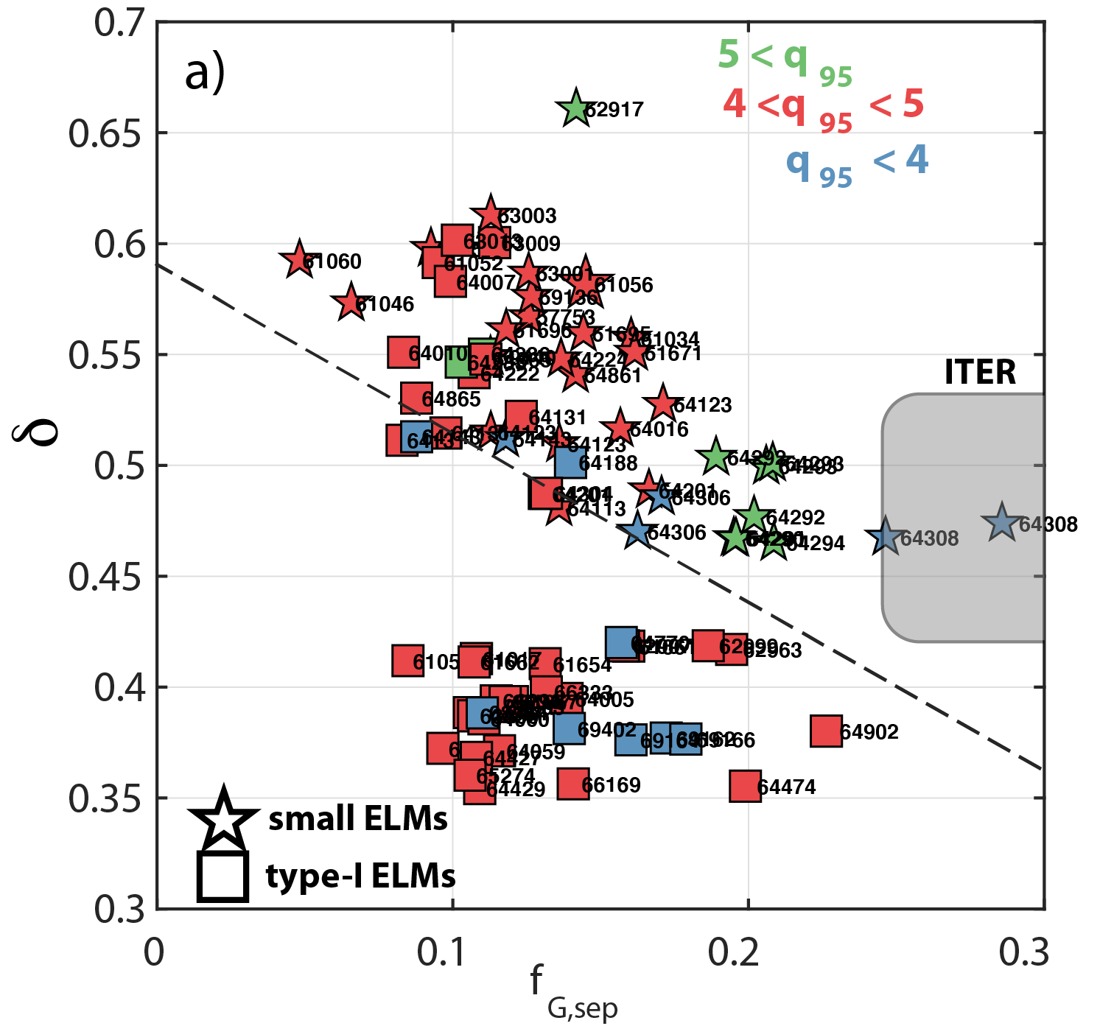
H-mode physics studies on TCV supported by the EUROfusion pedestal database
EX/P4-17
id=883
Pedestal database for TCV: Effort from EUROfusion MST1 devices and JET with common definitions – Available on IMAS (currently only for JET)
ITER relevant separatrix densities and pedestal colllisionality achieved but not simultaneously
With decreasing ν*^{ped}, pedestal closer to P-B boundary & w_{pe} ~0.1(β_{θ}^{ped})^{1/2} at the boundary (dominant electron heating)
Type-I and QCE achieved with NBI: extension of QCE to q95<4 with stronger shaping and/or larger n_{e}^{sep}
Operational space
QCE regime in TCV
NBH
ECRH

