Slide 1
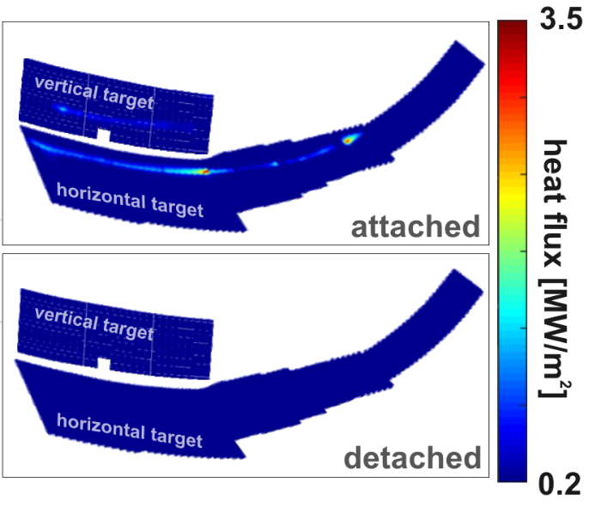
Results from divertor experiments at W7-X
M. Jakubowski for the W7-X team
Wendelstein 7-X demonstrated that island divertor is an attractive exhaust concept.
In attached state
  We can efficiently spread heat with wetted area of up to 1.5 m² Moreover it increases with P_{SOL}.
  Overloading divertor leading edge showed that plasma core is robust against impurity accumulation.
En-route to detachment we observed higher recycling regime. This has been enabled by good separation of counter-streaming flows in the island divertor.
Stable (≤ 26 s), complete detachment in many scenarios was achieved
14.05.2021
M.Jakubowski, et al. | Overview of divertor results at W7-X | IAEA-FEC EX/7-998

