Slide 1
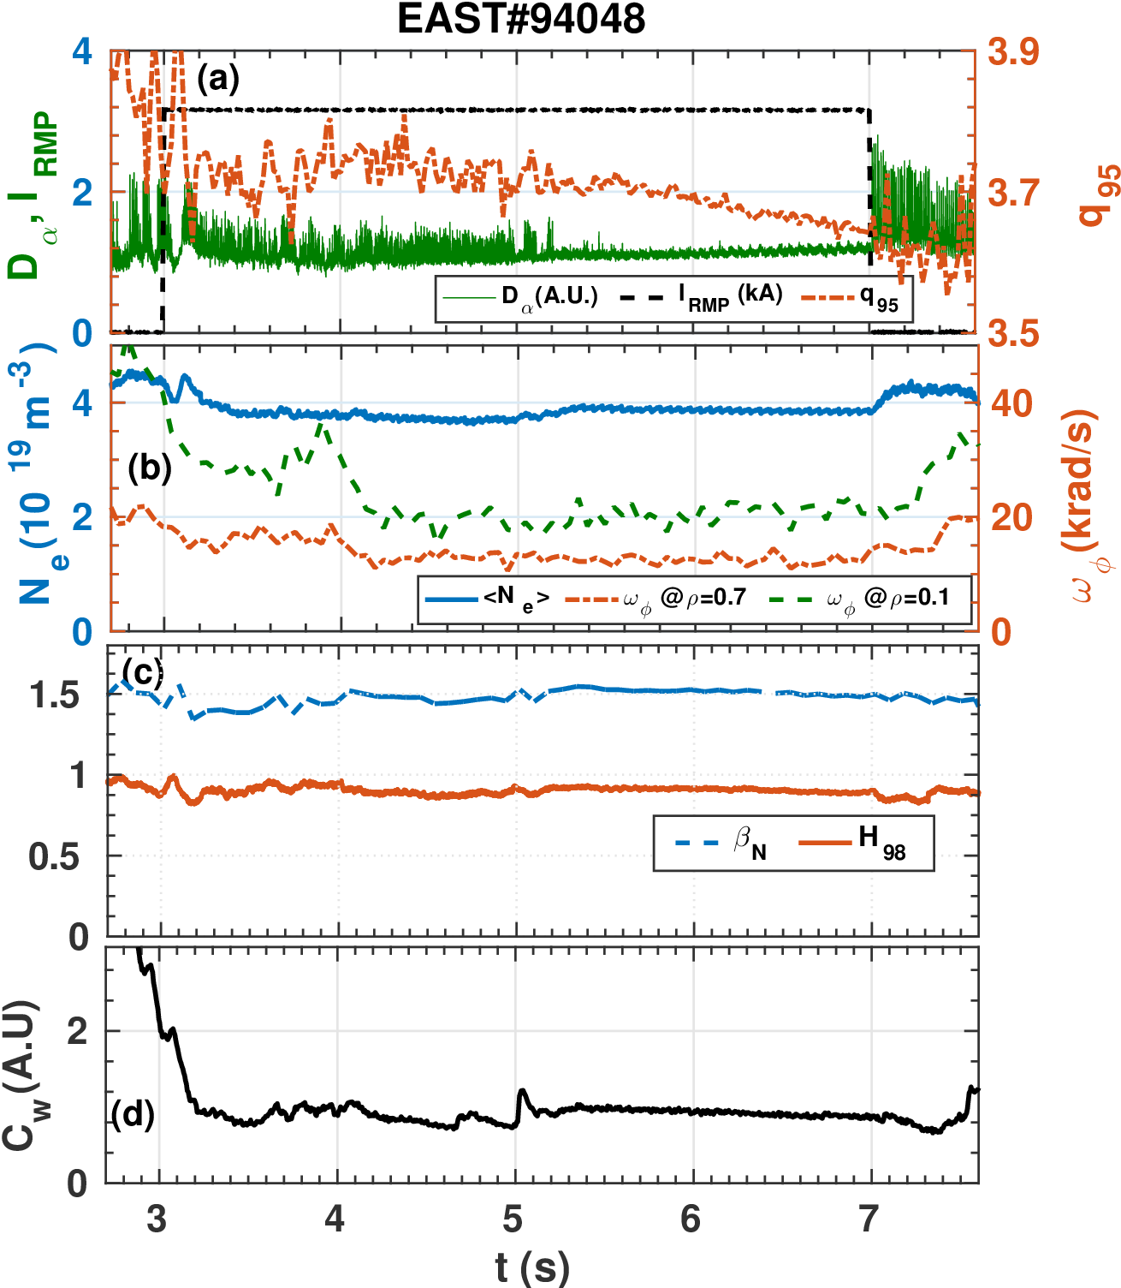
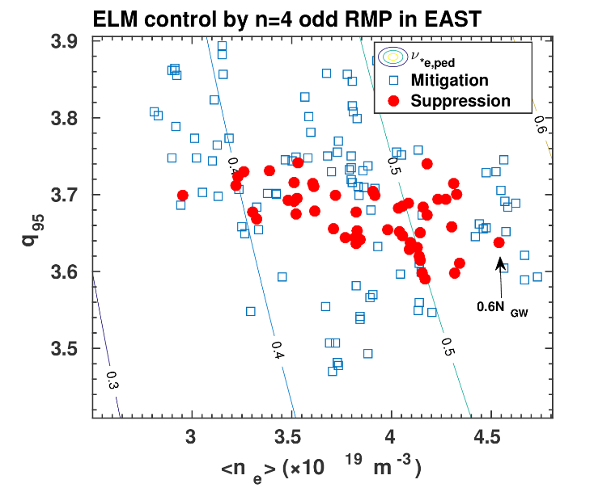
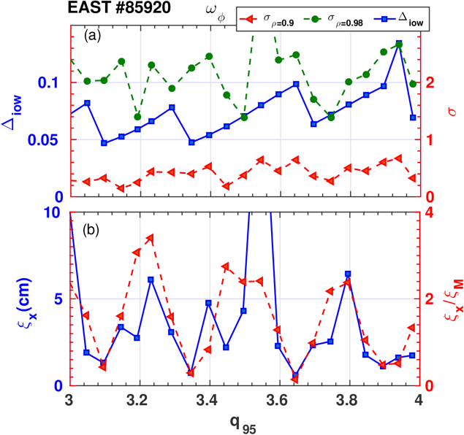
First demonstration of full ELM suppression by n=4 RMPs in low torque plasmas for ITER in EAST
suppression
suppression
Experimental condition relevant to the ITER type-I ELMy H-mode (Q =10) scenario
low torque T_{NBI} --> 0.44 N·m (< 0.9 N·m ITER equivalent torque in EAST)
W divertor, n=4 RMPs
Energy confinement does not obviously drop (<10%)
Core W concentration is clearly reduced demonstrating an effective W impurity exhaust
Suppression window consistent with MARS-F modelling

