Slide 1
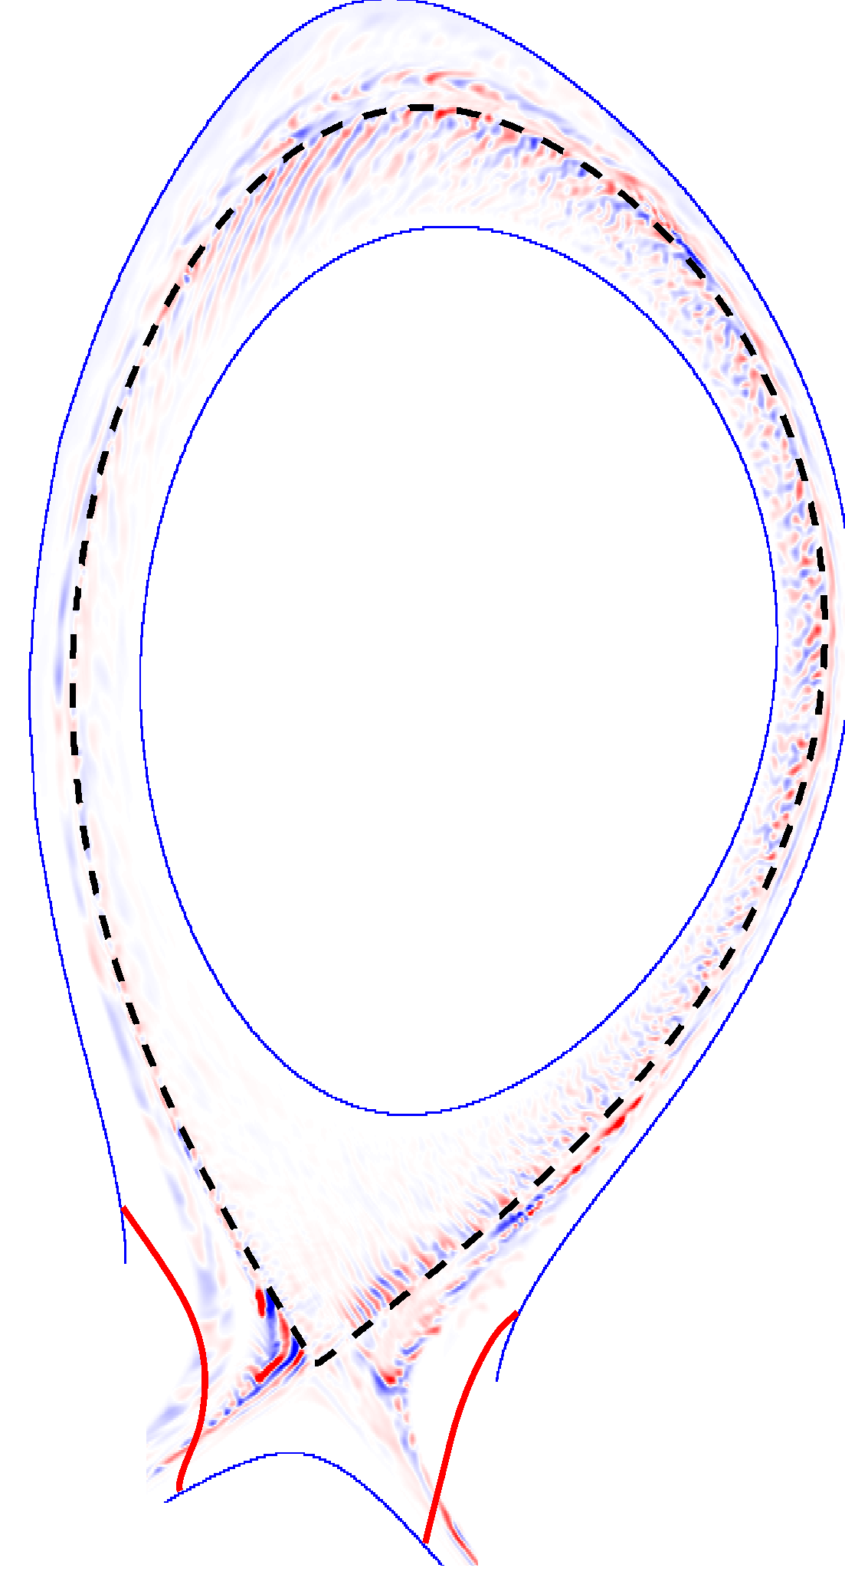
Simulations of turbulence and profile evolution across the edge and scrape-off layer of the ASDEX Upgrade tokamak
W. Zholobenko, T. Body, A. Stegmeir, P. Manz, B. Zhu, M. Griener, G. D. Conway, D. Coster, M. Francisquez, B. N. Rogers, E. Wolfrum, F. Jenko and the ASDEX Upgrade Team

Slide 2
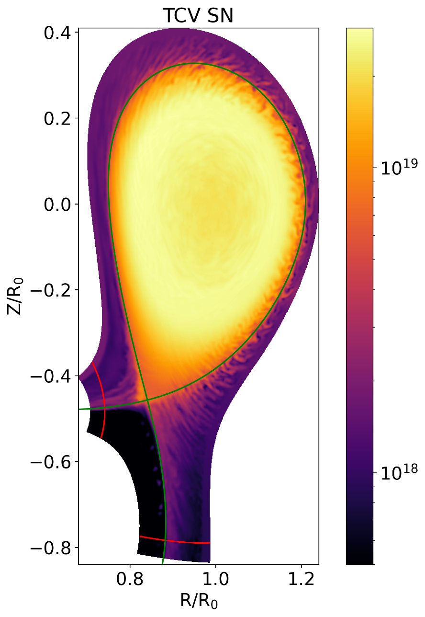
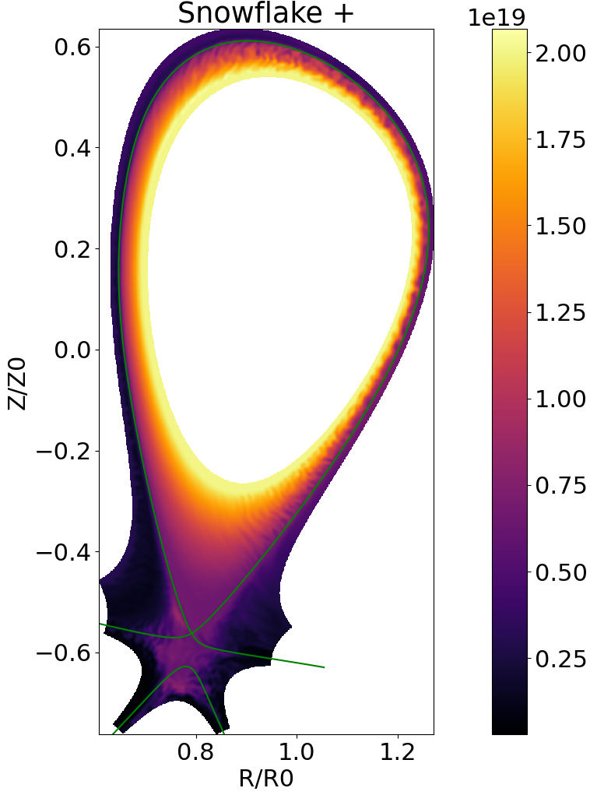


Divertor heat load & confinement optimization
$$m^{−3}$$
$$m^{−3}$$
A validation against the TCV tokamak is in preparation by Diego Sales de Oliveira, Thomas Body et al
Notes:
Major challange in magnetic fusion research: prediction & optimisation of div heat loads. 1) Detachment & radiation patterns. 2) Plasma flow distribution -> both largely geometry dependent. Shown – ADC simulations: SN, SF+. Requires partial abolishment of field alignment.

Slide 3
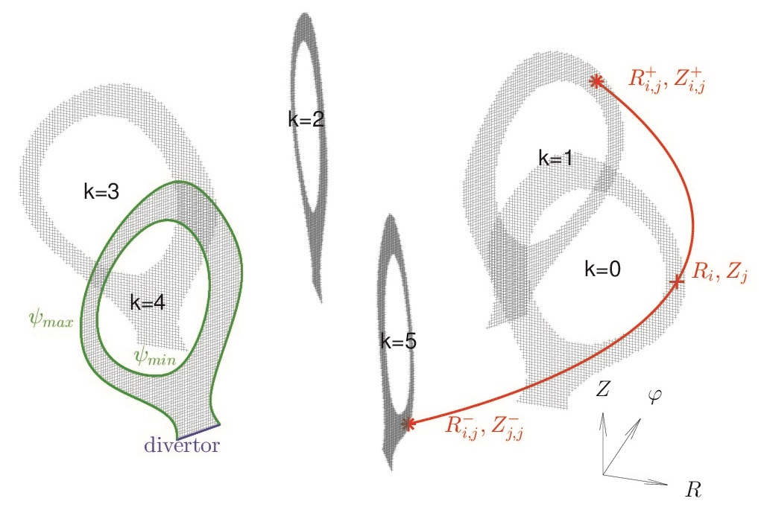
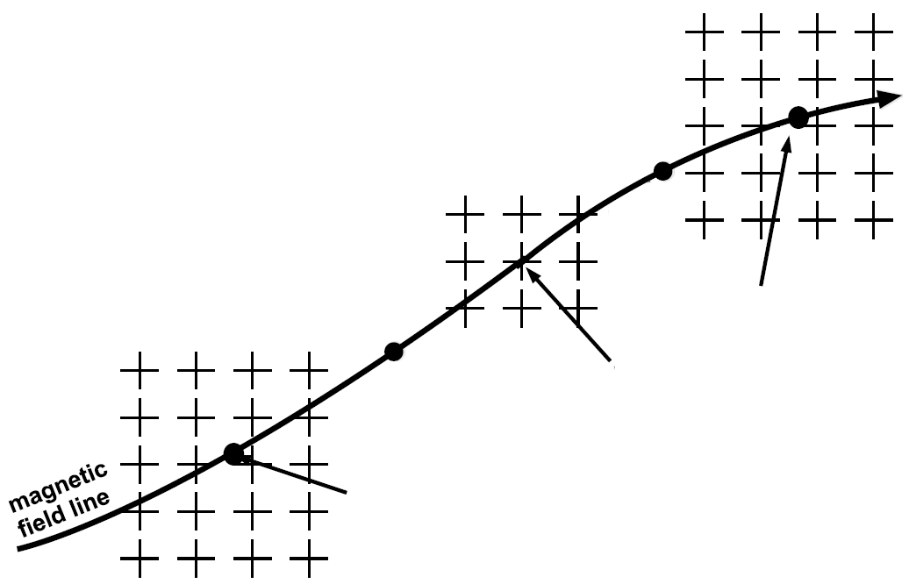

GRILLIX: locally field-aligned discretization
$$k_{⊥}≫k_{∥}$$
Flux-coordinate independent (FCI) approach
F. Hariri and M. Ottaviani, Comput. Phys. Comm. 184, 2419 (2013)
A. Stegmeir et al., Comput. Phys. Comm. 198, 139 (2016)
A. Stegmeir et al., Phys. Plasmas 26, 052517 (2019)
Notes:
Globally field-align coordinate systems necessarily singular at separatrix/X-point. Therefore, non-aligned global grid. However, physically, the mode structure of the turbulence will be field aligned, and using this property reduces the necessary grid resolution by orders of magnitude.
Problem solved by local field alignment through field-line tracing and interpolation.

Slide 4



Two-fluid Braginskii equations
plasma density
quasineutrality / vorticity
Drift reduction:
electron heat
ion heat
$\frac{d}{dt}=\frac{∂}{∂t}+δ\left(\frac{B×∇φ}{B^{2}}\right)⋅∇$,

Slide 5
Global drift-reduced Braginskii with diffusive neutrals
plasma density
quasineutrality / vorticity
momentum
Ohm & Ampère
electron heat
ion heat
neutral particles

Slide 6
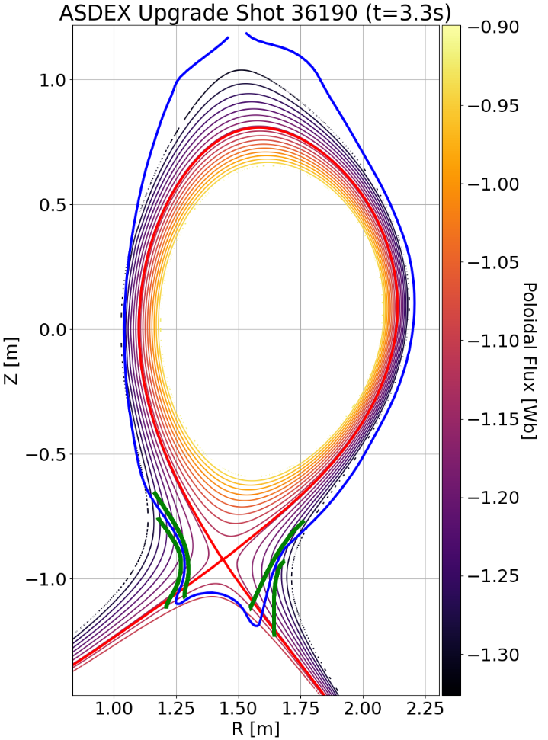
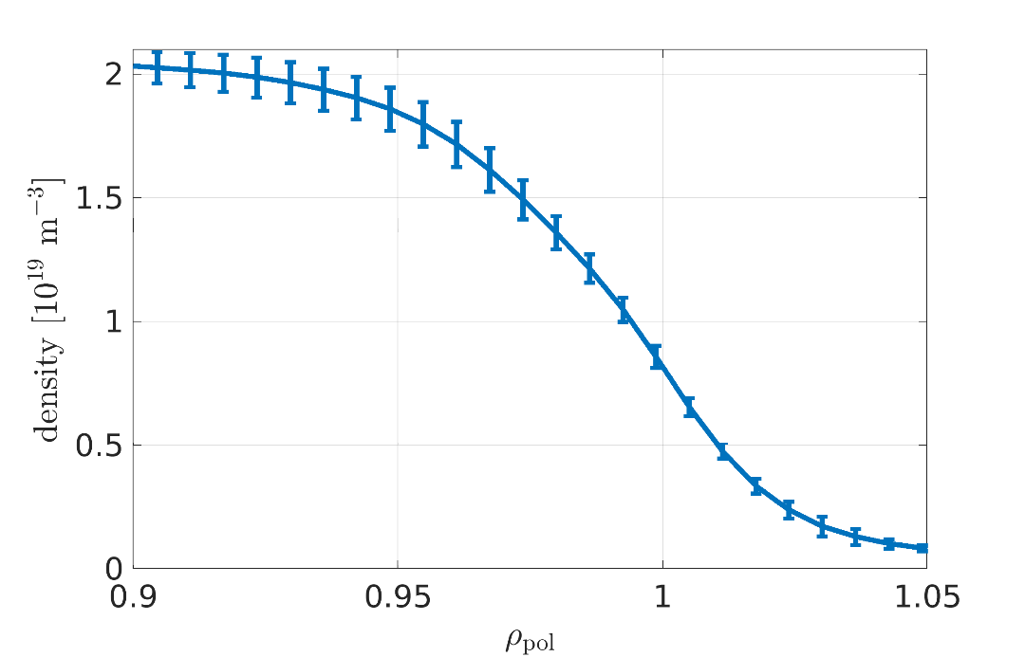
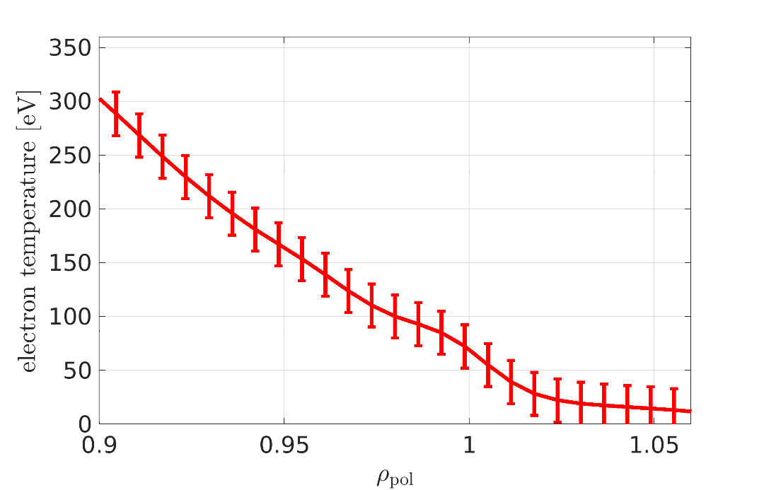

AUG discharge #36190: geometry and parameters
Outboard
mid-plane measurements
$B_{tor}=−2.5$T,
$I_{p}=+0.8 MA$,
500 kW ohmic,
-250 kW radiation,
550 kW NBI,
$$Z_{eff}=1.3$$

Slide 7
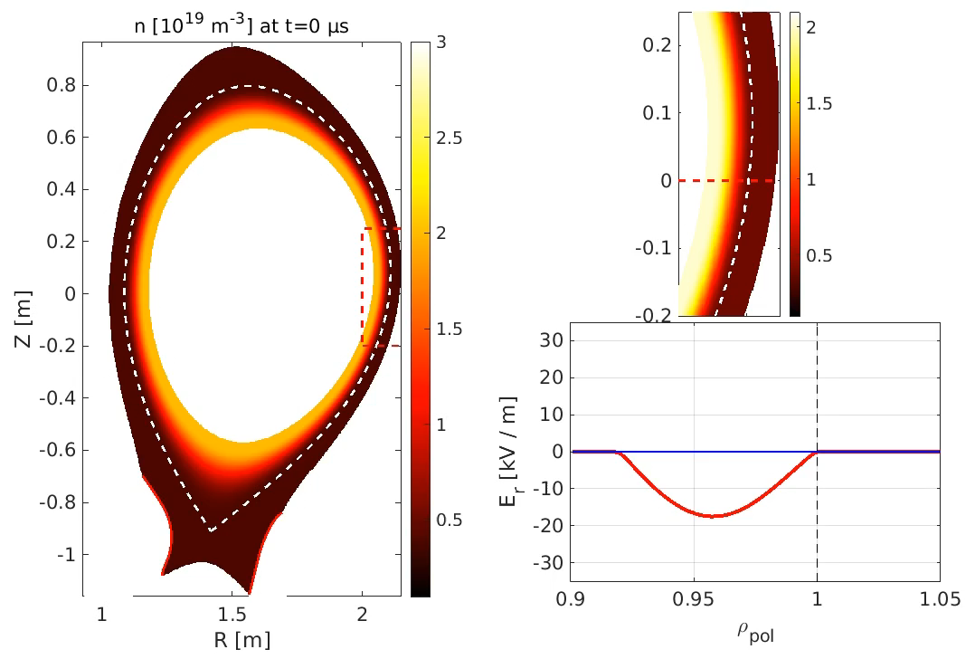

The simulation: density evolution and $E_{r}$
Notes:
Ionization source sits at the separatrix at and below the X-point. Sheared flow forms, visible at the OMP and in Er. Er < 0 in CR due to d_pi/dr/n, Er > 0 in SOL due to sheath b.c. + we have ZF and a poloidal flow from neutrals Siz. Saturation after 2-4 ms.

Slide 8
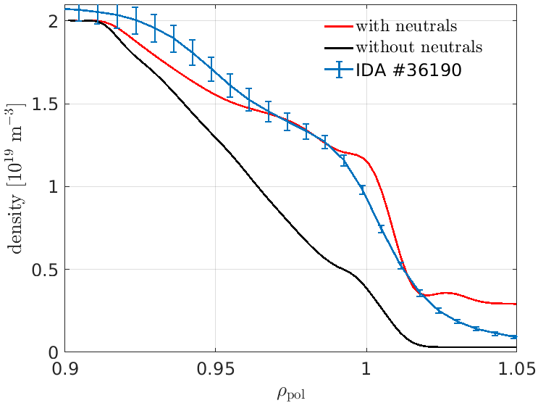
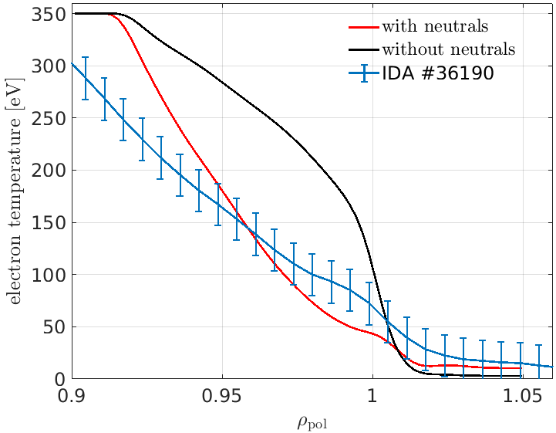
Validation driven development (AUG #36190)
outboard mid-plane profiles
Neutral gas completely changes the SOL dynamics and edge boundary conditions
A validation against the TCV tokamak is in preparation by Diego Sales de Oliveira, Thomas Body et al

Slide 9
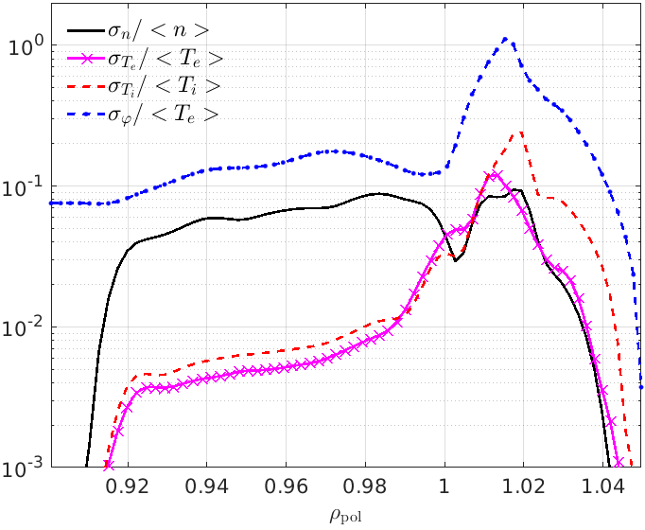
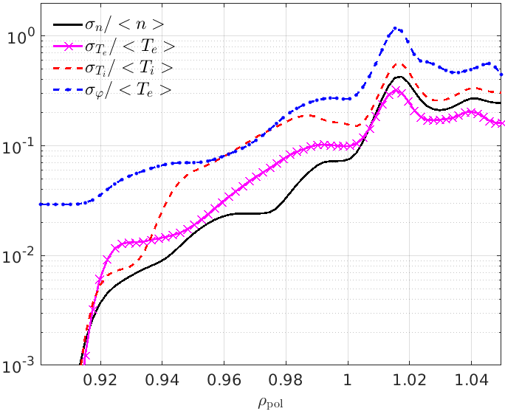






Turbulence characterisation
without neutrals (core source)
with neutrals (edge source)
$$σ_{f}^{2}=\left\langle f^{2}\right\rangle −{\left\langle f\right\rangle }^{2}$$
$$σ_{f}^{2} =\left\langle f^{2}\right\rangle −{\left\langle f\right\rangle }^{2}$$
$\frac{σ_{φ} }{\left\langle T_{e}\right\rangle }>2\frac{σ_{n}}{\left\langle n\right\rangle }≫\frac{σ_{T}}{\left\langle T\right\rangle } ⟹$ballooning
$\frac{σ_{φ} }{\left\langle T_{e}\right\rangle }≥\frac{σ_{T_{i}}}{\left\langle T_{i}\right\rangle } >\frac{σ_{T_{e}}}{\left\langle T_{e}\right\rangle }>\frac{σ_{n}}{\left\langle n\right\rangle } ⟹$ITG
$$χ_{⊥}^{e}=2/3D_{⊥}$$
$$\left\langle D_{⊥}\right\rangle ≈0$$

Slide 10
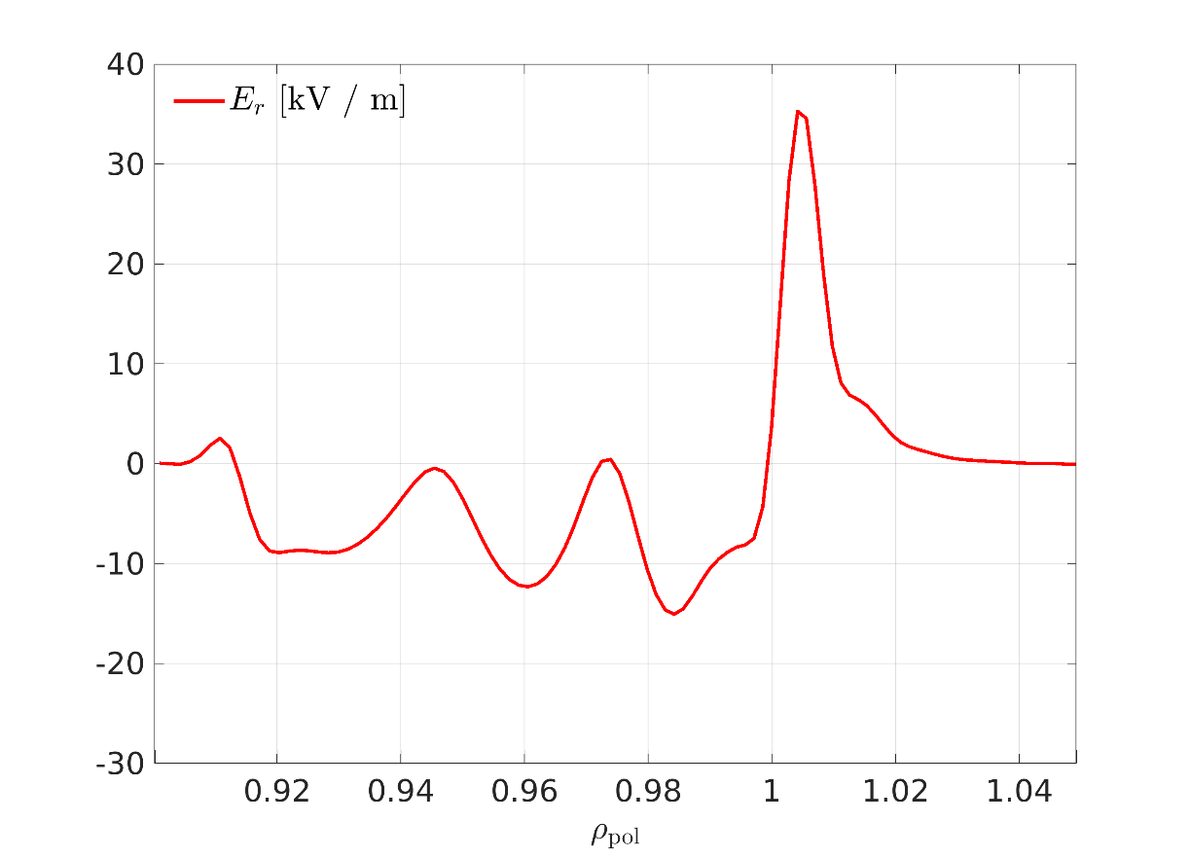
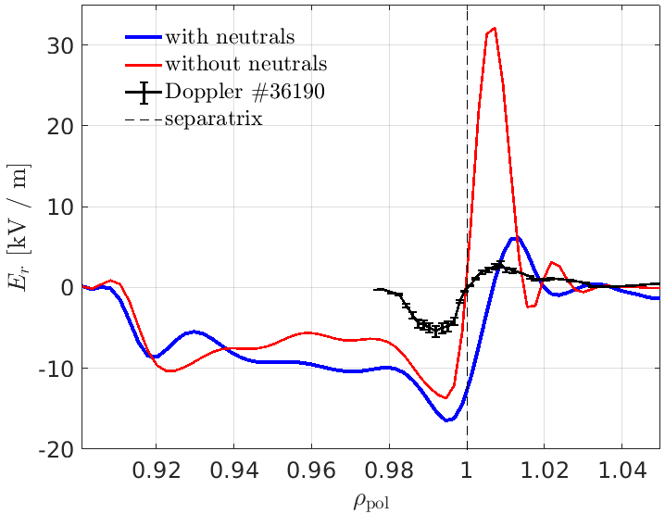
Radial electric field: validation and physics
validation
Analysis of contributions (no neutrals)
right shape, wrong magnitude
Braginskii model inconsistent with neoclassical theory
higher resolution?
Notes:
Zonal flows driven by drift waves on Larmor radius scale, transport driven by large scale interchange modes

Slide 11
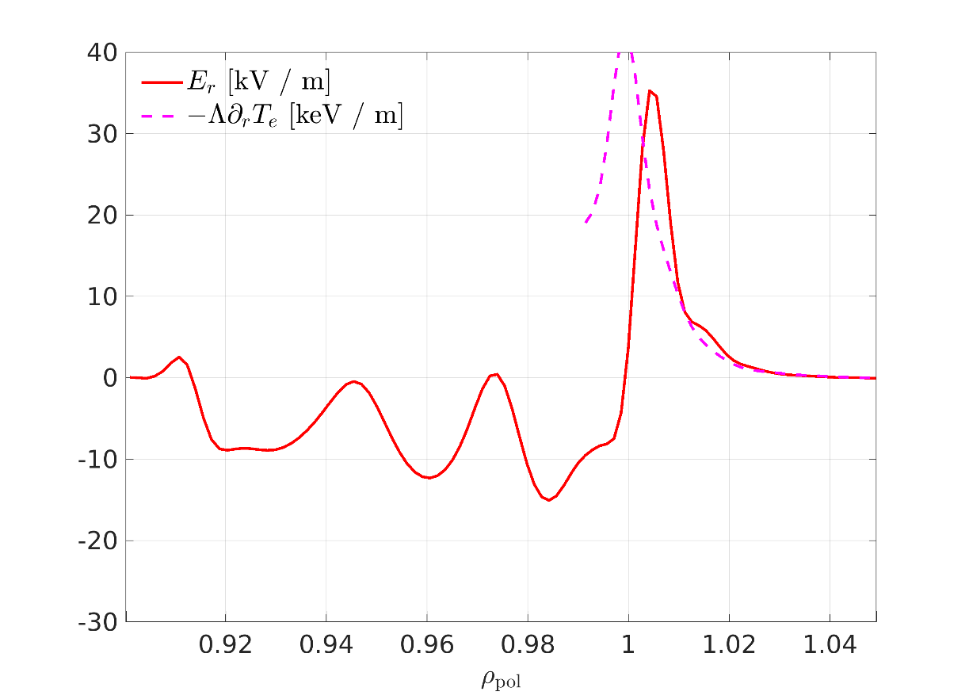
Radial electric field: validation and physics
validation
Analysis of contributions (no neutrals)
right shape, wrong magnitude
Braginskii model inconsistent with neoclassical theory
higher resolution?
Notes:
Zonal flows driven by drift waves on Larmor radius scale, transport driven by large scale interchange modes

Slide 12
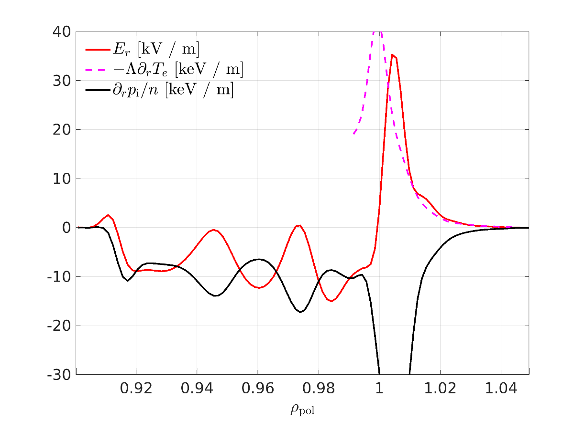

Radial electric field: validation and physics
validation
Analysis of contributions (no neutrals)
$∂_{r}p_{i} /en$ is the dominant contribution in CR
right shape, wrong magnitude
Braginskii model inconsistent with neoclassical theory
higher resolution?
Notes:
Zonal flows driven by drift waves on Larmor radius scale, transport driven by large scale interchange modes

Slide 13
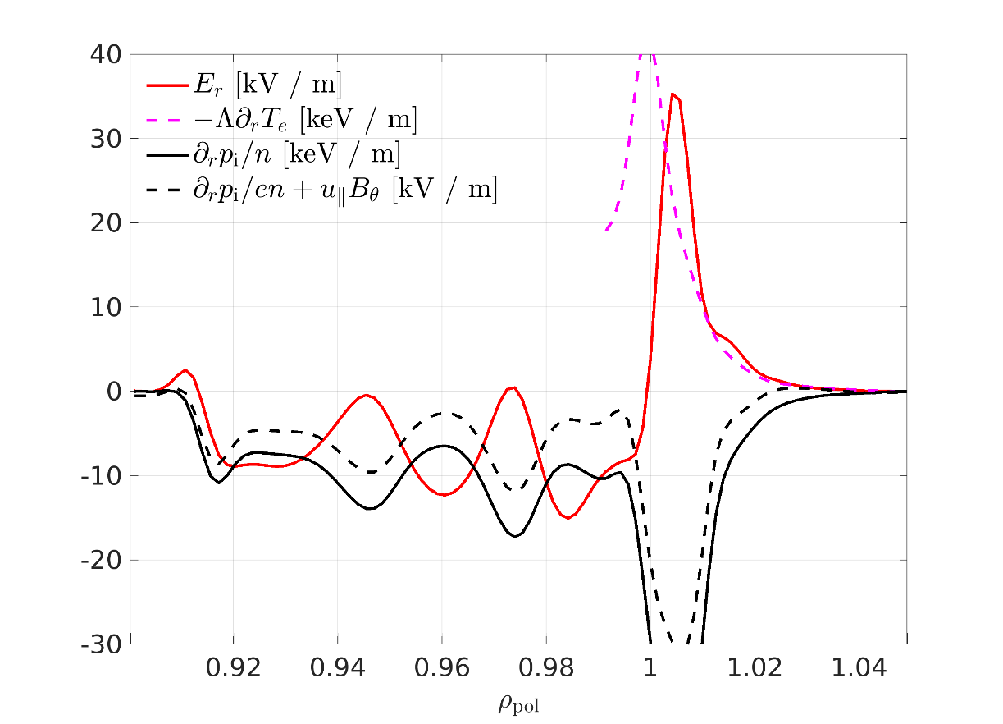
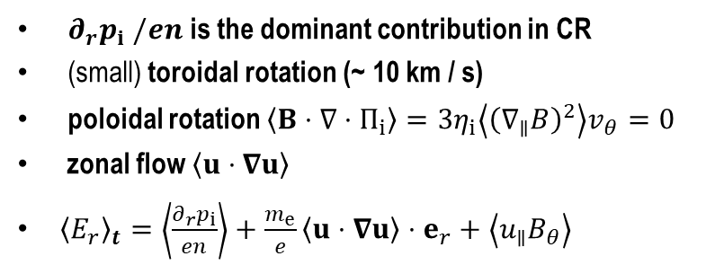
Radial electric field: validation and physics
validation
Analysis of contributions (no neutrals)
right shape, wrong magnitude
Braginskii model inconsistent with neoclassical theory
higher resolution?
$∂_{r}p_{i} /en$ is the dominant contribution in CR
(small) toroidal rotation (~ 10 km / s)
poloidal rotation $\left\langle B⋅∇⋅Π_{i}\right\rangle =3η_{i}\left\langle {\left(∇_{∥}B\right)}^{2}\right\rangle v_{θ}=0$
zonal flow $\left\langle u⋅∇u\right\rangle$
${\left\langle E_{r}\right\rangle }_{t}=\left\langle \frac{∂_{r}p_{i}}{en}\right\rangle +\frac{m_{e}}{e}\left\langle u⋅∇u\right\rangle ⋅e_{r}+\left\langle u_{∥}B_{θ}\right\rangle$
Notes:
Zonal flows driven by drift waves on Larmor radius scale, transport driven by large scale interchange modes

Slide 14
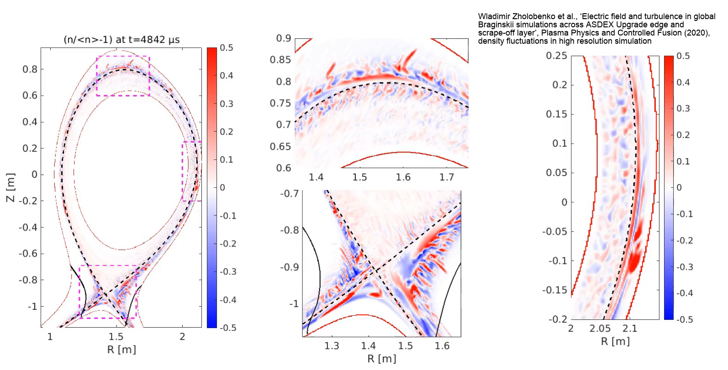
Turbulence dynamics across the separatrix
simulation without neutrals (core density source)
W Zholobenko et al 2021 Plasma Phys. Control. Fusion 63 034001, https://doi.org/10.1088/1361-6587/abd97e, ‘’Electric field and turbulence in global Braginskii simulations across the ASDEX Upgrade edge and scrape-off layer “
Notes:
1.5 months simulation time (14 M points) on 400 CPUs. Relative fluctuation amplitude increases outwards, as background decreases. Counter-propagating flow at the separatrix. Time scales increase outwards, as temperature drops. Stripes in CR – zonal flow. Extends up to separatrix: vortices simply absorbed into it (OMP). Top: vortex breaking. Fluctuations advected exclusively by ExB velocity.

Slide 15
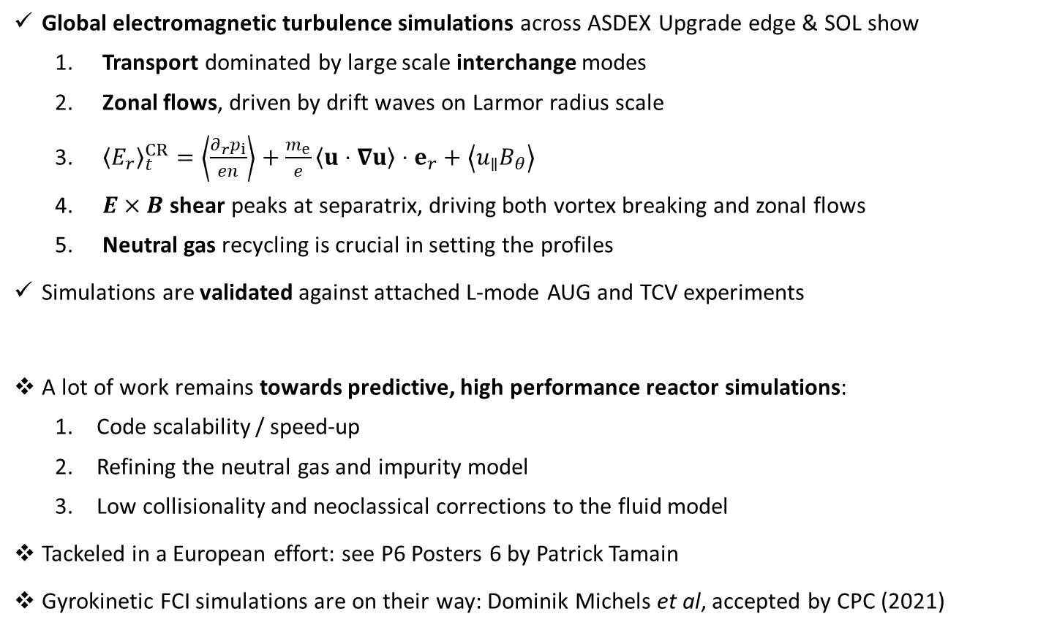
Conclusions and outlook
Global electromagnetic turbulence simulations across ASDEX Upgrade edge & SOL show
  Transport dominated by large scale interchange modes
  Zonal flows, driven by drift waves on Larmor radius scale
  ${\left\langle E_{r}\right\rangle }_{t}^{CR}=\left\langle \frac{∂_{r}p_{i}}{en}\right\rangle +\frac{m_{e}}{e}\left\langle u⋅∇u\right\rangle ⋅e_{r}+\left\langle u_{∥}B_{θ}\right\rangle$
  $E×B$ shear peaks at separatrix, driving both vortex breaking and zonal flows
  Neutral gas recycling is crucial in setting the profiles
Simulations are validated against attached L-mode AUG and TCV experiments
A lot of work remains towards predictive, high performance reactor simulations:
  Code scalability / speed-up
  Refining the neutral gas and impurity model
  Low collisionality and neoclassical corrections to the fluid model
Tackeled in a European effort: see P6 Posters 6 by Patrick Tamain
Gyrokinetic FCI simulations are on their way: Dominik Michels et al, accepted by CPC (2021)
Notes:
Theory, codes and computing systems have become mature enough for realistic global turbulence simulations of the plasma periphery. But work remains to be done towards reactor scale runs.

