Slide 1
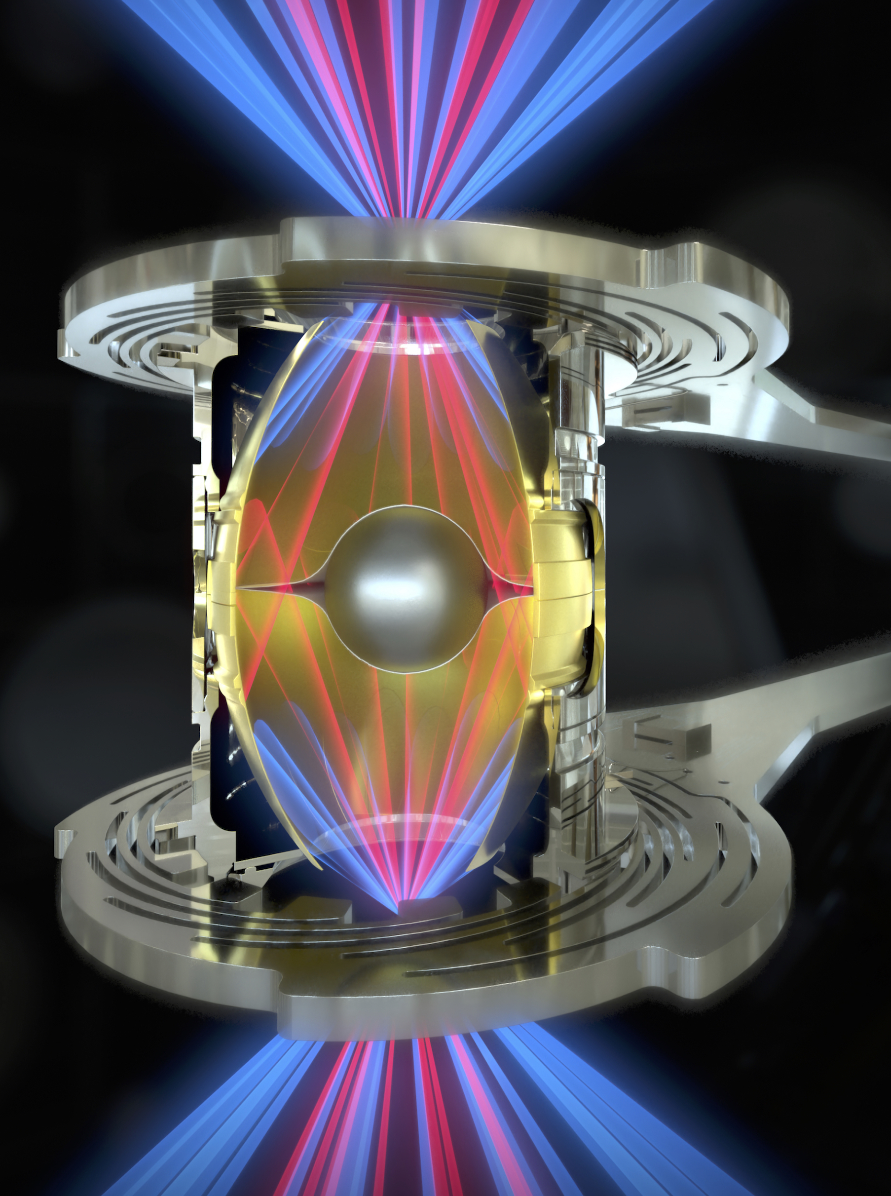
Reaching 30% Energy Coupling Efficiency For Al and HDC Capsules Using Rugby Hohlraums at NIF
Advanced hohlraums enhance energy coupling by accommodating larger capsules
~3x energy coupling from 10% to 30%, or ≥ 500kJ, is possible for hot spot ignition
Symmetry can be tuned by wall angle or wavelength detuning
Larger hot spot is more robust to defects and instabilities
High coupling enables volume ignition
Low convergence requirement
High-adiabat to suppress instabilities
Confinement dominated by ablator
Entire fuel is hot spot, more tolerance to asymmetry and perturbations
Ping, et al. Nature Phys. 15, 138-141 (2019); Phys. Plasmas 27, 100702 (2020)
Amendt, et al. Phys. Plasmas, 26, 082707 (2019); Phys. Plasmas 27, 122708 (2020)

