Slide 1

Overview of the TJ-II stellarator research programme towards model validation in fusion plasmas
C. Hidalgo
on behalf of the TJ-II team and collaborators

Slide 2
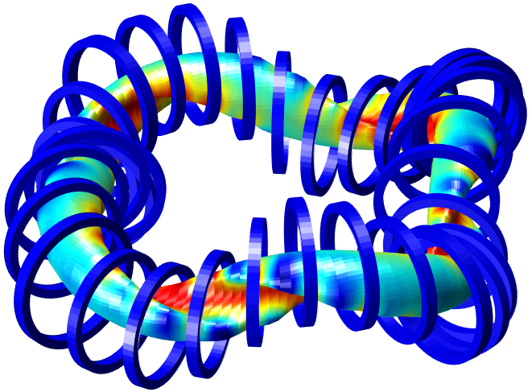
Outline: TJ-II supporting W7-X
Transport and asymmetries
Physics of plasma fuelling
Fast particles: actuators and stability
Turbulence control: Zonal Flows
Edge – SOL coupling physics
Power exhaust

Slide 3
Transport and asymmetries
Physics of plasma fuelling
Fast particles: actuators and stability
Turbulence control: Zonal Flows
Edge – SOL coupling physics
Power exhaust

Slide 4
CHALLENGE:
Transport and impurity control
Configuration optimization requires reduction of neoclassical transport and understanding and controlling turbulent transport.
Effective impurity control seems possible in some regimes
TJ-II strategy:
characterization of flux surface plasma POTENTIAL ASYMMETRIES and NC model validation
characterization of TURBULENCE ASYMMETRIES and GK model validation

Slide 5
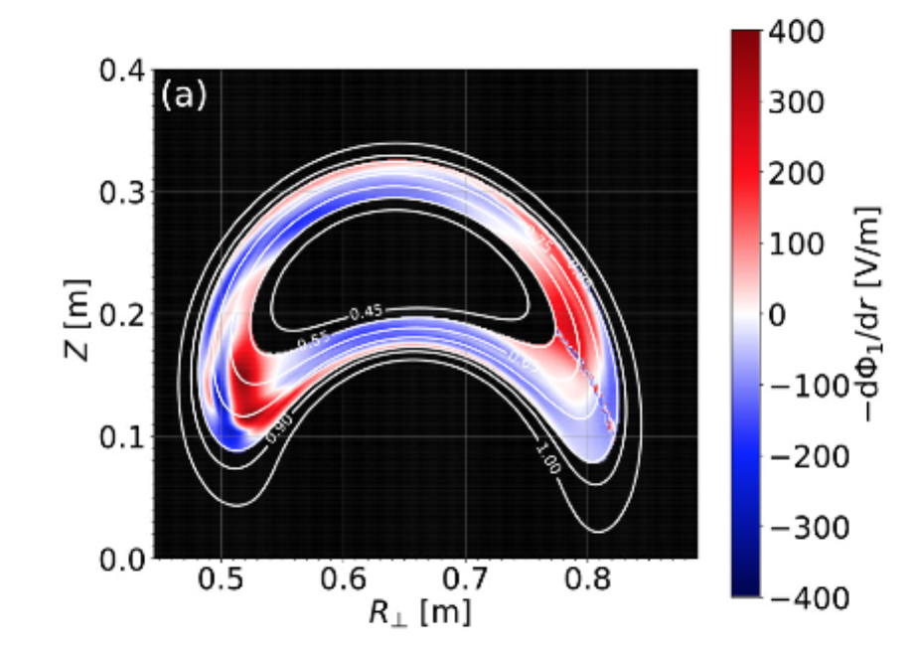
Asymmetries in radial electric fields:
TOWARDS VALIDATION OF NEOCLASSICAL SIMULATIONS
Predicted poloidal asymmetries in radial electric field (E_{r}) are comparable to those found in the experiments [Doppler reflectometry]
T. Estrada et al., NF-2019
E. Sanchez et al., NF-2019
KNOSOS produces more accurate calculations of the neoclassical energy flux for small values of the radial electric field.
J. L. Velasco et al., IAEA-2021

Slide 6
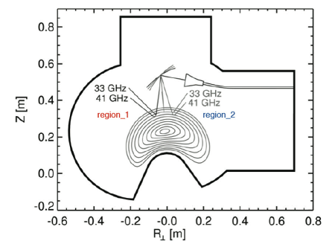
Asymmetries in plasma fluctuations:
TOWARDS VALIDATION OF GK SIMULATIONS
Region I
Region II
Different intensity in the density fluctuation spectra can be related to the poloidal locatlization of instabilities found in GK simulations.
T. Estada et al., NF-2019
E. Sánchez et al., NF-2019

Slide 7
Transport and asymmetries
Physics of plasma fuelling
Fast particles: actuators and stability
Turbulence control: Zonal Flows
Edge – SOL coupling physics
Power exhaust

Slide 8
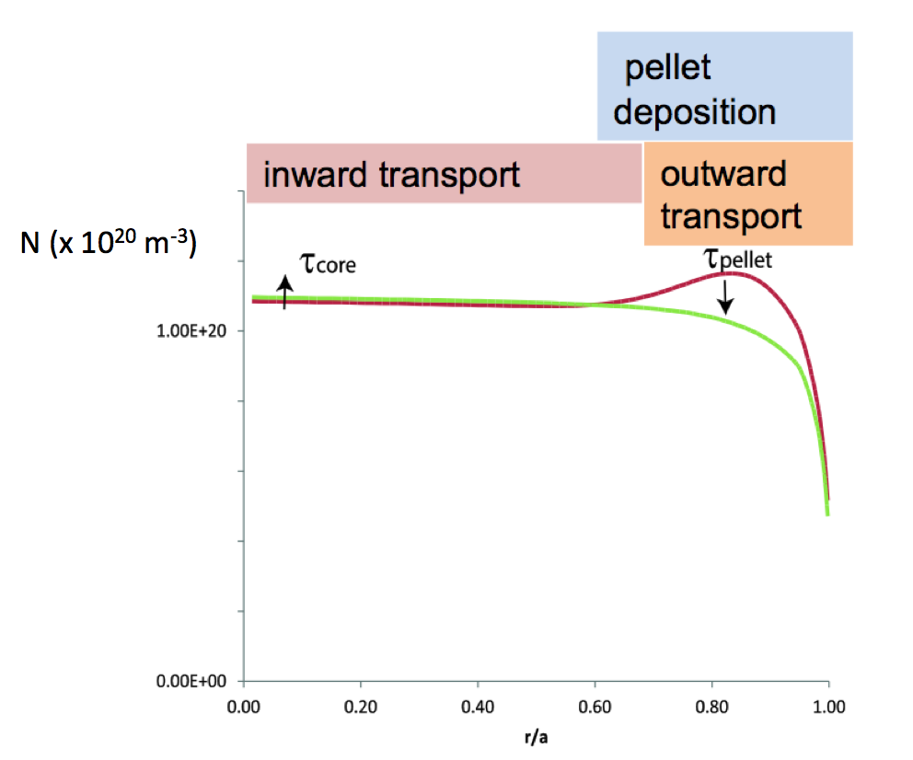
CHALLENGE:
Physics of fuelling
Is core fuelling feasible with shallow pellet penetration in reactor scenarios?
Role of turbulent / neoclassical mechanisms?
TJ-II strategy:
Influence of neoclassical and turbulence mechanisms during pellet ablation

Slide 9
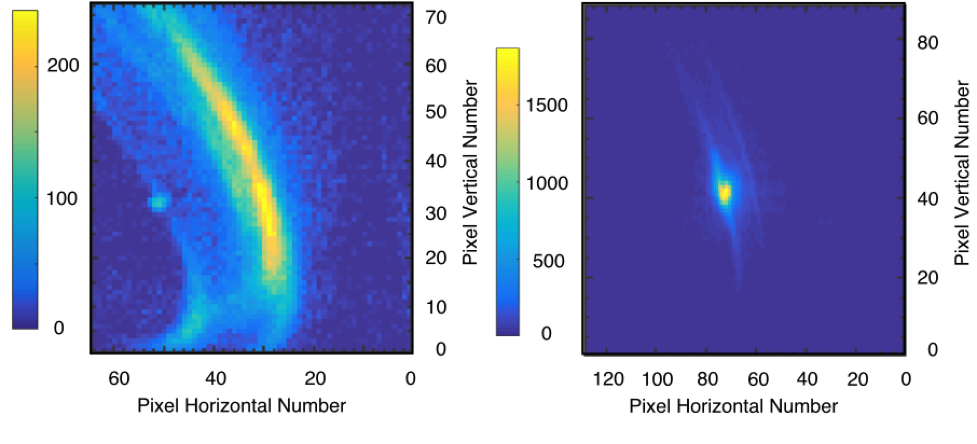
    Plasma fuelling and impurities
    Experiments and validation
TESPEL
Hydrogen pellet
NIFS, IPP-Greifwald, Centre for Energy Research [Budapest] collaboration
Post-injection particle radial distributions can be understood qualitatively from neoclassical predictions. BUT pellets can also impact strongly MHD plasma stability and plasma turbulence [N. Panadero et al., NF-2018 / K. McCarthy et al., IAEA-2021].
Enhanced pellet ablation due to fast-electron impacts can lead to higher fuelling efficiencies (<40%) [K. McCarthy et al., PPCF-2019 / IAEA-2021]
Comparisons with HPI2 simulations have revealed that interactions between outward drifting pellet material and a resonant surface can lead to the abrupt deceleration and hence reduced pellet material loss [K. McCarthy et al., NF-2021 / IAEA-2021].

Slide 10
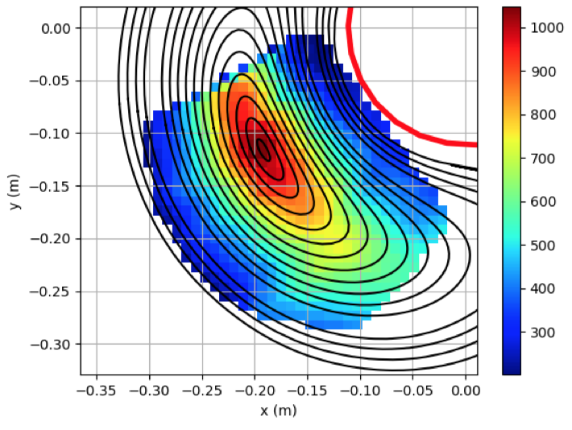
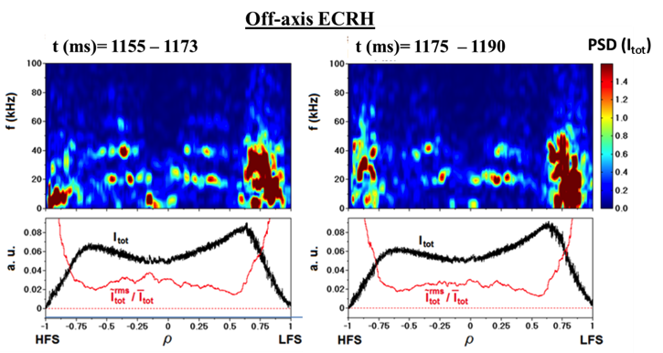
2-D mapping of plasma profiles and fluctuations
TOWARDS THE VALIDATION OF FUELLING PHYSICS
2-D
Plasma-potential
ECRH-plasmas
2-D mapping of plasma potential and density paves the way for model validation under positive and negative density gradient scenarios and asymmetries [Melnikov et al., EPS-2021].
Density fluctuations appear both at the positive and negative density gradient regions being stronger in the negative gradient region in agreement with TEM GK simulations [Sharma et al., PoP-2020].
Kurchatov – Kharkov collaboration

Slide 11
Transport and asymmetries
Physics of plasma fuelling
Fast particles: actuators and stability
Turbulence control: Zonal Flows
Edge – SOL coupling physics
Power exhaust

Slide 12
CHALLENGE:
Fast particle dynamics
Upcoming fusion devices will explore plasma regimes fully dominated by FAST PARTICLE DYNAMICS that are far from present devices in many aspects.
Extrapolations from pure empirical data can be misleading and reliable data are required to validate [fast particle] models in existing plasma scenarios.
Physics of AEs actuators?
Why fast particle EM induced stabilization?
TJ-II strategy:
Identification of AEs actuators (ECCD, ECRH, topology)
Validation of fast ion induced stabilization (Zonal Flows)

Slide 13
    Alfvén Eigenmodes
    TOWARDS THE VALIDATION OF FAST ION CONTROL
Without ECCD
The impact of ECRH and ECCD has been investigated demonstrating a clear effect of ECCD [due to rotational transform profile] on the observed mode spectrum
Moreover, linear stability analysis, using STELLGAP [MHD] and FAR3d [gyrofluid] codes, has allowed AEs identification in different heating scenarios.
Cappa et al., NF 2021 / IAEA-2021
S. Mulas et al., IAEA-2021
With counter-ECCD

Slide 14
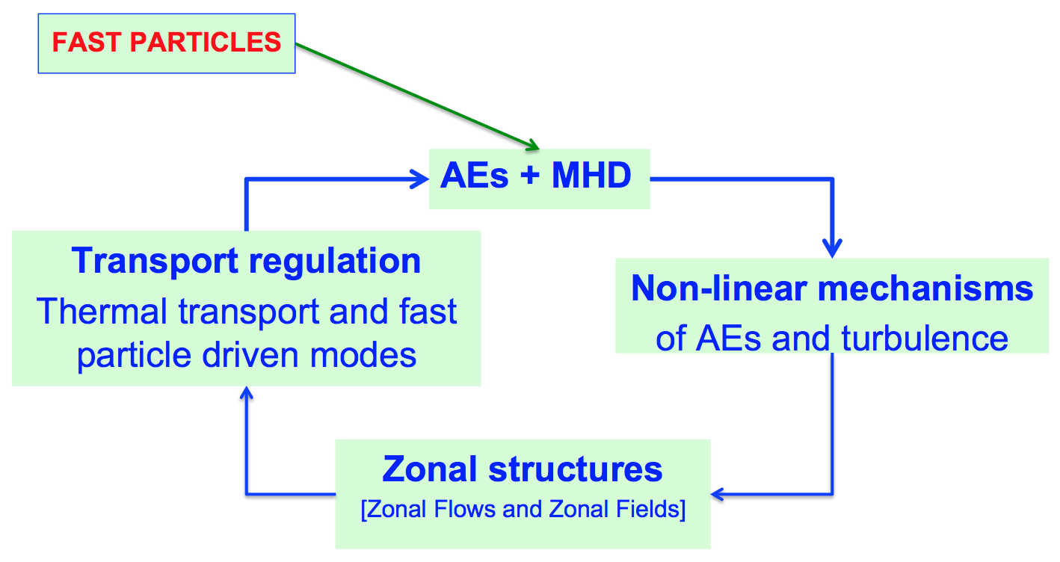
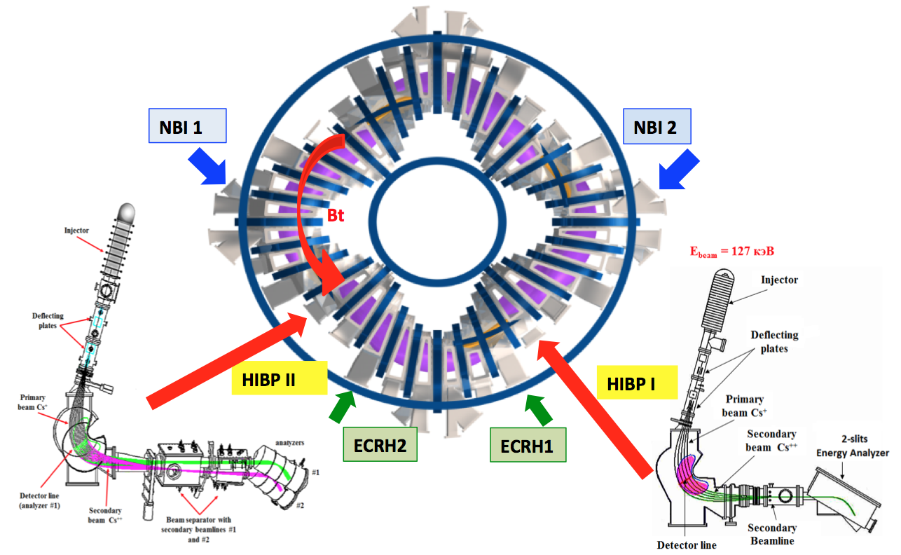
Fast particle induced stabilization and AEs actuators
TOWARDS THE VALIDATION OF FAST ION DYNAMICS
Why fast particle EM induced stabilization?

Slide 15
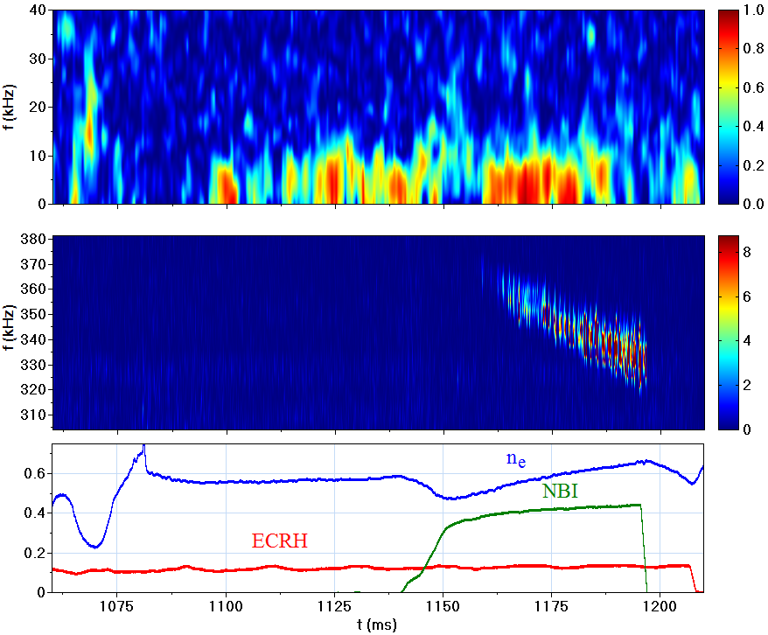
LRAlfvén Eigenmodes and Zonal Flows
LRC as proxy ZFs
HIBP-1 & HIBP2 rho ≈ 0.3
LRC frequency spectra / NBI
potential
ZF
AEs / HIBP potential
density
LRC correlations are detected both at the AEs frequencies and low frequencies (1 – 10 kHz).
LRC are observed in potential fluctuations but not in density fluctuations [i.e. ZF-like structures]
It is an open question whether those ZFs can be directly driven by fast particle effects

Slide 16
Transport an asymmetries
Physics of plasma fuelling
Fast particles: actuators and stability
Turbulence control: Zonal Flows
Edge – SOL coupling physics
Power exhaust

Slide 17
CHALLENGE:
PHYSICS OF SELF-ORGANIZATION
Historically, transport simulations have first predicted the development of inverse cascade of turbulent energy spectra to form Zonal Flows structures.
This prediction has been confirmed by experiments, providing the basis for the development of predicting capability of transport in future fusion devices
BUT,
Full validation of the plasma parameters affecting the amplitude and radial width of ZFs is still missing
TJ-II strategy:
Interplay between neoclassical E_{r} and zonal flows
Role of isotope effect
Influence of operational limits
Role of fast particles

Slide 18
  Edge Zonal Flows:
  INFLUENCE OF PLASMA HEATING ON radial scale
NIFS collaboration
The radial width of LRC is strongly affected by plasma heating.
The radial scale of LRC structures (as proxy of ZFs) is in the range of 20 ion Larmor radius in NBI plasmas, which is comparable to the radial scale length of neoclassical radial electric fields.
T. Kobayashi et al., NF-2019

Slide 19
  Edge Zonal Flows:
  INFLUENCE OF ION MASS AND OPERATIONAL LIMITS
NIFS / Kyoto University collaboration
Density Limit
NBI 1
NBI 1+2
The radial radial of LRC is strongly affected by isotope mass [Losada et al., PPCF- 2021 / IAEA-2021]
Amplification of ZFs in the vicinity of the density limit [Fernández-Ruiz et al., NF-2021]

Slide 20
Transport and asymmetries
Physics of plasma fuelling
Fast particles: actuators and stability
Turbulence control: Zonal Flows
Edge – SOL coupling physics
Power exhaust

Slide 21
CHALLENGE:
EDGE – SOL coupling
Plasma regimes of operation:
Development of integrated scenarios with controllers
CORE
EDGE
SOL
E_{r}
TJ-II strategy:
Characterization of plasma Edge-SOL coupling and role of Radial Electric Fields on turbulence spreading

Slide 22
Role of radial electric fields on EDGE–SOL coupling
TOWARDS THE VALIDATION OF SOL WIDTH PHYSICS
SOL
electron – root
Positive E_{r}
ion – root
Negative E_{r}
electron – root Positive E_{r}
RFX collaboration
EDGE
Turbulence radial spreading controlled by edge (sheared) radial electric fields has been experimentally identified during the electron-ion root transition and edge biasing [Grenfell NF-2019 / NF-2020].
The radial electric field was also found to have a profound impact on turbulence intermittence. This discovery opens up a new window for the study of the complex interactions between E_{r} and turbulence [Milligen et al., NF-2020]

Slide 23
Transport and asymmetries
Physics of plasma fuelling
Fast particles: actuators and stability
Turbulence control: Zonal Flows
Edge – SOL coupling physics
Power exhaust

Slide 24
CHALLENGE:
POWER EXHAUST AND LIQUID METALS
Whether ITER baseline exhaust strategy can be extrapolated to DEMO is an open question.
Therefore the development of alternative power exhaust solutions is necessary
TJ-II strategy:
LIQUID METALS USING CPS
HIGH FLUX FACILITY

Slide 25
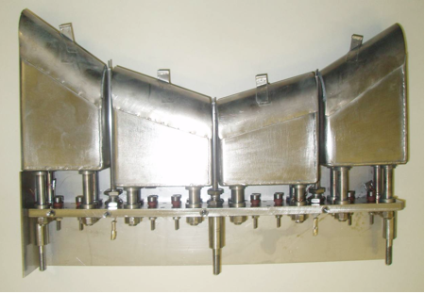
LIQUID METALS AND POWER EXHAUST
Sputtering, evaporation and retention
Solid and liquid samples of Li/LiSn/Sn in a CPS
The kinetic energy of ejected atomic species is well correlated to the different relative contributions of sputtered/evaporated atoms given by the thermal sputtering model
F. Tabarés et al., JNM-2018 / IAEA-2021
D retention
The retention of evaporated or plasma injected lithium on W was investigated to assess its impact on a fusion reactor operating with hot first wall (FW).
It was concluded that an exponentially decaying retention as the FW temperature is increased takes place, with negligible D/Li ratios at T>350ºC.
A. de Castro et al., NF-2018 / E. Oyarzabal et al., NF-2021

Slide 26
LIQUID METALS AND POWER EXHAUST
Secondary electron emission in Liquid surfaces
SEE of liquid Li surfaces in a CPS arrangement was investigated for the first time
Oxidation of Li leads to an increase in the SEE yield.
Annealing of the Li sample at 500 ⁰C was enough to revert the values to those corresponding to clean surfaces.
These results have a direct impact on the development of LM-based divertor targets in fusion.
E. Oyarzabal et al., Nucl. Mater. and Energy 2021

Slide 27
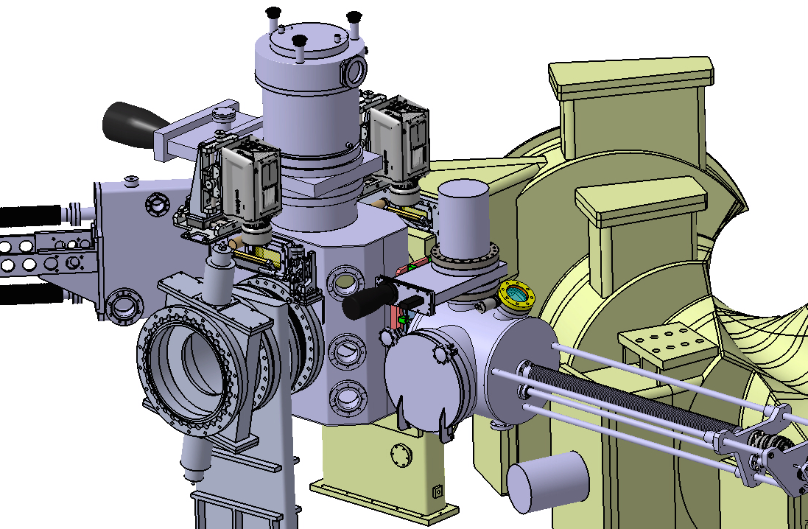
POWER EXHAUST
OLMAT: High heat flux facility
The OLMAT facility, aimed at testing prototypes under DEMO-relevant heat loads was constructed and installed.

Slide 28
TJ-II programme: towards model validation in fusion plasmas
Using its unique flexibility and advanced plasma diagnostics,
the TJ-II stellarator is contributing to
the understanding of critical challenges in fusion plasmas.
Transport [asymmetries]
Fast particle physics
[AEs control]
Edge-SOL coupling and SOL width
Turbulent & neoclassical
Entanglement
& self-organization
Physics
particle fuelling
Power exhausts

Slide 29
TJ-II collaborators
Laboratorio Nacional de Fusión, CIEMAT, Madrid, Spain
Max-Planck-Institut für Plasmaphysik, Greifswald, Germany
Universidad Carlos III, Madrid, Spain Department of Technology, CIEMAT, Madrid, Spain Institute of Plasma Physics, NSC KIPT Kharkov, Ukraine National Research Centre ‘Kurchatov Institute’, Moscow, Russian Federation
National Research Nuclear University ‘MEPhI’, Moscow, Russia Federation
Max-Planck-Institut für Plasmaphysik, Garching, Germany
General Physics Institute, Russian Academy of Sciences, Moscow, Russian Federation
National Institute for Fusion Science, Toki, Japan
Centre for Energy Research, Budapest, Hungary
Department of Physics and Astronomy, West Virginia University, US
ENN Energy Research Institute, Langfang, Hebei, China
IPFN, Instituto Superior Técnico, Universidade de Lisboa, Lisboa, Portugal
Institute of Advanced Energy, Kyoto University, Uji, Japan
Rudolf Peierls Centre for Theoretical Physics, University of Oxford, United Kingdom Eindhoven University of Technology, Netherlands
Consorzio RFX, Università di Padova, Padova, Italy

