Slide 1
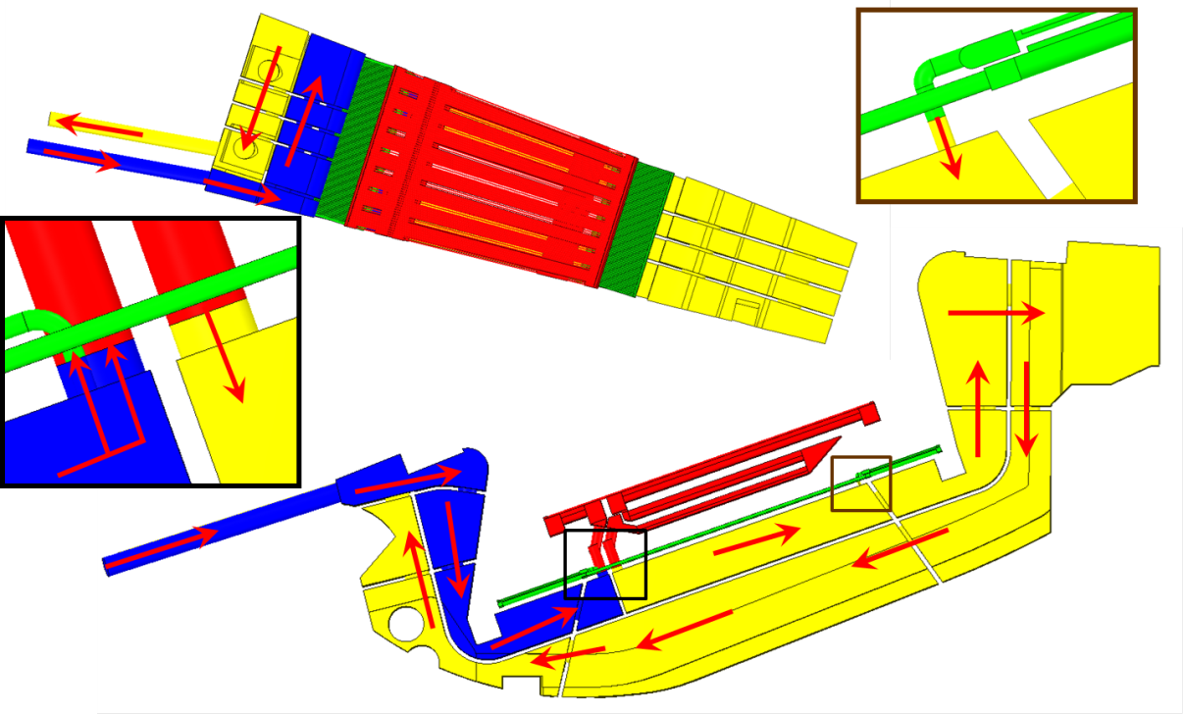
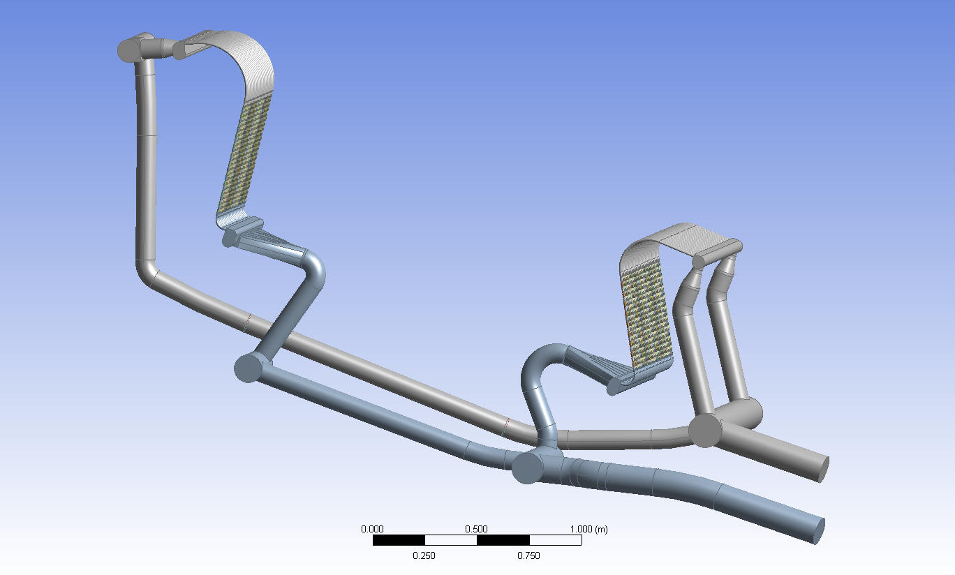
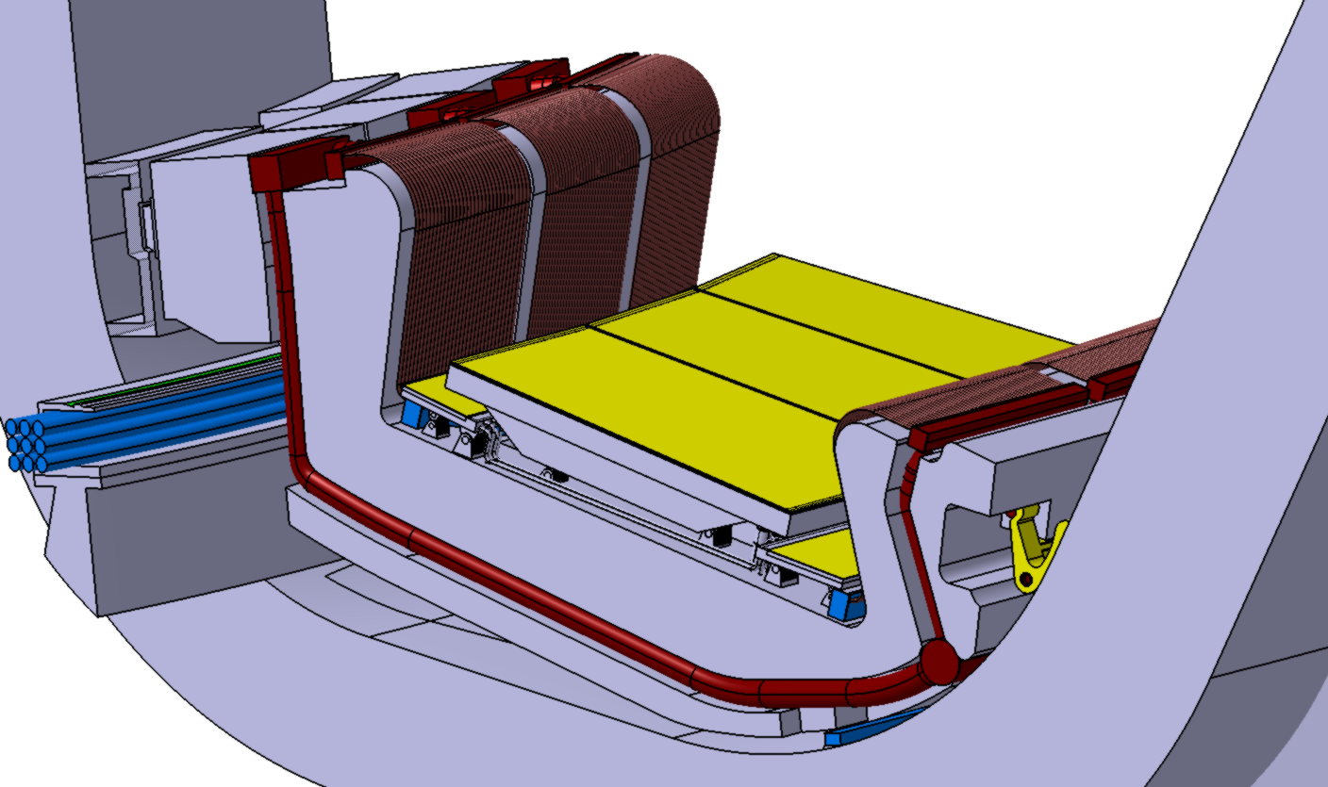
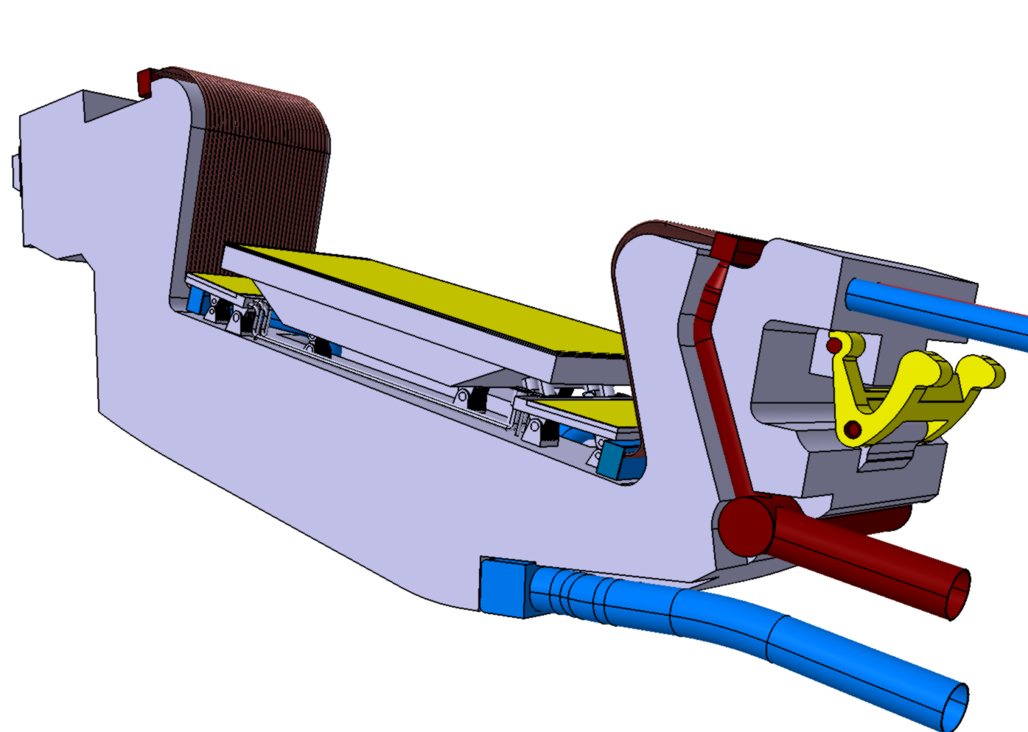
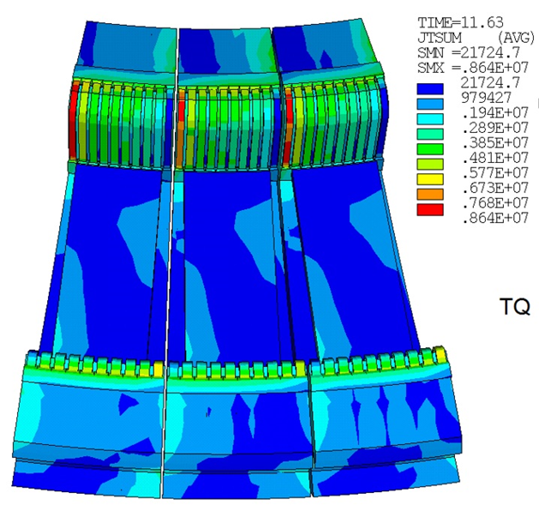
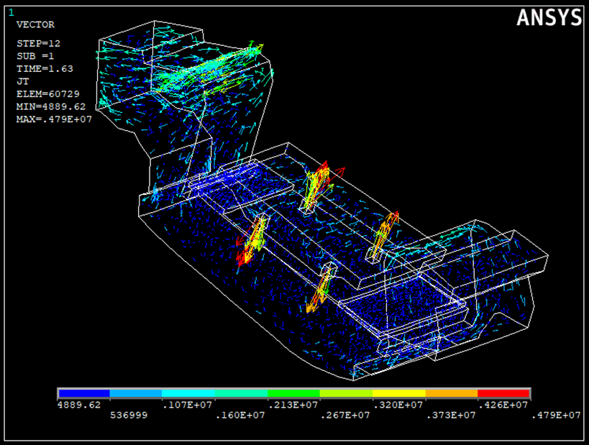
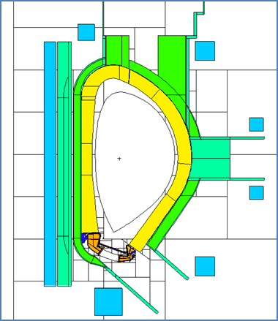
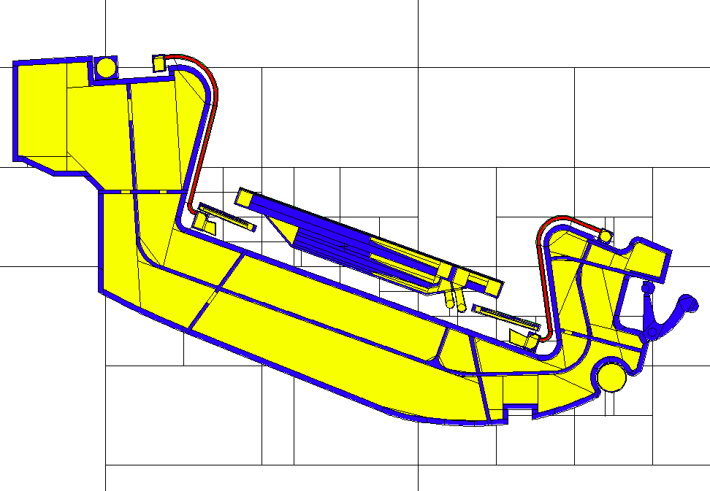
Poster Session I
(4 Nov 2019, 16:30-18:30)
ID: 049
DEMO Divertor - Cassette Design and Integration
G. Mazzoneª*, J-H. You^{b}, C. Bachmann^{c}, U. Bonavolontà^{d}, D. Coccorese^{d}, D. Dongiovanniª, D. Flamminiª , P. Frosiª, L. Forest^{g}, G. Di Mambro^{e}, V. Imbriani^{d}, A. Maffucci^{e}, D. Marzullo^{d}, P. A. Di Maio^{f}, M. T. Porfiriª, E. Vallone^{f}, R. Villariª, E. Viscaª, C. Vorpahl^{c}
ªENEA Frascati, Fusion & Technology for Nuclear Safety, via E. Fermi 45, 00044 Frascati, Italy; ^{b}Max Planck Institute of Plasma Physics, Boltzmann Str. 2, 85748 Garching, Germany; ^{c}EUROfusion, PMU-PPPT, Boltzmann Str. 2, 85748 Garching, Germany; ^{d}CREATE-/University of Naples, Industrial Engineering, Piazzale Tecchio 80, 80125 Napoli, Italy; ^{e}CREATE – University of Cassino and Southern Lazio, Via G. Di Biasio 43, 03043 Cassino, Italy; ^{f}University of Palermo, Depart. Energy, Viale delle Scienze, 90128 Edificio 6, Palermo, Italy; ^{g}CEA Saclay, DEN/DM2S/SEMT/LTA, bât.611, 91191 Gif sur yvette, France
*giuseppe.mazzone@enea.it
ABSTRACT
Thermo-Hydraulic analysis
Pre-conceptual design of EUROfusion DEMO Divertor cassette and integration, with configuration single-null, have been done. Many activities and analyses have been done to respect the design requirement in particular:
Detail Divertor CAD model within the DEMO Baseline 2018 (Fig. 1 and Fig 2); Neutronics analyses (Fig.3 and Fig. 4); Thermo-hydraulic simulation (Fig.5 and Fig. 6); Electromagnetic simulation (Fig. 7); Structural verification of main components; Manufacturing sequence of some components (e.g. Shielding Liner and cooling piping); Machining and welding procedure for Shielding Liner;
The cooling scheme of the DEMO divertor consists of two separate cooling circuits. One is for Eurofer components as CB, SP and RPs with p_{inlet}/T_{inlet} = 3.5 MPa/180ºC and the other one is for PCFs with p_{inlet}/T_{inlet}= 5 MPa/130ºC. The main design limits are:
1) Divertor Cassette cooling circuit (Fig. 5):
-Maximum Temperature on the Eurofer<550ºC; Maximum water pressure drop < 1.4 MPa; Margin against water saturation temperature > 20 ºC.
2) Plasma Facing cooling circuit (Fig. 6):
- Maximum water velocity in PFC tubes < 16m/s; CHF margin > 1.4; Maximum pressure drop < 1.4 MPa;
Divertor Components
PFCs Cooling Circuit
Pressure points | Δp [MPa]
IM_A - IM_B | 0.0038
IM_B - IVT_A | 0.0541
IVT_A - IVT_B | 0.0311
IVT_B - IVT_C | 0.7958
IVT_C - IVT_D | 0.0229
IVT_A - IVT_D | 0.8499
IVT_D - OM_A | 0.0358
IM_B - OVT_A | 0.0581
OVT_A - OVT_B | 0.8815
OVT_B - OM_A | 0.0002
IM_A - OM_A | 0.9436
The 2019 CAD reference for the DEMO divertor design is shown in Fig. 1 and Fig. 2. The divertor is made of 48 divertor assemblies. The main divertor components are: Inboard vertical target (IVT)-Outer Vertical target (OVT)-Shielding Liner (SL)-Reflector Plates (RPs)-Divertor Cassette (DC) -Inner locking on VV, so-called “nose”- Outer locking on VV, so-called “wishbone”-Cooling tubes and manifolds.
IVT_C
IVT_31
OVT_43
IVT_01
OVT_01
OVT_B
IVT_B
OVT_A
IVT_D
OM_A
Fig. 5 – Cooling circuit of CB, RPs and SL.
IVT_A
IM_B
IM_A
Fig. 6 – PFCs Results - Total Pressure Drop
nose
IVT
SL
OVT
wishbone
Electromagnetic simulation
The EM loads are the most important mechanical loads on the divertor components and in particular for the supports design (e.g. DC, PF, SL and RPs supports). The following divertor relevant EM conditions have been studied: VDEUP, VDEDW (both with a linear Current Quench of 74ms duration) and a Toroidal Magnet Fast Discharge (MFD) with a total TFC exponential current decay of 27ms.
Fig. 1 – Divertor assembly for one Demo sector (22.5 °)
RPs
DC
Fig. 2 – Single Divertor Assembly
Neutronics calculations
Neutronics analyses are under execution in 2019 on neutronic model in Fig. 3 end Fig. 4. The main objects to be check are:
- Cumulated damage (dpa) in Eurofer: in order to limit the material properties degradation under low temperature irradiation (<180°C), the damage on Eurofer shall be below of 6 dpa over its lifetime.
- Cumulated damage (dpa) on VV: a maximum damage of 2.75 dpa over 6 FPY have been fixed for AISI 316L(N) IG in order to have negligible irradiation damages in temperature range of 20°C to 375°C .
A possible solution for these issues can be to reduce the lifetime of Cassette to 1.22 FPY and to increase the neutron shielding performance of the CB/SL system (see Fig. 1 and Fig. 2).
Fig. 7 – Eddy current density in FAST VDE downward
CONCLUSION
A complete overview of the main design activities of the DEMO divertor have been presented together with the most relevant loads. Critical issues under study have been also pointed out, as for example, the damage on the materials of the divertor cassette (Eurofer) and of the VV .
ACKNOWLEDGEMENTS / REFERENCES
Fig. 3 – DEMO neutronics model.
Fig. 4 – DEMO DC neutronics model.
This work has been carried out within the framework of the EUROfusion Consortium and has received funding from the Euratom research and training programme 2014-2018 and 2019-2020 under grant agreement No 633053. The views and opinions expressed herein do not necessarily reflect those of the European Commission.

