Slide 1
Toward a game-theoretic metric for nuclear power plant security
International Conference on Nuclear Security
10-14 February 2020
Vienna, Austria
Lee T. Maccarone
Jacob R. James
Timothy R. Ortiz
Daniel R. Sandoval
Robert J. Bruneau
Daniel G. Cole
Christopher C. Lamb

Slide 2
Stochastic game theory is used to analyze interactions where the outcome is uncertain
Normal
Hacked
Hazard
Challenges:
Managing the size of the state space
Defining transition probabilities
Optimizing the solution

Slide 3
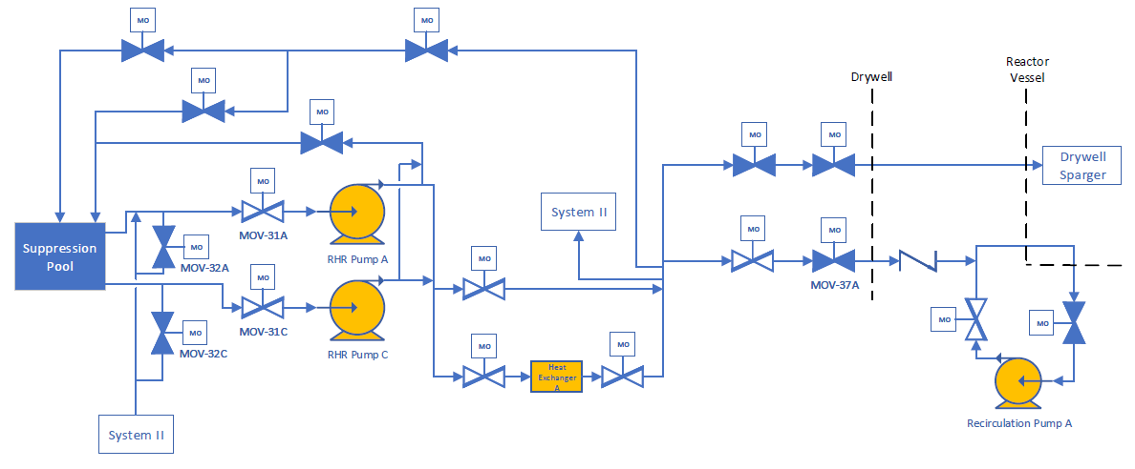
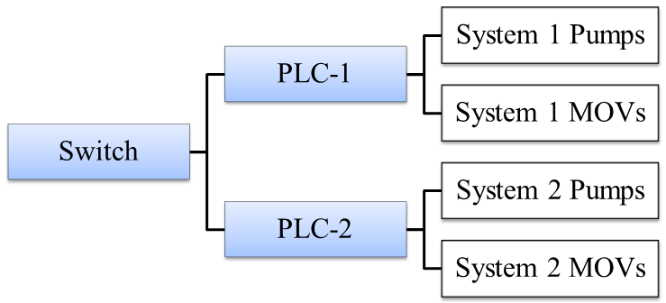
The residual heat removal system maintains reactor water level during a loss of coolant accident

Slide 4
System-theoretic process analysis was used to identify scenarios of interest
1. Identify losses, hazards, and constraints
2. Model the control structure
3. Identify the unsafe control actions
4. Identify loss scenarios

Slide 5
The stochastic states define the environment of the players’ interactions
PLC-1 Hacked
PLC-2 Hacked
Loss of Flow Path
PLC-1 & PLC-2 Hacked
Pump Damage
Normal
PLC-1, PLC-2, and Switch Hacked
Inadequate Flow
Initial State
Hacked States
Hazard States

Slide 6
Actions were defined for both players at each state
 | PLC-1 & PLC-2 | Switch | Communication Network
Defender’s Choices | Authentication: on/off Wireless: on/off | Authentication: on/off Firewall: on/off | Encryption: on/off
Attacker’s Choices | Join: yes/no Wireless Exploit: yes/no | Join: yes/no Attack: yes/no | Decryption: yes/no

Slide 7
The Common Vulnerability Scoring System was used to estimate state transition probabilities
CVSS Exploitability Metrics
Attack vector
Attack complexity
Privileges required
User interaction
Probabilities may be validated with capture the flag games

Slide 8
Reward functions were defined to quantify the costs and benefits for both players
Immediate reward function for player A/D:
Cumulative utility function for player A/D:

Slide 9
The Nash equilibrium provides the optimal action for each player at each state
There are several challenges to finding the solution.
1. Large parameter space: 576 probabilities
2. Parameter constraints: probability laws
3. Solution uniqueness

Slide 10
Stochastic game theory is a promising method for selecting cybersecurity control actions for nuclear power plants.
Threat actor was defined using threat agent libraries
System-Theoretic Process Analysis was used to manage the stochastic state space
The Common Vulnerability Scoring System was used to estimate transition probabilities
Solving the game presents additional optimization challenges
Christopher C. Lamb
Sandia National Laboratories cclamb@sandia.gov
Lee T. Maccarone
University of Pittsburgh
LTM10@pitt.edu

