Slide 1
The need for creative and effective nuclear security vulnerability assessment and testing
Matthew Bunn
Professor of Practice, Harvard Kennedy School
IAEA International Nuclear Security Conference, February 13, 2019
belfercenter.org/managingtheatom

Slide 2
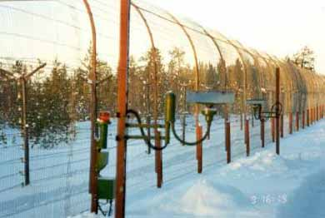
Intelligent adversaries can sometimes beat even impressive-seeming security systems
Understanding the real performance of security systems is difficult
Adversaries may think of ways to defeat the system defenders didn’t imagine
Often the case in non-nuclear thefts and attacks
U.S. experience:
Compliance with rules is not enough
Assessment of ability to defend against a few basic adversary paths is not enough
Creative teams with a “hacker” mentality often find vulnerabilities
Both in-depth vulnerability assessment and realistic testing are needed
Source: U.S. DOD

Slide 3
The IAEA recommends assessment and testing of nuclear security systems
INFCIRC 225/Rev. 5 calls for operators to have “quality assurance” programs to ensure that security systems provide the required level of protection
Inevitably includes in-depth assessment of potential vulnerabilities
INFCIRC 225/Rev. 5 also calls specifically for exercises to test security performance, at least annually
Many countries are not yet implementing such force-on-force exercises
Because these steps are included in IAEA recommendations, they are included in the commitments of the Strengthening Nuclear Security Implementation Initiative (INFCIRC/869), for states participating
Recently published (2018) guidance on force-on-force excercises (IAEA-TDL-008); WINS also offers guidance

Slide 4
Effective vulnerability assessment requires a creative search for weak points
Need to assign teams with a creative, “hacker” mentality to try to think like the adversary, try to find plausible ways to defeat the system
Teams should also offer suggestions for fixes
Teams need backing from organization’s leadership
Need to avoid ostracizing people who point out vulnerabilities
Assessing a few obvious pathways is not enough to understand real performance against clever adversaries
A vulnerability assessment that finds no vulnerabilities is almost certainly wrong

Slide 5
Challenges to vulnerability assessment
Large unknowns – about adversary capabilities and tactics, guard force behavior, and more…
Can only model what we can think of
Attackers may think of something else
High complexity, unexpected effects
Behavior of humans in the system difficult to predict
Insider threats difficult to model, assess
“What you see is all there is” – models may lead us to ignore the things left out of the model
?

Slide 6
The need for realistic performance testing
Testing is a crucial supplement to vulnerability assessment
Many types of testing are helpful, have their own pros and cons
Tabletop exercises
Limited-scope testing of particular security elements
Full-scale ”force-on-force” exercises
Realistic force-on-force exercises – “red team” outsiders attempting to break in, “red team” insiders attempting to smuggle items out or commit sabotage – can:
Reveal vulnerabilities that require correction
Convince higher-ups that more investment in security is in fact needed
Provide training for, increase security awareness of, guards and other security personnel
Many, many issues – cost, inconvenience, realism, cheating, who tests, how often, etc. – but clearly better than not conducting such exercises

Slide 7
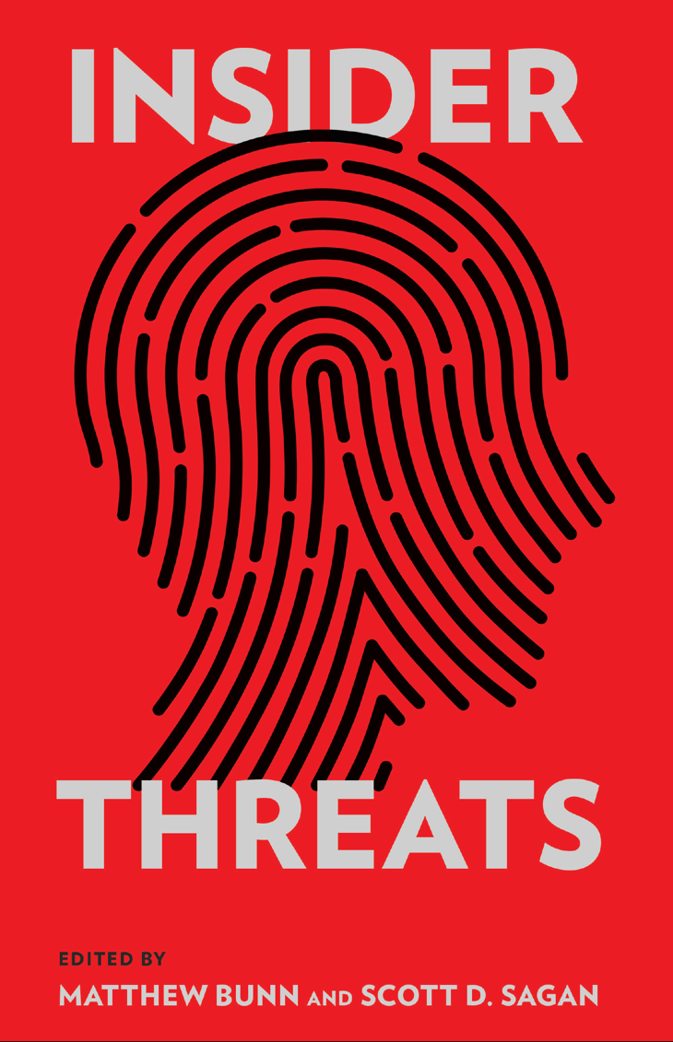
Challenges of testing insider threats
Insiders have months or years to observe security practices, develop plans to defeat them
Potentially far more than the effort that will be put into a plan for a test
Difficult to test full suite of potential insider actions while maintaining safety, security
Key insider protections – such as high employee morale, effective reporting systems – are difficult to model or test
Cognitive, organizational biases tend to blind organizations to insider threats
http://www.belfercenter.org/ publication/insider-threats

Slide 8
For further reading…
Matthew Bunn, “Modeling of Nuclear Security: Use the Tool, But Remember Its Limits” (Cambridge Mass.: Project on Managing the Atom, Harvard University, August 2019).
https://scholar.harvard.edu/files/matthew_bunn/files/modeling_of_nuclear_security_use_the_tool_but_remember_its_limits_3_0.pdf
Matthew Bunn, Nicholas Roth, and William H. Tobey, Revitalizing Nuclear Security in an Era of Uncertainty (Cambridge, Mass.: Project on Managing the Atom, Harvard University, January 2019).
https://scholar.harvard.edu/files/matthew_bunn/files/bunn_revitalizing_nuclear_security_in_an_era_of_uncertainty_2019.pdf

