Slide 1
Information technology solutions, used in stationary customs control systems for fissile and radioactive materials. Way of development
Mr. Vladislav Kotovshikov
Deputy Head of General Department of Information Techonology
Federal Customs Service
Russian Federation

Slide 2

REGULATORY DOCUMENTS FOR RADIATION CONTROL
FISSILE AND RADIOACTIVE MATERIALS (FRM) AS A RISK COMMODITY
  The illegal movement of FRM is a violation of the international nuclear non-proliferation agreement
  FRM can be used to carry out acts of nuclear and radiological terrorism
  Illegal trafficking of FRM can harm the health of the population of the Russian Federation and the environment
  The FRM have a high cost
Customs code of the Eurasian Economic Union, paragraph 8, article 351
Resolution of the Government of Russian Federation No. 456 of 19 July 2007, item 14 of the Rules for the physical protection of nuclear materials, nuclear installations and nuclear material storage facilities

Slide 3
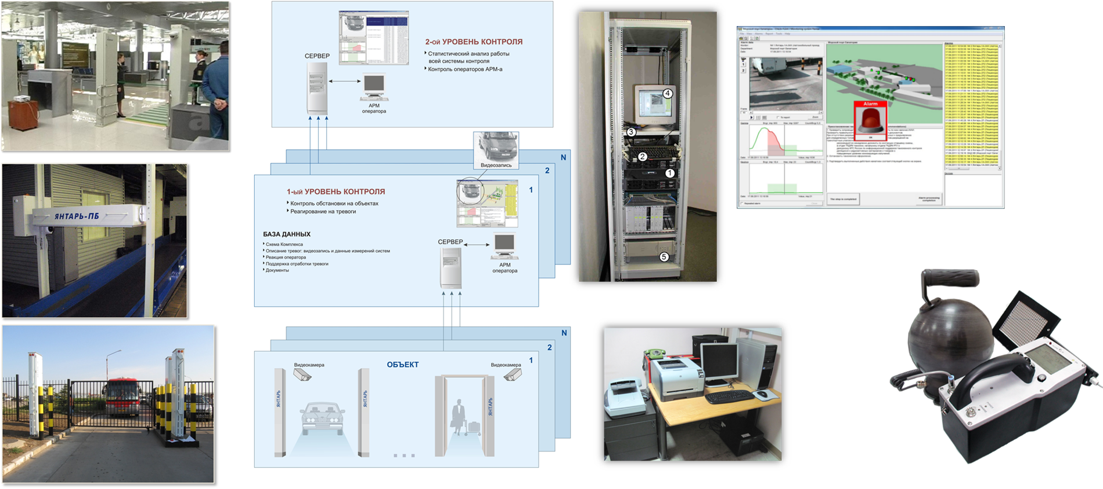
SOFTWARE AND TECHNICAL COMPLEX FOR AUTOMATION OF CONTROL OVER THE MOVEMENT OF RADIOACTIVA SUBSTANCES

Slide 4
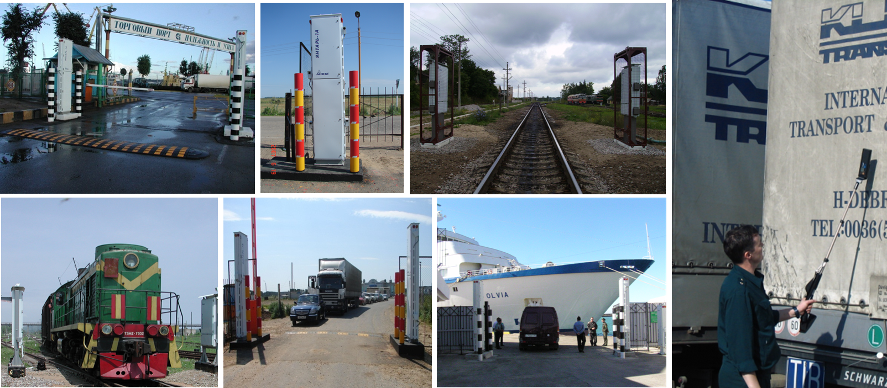
TECHNICAL MEANS OF RADIATION CONTROL
The customs authorities operate about 2,000 stationary radiation control systems and 7,000 portable radiation control equipment at checkpoints on the state border of the Russian Federation, which are external sections of the customs border of the Eurasian Economic Union

Slide 5





Improving the efficiency of customs control of fissile and radioactive materials
  Formalization and documentation the actions of
  officials
  Improving the quality and efficiency of decision-making
  Improving the coordination the actions of officials
  Increase of efficiency of operation of technical means of radiation control
  Prevention of radiation safety violations

Slide 6


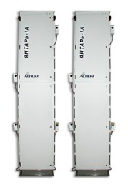

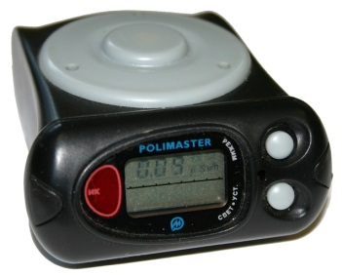
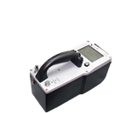
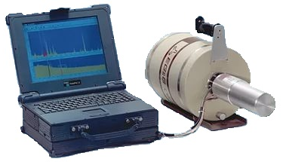
Technique of prevention of illicit trafficking
Customs Inspection
Radiation
Hazard
Signs
Information
From
Special
Services
RPM Alarm
Customs
Inspection
Procedure
Deep
Customs
Inspection
Procedure

Slide 7
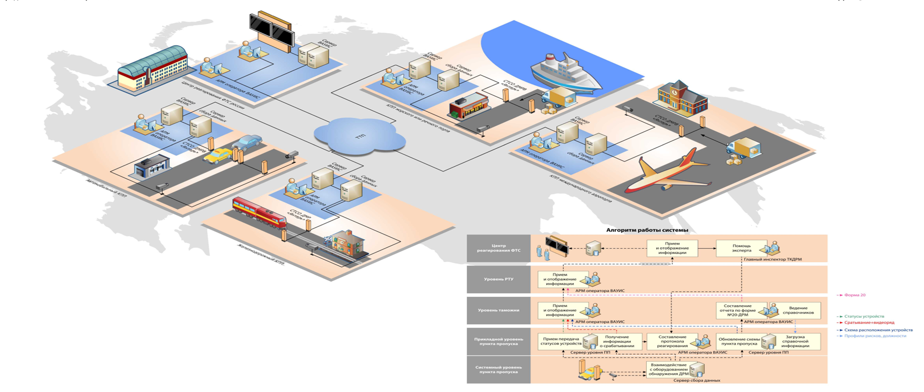
The scheme of the departmental automated management information system

Slide 8
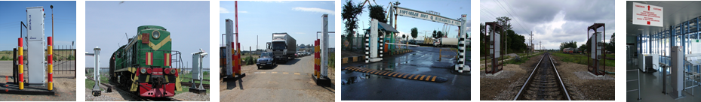
The structure of the departmental automated management information system
UAIS of customs authorities
ТТП
The level of the FCS of Russia Selective
Selective control of response and technical condition of STC AC FRM
CTS
ФТС России
FCS
DAMIS
The level of the RCO
Full control over the response and technical condition of STC AC FRM
CTS
ТТП
RCO
РТУ
RCO
РТУ
The level of customs
Full control over primary response technical condition of STC AC FRM, inspection and localization of IRS, maintenance of STC AC FRM
ТТП
CTS
Таможня
CUSTOMS
CUSTOMS
CUSTOMS
Таможня
CUSTOMS
Таможня
Таможня
Checkpoint level
Primary response to FRM detection (inspection) and daily maintenance of STC AC FRM
ТТП
CTS
CP/CH
CP/CH
CP/CH
ТП/ПП
CP/CH
CP/CH
ТП/ПП
ТП/ПП
ТП/ПП
ТП/ПП
ТП/ПП
ТП/ПП
ТП/ПП
CP/CH
CP/CH
CP/CH
Срабатывания
ССРК «Янтарь»
Operations of SCRCS «Yantar»
Locally placed at checkpoints software and technical complex of automated control of fissile and radioactive materials (STC AC FRM) on the basis of stationary customs radiation control system «Yantar»

Slide 9





The most important technological solutions for the digital transformation of customs control of fissile radiation materials
Artificial INTELLIGENCE – the science and technology of creating intelligent machines, especially intelligent computer programs; the property of intelligent systems to perform creative functions that are traditionally considered the prerogative of man. Artificial intelligence is associated with the similar task of using computers to understand human intelligence, but is not necessarily limited to biologically plausible methods;
BLOCKCHAIN TECHNOLOGIES are multifunctional and multilevel information technologies designed for reliable accounting of various types of assets (Melanie Swan). Blockchain is a distributed database that contains a continuously increasing set of ordered records (blocks), each block contains a timestamp and a link to the previous block. Blockchains are open, distributed registers that can record transactions between two participants in a reliable and reliable manner;
New state of the customs control procedures of the FRM
Artificial intelligence
End-to-end TECHNOLOGIES are a set of processing methods, which consist of a set of specialized programs on the basis of one system, independent of specific techniques and allowing for interactive data exchange. Primary data can be generated by both automatic systems and manual input, but their subsequent transmission and processing is completely automatic.
The distributed registry
Internet of things-the concept of a computer network of physical objects ("things") equipped with built-in technologies to interact with each other or with the external environment
Data storage and processing
IoT devices

Slide 10
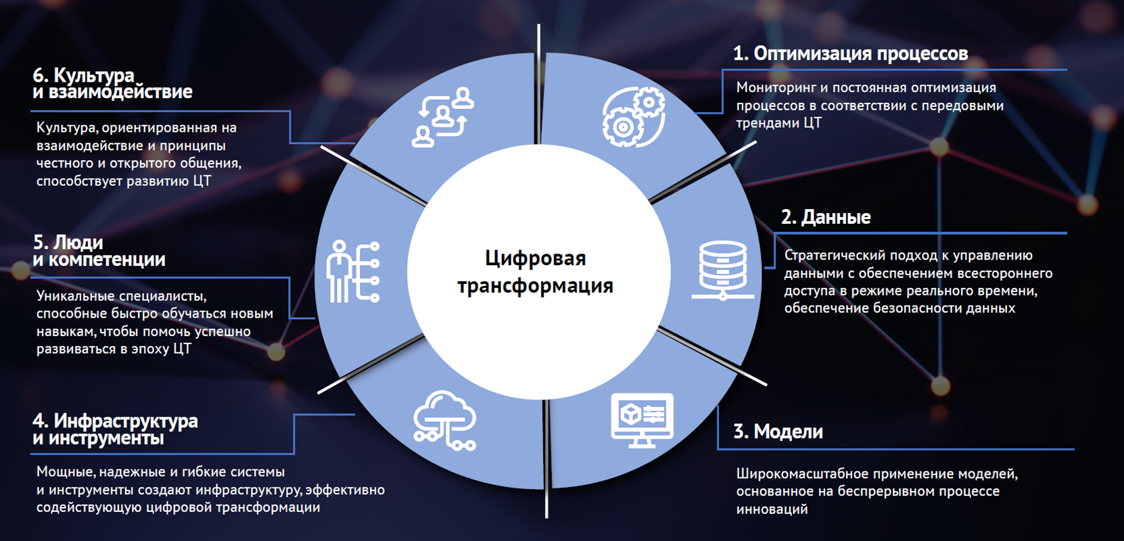
The basic ORGANIZATIONAL direction digital transformation
6. Culture and interaction
1. Process optimization
Monitoring and continuous optimization of processes in accordance with the advanced trends of digital transformation
A culture focused on interaction and the principles of honest and open communication contributes to the development of digital transformation
DIGITAL TRANSFORMATION
2. Data
5. People and competencies
A strategic approach to data management by providing comprehensive access to real-time, ensuring data security
Unique professionals, who are able to quickly learn new skills to help develop successfully in the era of digital transformation
4. Infrastructure and tools
3. Models
Powerful, reliable and flexible systems and tools create an infrastructure that effectively facilitates digital transformation
Large-scale application of models based on a continuous process of innovation

Slide 11
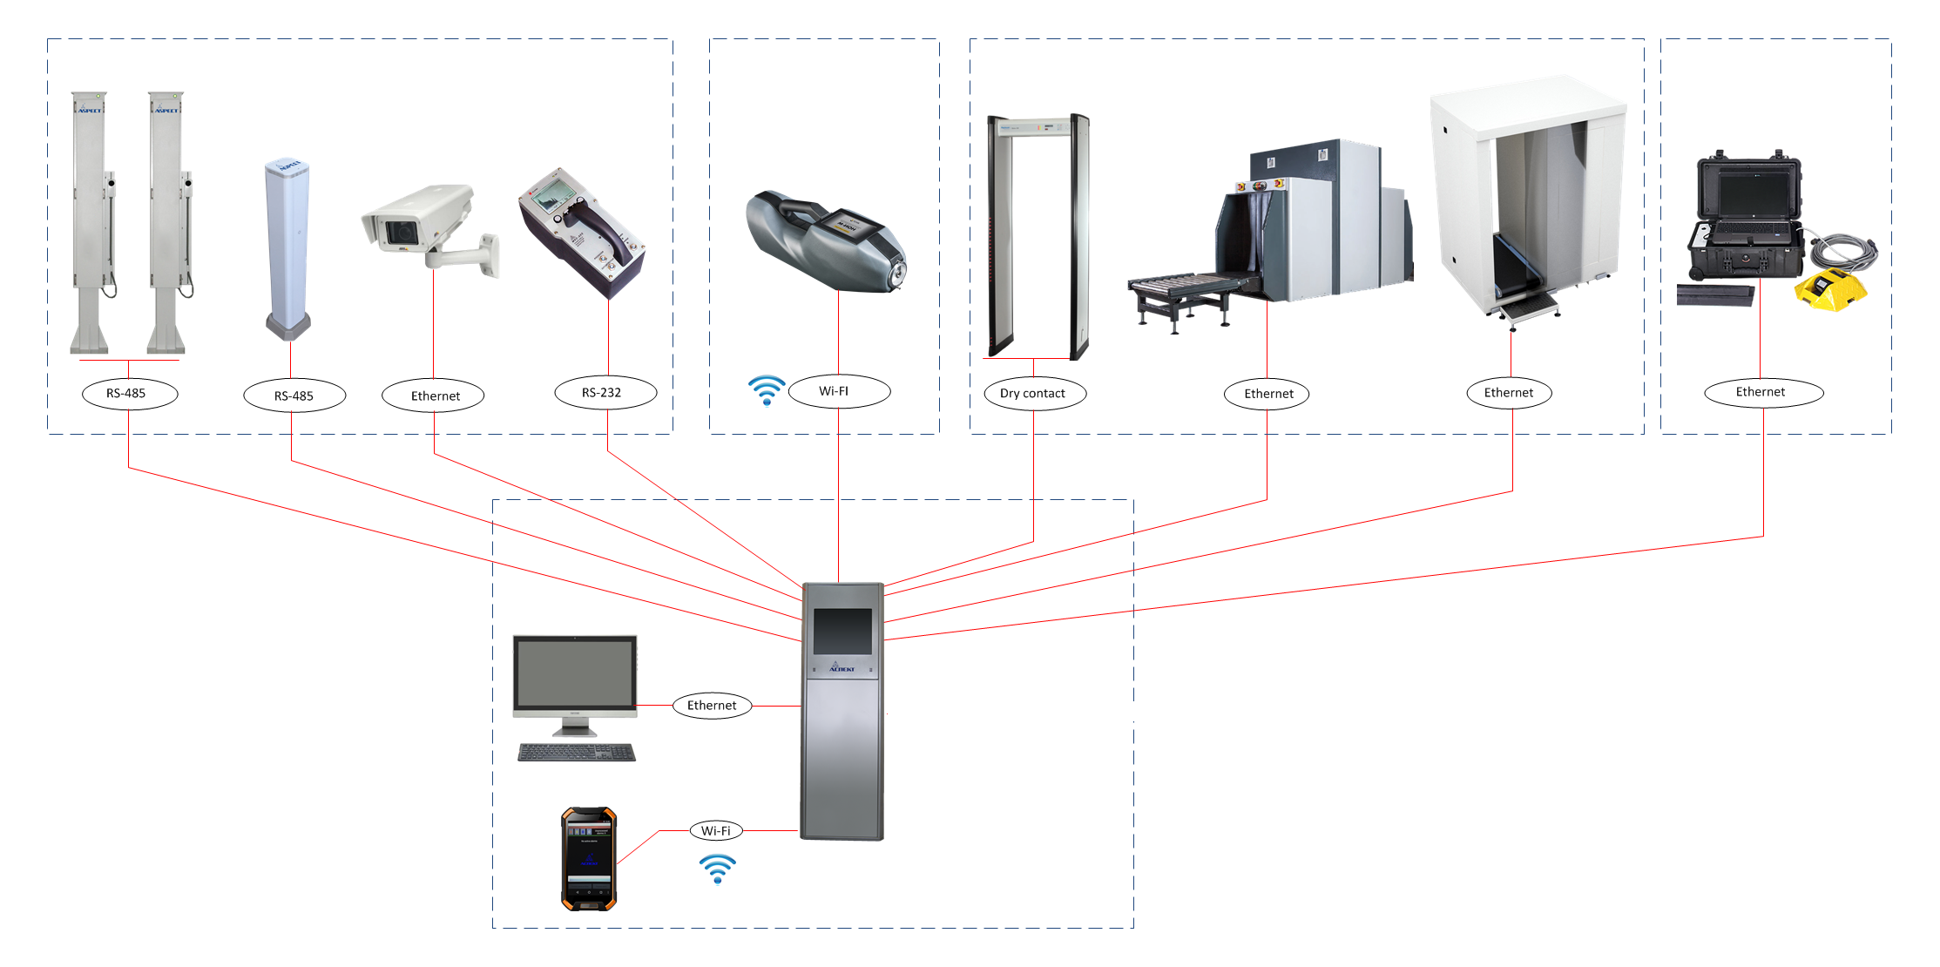
The main TECHNOLOGICAL directions digital transformation
use of intelligent technical means of control
the use
of technology
blockchain
implementation
of software
access
to operating
parameters and measurement results of technical means of control
organization of modern network technologies of data collection control
automatic execution of target functions
Single information environment (Information ecosystem of technical means of customs control)

Slide 12




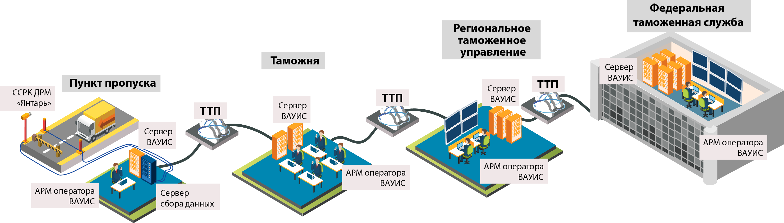


The scheme of functioning of the DAMIS
Correction order
Adjusted response protocol
Control action
FEDERAL CUSTOMS SERVICE
REGIONAL CUSTOMS OFFICE
CUSTOMS
Server DAMIS
CHECKPOINT
SCRCS «Yantar»
Server DAMIS
Server DAMIS
Server DAMIS
AWP of the DAMIS operator
AWP of the DAMIS operator
AWP of the DAMIS operator
AWP of the DAMIS operator
Data collection server

Slide 13
development of information technologies and digital transformation of customs control FRM
Improve the quality and efficiency of decisions
Will allow for an early analysis of possible action scenarios
Will reduce the material costs of maintaining an appropriate level of security

