Slide 1
Customs control system for fissile and radioactive materials in the Russian Federation
Mr. Vladislav Kotovshikov
Deputy Head of General Department of Information Techonology
Federal Customs Service
Russian Federation

Slide 2
Customs control of nuclear and radioactive materials in Russian Federation
Key Historical points
1995
FCS get the function of control of nuclear and radioactive materials
1996
Development of technical requirements for radiation monitoring equipment
2001
Four Educational centers of customs control of nuclear and radioactive materials are founded on basis of the Russian Customs Academy
2004
Implemented Risk Management System for Front Line Officers for control of nuclear and radioactive materials
2010
All Border crossings are fully equipped with RPM’s and handheld radiation monitoring equipment
1997
Testing of the samples of radiation monitoring equipment
1998
Start of equipping border crossings with radiation monitoring equipment
2001
Implemented technology of Objective monitoring of legal shipments of nuclear and radioactive materials
2006
Implemented System of online monitoring alarms of RPM’s and FLO reachback
2014, 2019
Providing the radiation safety of big international sports events (Olympic games, FIFA Confederations Cup, FIFA 2018)
Main functions
Prevention of illicit trafficking of nuclear and radioactive materials across the border
Objective monitoring of legal shipments of nuclear and radioactive materials
Implementation of equipment for customs control of nuclear and radioactive materials
International cooperation with customs services and special organizations on the control of nuclear and radioactive materials
Monitoring of the radiation safety of the Front Line Officers
Organization of training for the customs authorities on customs control of nuclear and radioactive materials and radiation safety

Slide 3
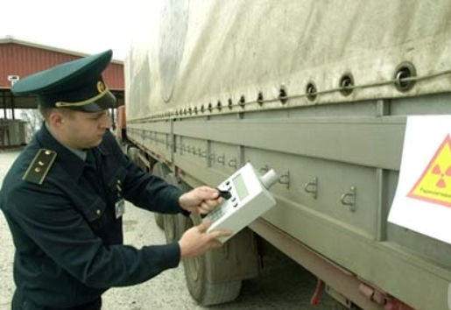
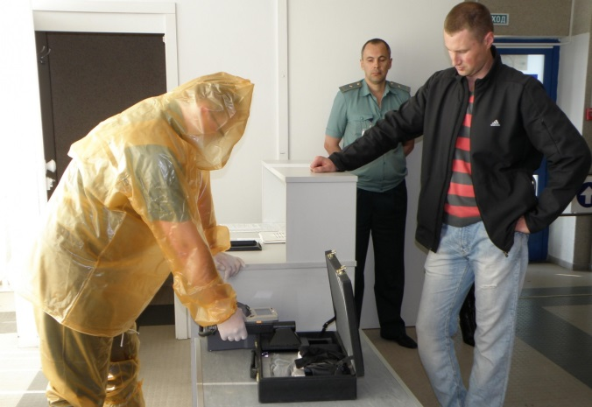
Customs authorities controlling nuclear and radioactive materials
Customs authorities controlling nuclear and radioactive materials
Front Line Officers
~ 4400 persons
Expert Officers
~1200 persons

Slide 4
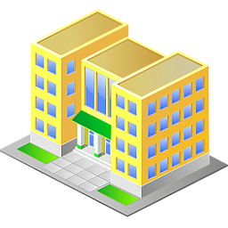
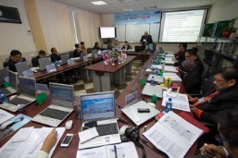
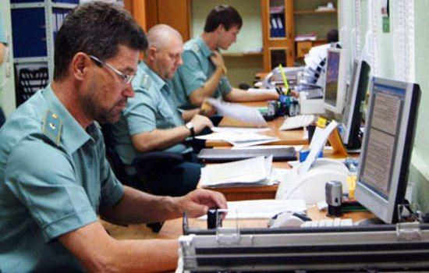
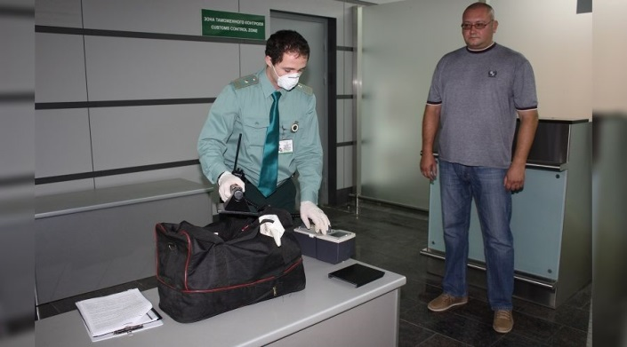
Custom authorities training
Customs control of nuclear and radioactive materials educational centers
Russian Customs Academy
Moscow Educational Center
Saint-Petersburg Educational Center
Vladivostok Educational Center
Rostov-on-Don Educational Center

Slide 5
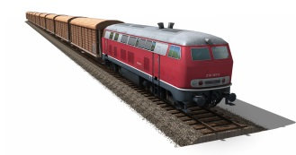
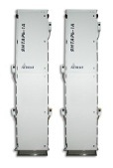
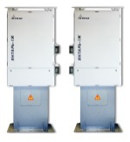
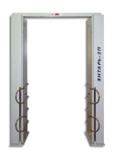
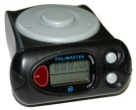
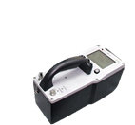
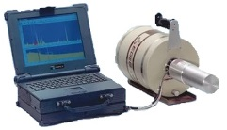
Equipment at border crossings
Radiation Portal Monitors
2000
Hand Held Equipment
7000

Slide 6
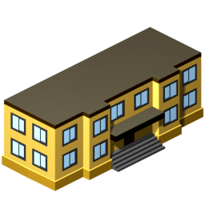
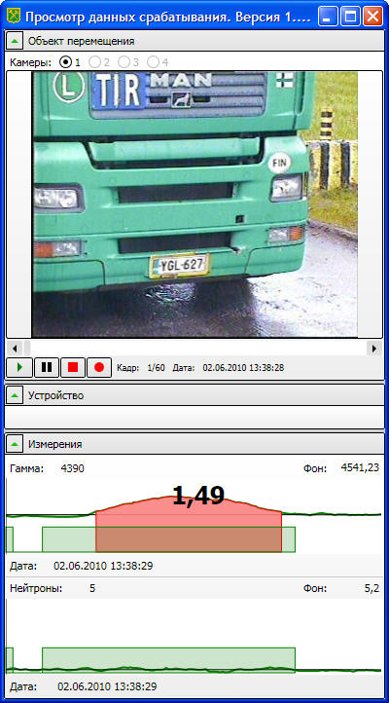
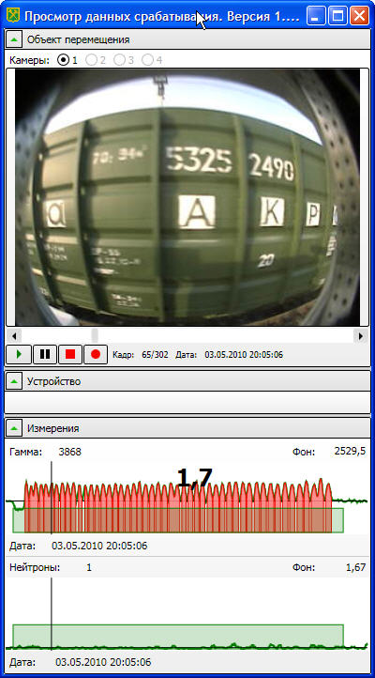
System of acquisition and analyzing data on alarms of PRM’s
Federal Customs Service
Control Center of customs control of nuclear and radioactive materials
Border Crossings
Customs Main Office
Examples of Alarm information from RPM’s which is sent to Control Center

Slide 7
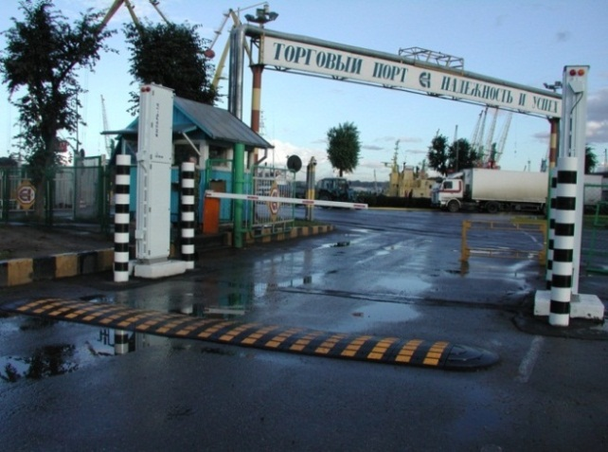
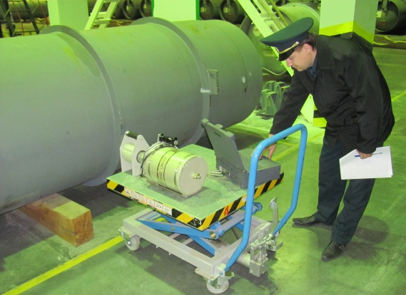
Custom control of nuclear and radioactive materials in Russian Federation
Custom control of nuclear and radioactive materials
Prevention of illicit trafficking of
nuclear and radioactive materials
across the border
Objective monitoring of legal shipments of nuclear and radioactive materials

Slide 8
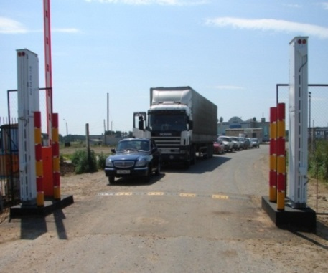
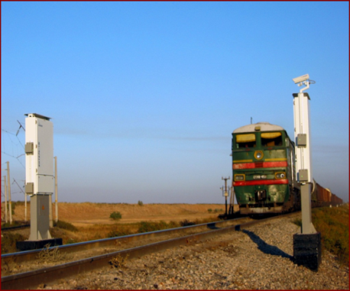
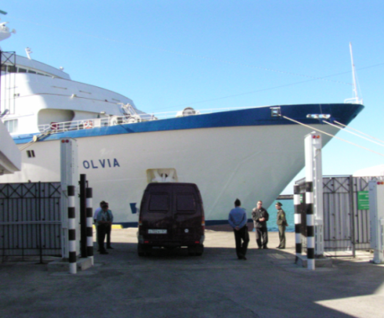
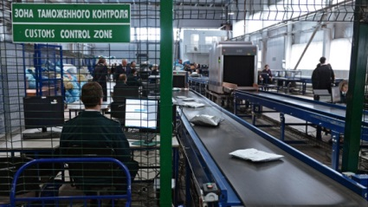
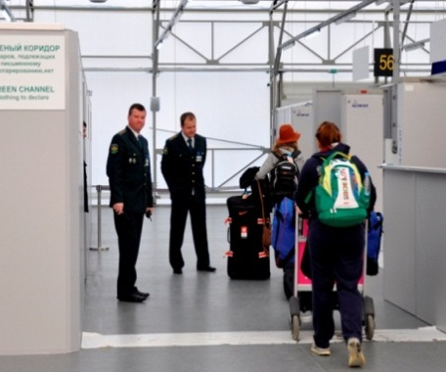
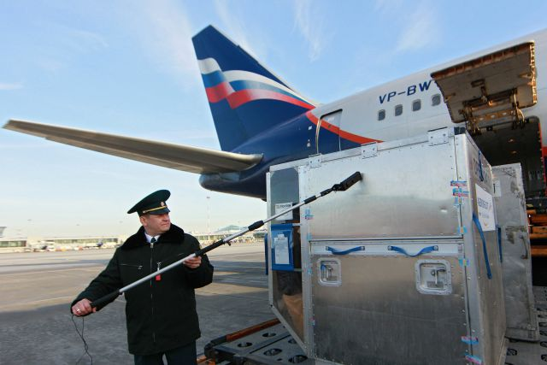
Prevention of illicit trafficking of nuclear and radioactive materials across the border
Vehicle
Railway
Seaports
Post terminals
Pedestrians
Airports

Slide 9
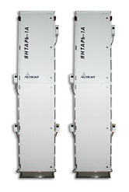
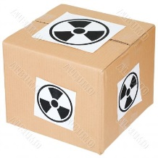
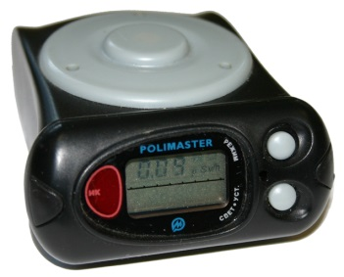
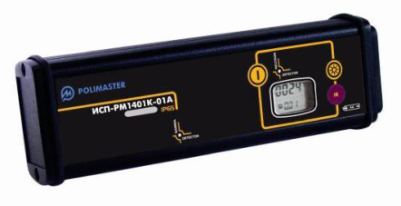
Technique of prevention of illicit trafficking Customs Inspection
RPM Alarm
Radiation
Hazard
Signs
Information
From
Special
Services
Customs
Inspection
Procedure
Front line officers are responsible for this procedure
During this procedure cargo compartments, luggage, package, etc. are NOT OPENED

Slide 10
Technique of prevention of illicit trafficking Deep Customs Inspection
γ Dose Rate > 1 µSv/h
γ Dose Rate < 1 µSv/h
Information
From
Special
Services
Neutron emission
detected
α,β pollution
detected
Local source
Deep
Customs
Inspection
Procedure
Expert officers are responsible for this procedure
During this procedure cargo compartments, luggage, package, etc. are OPENED

Slide 11
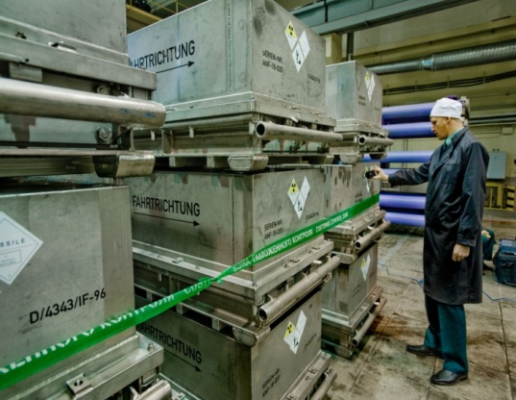
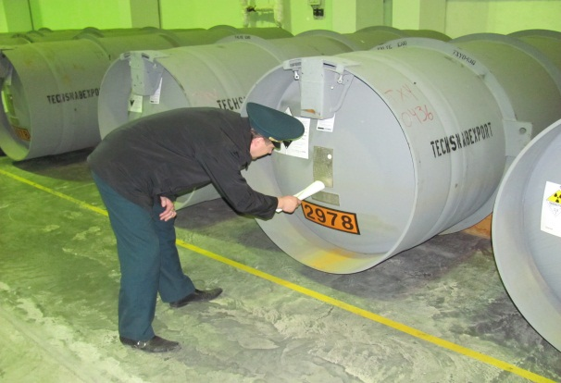
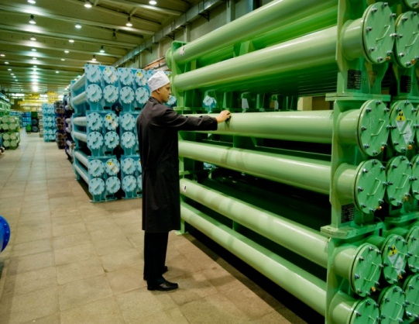
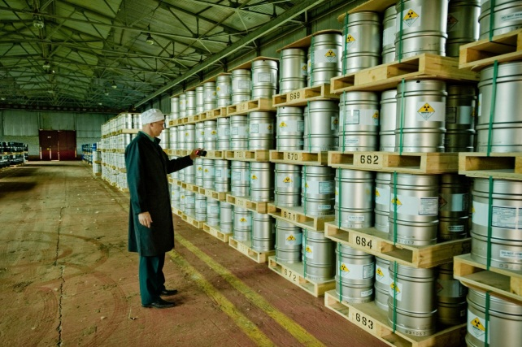
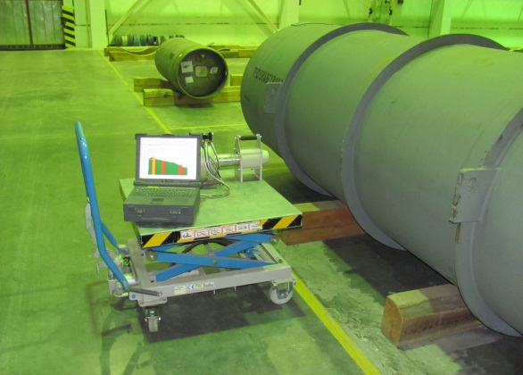
Customs control of legal shipments
This type of control always carried out in special warehouses in the customs control zone
Expert officers are responsible for this type of control

Slide 12
Training and exercises

Slide 13
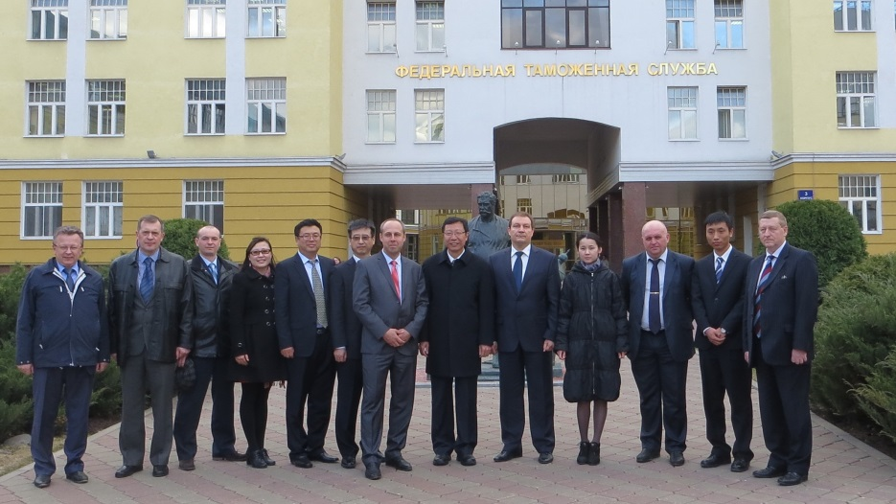
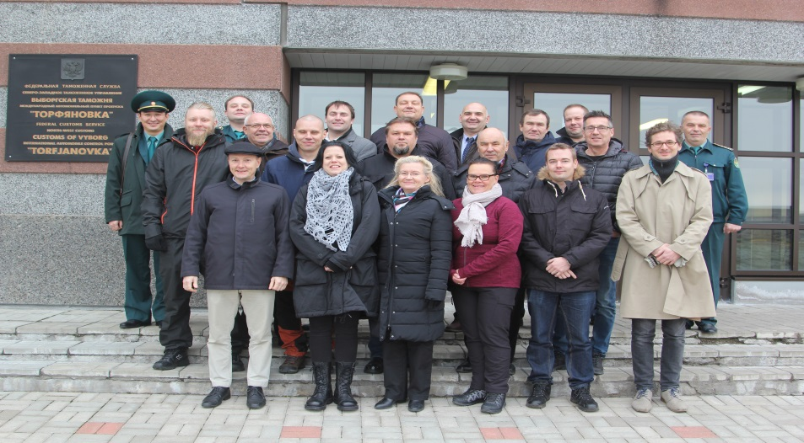
International cooperation
Work groups meetings are held every year

Slide 14
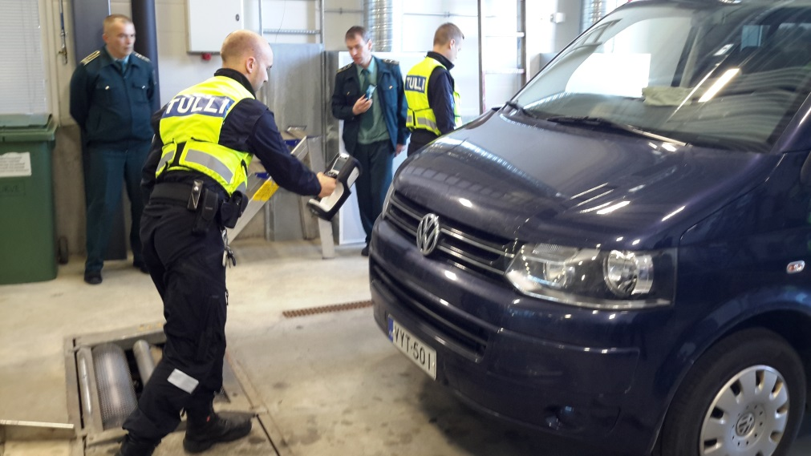
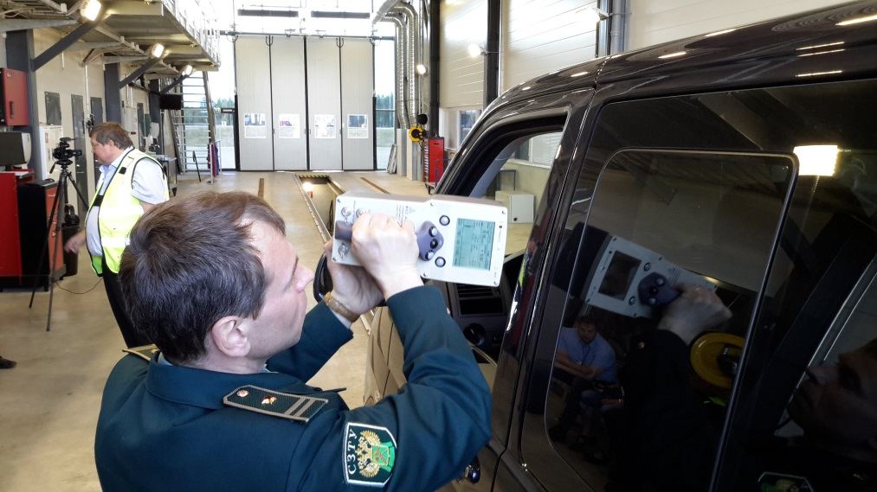
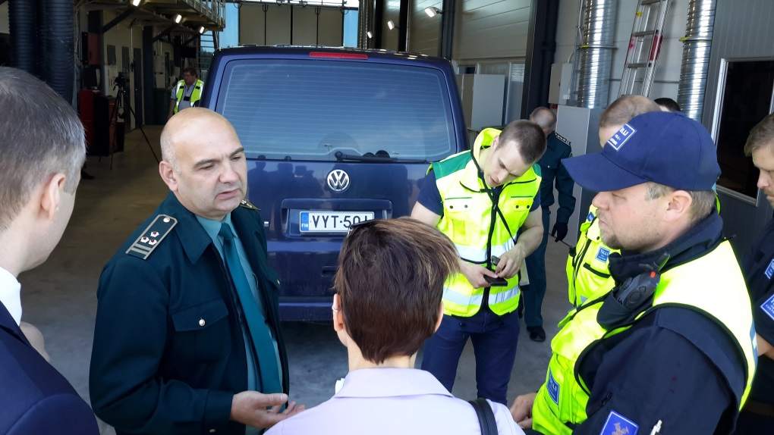
International cooperation
Joint Russian-Finnish exercises in Vaalimaa, Finland

Slide 15
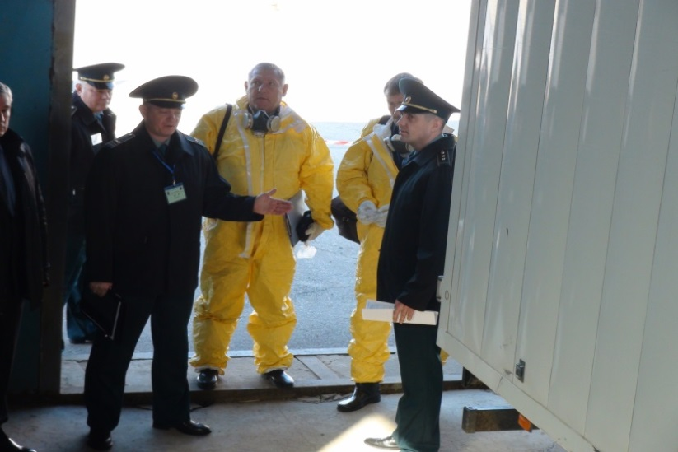
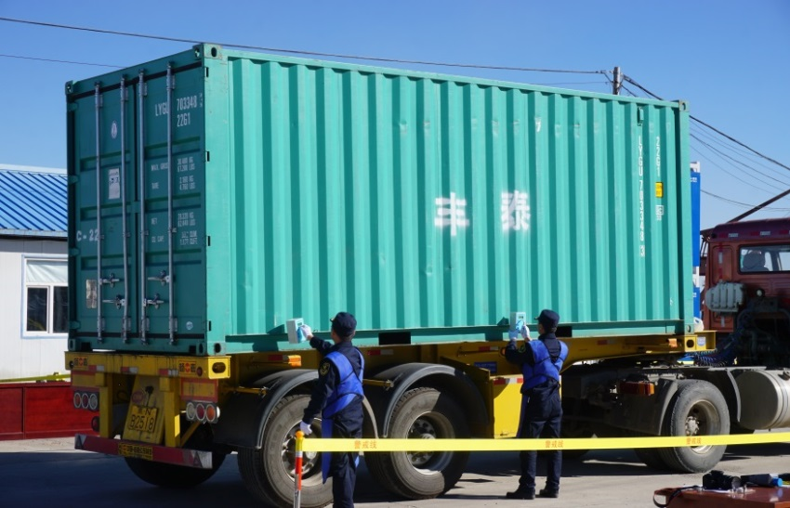
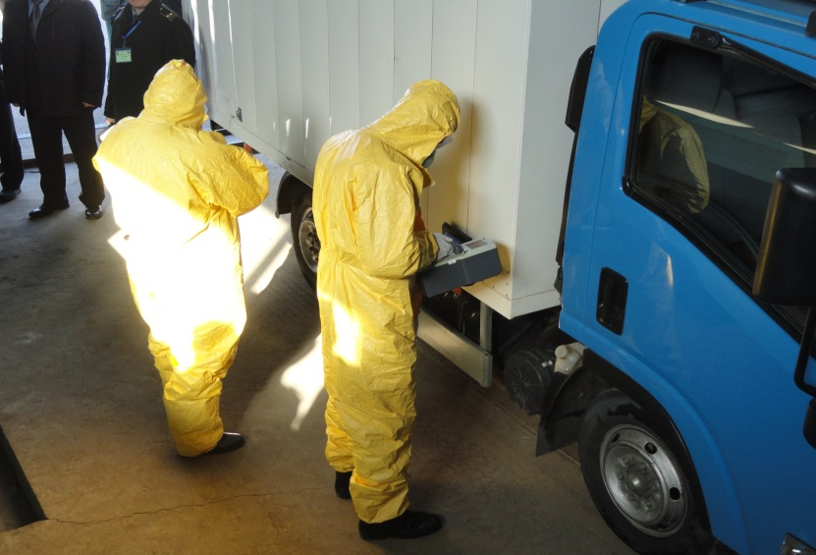
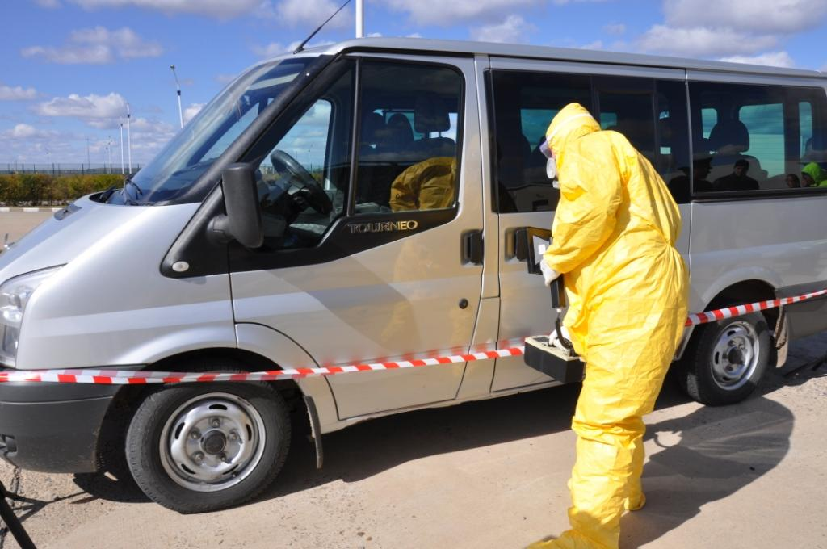
International cooperation
Joint Russian-Chines exercises in Blagoveschensk, Zabaykalsk, Russia
Heihe, Manchulia, China

Slide 16
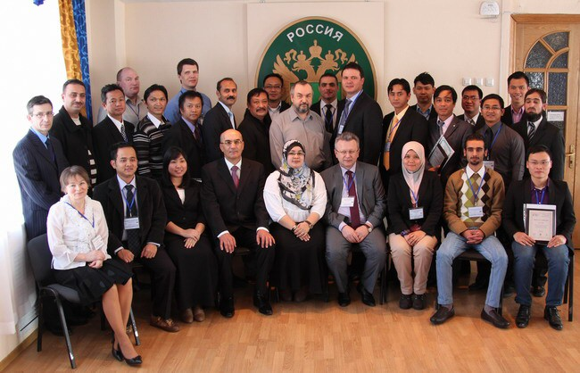
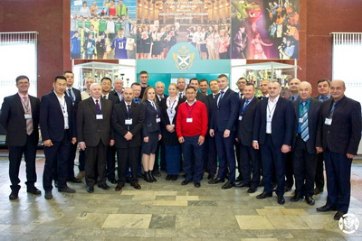
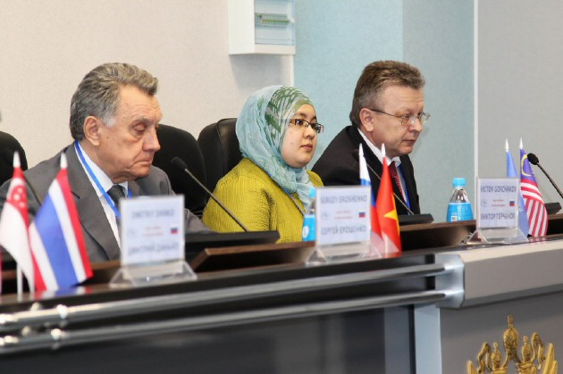
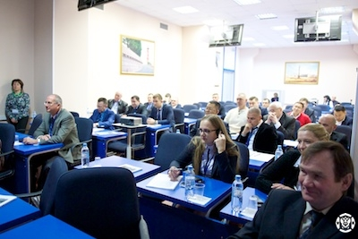
International cooperation
IAEA regional courses on radiation detection methods for front line and expert officers

