Slide 1
Switching from a Cesium-137 blood irradiator to an x-ray irradiator:
Experience at a Community-based Hospital in the Northeastern U.S.
Presented by:
Marissa Hernandez, M.S., DABMP
Manager & Chief Physicist, Radiation Physics & Safety, Atlantic Health System
Radiation Safety Officer, Morristown Medical Center
Notes:
Cesium blood irradiator pick-up & disposal 9/12/2017
cesium irradiator compares to x-ray irradiators, differences in maintenance costs, how to decide between x-ray manufacturers, process for making a corporate decision to remove the cesium, etc. If you could touch upon your experience addressing some of these questions,

Slide 2
Disclosure: The author/presenter has no direct financial nor non-financial/sponsoring relationships with any product/vendor mentioned in this presentation.

Slide 3
Outline:
Introduction
Rationale Behind the Decision to Replace the Cesium Irradiator and Subsequent Experiences in With Using the X-ray Irradiator
Timeline and Description of the Events on the Day of the Cesium Irradiator Disposal Pick-up
Factors That Deter Facilities From Switching to Alternative Technologies
Conclusions

Slide 4
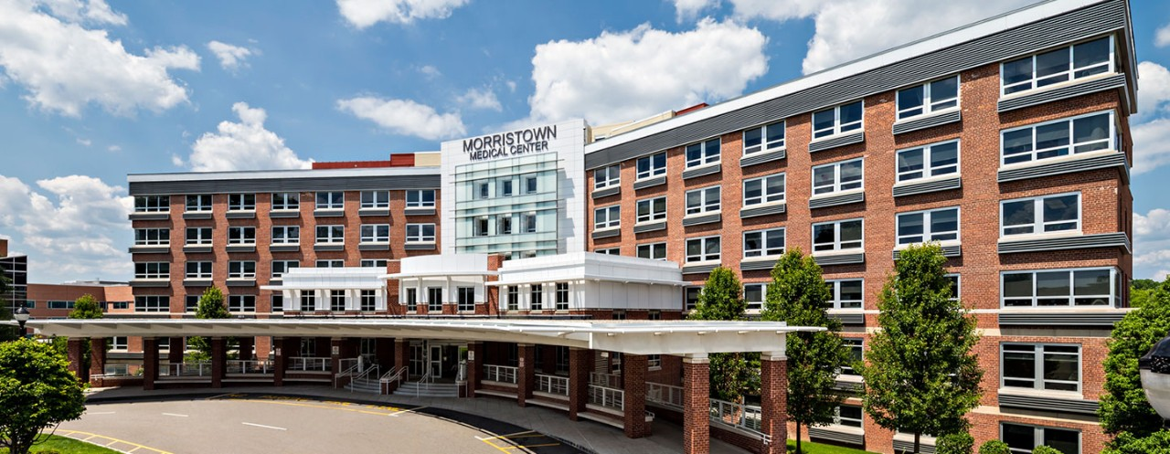
Introduction
Blood irradiators are often used to irradiate blood and blood components prior to transfusion to prevent the proliferation of certain types of T lymphocytes that can inhibit the immune response and cause graft-versus-host disease.
Morristown Medical Center, which is part of Atlantic Health System (AHS) based in northern New Jersey, employed a cesium-137 (Cs-137) blood irradiator for about 20 years.

Slide 5
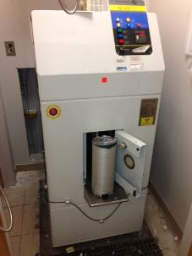
Introduction
November 14, 2005:
The U.S. Nuclear Regulatory Commission (NRC) issued Order EA-05-090, imposing increased controls for certain high-risk radioactive materials such as those contained in the blood irradiators.
December 5, 2007:
The NRC issued Order EA-07-305, imposing fingerprinting and criminal history records check requirements for unescorted access to certain radioactive material.
These increased control (IC) requirements were imposed on radioactive materials of concern such as cesium-137 (Cs-137) with activities greater than or equal to 27 Ci (1 TBq).
During the time of the IC orders, Morristown Medical Center had a blood irradiator that contained approximately 1400 Ci (52 TBq).
The Blood Bank policies, Security enhancements, and response protocols were set in place, in order to comply with the USNRC IC Orders.

Slide 6
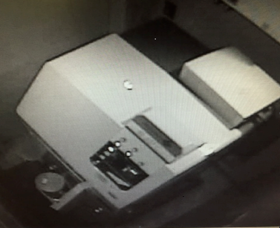
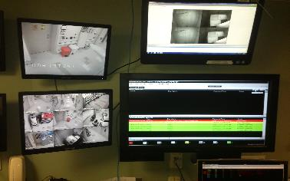
Introduction
February 2011:
The National Nuclear Security Administration (NNSA/U.S.DOE) visited Morristown Medical Center (MMC) to assess the security of radioactive materials - specifically the blood irradiator.
AHS/MMC volunteered to participate in NNSA's Global Threat Reduction Initiative (GTRI) program, which is now referred to as the Office of Radiological Security (ORS).
The goal of the program is to bolster the security of radioactive materials, both nationally and globally.
NNSA agreed to cover 100% of the costs for numerous necessary systems/installations to enhance security.
The security enhancements were incorporated into the existing site access control system:
intrusion detection system
CCTV system
installation of a remote monitoring system (RMS).

Slide 7
Introduction
March 19, 2016:
U.S.NRC Title 10 CFR Part 37 took in effect on in New Jersey.
It superseded the previous IC orders.
It imposed further requirements on security protocols & procedures such as:
Reinvestigation every 10 years for any individual with unescorted access (fingerprinting and an FBI identification and criminal history records check);
Establishment of “Security Zones” as well as “continuous physical barriers” involving access via established control points or direct control by approved individuals;
Maintaining capability to continuously monitor & detect without delay, all unauthorized entries into Security Zones;
Appropriate Security training, both initial and annually, not to exceed 12 months.

Slide 8
Rationale Behind the Decision to Replace the Cesium Irradiator and Subsequent Experiences in With Using the X-ray Irradiator
MMC eventually came to the decision to dispose the cesium irradiator and replace it with an X-ray irradiator as part of the ORS Cesium Irradiator Replacement Project (CIRP).
These were the factors that influenced the decision:
Increased efficiency and throughput from x-ray irradiators
More prohibitive and costly regulatory requirements on cesium irradiators
Issues and protocols related to security requirements
Considerable expense reduction when an x-ray irradiator is employed instead of a cesium irradiator
Requirements and expectations from ORS CIRP participation after x-ray irradiator installation

Slide 9
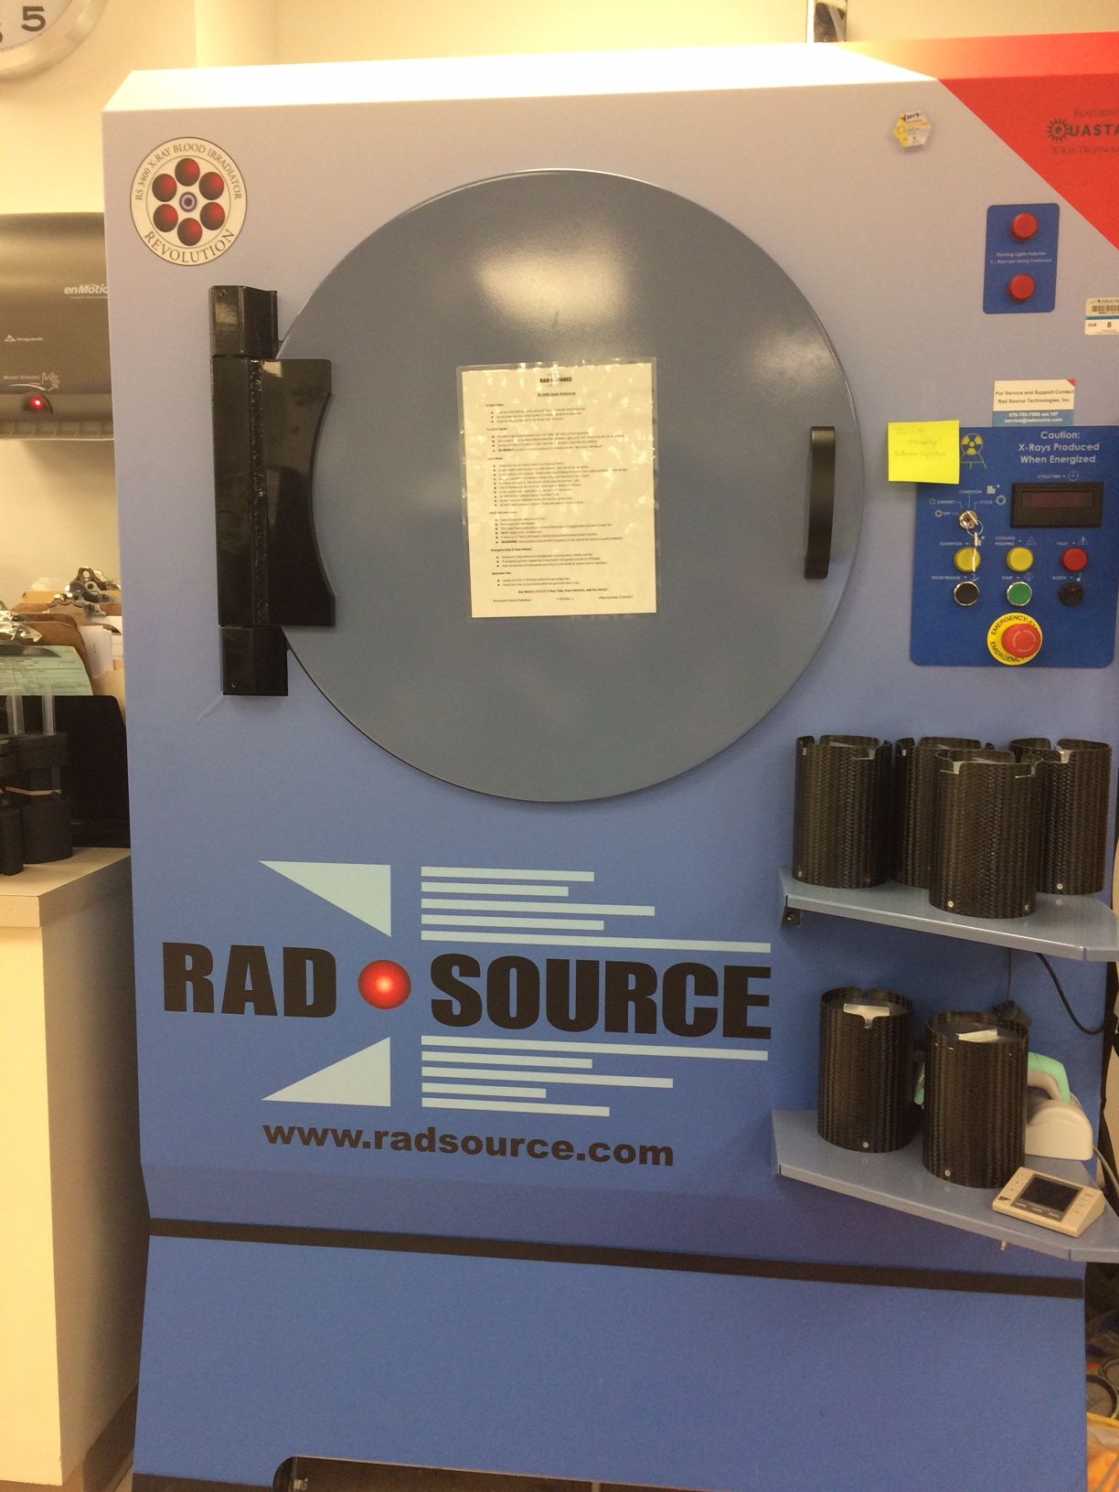
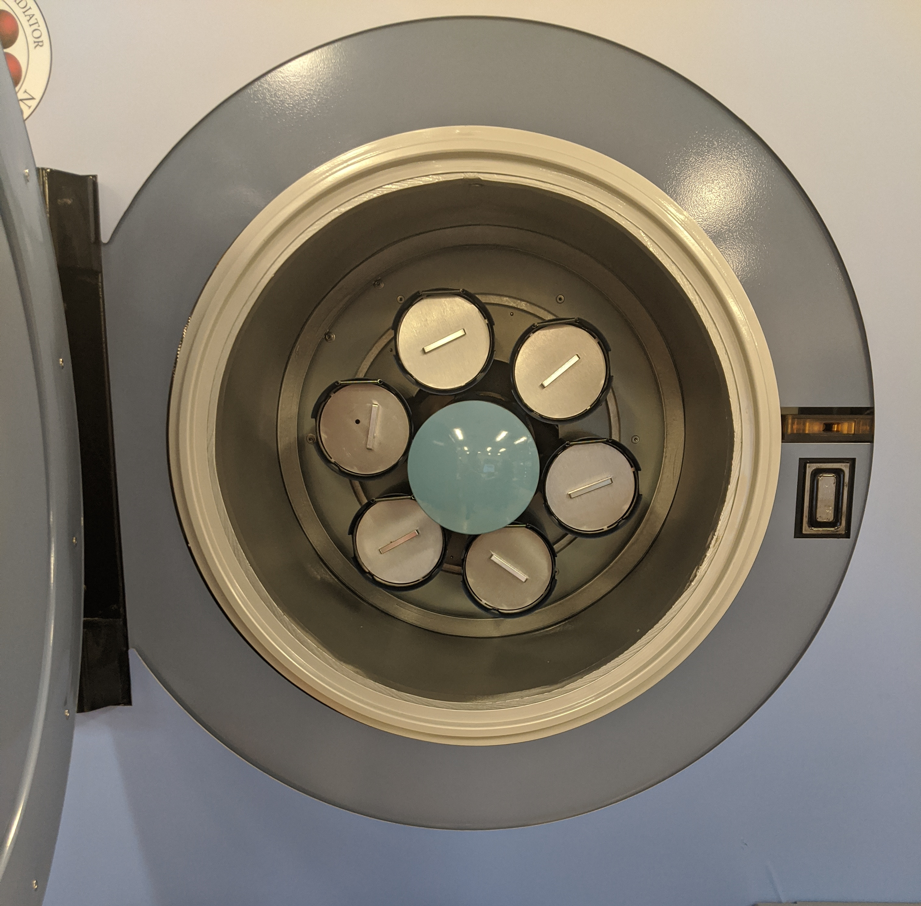
Rationale Behind the Decision to Replace the Cesium Irradiator and Subsequent Experiences in With Using the X-ray Irradiator
Increased efficiency and throughput from x-ray irradiators
EFFICIENCY & THROUGHPUT COMPARISONS BETWEEN A CESIUM IRRADIATOR
 | Cesium Irradiator (IBL-437C) (~1100 Curies at disposal date) | X-ray Irradiator
Turnaround Time | 12 minutes / cycle | < 5 minutes / cycle
Cycle Time | Increases every month due to decaying radioactive source | Never changes
Workload | Can irradiate 1-2 products/units at a time | Can irradiate up to 6 products/units at a time
Product Types | Cannot combine different blood products | Can do multiple types of products at a time
The quicker turnaround time as well as the ability to irradiate up to 6 products/units at a time yielded improved patient care, especially in the Outpatient areas as well as the Neonatal Intensive Care Unit (NICU) at MMC.

Slide 10
Rationale Behind the Decision to Replace the Cesium Irradiator and Subsequent Experiences in With Using the X-ray Irradiator
Increased efficiency and throughput from x-ray irradiators (continued)
The following feedback were expressed by various laboratory personnel in the Blood Bank at MMC, when asked how their x-ray irradiator compared with their former cesium irradiator:
“There is no comparison”
“Minimal maintenance on the x-ray irradiator”
“Higher throughput”
“No separate water hook-up needed”
“One day during the first week of use, the x-ray irradiator faulted 4 times – only happened that time – no other instances; if it happens again, we simply call the vendor and they will deploy service personnel”
“No security issues”

Slide 11
Rationale Behind the Decision to Replace the Cesium Irradiator and Subsequent Experiences in With Using the X-ray Irradiator
Increased efficiency and throughput from x-ray irradiators (continued)
From the time the X-ray irradiator was operational at MMC, from August 2017 to the present, there have only been:
Three corrective services performed by the vendor. These included replacements of a control board and an HV cable and yielded a total downtime of less than 45 minutes.
Two annual preventive maintenance services, at approximately 2.5 hours each time, yielded a total downtime of less than 30 minutes.
During such maintenance periods, the service technician can allow interruptions to let the staff perform irradiations, if necessary.
In addition, when such services are anticipated, the facility is able to irradiate products ahead of time.

Slide 12
Rationale Behind the Decision to Replace the Cesium Irradiator and Subsequent Experiences in With Using the X-ray Irradiator
More prohibitive and costly regulatory requirements on cesium irradiators
Based on our experience at MMC, the regulatory requirements for cesium irradiators are more prohibitive and costly than those for X-ray irradiators:
Cesium Irradiator (IBL-437C) (~1100 Curies (41 TBq) at disposal date) | X-ray Irradiator
Must comply with Title 10 CFR 37: (Trustworthiness & Reliability (T&R) requirements, Security, etc.): | Must comply with NJ Department of Environmental Protection (NJDEP) Cabinet X-ray Regulations:
T&R Background Checks by HR | Annual Physics Testing
Fingerprinting – initially & every 10 years | Semi-annual Door Interlock checks
Annual Refresher Training – Security Program
Annual Review – Access Authorization Program & the Security Program
Local Law Enforcement Agency (LLEA) – Annual Training; Annual signed agreement; Facility Security updates; Incident notifications
Quarterly RMS testing by Security & the Alarm Company
24/7 Security Surveillance of the Irradiator (redundant systems); High-level Security Measures
MMC had a total of almost 300 staff & contractors who were required to meet the above 10 CFR 37 requirements; 75% of which were required to be fingerprinted, as well as undergo FBI background checks.

Slide 13
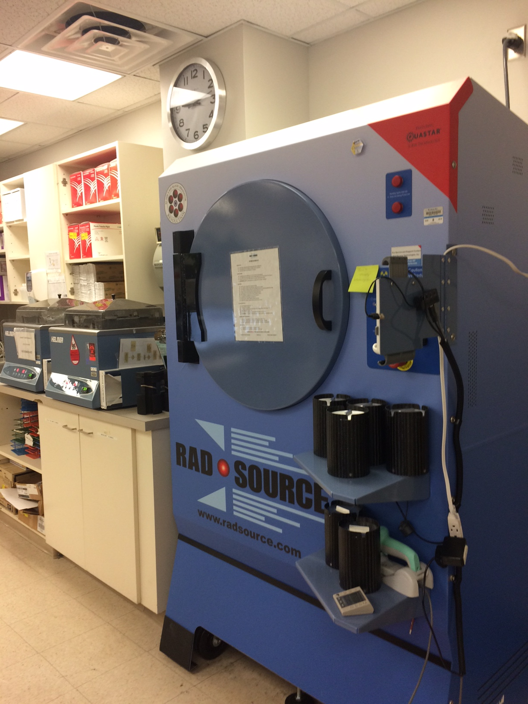
Rationale Behind the Decision to Replace the Cesium Irradiator and Subsequent Experiences in With Using the X-ray Irradiator
More prohibitive and costly regulatory requirements on cesium irradiators (continued)
The manufacturer’s specifications on MMC’s X-ray irradiator requires:
Monthly door interlock checks, instead of the semi-annual frequency that the NJDEP requires.
Semi-annual dosimetry phantom test – an irradiation cycle is run on a phantom that is sent to the facility, which subsequently sends the phantom to a calibration site in Texas for dosimetry readings.
As needed, a condition cycle is run whenever the irradiator is not used during an entire work shift, causing the condition light to illuminate. No conditioning required if the irradiator is used constantly.

Slide 14
Rationale Behind the Decision to Replace the Cesium Irradiator and Subsequent Experiences in With Using the X-ray Irradiator
Issues and protocols related to security requirements
Medical facilities such as MMC are a vulnerable target for terrorist infiltration involving radioactive materials. They are typically open-access facilities with limited security measures. Note that cesium-137 is an attractive radioactive source candidate for WMDs.
Having the cesium irradiator at MMC presented some security issues, as well as subjected the facility to implement security protocols as per 10 CFR 37:
Cesium Irradiator (IBL-437C) (~1100 Curies (41 TBq) at disposal date)
Facility/Community vulnerability to terrorism
Conduct Fingerprinting
Attend Annual Refresher Training – Security Program
Perform Annual Review – Access Authorization Program & the Security Program
Local Law Enforcement Agency (LLEA) Coordination – Annual Training; Site Tours; Annual signed agreement; Facility Security updates
Conduct Quarterly RMS testing – Coordinate with Alarm Company
Ensure 24/7 Security Surveillance of the Irradiator (redundant systems); High-level Security Measures

Slide 15
Rationale Behind the Decision to Replace the Cesium Irradiator and Subsequent Experiences in With Using the X-ray Irradiator
Considerable expense reduction when an x-ray irradiator is employed instead of a cesium irradiator
Cost is another imperative deciding factor for switching to an alternative technology for blood irradiation, because it can yield considerable savings:
Cesium Irradiator (IBL-437C) (~1100 Curies (41 TBq) at disposal date) | X-ray Irradiator
Title 10 CFR 37 requirements: | Cesium Irradiator Replacement Project (CIRP):
HR Staff hours to implement T&R Background Checks | 50% reimbursement on x-ray irradiator cost (total cost (including 1-year warranty) ~ US$250k)
Fingerprinting – Security staff hours; NRC processing charges US$26/fingerprint card | 100% coverage of cesium irradiator pick-up & disposal
Security staff hours to perform Quarterly RMS testing and other periodic testing
High cost of security enhancements; periodic maintenance cost on security equipment after the federal contract period runs out

Slide 16
Rationale Behind the Decision to Replace the Cesium Irradiator and Subsequent Experiences in With Using the X-ray Irradiator
Requirements and expectations from ORS CIRP participation after x-ray irradiator installation
As part of the ORS CIRP participation, upon installation of the new X-ray irradiator, Pacific Northwest National Laboratory (PNNL) requires that the facility submit a report in Excel format, specifying the amount and type of product irradiated, cycle time of irradiation, and any issues that arise.
This can be done by collecting daily irradiation statistical user and product data.
The report shall be supplied on a quarterly basis for a period of one year, together with all manufacturer and/or contractor service/repair reports, if any.
Morristown Medical Center complied with these requirements accordingly.
Note that as expected, the reimbursement check for 50% of the X-ray irradiator cost, was received from PNNL, one month after the cesium irradiator pick-up.

Slide 17
Timeline and Description of the Events on the Day of the Cesium Irradiator Disposal Pick-up
Overall, the preparations for and execution of the irradiator disposal pick-up, were carried out accordingly.
Preparations and pick-up occurred, all within 8 hours as expected:
7:00-11:00 a.m. | Removal company staff prepared the cesium blood irradiator, located in the Blood Bank
7:30 a.m. | Crane arrival
8:00 a.m. | Arrival of trailer/cask and Idaho National Lab (INL) personnel
11:00 a.m. | Removal company staff wheeled out the irradiator from the Blood Bank, out to the parking lot area next to the trailer
11:00 a.m. – 3:00 p.m. | INL prepared the irradiator for transport – including leak tests and radiation surveys
3:00 p.m. | Trailer transporting the cask containing the irradiator, left the facility

Slide 18
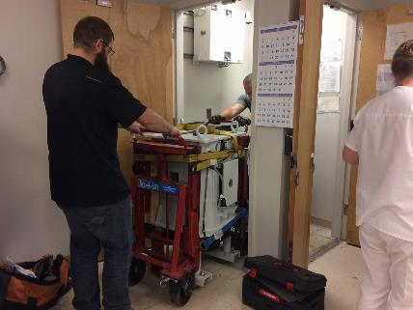
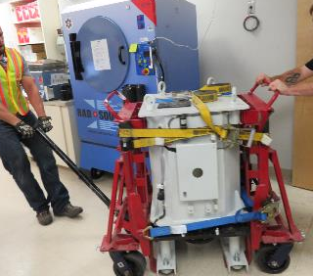
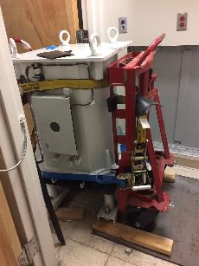
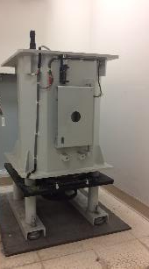
Timeline and Description of the Events on the Day of the Cesium Irradiator Disposal Pick-up
Visual description of the day when the cesium irradiator was picked up from MMC for disposal:
Disposal preparation
Cesium irradiator (2150 kg (4730 lbs)) being transported out of the Blood Bank
Cesium irradiator with the cover removed
Notes:
>>> The proposal includes unloading the IBL-437C source using a 15,000 lb portable hot cell for shipment in the INL 10-160B Type B transportation package. This package is mounted on its own tractor trailer.
>>> The total dimensions of the tractor and trailer are below:
>>> Total vehicle length - 71 feet
>>> Vehicle width - 8.6 feet
>>> Vehicle height - 13.6 feet
>>> Cask height - 13 feet
>>> Ground clearance - 8 inches
>>> Weight 80,000 lbs (with cask empty)
>>> A minimum of a 30 ton hydraulic crane is needed to support the project - crane is provided as part of the bid.

Slide 19
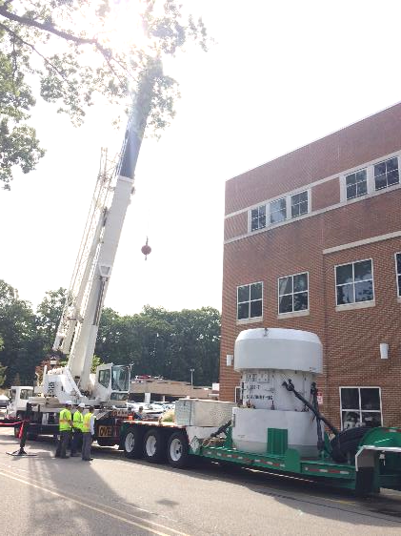
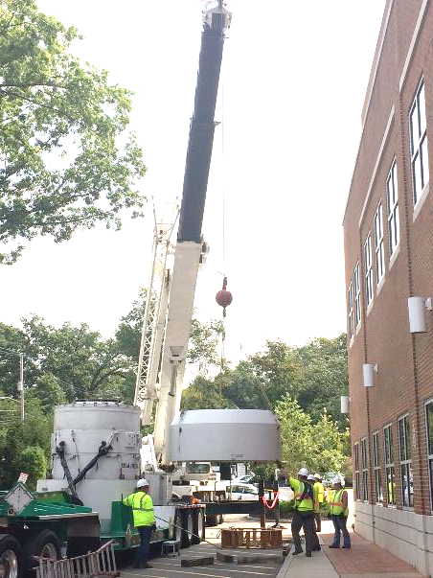
Timeline and Description of the Events on the Day of the Cesium Irradiator Disposal Pick-up
Visual description of the day when the cesium irradiator was picked up from MMC for disposal:
The crane and the cask in the parking lot behind the facility
Notes:
>>> The proposal includes unloading the IBL-437C source using a 15,000 lb portable hot cell for shipment in the INL 10-160B Type B transportation package. This package is mounted on its own tractor trailer.
>>> The total dimensions of the tractor and trailer are below:
>>> Total vehicle length - 71 feet
>>> Vehicle width - 8.6 feet
>>> Vehicle height - 13.6 feet
>>> Cask height - 13 feet
>>> Ground clearance - 8 inches
>>> Weight 80,000 lbs (with cask empty)
>>> A minimum of a 30 ton hydraulic crane is needed to support the project - crane is provided as part of the bid.

Slide 20
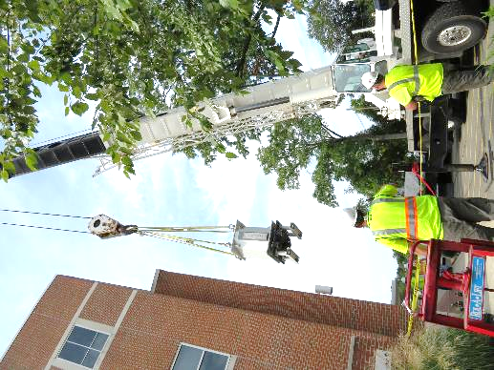
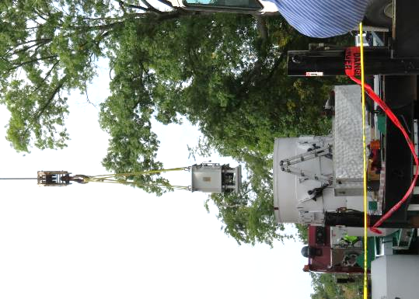
Timeline and Description of the Events on the Day of the Cesium Irradiator Disposal Pick-up
Visual description of the day when the cesium irradiator was picked up from MMC for disposal:
Cesium irradiator being hoisted into the cask
Notes:
>>> The proposal includes unloading the IBL-437C source using a 15,000 lb portable hot cell for shipment in the INL 10-160B Type B transportation package. This package is mounted on its own tractor trailer.
>>> The total dimensions of the tractor and trailer are below:
>>> Total vehicle length - 71 feet
>>> Vehicle width - 8.6 feet
>>> Vehicle height - 13.6 feet
>>> Cask height - 13 feet
>>> Ground clearance - 8 inches
>>> Weight 80,000 lbs (with cask empty)
>>> A minimum of a 30 ton hydraulic crane is needed to support the project - crane is provided as part of the bid.

Slide 21
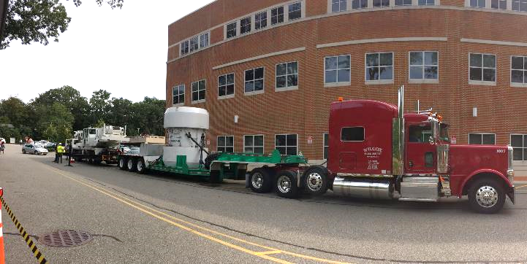
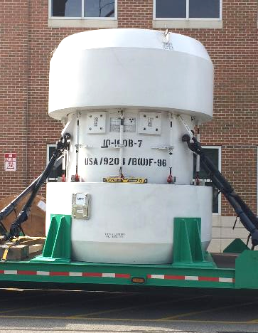
Timeline and Description of the Events on the Day of the Cesium Irradiator Disposal Pick-up
Visual description of the day when the cesium irradiator was picked up from MMC for disposal:
Trailer hauling the cask containing the irradiator, as it left the facility
The cask containing the irradiator, ready for transport.
Notes:
>>> The proposal includes unloading the IBL-437C source using a 15,000 lb portable hot cell for shipment in the INL 10-160B Type B transportation package. This package is mounted on its own tractor trailer.
>>> The total dimensions of the tractor and trailer are below:
>>> Total vehicle length - 71 feet
>>> Vehicle width - 8.6 feet
>>> Vehicle height - 13.6 feet
>>> Cask height - 13 feet
>>> Ground clearance - 8 inches
>>> Weight 80,000 lbs (with cask empty)
>>> A minimum of a 30 ton hydraulic crane is needed to support the project - crane is provided as part of the bid.

Slide 22
Factors That Deter Facilities From Switching to Alternative Technologies
Facilities that are considering switching from a cesium irradiator to an x-ray irradiator, may be having some notions or perceiving certain drawbacks that would deter them from doing so:
Resistance to change
Possible loss of research grant funding from agencies such as the NIH – note that it is said that the NIH is technology agnostic so long as the researcher demonstrates the effectiveness of the irradiator; in any case, the importance of this consideration varies from user to user.
X-ray irradiator performance issues – note that generally, these no longer apply to the newer units.
X-ray irradiators generate heat; however, this can be solved by adequate ventilation and alleviated by a high-performance chiller.
Cost for service contract is approximately $17,500 per year per irradiator
Cost of x-ray tube replacement is approximately $20,000; note that irradiator x-ray tubes can typically last up to 7-10 years
All things considered, it is concluded that switching from a cesium irradiator to an x-ray irradiator, yields benefits which far outweighs the drawbacks, if any.

Slide 23
Conclusions
The deciding factors presented prove to be compelling reasons to dispose of a cesium blood irradiator and replace it with an alternative technology, such as an x-ray irradiator, which yields better performance and negates vulnerability from theft & sabotage involving high-activity radioactive materials.
It is hoped that our experience in switching from a cesium irradiator to an x-ray irradiator, will engage and inspire other facilities to do the same.

Slide 24
Acknowledgements
The author wishes to thank certain individuals from Morristown Medical Center (MMC) for information and support they contributed:
Joanne Socolow (Supervisor, Clinical Laboratory) and the rest of the Blood Bank staff
Manny Ayers, Senior Supervisor, Protection & Security Services
Special thanks to these individuals for their support on the cesium irradiator security program as well as the irradiator disposal:
Director Veronica Fraser, Manager Jane Francella and the rest of the Blood Bank/Lab Operations staff at MMC
Protection & Security Services staff at AHS/MMC
Manager Patrick Burke and the rest of the Plant Engineering staff at MMC
Senior Management at AHS
LLEA Morristown Police Department
Finally, special appreciation is extended to the NNSA, PNNL, Idaho National Laboratory, Los Alamos National Laboratory, International Isotopes, and Southwest Research Institute, for seamlessly & successfully implementing the CIRP at MMC.

Slide 25
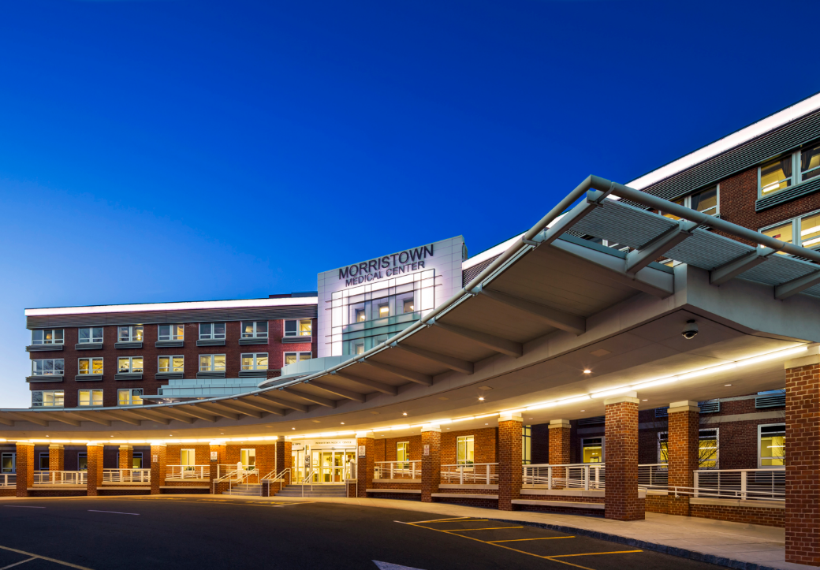
Thank you for your interest & attention.
Marissa Hernandez, M.S., DABMP
Manager & Chief Physicist, Radiation Physics & Safety, Atlantic Health System
Radiation Safety Officer, Morristown Medical Center
marissa.hernandez@atlantichealth.org

