Slide 1
IEC STANDARD-FAMILY ON CYBERSECURITY FOR NUCLEAR POWER PLANTS
Thomas WALTER
IAEA International Conference on Nuclear Security: Sustaining and Strengthening Efforts (ICONS2020),
10th to 14th of February 2020, Vienna

Slide 2

Content
What is IEC and Cybersecurity Standards
IEC 62645 overview
IEC 62859 overview
IEC 63096
  IEC 63096 scope and What is a security control?
  IEC 63096 structure
  Structure of each security control
  Security controls overview list in IEC 63096, Annex A
  IEC 63096 development timeline

Slide 3
What is IEC? (1)
Leading global organization that prepares and publishes standards for:
  Electrical and electronic products
  Related technologies
    Electricity, electronics, magnetics, electro-magnetics, electro-acoustics, multimedia, telecommunication, energy production and distribution, electromagnetic compatibility, measurement and performance, dependability, safety, environmental aspects
Membership is by National Committees

Slide 4
What is IEC? (2)
Organized in Technical Committees (TC) and Subcommittees (SC)
104 TC
99 SC
TC45 for Nuclear instrumentation
SC45A for instrumentation, control and electrical systems of nuclear facilities
SC45B for radiation protection instrumentation

Slide 5
What is IEC SC45A? (1)
SC 45A: Instrumentation and Control of Nuclear Facilities
WG 2 Sensors and measurement techniques
WG 3 ICS: architecture and system specific aspects
WG 5 Special process measurement and radiation monitoring
WG 7 Functional and safety fundamentals of instrumentation, control and electrical power systems
WG 8 Control rooms
WG 9 System performance and robustness toward external stress
WG 10 Ageing management of instrumentation, control and electrical power systems in NPP
WG 11 Electrical power systems: architecture and system specific aspects

Slide 6
What is IEC SC45A? (1)
P-Members
• Argentina | • Korea (Rep. of)
• Belgium | • Netherlands
• Canada | • Norway
• China | • Romania
• Czech Republic | • Russian Fed.
• Egypt | • South Africa
• Finland | • Sweden
• France | • Switzerland
• Germany | • U.S.A.
• Italy | • Ukraine
• Japan | • United Kingdom
O-Members
• Belarus
• Greece
• Pakistan
• Portugal
• Spain
Participating members (22)
Observer members (5)

Slide 7
Standardization Context (1)
IEC 61513 Ed 2.0 2011 – Nuclear Power Plants – I&C for Systems Important to Safety – General Requirements for Systems (Similar to IEEE-603-1998)
IEC 60880 Ed 2.0 (2006) – Nuclear Power Plants – I&C Systems Important to Safety Software Aspects for Computer-Based systems performing Category A Functions (Similar to IEEE 7- 4.3.2-2003)

Slide 8
Standardization Context (2) SC45A Standard Hierarchy
Nuclear Power Plants (NPPs) –
I&C Systems Important to Safety
General Requirements for Systems
IEC 61513
NPPs-
Categori-zation
IEC 61226
NPPs-
Cat. A
Software
IEC 60880
NPPs-
Cat. B+C
Software
IEC 62138
NPPs-I&C and electrical Systems -
Requirements for Security Programs for Computer Based Systems
IEC 62645, Ed. 2, FDIS
NPPs-I&C Systems-
Requirements for Coordinating Safety and Security
IEC 62859, Ed. 1
NPPs-I&C and electrical Systems -
Security Controls
IEC 63096, Ed. 1, CDV

Slide 9
IEC 62645 – Scope
Cybersecurity requirements and guidance for development and management of effective computer-based I&C systems, possibly integrating HPD with HDL (Hardware Description Language)
limited only to I&C programmable digital systems systems
inherent to these requirements and guidance the power plant’s security programme should comply with the applicable country’s I&C CB&HPD security requirements.
Human errors, natural events are excluded

Slide 10
IEC 62645 – Second Edition
adapt the 2013 editions structure and high-level principles of ISO/IEC 27001 and ISO/IEC 27002.
consistency with IAEA principles and concepts (NSS17)
consistency with IEC 62443 series, when relevant
consistency and articulation with IEC 61513
coordination with IEC 62138, IEC 60880, and all SC45A standards mentioning computer security
Rearrangement of the structure to take into account the future second level documents

Slide 11
IEC 62645 – Modification 2nd Ed.
concept of security degrees and their associated criteria:
  possibility of further security degrees for non-I&C systems (NSS17).
Confidentiality issues should be addressed
Consideration of (smart) electrical systems
Specific guidance, on legacy systems
Guidance, recommendations or requirements about cybersecurity audits and risk assessment
High-level security requirements and/or recommendations to wireless technologies.

Slide 12
IEC 62645 – Timeline
2008
2009
Approved by 19 NC and experts from 5 NC nominated
2010
Draft for Vote (CDV) after full committee meeting
2013
2012
Interim meeting
2014
New Work Proposal (NWIP) from US
CDV Comments addressed in full CM
Final Draft (FDIS) and issued
First working group meeting
2015
2016
First working draft to address the principles in January
2017
Draft for Vote (CDV)
2019
2018
Comments addressed in the full committee meeting
Stability date for first edition ends
CDV Comments addressed in full CM
Record of revision with principles
Draft in fall 2016
International Standard issued (11-2019)
2020
Start of work on EN
Edition 1 Edition 2

Slide 13




IEC 62859 – Overview
Title: Requirements for coordinating cybersecurity and safety
Scope:
Reinforcement
Antagonism
Dependancy
Independance
  Safety
  Cybersecurity
Need for a normative framework to master these interdependencies in I&C system nuclear environements

Slide 14
IEC 62859 – Timeline
2012
2014
Draft CD1
2016
FDIS and issued
New Work Proposal (NWIP)
2018
2019
Creation of an amendment
2020
Start of work on EN
CENELEC decision: IEC 62859 should become EN
CDV + FDIS + issued
Edition 1 Amendment for EN

Slide 15
IEC 63096 – Scope
Security controls for I&C and electrical systems in NPPs
  Security controls catalogue based on ISO/ IEC 27002
  → Definition of highly recommended and optional security controls
  → Depending on grading (security degree)
  Details on the process of applying security controls in line with the IEC 62645 requirements
  To prevent, detect and correct cyber security attacks
For …
  new NPPs
  modernization of I&C in existing NPPs
Crediting/ inheritance of existing programs
Legacy I&C systems

Slide 16
What is a Security Control?
Explanation of the term security control
  Security controls are measures/ countermeasures/ provisions to avoid, detect, counteract, or minimize cybersecurity risks
Classification of security controls according to point of time they act
    Before the event: Preventive security controls are intended to prevent an incident from occurring (e.g. by requiring an authentication during login, firewalls)
    During the event: Detective security controls are intended to identify an incident (e.g. sending an alarm if somebody has pulled a network cable);
    After the event: Corrective security controls are intended to limit the extent of any damage caused by the incident (e.g. by restoring an attacked component, analyzing security event logs in order to analyze what has happened)
Classification of security controls according to their nature
  Technical security controls (e.g. Integrity monitoring, firewalls, data diode)
  Physical security controls (e.g. locked cabinet doors, locked electronic rooms)
  Administrative controls (e.g. incident response processes, security awareness training)

Slide 17
IEC 63096 consistent with IEC 62645
Graded Approach (Security Degrees)
    Security degree S1, highest level, safety class 1 I&C programmable digital systems
    S2 as minimum for safety class 2 I&C programmable digital systems
    S3 as minimum for safety class 3 I&C programmable digital systems
    Baseline requirement
    Security degree also dependent on the consequences on the plant when the I&C is attacked
Process of applying security controls
    Is in line with IEC 62645, Ed. 2, CDV
    Process has been detailed together with the IEC 62645 Project Lead
IEC 63096 details the security controls topic that is described in IEC 62645 on a high level

Slide 18
Connection to IEC 62645 and ISO/IEC 27002
IEC 62645
ISO/ IEC 27005 for risk management
For IEC 63096 the ISO/IEC 27002 security controls catalogue has been copied, modified and extended
IEC 63096: Security controls for:
I&C platform and I&C system
(typically technical and physical security controls)
Development environment
Engineering environment
Operation & Maintenance Environment

Slide 19
IEC 63096 structure (1)
Generic Part
1 Scope
2 References
3 Terms and definitions & Abbreviations
Standard IEC structure
4 Nuclear I&C specific Security Controls
4.1 Audience
4.2 Source for definition of nuclear I&C specific security controls
Audience
Source for security controls
4.3 Security controls catalogue
Structure for security controls description
4.4 Process of selecting security controls
4.4.1 Process of selecting and implementing security controls for
the actual I&C platform and I&C system
4.4.2 Process of selecting and implementing security controls for D- activity
→ I&C Platform Development
4.4.3 Process of selecting and implementing security controls for E- activity
→ I&C system engineering
4.4.4 Process of selecting and implementing security controls for O- activity
→ Operation and Maintenance of I&C system
Process of applying security controls (consistent with IEC 62645, Ed 2)
Crediting/ inheritance of existing programs
Legacy topics

Slide 20
IEC 63096 structure (2)
Security Controls Catalogue
5 Information security policies
6 Organization of information security
7 Human resource security
8 Asset management
9 Access control
10 Cryptography
11 Physical and environmental security
12 Operations security
13 Communications security
14 System acquisition, development and maintenance
15 Supplier relationships
16 Information security incident management
17 Information security aspects of business continuity management
18 Compliance
Description of security controls:
Headings and numbering identical with ISO/IEC 27002
A variety of 27002 security controls have been modified or extended
Additional security controls have been added, e. g.:
  Security controls for the I&C platform or I&C system (typically technical and physical security controls)
Extensions and modifications compared to IEC 27002 are marked in ITALIC letters
19 NUC - Cybersecurity and architecture
20 NUC - Virtualization environment and infrastructure controls
Additional nuclear I&C specific security control
clauses
The security controls catalogue …
represents the statement of applicability (SOA) for the nuclear I&C domain.
contains technical, physical and administrative security controls.

Slide 21
Structure of each security control (1)
Control
This subclause contains a short description of the specific security control. If there is no modification the original ISO/ IEC 27002 text has been taken over.
Preservation of
Description of the objective of the security control in terms of Confidentiality, Integrity and Availability (CIA):
    C → Confidentiality
    I → Integrity
    A → Availability
Control focus
This subclause contains the description of the focus of the security control in terms of prevention, detection and correction
    p → Prevention
    d → Detection
    c → Correction

Slide 22
Structure of each security control (2)
Implementation guidance (1)
    The implementation guidance is described in a standardized table format.
    The implementation guidance depends on the security degree (as defined in IEC 62645) that is assigned to the individual I&C system.
    If no security degree is assigned the implementation guidance of the security baseline “Baseline Requirement” applies.
    For the security baseline and the security degrees following column headings are defined:
        BR → Baseline Requirement
        S3 → Security degree 3
        S2 → Security degree 2
        S1 → Security degree 1

Slide 23
Structure of each security control (3)
Implementation guidance (2)
    The applicability of the implementation guidance also depends on one or several of the following activities, shown by the following activity letters in columns BR, S3, S2, S1:
I&C Platform Development
Project Engineering for plant specific I&C system
Operation & Maintenance of I&C system
  D → I&C Platform Development
E → Project Engineering for plant specific I&C system
  E_{b} → Project Engineering before “Installation” and “Commissioning”
  E_{d} → Sub- activities “Requirements”, “Specifications” and “Detailed design and implementation”
  E_{g} → Sub- activity “Integration (offsite integration)”
  E_{v} → Sub- activity “Validation (factory acceptance testing)”
  E_{s} → Sub- activity “Shipping to site”
E_{ic} Project Engineering activities “Installation” and “Commissioning”
  E_{i} → Sub- activity “Installation (onsite Integration and Acceptance Testing)”
  E_{c} → Sub- activity “Commissioning (Commissioning and Acceptance Testing)”
O → Operation and Maintenance of I&C system
  O_{o} → Sub- activity “Operation”
  O_{m} → Sub- activity “Maintenance”
  O_{r} → Sub- activity “Retirement”
D → activity letter

Slide 24
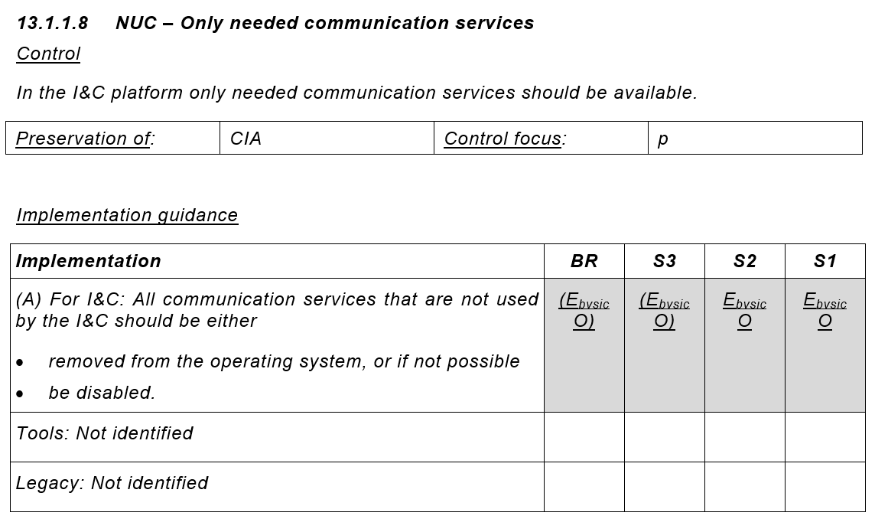
Security controls description
Security Controls example for I&C platform or system
p -> Prevention
d -> Detection
c -> Correction
Gray shading and activity letters underlined:
→ Security control for
I&C platform or I&C system
Additional to ISO/ IEC 27002 for nuclear domain (NUC)
C -> Confidentiality
I -> Integrity
A -> Availability
Security Degrees
Activity letter without parenthesis (no “(…)”)
→ Security control is highly recommended
Letters are italic→ new security control compared to ISO/ IEC 27002
Activity letters show applicability:
E_{b}: To handled in all Engineering phases before installation and commissioning
E_{vs}: To be in place and tested in the I&C system during Integration and Validation; in place during shipping
E_{ic}: To be in place in the I&C system during Installation and Commissioning
O: To be in place in the I&C system in all
phases of Operation and Maintenance
Security Control description
Hints for tools for implementing security control (in this case no hint)
Activity letter with parenthesis (“(…)”)
→ Security control is optional
How Legacy could be handled
(In this case no recommendation)

Slide 25
Simplified process overview for applying security controls
x
from slide 18
Security degree assignment for each I&C (sub-) system according to IEC 62645
1
Identification of highly recommended security controls acc. IEC 63096 security controls catalogue based on I&C (sub-) system’s security degree and the activity (DEO)
2
Based on the security architecture and its security zoning (see IEC 62645):
→ Application of selected security controls
3
Threat and Risk Analysis: In case of unacceptable residual security risks → Additional compensatory security controls for risk mitigation necessary
4
Periodical reassessment of Threat and Risk Analysis, also event driven in case of new threats or new assets
5

Slide 26
Security controls overview list in IEC 63096, Annex A
Using the XLSX or CSV file, the table can be extended project specifically
Filtering available
Annex A also included as attachments to the IEC 63096- PDF file in two different machine readable formats
Identification of security controls for the I&C platform or I&C system
XLSX
CSV

Slide 27
IEC 63096 - timeline
08/2016
  Approval of NWIP
  New Work Item Proposal (NWIP) idea from the US
12/2018
  CD2 issued for IEC review
03/2017
  First WD (working draft)
  Review at IEC TC45A WGA9 Intermediate meeting
04/2019
  IEC TC45A conference in Paris
06/2017
  CD (committee draft) proposal ready for WGA9 review
07/2019
  CDV (committee draft for vote) handed over to TC45A secretary for IEC review preparation
08/2017
  CD proposal review by WGA9
01/2020
  CDV IEC review results expected to be available
10/2017
  IEC TC45A conference in Shanghai
02/2020
  IEC TC45A WGA9 Intermediate meeting in Erlangen, Germany, scheduled
02/2018
  CD1 issued for IEC review
12/2020
  Planned FDIS (Final Draft International Standard) hand over to IEC
Completion of IEC 63096 FDIS planned for end of 2020

Slide 28
Thank you!
Thomas WALTER
PreussenElektra GmbH thomas.walter1@preussenelektra.de
in Cooperation with
E. L. Quinn, Technology Resource Inc., USA
L. Pietre-Cambacedes, EdF, France
J. E. Bochtler, Siemens AG, Germany
Thomas WALTER
IAEA Technical Meeting on Computer Security Approaches and Applications within the Nuclear Security Regime,
25th of September 2019, Berlin

