Slide 1
The Border Monitoring Working Group Front Line Officer Training

Slide 2
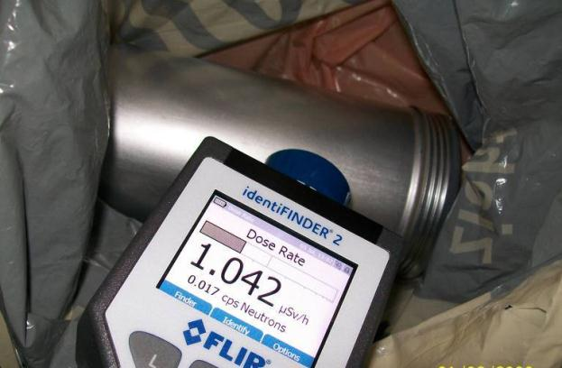
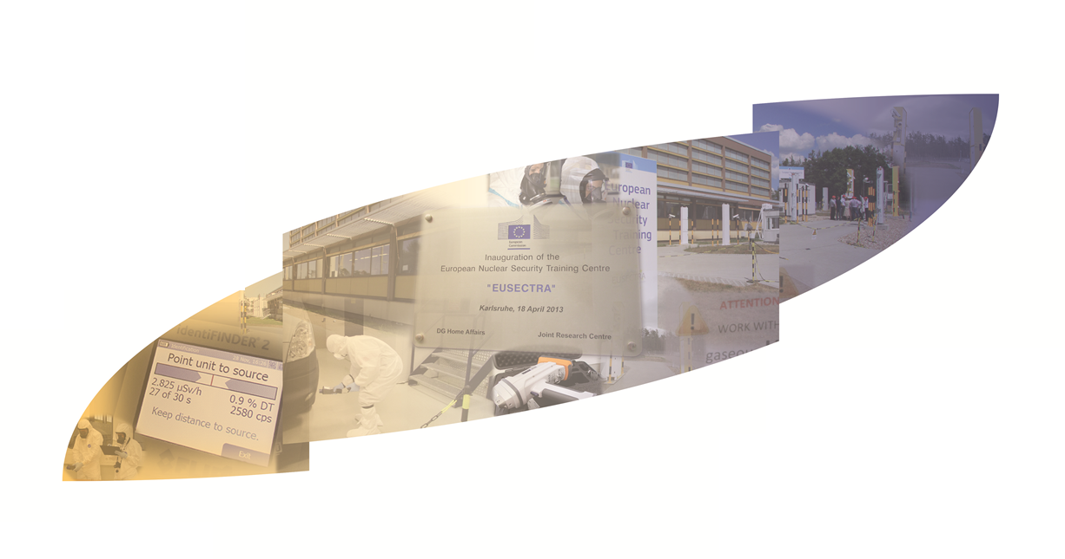



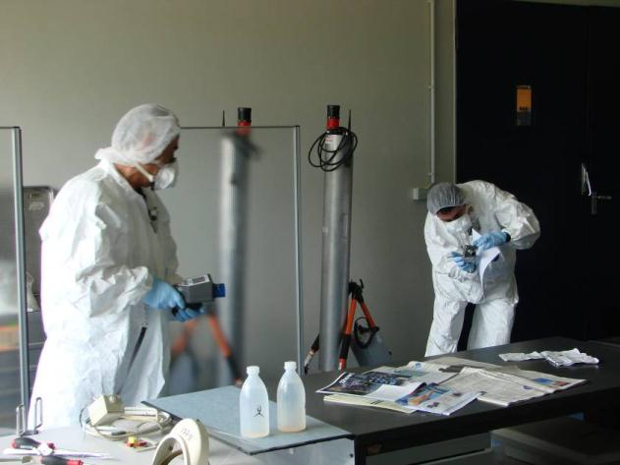

The Border Monitoring Working Group Front Line Officer Training
S. Peper¹, J. Galy², W. Van-Heeswijk³
¹ U.S. Department of Energy, Pacific Northwest National Laboratory, Richland, Washington, USA
² European Commission, Joint Research Centre, Directorate Nuclear Safety and Security, Karlsruhe, Germany
³ European Commission, Directorate-General Taxation and Customs Union

Slide 3
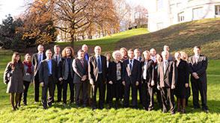

The Border Monitoring Working Group (BMWG)
The BMWG was created in 2005 by three major donor organizations: the International Atomic Energy Agency (IAEA), the European Commission represented by the Joint Research Centre (JRC) and the United States represented by the Department of Energy Nuclear Smuggling Detection and Deterrence (NSDD).
These three organizations as well as European External Action Service (EEAS) are the principal members of the BMWG. In addition, there are regular participants from the Directorate-General for International Cooperation and Development (DG DEVCO) and Directorate-General for Taxation and Customs Union (DG TAXUD) of the European Commission, US Department of State Bureau of International Security and Non-proliferation (ISN) as well as US Department of Homeland Security Domestic Nuclear Detection Office (DNDO).

Slide 4
The BMWG as major coordination forum in support to strengthening Nuclear Security
Since its establishment, the BMWG has proven to not only be an effective tool for avoiding duplication and maximizing and targeting resources, but also a forum to address common technical concerns and jointly develop capacity building tools.
Among it is many accomplishments, the BMWG has coordinated joint training, workshops and exercise activities; developed a progressive and modular front line officer curriculum; coordinated assessment and deployment activities; shared advances in technical issues; and promoted fixed and mobile detection while optimizing resources among the group. The BMWG has established itself over ten years as a ready resource for other international assistance organizations and is recognized as a model working group that inspires other, similar coordination initiatives relating to nuclear security.

Slide 5
Training as strategic measure for cascading nuclear security related knowledge to the competent user groups in the Member States
Aim of developing a joint training curriculum under the aegis of BMWG:
improving detection/response capability at border crossing points and elsewhere on the external borders and in interior for Radioactive and Nuclear materials;
increasing knowledge, skills, and expertise of the front line officers operating RN detection equipment, and for expert on dedicated techniques or procedures;
facilitating that best practices are identified and absorbed by the participants in all areas of nuclear security from detection to forensics;
maintaining competency, providing national trainers;
common but modular and tailorable curriculum deployed by international partners.

Slide 6
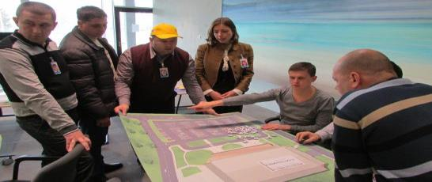
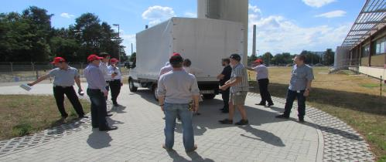
Training methodology and implementation
Curriculum developed by the Border Monitoring Working Group
Using the Systematic Approach to Training (SAT) methodology
Tailored to participants
Performance based
Logical order of lesson, demonstration and exercises
Flexible
Active contribution of the trainees
5 days

Slide 7
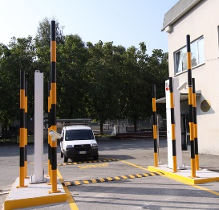
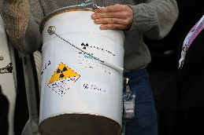
BMWG FLO training major milestones
Pilot of FLO and implementation in different international programme of partners
Course V2 piloted @EUSECTRA, then in 2016 in Slovakia @national training centre
2005
2014
2020
2009...
2015
Revision and implementation of course with new teaching methods and approaches
BMWG creation and decision of common training material
Major revision of curriculum involving additional members (e.g. WCO, DG TAXUD, US agencies…)

Slide 8
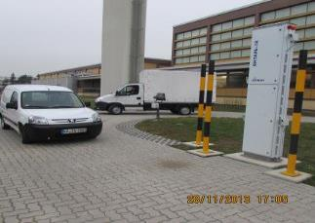
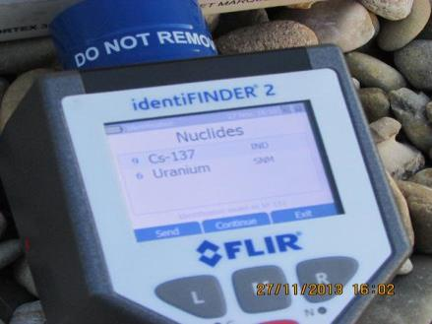
BMWG Developed Modular FLO Curriculum: main review (2014-15)
Modular Front Line Officer (FLO) curriculum designed for better alignment with officer’s job tasks associated with operating the radiation detection measures.
  Responsibilities determined by legal/regulatory framework and typically added to existing job duties
  EC-DG-TAXUD and WCO part of BMWG development team
Training materials kept in BMWG library
  PowerPoint slides, exercise scenarios, case studies, e-learning modules, and job aids
BMWG FLO curriculum used routinely at EUSECTRA and by IAEA for in-country missions

Slide 9
Course Objectives (refined and modular)
 | What is the FLO looking for and why? | How do they find what they are looking for? | How do they confirm what they find? | What do they do if they find something? | How do they support any follow up?
Objectives | Introduction to radiation and radioactive materials Overview of operational situations where radiation is encountered Description of nuclear security threats and risks | Overview of approaches for detection: Information alert Awareness of suspicious indicators Detection technologies Primary detection | Alarm/alert assessment procedures Secondary inspection techniques | Response to real alarms: Safety Isolation, containment Notification Documentation and data collection | Connection of FLO to a larger context (nationally and internationally): National response Investigations and nuclear forensics Additional support for FLO: Technical support/ reachback
Notes:
Rev. 3
Once we had established the key purpose of training FLO and the high level goals for the course, we identified 5 key objectives, and their subcomponents, and sough to develop material that would enhance FLOs awareness and actual expertise in these areas.

Slide 10
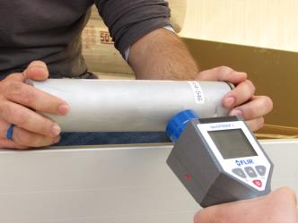
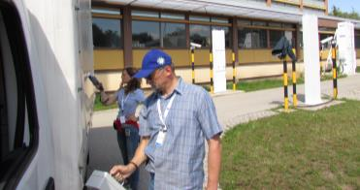
Example of cascading implementation of the BMWG FLO curriculum: DG-TAXUD INITIATIVE: trains EU Customs officers at the EUSECTRA
DG TAXUD and the JRC, together with the European Customs Detection Technology Expert Group have jointly developed an advanced pilot training programme for the EU customs officers on Radiation and Nuclear detection.
Selected customs detection experts of all the EU Member states plus customs experts from Albania, Bosnia and Herzegovina, the Former Yugoslav Republic of Macedonia, Montenegro, Serbia and Turkey were trained over in total five training sessions scheduled between June 2015 and March 2016
Second campaign 2018-2019 with focus on T3

Slide 11

Implementation of the course at select nuclear security support centers
The international organizations such as the European Commission or the US Department of Energy (DoE) support training activities in international Nuclear Security Training Centers
  DOE Volpentest Hazardous Materials Management and Emergency Response (HAMMER) Training Center
  the European Nuclear Security Training Centre (EUSECTRA) operated by the Joint Research Centre of the European Commission.
Benefit from the experience and support of BMWG members to assist Member States in indigenizing such training activities by integrating these elements into their established law enforcement curricula.

Slide 12

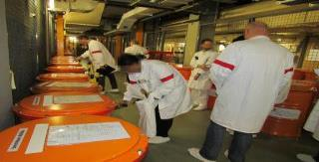
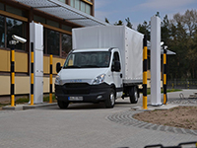

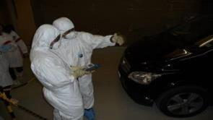
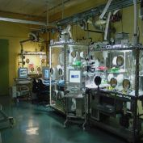
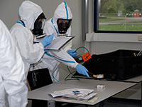
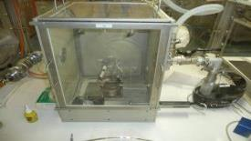
The European Nuclear Security Center (EUSECTRA)
Safeguards (IAEA & Euratom) trainings
Detection for front-line officers
Expert support skill enhancement (response team, measurement experts,
law enforcement, etc.)
Nuclear forensics dedicated trainings and associated classical forensics support

Slide 13
Lessons learned and new approaches
Instructional systematic design (ISD) approach to curriculum development is critical to collaboration efforts, the efficacy of the resulting training and its portability across organizations and training centers.
  Provides framework for subject matter experts to contribute to the technical content of the material
  Helps ensures that stakeholder roles and responsibilities are appropriately incorporated into curriculum
  Promotes the development of progressive techniques, such as “flipped classroom” approach that enhances student engagement.
  Extends the impact when curriculum is implemented in regional centers such as EU Centres of Excellence and IAEA Nuclear Security Support Centres
Instructor qualification is paramount to sustaining training and efforts to share instructor resources across organizations
  Can be difficult to develop common qualification criteria

Slide 14
Outcomes: every end is a new beginning
“Successful fight against nuclear terrorism can only be achieved through coordinated international efforts.”

Slide 15
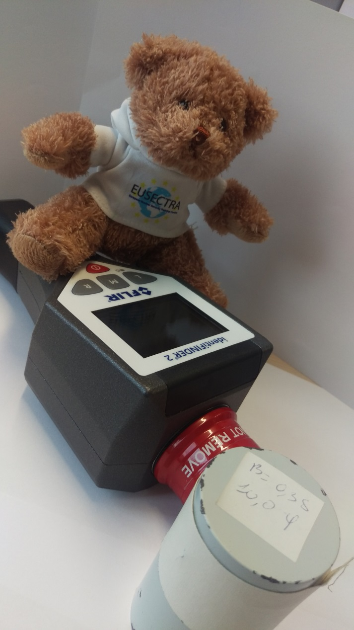
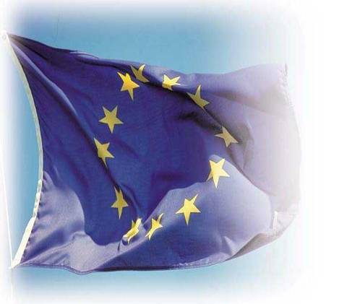
…Thank you for your attention !

