Slide 1
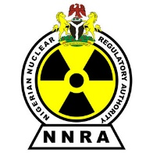
PREPARING FOR A NUCLEAR TERRORIST ATTACK
BY CREATING A UNIFIED RESPONSE THROUGH
NATIONAL NUCLEAR RESPONSE FRAMEWORKS
ABDULMAJEED IBRAHIM &
Dr. ISA SAMBO
Nigerian Nuclear Regulatory Authority
Abuja, Nigeria

Slide 2
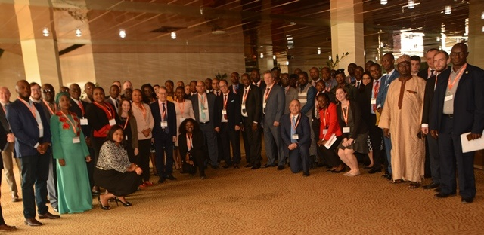
Overview of the GICNT
Valiant Eagle Workshop Outcomes
Interagency Coordination
Public Communication
International Coordination
Workshop Outcomes
Introduction

Slide 3
Global Initiative to Combat Nuclear Terrorism (GICNT)
Co-Chairs
Origin: Established in 2006
Mission: To strengthen global capacity to prevent, detect, and respond to nuclear terrorism by conducting multilateral activities that strengthen the plans, policies, procedures, and interoperability of partner nations
Membership: 89 nations and 6 observers (IAEA, EU, INTERPOL, UNODC, UNOCT, UNICRI)
Russian Federation
United States
IAG
Coordinator
Special
Advisors
Implementation and Assessment Group
Morocco
Finland
Netherlands
NDWG
NFWG
RMWG
Nuclear Detection Working Group
United Kingdom
Nuclear Forensics Working Group
Canada
Response & Mitigation
Working Group
Argentina
Notes:
The GICNT was established in 2006 and is co-chaired by the Russian Federation and the United States.
Its missions is to strengthen global capacity to prevent, detect, and respond to nuclear terrorism by conducting multilateral activities that strengthen the plans, policies, procedures, and interoperability of partner nations.
The GICNT is made up of 88 partner nations and 6 international observer organizations including the European Union, the International Atomic Energy Agency, INTERPOL, the United Nations Interregional Crime and Justice Research Institute, the United Nations Office of Counter-Terrorism, and the United Nations Office on Drugs and Crime.
There are three working groups that were established to provide a forum for policymakers, technical experts, and other key stakeholders to interact, collaborate, and help promote key nuclear detection, forensics, and response capabilities.
Finland, as the current Implementation and Assessment Group (IAG) Coordinator for 2017-2019, is charged with implementing GICNT priorities and ensuring GICNT activities are coordinated and complementary to other international efforts.
The Netherlands and Morocco currently serve as special advisors to the IAG Coordinator.
The United Kingdom chairs the Nuclear Detection Working Group,
Canada the Nuclear Forensics Working Group,
and the Response and Mitigation Working Group is chaired by Argentina.

Slide 4
Valiant Eagle Workshop
Host: Nigeria and the UNOCT
Date: 9-11 April 2019
Objective: Analyze approaches for adapting existing regional agreements on counterterrorism and disaster response plans to National Nuclear Security Frameworks (NNRFs).
Format: Workshop with Tabletop Exercise

Slide 5
Valiant Eagle Workshop Outcomes
Interagency Coordination
Public
International Coordination
A key nuclear terrorism response preparation component is a NNRF, which details the policies, procedures, capabilities, and priorities for responding to a nuclear or radiological terrorist attack.
Defining the roles and responsibilities as well as coordination mechanisms among national and international bodies will help ensure the framework creates a unified response.
In turn, a unified response will help streamline the response and avoid confusion in the field.
Communication
FIG 1. NNRF Critical Coordination Factors

Slide 6
Interagency Coordination
NNRFs should outline a multi-faceted command and control structure that details agencies’ roles and responsibilities as well as chain-of-command.
Frameworks should clearly define interagency coordination by stating the roles and responsibilities of each agency. Each responsibility should have an assigned lead agency as well as supporting agencies.
NNRFs should also clearly identify the communication requirements and mechanisms among agencies.

Slide 7
Public Communication
Public communication strategies within NNRFs should be comprehensive and define what is being communicated, why it is being communicated, and who is responsible for communicating it to the public.
A key first step is identifying messaging priorities. Then agencies can collaborate to create pre-approved scripted messages, which will aide in quickly disseminating information during an incident and ensure all agencies are releasing the same information.
A unified, pre-approved public messaging strategy will decrease the chances of conflicting information and increase clarity. A best practice to ensure a unified public messaging is by identifying a singular communication authority to disseminate all public information after an attack.
Without effective, consistent public communication authorities cannot achieve their emergency response objective to save human lives and protect the public and the environment.

Slide 8
International Coordination
NNRFs should identify a responsible agency to coordinate with international and regional partners
NNRFs should reference international laws and requirements countries are beholden to.
Regional exercises can assist nations in defining regional coordination mechanisms included in their NNRFs
FIG. 3 Participants sharing response coordination mechanisms at Valiant Eagle

Slide 9
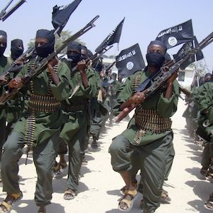
Workshop Outcomes
The workshop produced the following key findings and best practices:
Nations should adapt existing response and incident management plans for incidents involving nuclear terrorism
National frameworks for nuclear security should include concepts of operation for multi-agency coordination, lead authority, and R/N technical support and advice to senior leadership.
Relevant agencies should have their own established protocols and procedures.
First responders should have awareness of basic R/N response procedures outside their standard operating procedures, including those related to the preservation of evidence.

Slide 10
Thank you
Questions?
ABDULMAJEED IBRAHIM & Dr. Isa Sambo
Nigerian Nuclear Regulatory Authority
Abuja, Nigeria
Notes:
I thank you for your time.
I am happy to take questions now or to during the breaks.

