Slide 1
U.S. CYBER SECURITY EXPERIENCES
Jim Beardsley, Chief
Cyber Security Branch (CSB)
Division of Physical and Cyber Security Policy (DPCP)
Office of Nuclear Security and Incident Response (NSIR)
james.beardsley@nrc.gov

Slide 2
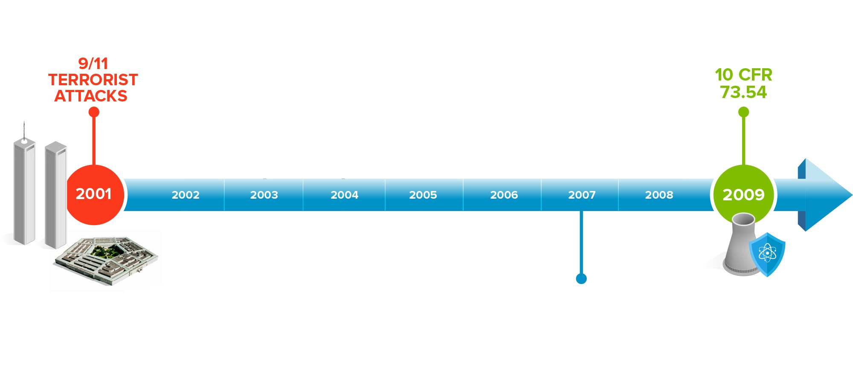
US NRC Cyber Security Regulation Development
Development of the Cyber Rule 10 CFR73.54 for NPPs
Industry’s Voluntary Implementation of an Interim Cyber Security Program
NRC Conducts Assessment Visits
NRC Issues various Orders & Guidance Documents for NPPs and Fuel Cycle Facilities to address the Physical & Cyber Threat
Updated DBT
10 CFR 73.1
(Applicable to NPPs and Fuel Cycle Facilities)
DBT Update
Public Law 109-58 Energy Policy Act 2005

Slide 3
US NRC Cyber Security Program Implementation
RG 5.71 & NEI 08-09 Implementation Guidance Acceptable for Use
Licensee Interim Implementation Completed
NRC Cyber Security Notification Rule
10 CFR 73.77
Full
Implementation
NRC & Industry agree on MS 1 – 7 Implementation Schedule
Industry’s Interim Implementation Schedule
MS 1 – 7 Inspections
2009
2017
Cyber Security Implementation Inspections
2010
2011
2012
2013
2014
2015
2016
All NPPs Cyber Security Plans & Implementation Schedules Approved
NRC & Industry collaborative work on implementation guidance:
Security Frequently Asked Questions (SFAQs)
NEI 13-10 Assessment of Security Controls
NRC Participates in Industry Workshops & Tabletops to assess inspection procedure
Development of Additional Guidance for Implementation Schedules

Slide 4
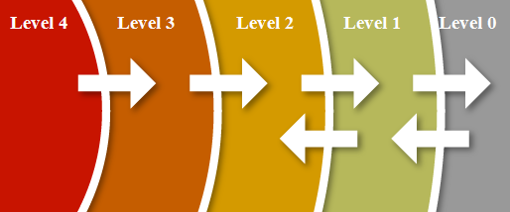
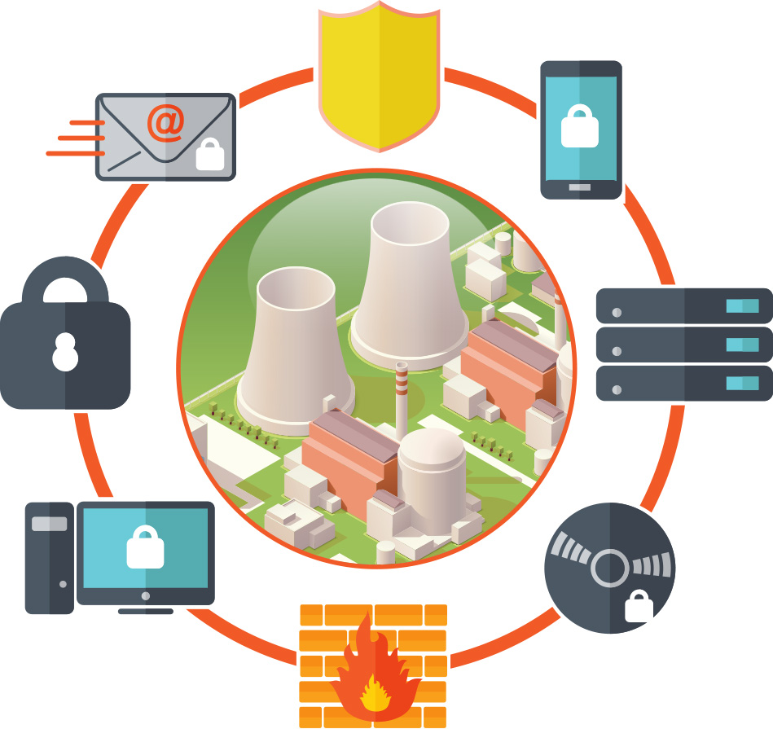
Generic Defensive Architecture
Security / Safety Systems
Site
Network
Corporate
Network
Internet
One-way Deterministic Device

Slide 5
Future of US NRC Cyber Security Program
Licensee Interim Implementation Completed
RG 5.71 & NEI 08-09 Implementation Guidance Acceptable for Use
NRC Cyber Security Notification Rule
10 CFR 73.77
Full
Implementation
NRC & Industry agree on MS 1 – 7 Implementation Schedule
Industry’s Interim Implementation Schedule
MS 1 – 7 Inspections
Full Implementation Inspections at all Licensee Sites
2009
2017
Future
Inspection Program
2010
2011
2012
2013
2014
2015
2016
2018
2019
2020
All NPPs Cyber Security Plans & Implementation Schedules Approved
NRC & Industry collaborative work on implementation guidance:
Security Frequently Asked Questions (SFAQs)
NEI 13-10 Assessment of Security Controls
NRC Participates in Industry Workshops & Tabletops to assess inspection procedure
Development of Additional Guidance for Implementation Schedules
Power Reactor
Cyber Security
Self-Assessment

Slide 6
Future Cyber Security Effort
Review criteria for digital asset analysis and protection
Emergency Preparedness, Balance-of-Plant, Security, Safety-Related and Important-to-Safety
Identify best practices for digital asset assessment
Evaluate the control set applied to protect digital assets
Future inspection program
Incorporate performance licensee metrics into inspection process
Evaluate performance testing as a element in the inspection/oversight program

Slide 7
Questions

