Slide 1
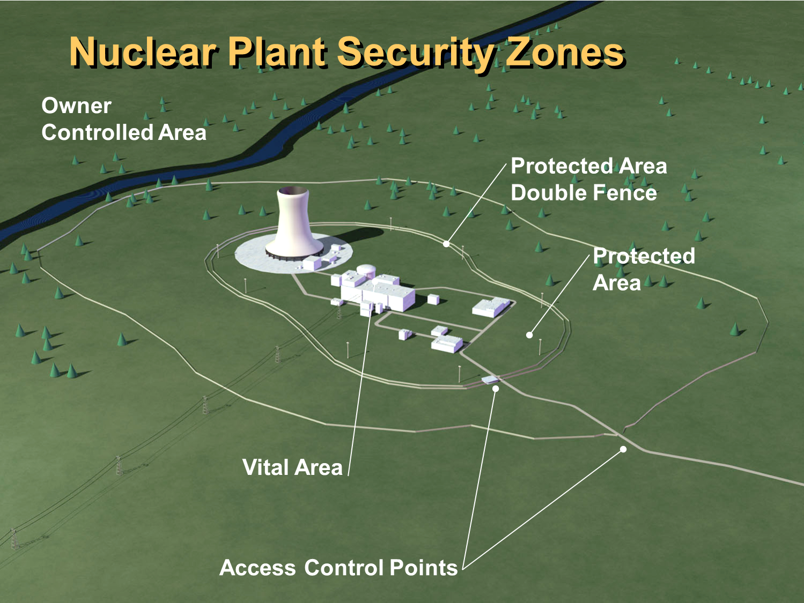
Wesley Held, Security Risk Analyst
Risk-Informing Security at the U.S. NRC
Risk informing security at the U.S. NRC involves the application of risk insights
to three main areas:
threat information, evaluation of program effectiveness,
and potential consequences.
What It Is
What It Isn’t
Focus on Realism – Applying the concept of “reasonable assurance of adequate protection” in the security framework and using current, relevant data to inform licensee oversight
Reliance on Qualitative or Semi-Quantitative Analyses for Physical Security – Quantitative data may not be readily available or feasible to produce for physical security events
Dependence on “PRA-like” Analyses for Physical Security - Most physical and cyber security events are not random events, hence quantifying risk poses a challenge
Mechanism to Change the Design Basis Threat (DBT) - The current DBT must be included in any risk-informing activity. A separate process exists to evaluate the need to modify the DBT
Current Activities
Force-on-Force Program Evaluation: Numerous areas of the force-on-force program at the NRC have been evaluated to include risk information. This includes a heightened focus on realism, including the binning of adversary tactics based on difficulty and using current intelligence reporting, and a scoring system for exercise scenarios.
Baseline Physical Security Program Update: The baseline physical security inspection program and corresponding guidance were revised to focus resources on risk-significant areas.
Crediting Additional Resources: The staff is currently evaluating a number of additional resources that licensees can credit in their physical protection programs. These include: support from local law enforcement; the use of FLEX (Diverse and Flexible Mitigation Capability) equipment to aid in mitigation and recovery activities; allowing for additional operator actions as target set elements, and the recall of off-duty security personnel.
Rulemakings: The NRC is promoting risk-informing in the development of multiple rulemakings. A rulemaking addressing decommissioning reactors adjusts the physical security requirements to account for the reduced risk as fuel cools and is removed from the spent fuel pool. A rulemaking on security for advanced reactors is being developed that will account for potential changes in consequences based on reactor designs.
Licensing: The staff is revising its existing processes for reviewing security plan changes to ensure consistency by both licensees and staff. The staff is also reviewing the practices licensees uses as they transition from their physical security plan to their safeguards contingency plan during a contingency event to ensure their processes fully credit the protection provided by each plan (reducing unnecessary overlap).
*The authors gratefully acknowledge the work of all those who contributed to the presented results.*
Poster Ref. Number:

