Slide 1

International Symposium on Transport Security of Nuclear and other Radioactive Material;
Tokyo, Japan, November 2019
ISCN/JAEA: NORO Naoko
DOE/NNSA: Brian Abeyta, Katherine Holt
ORNL: David Duhamel
Integrated Support Center for Nuclear Nonproliferation and Nuclear Security
Japan Atomic Energy Agency
IAEA International Nuclear Security Conference
February 10-14, 2020
Vienna, Austria

Slide 2
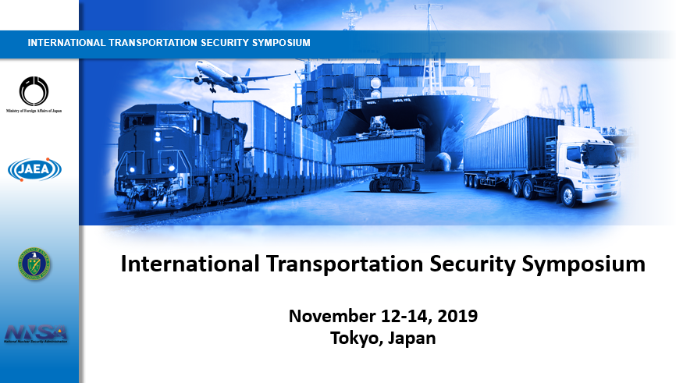
ITSS: International Transportation Security Symposium

Slide 3
ITSS: International Transportation Security Symposium
Organizers: Ministry of Foreign Affairs of Japan, in cooperation with Japan Atomic Energy Agency (JAEA), supported by U.S. Department of Energy, National Nuclear Security Administration (DOE/NNSA)
Dates: November 12-14, 2019
Venue: Tokyo, Japan
Participants: 104 from 38 countries and international organizations

Slide 4
Nuclear Security Summit
Gift basket for transportation security
Japan led the international effort on the development of “Good Practices Guides” for air, rail, road and sea transport modes
INFCIRC/909: Joint Statement
Japan sponsored the IAEA Information Circular 909 (INFCIRC/909), Joint Statement on Transport of Nuclear Materials
commitment to further exchange national practices on the transport security of nuclear and radioactive materials and actively support the IAEA, Global Initiative to Combat Nuclear Terrorism (GICNT), and the Global Partnership Against the Spread of Weapons and Materials of Mass Destruction (GP) in advancing nuclear transport security obligations

Slide 5
ITSS: Objectives
to examine threats to the secure transportation of nuclear and radiological materials
engage the international community to seek solutions to counter the threats
strengthen the security regimes for these materials in transport
provide a forum for partner countries to discuss their good practices and exchange knowledge to improve existing regimes
to showcase INFCIRC/909, identify areas where INFCIRC/909 subscribers should be focusing their efforts, and to encourage further subscribers
4

Slide 6
Key Themes
Transport security, why is it important to the international community?
Building an international solution to transport security
Threat issues that impact a transport security regime
Engaging industry and other non-state stakeholders in transport security
International and regional cooperation in capacity building and assistance
5

Slide 7
1. Transport Security: Why is it important?
Panel: IAEA, International Nuclear Services (UK), International Maritime Organization (IMO), SOGIN (Italy)
Transport security: inevitable for nuclear fuel cycle, research and medical procedures, etc.
Unique challenges: operating in the public domain, reliance on technology and the growing cyber threat, risks in the supply chain, delay and denial of shipments, intermodal changes, armed robbery, and piracy
Information security vulnerabilities
Key Takeaway: Transport can be one of the most attractive areas of the nuclear fuel cycle to adversaries due to its unique challenges.
6

Slide 8
2. Building an international solution to transport security
Speakers: Canada, Romania
Key roles of international organizations to build capacities with countries
Importance of regulatory frameworks that include all of the stakeholders
Defense-in-depth concept: multiple different measures
Subscription to INFCIRC/909
Key Takeaway: Threats are constantly evolving. Regulators needs to ensure that operators implement proper security for shipments to include producing and adhering to robust transport security plans
7

Slide 9
3. Threat issues that impact a transport security regime
Panel:
Regulators and industry must establish an appropriate base level of security – no uniform type of security
A major evolving threat to transport security is cyberattacks
Delay and denial of shipments
Security culture
Key Takeaway: A successful transport regime must balance economic realities with the security requirements of the material and the threats posed
8

Slide 10
4. Engaging Industry and Other Non-state Stakeholders
Panel: INS (UK), ISSPA, WNA, IMO, US
Graded approach to security as an important factor
Create a strong relationship between regulator and industry - communication in both directions
Harmonization in security regulations across borders
Regulatory frameworks allowing for innovation
Appropriate DBT
Balance with economic realities
Key Takeaway: communication bet. Regulator and industry, economics as a major driver of providing secure transportation, appropriate balance should be maintained
9

Slide 11
5. International and Regional cooperation in Capacity Building
Panel: IAEA, MESIS (Jordan), Argentina, ISCN/JAEA (Japan)
International/regional experience in capacity building cooperation
Information, good practice sharing
Need a network of resources
Effective evaluation of capacity building support program
Key Takeaway: Sharing good practices and tailoring efforts to specific groups and audiences can greatly improve the global capabilities in this area
10

Slide 12
Unique Features of ITSS
Scenario-based Exercises
A hypothetical video scenario
  Video presentation followed by online survey
  Demonstrate multiple failures of security culture and problems can arise from an inadequate regulatory environment
  Clear roles and responsibilities of all stakeholders
  Procedure for information sharing
  Threat assessment, trustworthiness determination
  Information security
11

Slide 13
Unique Features of ITSS
Scenario-based Exercises
Breakout session for focused discussion
  Laws and regulatory framework
    Effective coordination among competent authorities
    Implementation guidance for operators
    Challenge in sharing threat information
    A national CBRN response plan facilitate the different stakeholders to communicate and prepare response
12

Slide 14
Unique Features of ITSS
Scenario-based Exercises
Breakout session for focused discussion
  Physical protection systems and response
    Defence-in-depth with performance verification and effective inspection
    Coordination with law enforcement
    Training and exercise
  Insider threats
    Trustworthiness determination program
    Mitigating strategies: behavior observation
    Safe and secure communication on shipments
    Sharing information with law enforcement
13

Slide 15
Conclusion and Next Step
Shared commitment to continue the conversation on transport security
Encourage subscription to INFCIRC/909 – identify the benefits of INFCIRC/909
Importance of raising awareness through existing international frameworks (i.e., ICONS)
IAEA Technical Meeting on transport security
NSSC Network
14

