Slide 1


Sustainable the Border Monitoring Activities in Thailand Program
Kalaya Changkrueng*, Saowaluck Thong-in, Paphon Phaukkachane, Ladapa Srijittawa, Areerak Rueanngoen, Harinate Mungpayaban,
Arug Wititteeranon
Office of Atoms for Peace
Ministry of Higher Education Science Research and Innovation, Thailand
kalaya.c@oap.go.th

Slide 2




CBRN CoE Project-28: Supporting Development of an Integrated National Security System for Nuclear and Radioactive Materials
In 2006, JRC integration with US, IAEA and EU at the Border Monitoring Working Group:
to share information in border monitoring activities
to coordinate international support programs
Training and Workshop
Equipment deployment
Train-the-Trainer
1
2
3
4
5
6
7
8
9
10

Slide 3
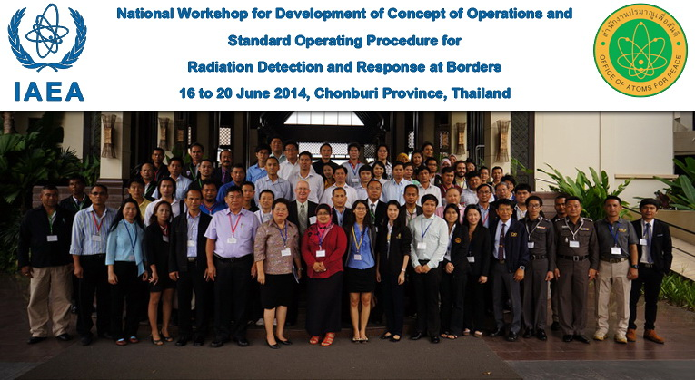
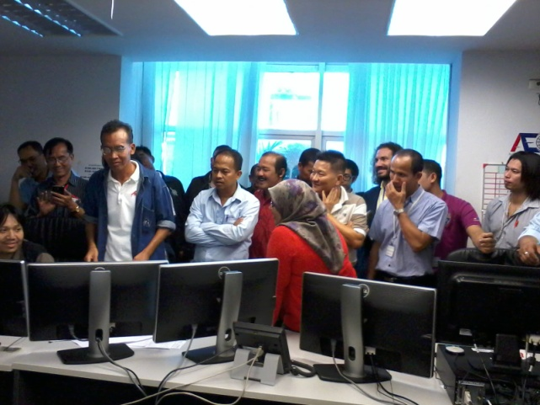
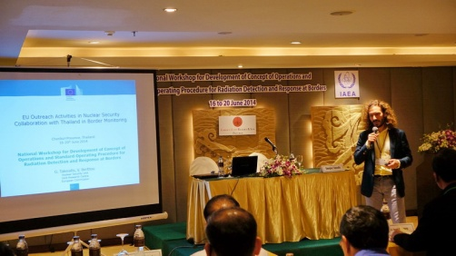
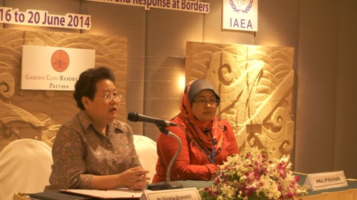
National Workshop for Development of Concept of Operations and Standard Operating Procedure for Radiation Detection and Response at Borders
16 – 20 June 2014
1
2
3
4
5
6
7
8
9
10

Slide 4
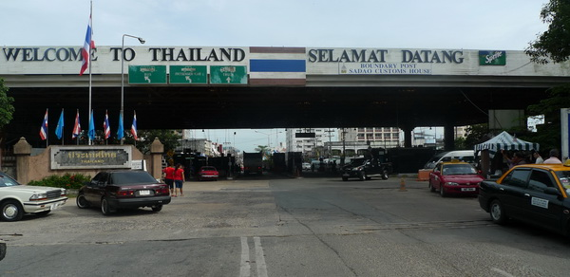
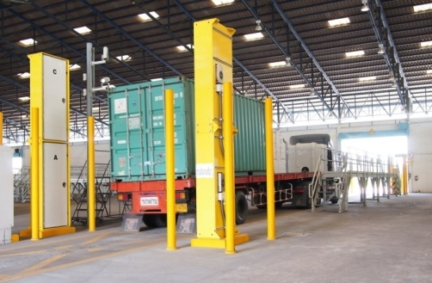
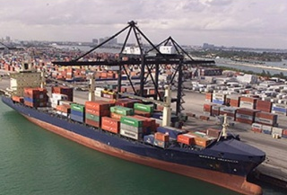
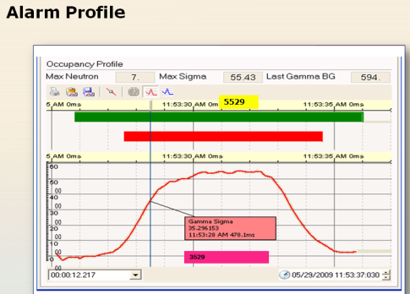
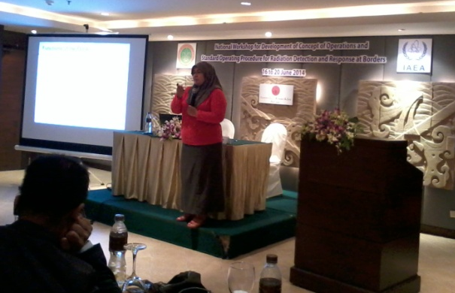
National Workshop for Development of Concept of Operations and Standard Operating Procedure for Radiation Detection and Response at Borders
16 – 20 June 2014
Radiation Detection and Response at Borders
CONOPs and SOP
Radiation Equipments
National Response Plan
Tabletop Exercise
Nuclear Security
1
2
3
4
5
6
7
8
9
10

Slide 5
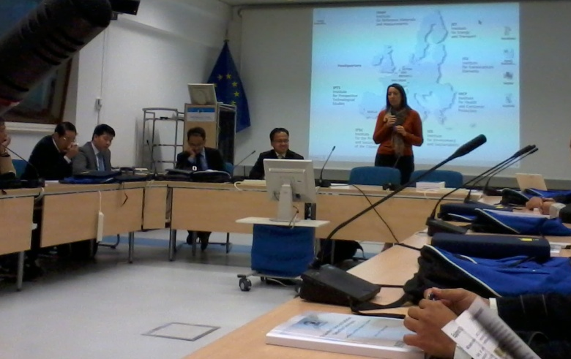
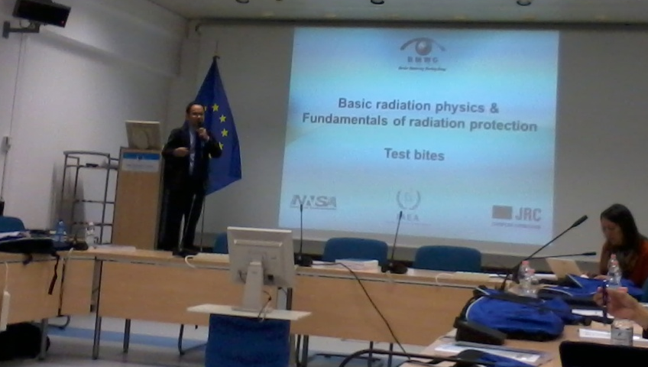
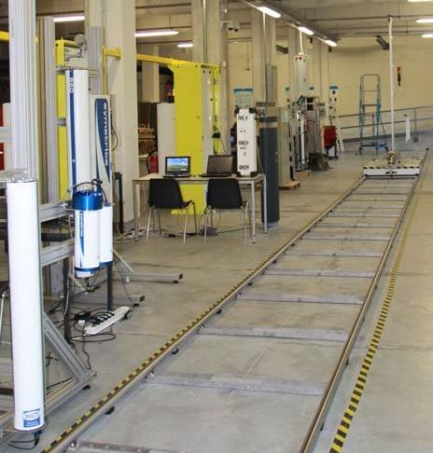
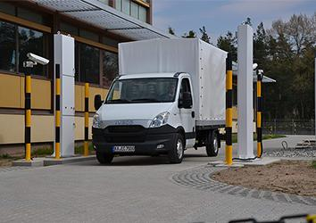
Train-the-Trainer on Radiation Detection Techniques at JRC-Ispra, Italy
1
2
3
4
5
6
7
8
9
10

Slide 6
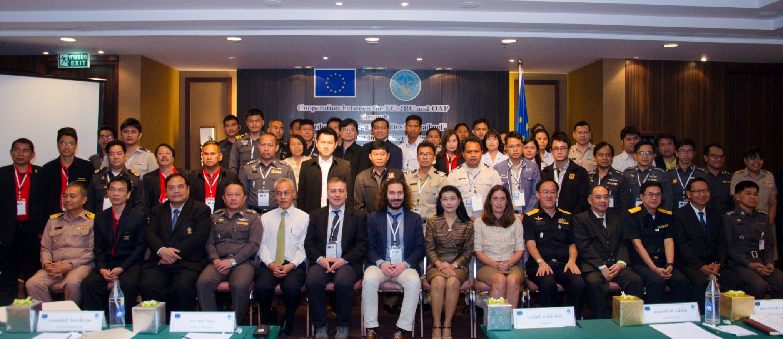
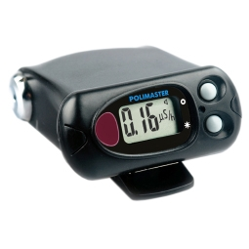
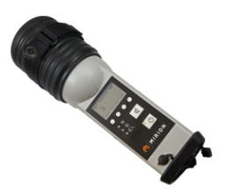
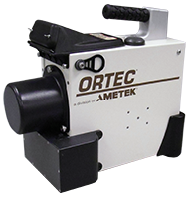
Cooperation between the EC-JRC and OAP through “Border Monitoring Activities in Thailand”
14 - 18 March 2016 Bangkok, Thailand
PRD = 130
Personal
Radiation
Detector
RID = 14
Radiation
Identification
Detector
HPGe = 2
(ORTEC)
1
2
3
4
5
6
7
8
9
10

Slide 7
Cooperation between the EC-JRC and OAP through “Border Monitoring Activities in Thailand”
14 - 18 March 2016 Bangkok, Thailand
Organization | PRD | RID | HPGe
Thai Customs Department | 23 | 6 | 0
Immigration Bureau | 23 | 0 | 0
Office of Police Forensic Science | 24 | 0 | 0
Port Authority (Bangkok port) | 4 | 1 | 0
Thailand Post | 21 | 2 | 0
Airports of Thailand | 20 | 3 | 0
Civil Aviation | 8 | 0 | 0
U-Tapao Airport | 2 | 0 | 0
Chulalongkorn University | 3 | 1 | 1
OAP | 2 | 1 | 1
Total | 130 | 14 | 2
1
2
3
4
5
6
7
8
9
10

Slide 8
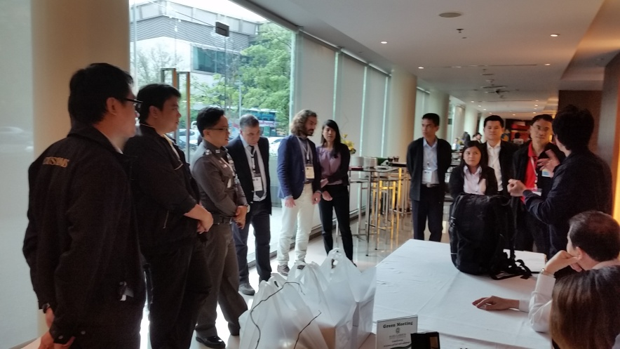
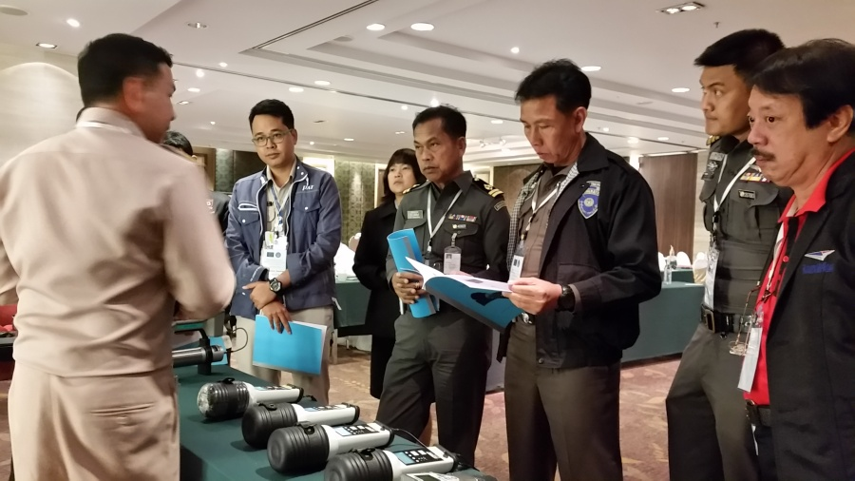
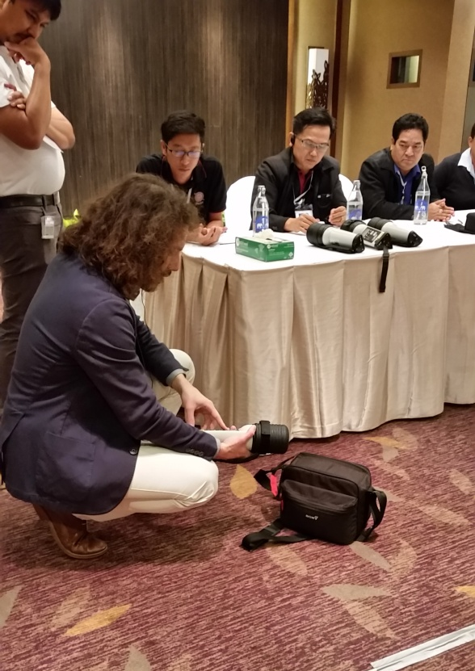
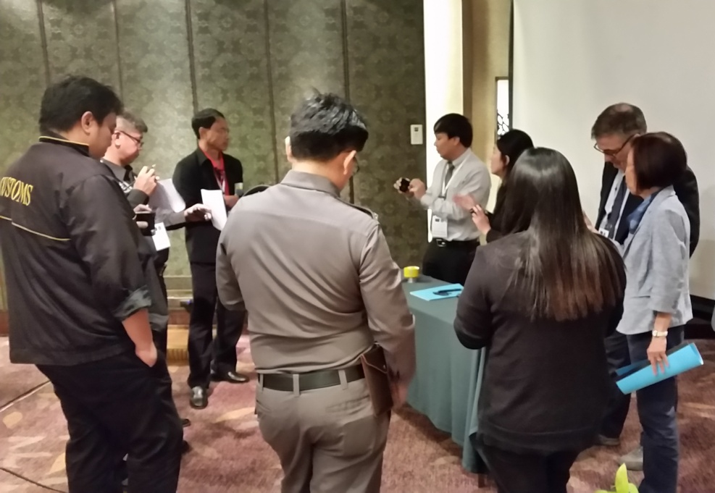
1
2
3
4
5
6
7
8
9
10

Slide 9



Sustainability and challenge
Routine and emergency preparedness and response
Feedback: user interface, weather condition, etc.
Maintenance and consult program
Develop Standard Operation Procedure (SOP)
Emergency
1
2
3
4
5
6
7
8
9
10

Slide 10

Nuclear and radiological accident / nuclear terrorism
The first responder notify local police and OAP
STANDARD OPERATING PROCEDURE OF NUCLEAR FORENSICS
Radiological Emergency Preparedness and Response Plan (OAP)
No
Illegal
Court of law
Yes
Prosecutor
IO approach to the crime scene
IO complete the inquiry from evidence collection for a case report
Department of Disaster Prevention and Mitigation
Yes
Extension of the event
No
Physical and documentary evidence
(OPFS/ CIFS)
RM / NM and Contaminated evidence (OAP)
Public disaster
No
OAP survey the radiation for risk assessment and control the situation
Yes
IO submit the evidence to the designated forensic laboratories
National Disaster Prevention and Mitigation Plan
OAP apply exposure reduction procedures
OPFS / CIFS collect the evidence
IO release of the crime scene
OAP recheck radionuclide contamination
IO collect the evidence from the forensic expert
1
2
3
4
5
6
7
8
9
10

Slide 11
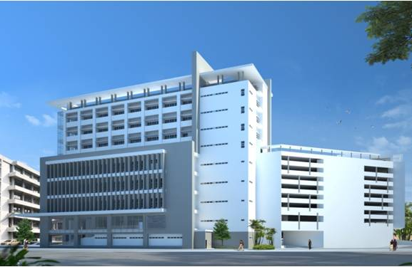
Acknowledgement
Regulation Technical Support Division, Office of Atoms for Peace,
Ministry of Higher Education Science Research and Innovation, Thailand
Mr. Arug Wititteeranon
Ms. Harinate Mungpayaban
Mrs. Areerak Rueanngoen
Mrs. Ladapa Srijittawa
Mr. Paphon Phaukkachane
Ms. Soawaluck Thong-in
Joint Research Centre (JRC) - Ispra, Italy
Joint Research Centre - Institute for Transuranium Elements (JRC-ITU) - Germany
IAEA: Department of Nuclear Safety and Security
US-Department of Energy (US-DOE)
1
2
3
4
5
6
7
8
9
10

