Slide 1
FROM THEORY TO PRACTICE ON NUCLEAR SECURITY
(THE EXPERIENCE OF GKTC)
Institute for Nuclear Research
of the National Academy of Sciences of Ukraine, Kyiv

Slide 2
BACKGROUND
George Kuzmycz Training Center for Physical Protection, Control and Accounting of Nuclear Material was officially opened as a department of the Institute for Nuclear Research of the National Academy of Sciences of Ukraine on October 8, 1998.
GKTC was established in compliance with the Directive of the Cabinet of Ministers of Ukraine, with financial and technical support of the US Department of Energy (DOE)

Slide 3
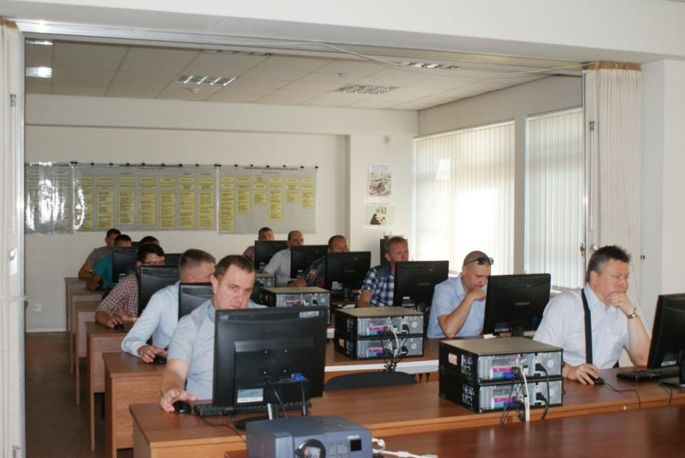
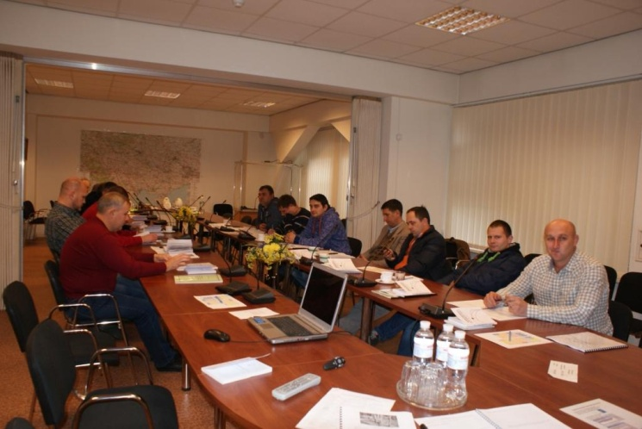
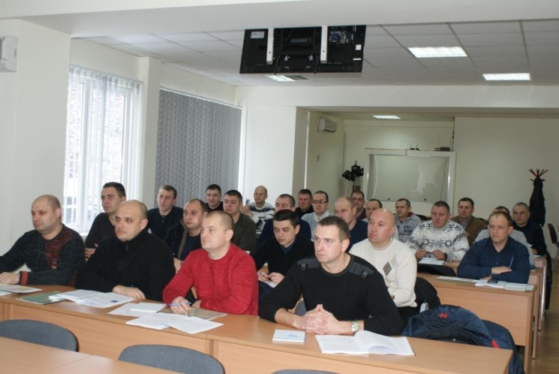
TRAINING ACTIVITIES
GKTC is a part of the Ukrainian State system of training, retraining and advanced training of MPC&A specialists
During the years of operation, GKTC has prepared and delivered near 300 national training courses on nuclear security
More than 4000 Ukrainian specialists of about 90 institutions and organizations of Ukraine have raised the level of their skills at these training courses

Slide 4
TRAINING AUDIENCE
Initially, GKTC pursued the following objectives:
to implement systematic approach to organization of specialists training and qualification upgrading on nuclear security;
to develop training curricula and programs to support and upgrade qualification of specialists on nuclear material physical protection, control and accounting, on nuclear security culture and computer security;
to develop training materials (training course plans, manuals, practical training guides, visual training aids);
to develop draft regulatory and legal acts on PP, MC&A, nuclear security culture;
to provide an advisory support in nuclear material physical protection, control and accounting to organizations and individual experts involved in nuclear security;
to organize working meetings to assess sufficiency and effectiveness of current regulatory documents on nuclear material physical protection, control and accounting, involving representatives of the state regulatory and control agencies, public authorities and experts in physical protection, control and accounting of nuclear material;
to propagate an experience in physical protection of nuclear facilities and nuclear material, and control and accounting of nuclear material towards activities involving protection of other hazardous objects.

Slide 5
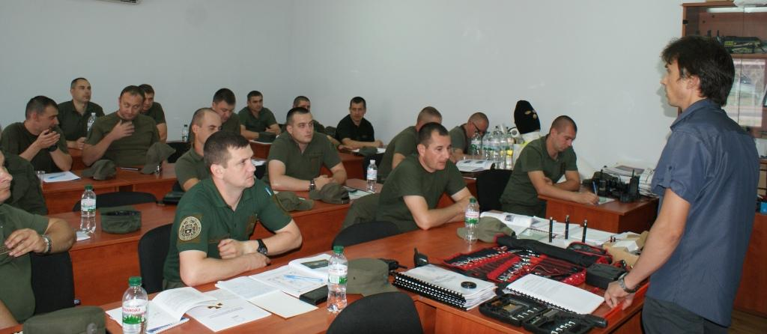
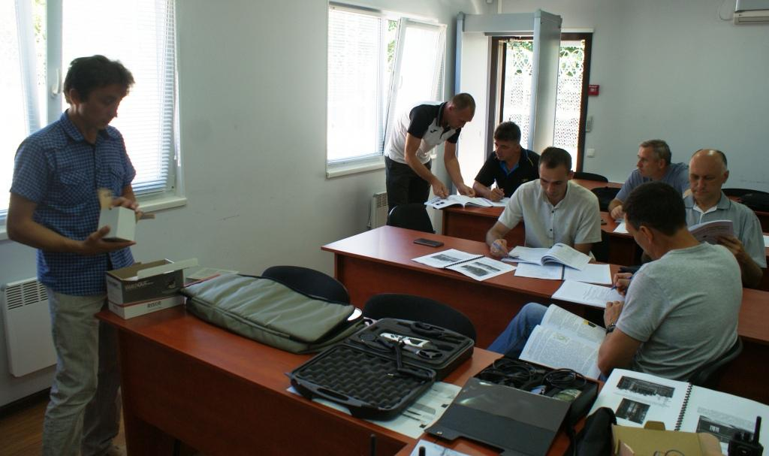
TRAINING AUDIENCE
GKTC develops training materials and conducts training courses for various categories of participants, particularly for:
state inspectors, physical protection specialists of the state control bodies, personnel of guard units, personnel of physical protection departments of nuclear facilities, radioactive waste handling facilities, divisions that perform control and accounting of nuclear materials at nuclear facilities, and specialists of institutions dealing with SIRs

Slide 6
TRAINING ACTIVITIES
Today GKTC has already developed, delivered and revised training courses on
28 topics on physical protection,
6 topics on control and accounting of nuclear material,
5 topics on nuclear security culture
19 topics for personnel of National guard of Ukraine and
4 topics for state inspectors
Now GKTC developed new topics for National police of Ukraine, State Corporation "Ukrainian State Association "Radon" and Anti-terrorist center of Security Service of Ukraine

Slide 7
Topics of the course on physical protection for NF personnel | Duration (hours)
Physical Protection as an Element of the National Security | 24
Legal and Regulatory Basis for Physical Protection | 36
Fundamentals of PP of Nuclear Facilities and Nuclear Materials | 36
Fundamentals of Physical Protection of SIRs and RAW | 36
Introduction to Physical Protection for Pro Forces | 36
Introduction to Physical Protection Systems Design | 36
Analysis and Modeling of Physical Protection Systems | 36
Physical Protection Systems Performance Testing | 36
Vulnerability Assessment Methodology | 36
Physical Protection Procedures | 36
Physical Protection System Guard Unit Functions | 36
Management of Engineering and Technical Means of PP System | 36
Security Transportation | 36
Vital Area Identification | 36
Physical Protection System Management | 72
Ensuring of Continuous Functioning of Effective Physical Protection System | 36
Physical Protection for Instructors on PP from NPP Training Centers | 36
CAS: Destination, its Operators, Functions | 144

Slide 8
Topic of the course on physical protection for personnel of the Guard units of NGU | Duration (hours)
Ukrainian Legislation on Physical Protection and Military Guarding | 24 /40
The Insider Threat | 12/40
Introduction to Physical Protection | 40
Role and Tasks of Guard Unit Within the Physical Protection System of NPP | 80
Guards in Physical Protection System During Transportation of NМ | 40
Physical Protection Procedures | 40
Engineering and Technical Means of Physical Protection System Performance Testing | 40
Operation of Engineering and Technical Means of PPS by the Guard Unit | 40
Theoretical Aspects of Computer Security | 40
Psychological Aspects of Performance of Duty by Guard Unit Personnel | 40
Response to and Mitigation of Radiation Incidents | 40

Slide 9
Topic of the course on nuclear security culture (NSC) | Duration (hours)
NSC for mid-level managers of departments of physical protection, control and accounting of nuclear materials | 24
NSC for high-level manager on physical protection, control and accounting of nuclear materials | 20
NSC for pro-force units’ officers | 12/24
NSC for NSC’ coordinators at nuclear facilities | 36
NSC for responsible persons for NSC at nuclear facility's departments | 15

Slide 10
Topic of the course on control and accounting of nuclear materials | Duration (hours)
Fundamentals of control and accounting of nuclear materials | 36
Legislation of Ukraine on control and accounting of NM | 20
State system of control and accounting of nuclear materials. Site system of control and accounting of NM | 36
Computerization of system of control and accounting of NM | 36
Methods of detection of nuclear and radioactive materials. Nondestructive analysis of nuclear materials: gamma- spectrometric and neutron | 36
Methodology of physical inventory conducting | 36
Means of access control to NM. Means of intrusion detection | 36

Slide 11
Topic of the course on physical protection for Radon | Duration (hours)
Transportation Security | 40
Fundamentals to Physical Protection | 40
Nuclear Security Culture | 24
Topic of the course on physical protection for National Police
Introduction to physical protection | 36
Role in Anti-Sabotage Cooperation Plan | 36
Means of access control to NM. Means of intrusion detection | 36
Topic of the course on physical protection for ATC SBU
Introduction to Physical Protection | 24
Vulnerability Assessment | 36
Transportation Security | 32

Slide 12
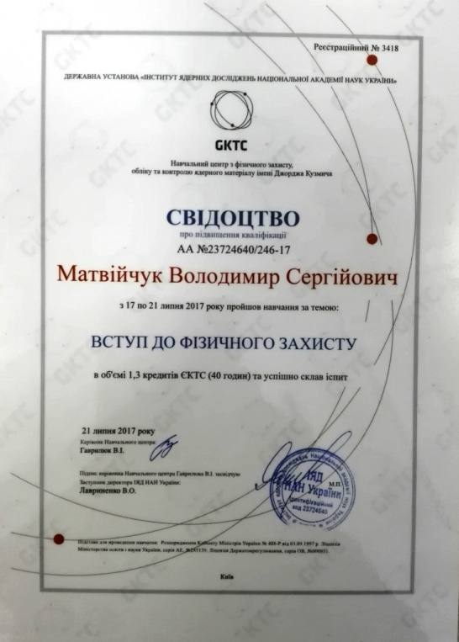
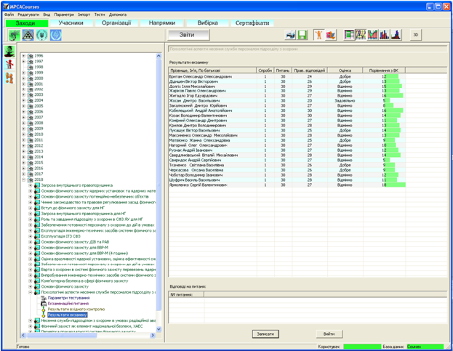
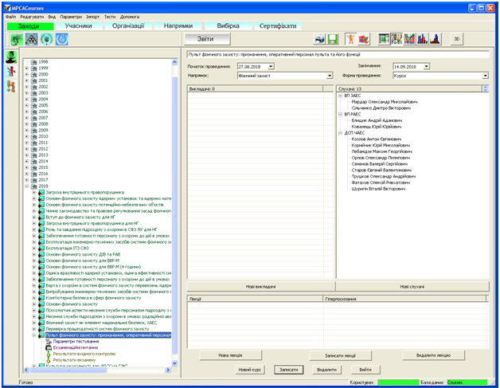
TRAINING ACTIVITIES
Duration of training courses is from 12 to 144 hours.
All students before and after training pass a computer testing. Results of testing and other information on students are kept in the GKTC database.
After the training and successful final testing students receive Certificates on advanced training.

Slide 13
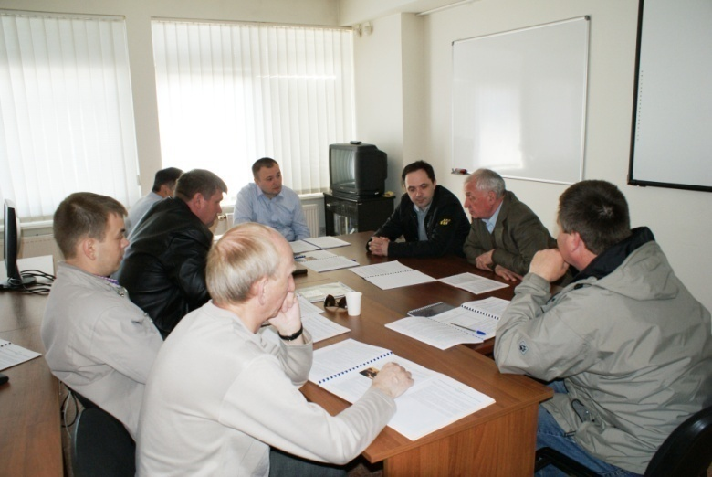
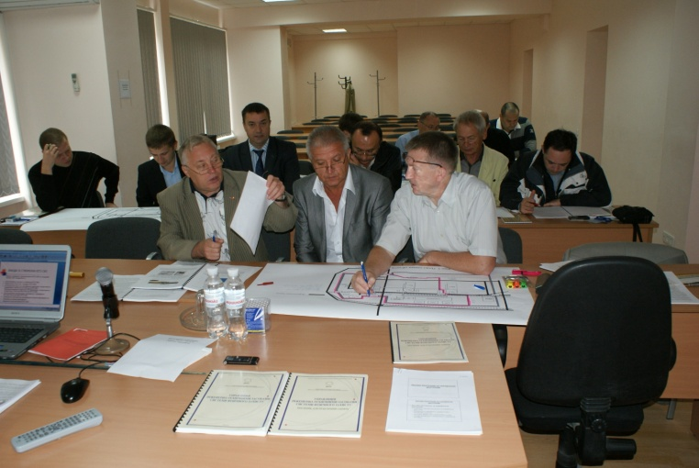
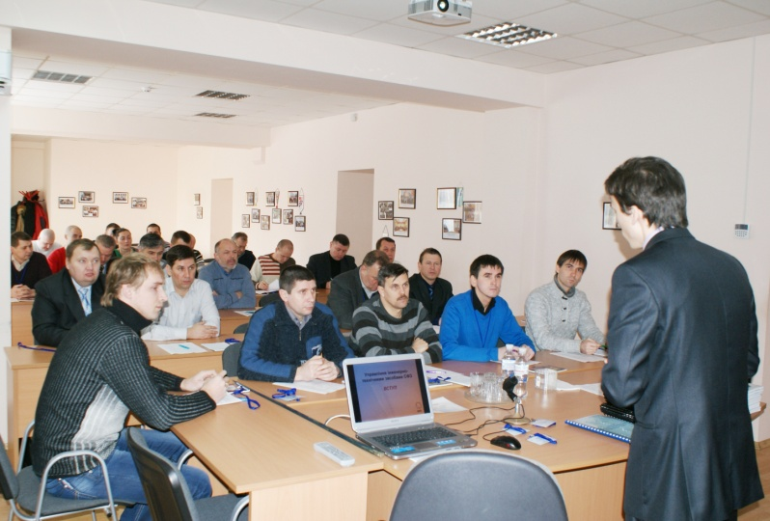
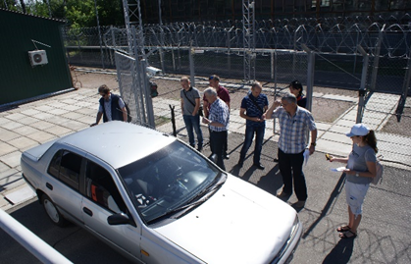
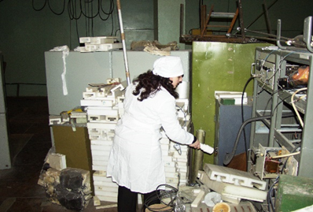
TRAINING COURSES
Advanced training of PP specialists includes not only theoretical training but also developing of the practical skills. Program of each training course provides from 30 % to 70 % of total training time for practical and laboratory exercises

Slide 14
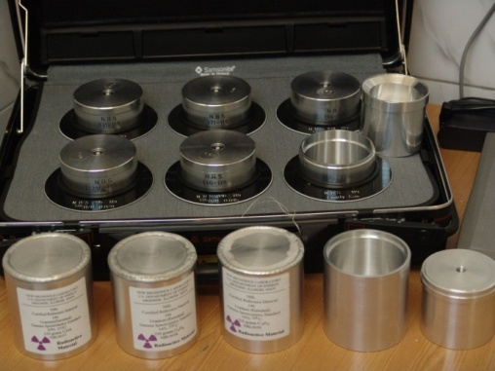
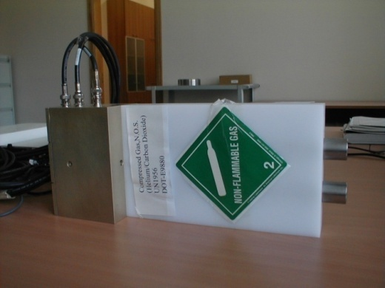
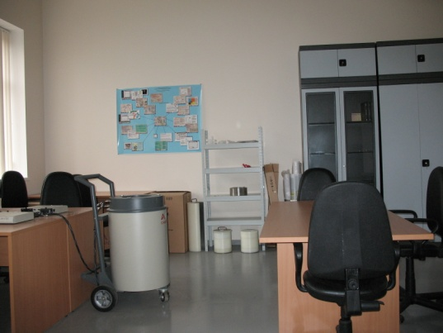
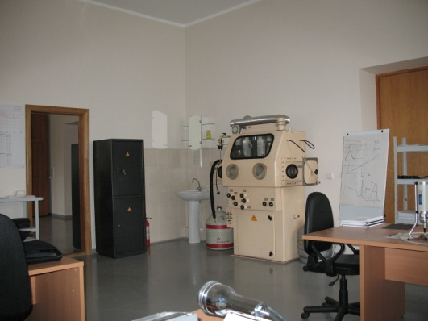
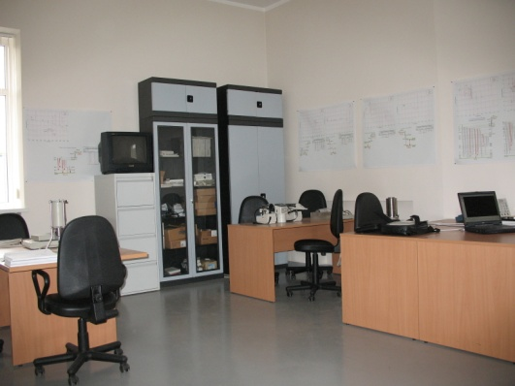
Non-Destructive Analysis Laboratory
Laboratory for non-destructive analysis of nuclear materials with classrooms for neutron analysis, gamma-analysis and for preparation of practical training by lecturers and instructors
Uranium standards
Neutron detector
Neutron detector
in the barrel-shaped
Glovebox
Gamma laboratory

Slide 15
Neutron analysis laboratory equipment includes:
neutron detection systems for practical classes on neutron non-destructive methods of nuclear material analysis;
active counter of neutrons and neutron-neutron coincidences to measure Uranium-235 mass;
passive counter of neutrons and neutron-neutron coincidences to measure Plutonium-239 mass.
Neutron detector
in the barrel-shaped
Neutron detector
Uranium standards

Slide 16
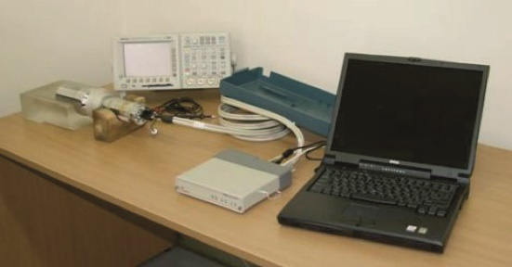
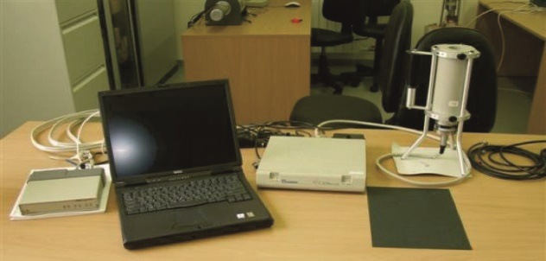
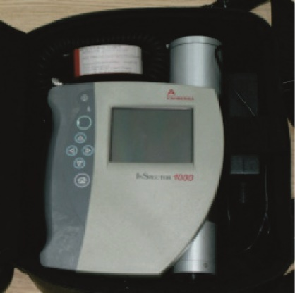
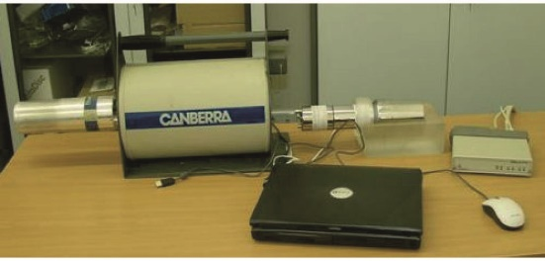
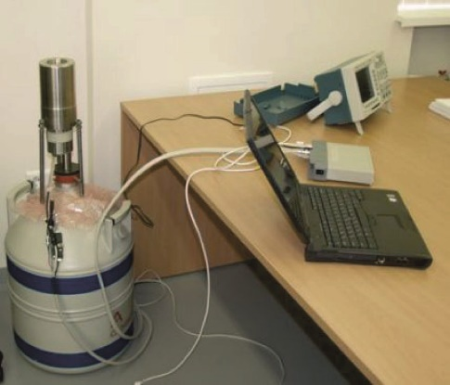
Gamma-ray analysis lab equipment includes:
gamma spectrometers with NaI, Ge and HPGe detectors used in practical classes on non-destructive gamma-ray methods of nuclear material analysis;
portable spectrometer for practical classes on non-destructive analysis of nuclear material and radioactive sources;
portable radiation detectors (for both gamma and beta radiation) used in practical classes on nuclear material and radioactive source control methods;

Slide 17
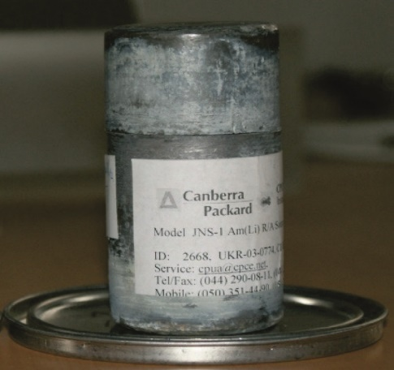
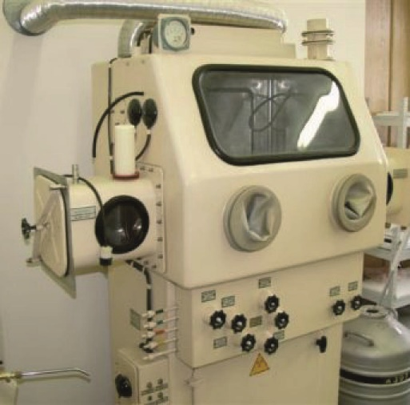
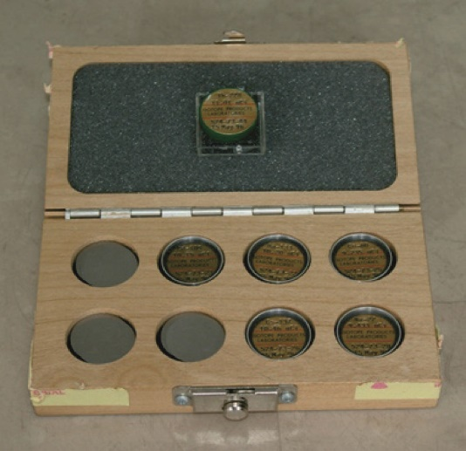
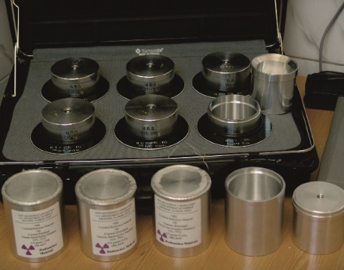
Gamma-ray analysis lab equipment includes:
standard nuclear material samples (LEU and HEU);
standard radioactive sources for gamma spectrometers calibration;
glove box for work with highly active materials.

Slide 18
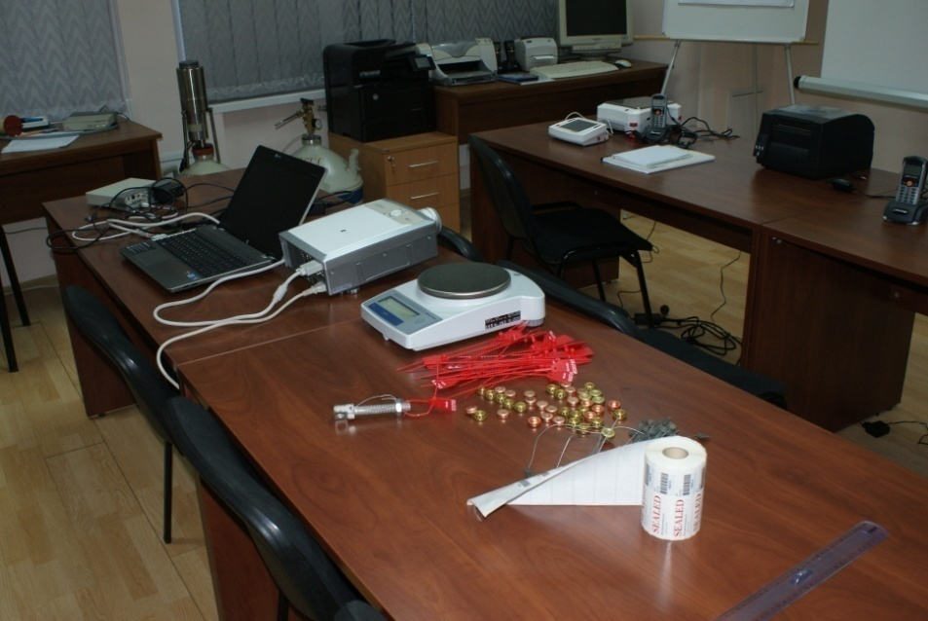
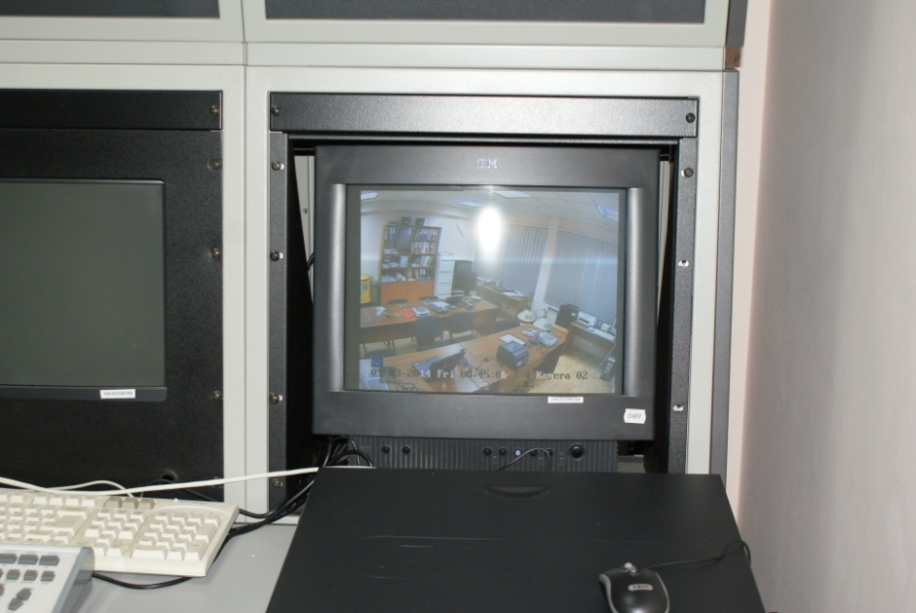
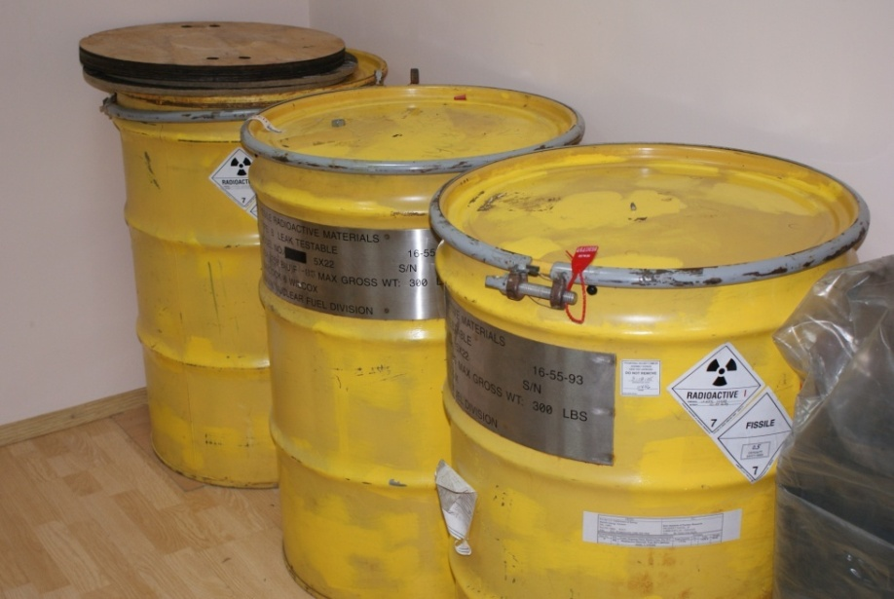
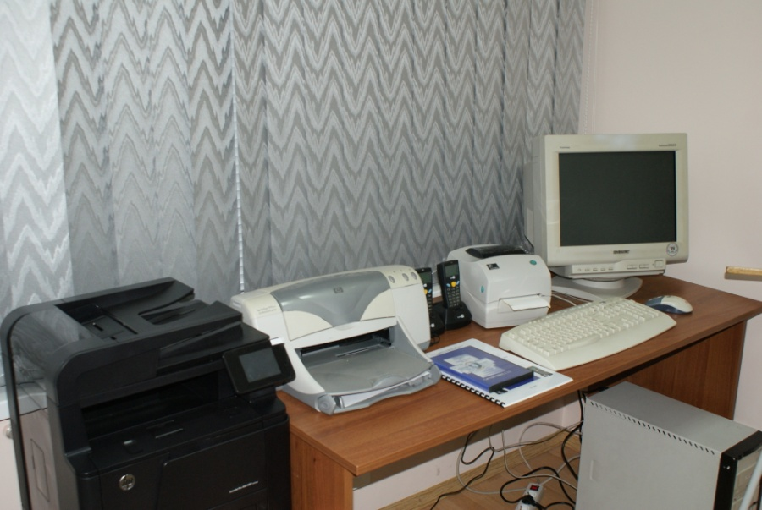
MC&A CLASS
Seals
CCTV
Container
System “AIMAS”

Slide 19
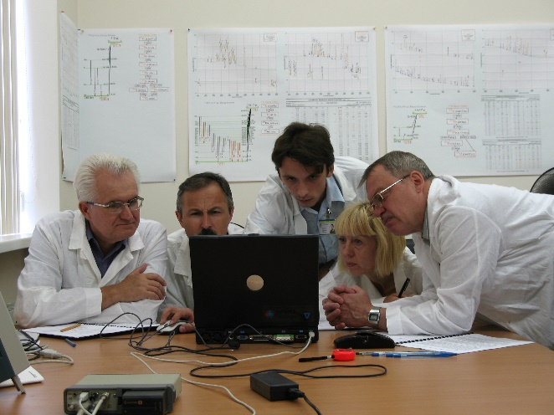
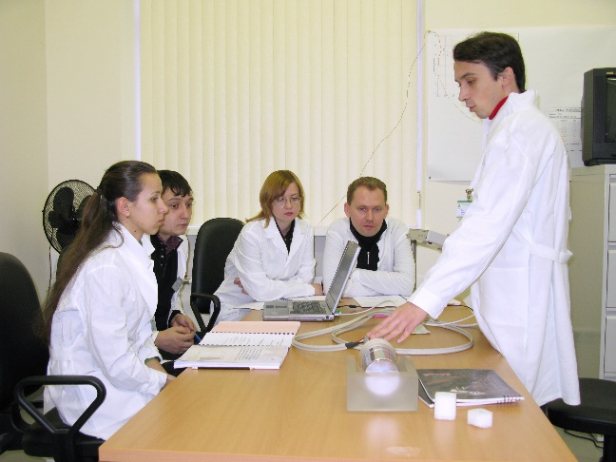
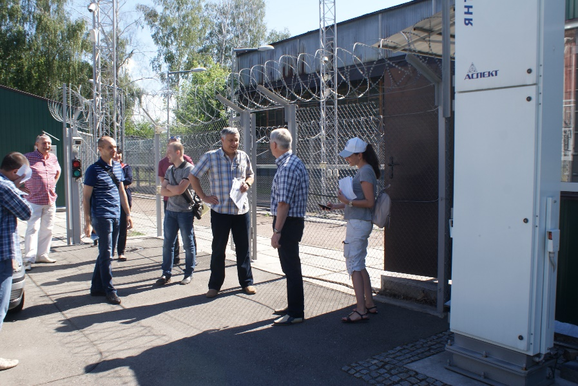
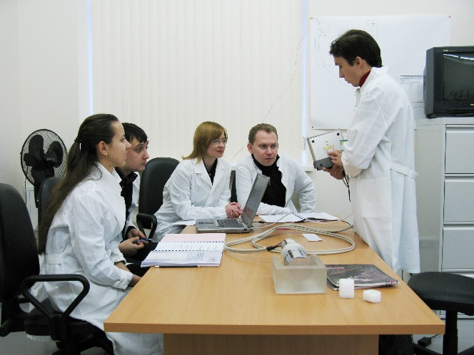
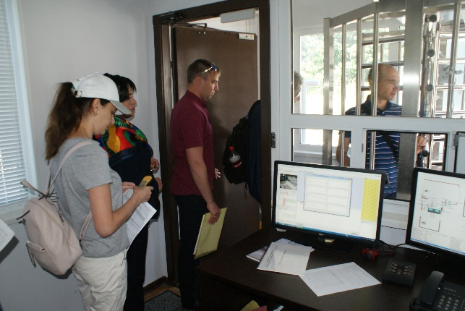
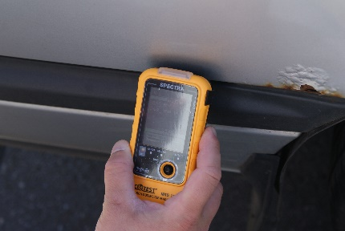
TRAINING ACTIVITIES
About 40 such training courses have been conducted at GKTC during 20 years
of its operation; more than 800 foreign participants from almost 20 foreign countries participated in these training courses

Slide 20
“NPP with elements of the physical protection system” Interactive Complex (“NPP with PPS elements ” IC)

Slide 21
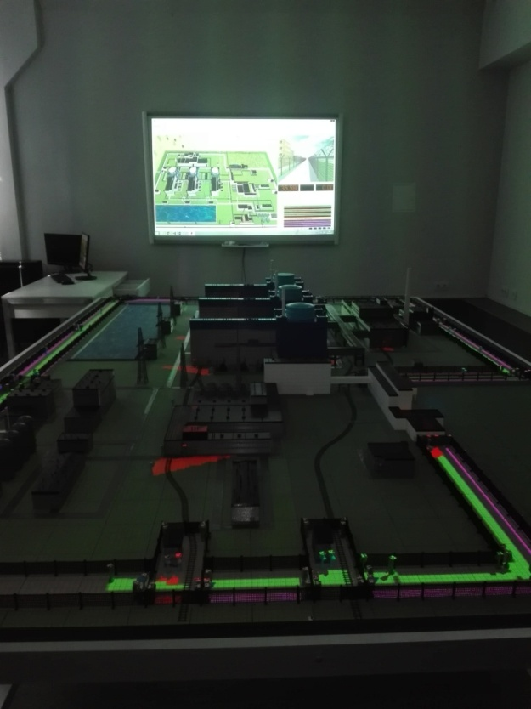
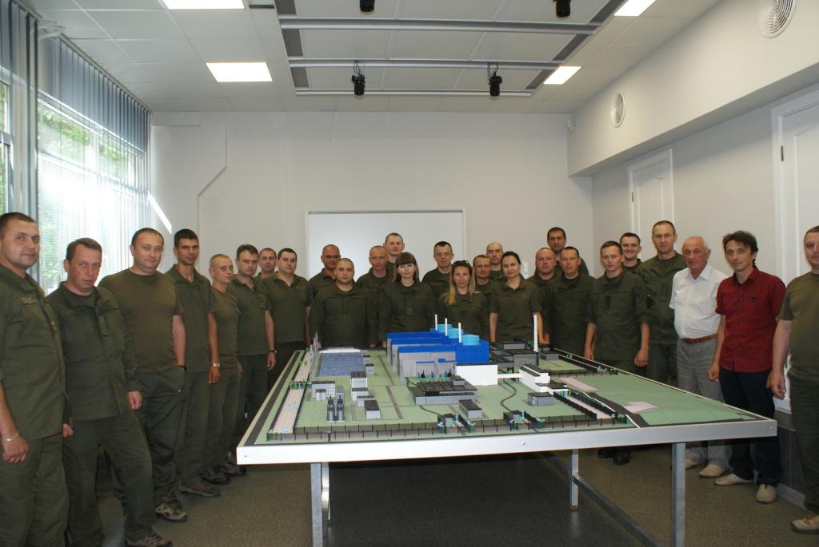
“NPP with PPS elements” IC
“NPP with elements of physical protection system” Interactive complex was created this year and GKTC have already provided training using this complex
The use of "NPP with PPS elements" IC during the training will stimulate creative activity and analytical thinking of students, will allow students to acquire the skills they need to perform the functions of guarding and protection of nuclear facilities

Slide 22
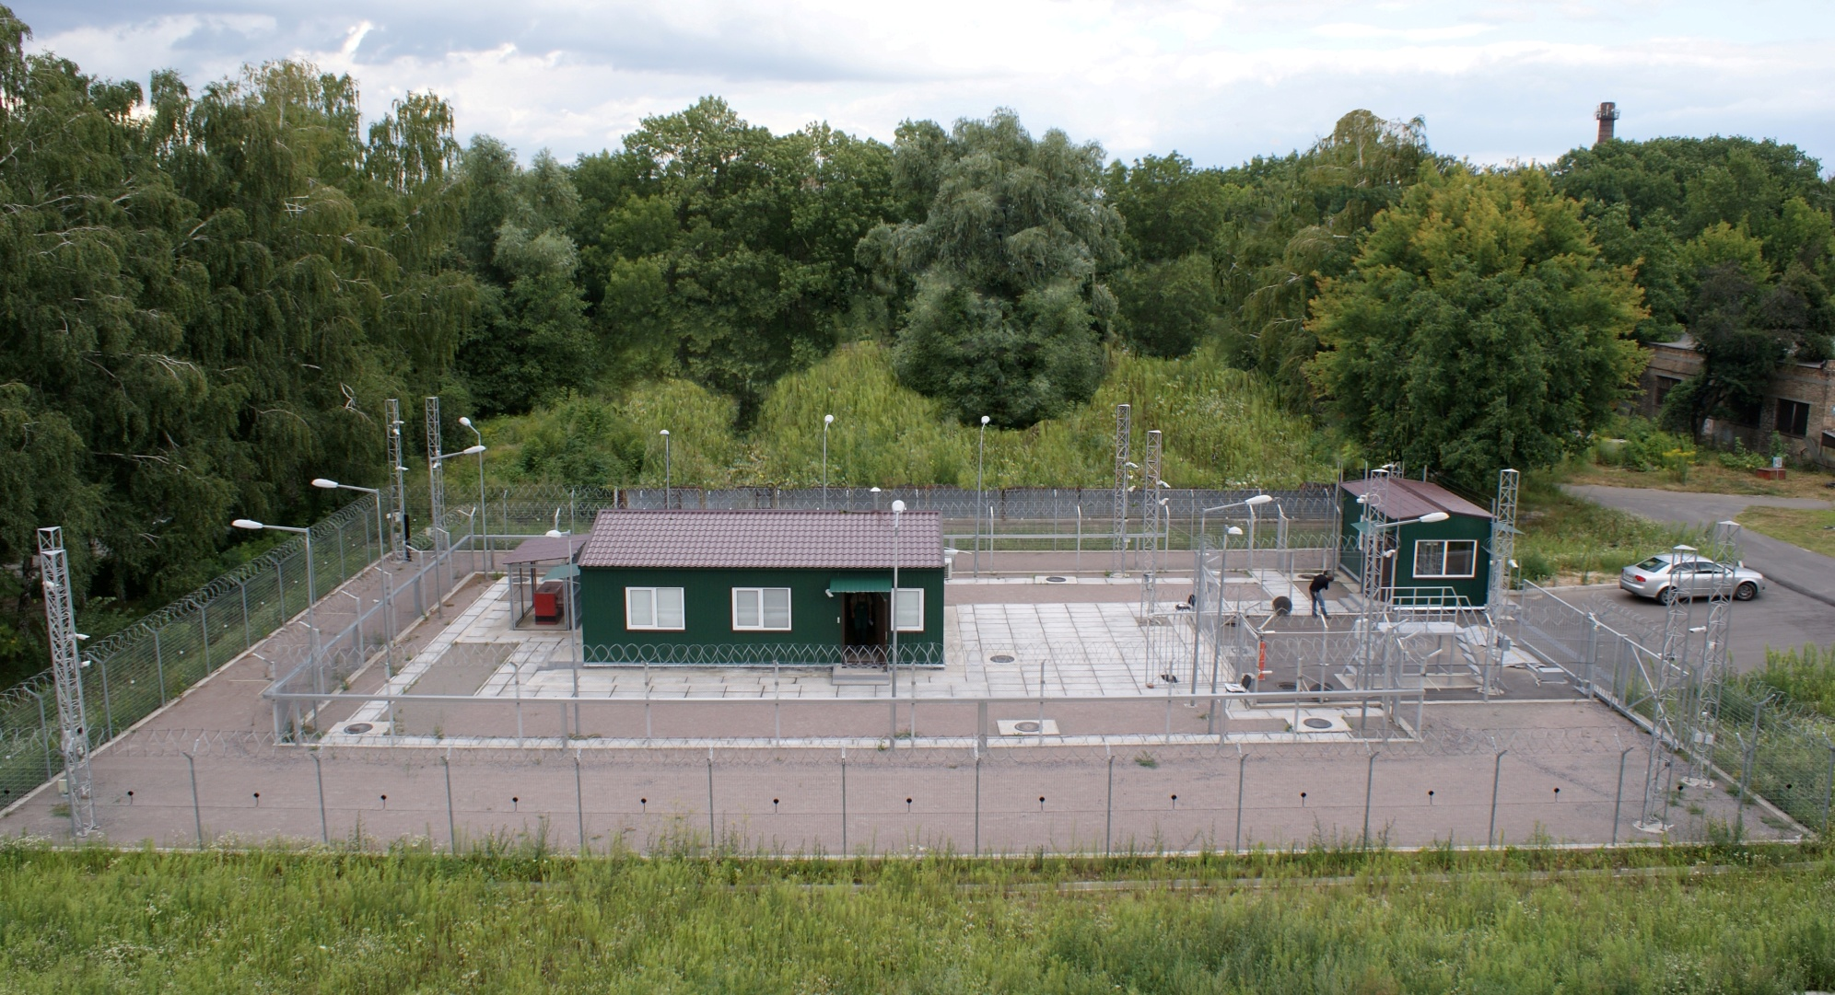
EXTERIOR TRAINING SITE
Exterior Training Site “Complex of Engineering and Technical Means of Physical Protection System” (ETC) with central and backup alarm stations, and training classroom

Slide 23
Exterior Training Site
ETS has unique complex of engineering and technical means of physical protection system
This site is designed for:
advanced training of senior managers of nuclear facilities and radioactive waste handling sites in order to facilitate with modern engineering and technical means which are used in physical protection systems
advanced training of physical protection staff and guard units personnel on operating control and technical maintenance of physical protection systems during normal operation, in case of emergency and contingency situations at the facility
carrying out field exercises for relevant personnel of anti-terrorist entities in order to perfect their actions during executing anti-terrorist operations
testing of technical means for compliance with the requirements of legislation before the decision on their utilization in the specific physical protection system is made

Slide 24
Exterior Training Site
ETS is unique site in the country where GKTC staff can create in real time situations that may occur at the facilities as a result of social and political nature events. It is clear that such training cannot be hold at functioning nuclear facility without reducing the level of security
This means that the major objective of GKTC is to ensure effective training of PP personnel to develop the skills and experience sufficient for the operating equipment deployed in a Physical protection system, to conduct performance testing of such equipment, to carry out vulnerability assessment, as well as to train Physical protection and Pro-force personnel on operations during abnormal and emergency situations

Slide 25
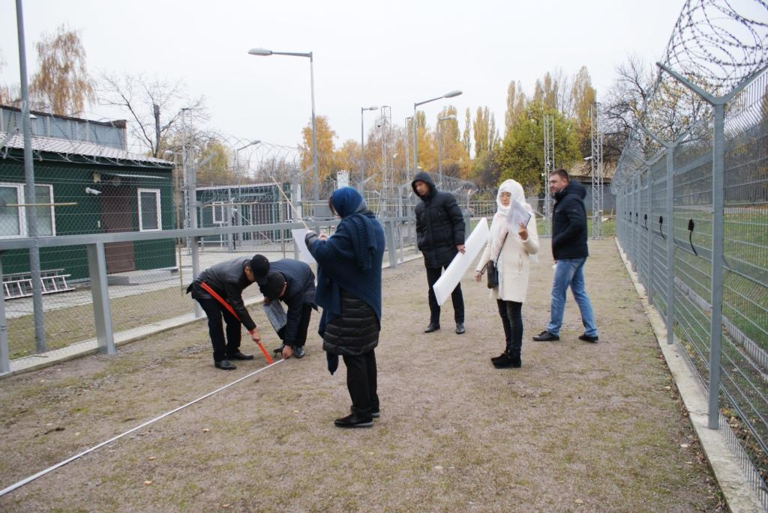
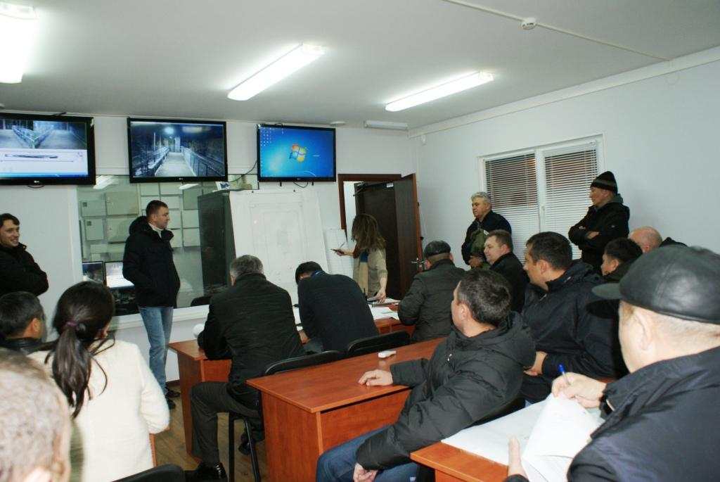
Exterior Training Site
Two year ago GKTC’s facilities including Exterior training site were used for conducting “Performance Testing for Performance Assurance” training course for representatives of the National Guard of the Republic of Kazakhstan . There were involved instructors from the USA and Ukraine

Slide 26
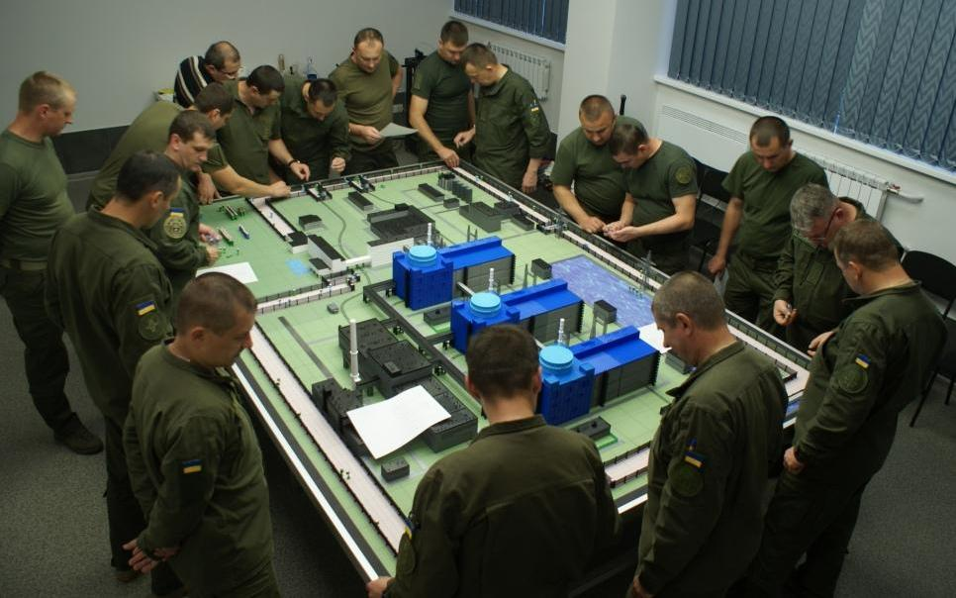
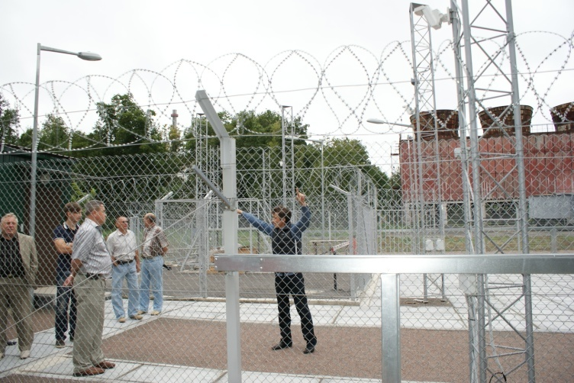
TRAINING COURSES
That’s why Exterior Training Site “Complex of Engineering and Technical Means of Physical Protection System” and “NPP with elements of the physical protection system” interactive complex” were built on the territory of the Institute for Nuclear Research

Slide 27
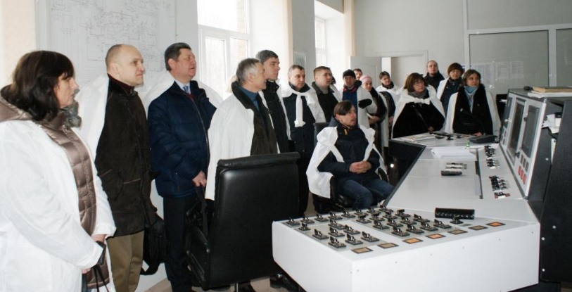
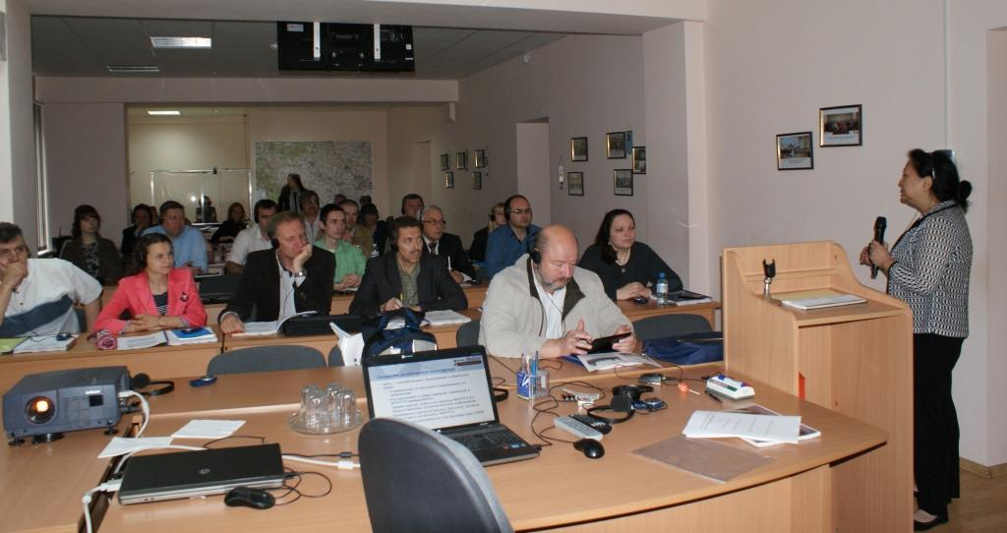
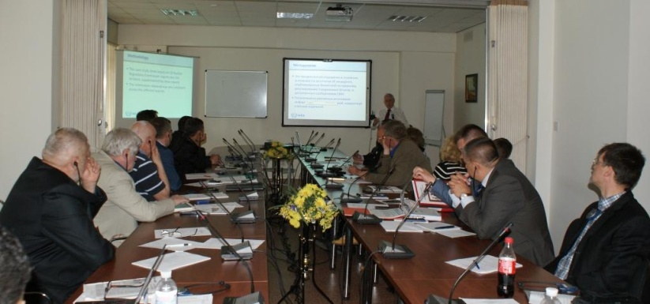
TRAINING ACTIVITIES
Training courses of the IAEA, European Commission, and National Laboratories of US DOE were arranged and conducted on the GKTC basis and with the involvement of GKTC instructors
About 40 such training courses have been conducted at GKTC during 20 years of its operation; more than 800 foreign participants from almost 30 foreign countries participated in these training courses
For example, last and this year the IAEA have
conducted a line of training courses and workshops
on the basis of GKTC on the following topics:
Cyber Security, Threat Assessment and DBT,
Nuclear Security Architecture, Use of NM C&A for Nuclear Security, Radiological Crime Scene Management, Preventive and Protective Measures against Insider Threats, Nuclear Security Measures for Major Public Events, Nuclear Security Information Exchange and Coordination for Ukraine

Slide 28
TRAINING ACTIVITIES
Having experience in training and a good technical base, during the training process GKTC bases on a system of effective training principles, such as:
consciousness and activity;
visibility;
systematic and consistent;
strength;
accessibility;
the connection between theory and practice.

Slide 29
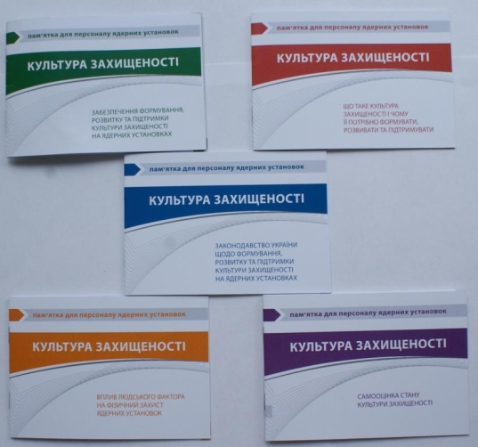
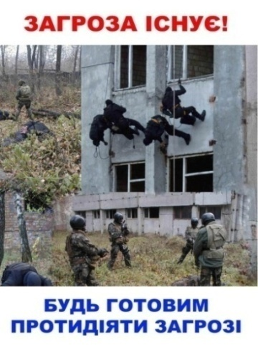
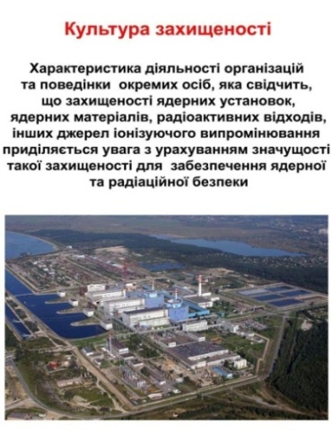
GKTC ACTIVITY
GKTC has developed two drafts of regulatory requirements acts on nuclear security culture that were put in force by the order of the State Nuclear Regulatory Inspectorate of Ukraine
Also GKTC has developed nuclear security culture booklets, posters and other visual aids that were distributed among nuclear facilities and radiation-dangerous facilities

Slide 30
GKTC ACTIVITY
GKTC is a permanent organizer of annual Ukrainian MPC&A Conferences.

Slide 31
GKTC ACTIVITY
In September 2019 the 16th Ukrainian Conference on Physical Protection, Control and Accounting of Nuclear Material was conducted at city Lviv under sponsor support by the Swedish Radiation Safety Authority and Norwegian Radiation Protection Authority
Participants of the Conferences were experts from the State Nuclear Regulatory Inspectorate of Ukraine, Ministry of Energy and Coal Industry of Ukraine, SE NNEGC “Energoatom”, Nuclear Power Plants, National Guard of Ukraine, National Academy of Sciences of Ukraine, State Border Guard Service of Ukraine, National Police of Ukraine, Ministry of Interior of Ukraine, Ministry of Education and Science of Ukraine, Ministry of Health of Ukraine, Anti-Terrorist Center of the Security Service of Ukraine, State Agency of Ukraine on Exclusion Zone Management, State enterprise “East mining-processing combine”, Kyiv Research and Design Institute “Energoproject”, and representatives from international organizations and institutions.

Slide 32
GKTC ACTIVITY
Topics of the 16th Conference:
Improvement of the legal framework on physical protection, control and accounting of nuclear material.
Gender issue (impact of gender stereotypes) in nuclear security activities
Staffing of the physical protection, control and accounting of nuclear material.
Management of risks in the area of nuclear security
Interaction of nuclear safety and nuclear security.
Interaction of the State Physical Protection System with activities on protection of the critical infrastructure.
Nuclear security culture. Evaluation of the nuclear security conditions.
Cyber security in the nuclear security area.
Issue of physical protection of spent fuel transportation to the ISFS-2 facility and the centralized Spent Nuclear Fuel Disposal Facility.
Improvement of the interaction mechanism for participants of the objective interaction plan, of the regional and State interaction plans.
Issues of concern of the State System of Control and Accounting of Nuclear Material.
The architecture (structure) of detection of nuclear materials in illicit trafficking and response for such events. Nuclear forensics.

Slide 33
SUMMARY
Any training that is not secured by a sufficient amount of practice is ineffective. But for effective practical training, just desire is not enough, sufficient material and technical base is needed.
Having the material and technical base, this is also just a pile of iron without having specialists for setting up, repair and training.
GKTC has everything that is necessary for the proper training of students at the highest level.
GKTC has highly qualified personnel, high-tech technical base and training facilities.
During the process of the courses formation GKTC uses the latest techniques and technologies, and most importantly, GKTC has the support of domestic and foreign colleagues and organizations

Slide 34
THANK YOU
for your attention

