Slide 1
PRESENTATION
Colonel Alain Nathan ALLOGO NDONG
Of Gabon

Slide 2
INTRODUCTION
Thanks to the development of means of transport, the world has almost become a global village marked essentially by the mobility of people and goods.
The issue of the Transport of Dangerous Goods and Sources, that we will discuss together here, is part of this set.
The subject may hold our attention for several reasons; indeed:

Slide 3
CHALLENGES
-In economic terms, the Transport of Dangerous Goods sector is of interest to several stakeholders: packers; shippers; chargers; carriers; unloaders;
In addition, 15 per cent of the world's traffic, all products and all modes of transport combined are goods classified as dangerous but which we need to meet our daily needs, and the needs of our industries.
Thus, these goods allow us to feed the factories' boilers, to fill the tanks of our cars, to manufacture drugs, fertilizers, building materials, to treat drinking water, waste water; to do x-rays and chemotherapy including tests in oil environment, ect ..
. - In practical terms, the need for this type of transport is well established; however, risks must also be controlled because of their dangerousness.

Slide 4
Since safety is everybody's business, the Gabon public authorities propose for their part:
- to review the legal framework of this sector of activity in order to align it with the international context;
- to raise the awareness of the actors involved in this sector;
- to reinforce the reaction capacities of the competent services in the face of the related accidents, all the more so since, in view of the statistics of transport accidents available throughout the world, we have most of the accidentology in the transport of Dangerous substances with consequences for the population and the environment.

Slide 5
SPEECH’S OBJECTIVE
During my speech, I will present the various Gabonese standards that govern the Transport of Nuclear and Radioactive Hazardous Materials

Slide 6
SOURCES TRANSPORT’S LAW
Gabon Law number 17/2013, fixed the regime of Safety and Security nuclear and radioactive,
It states that, there is an authority at the head of the Agency. It issues all transport licenses from Radioactive and Nuclear sources.

Slide 7
TRANSPORT CONDITIONS ARE CHECKED BY OPERATORS THROUGH SAFETY AND SECURITY CHECKS WHOM CONCERN:
The Sender
The Carrier
The Driver
The Charger
The receiver
For safety

Slide 8
THE SENDER
Ensures the packaging of sources and this packaging must be homologated to the SGH (General Harmonized System) standard
He does the Labeling
It puts the General Harmonized System Pictogram sources
This pictogram must have a red border with a white background and inside
the symbol of the danger code
On this packaging it puts the name of the source, as well as the quantity and weight of the source.
He does the packing
He contacts the shipper, the carrier and the consignee and sends them all the information.
He must obtain the authorization of the head of the Radioactive and Nuclear Regulatory Agency

Slide 9
THE CARRIER
Must have source transportation protocol
He checks the packaging
Check the number of packages
Check that the safety sheet is full
Check the recipient's address
Check that the recipient is waiting for the package
The approval of the head of the Radioactive and Nuclear Regulatory Agency
He is assisted by a security advisor and a commissionaire
He must have the consignment note
The carrier must ensure that there is in his vehicles, the safety equipment
The Extinguisher
The holds
Cones or Triangle
The Lot of Edge
Personal protective equipment

Slide 10
THE DRIVER
Trained in the transport and recovery of Radioactive and Nuclear sources
The driver has a driver's license and his authorization to drive the vehicle of Transport of the sources
Check the condition of the vehicle
There must be source signage documents
Have the category of sources to transport: If category 1 and 2, it will take a police or gendarmerie escort
Certificate of registration
Certificate of the technical visit
Insurance
Check the bill of lading,
the number of packages,
the nature of the product,
the unique UN number and the CAS or the trade name plus the nomenclature.
Checks Precautions, Shipper / Sender Manufacturer's Call Numbers,
Emergency Locator Numbers to Cross,
Permit to Move and Transport Product
The Vehicle must be homologated and have an approval compatible with the 4transported product
It must have the UN Pictogram on the back and on the sides
He must also have the documents of transport of dangerous materials, the safety cards in the truck (phone number of the person in charge of the sending company to seize in the event of an accident)
There must be a document that shows the nomenclature of the dangerous goods being transported, the maximum speed, the safety instructions and the instructions for driving, driving and schedules

Slide 11
THE CHARGER
Train the loader using the loader
Have the protocol of loading loaders
Have chargers approved by the UN
Have a Transport Document for the transport of dangerous goods
Know the number of packages
Have a driver's license as a loader
Have the Training Certificate
The machine in charge must have the UN number

Slide 12
THE RECEIVER
This is where there is unloading
He must follow the Unloading Protocol
It has the same instructions as the charger
He is assisted by a security advisor and a commissionaire
It must have sufficient storage depots to store the product during unloading,
All safety barriers must be operational

Slide 13
FOR SAFETY
Safety plans are required for certain products and substances
To prevent theft and accidents requires morality investigations
In the event of an accident, report to the facility classified to the environment, to the police, gendarmerie and customs;
put a signage;
alert the rescue quickly

Slide 14
GABON FIRE BRIGADE CBRN’ACTION IN INCIDENT OR ACCIDENT CASE BACKGROUND
Radiological emergencies1 are those emergencies involving radioactive material that can occur anywhere and include:
􀂃 Uncontrolled (accident of the transport, abandoned, lost, stolen or found) dangerous sources);
􀂃 Misuse of dangerous industrial and medical sources ( those used in radiography);
􀂃 Public exposures and contamination from unknown origins;
􀂃 Serious overexposures;
􀂃 Malicious threats/acts; and terrorist
􀂃 Transport emergencies.
Experience shows that local emergency services ( local medical, law enforcement, and fire brigade) will have the most important role in the early response to a radiological emergency.
Within hours, national officials may also have an important role to play in supporting the response at the local level.

Slide 15
OBJECTIVE
The objective of this brigade is to provide practical response within the first few hours of a radiological emergency.
This includes for the emergency service the personnel who would initially respond at the local level and the national officials who would support this early response.

Slide 16
ACTION GUIDES FOR INCIDENT COMMANDER Protect self/assess (size up) the situation
􀂉 Observe from a distance (at least 30 meters) and look for:
􀂃 Possible radiological hazard in accordance with Instruction and other possible hazards.
􀂃 People at risk.
􀂃 Security concerns, such as: armed individuals, explosives; and Transport dangerous goods placard(s)/label(s)/markings or UN number .
􀂉 Assess the situation. Determine the inner cordoned area. Reposition personnel, vehicles and equipment accordingly.
􀂉 Respond following the personnel protection guidelines.
􀂉 For criminal/terrorist activity, assume that perpetrators are among the public and avoid the
use of mobile phones and radio communications until the area is cleared of explosives, secondary devices and booby traps.
􀂉 Maintain the records of your decisions.
Save lives and prevent escalation
NOTE
Do not delay life saving actions because of the presence of radioactive materials.
Ensure implementation of the following:
􀂉 Rescue people in life threatening situations.
􀂉 Establish and mark the safety perimeter (inner cordoned area boundary) Within this area:
􀂃 Keep account of personnel.
􀂃 Limit entry to response personnel only.
􀂃 Follow personnel protection guidelines.
􀂃 Continue life saving actions, searching for and rescuing the injured.
􀂃 Evacuate the public.
􀂃 Assume that people from the area are contaminated.
􀂃 Deal with serious conventional hazards (e.g. fire).
􀂉 Take actions to protect the public
􀂉 Conduct interviews to locate suspected radioactive devices and to identify possibly exposed
individuals.

Slide 17
ACTION GUIDES FOR SPECIFIC FIRST RESPONDERS RESPONSE TO A LOST OR STOLEN POTENTIALLY DANGEROUS SOURCE First responsible person to become aware of the event:
􀂉 Report loss/theft to the appropriate officials.
􀂉 Request, throughto the national Radiological service (or in accordance with prior arrangements), a radiological
assessor/team and obtain advice, by phone.
􀂉 Secure area and treat as a crime scene.
􀂉 Conduct a local search and investigation of the possible means of loss.
􀂉 Check and ensure the physical security and control of other sources.

Slide 18
Incident commander
Being the senior first responder assume the role of the IC until relieved.
􀂉 Respond following the personnel protection guidelines in Instruction .
􀂉 Assess the situation in accordance with Instruction.
􀂉 Confirm the completion of the tasks of the first responsible person listed above.
􀂉 Maintain the records of your decisions.
􀂉 If public contamination or exposure is possible, implement “General on-scene response to a radiological emergency”.
􀂉 Coordinate all response actions with law enforcement. 6
􀂉 Conduct interviews to locate and isolate the source and to identify possibly exposed
individuals.
􀂉 Inform all appropriate authorities of the situation and of the name of the IC.
􀂉 Alert nearby medical facilities, fire fighters, law enforcement, border crossings and scrap
metal dealers, providing a description of the source and associated hazard.
􀂉 Have radiation medical experts or national. Provide local hospitals with a description of
radiation injuries (e.g. skin burns with no apparent cause).
􀂉 After informing local officials, make a public announcement describing the source and
stressing the associated hazard (see Appendix II for an example media statement).
􀂉 Notify the national Emergency security if there are indications that other States or their citizens may be
affected (transnational emergency).
􀂉 Plan and initiate public searches in cooperation with the radiological assessor/team.
􀂉 If the source is found and/or public contamination or exposure is possible, implement, inform the Agency autority.

Slide 19
DECONTAMINATION
After the sources secures the intervenient must be decontaminate by the shawer

Slide 20
FOR EXEMPLE, THE RECHERCH OF ABANDON RADIOACTIVES SOURCES LIBREVILLE CUSTOM STORES AIR PORT BY:
Gabon Nuclear surety, Security Radioprotection, General Direction of Energy Ministry and fire fither intervention CBRN Brigade, after the call of the International Libreville air port authority due to the discover , abandon sources radiological in the transit area.
In the end ; we found five (5) actives radio sources transport packages stored in customs warehouses, the sources found are:
- three gammadensimètres used in public work
- two gammagraphes used in non-destructive welding tests in the oil industry.
The recommendation had been to seal the storage room and hold the employees far ofthe affect area.

Slide 21
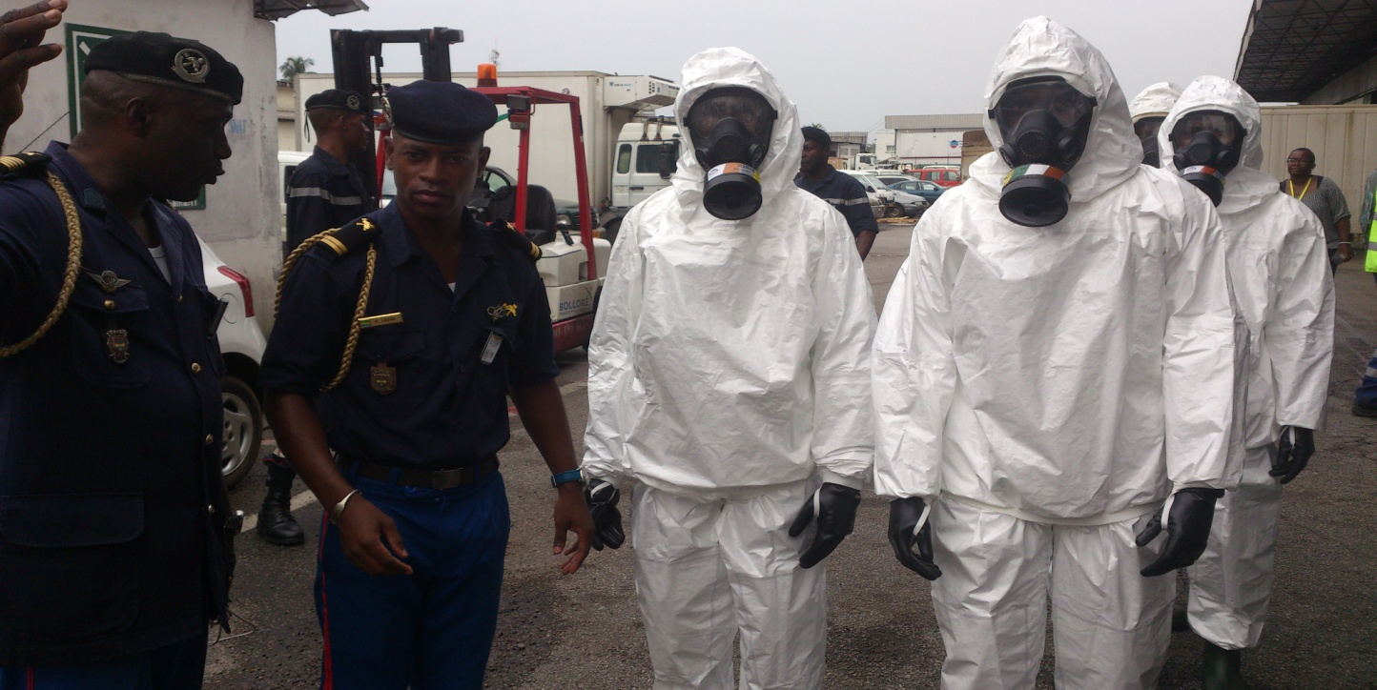
Intervention:
a) Fire fither intervention uniform’s protection

Slide 22
b) Create a security perimeter
Wearing of personal protective visual means
Implementation of collective means of detection
Choose the team’s members

Slide 23
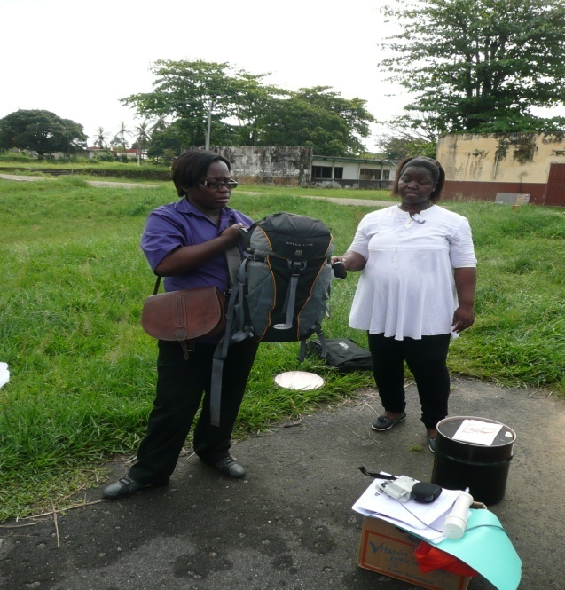
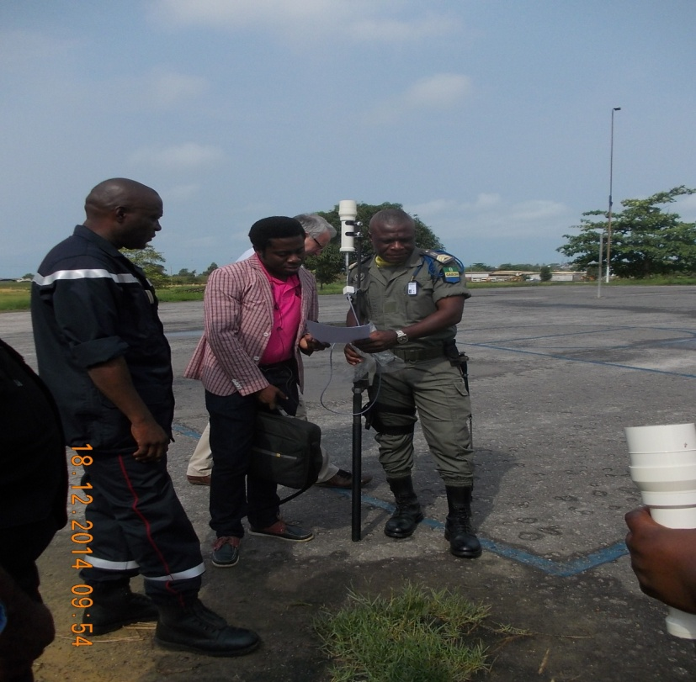
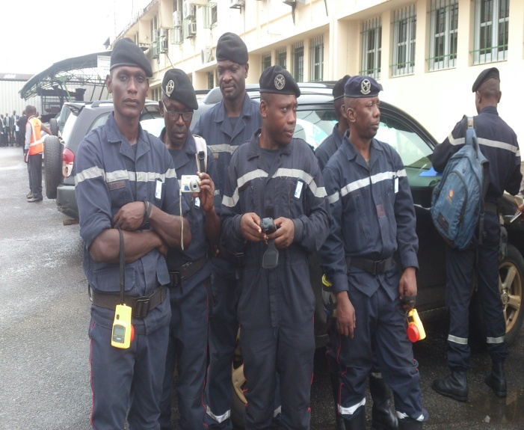
Detection materials
Back Pack detection
Dosimeter
E-Nose At distance
Radiameter

Slide 24
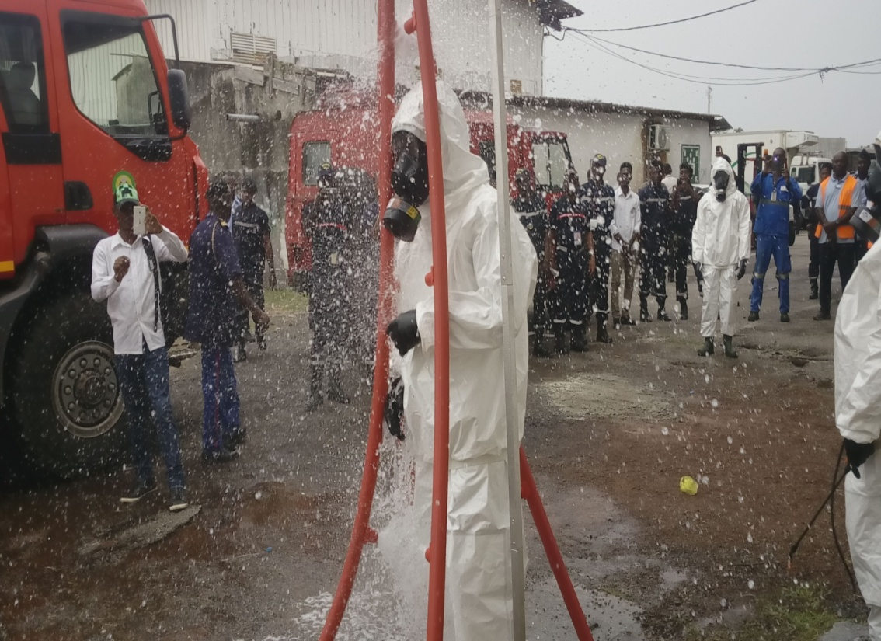
After work: decontamination

Slide 25
THE GABON BOTH RADIOLOGICAL DETECTOR’S TEAM

Slide 26
THE END
THANK YOU FOR YOUR ATTENTION
QUESTIONS?

