Slide 1
Sustaining Nuclear Security Regimes through Continuous Learning Experiences
A Case Study in Knowledge Management Systems supporting Human Resource Development
Georgia Adams and Matt Tremonte
Pacific Northwest National Laboratory
IAEA International Conference on Nuclear Security
February 2020
Vienna, Austria

Slide 2
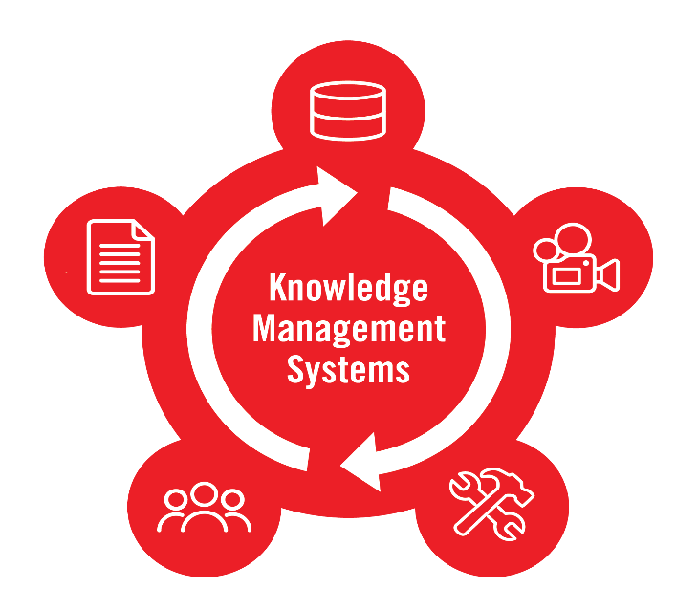
Overview
Nuclear Security Regimes
Notes:
Overview: (These are the topics to define as you describe this slide):
Knowledge Management Systems Supporting Nuclear Security Regimes
Nuclear Smuggling Detection and Deterrence (NSDD) Knowledge Management Website (KMW)
Planning, Managing, and Operating the KMW
Lessons Learned
Next Steps for the KMW

Slide 3
Sustaining Nuclear Security Regimes
How can a State continue to grow and mature its nuclear security expertise?
How can States manage human resources so that nuclear security regimes are strengthened over time?
How can information be provided to those that need it to perform their jobs efficiently and effectively?
Notes:
Sustaining nuclear security regimes
Sustaining the “people” aspect of the nuclear security regime poses challenges
As countries build, enhance, and sustain their nuclear security regimes, security systems are designed and deployed. Staff are trained. Systems are operated. But then, what?
Recognizing the threat and then designing and deploying systems and measures to reduce the risks is important. But, once the work is “done,” States must consider how to maintain the level of security and confidence that the people, processes, and equipment in place are indeed mitigating the risks.
IAEA references:
Sustainability is fundamental to a State’s nuclear security regime, and as part of sustainability, the IAEA recommends that States allocate sufficient human, financial, and technical resources to carry out the organization’s nuclear security responsibilities on a continuing basis – NSS20.
Human resource development, according to the IAEA, includes education, training, and knowledge management NSS20.
In NSS 30-G, knowledge management involves “capturing, structuring, and transferring information to ensure that organizations retain the experience and knowledge gain by their staff over time.”

Slide 4
NSDD Knowledge Management Website (KMW)
KMW is a web-based platform launched in 2015 by the Nuclear Smuggling Detection and Deterrence Program (NSDD)
Serves as a “just-in-time” information resource to international partners implementing and sustaining their radiation detection programs
https://nsddkmw.energy.gov/
Notes:
The DOE/NNSA Nuclear Smuggling Detection and Deterrence (NSDD) Program works with international partners to strengthen capabilities to detect, disrupt, and investigate the smuggling of nuclear and other radioactive materials before they can be used in acts of terrorism.
The NSDD Program and its predecessor organizations have worked for the past two decades with over 100 partners in more than 70 countries to enhance nuclear security detection capabilities.
To build sustainable capabilities with partnering agencies distributed globally, the NSDD Program devoted considerable resources to developing and maintaining a knowledge management system.
Developing a thoughtful and deliberate knowledge management system supporting the roles and responsibilities in the nuclear security regime enables continued reliance on, and resilience in, the systems and measures a State develops to address nuclear security threats​.
The NSDD Program and its partnering organizations recognized the importance of maintaining and retaining the knowledge of experienced staff over time.
For example, significant resources were involved in planning and delivering training to operate and maintain detection systems, but if training could only be delivered once or maybe twice a year at a remote site, or perhaps at a centralized location like a training academy, what additional tools could be available for staff to access the information they needed?
The KMW allowed training products and procedures to be distributed “just in time,” meaning the information was available and accessible to those that needed it, when they needed it.
Front line officers (FLOs) operating the detection equipment or the maintenance provider troubleshooting the detection instruments would not have to wait for the next available in-person training course—they could log on and find the information they needed, when they needed it.
The KMW would empower external NSDD Program partner country collaborators to pull materials themselves as they are published.
The KMW was a cost-effective mechanism to disseminate information to end users located around the world, providing ready access to materials for the NSDD Program’s foreign partners in a secure, user-friendly environment.

Slide 5
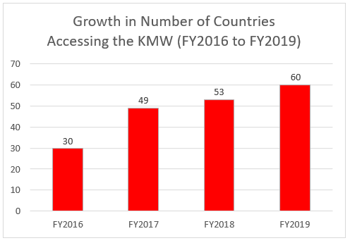
NSDD KMW Case Study
KMW includes training materials, maintenance procedures, technical service bulletins, operating procedures, how-to videos, and eLearning modules
Materials available in 20 languages
More than 60 countries have signed up for and actively use the KMW
Notes:
Planning Considerations
Engaging with prospective user communities
Defining the functional requirements
Choosing a platform for publishing materials
Aligning the KMW development with NSDD training
Defining a strategic roadmap for KMW development

Slide 6
KMW Tour
Notes:
Managing and Operating the KMW
Assigning a content manager
Engaging with the end users
Adapting the KMW to evolving user requirements
Conducting data analysis
Adhering to security requirements
Growing the KMW user base

Slide 7
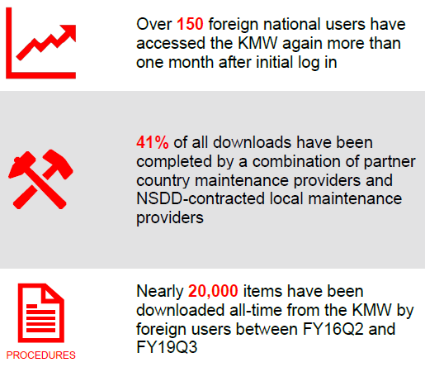
Lessons Learned
Adopt a graded approach
Identify user communities
Define performance metrics
Obtain organizational management sponsorship
Integrate with nuclear security training curriculum or materials development programs
Develop a comprehensive and living taxonomy
Streamline content management practices
Notes:
[Spend more time on this than other slides]

Slide 8
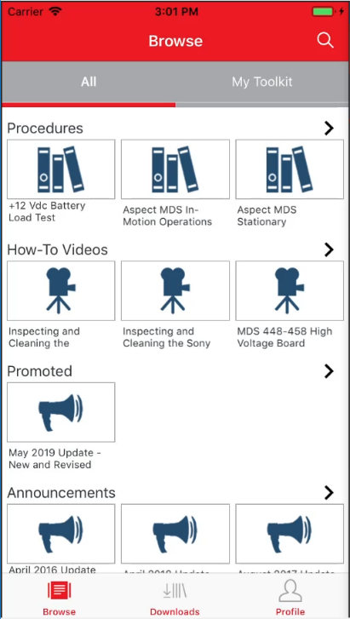
Next Steps
Launch the KMW mobile application
Retire outdated information
Update content with the latest systems and technologies
Use the KMW as a resource prior to equipment deployment
Example: – using eLearning modules as prerequisites to in-person training activities

Slide 9
Conclusion
Implementing knowledge management systems as part of States’ human resource development objectives are an important part of sustaining nuclear security regimes
The NSDD KMW offers lessons learned for planning, operating, and managing knowledge management systems
https://nsddkmw.energy.gov/
Interested in learning more?
Email NSDDKMW@nnsa.doe.gov
Notes:
A knowledge management system that fosters the continuous development of nuclear security expertise without depending solely on direct human interactions need not be overly complex or prescriptive.
If carefully planned with the end user in mind, knowledge management is an achievable capability as States and the broader international community come together to prevent, detect, and respond to nuclear security events.

Slide 10
Questions
10PNNL-SA-150170

