Slide 1
Insider Analysis in the Secure Transport of Nuclear, Radiological, and other High-Risk Materials
Meghann Parrilla
Allyn K. Milojevich
Y-12 National Security Complex
INDICO #424
Notes:
Y-12 Information Release Office #14380

Slide 2
Insider Quantification and Ranking Process (IQRP)
An assessment tool that effectively and accurately identifies and documents the potential negative effects an insider can have on a site’s protective posture
  Involves conducting interviews, physical protection analyses, and validating or invalidating current analysis documentation or assumptions.
  The "risk-based" interview questionnaire aids in the quantification, or scoring, of insiders based off individual access, authority, and knowledge
Tool is designed to assess positions
  Assesses the potential for individuals in different positions to become inside threats.
  Assesses how dangerous an insider threat they pose based on their position.
Does NOT identify individuals that are nefarious insiders or have the potential to become insiders

Slide 3
Insider Quantification and Ranking Process
Step 1
Identify Insider Job Categories
Step 2
Prioritize Insider Job Categories for Analysis
Determine Insider Attributes for each Job Category
Step 3
Step 4
Rank Insiders based on Job Category
Step 5
Develop Insider Scenarios
Step 6
Identify Insider Threat Mitigation Programs
Step 7
Conduct Performance Assurance Activities

Slide 4
Insider Quantification and Ranking Process
Step 1
Identify Insider Job Categories
Step 2
Prioritize Insider Job Categories for Analysis
Determine Insider Attributes for each Job Category
Step 3
Step 4
Rank Insiders based on Job Category
Step 5
Develop Insider Scenarios
Step 6
Identify Insider Threat Mitigation Programs
Step 7
Conduct Performance Assurance Activities

Slide 5
Identify and Prioritize Insider Job Categories
Identify and prioritize insider job categories that potentially pose a risk to the security of nuclear transport
  Analysts must have an understanding of the current configuration of the facilities, including physical security measures and facility specific job duties and responsibilities related to:
    shipping and receiving,
    knowledge of the physical protection posture during shipping, and
    understanding of the detection and response to a security incident
  Analysts should differentiate between direct and indirect access to the asset
    Direct access is defined as job categories who have authorized access to place hands on the asset or systems that control the asset
    Indirect access is defined as job categories who have access to either storage or processing areas
Access to the asset*
Authority over those who have access to the asset
Everyone else who has access to the facility/site

Slide 6
Insider Quantification and Ranking Process
Step 1
Identify Insider Job Categories
Step 2
Prioritize Insider Job Categories for Analysis
Determine Insider Attributes for each Job Category
Step 3
Step 4
Rank Insiders based on Job Category
Step 5
Develop Insider Scenarios
Step 6
Identify Insider Threat Mitigation Programs
Step 7
Conduct Performance Assurance Activities

Slide 7
Interview Process
The interview questionnaire is designed to validate, or invalidate, assumptions associated with job categories and associated capabilities, and to assess access, authority, and knowledge
  Involves conducting interviews, physical protection analyses, and validating or invalidating current analysis documentation or assumptions.
  Analysts should use a specific Insider Interview Questionnaire to ensure consistency throughout the insider analysis
Questions used in the interview should be focused on gaining information specific to insider objectives
  General information
  Access
  Authority
  Knowledge

Slide 8
Interview Process – General Information
Captures general information about the specific person being interviewed, such as job title, job description, years of service, years in current role, previous jobs/positions, clearance level, and two-person rule certified
  It is important to obtain and document general information, such as the employees previous job duties, years of service, facilities that employee works in (if necessary), and any programs the employee may be in, such as HRP
  The IQRP quantifies the average employee’s access, authority, and knowledge within each job category
  Previous job positions have their own set of attributes different than current attributes, and the knowledge gained from that experience is not forgotten
It is particularly important to analyze the employees perceived job duties versus actual documented job duties

Slide 9
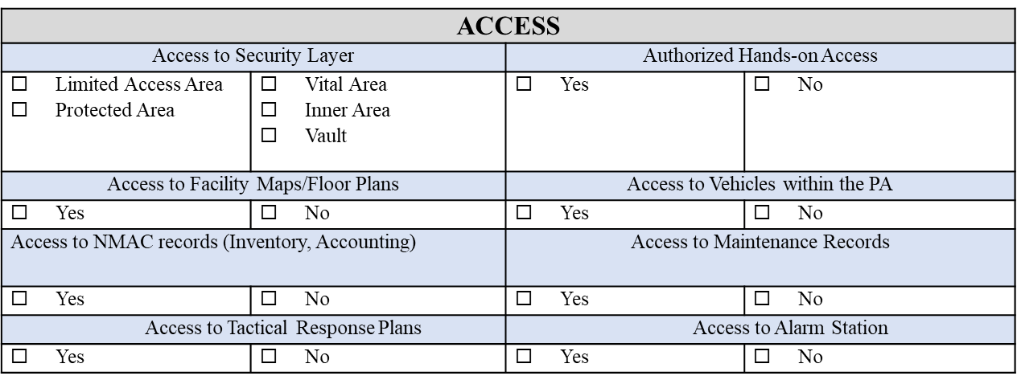
Interview Process – Access Information
Captures the employee’s access capabilities to material, facilities, procedures and systems
  Insiders can use defeat methods not available to outsiders to bypass protection measures and access control procedures.
  Analysts should pay particular attention to direct versus indirect access, escorted versus unescorted access, and cyber access
  Typically yes/no answers

Slide 10
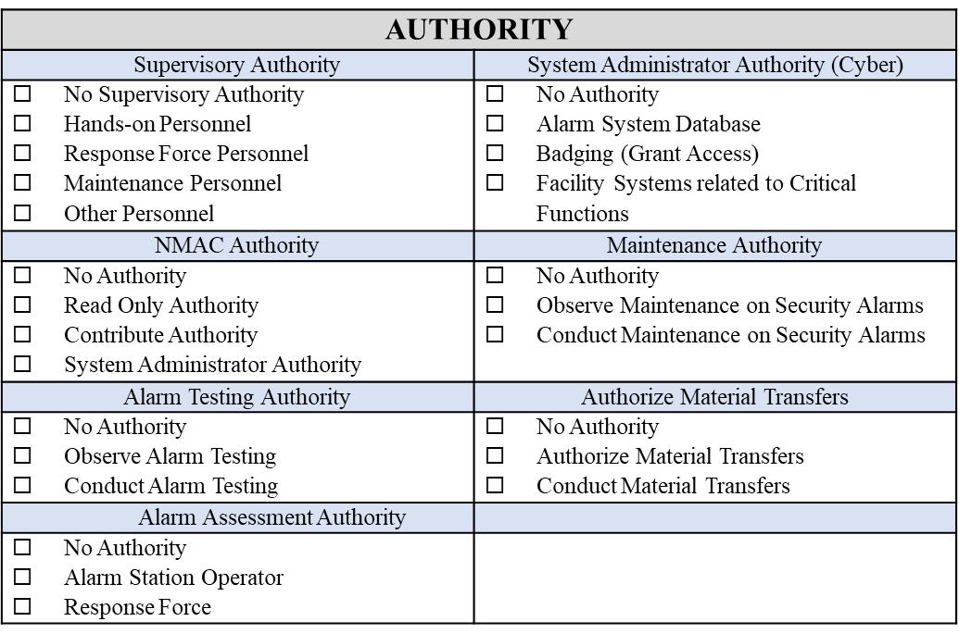
Interview Process – Authority Information
Captures the employee’s capabilities within systems, administrative procedures, and other employees
  Systems to consider are security systems, such as alarm systems, badging systems, and Nuclear Material and Control tracking systems.
  Analysts should pay particular attention to personnel who have authority to assess, conduct maintenance, or performance test on alarms
  Typically yes/no answers

Slide 11
Interview Process – Knowledge
Insider knowledge is comprised of knowledge of the asset itself, the facility, and protection measures and is the most complex attribute to assess
  Using a “defeat strategy” interview technique, the analyst can gain a holistic understanding of the employee’s knowledge, including asset and facility information, as well as any protection measures and weaknesses associated with those methods
  The defeat strategy interview technique must be adjusted based on the job category and the information the analyst is trying to receive
Topics for discussion could include:
  Asset
    Locations, attributes, protection measures, etc.
  Facility
    Protection measures
    Building construction
    Ingress/engress routes
    Emergency evacuation procedures
Once multiple individuals are interviewed within a job category, assessments can be completed to determine how critical different positions are to a robust transportation security system
  Transportation
    Protection measures
    Construction
    Transportation routes

Slide 12
Insider Quantification and Ranking Process
Step 1
Identify Insider Job Categories
Step 2
Prioritize Insider Job Categories for Analysis
Determine Insider Attributes for each Job Category
Step 3
Step 4
Rank Insiders based on Job Category
Step 5
Develop Insider Scenarios
Step 6
Identify Insider Threat Mitigation Programs
Step 7
Conduct Performance Assurance Activities

Slide 13
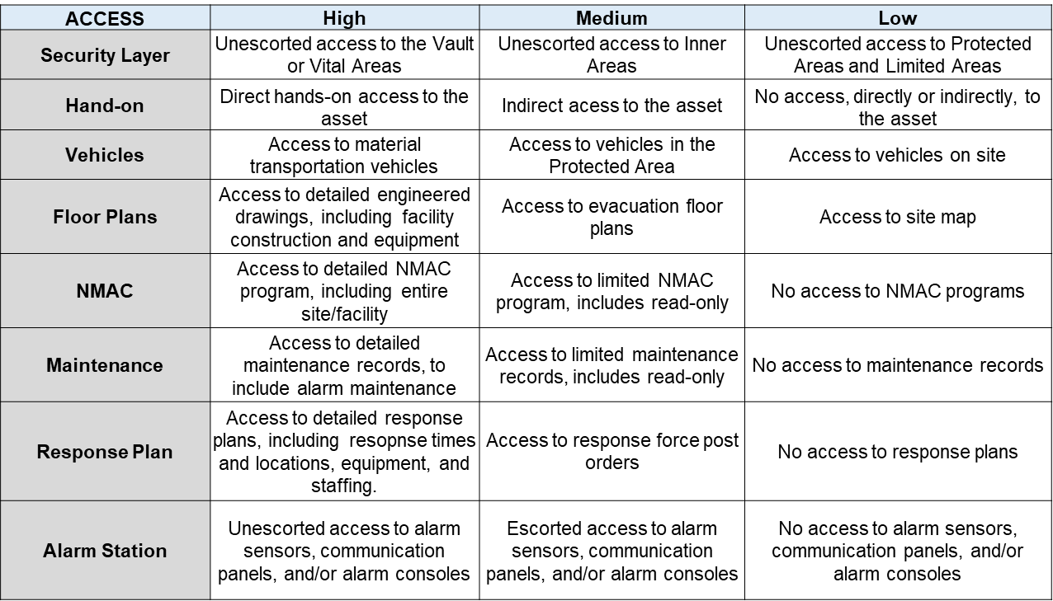
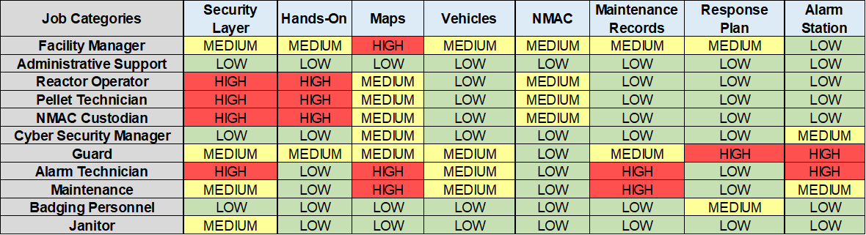
Ranking Insider Attributes – Access

Slide 14
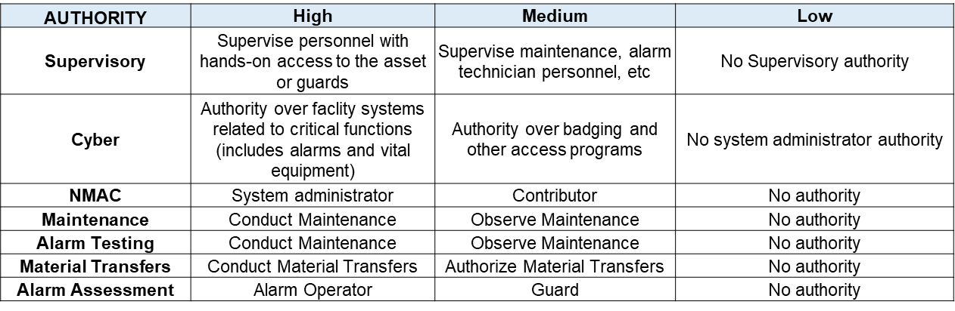
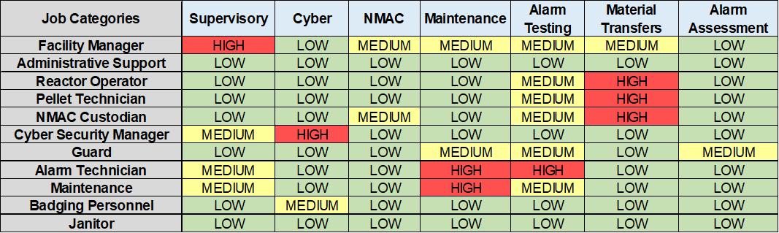
Ranking Insider Attributes – Authority

Slide 15
Ranking Insider Attributes – Knowledge
Low: Information gained from the public domain. Examples include the internet, library, blogs, newspapers, social media, etc. It is usually assumed that all types of insiders have this level of information
Medium: Information gained from having physical access to an area. This allows insiders to gain information that is readily available, but not specific or restricted to a particular job duty
High: The most detailed level of knowledge and is usually associated with a particular job function

Slide 16
Insider Quantification and Ranking Process
Step 1
Identify Insider Job Categories
Step 2
Prioritize Insider Job Categories for Analysis
Determine Insider Attributes for each Job Category
Step 3
Step 4
Rank Insiders based on Job Category
Step 5
Develop Insider Scenarios
Step 6
Identify Insider Threat Mitigation Programs
Step 7
Conduct Performance Assurance Activities

Slide 17
Insider Threat Mitigation Program (ITMP)
Data gathered from insider interviews should be used to inform risk-based decisions regarding insider mitigation
  Mitigation programs vary to include physical security systems, administrative controls, and comprehensive programs
The rigor and level of the ITMP is typically based on the asset, security and organizational culture, and finances

Slide 18
Summary
The major benefit of the IQRP is that it is an assessment tool that requires minimal costs aside from staff time, unlike implementation of an HRP, which requires capital investments
  IQRP simply requires the time of several staff members.
The IQRP will better aid in the development and implementation of a cost-effective and efficient Insider Threat Mitigation Program (ITMP) by better identifying positions that would be subject to a personnel reliability program (like an HRP)
  This assessment tool provides quantitative data that facility management can use when considering how to address the concerns over insider threat.
Does NOT identify individuals that are nefarious insiders or have the potential to become insiders

Slide 19
This work of authorship and those incorporated herein were prepared by
Consolidated Nuclear Security, LLC (CNS) as accounts of work sponsored
by an agency of the United States Government under Contract
DE‑NA0001942. Neither the United States Government nor any agency
thereof, nor CNS, nor any of their employees, makes any warranty,
express or implied, or assumes any legal liability or responsibility to any
non‑governmental recipient hereof for the accuracy, completeness, use
made, or usefulness of any information, apparatus, product, or process
disclosed, or represents that its use would not infringe privately owned
rights. Reference herein to any specific commercial product, process,
or service by trade name, trademark, manufacturer, or otherwise, does
not necessarily constitute or imply its endorsement, recommendation,
or favoring by the United States Government or any agency or contractor
thereof. The views and opinions of authors expressed herein do not
necessarily state or reflect those of the United States Government or
any agency or contractor (other than the authors) thereof.

