Slide 1
THE BENEFIT IN DEVELOPING AND IMPLEMENTING INSTRUCTOR TRAINING FOR FRONT LINE OFFICER ON NUCLEAR SECURITY DETECTION IN MALAYSIA
N. F Rabani N.F Bakri
Atomic Energy Licensing Board Atomic Energy Licensing Board
Selangor, Malaysia Selangor, Malaysia
Email: faezahrabani@aelb.gov.my Email: fitriah@aelb.gov.my

Slide 2
INTRODUCTION
Malaysia has developed nuclear security detection capability focusing at our major point of entries and exits since 2007.
The roles of nuclear security detection have been extended thus since then to nuclear security detection for major public event such as to the South East Asian (SEA) Games and Visits of Senior Foreign Leaders as well as to address interior detection on day to day operation in Malaysia.

Slide 3
CHALLENGES IN DEVELOPING AND IMPLEMENTING INSTRUCTOR TRAINING FOR FRONT LINE OFFICER ON NUCLEAR SECURITY DETECTION IN MALAYSIA
Cooperation among related agencies for security control of nuclear and radioactive materials out of regulatory control to work hand in hand to create a network of cooperation in protecting national borders from any attempt to smuggle nuclear and radioactive materials into the country.
To ensure continuous capacity for frontline agencies in ensuring their capabilities to perform task related to nuclear security detection.
The nature of FLO duties that are subject to job rotational policy

Slide 4
THE SUCCESSFUL OF INSTRUCTOR TRAINING FOR FRONT LINE OFFICER ON NUCLEAR SECURITY DETECTION IN MALAYSIA
Num. | Training | Duaration | Total Participant
1. | National Workshop on Training Programme on Trainer for Front Line Officer (FLO) on Nuclear Security Detection | May 2017- 2 weeks | 15
2. | Regional Training Course for Instructors of Front Line Officers on the Detection of Nuclear and Other Radioactive Material out of Regulatory Control | September 2017- 2 weeks | 15
3. | Technical Visit Of Front Line Officer (FLO) Instructors From Sudan On Nuclear Security Detection | Mac 2019- 1 weeks | 4
4. | International Training Course for Instructors of Front Line Officers on the Detection of Nuclear and Other Radioactive Material out of Regulatory Control | July 2019- 2 weeks | 15

Slide 5
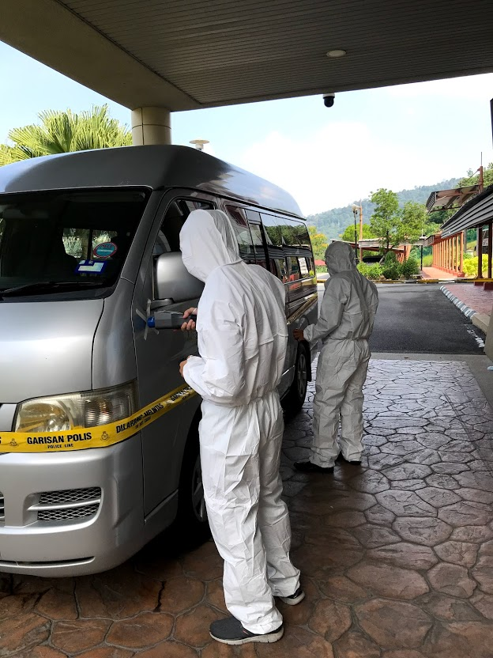
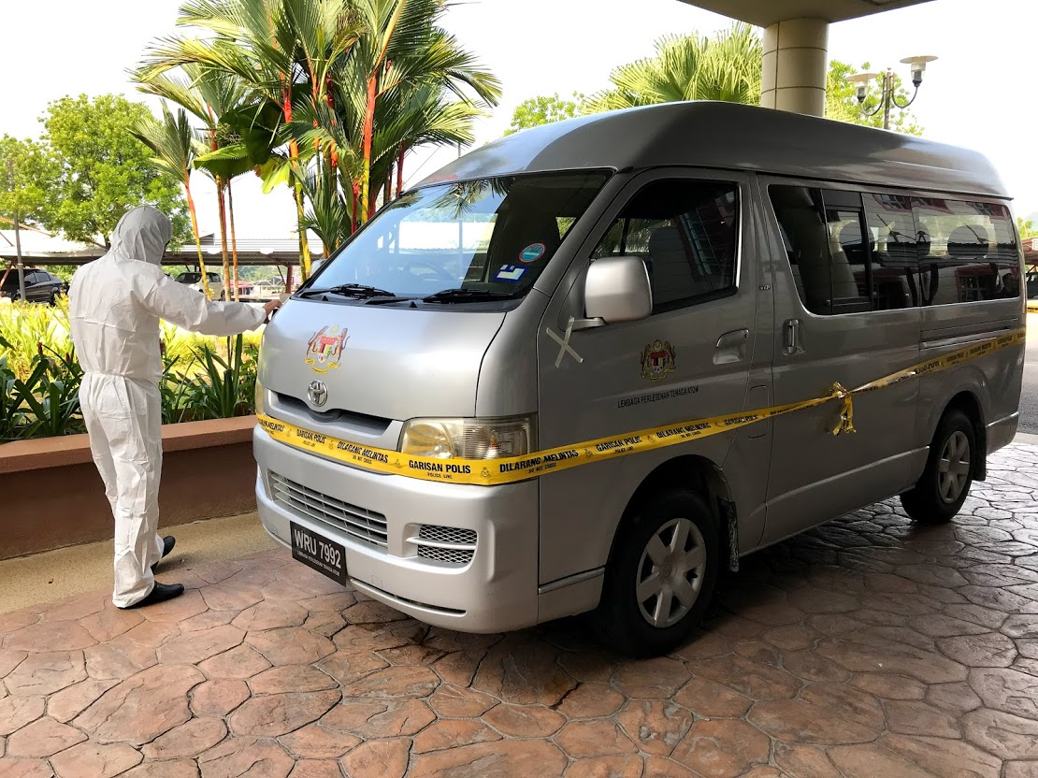
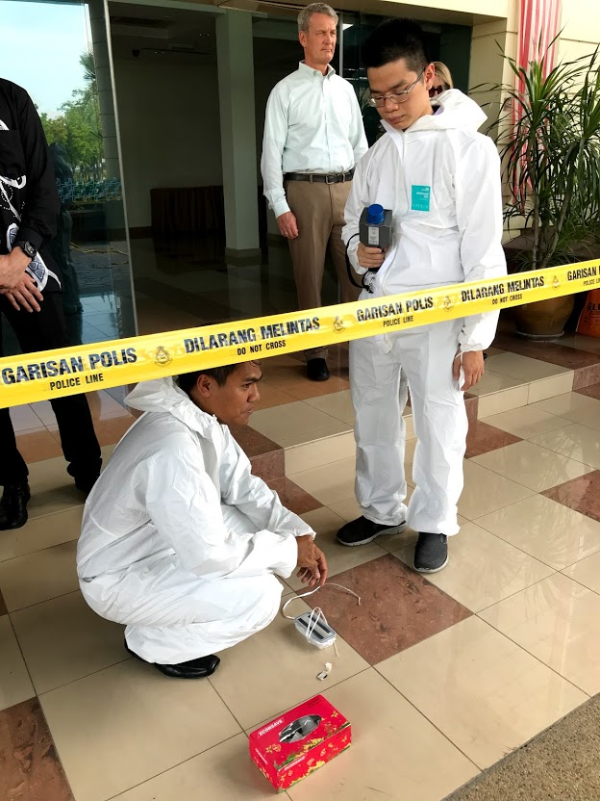
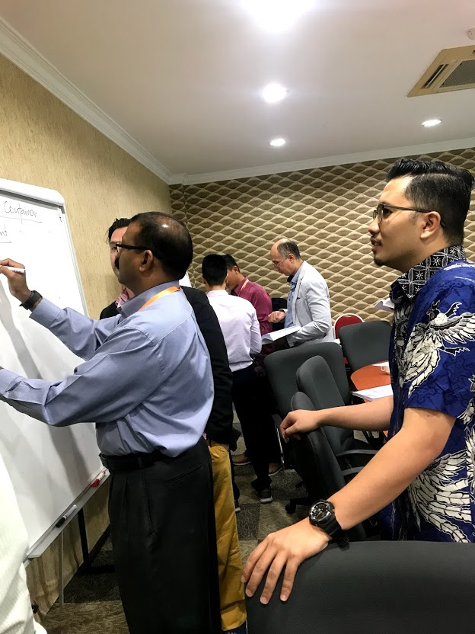

Slide 6
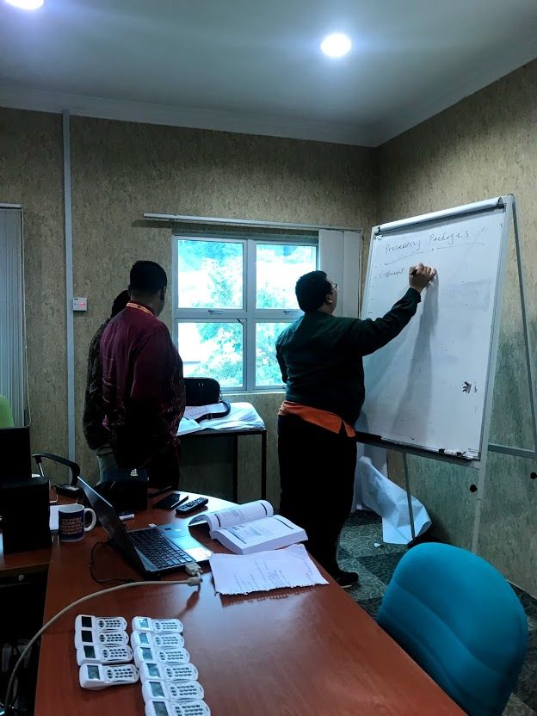
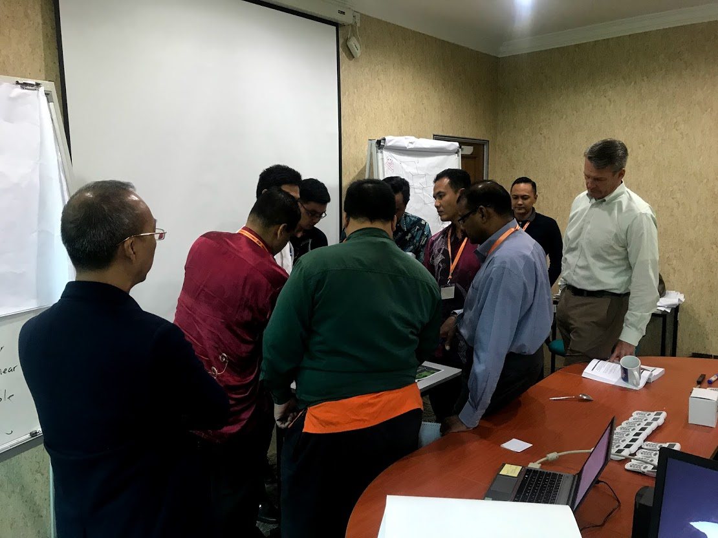
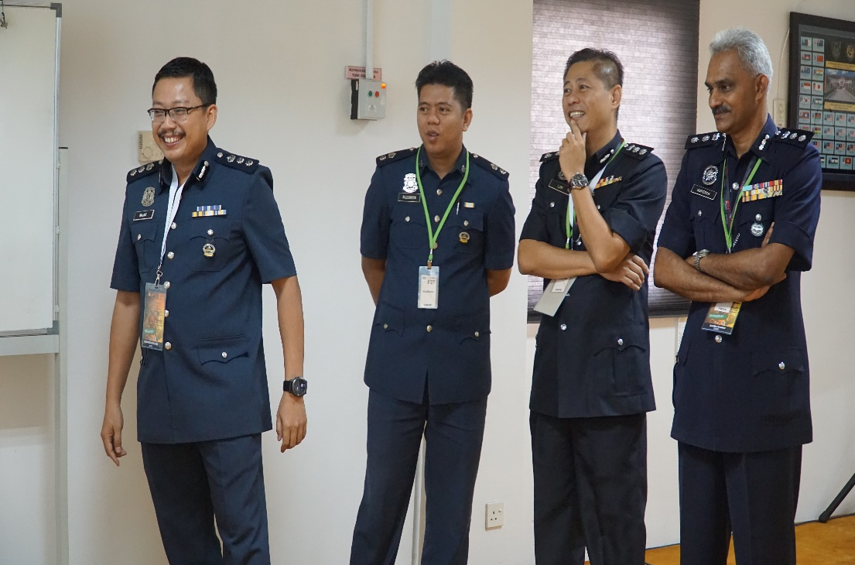
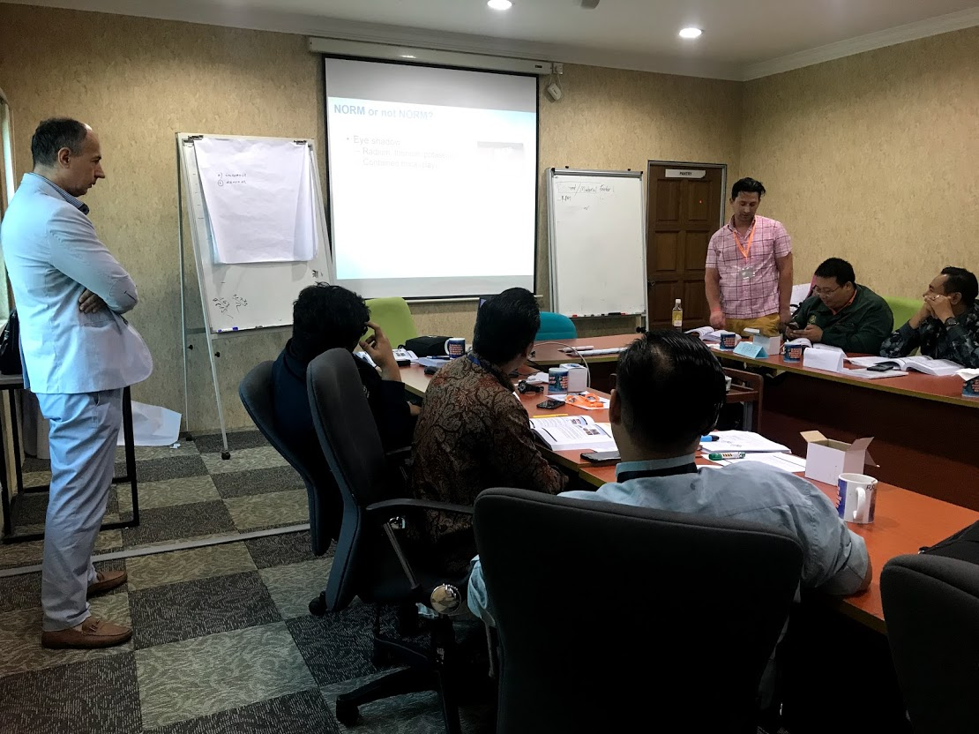
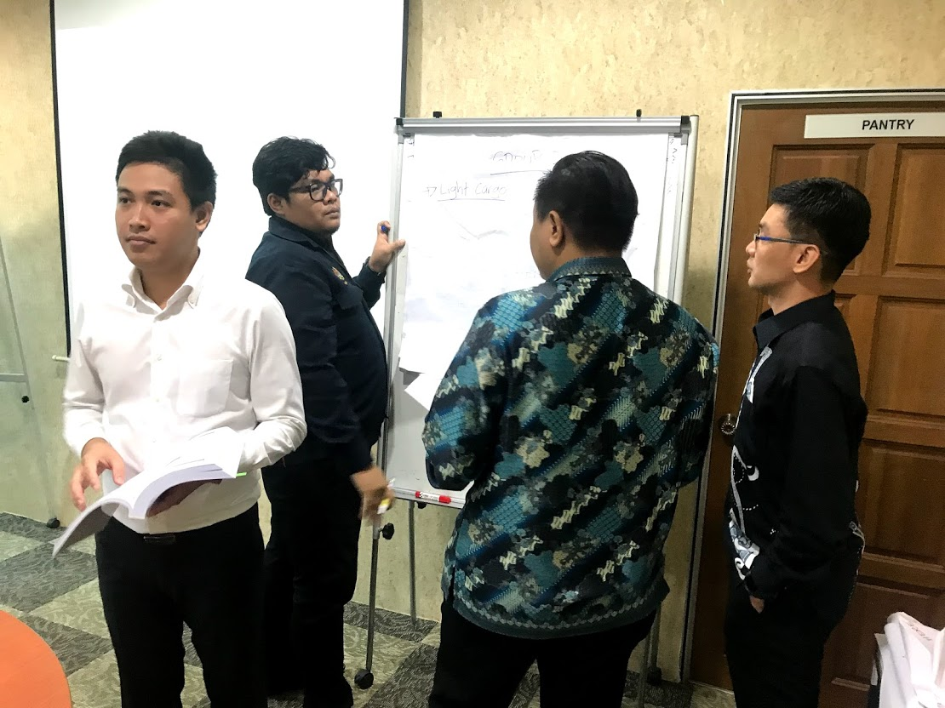

Slide 7
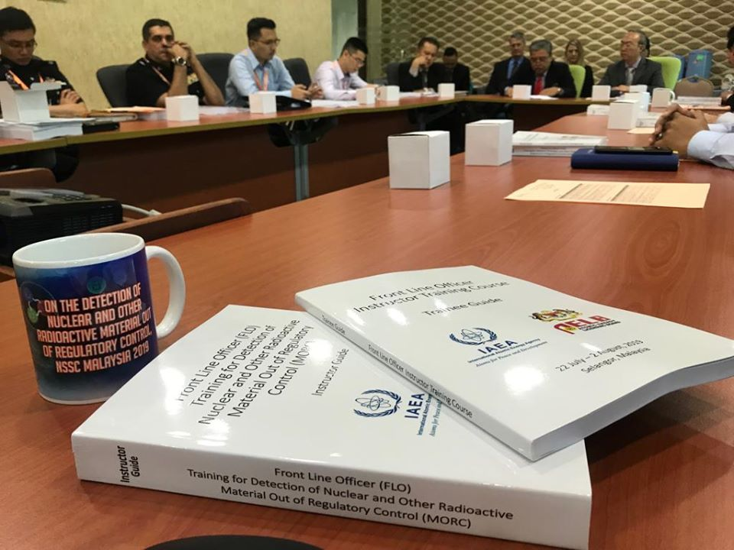
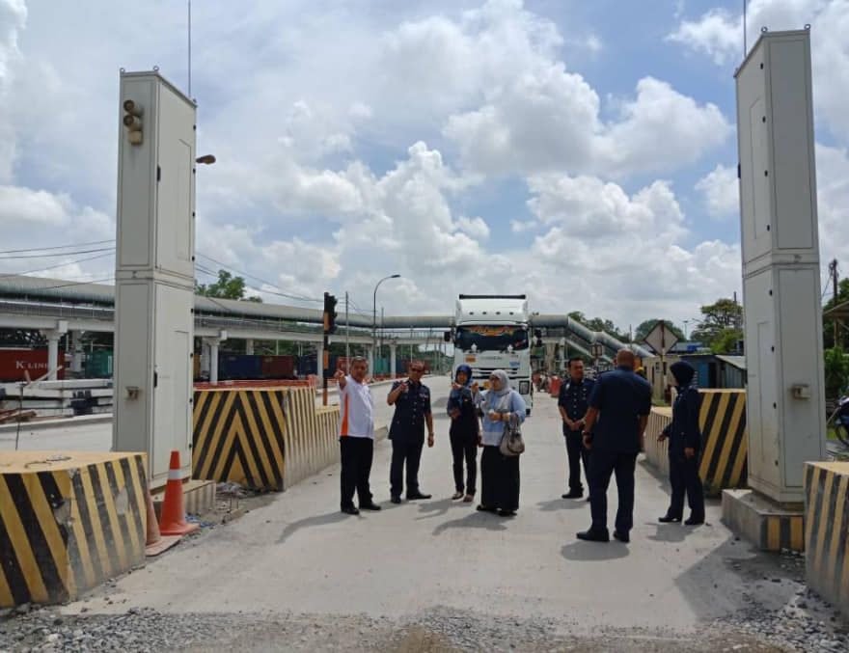
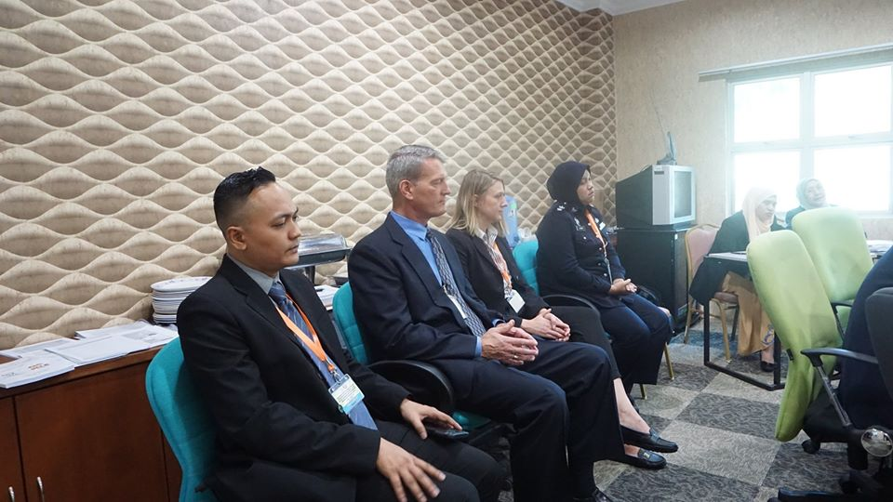

Slide 8
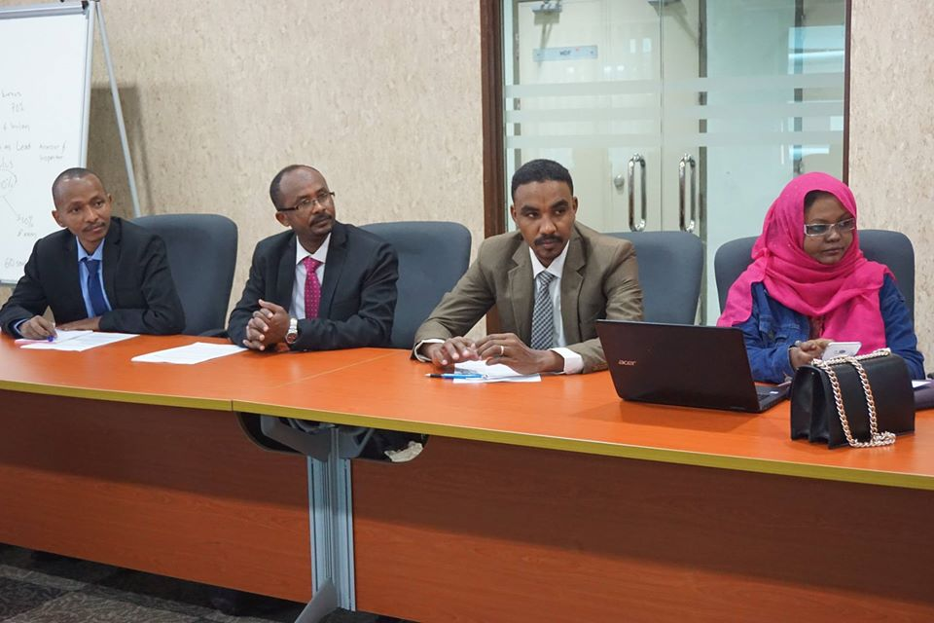
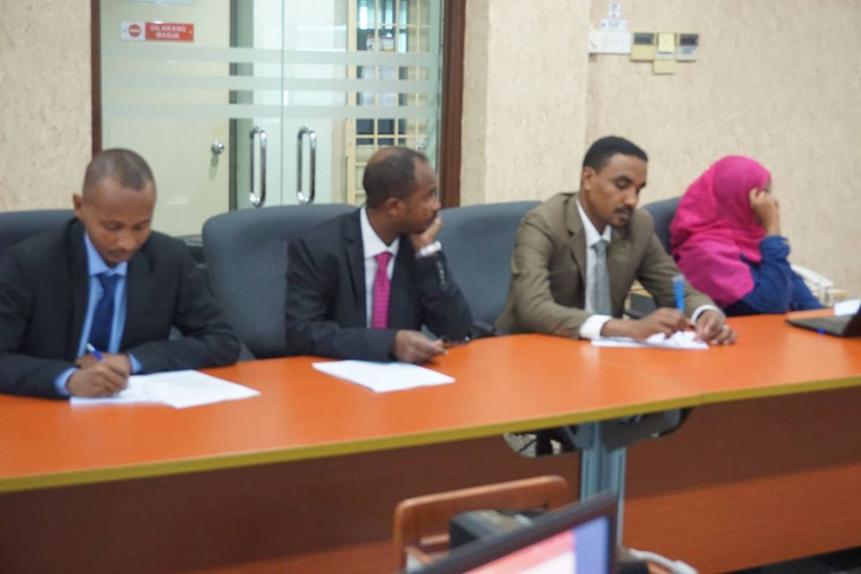
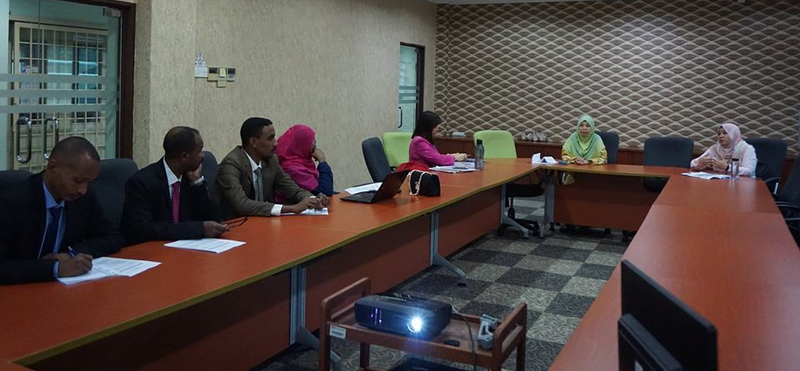

Slide 9
Conclusion
The strategic approach in implementing Instructors training programme addresses high needs of competent FLO within job rotational environment and has been one of the best initiatives undertaken by Malaysia’s NSSC in the effort to ensure effective and sustainable nuclear security detection capabilities in Malaysia.
Malaysia has successfully trained 49 trainer from 2017- 2019 for front line officer on nuclear security detection in Malaysia.

