Slide 1
Development of the Asherah Nuclear Power Plant Simulator for Cyber Security Assessment
&
UNDERSTANDING NUCLEAR CYBER SECURITY MEASURES, RISKS
AND CONSEQUENCES: FROM TANK LEVELS TO PLANT PROCESSES
Rodney Busquim e Silva
Koroush Shirvan
José Roberto Castilho Piqueira
Ricardo Paulino Marques
Scott Purvis
Paul Smith
Mitchell Hewes
Jianghai Li
Robert Altschaeffel

Slide 2
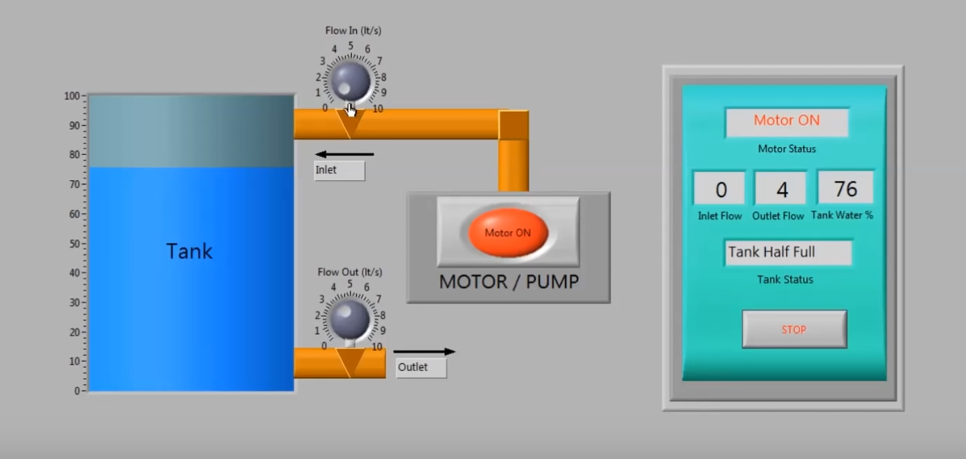
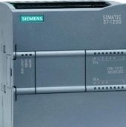
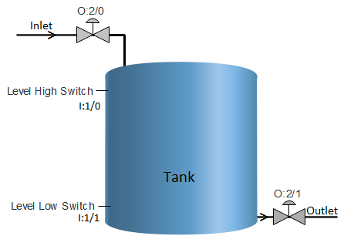
WHY?
Tank level controllers are common to industries such as energy, oil & gas, chemical and metallurgy.
Due to their simplicity, tank level controllers are the tools-of-choice to represent the effects of a cyber-attack in real world equipment.

Slide 3
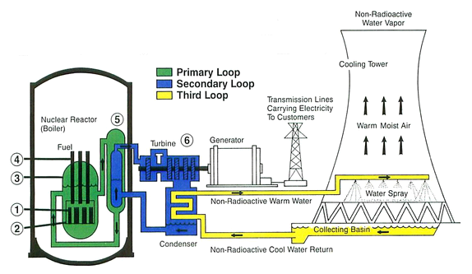
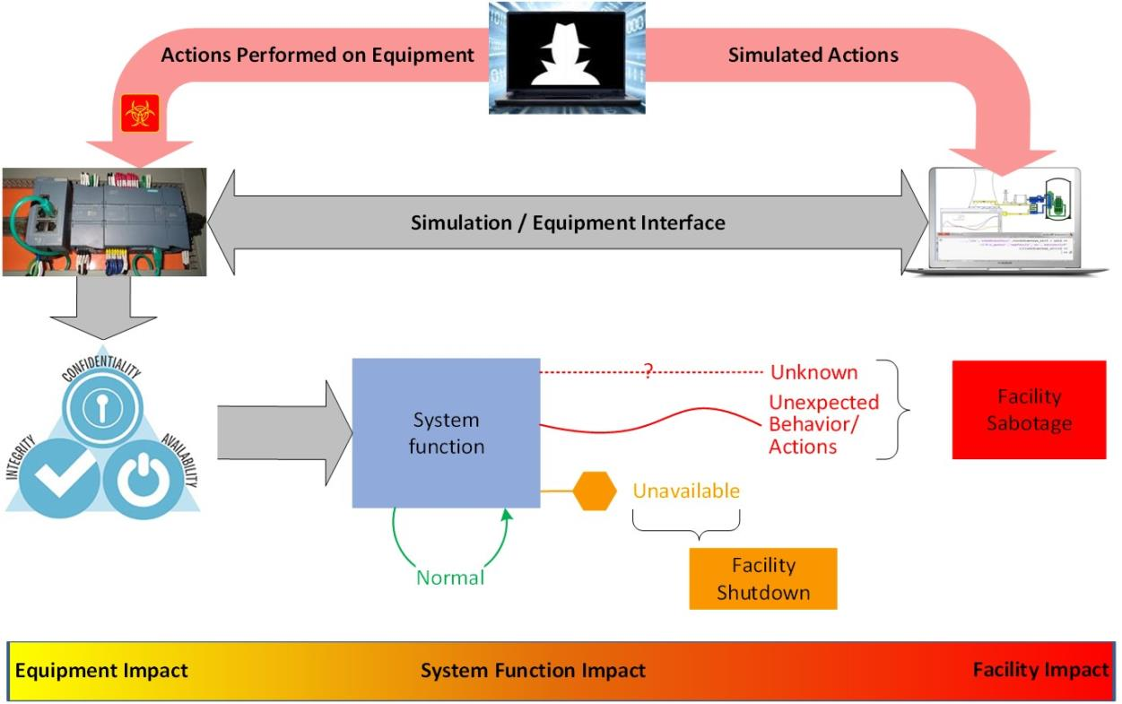
WHY?
Fictitious Asherah NPP
Asherah NPP
Simulator
Modeling
Plant Simulation
Hardware in the Loop
Assessment

Slide 4
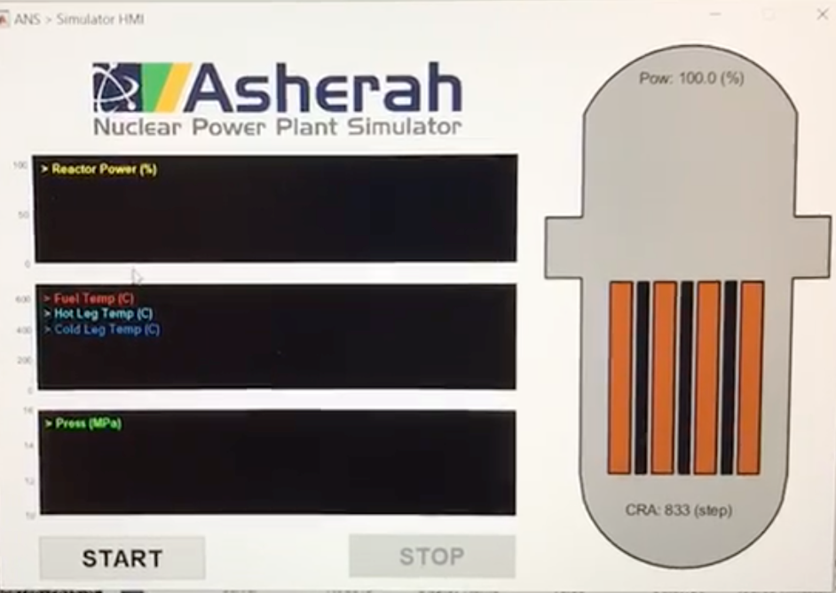
WHAT?
The ANS reproduces the Asherah NPP behavior using dynamic models.
It is based on the TMI core along with typical industry equipment and systems and standard control logic.
USP has implemented ANS using the MATLAB/SIMULINK environment to interface with digital IT/OT equipment.

Slide 5
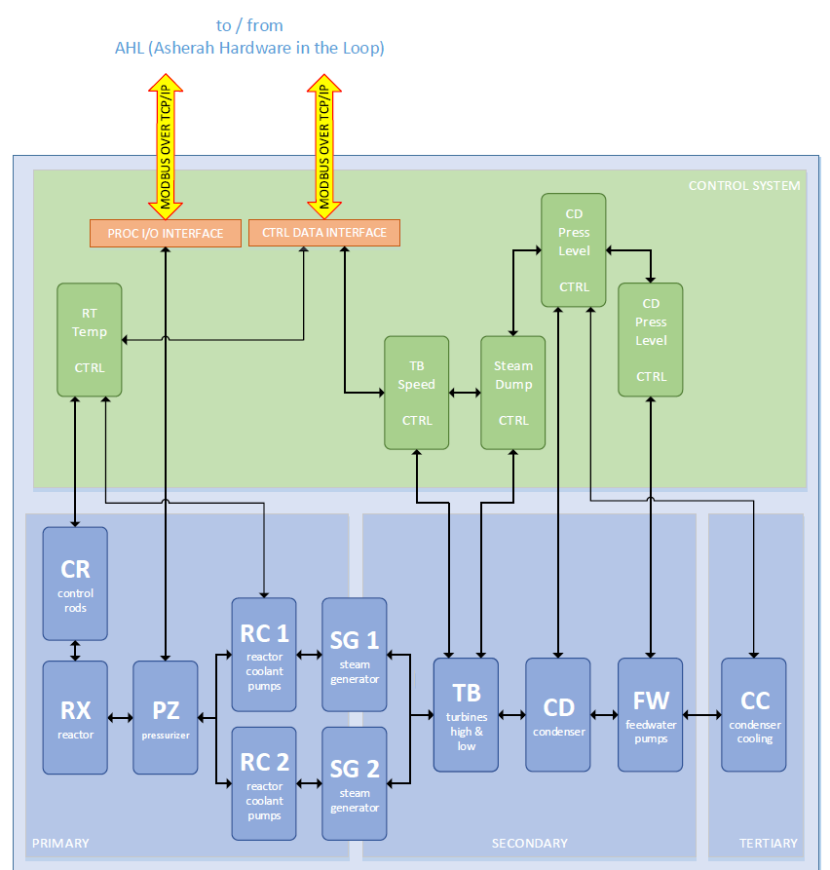
HOW?
Process I/O Interfaces
allow physical processes interfacing
Control I/O Interfaces
allow Hardware in the Loop implementations

Slide 6
Model-Based Run
Standalone Run
HIL-Based Run
ANS running in one Laptop
Laptop plus dedicated hardware (PLC, for example)
ANS Controller & Plant running in more than one Laptop
Portable
Comprehensive

Slide 7
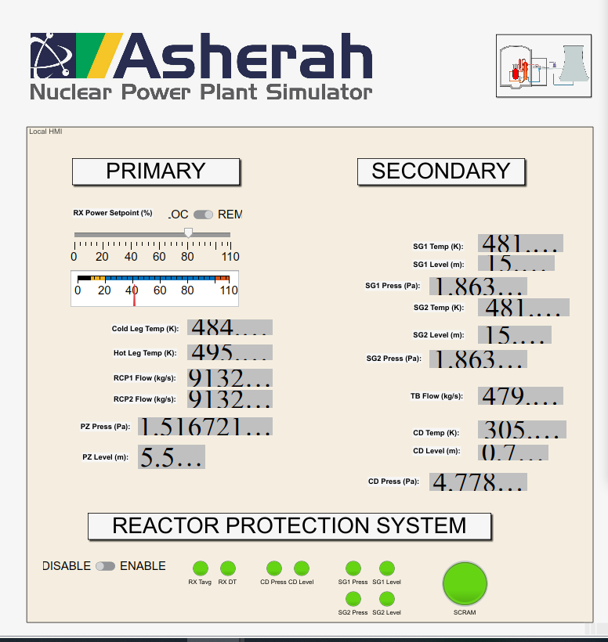
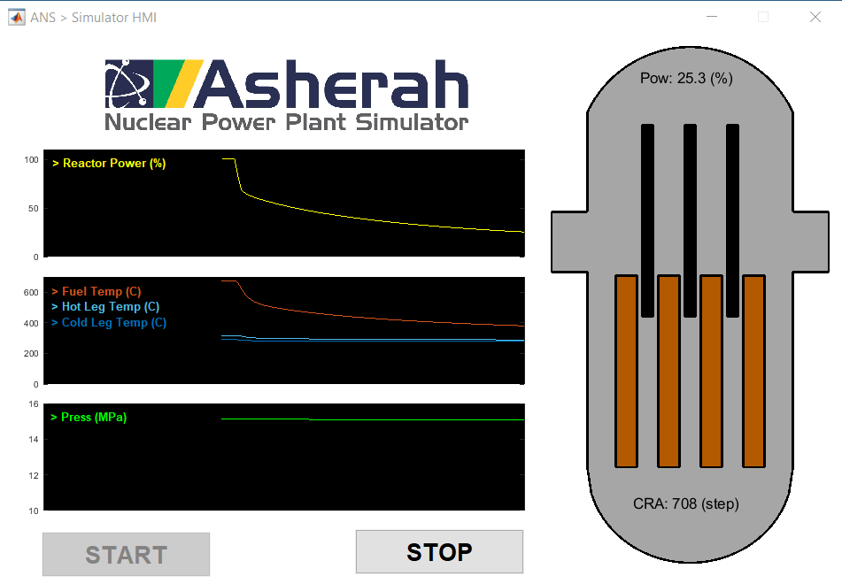
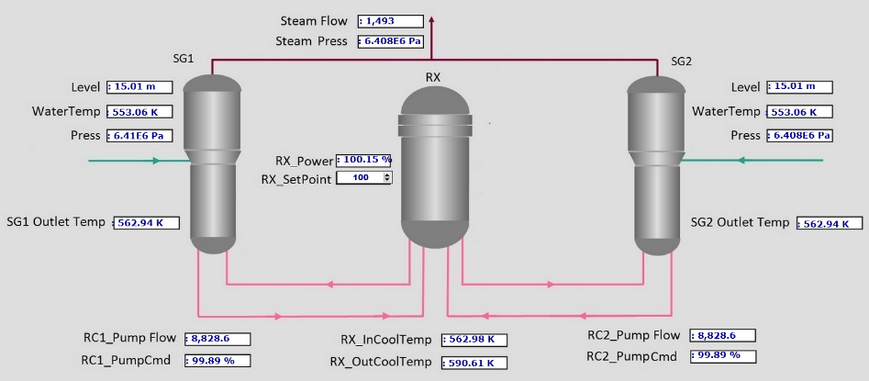
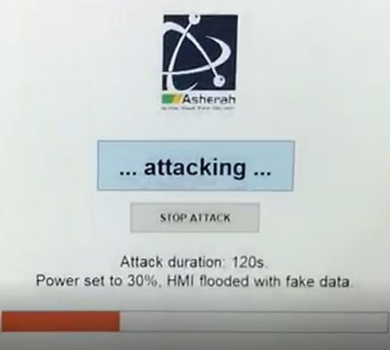
ICONS 2020 DEMO
CONTROL ROOM HMI
LOCAL HMI
REACTOR CORE PANEL
3 Virtual Machines
1 Programmable Logic Controller
Virtual process network
CONFIGURATION AND ATTACK TERMINAL

Slide 8
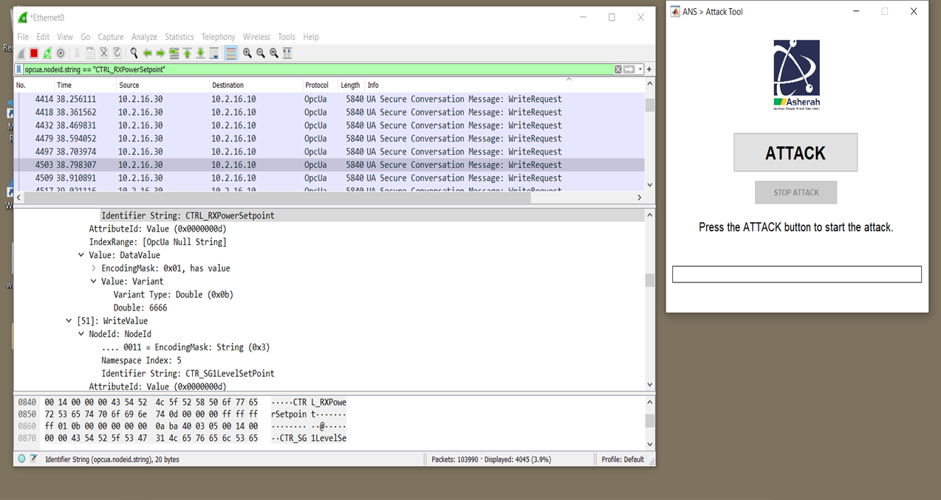
ICONS 2020 DEMO
Wireshark Packet Inspection

Slide 9
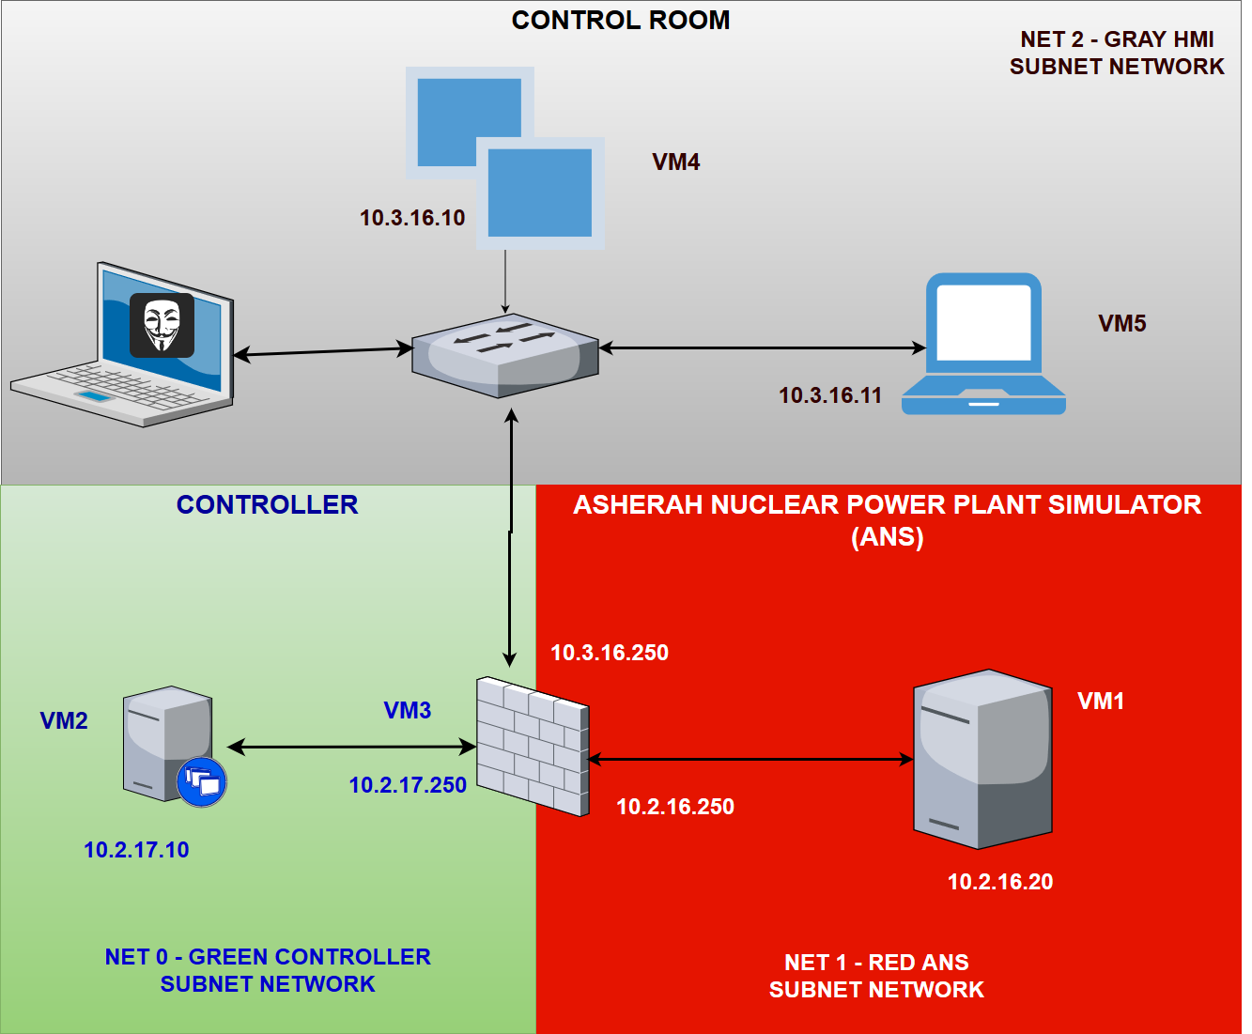
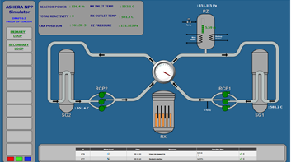
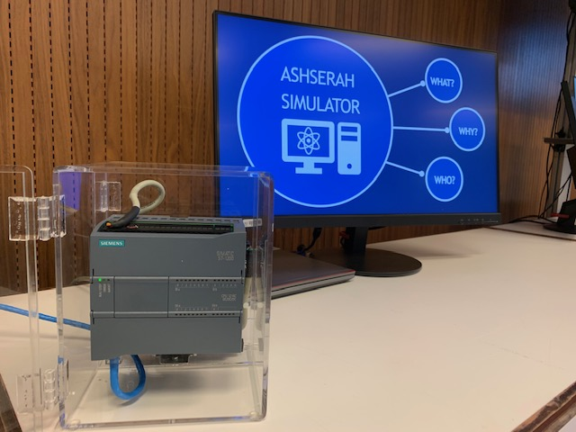
CYBER ATTACK SCENARIO

Slide 10
Condensate Cooling Pump (CCP) controller compromised.
100 % rated speed to shutdown.
Facility impact & physical consequences assuming:
Case a) With safety systems:
- Reactor Protection System (RPS): Reactor shutdown
- Engineered Safety Functions (ESF): Heat removal
Case b) Without Safety Systems
Condenser Cooling Pump Stopped

Slide 11
Condenser Pressure
Case a)
Case b)
Condenser Level
Case a)
Case b)

Slide 12
Reactor Average Temp.
Case a)
Case b)
Reactor Power
Case a)
Case b)

Slide 13
PLEASE FELL FREE TO PLAY WITH ANS
AND RUN THE ATTACK DEMO @ CYBER VILLAGE

