Slide 1
Vulnerability Assessment of Nuclear Security Systems in Kenya Mercy Muriithi & Isaac Mundia Kenya Nuclear Regulatory Authority
International Conference on Nuclear Security

Slide 2
Contents
Why vulnerability assessment?
Overview of Nuclear Security Systems in Kenya
Potential targets and Threats
Kenya’s Threat profile
Vulnerability assessment by the competent authority
Recommendations

Slide 3
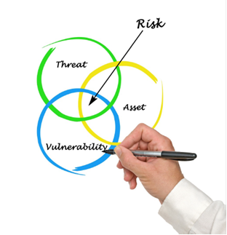
Why vulnerability assessment?
Vulnerability assessment is an effective process in achieving design-based mitigation of threat.
Risk- Likelihood of unacceptable consequence.= Vulnerability x Threat x Asset criticality.
Risk= Vulnerability exposed to threat

Slide 4
Overview of Nuclear Security Systems in Kenya
Nuclear and radioactive materials are utilized all sectors of our economy.
Number of radioactive materials are in increase due to socio-economic development currently there are over 4,000 radioactive material in use.
Health, Mining, Research, Agriculture, Oil and gas exploration, Industry etc.
Kenya is also an embarking country.
Kenya is a party to CPPNM/A and ICSANT

Slide 5
Nuclear Security Systems in Kenya
Up to December 2019, the legal and regulatory framework for nuclear security was based on the Radiation Protection Act Cap 243
It established Radiation Protection Board as the competent authority.
Radiation Protection Act Cap 243 was repealed by the Nuclear Regulatory Act 2019.
The new Act transforms RPB to Kenya Nuclear Regulatory Authority.
The previous act did not exhaustively provide necessary provisions for security

Slide 6
Nuclear Security Systems in Kenya, cont’d
There is a national nuclear security coordinating mechanism
Kenya Nuclear Security Coordination Centre (KNSCC)
It comprises 18 Government agencies.
The competent authority Regional CBRN Secretariat for Eastern & Central Africa

Slide 7
Potential Targets and threats
More 4000 radioactive materials are in use in Kenya
Several Category I and II sources
Large number of portable RMs
There is also a Central Radioactive Waste Processing Facility holding category I and II disused RMs
Kenya has a designated POC for IAEA-ITDB, and has reported several cases through this forum. Including:
Unauthorized trade (2 Cases)
Unauthorized Movement (1 Case)
Theft (2 Cases)
Unauthorized Possession (3 Cases)
Discovery (1 Case) and
Scam/Fraud (4 Cases)

Slide 8
Kenya’s Threat Profile
There have been several terrorist attacks in Kenya.
Attacks have been carried out by well known terrorist groups such as Al Qaeda and Al Shabaab.
The groups have large source of funding and trained paramilitary personnel.
It is purported that some of these adversaries have been actively pursuing nuclear/radioactive material which they could use to make INDs or RDD.
Other adversaries include criminal gangs, separatist movements and politically aligned networks.

Slide 9
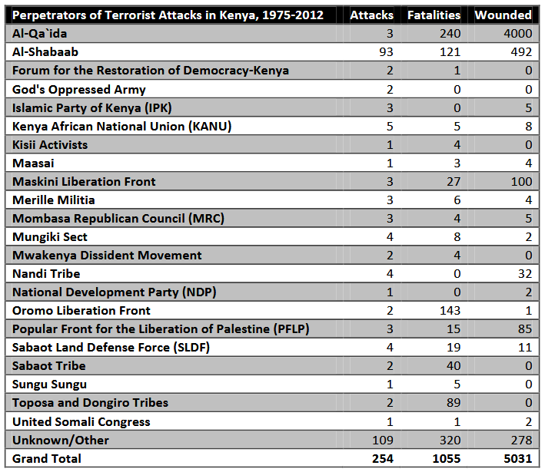
Kenya’s Threat Profile

Slide 10
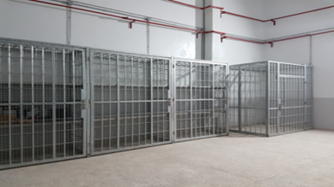
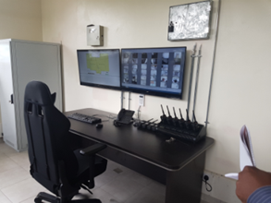
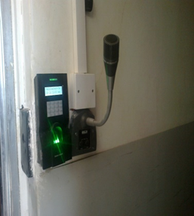
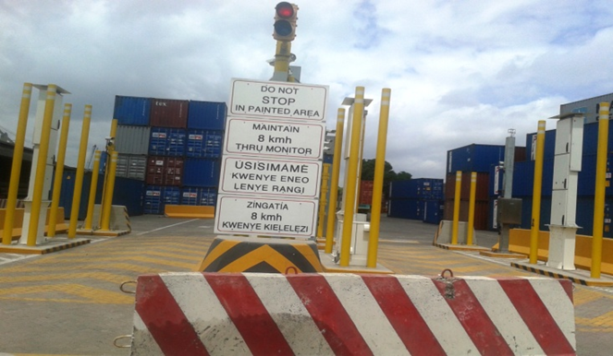
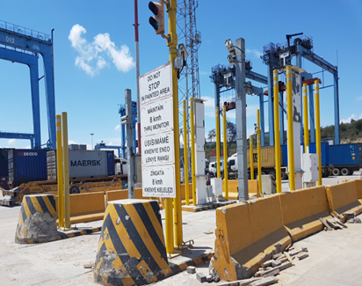
Physical Protection Systems in place
Kenya has benefited from various physical security upgrade initiatives.
Global Threat Reduction Initiative (GTRI)at CRWPF
Mega Ports Initiative (MPI) at Port Kilindini

Slide 11
Vulnerability Assessment
The competent authority periodically conducts vulnerability assessment of key facilities
This includes compliance with the regulatory requirements
Both Performance based and prescriptive inspections are done.
Evaluation of procedures, access control systems, intrusion detection systems, identification systems, among other elements

Slide 12
Recommendations by the authority
Conducting comprehensive threat assessment and design basis threat, periodically reviewing and updating it
Continuous testing and force on force exercises on the physical barriers to identify areas of weakness.
Continuous training and capacity building
Comprehensive NMAC
Cooperation among stakeholders
Adapting alternate technologies e.g. LINAC instead of teletherapy units

Slide 13
THANK YOU
SHUKRANI

