Slide 1
International Atomic Energy Agency
(IAEA)
CoSSeN
Mrs Chloé DEBIEVE
International Conference On Nuclear Security (ICONS) 2020.
Commandement
Spécialisé pour la
Sécurité
Nucléaire
Specialized Command For
Nuclear Security
RESTRICTED

Slide 2
Improve coordination of security actors
CoSSeN
Enhance, harmonize and coordinate operational concepts
Centralize, analyze, and share information
Control and monitor individuals accessing nuclear facilities
Improve expertise of security forces
Administrative investigations
RESTRICTED

Slide 3
CoSSeN’s position in the national framework
CoSSeN
Ministry of the Interior
Ministry of Energy
STATE ACTORS
NUCLEAR ACTORS
Ministries
HIS AUTHORITIES…
Nuclear operators
Police and Gendarmerie
WORKS WITH…
WORKS WITH…
CoSSeN
(2016)
Nuclear and radiation protection experts
Intelligence agencies
IS COMPOSED OF…
Gendarmerie officers
Police officers
Civil servants
RESTRICTED

Slide 4
Control and monitor individuals accessing
nuclear activities and facilities
CoSSeN
Why?
To better manage insider threats with an accurate picture of the entire nuclear population
How?
Harmonize and reinforce control procedures
Conducting background investigations on individuals requesting access to nuclear facilities
Monitoring individuals accessing nuclear facilities (ex: development of a specific monitoring tool for legal and natural persons)
RESTRICTED

Slide 5
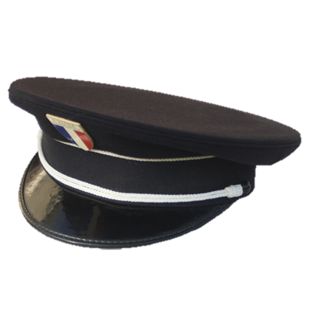
For this end
CoSSeN
ACCReD
(2017)
9 security
databases
Vulnerabilities ?
RESTRICTED

Slide 6
The stages of access control
CoSSeN
Request
Screening
Doubt removal
Nuclear operator
CoSSeN
CoSSeN
Validation
Analysis
Further information
CoSSeN
CoSSeN
CoSSeN
Opinion
Decision
Appeal
CoSSeN
Nuclear operator
Ministry of Energy
Legend : Operator
CoSSeN
Ministry of Energy
RESTRICTED

Slide 7
Statistics 2019
CoSSeN
Registrations
in ACCReD
Registrations
in TAJ
Negative opinions
Hierarchical
appeals
Number of
requests
RESTRICTED

Slide 8
Conclusion
CoSSeN
Administrative investigations = essentials to protect internal security and public safety
A system regulated by the law
A system that reassures and satisfies the French nuclear groups
RESTRICTED

Slide 9
Any Questions ?
CoSSeN
Commandement
Spécialisé pour la
Sécurité
Nucléaire
Specialized Command For
Nuclear Security
RESTRICTED

