Slide 1

Visualization And Machine Learning For Interactive Cyber Threat Analysis In Critical Infrastructures
3rd International Conference on Nuclear Security: Sustaining and Strengthening Efforts (ICONS 2020)
Vienna, Austria, February 10-14, 2020
START
R. AZZABI, C. GOUY-PAILLER, F. VALLEY and H. DUBOIS

Slide 2

p19.
  The foundation of nuclear security culture is recognition […] that a credible threat exists and that nuclear security is important.
  Computer security culture is a subset of the overall security culture […].
  Experience has demonstrated that the majority of computer security incidents are human related and the security of any computer system depends largely on the behavior of all its users.

Slide 3
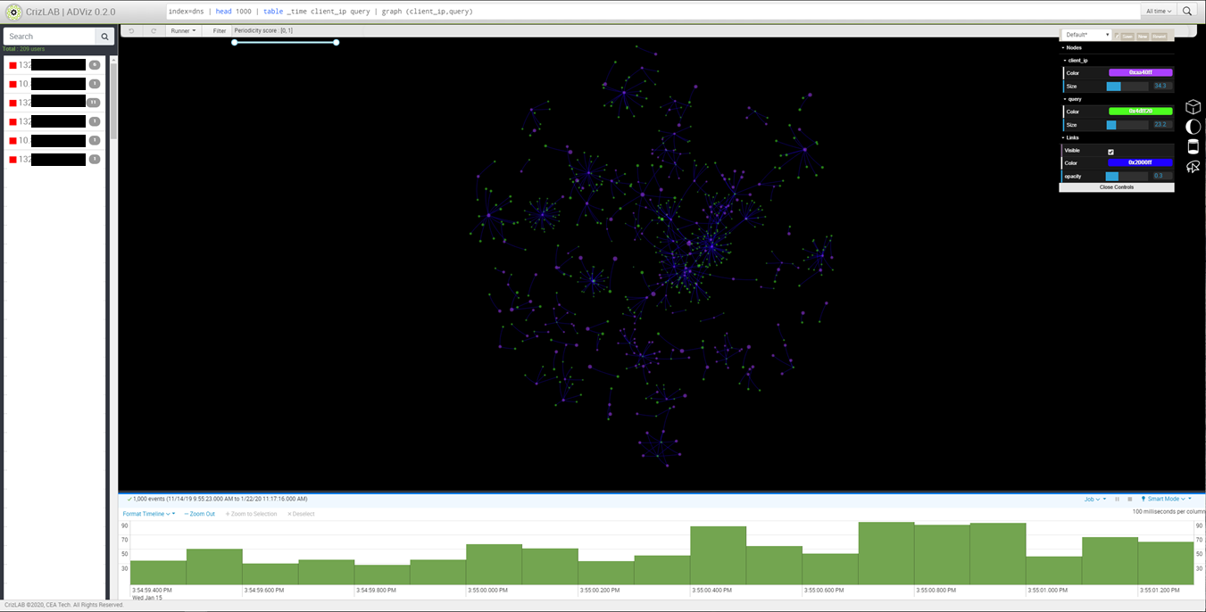
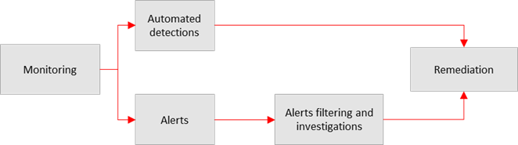
Main idea: Cybersecurity experts remain the essential element regarding computer security analysis. Recent advances in machine learning, artificial intelligence and visualization can empower experts in cyber-analysis tasks.
Our proposal: A tool, incorporating 3D visualization and artificial intelligence, to assist cybersecurity experts in everyday operations.

Slide 4

Visualization And Machine Learning For Interactive Cyber Threat Analysis In Critical Infrastructures
CONTEXT
Threat identification and characterization is a continuous and perpetual effort.
A plethora of tools currently generate too many alerts to be effectively managed by humans.
OBJECTIVES
To help operators investigate the criticity of cyber threats alerts in Security Operational Centers (SOC) of critical infrastructures.
FRAMEWORK
A dedicated software tool to help SOC operators that combines machine learning and visualization.
Use-case scenarios designed with cybersecurity experts.
Identify a particular behavior of the offending machine to detect similar attacks on a network.
CASE STUDY
Experimental assessment: to reduce investigation time.
A powerful combination between 3D visualization capabilities, machine learning and AI techniques.
CONCLUSION

Slide 5
Visualization And Machine Learning For Interactive Cyber Threat Analysis In Critical Infrastructures
CONTEXT
Threat identification and characterization is a continuous and perpetual effort.
An abundance of tools generates too many alerts to be effectively managed by operators.
.
Critical systems evolve and become increasingly interconnected
New vulnerabilities and new attacks have emerged.
Attackers’ techniques have evolved: from simple approaches to advanced and specific targeting.
Cyber threat identification and characterization has become a critical task.
Attack Sophistication vs. Intruder Technical Knowledge.
Source: CERT Coordination Center, ©2002 by Carnegie Mellon University.
CONTEXT
OBJECTIVES
FRAMEWORK
CASE STUDY
CONCLUSION

Slide 6
Visualization And Machine Learning For Interactive Cyber Threat Analysis In Critical Infrastructures
OBJECTIVES
Help operators to investigate the criticity of cyber threat alerts in Security Operational Centers (SOC) of critical infratructures.
Network operations and maintenance still require large scale supervision in a time-deferred fashion.
Detecting malicious activities is an important part of an information security strategy
Effective detection on anomalous behaviour is a key element in detecting attacks
Automated detection saves time but generates a significant number of false positives
Manual investigation remains a complex task but with fewer false positives
Efficient analysis tool with mixed approach :
Machine learning for automatic anomaly detection
Interactive visualization for efficient manual analysis
How to reduce investigation’s time and complexity
CONTEXT
FRAMEWORK
CASE STUDY
CONCLUSION
OBJECTIVES

Slide 7
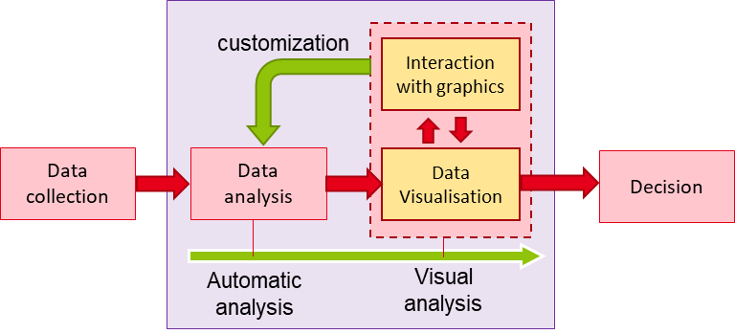
Visualization And Machine Learning For Interactive Cyber Threat Analysis In Critical Infrastructures
FRAMEWORK
A dedicated software tool to help SOC operators that combines machine learning and visualization
We advocate that operators’ investigations can be accelerated using advanced contextualization:
  characterizing the historical behavior of a user
  understanding the historical usage profile
  clustering activities according to the historical patterns.
Operators need to quickly decide whether an activity should be considered as a threat or a legitimate activity.
Operators need to explore complex raw data results via interactive visualization
Operators need to configure and customize algorithms for the next process analysis
CONTEXT
FRAMEWORK
CASE STUDY
CONCLUSION
OBJECTIVES

Slide 8
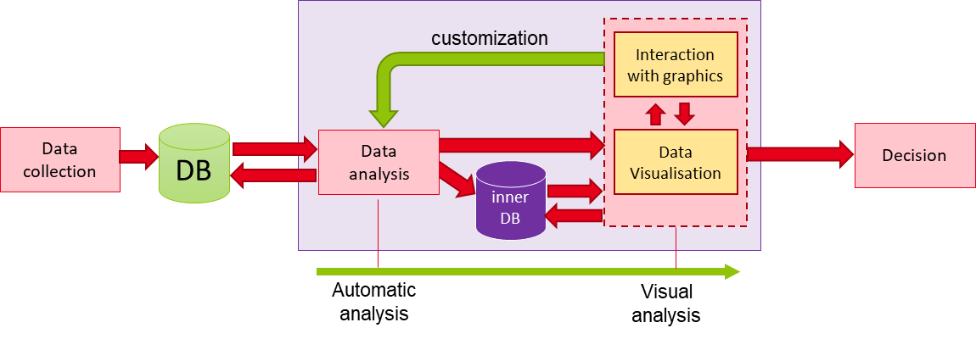
Visualisation And Machine Learning For Interactive Cyber Threat Analysis In Critical Infrastructures
FRAMEWORK
(1) Machine Learning and IA Modules
(2) HMI and data visualization Modules
CONTEXT
FRAMEWORK
CASE STUDY
CONCLUSION
OBJECTIVES

Slide 9
Visualization And Machine Learning For Interactive Cyber Threat Analysis In Critical Infrastructures
FRAMEWORK
(1) Machine Learning and IA Modules
A memoryless algorithm is operationally used as a functional black box.
Three machine-learning algorithms are available :
  Behavior modeling and summarization
  Dimensionality reduction
  Similarity search, top-k requests and clustering
Three main possibilities of interaction between the user and the algorithms:
  Lightweight memoryless algo
  Heavyweight algo
  Stage-separable algo
CONTEXT
FRAMEWORK
CASE STUDY
CONCLUSION
OBJECTIVES

Slide 10

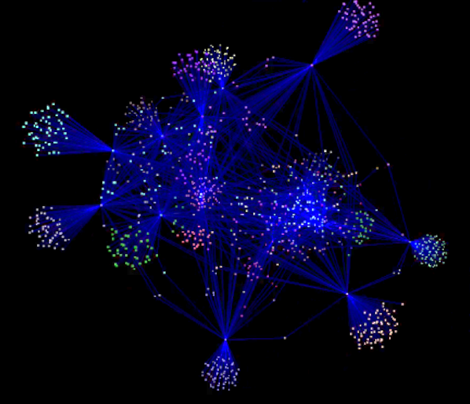
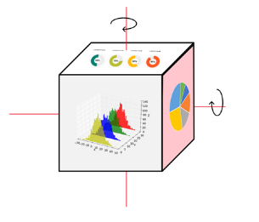

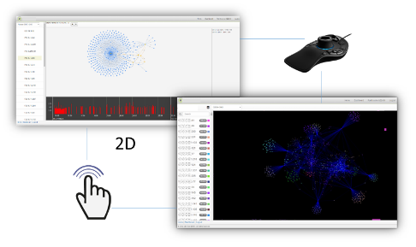
Visualization And Machine Learning For Interactive Cyber Threat Analysis In Critical Infrastructures
FRAMEWORK
(2) HMI and data visualization Modules
Data visualization.
  2D representation (a)
  3D representation (b)
  Extended visualization Area (c)
Data interaction:
  3D points cloud selection techniques (d)
  Freeform selection (e)
  Multi-interaction level (f)
(a)
(b)
(c)
(d)
(e)
(f)
CONTEXT
FRAMEWORK
CASE STUDY
CONCLUSION
OBJECTIVES

Slide 11
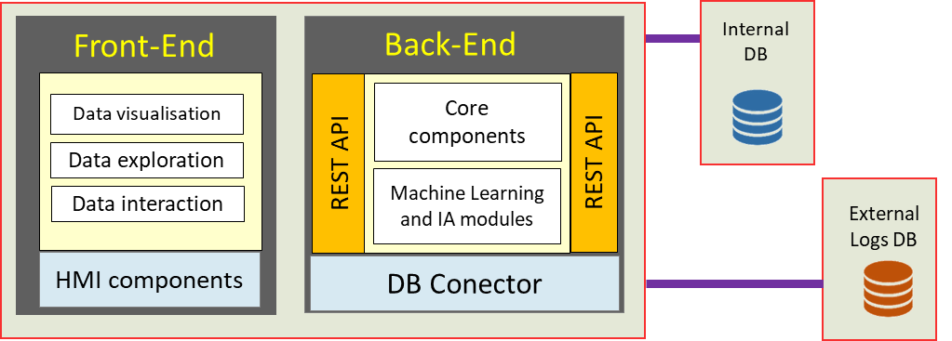
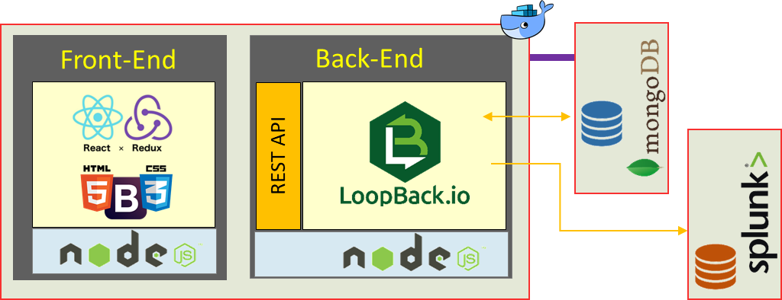
Visualization And Machine Learning For Interactive Cyber Threat Analysis In Critical Infrastructures
FRAMEWORK
A full stack architecture
Software architecture
Technologies used
CONTEXT
FRAMEWORK
CASE STUDY
CONCLUSION
OBJECTIVES

Slide 12
Visualization And Machine Learning For Interactive Cyber Threat Analysis In Critical Infrastructures
FRAMEWORK
Video will be added here
CONTEXT
FRAMEWORK
CASE STUDY
CONCLUSION
OBJECTIVES

Slide 13
Visualization And Machine Learning For Interactive Cyber Threat Analysis In Critical Infrastructures
CASE STUDY
Use-case scenarios designed with cybersecurity experts
Identify a particular behavior of the offending machine to detect similar attacks on a network
Incident trigger
TS
1
HMI
3D Visualization
7
3D interaction
SRC
Front end
Target
Automatic Analysis
Visual Analysis
2
6
10
8
REST API
DB
3
Back end
Search_fn
4
Data_denoising_fn
5
Grapher_fn
9
Data_correlation_fn
Logs
CONTEXT
FRAMEWORK
CASE STUDY
CONCLUSION
OBJECTIVES
Notes:
The manual procedure could follow five main steps:
DNS activity visualization of the identified targeted machine, during a short period of time around the vulnerability trigger;
Filtering: DNS data denoising to remove normal activities such as periodic system activity or activity-induced logs.
Node selection (suspicious domain names);
From the previous selection of domain names, perform a similarity search on the whole network to detect computers, which have had a similar DNS activity in an extended period of time.
Correlate these DNS activities on the extended set of selected suspicious machines to analyze corresponding Active Directory activities to complete this specific malware detection.

Slide 14
Visualization And Machine Learning For Interactive Cyber Threat Analysis In Critical Infrastructures
CONCLUSION
Experimental assessment: to reduce investigation time.
A powerful combination between 3D visualization abilities, machine learning and AI techniques.
Evaluation (initial assessments)
Useful for reducing specific investigation tasks:
  AI can scale down the number of events to be analyzed,
  3D visualization is useful for large and multidimensional raw data representation
  Reactive HMI allows easier data exploration
Tool can be used for both investigation approaches:
  Launching an investigation from a known incident
  Exploring data to identify new anomalies
Limits
Some functionalities were unfeasible for real time investigations -> need to schedule pre-computations
3D interactions (eg. selection and navigation) are difficult for non-experienced users
Big graph rendering -> need to generate graph on server side and stream results to client side
CONTEXT
FRAMEWORK
CASE STUDY
CONCLUSION
OBJECTIVES

Slide 15
Visualization And Machine Learning For Interactive Cyber Threat Analysis In Critical Infrastructures
CONCLUSION
Experimental assessment: to reduce investigation time.
A powerful combination between 3D visualization abilities, machine learning and AI techniques.
Roadmap
Tool:
  Improve functionalities
  Improve/simplify user interactions
End user:
  Advanced ergonomic study
User-case:
  Test our approach with a new use-cases ex: real-time anomaly detection within an ICS (Industrial Control System) dataset.
CONTEXT
FRAMEWORK
CASE STUDY
CONCLUSION
OBJECTIVES

Slide 16
Thank you for your attention
Radhouene AZZABI
radhouene.azzabi@cea.fr

