Slide 1
How to react of signs of changes in behaviour that might be signes of concern?
Lisa De Laet, Christelle Creus, Rony Dresselaers, Tony Snoeck
FANC
‘See something, Say someting’
In practice

Slide 2
Behavioral observation
Vetting = Picture of a persons situation
What is behind this picture?
Exercise in the field: the balance on when to react on signs
Aftercare System
Prevention
Detection
Handling a threat
Notes:
Home Page

Slide 3
Excercise in the field
Exercise: Baseline of behavior was provided, subtle changes in behavior where mentioned to see what would trigger a reaction
ITM Symposium, Brussels, March 2019:
Mainly regulators
A single sign did not trigger a reaction
More than one sign would trigger at least
a conversation MORE…

Slide 4
Excercise in the field
Exercise: Baseline of behavior was provided, subtle changes in behavior where mentioned to see what would trigger a reaction
Advanced ITM course, Albuequerque, July 2019:
Mainly operators
A single sign did trigger a reaction, they would like to talk to the person
Immediately there where ideas on how to further follow up

Slide 5
Prevention
Level 1 : Limit the risk factor
Level 2 : Identify people at risk
Level 3 : Discourage the action

Slide 6
Prevention
Level 1 : Limit the risk factor
Limit the risk factor → limit the attributes:
ACCESS
AUTHORITY
KNOWLEDGE
→ Compartmentalise

Slide 7
Prevention
Level 2 : Identify people at risk
Identity the people at risk
= Overview of the access, authority and knowledge of everyone
→ Job history at the facility is important
→ Define who could become more of a threat to you facility

Slide 8
Prevention
Level 3 : Discourage the action
Discourage the possible thought of an action against the facility
Notion that they will be caught
Good aftercare
Severe punishment
…
→ Make employees feel part of the organisation to make sure they don’t WANT to act against you facility

Slide 9
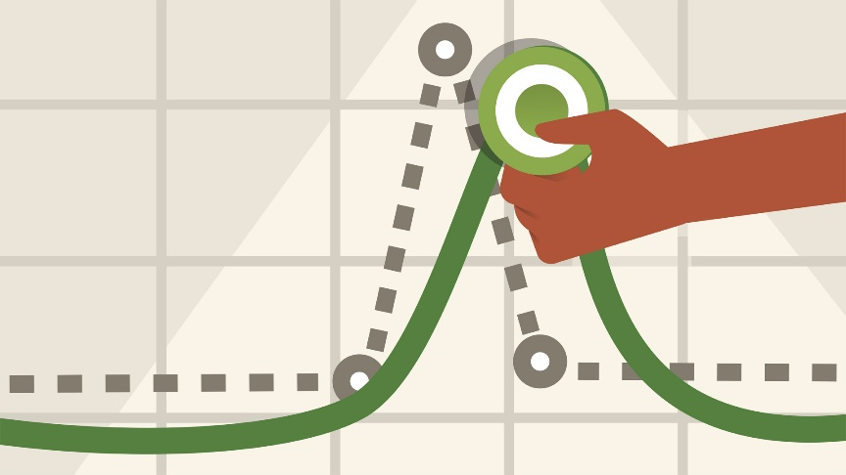
Detection
Reporting
Define a baseline
Security Culture

Slide 10
Detection
Reporting
REPORT IT!
In order to:
Identify the intention
Detect indicators
Safety and security violations
Reporting system:
Easy access
Ensure information is used

Slide 11
Detection
Define a baseline of behavior
To see change
= knowing a persons behaviour!
Behavioural observation
Identify the difference between a change in behaviour and a bad day

Slide 12
Change of behaviour
Baseline of behaviour
Difference in behaviour
Depends on the person:
Someone loud that acts quiet = change
Someone quiet that acts loud = change
→ Know your personnel and co-workers

Slide 13
Detection
Security Culture
‘The ideas, custums and values of a group’
Awareness on insider threat
Behavioural observation = education
Important to focus on the people in the organisation

Slide 14
Handling a threat
In order to act on a reported or identified item, you need to know how to handle the incident
And have clear procedures
Important:
Define the partners
Reaction & Legal constraints

Slide 15
Handling a threat
Define the partners
Partners in analysing signs of concern
To put the pieces of the puzzle together:
Security
Line management
HR
Civil society, …
= A Multi-lateral approach with
Information sharing!
Define what can be shared with who
AND..
→ Depends on the legislation of your country

Slide 16
Handling a threat
Define the partners
Stakeholders in handling an incident
To handle the threat:
Law enforcement
Vetting authority, …
It needs to be defines before an
incident happens in order to take
Efficient and accurate measures
→ Depends on the legislation of your country

Slide 17
Handling a threat
Reaction & Legal constraints
Reaction: Proportionally
Case by case analyses
BUT general framework needs to be defined:
Conversation with the person
Provide help to the person
Act on an incident
Ask the vetting authority for additional information
Contact law enforcement, …
Reported elements:
Follow-up necessary
No overreaction

Slide 18
Handling a threat
Reaction & Legal constraints
The reaction is defined by
Legal Contraints : what actions can I legally do
Which information can I share, can I look for
ex.: privacy?
Culture : what is tolerated in my culture
Country, company, team culture
Have procedures in place that define these aspects in advance, then you can focus on the person

Slide 19
Conclusion
General guidance is difficult
Depends on legal possibilities and culture
Case by case approach
Reporting and reacting appropriatly is a difficult balance
Share experience & International cooperation in order to takle these challenges
Join INFCIRC/908
→ No two insider cases are the same

Slide 20
Thank you for your attention

