Slide 1
Advancing the Transportation-Security, Tracking, and Reporting System (T-STAR)
International Conference on Nuclear Security: Sustaining and Strengthening Efforts (ICONS 2020) 10-14 FEB 2020
Michael Schultze Oak Ridge National Laboratory

Slide 2
Acknowledgements
James Younkin, Michael Schultze, Shane Frank, Brad Stinson, Bogdan Vacaliuc, Lloyd Clonts, Ronald Salesky, Alexandra Hackett, Nick Burchfield, Janet Jentilet Oak Ridge National Laboratory Thad Thompson, Caleb Askew CADRE Kristina Hatcher/Temeka Taplin Office of Radiological Security U.S. Department of Energy, USA James Shuler Packaging Certification Program US Department of Energy, USA

Slide 3
Agenda
Concept
General Capabilities
TSTAR Gen 3 Design Goals
Gen 3 Elements
MAVNet Multi-Channel Communications (MCM)
Authenticated Container Tracking Seal (ACTS)
Expansion capabilities
Data Authentication
Conclusion

Slide 4
Concept and Design Goals
Easy to use and flexible tracking and security system to stakeholders to provide visibility and intrusion detection on shipments.
Optimize power consumption
Extended battery life during tracking
Vehicle power and charging
Leverage existing technologies
Unmanned Aerial Vehicle UAV communications
ACTS low power and design concepts
Use Commercial Off-The-Shelf Sensors (COTS)
Wireless Sensor Network (WSN)
Wired Sensors
AWS Cloud Based Service or Stand-alone Server Host
Data signing for data authentication

Slide 5
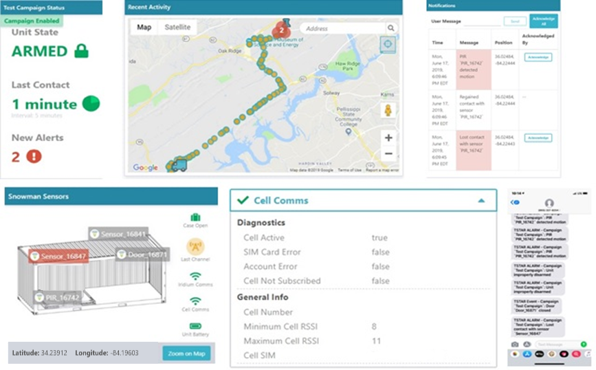
T-STAR Web Application
Notes:
The T-STAR web application running on a desktop computer and smartphone displays information that allows assessment of the shipment's status. A user may opt to receive SMS and/or email messages of the system notifications.

Slide 6
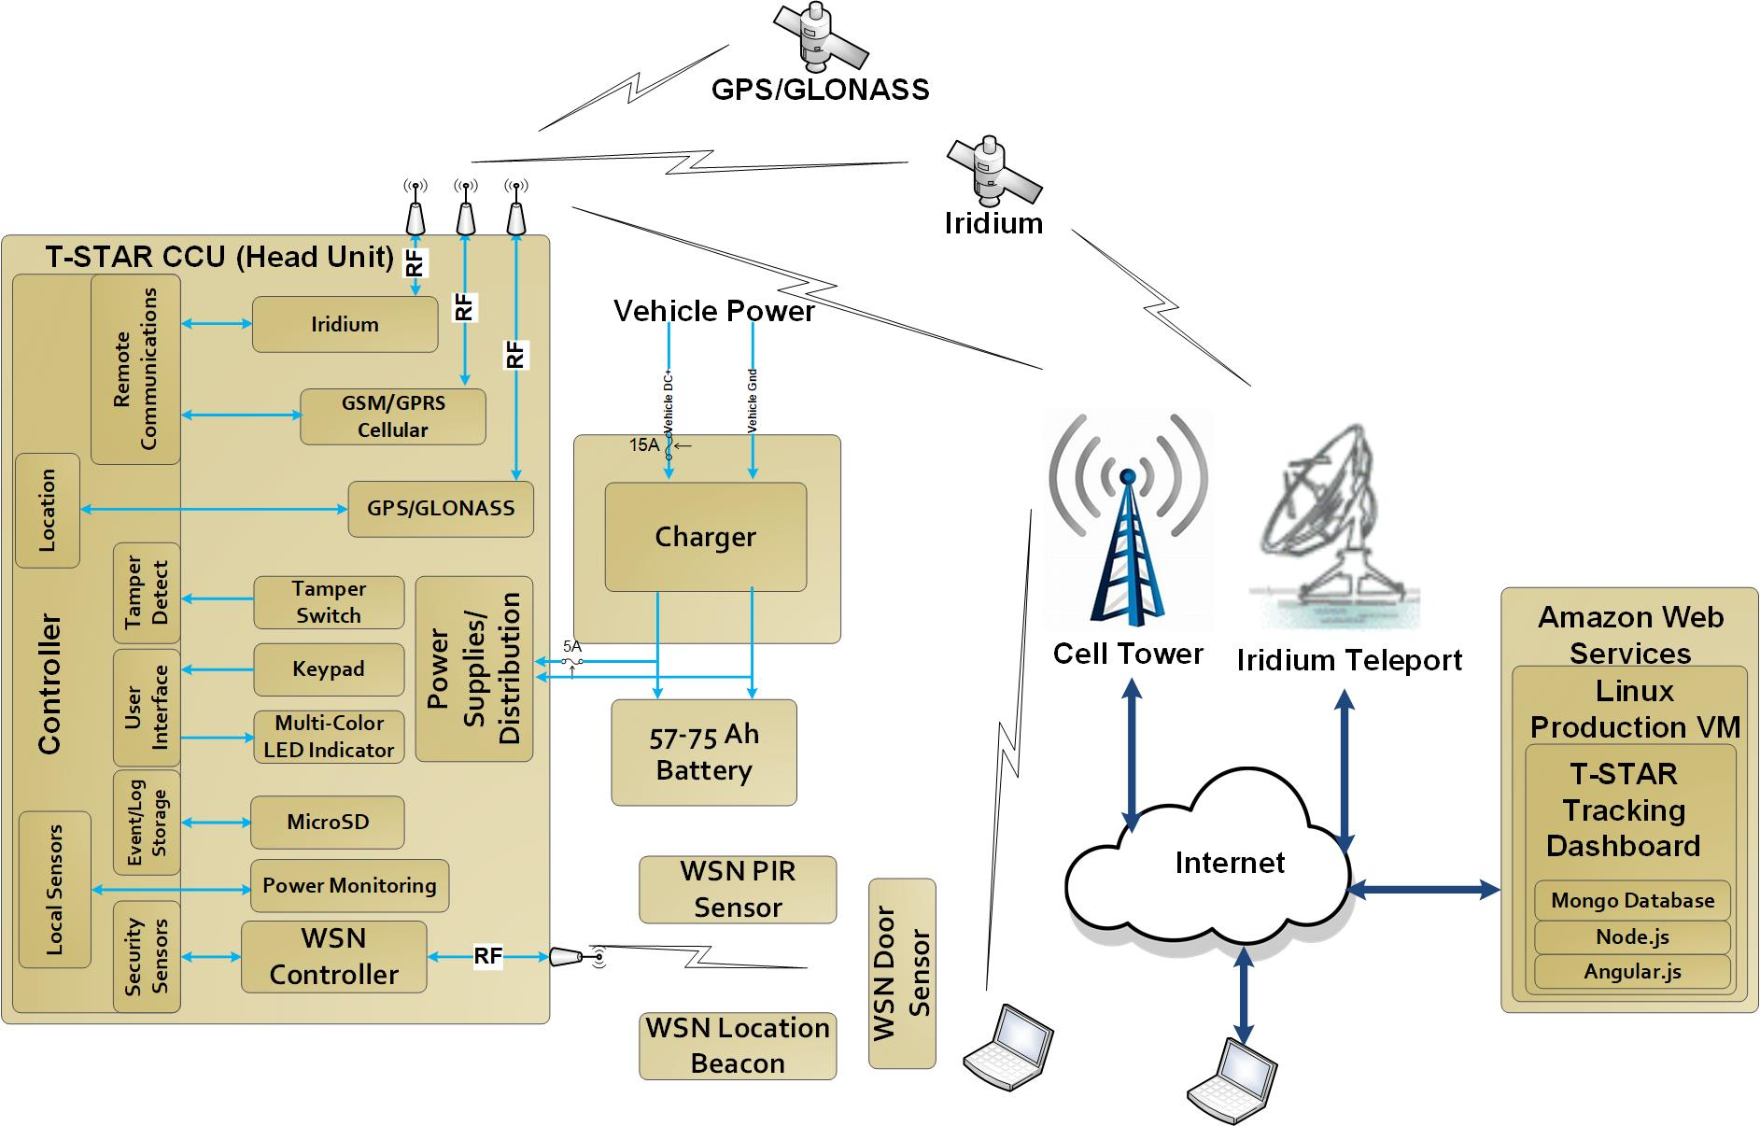
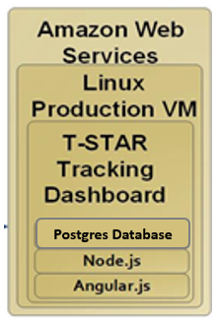
First T-STAR Block Diagram
Communications Modes
Onboard and Wireless Sensors
Network Infrastructure
Web Services

Slide 7
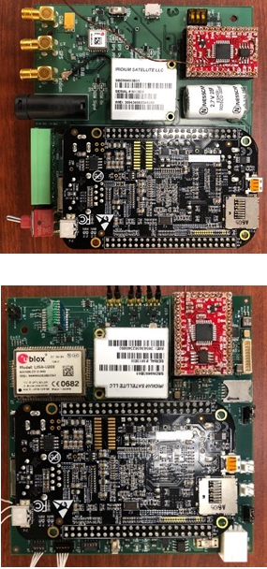
T-STAR Generation 1 and 2
Motino Wireless Sensor Network
Antenna Switching between External and Internal Antennas
Cellular Communications
Continued use of BeagleBone Black CPU
Improved User Interface/Web Services
Gen 1
Gen 2

Slide 8
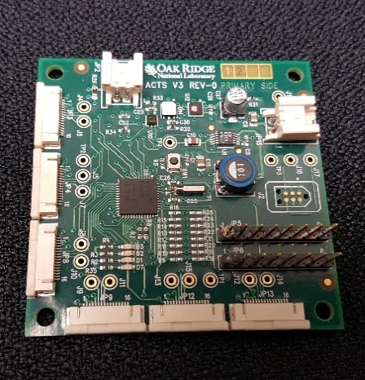
Authenticated Container Tracking Seal (ACTS)
Low Power processor
Peripheral expansion slots
Existing on board sensor suite
Temperature
Humidity
Barometric pressure
Ambient light
Tamper switch
Inertial Measurement Unit
3 axis accelerometer, gyrometer, magnetometer
Senses motion to reduce power consumption and control communication device up-time.
Notes:
What is the size?

Slide 9
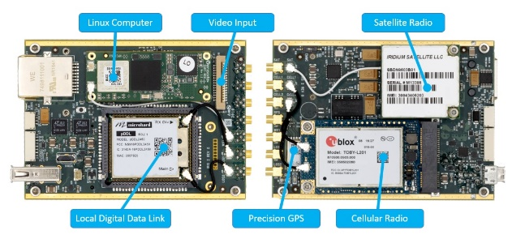
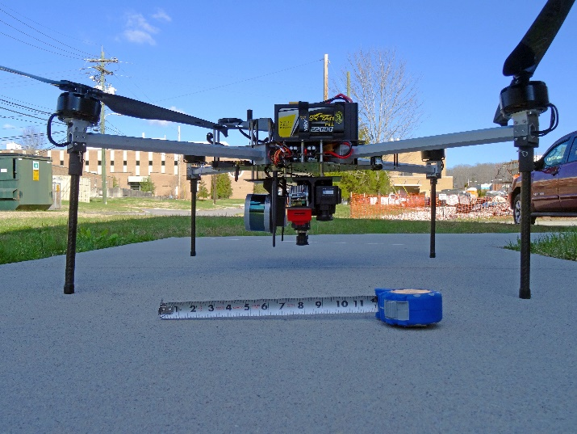
MAVNet Communications Board (MCM)
Active/Passive GPS
Cellular
Iridium Satellite
Wi-Fi
Off loads communications operations from controller
Autonomously determines optimum communication channel

Slide 10
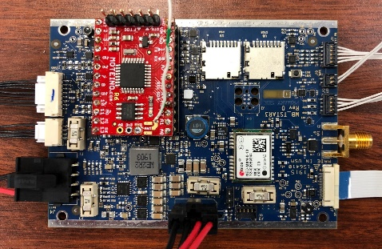
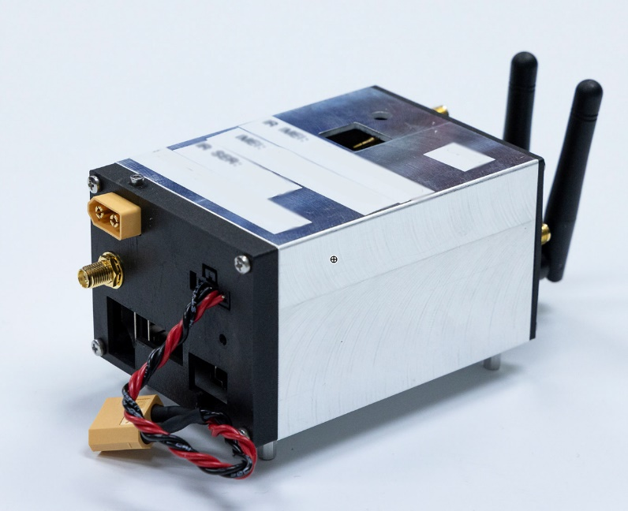
T-STAR Gen 3 Board
Active GPS
Micro SD Card Storage
Low Power Processor
ACTS on-board sensors
Peripheral Expansion Slot provides additional capabilities
Wireless Sensor Network
T-STAR Core System
Notes:
The T-STAR Gen 3 board controls the operation of the T-STAR head unit. A suite of onboard environmental sensors; an IMU; and interfaces to the MCM, HSM, microSD card, keypad, LED indicator, GPS unit, peripheral expansion slot, and WSN are included.

Slide 11
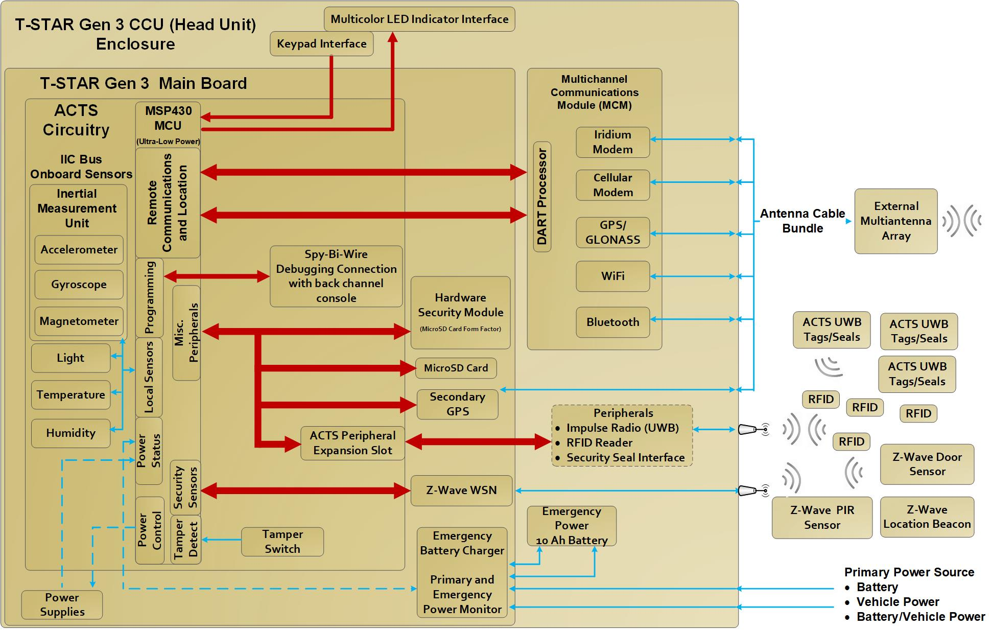
T-STAR Generation 3 Architecture
Combines MCM and ACTS

Slide 12
Wireless Sensor Network (WSN)
Home security market driving availability of a vast ensemble of easily attainable sensors
Wireless and Inexpensive
Low power requirements
Industrial Safety and Security Systems available
Often wired and WiFi
Higher power requirements
Custom Sensor Integration

Slide 13
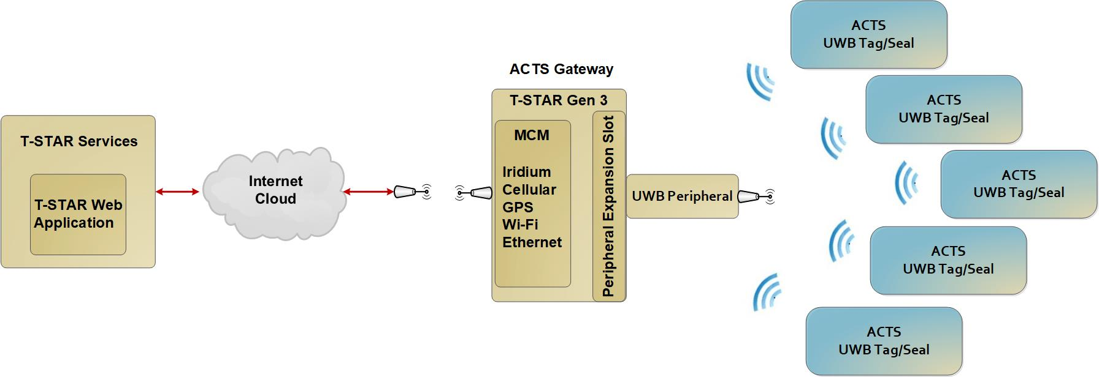
Ultra Wide Band (UWB)
ACTS tags/seals on containers can be continuously inventoried and reported during shipment.

Slide 14
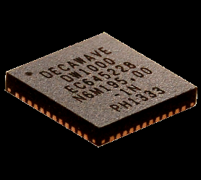
DecaWave DW1000 IR-UWB
Single chip UWB transceiver
IEEE802.15.4-2011 Standard
Real Time Location capabilities (10cm indoors)
Up to 6.8 Mbps
Coherent receiver (300m range)
Short packet durations (11,000 devices in a 20m radius)
Highly immune to multipath fading
Low power consumption (mode dependent)
Two-way ranging
Source: decawave.com

Slide 15
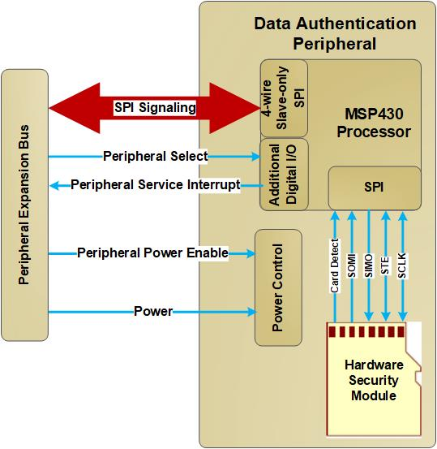
Data Authentication
Public Key Infrastructure (PKI)
Digitally Sign data to ensure the data transmitted is not modified and can be trusted.
SC-HSM (smart card hardware security module)
PKI Infrastructure
Encrypt and/or sign data
Sign transmission packet on the head unit
Validate received packet on the server
Notes:
None of this matters if we can’t trust the information we are receiving.

Slide 16
Summary
T-STAR Gen 3 leverages hardware and firmware from ACTS and MAVNet to reduce power consumption (extend longevity when operating on battery power) and improve and extend communications capability and reliability.
MAVNet’s robustness is requisite for controlling unmanned aerial vehicles anywhere in the world from anywhere in the world.
T-STAR Gen 3 replaces previous custom wireless security sensor network with COTS security sensors and protocols.
The expansion slot and additional communications channels of the MCM allow interfacing of any number and types of instrumentation and sensors to collect more pertinent data for providing better situational awareness for the entire journey of sensitive cargo.

Slide 17
Summary (cont.)
TSTAR is a unique platform that can be tailored to a variety of package tracking applications
Can support a variety of communications, location services, and containment monitoring needs
An ACTS data security peripheral would allow data acquired by ACTS sensors to be digitally signed
The IR-UWB peripheral enables two-way ranging for locating ACTS tags in 2D or 3D space to facilitate an inventory or to detect the repositioning or movement of ACTS tagged items.

